Slide 1
GMOD/GBrowse_syn
Sheldon McKay
Reactome Ontario Institute for Cancer Research

Slide 2
Outline
A few words on whole genome alignment
A brief survey of synteny browsers
A few challenges of rendering comparative data
Comparative genome browsing with GBrowse_syn

Slide 3
Hierarchical Genome Alignment Strategy
Raw genomic sequences
Mask repeats
(RepeatMasker, Tandem Repeats Finder, nmerge, etc
Identify orthologous regions
(ENREDO, MERCATOR, orthocluster, etc)
GBrowse_syn
Nucleotide-level alignment
(PECAN, MAVID, etc)
GBrowse_syn
Further processing
GBrowse

Slide 4
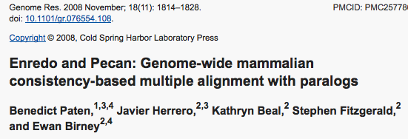


Slide 5
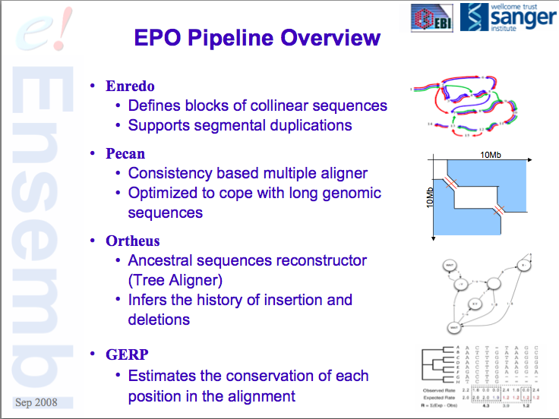

Slide 6
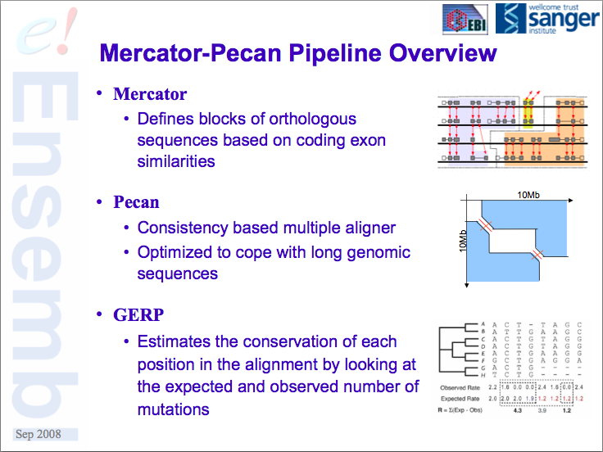

Slide 7
A Few Use Cases
Multiple sequence alignment data from whole genomes
Synteny or co-linearity data without alignments
Gene orthology assignments based on proteins
Self vs. Self comparison of duplications, homeologous regions, etc
Others

Slide 8
What is a Synteny Browser?
- Has display elements in common with genome browsers
Uses sequence alignments, orthology or co-linearity data
to highlight different genomes, strains, etc.
Usually displays co-linearity relative to a reference
genome.

Slide 9
GBrowse_syn
Does not rely on perfect co-linearity across the entire displayed region (no orphan alignments)
Offers “on the fly” alignment chaining
No upward limit on the number of species
Used grid lines to trace fine-scale indels (sequence insertion/deletions)
Integration with GBrowse data sources
Ongoing support and development

Slide 10
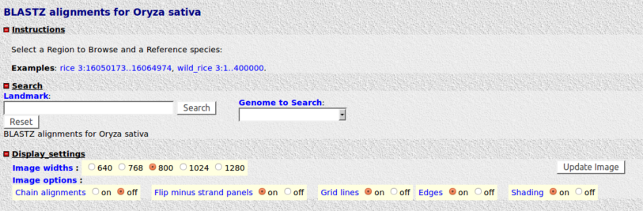
GBrowse-like interface

Slide 11
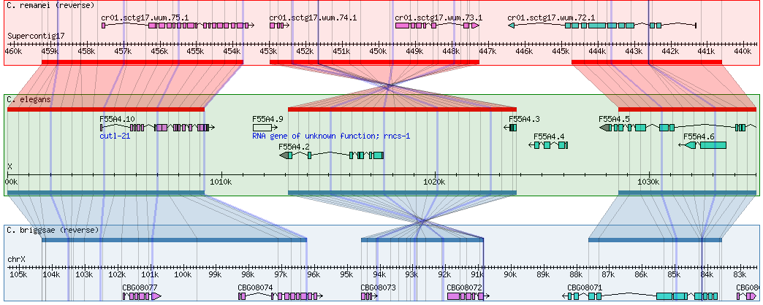
GBrowse_syn
GBrowse
Databases*
GBrowse_syn
alignment
database
*.syn
or
*.conf
*.synconf
Species config. Master config.

Slide 12
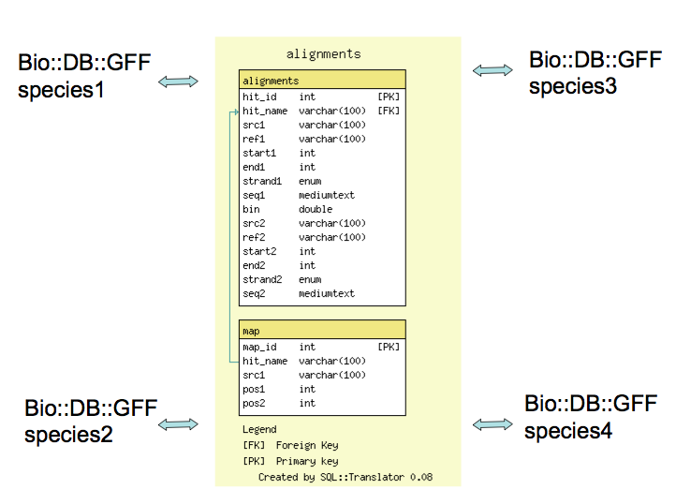

GBrowse_syn Architecture
[GBrowse]
[GBrowse]
[GBrowse]
[GBrowse]

Slide 13
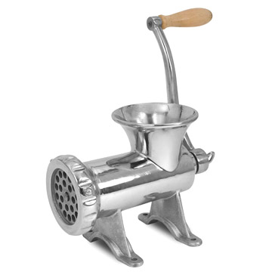
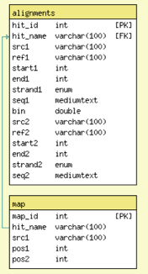
Getting Data into GBrowse_syn
CLUSTALW PECAN
MSF ad hoc tab-delimited
FASTA STOCKHOLM
GFF3 etc…
Loading scripts

Slide 14
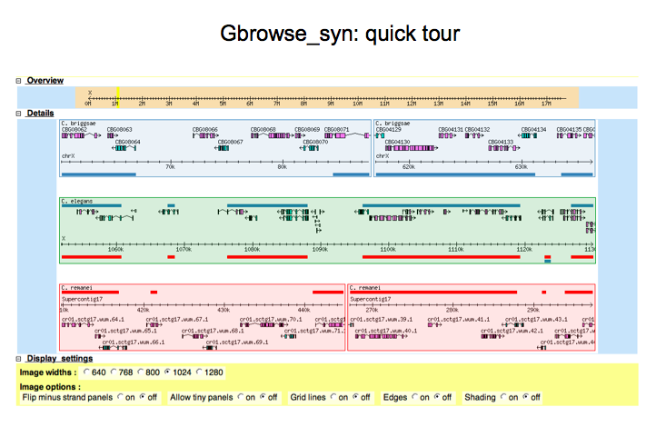

Slide 15
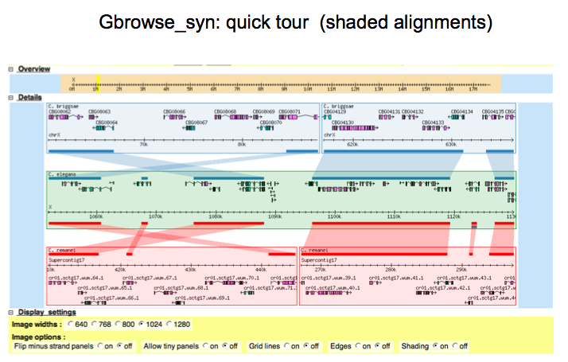

Slide 16
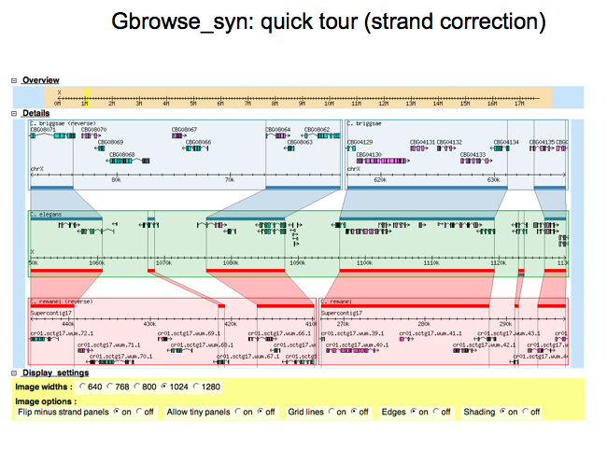

Slide 17
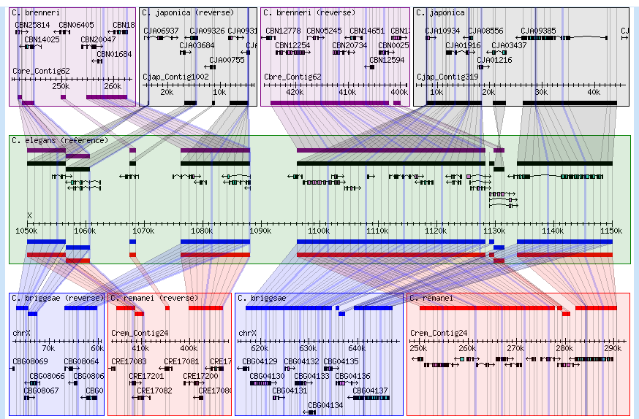
Optional “All in one” view

Slide 18
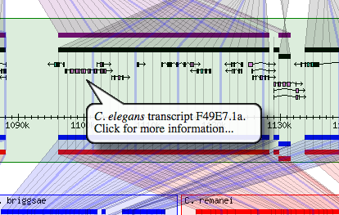
Adding markup to the annotations

Slide 19
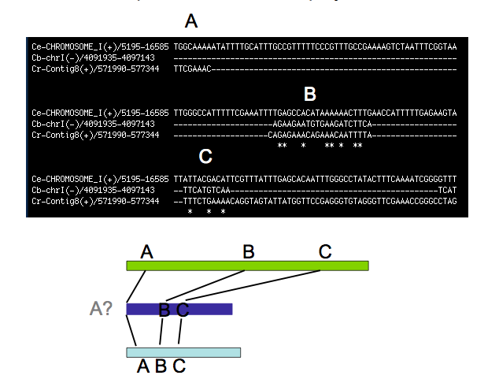
Problem : How to use Insertions/Deletion data

Slide 20
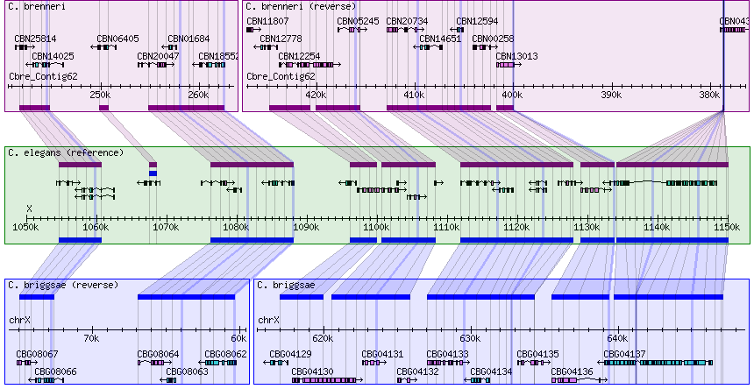
Tracking Indels with grid lines

Slide 21
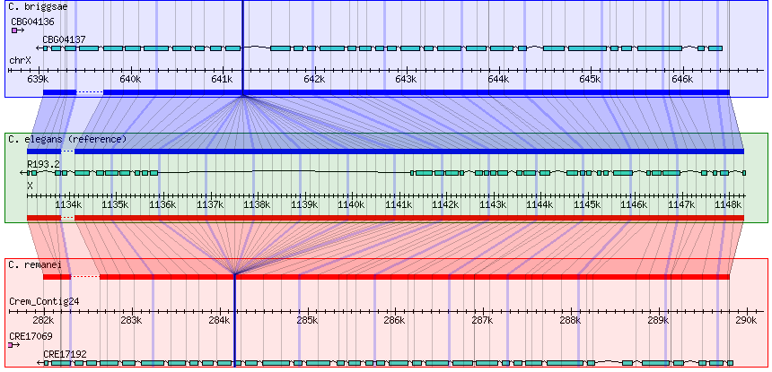
Evolution of Gene Structure

Slide 22
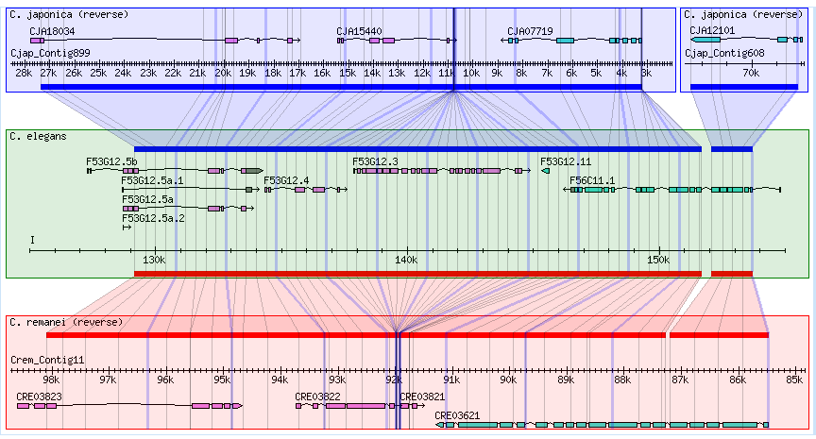
Putative gene or loss

Slide 23
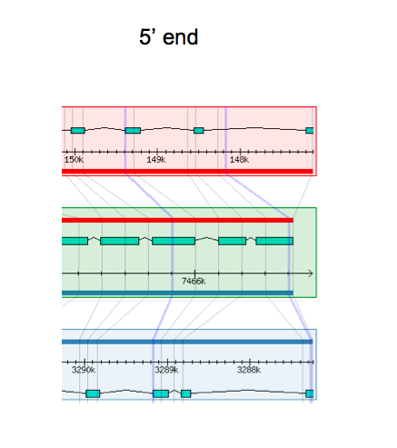
Comparing gene models

Slide 24
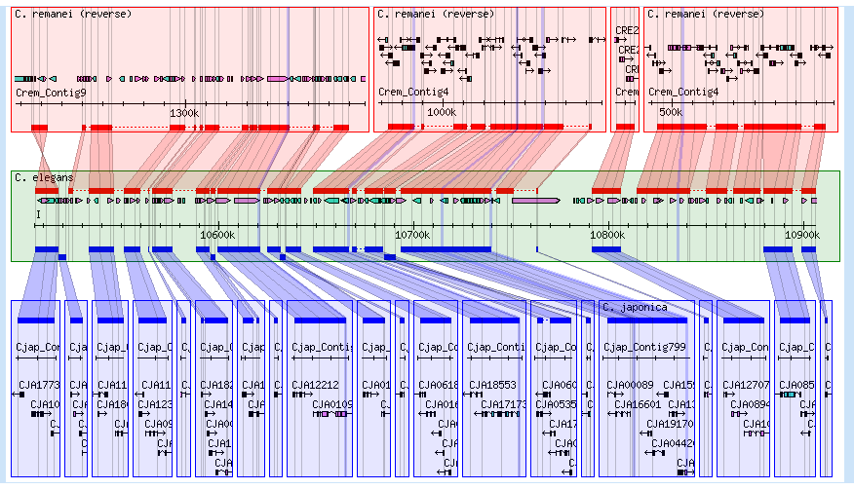
Comparing assemblies
Not bad
Needs work

Slide 25
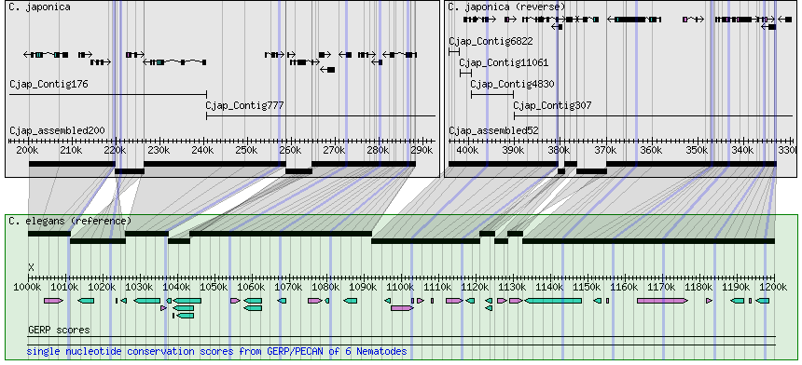
Example Mercator Alignment

Slide 26
Getting the most out of small aligned regions
or orthology-only data

Slide 27
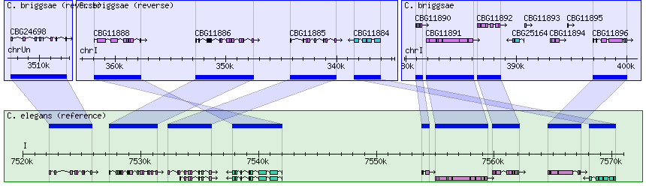
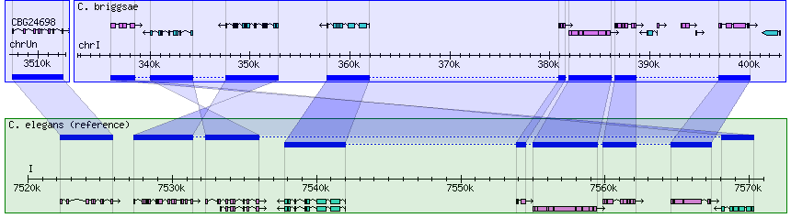
Gene Orthology
Chained Orthologs

Slide 28
2 panels merged
Inversion + translocation?

Slide 29
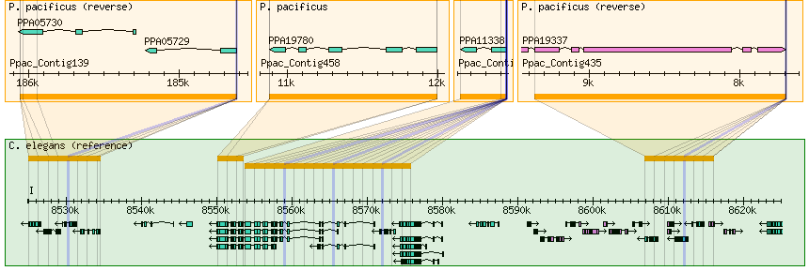
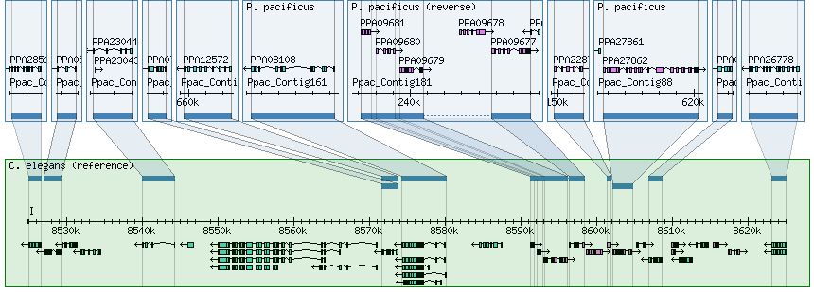
Pecan alignments
Protein orthology based Synteny blocks

Slide 30
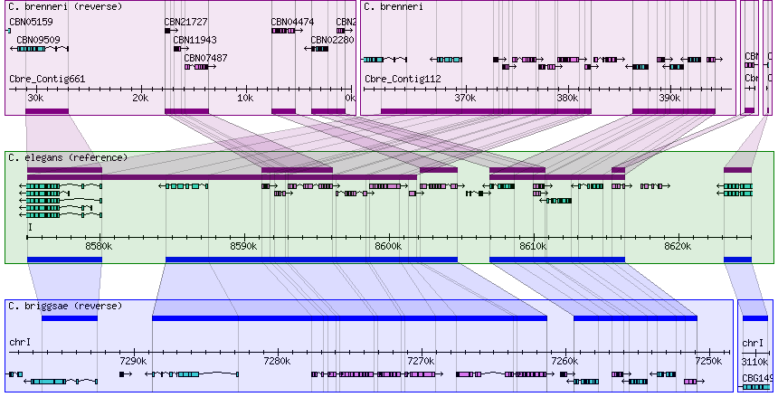
Duplications

