Slide 1
GMOD Projects at the Center for Genomics and Bioinformatics
Chris Hemmerich - Indiana University, Bloomington

Slide 2
A Simple Web Interface for Configuring GBrowse: WebGBrowse
Ram Podicheti

Slide 3
WebGBrowse
A web interface for configuring GBrowse installations
Upload GFF file
Upload optional config file to use as starting point
Add, edit, and remove new tracks using web forms
Extensive help embedded in forms and includes tutorial
Preview your changes at any point in GBrowse
Makes GBrowse more feasible for small projects
We host the GBrowse server, so no installation is required
Configuration is done online through form
Use one configuration for multiple GFF files

Slide 4
WebGBrowse
http://webgbrowse.cgb.indiana.edu/
Available for download and local installation
gmod-webgbrowse@lists.sourceforge.net
Support, make feature requests, contribute
We want to help you help us add support for more features
Pending GMOD component
Migration of development environment
Podicheti, R., Gollapudi, R. & Dong, Q*. WebGbrowse – a web server for GBrowse Bioinformatics, 2009

Slide 5
Web-based Bioinformatics Pipelines for Biologists: ISGA
Chris Hemmerich, Aaron Buechlein
Ram Podicheti, Jeong-Hyeon Choi, Boshu Liu

Slide 6
ISGA: Driving Forces
Workflow Management system that can meet the needs of a small sequencing center.
Flexible pipeline definition
Design new pipelines
Incorporate new programs as components
Support distributed computing environments
Potential need to grow beyond local computing resources
Minimize CGB staff involvement in pipeline running
Free resources for building new pipelines

Slide 7
Workflow Management
Ergatis (http://ergatis.sourceforge.net)
Institute for Genome Sciences, U. Maryland
Build pipelines from existing programs
Supports distributed computing environments
Robust monitoring of pipeline execution
Orvis J, Crabtree J, Galens K, Gussman A, Inman JM, Lee E, Nampally S, Riley D, Sundaram JP, Felix V, Whitty B, Mahurkar A, Wortman J, White O, Angiuoli SV. Ergatis: A web interface and scalable software system for bioinformatics workflows. Bioinformatics. 2010 Jun 15;26(12).

Slide 8
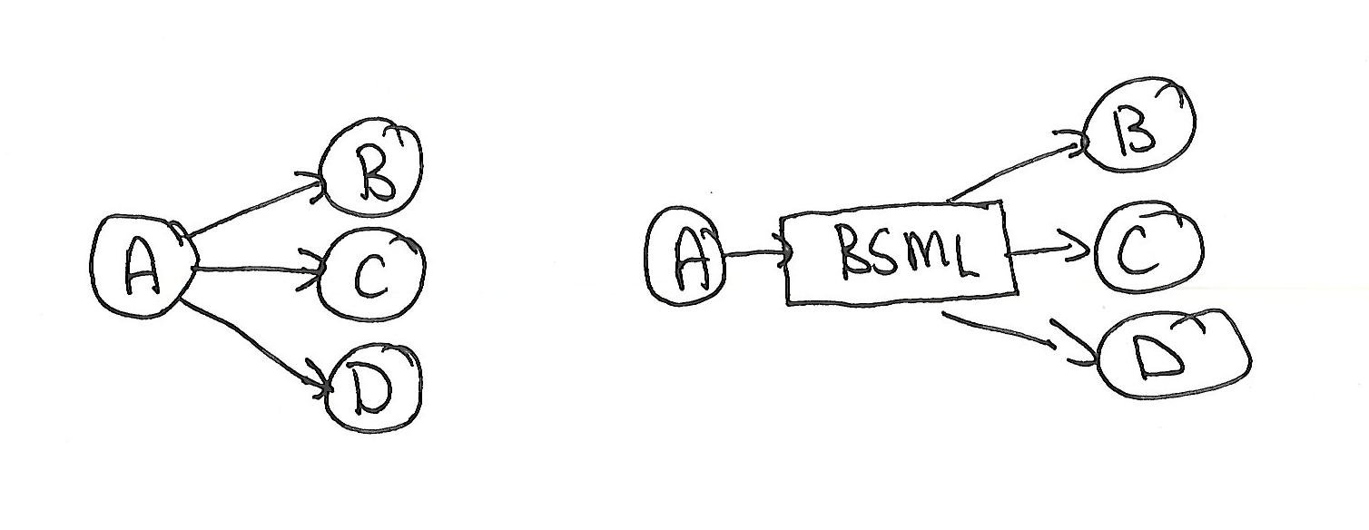
Ergatis Workflow
10+ readily available pipelines, more in the community
220 components in svn, more in the community
XML component and pipeline definition
XML/BSML common data exchange format
Optional, but recommended for reusable components
Conversion tools for FASTA, GFF, Chado, etc…
Isolates format changes from other programs

Slide 9
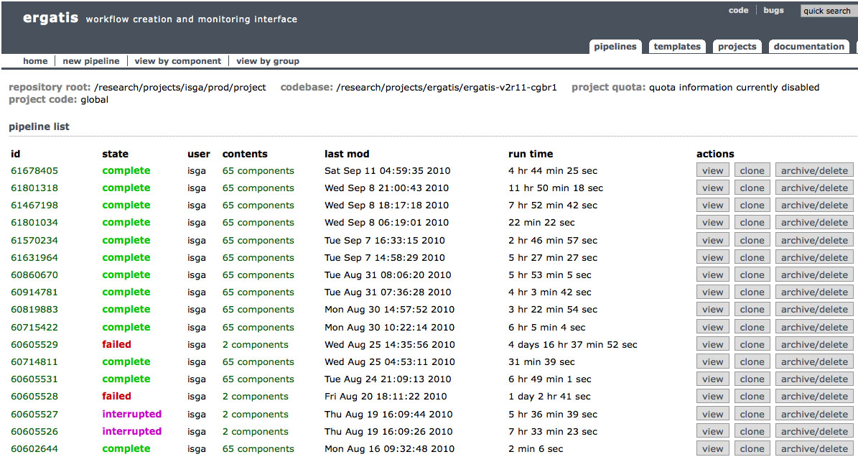
Ergatis: Pipeline List

Slide 10
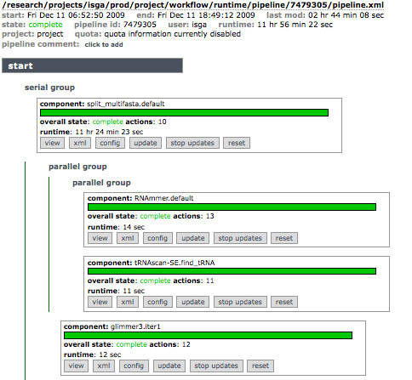
Ergatis: Pipeline Monitor

Slide 11
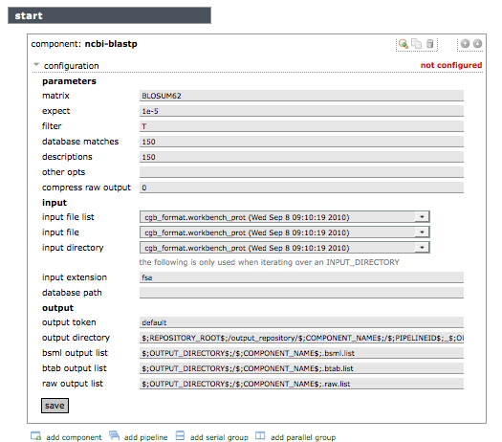
Ergatis: Configure Component

Slide 12
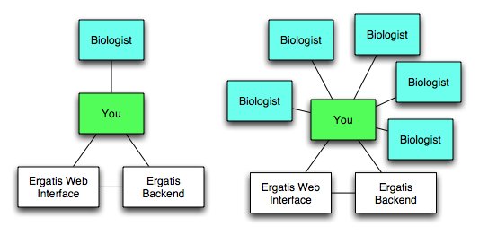
Ergatis Architecture

Slide 13
Biologist Interface Requirements
Support single-lab biologists
Self-sufficient but have limited bioinformatics resources
Embrace tools that don’t require extensive training
Ability to run pre-configured pipelines quickly
Option to customizing specific tools in a pipeline
Interface that encourages exploration
Remove complexity and information they don’t need
Inline help
Immediately detect errors and allow them to correct them
Return output in useful formats
Simple tools for visualizing and searching large result sets

Slide 14
ISGA Design
Simplify pipelines
Hide housekeeping components
Group components into clusters representing processes
Support customization
Disable components where possible
Replace components with pre-computed data where possible
Edit scientifically-active program parameters
Help and validation for all forms
Users and data privacy
Provide download and upload
Incorporate visualization & analysis tools

Slide 15
Why develop ISGA as a separate package?
ISGA only re-implements the web interface of Ergatis
Ergatis libraries, component definitions, and method of running and monitoring pipelines is used by ISGA as-is
ISGA adds and removes Ergatis features
Accessing component information
Building pipelines from components
A hybrid ISGA/Ergatis interface wouldn’t serve anyone
ISGA biologist users need to be given limited functionality for simplicity and security
Ergatis bioinformatician users need full functionality and a complex interface to work efficiently

Slide 16
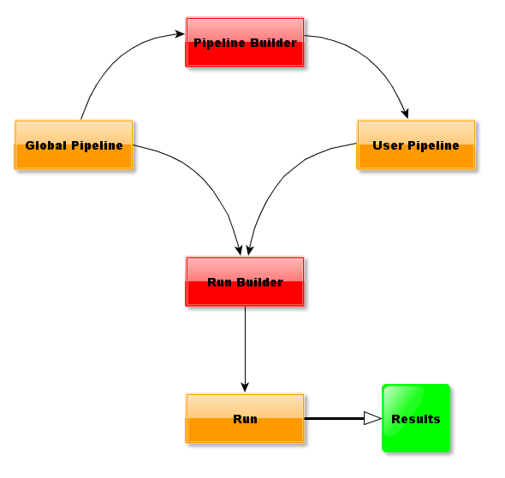
Workflow

Slide 17
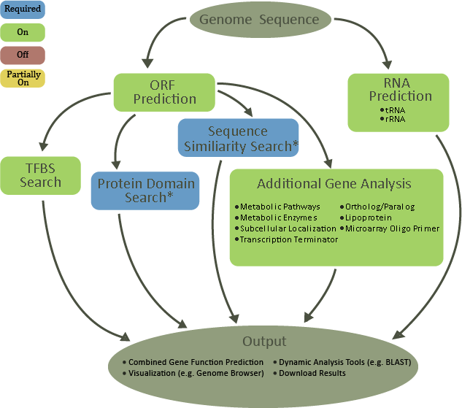

Slide 18
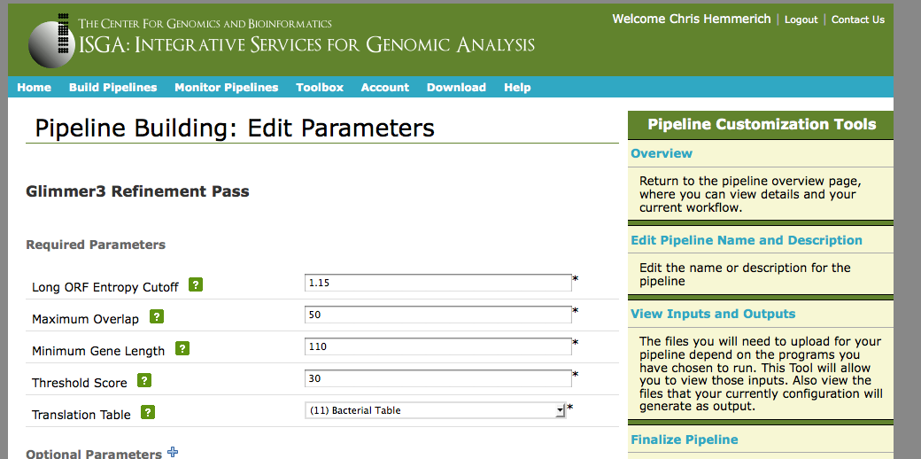
Pipeline Builder

Slide 19
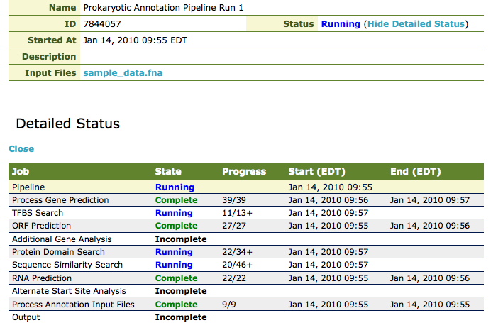
Run Status

Slide 20
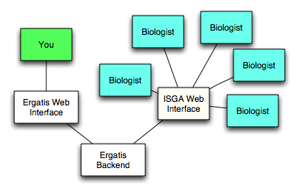
ISGA Architecture

Slide 21
Under the Hood
ISGA Web Interface
pipeline builder
genome browser
monitor pipelines
download results
blast search
PostgreSQL Database
pipeline specification
user account
annotation results
Ergatis
XML configuration
workflow engine
Shared Storage
Sun Grid Engine
bioinformatics tools
input and results
computation nodes
job scheduler
ISGA Backend

Slide 22
Usage
> 100 pipelines run
> 60 users
Two external sites evaluating local ISGA installations that we know of

Slide 23
What’s new?
Celera assembly pipeline
Ability to accept parameters with pipeline inputs
Ability to iterate components over a list of pipeline inputs
Conversion scripts for Hawkeye visualization
Installation instructions :shame
isga-users@lists.sourceforge.net
Administration improvements
Online configuration
User classes and pipeline quotas

Slide 24
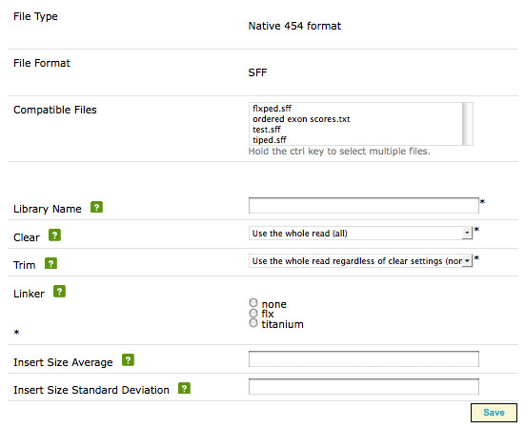
Parameterized Inputs

Slide 25
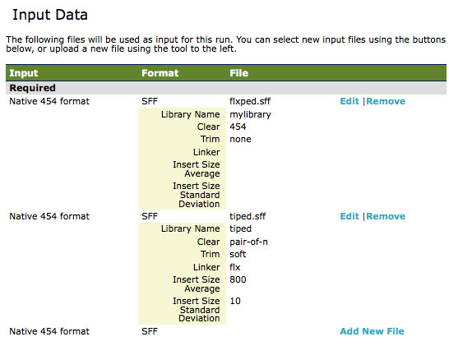
Input Iterator

Slide 26
What’s in the works?
Pipelines
SHORE SNP Calling (ISGA)
Gene clustering over Microbial phylogenies (Ergatis)
Transcriptome annotation pipeline (Ergatis)
Methyl-seq (Ergatis)
Features
Pipeline reproducibility and provenance
User groups and sharing
Modular pipeline and toolbox installation
ISGA pipelines as standalone Ergatis templates
ISGA pipeline over Amazon EC2 via CLoVR

Slide 27
Cloud Resources through CloVR
Execute Ergatis Pipelines over an SGE instance hosted on Amazon EC2 machine images
CloVR manages creation and shutdown of cloud images as part of pipeline
Upload input as part of pipeline or access data hosted at Amazon
Results are retrieved to local machine
Ergatis assumes a shared filesystem, so some modification is required to manage file transfers

Slide 28
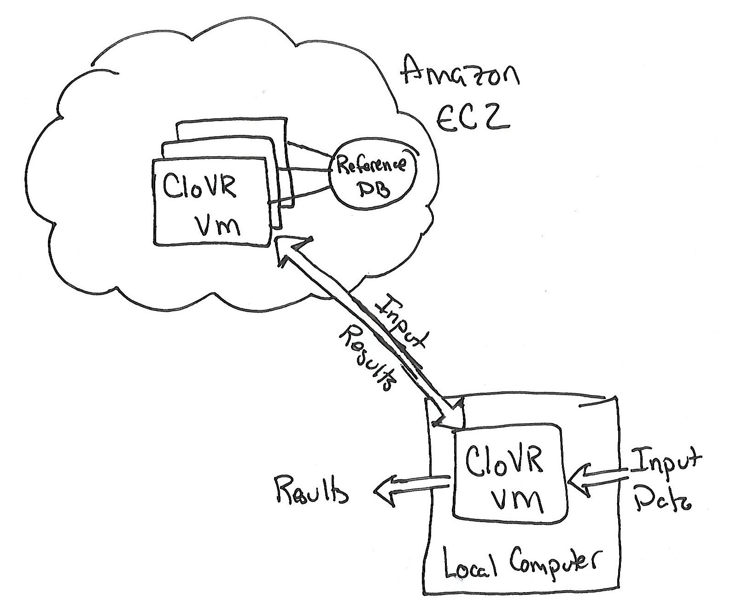
CloVR Architecture

Slide 29
Using CloVR with ISGA
ISGA/Ergatis pipelines can be ported to ISGA/CloVR
ISGA installation communicates with local Ergatis and CloVR
EC2 presents challenges for billing customers

Slide 30
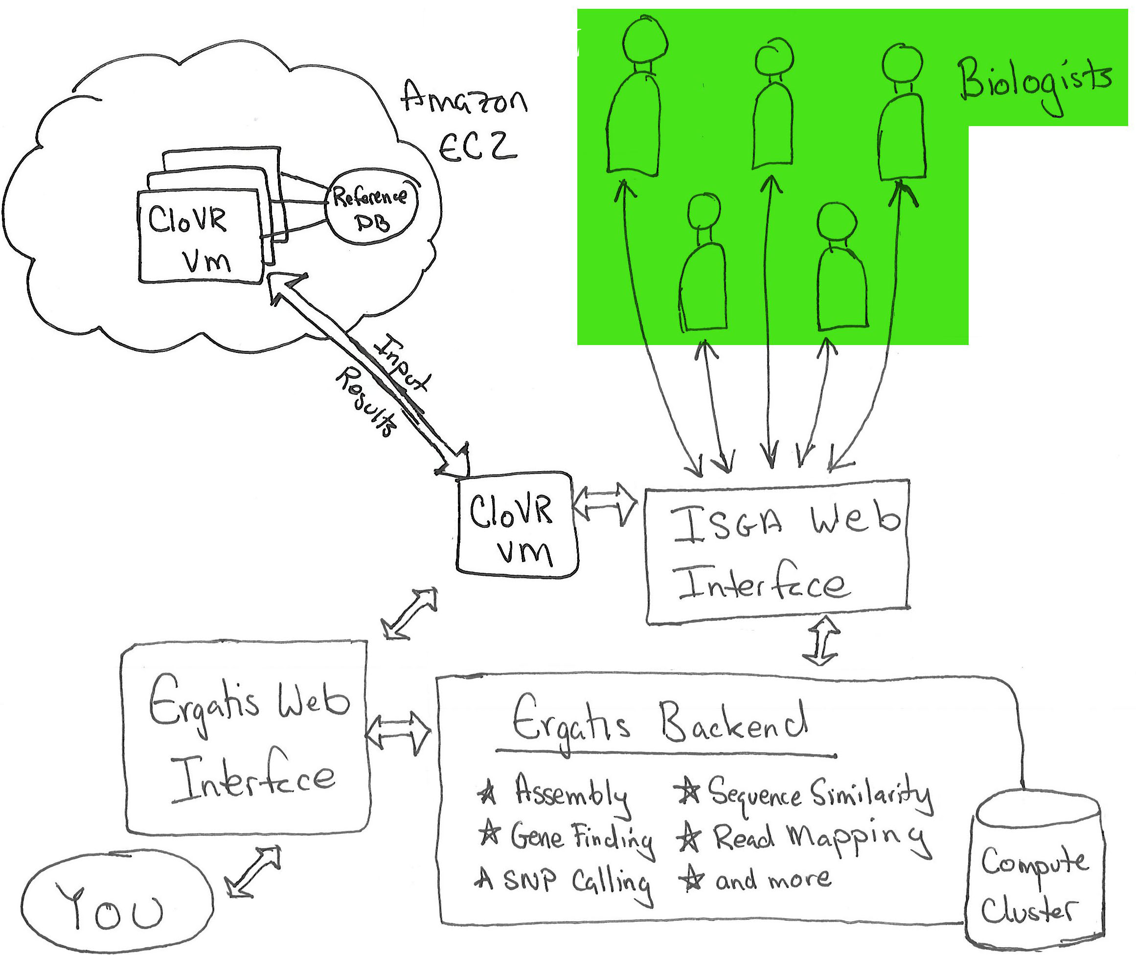
ISGA with CloVR Architecture

Slide 31
Acknowledgements
Funding
Indiana Metabolomics and Cytomics Initiative(METACyt) – Lilly Endowment, Inc.
National Institutes of Health under grant 5 RC2 HG005806-02.
CGB
Genomics
John Colbourne
Keithanne Mockaitis
Bioinformatics
Haixu Tang
Jeong-Hyeon Choi
Aaron Buechlein
Ram Podicheti
Computing
Phillip Steinbachs
Jon Burgoyne
ISGA Aumni
Qunfeng Dong
Kashi Revanna
External Projects
Joshua Orvis & Ergatis team
Sam Angiuoli & CLoVR team
Anup Mahurkar & Workflow team

Slide 32


