Slide 1
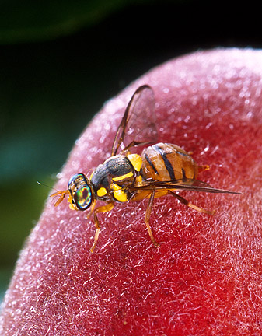
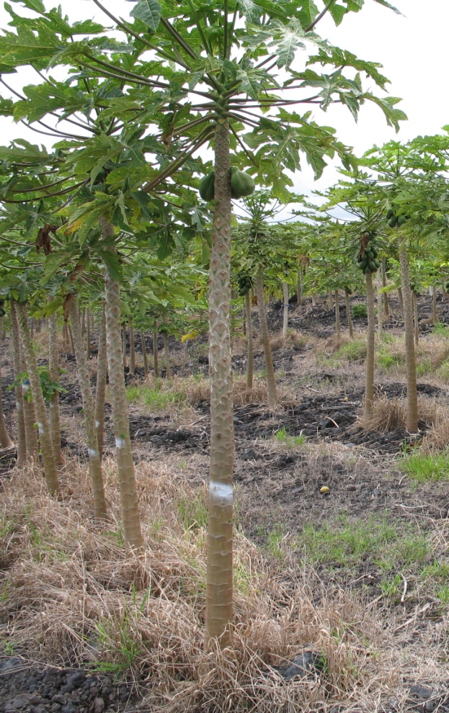


Developing genome sequencing for identification, detection, and control of Bactrocera dorsalis (Hendel) and other Tephritid pests
Thomas Walk, Scott Geib
USDA-ARS Pacific Basin Agricultural Research Center, Hilo HI

Slide 2
Summary
Oriental fruit flies are important agricultural pest
It has been sequenced
Not all sequences are equal
Assembly ongoing, then the fun stuff

Slide 3
GMOD implementation
Chado
Maker
Apollo
Gbrowse
Tripal

Slide 4
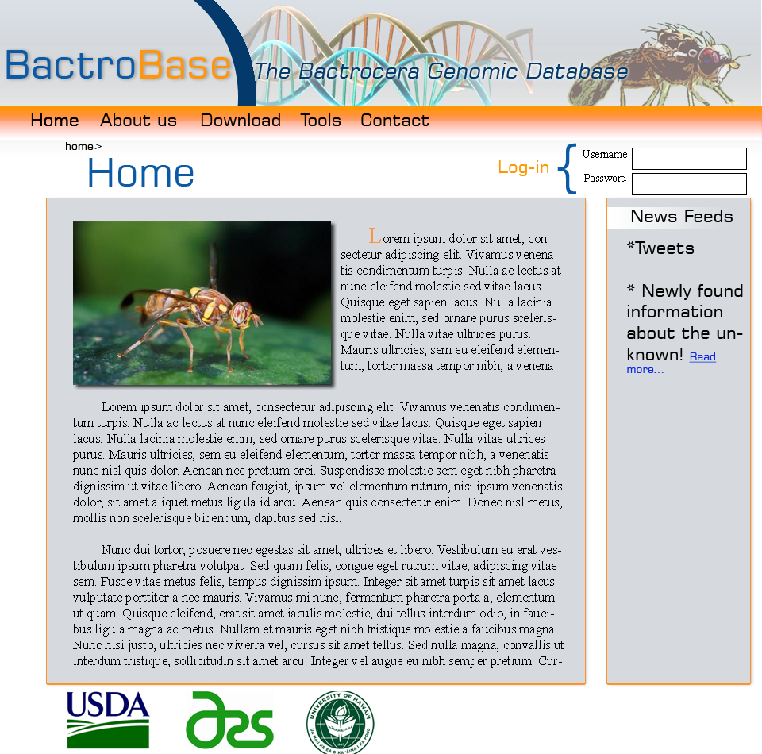
Website: www.bactrobase.org
Currently under development
Project news
Access to data
Sequence assembly
Annotations
SNPs/markers
Tools
BLAST
Gbrowse
If you have interest in collaborating please contact
Assist in annotation
Fly sample/species of interest for sequencing
Compare against other datasets
?????
scott.geib@ars.usda.gov
tom.walk@ars.usda.gov

Slide 5
Tephritid flies are diverse and evolving
Diptera: Tephritidae: Dacinae
Major pest around the Pacific
Larvae feed on wide range of fruits
Adults can have high mobility, fecundity
Recent taxonomic work on the dorsalis complex suggests that it includes over 50 species
8 considered of high economic significance.
Discrimination of B. dorslais, B. papayae, and B. philippinensis has been especially problematic for many previous molecular studies.

Slide 6
Objectives
Sequence and create a de novo assembly of the genome of the oriental fruit fly (B. dorsalis)
Genomics:
Provide structural and functional annotation of genome through transcriptome sequencing and annotation pipeline
Comparative Genomics:
Perform genome-wide comparative analysis of related strains of B. dorsalis (species complex)

Slide 7
Goals
Create/annotate oriental fruit fly genome
Use as a foundation for developing novel tools
Resistant fruits
Identify genes that could be used in novel control methods
Improve mass rearing
Perform comparative genomics on dorsalis species complex
Develop new molecular markers for distinguishing species boundaries
Develop techniques for rapid ID of flies

Slide 8
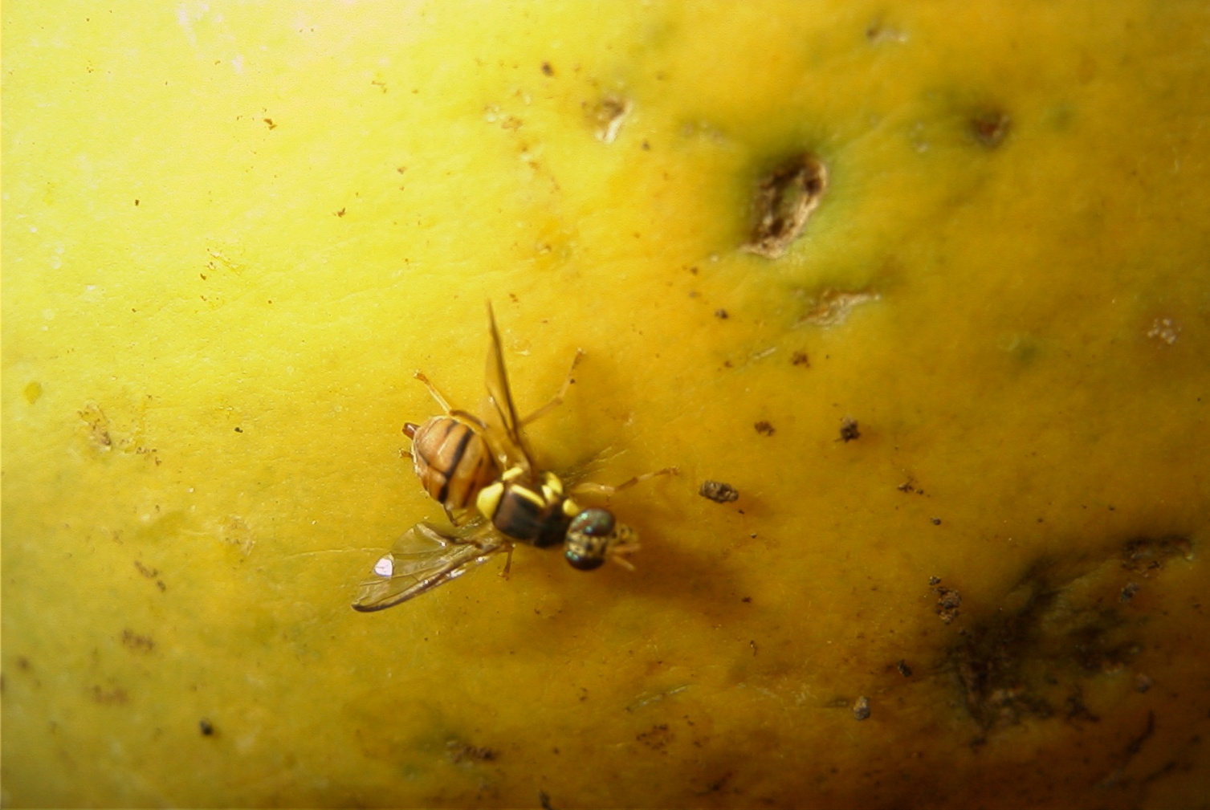
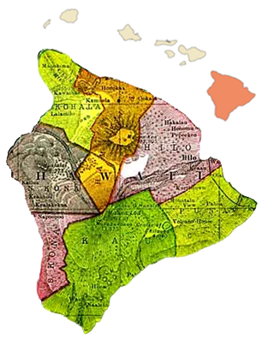
Genome sequencing project
Genome size:
400-600 Mb in size
Source of DNA
USDA-PBARC lab colony strain
Initially collected in Puna, Hawaii
Approach
454 pyrosequencing
Shotgun and Paired-end sequencing
8.2 Gb of sequence (~15X coverage)
Assemble Sequence
Annotate Assembly

Slide 9
Origin of DNA sample:
DNA was from the B. dorsalis lab colony, originating from Puna, HI.
To create the DNA sample:
larvae were reared on artificial diet
a pool of larvae was pulled, starved, and extracted.
estimated that 100’s of larvae were included in each extraction
Two different DNA samples were sequenced
Look at which DNA sample used in each sequencing library.
Issues that can be caused from using 100’s of individuals for sequencing
Variations in population can cause havoc to assembler
Assembler assumes that there is little/no variation in sample
Rather than sequencing a single genome, we are sequencing all of the variation in all of the individuals

Slide 10
Sequencing and Assembly

Slide 11
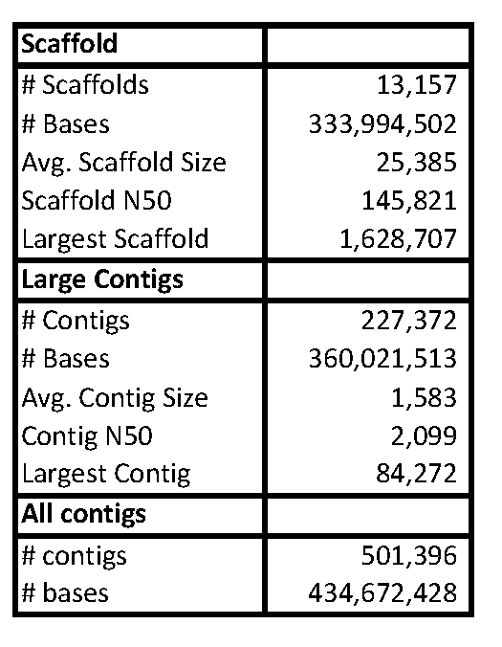
Current Bdor Assembly (Newbler 2.X Developmental version)
Current assembly includes 435 Mb of sequence
in the range of the estimated genome size
83% of that sequence has been places into large contigs (those longer than 500 bp)
77% are placed into scaffolds

Slide 12
Compare to other assemblies
Communicating with other groups doing insect genomes on 454
Al Handler (USDA-ARS), Baylor Seq Center
Medfly: Similar issue with small contig size (under 2kb), no PE data yet (only 3 kb planned at this point)
Baylor
Centipede: 29X coverage w/454, N50 Scaffold size is 175 kb
Pea Aphid: 464 Mb genome size, 22,800 scaffolds with N50 scaffold size of 88.5 kb (not 454 project)
454 life sciences/U of Wisconsin
Leaf-cutter ant: N50 Scaffold 6.2 Mb from 13 shotgun, two 8kb, and one 20kb PE runs. (all ants are sibs from same queen, low heterozygosity)

Slide 13
Shortfalls of current assembly
Heterozygosity
Poor read pairing 20 kb PE library
Contig size small
N50 length is 2,100 bases (half of the genome is in contigs of 2,100 bases or larger)
Solutions:
Sequence more
More inbreeding, fewer individuals
Sequence smaller paired-end library (3kb)
Increase coverage
Use better assemblers

Slide 14
Quality of PE library construction:
It is expected that ~50-80% of the PE library reads should contain 2 mate pairs with linker sequence
For the 8 kb libraries, the quality of the libraries looked very good
Size of library is very consistent, deviation of library is low, and the number of reads with mates is high
For the 20 kb libraries, the quality was less
Size of library is also consistent (~17.5 kb), deviation is several thousand bases, but the number of reads with mates is very low (~5-10% of the library)
2.17 M reads of 20 kb PE library = 265k PE reads

Slide 15
454 Suggested Sequencing Approach
Do WGS to 15x coverage, add 3-4x 3kb PE, 2x 8kb, and 2x 20kb
6-8x coverage gives good contig assembly/coverage
10-12x Scaffolds start to form
12-18x coverage Large Scaffolds start forming
25x coverage Limit to improving assembly, no need for additional sequencing
We followed this pretty well (although we have no 3 kb PE data)

Slide 17
Improving assembly with more sequencing??
Remake 20kb libraries and get more PE information
Most critical thing to do!
Other things that could be done:
Improve depth with Illumina sequencing?
Could increase contig size
Issue with compatible assemblers
BAC-end sequencing?
Obtain very long PE information
No method for BAC-end library prep for 454

Slide 18
Illumina sequencing
Illumina short insert libraries will help increase small contig size (and very cost effective, $3,000/run)
Suggested by folks at Baylor and 454
At the end of January Illumina sequence returned
10 million reads of short insert DNA sequencing
6 libraries (~14 M reads/library) RNA-seq (transcriptome) sequencing
Currently preparing for assembly

Slide 19
Assembly of Illumina and 454
JCVI Celera Assembler
Supports hybrid 454/illumina assembly
Estimated memory usage higher than what we have currently at PBARC or Maui-HOSC
New Cluster will be able to handle assembly

Slide 20
Alternative Assemblers
Working with Sergey Koren at JCVI on using Celera Assembler
Takes more time/memory/disk space than Newbler
1 week (on 8 cores), 50 gigs RAM, 800 GB disk space
Others have found it better than Newbler, trial run on our data did not find this
many more smaller scaffolds, but larger contigs:
Also plans to try CLC Bio assembler and ARACHNE (this could go faster with access to more computing power)
 | “Best” Newbler Assembly | Initial Celera Assembly
# Scaffolds | 13k | 97k
Scaffold N50 | 145k (1.2 MB largest) | 11k (58 k largest)
Scaffold Length | 333 Mb | 350 Mb
Largest Contig | 96K | 121k
Contig N50 | 2050 | 2442

Slide 22
Other genomics work
RNAi gene silencing based on proteomics results
Genome wide analysis for novel markers
RAD sequencing (Restriction Site Associated DNA sequencing)
Sequence 1000’s of sites across genome associated with restriction enzyme cut site
Rapid ID of SNPs/polymorphic regions and genetic mapping
Potentially screen 100’s of flies
Transcript analysis
RNAseq
Sequence 1000’s of sites across genome associated with restriction enzyme cut site
Rapid ID of SNPs/polymorphic regions and genetic mapping
Potentially screen 100’s of flies

Slide 23
RNAi based gene silencing
Working with gene list made with Chiou Ling (Stella) Chang’s proteome data
Target genes that will disrupt digestion/absorption of nutrients in food and/or reproductive capability of fly.
Silence genes in flies growing in liquid diet to ID physiological changes.
Create gene list of targets for plant engineering

Slide 24
Genome-wide comparison of the dorsalis complex
Using RAD-tag approach
Restriction site associated sequencing to produce tags across genome
Sequence ~20 populations within the dorsalis complex
Map back to our dorsalis reference
Define regions which are stable within but variable between populations to define species/subspecies in complex.

Slide 25
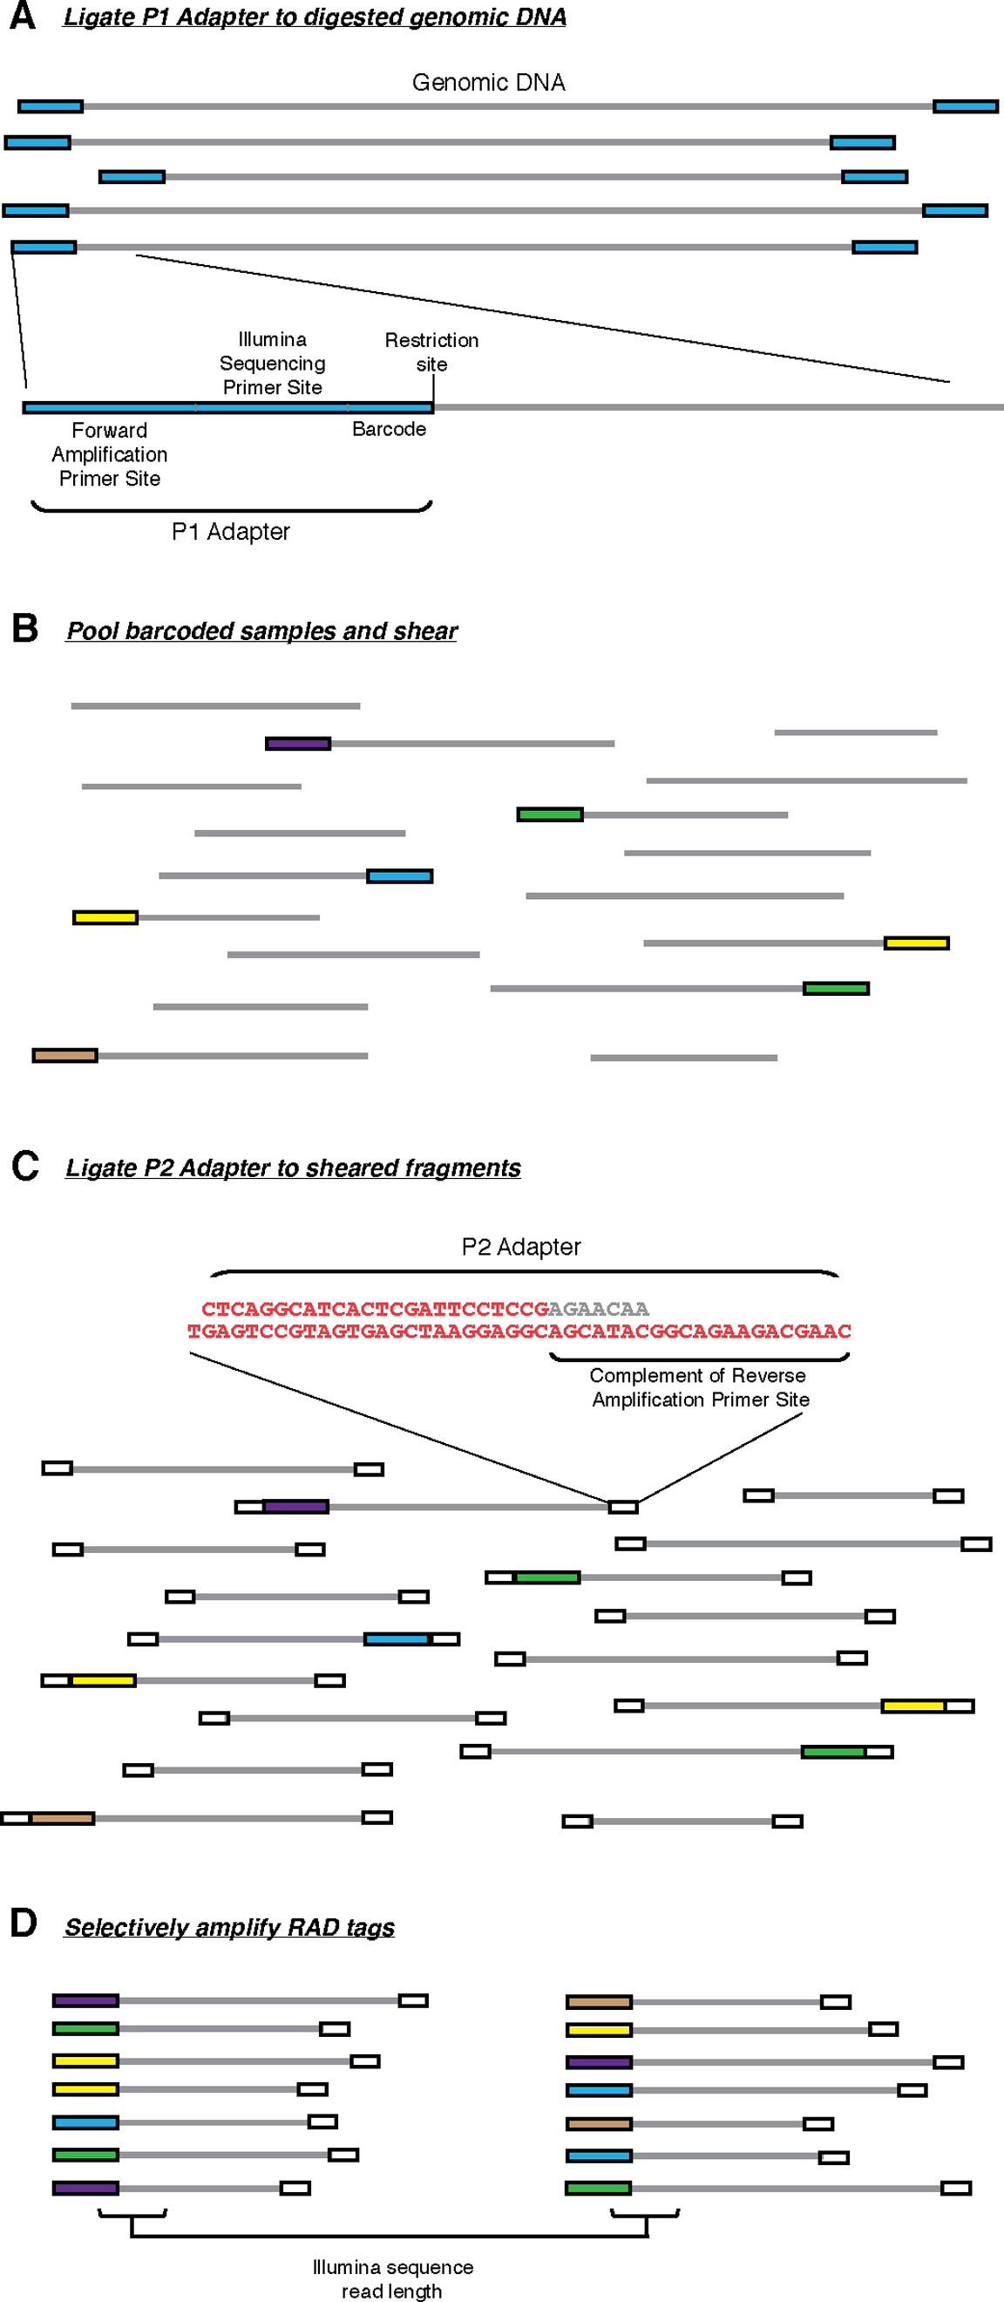
RAD-tag sequencing
Baird et al., 2008

Slide 26
RNAseq Analysis
Sequence gene expression through life cycle of Oriental fruit fly
RNA (cDNA) from the following life stages (whole organism)
sequenced on Illumnia GAIIx, 2 samples/lane
Uses
Construct database for proteomics
Expression analysis
Annotation evidence
Population genetics when combined with other population sequences
Eggs
Larvae
Pupae
Adult males
Adult females unmated
Adult female mated

Slide 27
Sequence QC
Read length
All reads are 100 bp in length and have a mated ~ 150 bp away from it
Number of reads/library
Approximately 15-20 million reads/library X 2
Quality of reads is high, but tails off at end of read
Several different filtering methods attempted
Filtering reads that contained >=10% bases with quality score below 20 seemed to be a nice stringency
Reduce # reads from ~ 18 M to ~ 13 M

Slide 28
Sequence assembly
ABySS/trans-ABySS k-mer assembly software chosen to perform assemby and library comparisons
Perform assembly with different k-mer (hash) sizes from N/2 to N-1 (N = read length)
Smaller kmer- low abundant transcripts
Larger kmer- high abundant transcripts
For our reads that means from 50 – 96 bp
ABySS then merges these 25 assemblies into a consensus assembly

Slide 29
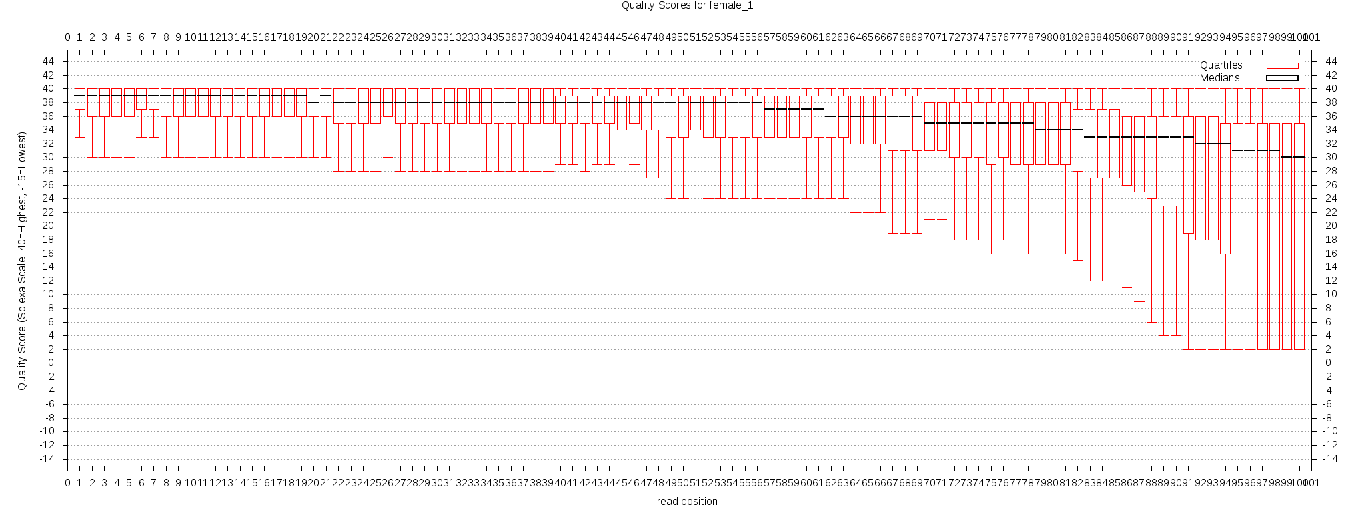
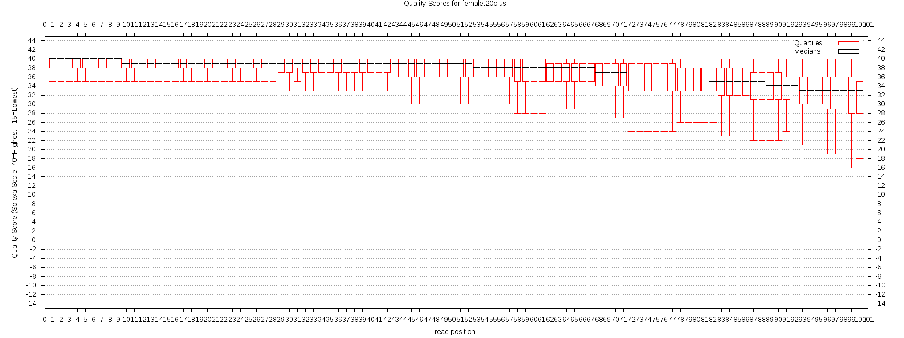

Slide 31
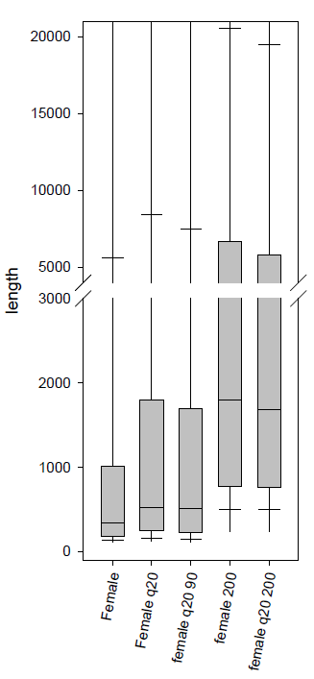
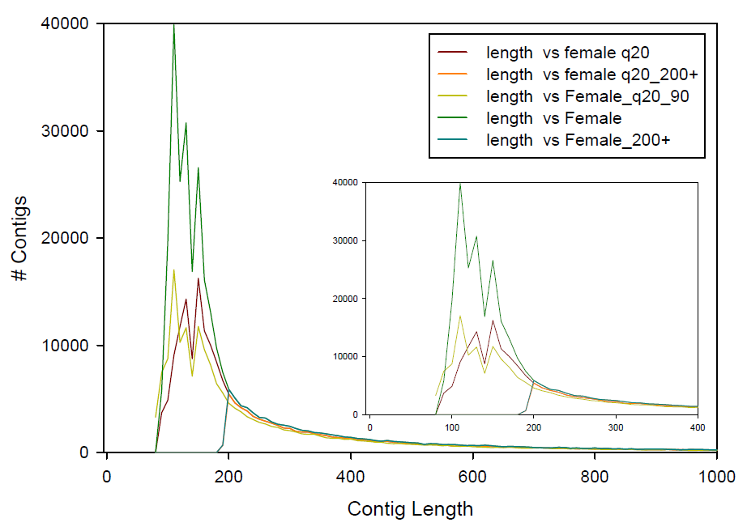

Slide 33
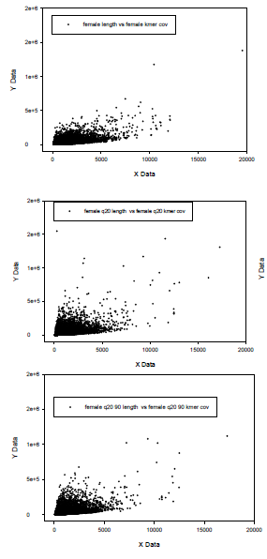
Length vs coverage
Quality filtering reads
Increase coverage
Increase read length
Fewer short contigs

Slide 34
So next step
Assemble all libraries separately
Just finished
Assemble all libraries together
Running right now
Annotate Assemblies
BLAST, GO, PATHWAY
SNP Call
Between our libraries and Taiwan and NZ
RNAseq analysis

Slide 35
Other Transcriptome Projects
Juchun in Tiawan is giving us access to her data, different population of Oriental fruit fly
Karen Armstrong in NZ has data from 2 other populations.
Interesting possibility to explore genome wide species variation (of interest to IAEA and APHIS in species definition)
Good Multinational Collaboration

Slide 36
Papaya Genome
ONLY NEW 454 data, Average depth = 10X Est. genome size 463 MB
scaffoldMetrics
numberOfScaffolds = 13069;
numberOfBases = 330192496;
avgScaffoldSize = 25265;
N50ScaffoldSize = 1511029;
LargestScaffoldSize = 7677599;
largeContigMetrics
numberOfContigs = 77548;
numberOfBases = 269131402;
avgContigSize = 3470;
N50ContigSize = 6644;
largestContigSize = 85477;
Need to add in the old Sanger sequencing data, it is the next thing to run on my computer in my office

Slide 37
Annotation and Databasing
As we have been waiting for sequencing data and assembly:
Annotation pipeline is setup and tested on a subset of data
GMOD database (CHADO/postgresql) setup and configured to handle data
Project website designed by UH Hilo student to disseminate data (through secure login) using genome browser, blast, and ftp
Basically, once we get a quality assembly, we are ready to run with the data

Slide 38
Acknowledgments
PBARC
Eric Jang
Dennis Gonsalves
Steven Tam
Nicholas Manoukis
Stella Chang
Natasha Sostrom
Sequencing
Shaobin
Collaborators with other sequences
JuChun
Karen Armstrong

Slide 40
Assembly supplemental material

Slide 41
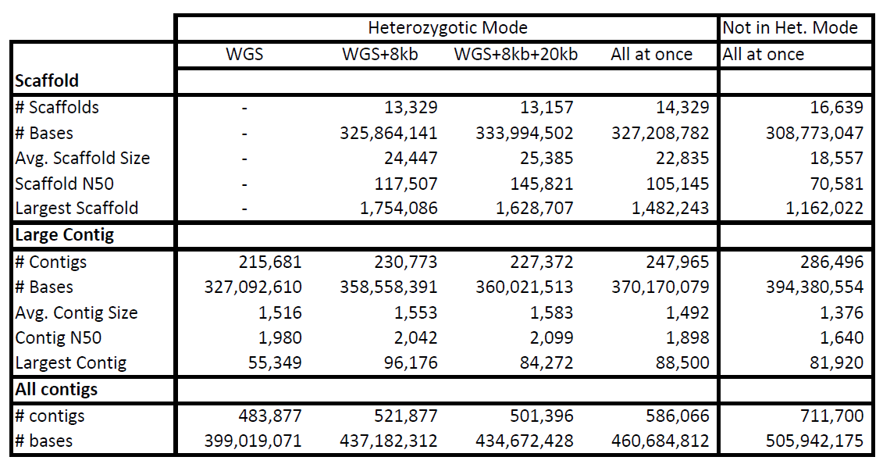
Influence of Het. Mode and incremental assembly on assembly

Slide 42

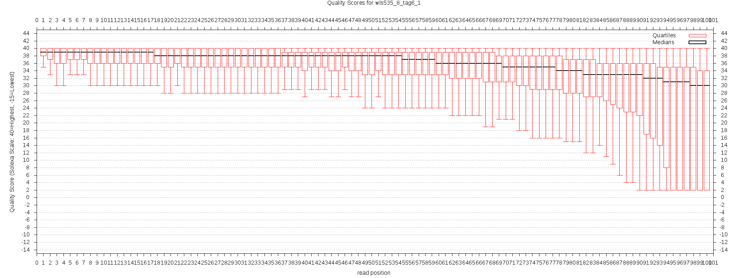

Slide 43
Not all reads in PE library are PE reads
Library Type | # Reads Used | # Bases Used | % Reads Assembled | Read Error | % Paired Reads | # Paired Reads | % Pairs Both Assembled
WGS | 451503 | 169811016 | 81 | 2.11 | 0% | 0 | 0
WGS | 406738 | 146314499 | 81 | 2.18 | 0% | 0 | 0
WGS | 478774 | 176715960 | 81 | 2.13 | 0% | 0 | 0
WGS | 466891 | 166145321 | 81 | 2.17 | 0% | 0 | 0
20kb paired | 472006 | 104431550 | 86 | 1.61 | 8% | 36486 | 63
20kb paired | 401175 | 100713122 | 86 | 1.56 | 9% | 34140 | 65
20kb paired | 473942 | 105492565 | 86 | 1.76 | 9% | 44788 | 64
20kb paired | 229300 | 59436199 | 87 | 1.54 | 12% | 26828 | 68
8kb paired | 683641 | 129755291 | 80 | 2.68 | 54% | 369166 | 63
8kb paired | 768914 | 146587872 | 80 | 2.67 | 55% | 423441 | 63
8kb paired | 787016 | 156941914 | 80 | 2.67 | 56% | 442146 | 64
8kb paired | 636722 | 125734498 | 80 | 2.79 | 56% | 358283 | 64

Slide 46
New 20 kb Library Statistics
First two runs very good,
Next two runs not as good, Shaobin was not sure why
Run | Date | Insert Size | Read Error | % Read with Mates | Average Read Length
GPWPV9K04.sff | 10/23/2010 | 20529 | 2.05 | 59% | 309
GQHTMLN01.sff &2 | 11/3/2010 | 20585 | 1.92 | 67% | 331
GP33VEV01.sff & 2 | 11/9/2010 | 20542 | 2.04 | 43% | 235
GQKSO6A01.sff & 2 | 11/9/2010 | 20049 | 2.36 | 41% | 224

Slide 47
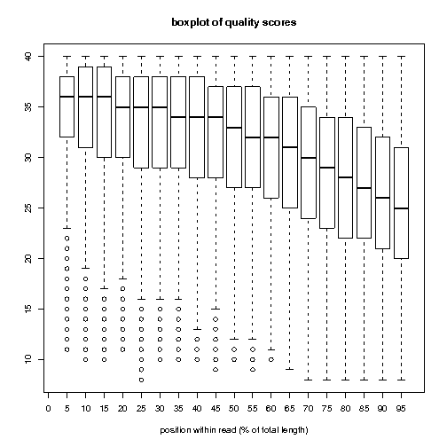
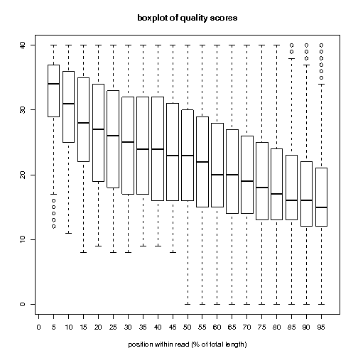
Read Quality distributiuon (average score across read) GPWPV9K04 GP33VEV02

Slide 48
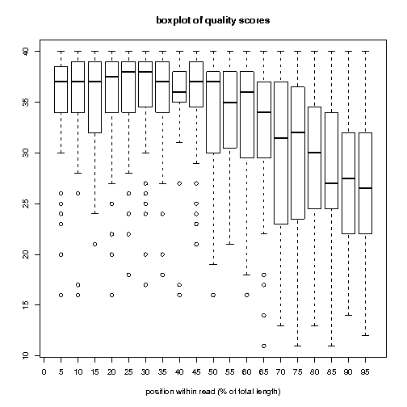
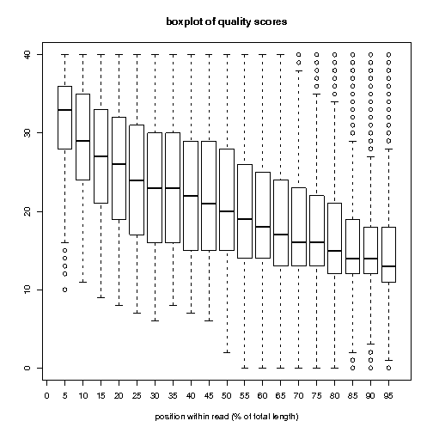
GQKSO6A02
Example High Quality Data

Slide 49
Using the (good) 20 kb data to improve assembly (January 2011)
 | With new 20 kb | Previous assembly
numberOfScaffolds | 15,729 | 16639
numberOfBases | 348,980,902 | 308 Mb
N50ScaffoldSize | 167,467 | 80,000
largestScaffoldSize | 2,175,715 | .9 Mb
numberOfContigs | 271,272
numberOfBases | 393,833,947 | 394 Mb
N50ContigSize | 1,796 | 1640
largestContigSize | 88,671
Take home from this, Scaffolds are getting big, but contigs are staying small

