Slide 1
QTL Data Standards at PeanutBase and LegumeInfo
January 11th, 2015
Plant Phenotype Workshop
Ethalinda Cannon
Iowa State University

Slide 2
Who We Are
PeanutBase.org is a new resource for the peanut breeding community.
LegumeInfo.org is the new implementation of the Legume Information System, a clade database for the legumes with an emphasis on comparative analysis.

Slide 3
Some Background
Both PeanutBase and LegumeInfo are implemented in Tripal.

Slide 4
Some Background
Both PeanutBase and LegumeInfo are implemented in Tripal.
Tripal is a framework for developing biological websites.

Slide 5
Some Background
Both PeanutBase and LegumeInfo are implemented in Tripal.
Tripal is a framework for developing biological websites.
Tripal uses the Chado database schema for storing data.

Slide 6
Some Background
Both PeanutBase and LegumeInfo are implemented in Tripal.
Tripal is a framework for developing biological websites.
Tripal uses the Chado database schema for storing data.
Chado is a generic database schema for biological data.

Slide 7
Some Background
Tripal and Chado are part of the GMOD (Generic Model Organism Database) project, along with CMap and GBrowse.

Slide 8
Some Background
Tripal and Chado are used by a number of plant databases.

Slide 9
Some Background
Tripal and Chado are used by a number of plant databases.
Because of the Tripal and Chado support for module development, modules developed by one database can be shared with other databases that also use Tripal and Chado.

Slide 10
Some Background
Tripal and Chado are used by a number of plant databases.
Because of the Tripal and Chado support for module development, modules developed by one database can be shared with other databases that also use Tripal and Chado.
This means that a Tripal module for QTL data that is developed at PeanutBase/LegumeInfo can be shared with other databases.

Slide 11
Some Background
Tripal is in use by these databases:
Banana Genome Hub
Cacao Genome Database
Citrus Genome Database
Cool Season Food Legume Genome Database
CottonGen
Fagaceae Genomics Web
Genome Database for Rosaceae
Genome Database for Vaccinium
GeneNetEngine
Hardwood Genomics Project
KnowPulse: Pulse Crop Genomics & Breeding
Legume Information System
PeanutBase
5k Workspace@NAL

Slide 12
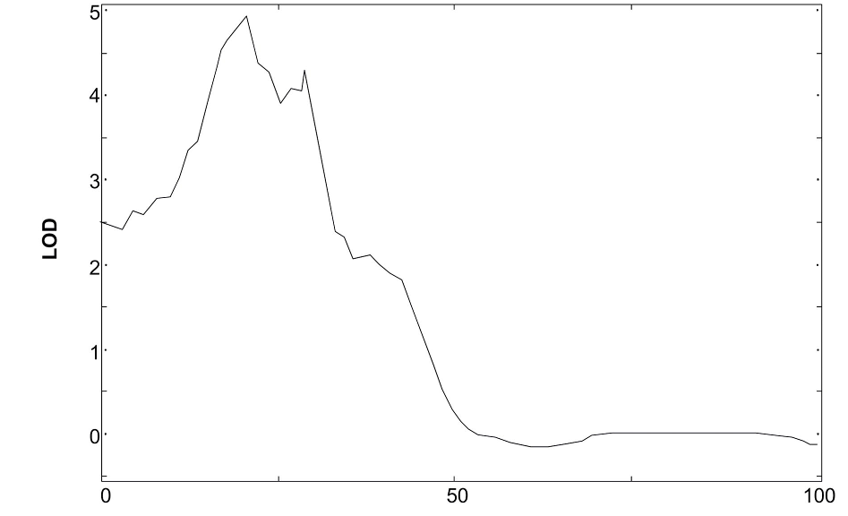
A QTL is a Quantitative Trait Locus
A genetically mapped quantitative trait, like plant height.

Slide 13
A QTL is a Quantitative Trait Locus
A genetically mapped quantitative trait, like plant height.
A region that is linked to variance of this trait.

Slide 14
A QTL is a Quantitative Trait Locus
A genetically mapped quantitative trait, like plant height.
A region that is linked to variance of this trait.
The actual gene may or may not be contained in this region; it’s more likely to be “nearby”.

Slide 15
A QTL is a Quantitative Trait Locus
QTL peak
Maximum LOD score
A genetically mapped quantitative trait, like plant height.
A region that is linked to variance of this trait.
The actual gene may or may not be contained in this region; it’s more likely to be “nearby”.

Slide 16
A QTL is a Quantitative Trait Locus
A genetically mapped quantitative trait, like plant height.
A region that is linked to variance of this trait.
The actual gene may or may not be contained in this region; it’s more likely to be “nearby”.
marker B
marker B
marker C
marker D
marker E
nearest marker

Slide 17
A QTL is a Quantitative Trait Locus
A genetically mapped quantitative trait, like plant height.
A region that is linked to variance of this trait.
The actual gene may or may not be contained in this region; it’s more likely to be “nearby”.
LOD = 2
region start
region end

Slide 18
A QTL comes with metadata
Growing location, conditions, and treatments

Slide 19
A QTL comes with metadata
Growing location, conditions, and treatments
Description of the traits studied

Slide 20
A QTL comes with metadata
Growing location, conditions, and treatments
Description of the traits studied
Markers and genetic map used in study

Slide 21
A QTL comes with metadata
Growing location, conditions, and treatments
Description of the traits studied
Markers and genetic map used in study
Description of the population

Slide 22
A QTL comes with metadata
Growing location, conditions, and treatments
Description of the traits studied
Markers and genetic map used in study
Description of the population
Description of the analysis

Slide 23
A QTL comes with metadata
Growing location, conditions, and treatments
Description of the traits studied
Markers and genetic map used in study
Description of the population
Description of the analysis
Publication

Slide 24
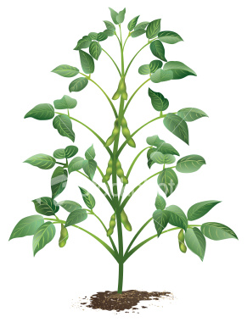
Plant height QTL
Consider a trait named “plant height”.

Slide 25
Plant height QTL
Consider a trait named “plant height”.
Its description might be, “height of plant from the base of the root to the tip of the highest leaf” OR “height of plant from the base of the root to the highest node”.

Slide 26
Plant height QTL
Consider a trait named “plant height”.
Its description might be, “height of plant from the base of the root to the tip of the highest leaf”.
Its units might be “cm”.

Slide 27
Plant height QTL
Consider a trait named “plant height”.
Its description might be, “height of plant from the base of the root to the tip of the highest leaf”.
Its units might be “cm”.
The conditions under which this QTL was measured could be “Field location at 42°02′05″N 93°37′12″W, summer of 2012, drought year.”

Slide 28
Plant height QTL
Consider a trait named “plant height”.
Its description might be, “height of plant from the base of the root to the tip of the highest leaf”.
Its units might be “cm”.
The conditions under which this QTL was measured could be “Field location at 42°02′05″N 93°37′12″W, summer of 2012, drought year.”
It might be placed on a genetic map that was described in an earlier publication.

Slide 29
Plant height QTL
Consider a trait named “plant height”.
Its description might be, “height of plant from the base of the root to the tip of the highest leaf”.
Its units might be “cm”.
The conditions under which this QTL was measured could be “Field location at 42°02′05″N 93°37′12″W, summer of 2012, drought year.”
It might be placed on a genetic map that was described in an earlier publication.
Its position might be indicated by flanking markers or a genetic position, or a range.

Slide 30
Plant height QTL
Consider a trait named “plant height”.
Its description might be, “height of plant from the base of the root to the tip of the highest leaf”.
Its units might be “cm”.
The conditions under which this QTL was measured could be “Field location at 42°02′05″N 93°37′12″W, summer of 2012, drought year.”
It might be placed on a genetic map that was described in an earlier publication.
Its position might be indicated by flanking markers or a genetic position, or a range.
The population used in the study might be a subset of the population used to create the genetic map.

Slide 31
The challenges
QTL data are complex, difficult to collect and highly variable in presentation.

Slide 32
The challenges
QTL data are complex, difficult to collect and highly variable in presentation.
Each data web portal that serves QTL data must solve the problem of collection, storage and presentation individually.

Slide 33
The challenges
QTL data are complex, difficult to collect and highly variable in presentation.
Each data web portal that serves QTL data must solve the problem of collection, storage and presentation individually.
Therefore, there is a proliferation of methods to collect, store, and present QTL data.

Slide 34
What’s out there now for plants?
Minimum Information about QTL or Association Study (MIQAS) – animal-centric

Slide 35
What’s out there now for plants?
Minimum Information about QTL or Association Study (MIQAS) – animal-centric
Collection templates available from:
PeanutBase and LegumeInfo
Genome Database for Rosaceae, CottonGen, CoolSeasonFoodLegumes
GrainGenes
Possibly others

Slide 36
MIQAS - Minimum Information about a QTL or Association Study (http://miqas.sourceforge.net/)
experiment description: meta-data about the experiment.

Slide 37
MIQAS - Minimum Information about a QTL or Association Study (http://miqas.sourceforge.net/)
experiment description: meta-data about the experiment.
population description: describes the population used for the analysis.

Slide 38
MIQAS - Minimum Information about a QTL or Association Study (http://miqas.sourceforge.net/)
experiment description: meta-data about the experiment.
population description: describes the population used for the analysis.
pedigree: gender and pedigree for the individuals.

Slide 39
MIQAS - Minimum Information about a QTL or Association Study (http://miqas.sourceforge.net/)
experiment description: meta-data about the experiment.
population description: describes the population used for the analysis.
pedigree: gender and pedigree for the individuals.
trait description: describes the trait(s) under investigation.

Slide 40
MIQAS - Minimum Information about a QTL or Association Study (http://miqas.sourceforge.net/)
experiment description: meta-data about the experiment.
population description: describes the population used for the analysis.
pedigree: gender and pedigree for the individuals.
trait description: describes the trait(s) under investigation.
marker description: provides accession numbers and possible alleles for all markers.

Slide 41
MIQAS - Minimum Information about a QTL or Association Study (http://miqas.sourceforge.net/)
experiment description: meta-data about the experiment.
population description: describes the population used for the analysis.
pedigree: gender and pedigree for the individuals.
trait description: describes the trait(s) under investigation.
marker description: provides accession numbers and possible alleles for all markers.
map: provides the genetic map for the markers as generated on the study sample. genotype data file: Contains the genotypes for all markers vs individuals.

Slide 42
MIQAS - Minimum Information about a QTL or Association Study (http://miqas.sourceforge.net/)
experiment description: meta-data about the experiment.
population description: describes the population used for the analysis.
pedigree: gender and pedigree for the individuals.
trait description: describes the trait(s) under investigation.
marker description: provides accession numbers and possible alleles for all markers.
map: provides the genetic map for the markers as generated on the study sample. genotype data file: Contains the genotypes for all markers vs individuals.
genotype data: the genotypes for all markers vs individuals.

Slide 43
MIQAS - Minimum Information about a QTL or Association Study (http://miqas.sourceforge.net/)
experiment description: meta-data about the experiment.
population description: describes the population used for the analysis.
pedigree: gender and pedigree for the individuals.
trait description: describes the trait(s) under investigation.
marker description: provides accession numbers and possible alleles for all markers.
map: provides the genetic map for the markers as generated on the study sample. genotype data file: Contains the genotypes for all markers vs individuals.
genotype data: the genotypes for all markers vs individuals.
phenotype data: phenotypes for all traits vs individuals.

Slide 44
MIQAS - Minimum Information about a QTL or Association Study (http://miqas.sourceforge.net/)
experiment description: meta-data about the experiment.
population description: describes the population used for the analysis.
pedigree: gender and pedigree for the individuals.
trait description: describes the trait(s) under investigation.
marker description: provides accession numbers and possible alleles for all markers.
map: provides the genetic map for the markers as generated on the study sample. genotype data file: Contains the genotypes for all markers vs individuals.
genotype data: the genotypes for all markers vs individuals.
phenotype data: phenotypes for all traits vs individuals.
results: specifics for the analysis and location of QTLs and associated markers.

Slide 45
More challenges
Plants are not animals

Slide 46
More challenges
Plants are not animals
Plants present different challenges
Gender of parents often not known
Pedigree by individuals rarely known

Slide 47
More challenges
Plants are not animals
Plants present different challenges
Gender of parents often not known
Pedigree by individuals rarely known
Different plant species can present different challenges
Interspecific mapping populations (e.g peanut)
Breeding challenges (e.g. tetraploid breeding)

Slide 48
More challenges
Plants are not animals
Plants present different challenges
Gender of parents often not known
Pedigree by individuals rarely known
Different plant species can present different challenges
Interspecific mapping populations (e.g peanut)
Breeding challenges (e.g. tetraploid breeding)
Plants also have advantages, for example, inbreds.

Slide 49
More challenges
Different plant research communities have different practices (e.g. in statistics typically reported).

Slide 50
More challenges
Different plant research communities have different practices (e.g. in statistics typically reported).
Different plant research communities have different resources that dictate what kinds of QTL studies can be done (Inbreds, RIL populations, good consensus genetic maps, reference genomes).

Slide 51
More challenges
Different plant research communities have different practices (e.g. in statistics typically reported).
Different plant research communities have different resources that dictate what kinds of QTL studies can be done (Inbreds, RIL populations, good consensus genetic maps, reference genomes).
Even within a particular research community, the information provided in a published QTL study varies greatly.

Slide 52
More challenges
Different plant research communities have different practices (e.g. in statistics typically reported).
Different plant research communities have different resources that dictate what kinds of QTL studies can be done (Inbreds, RIL populations, good consensus genetic maps, reference genomes).
Even within a particular research community, the information provided in a published QTL study varies greatly.
We are not the only ones working on QTL standards.

Slide 53
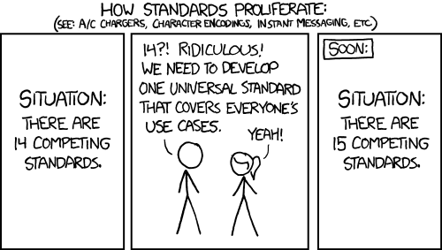
More challenges

Slide 54
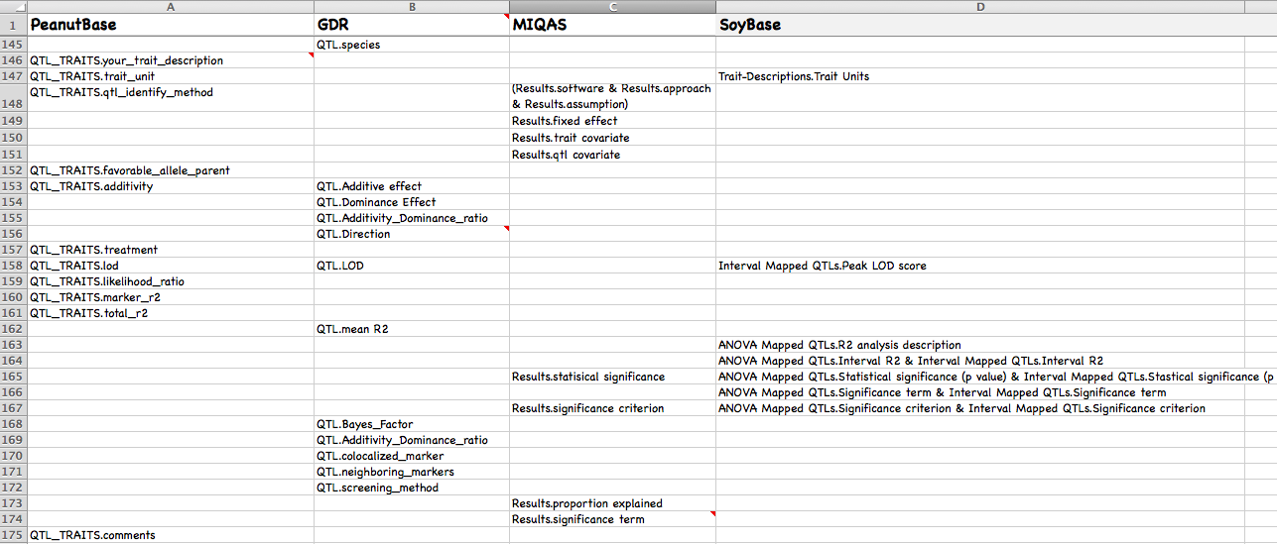
Avoiding proliferation of standards
Collaborating with SoyBase, PeanutBase, and the Genomic Database for Rosacae to create a consensus data collection template in keeping with MIQAS.

Slide 55
Some principles
Acknowledge differences between organisms and research communities: must be flexible and extendable.

Slide 56
Some principles
Acknowledge differences between organisms and research communities: must be flexible and extendable.
Acknowledge history of long-time databases with legacy data.

Slide 57
Some principles
Acknowledge differences between organisms and research communities: must be flexible and extendable.
Acknowledge history of long-time databases with legacy data.
Focus on plant needs.

Slide 58
Some principles
Acknowledge differences between organisms and research communities: must be flexible and extendable.
Acknowledge history of long-time databases with legacy data.
Focus on plant needs.
Create a simplified data collection spreadsheet for researchers and a more complex one for data curators.

Slide 59
Some principles
Acknowledge differences between organisms and research communities: must be flexible and extendable.
Acknowledge history of long-time databases with legacy data.
Focus on plant needs.
Create a simplified data collection spreadsheet for researchers and a more complex one for data curators.
Try not to overwhelm with all possible data one might collect from a QTL study.

Slide 60
Some more principles
We recommend not overriding published trait names and QTL symbols, but rather correlating them to a set of consistent internal names.

Slide 61
Some more principles
We recommend not overriding published trait names and QTL symbols, but rather correlating them to a set of consistent internal names.
The internal trait names must rely on existing ontologies where possible (Plant Ontology, CROP ontology, et cetera).

Slide 62
The plan
Objective 1: develop a data collection template for QTL collection that could be adopted by any plant database.

Slide 63
The plan
Objective 2: develop a data structure for loading QTL data into the Chado database schema and scripts to load the data. Any database that uses Chado could potentially make use of the structure and loading scripts.

Slide 64
The plan
Objective 2: develop a data structure for loading QTL data into the Chado database schema and scripts to load the data. Any database that uses Chado could potentially make use of the structure and loading scripts.
Chado is a database schema for biological data in wide use.

Slide 65
The plan
Objective 2: develop a data structure for loading QTL data into the Chado database schema and scripts to load the data. Any database that uses Chado could potentially make use of the structure and loading scripts.
Chado is a database schema for biological data in wide use.
Data must be mapped onto the Chado schema.

Slide 66
The plan
Objective 2: develop a data structure for loading QTL data into the Chado database schema and scripts to load the data. Any database that uses Chado could potentially make use of the structure and loading scripts.
Chado is a database schema for biological data in wide use.
Data must be mapped onto the Chado schema.
Chado’s generic structure and flexibility presents challenges for data as complex as QTL data.

Slide 67
The plan
Objective 2: develop a data structure for loading QTL data into the Chado database schema and scripts to load the data. Any database that uses Chado could potentially make use of the structure and loading scripts.
Chado is a database schema for biological data in wide use.
Data must be mapped onto the Chado schema.
Chado’s generic structure and flexibility presents challenges for data as complex as QTL data.
It is possible for everyone to load QTL data into Chado differently.

Slide 68
The plan
Objective 2: develop a data structure for loading QTL data into the Chado database schema and scripts to load the data. Any database that uses Chado could potentially make use of the structure and loading scripts.
Chado is a database schema for biological data in wide use.
Data must be mapped onto the Chado schema.
Chado’s generic structure and flexibility presents challenges for data as complex as QTL data.
It is possible for everyone to load QTL data into Chado differently.

Slide 69
The plan
Objective 3: build a Tripal web module for searching, viewing, and downloading the data. This module will be available to any database built with Tripal.

Slide 70
The plan
Objective 3: build a Tripal web module for searching, viewing, and downloading the data. This module will be available to any database built with Tripal.
Tripal is a website framework that uses Chado.

Slide 71
The plan
Objective 3: build a Tripal web module for searching, viewing, and downloading the data. This module will be available to any database built with Tripal.
Tripal is a website framework that uses Chado.
Tripal is widely used by plant databases, including PeanutBase and LegumeInfo.

Slide 72
Where we are
A QTL collection template is available now at PeanutBase and LegumeInfo, but will be modified to meet the needs of collaborating databases.
Scripts for loading QTL data into Chado are functional but not yet ready to be widely shared.
A prototype Tripal module for searching and displaying the QTL data is in use at PeanutBase and LegumeInfo.

Slide 73
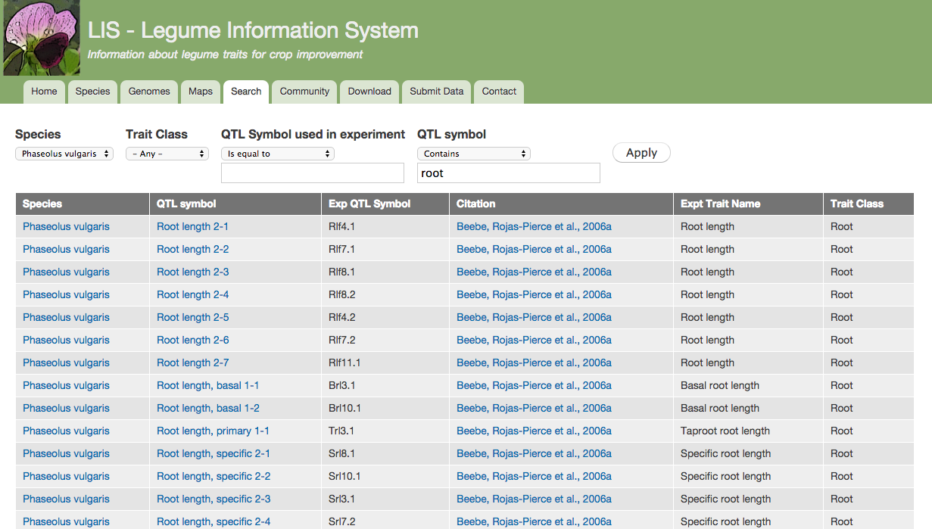
QTL module prototype (with a lot of help from Stephen Ficklin at CoolSeasonsFoodLegume.org)

Slide 74
QTL module prototype

Slide 75
QTL module prototype

Slide 76
QTL module prototype

Slide 77
QTL module prototype

Slide 78
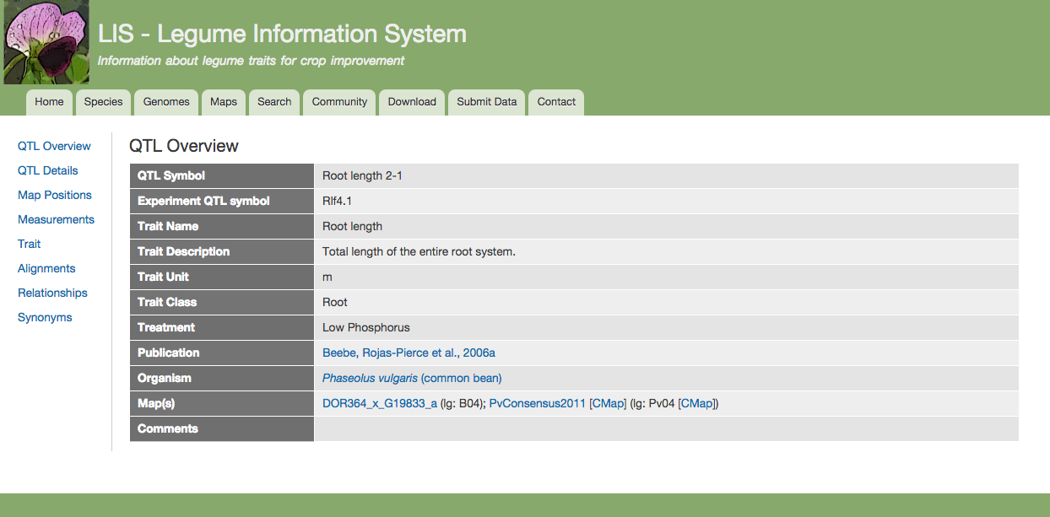
QTL module prototype

Slide 79
QTL module prototype

Slide 80
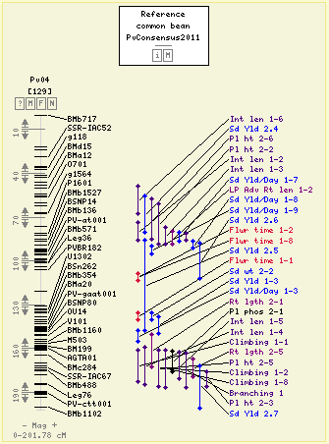
QTL module prototype

Slide 81
QTL module prototype

Slide 82
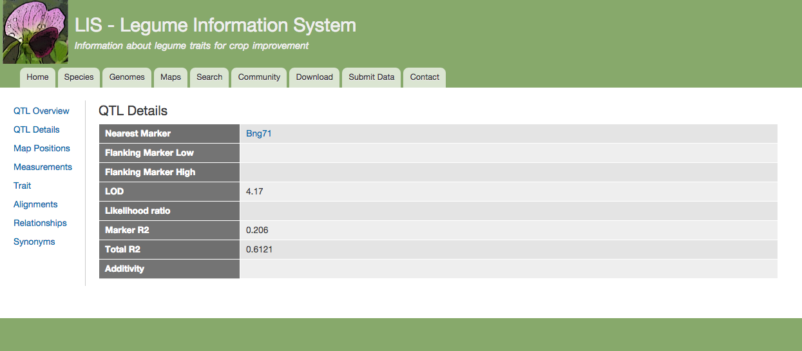
QTL module prototype

Slide 83
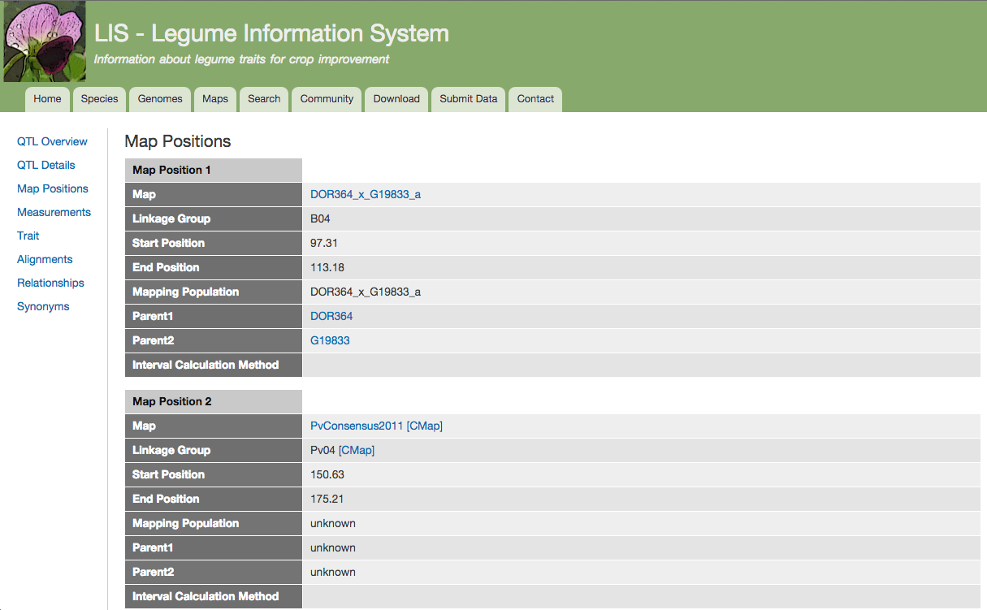
QTL module prototype

Slide 84
More information
Tripal: Tripal workshop today at 4:00 in the California Room
Chado: GMOD workshop Wednesday at 10:30 in Golden West
QTL at PeanutBase: Poster # P0737
Contact me: ekcannon@iastate.edu

Slide 85


Acknowledgements
PeanutBase/LegumeInfo
Steven Cannon
Andrew Farmer
Sudhansu Dash
Ethy Cannon
Scott Kalberer
Iliana Toneva
Pooja Umale
Alan Cleary
Nathan Weeks
Jugpreet Singh
SoyBase
David Grant
Rex Nelson
GDR
Dorrie Main
Sook Jung
CoolSeasonFoodLegume
Dorrie Main
Stephen Ficklin
Funding by the Peanut Foundation and the USDA-ARS

