Slide 1
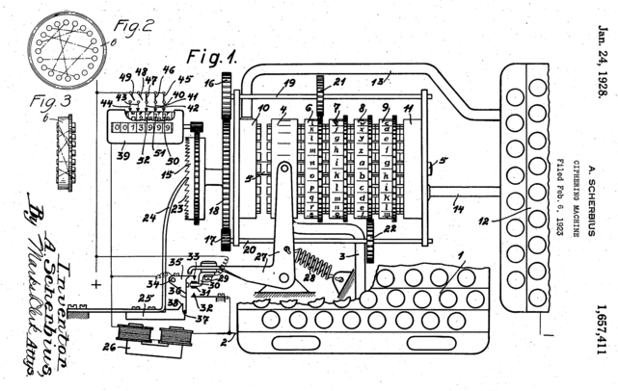


ENIGMA: comparative, consensus gene structure annotation
Will McKerrow Ian H. Holmes, UC Berkeley
Aaron J. Mackey University of Virginia

Slide 2
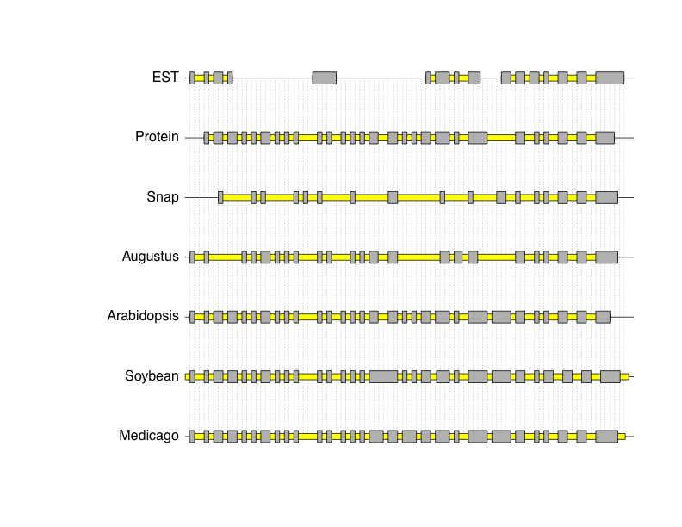
structural gene evidence
manual curation is not practical, nor cost-effective, for each new genome to be annotated
goals for automated curation:
do a good job
flag cases where manual curation is desirable

Slide 3
comparative structural gene evidence

Slide 4
consensus gene structures: why?
all sources of structural evidence harbor errors
even RNAseq! (accuracy varies with isoform abundance, coverage, and read alignment methodology)
gold standard manual curations are best saved for QC
don't use them for training gene finders!
certainly don't waste them training combiners!
evidence-integrating methods are more accurate
differing assumptions/tunings particular to each evidence source can capture varying biological features
don't compete to determine best methods; use them all!

Slide 5
consensus gene structures: how?
combine across all available evidence:
complete evidence: gene models, full-length cDNA/homologous protein alignments, …
partial evidence: EST/RNAseq alignments, proteomics, SAGE tags, conservation, epigenetic marks, …
Combiner/JIGSAW (J. Allen and S. Salzberg)
requires training on gold standard to learn error parameters (wastes valuable QC reagent?)
EVM (B. Haas)
requires users to specify relative confidence in evidence sources (how do you know this?)

Slide 6
GLEAN (sites) and Evigan (segments)
fundamental concept: all evidence harbors errors
false positives: diminish specificity
false negatives: diminish sensitivity
learn estimates of FP and FN error rates for each source, directly from the observed data
not because we want to pick the best source!
stitch together sites (segments) into complete gene models, accounting for FP/FN error rates of evidence supporting each site (segment)
yield gene models that minimize expected errors

Slide 7
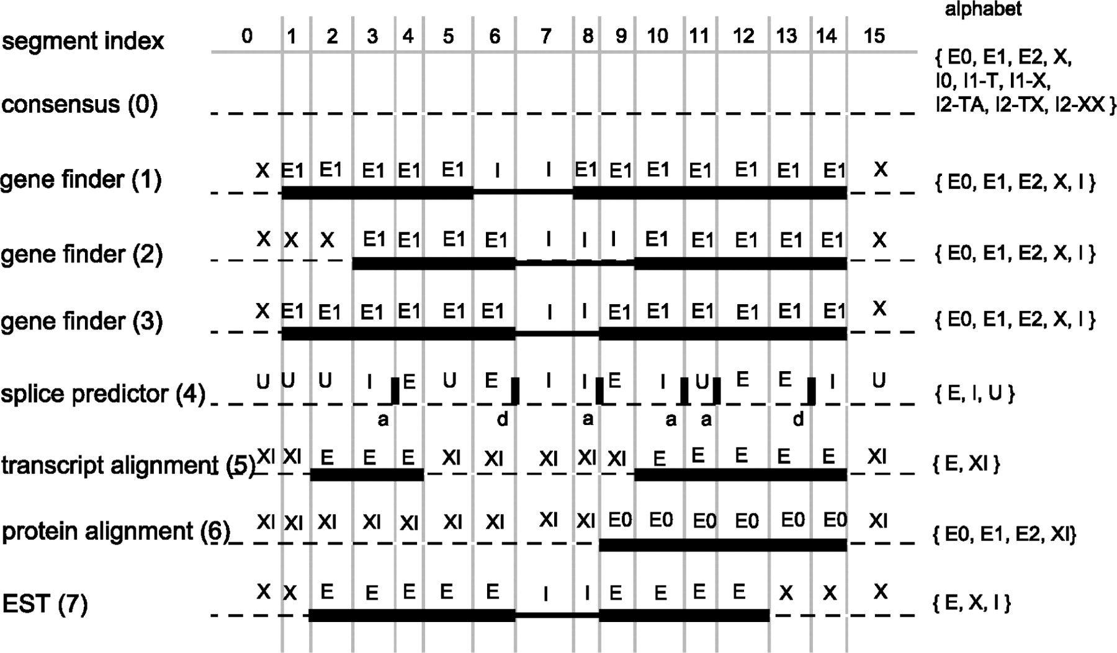
evidence-induced segmentation

Slide 8
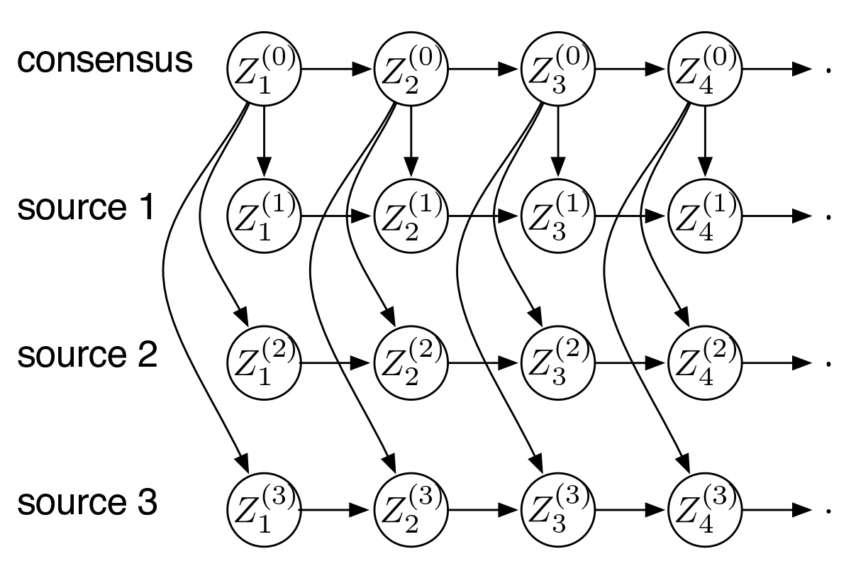
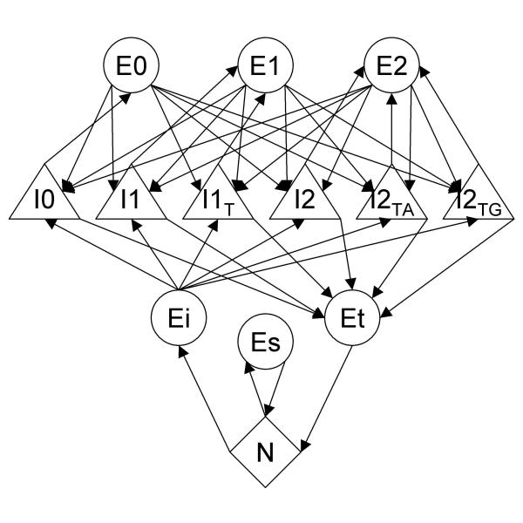
Evigan's DBN model

Slide 9
GLEAN vs. Evigan
GLEAN: (dis)agreement at start/stop, donor/acceptor Evigan: (dis)agreement of segment labelings
segmentation induced by evidence
evidence type-specific alphabets
Evigan can more easily use incomplete evidence
GLEAN: two step procedure
1) ML point estimates of FP/FN for each type of site 2) Viterbi max-path (dependent on ML point estimates)
Evigan: one step procedure
FP/FN estimated jointly with max-path (Baum-Welch)
estimates are more robust, and can integrate more sources of evidence

Slide 10
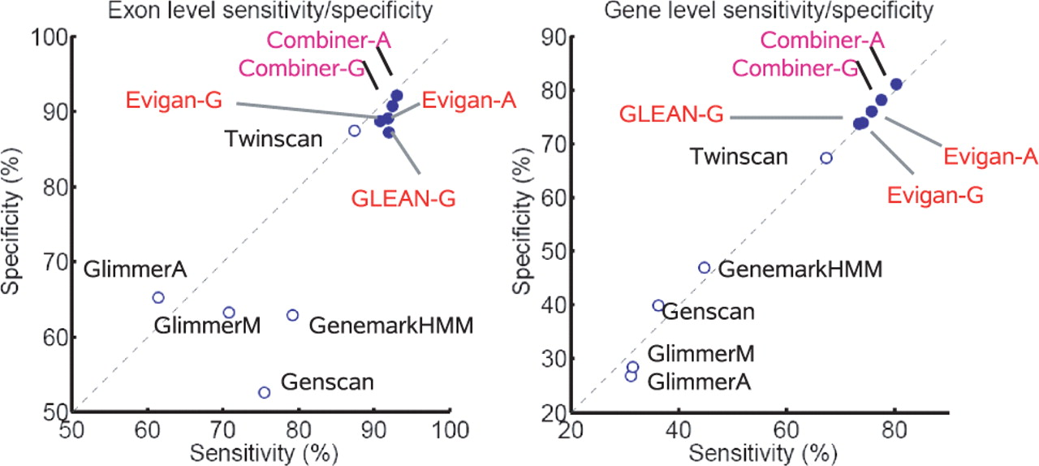
GLEAN & Evigan on A. thaliana

Slide 11
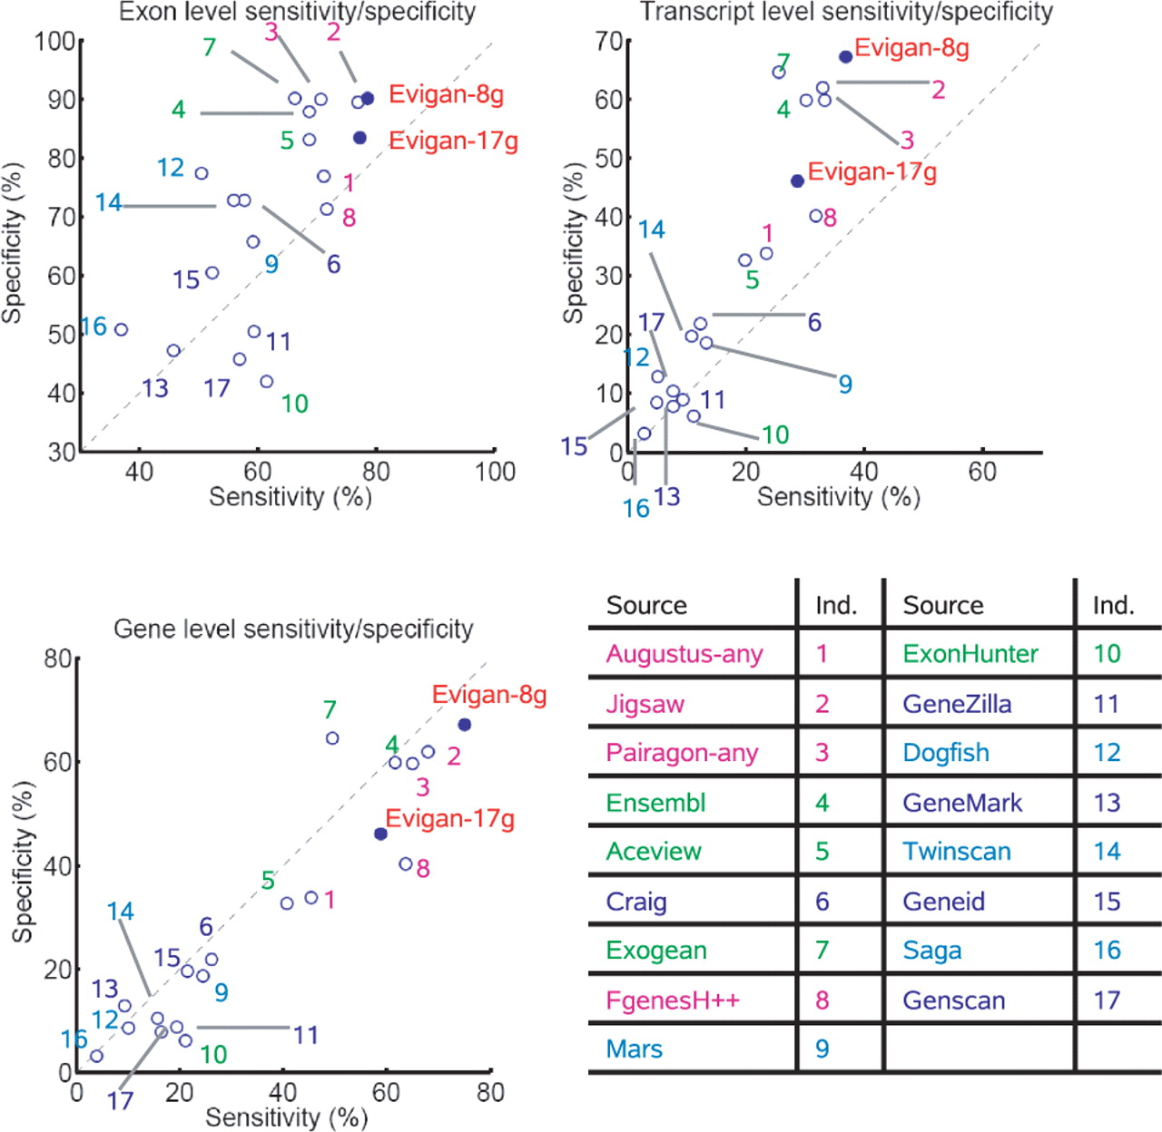
Evigan on human ENCODE

Slide 12
current limitations:
fundamental modeling assumption: evidence independently generated by hidden consensus structure – no means to model more complicated dependencies between evidences
hidden states represent CDS exon/introns (no UTRs)
no annotation of alternative splicing, despite available evidence (RNAseq or otherwise)
software depends on antiquated GFF2-formatted datasets – requires reimplementation of Evigan

Slide 13
solution: ENIGMA
ENIGMA is the next-generation Evigan; a generalized hidden consensus calculating engine
ENIGMA uses Ian Holmes's xrate toolkit for flexible, grammar-based specification of phyloHMM model
allows more flexible dependencies
can be expanded to incorporate UTRs
can be further expanded to model alternative splicing
PhyloHMMs provide a natural means to include comparative data across many species
does not force any one species to be the "gospel truth"
allows uncertainty in gene structure across species to be embraced: diminish the poison of misannotations!

Slide 14
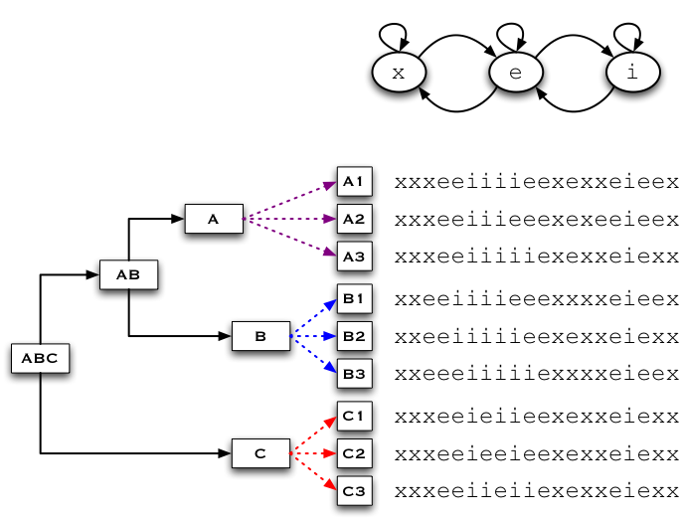
evidence (dis)agreement, across species

Slide 15
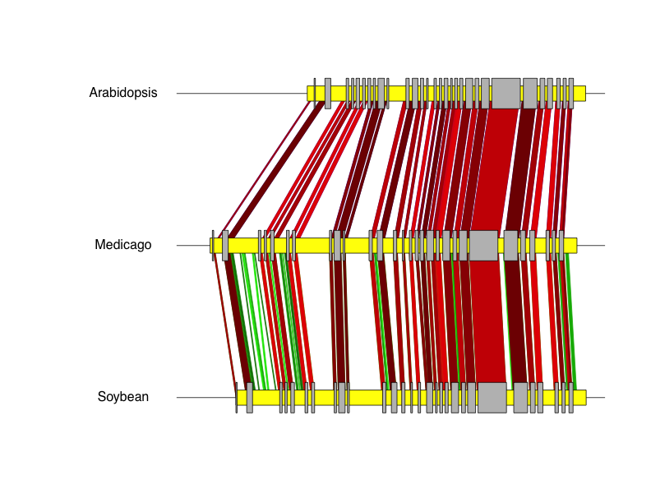
an example from Medicago

Slide 16
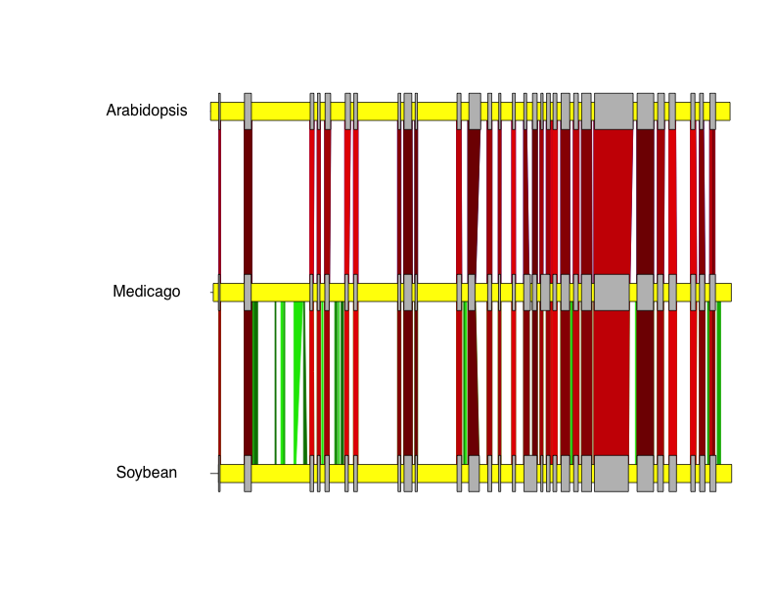
stretched out a bit …

Slide 17
Cactus-guided segmentation
MAKER
Cactus

Slide 18
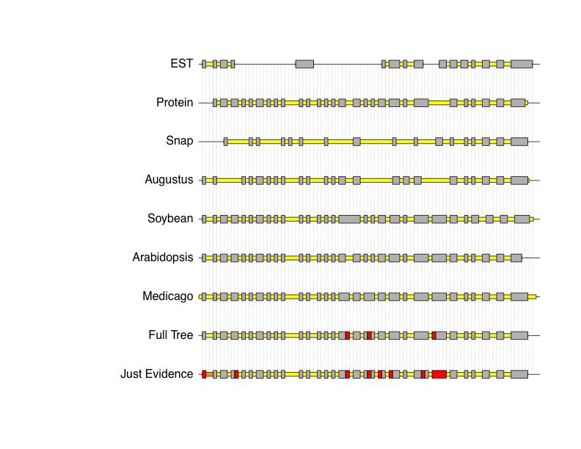
MAKER evidence in Medicago:
Cactus-aligned phylogenetic evidence:
Candidate gene models:

Slide 19
ENIGMA results: AED
 | MAKER evidence | MAKER evidence + A, S
existing Medicago annotation | 0.182 | 0.127
ENIGMA model, from MAKER evidence | 0.120 | 0.113
ENIGMA model, from MAKER evidence + A, S | 0.152 | 0.112

Slide 20
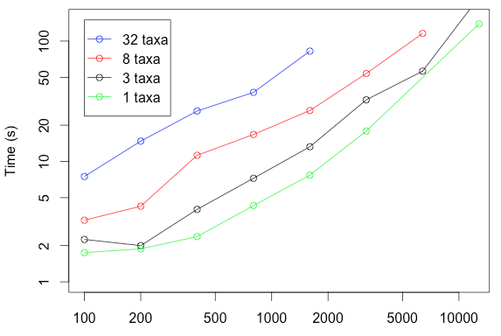
ENIGMA scales exponentially

Slide 21
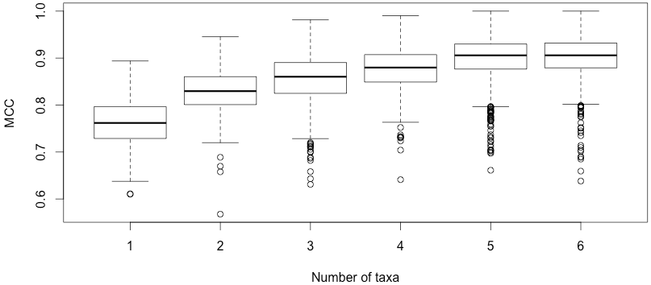
accuracy improves with more species

Slide 22
comparative consensus gene structures – when?
ENIGMA will be baked into MAKER, as an alternative consensus-generating option to the default AED
hope to finish this by end-of-summer 2012, wanna help?
Cactus genome MSA pipeline undergoing rapid development as part of assemblathon
not sure we actually require Cactus; any source of MAF blocks should suffice
UTR handling will be native in Fall 2012
conservation-aware alternative splicing in Spring 2013
MSA uncertainty-aware in Fall 2013 (string transducers)

Slide 23
Questions for GMOD'ers
how do you run MAKER (local, MPI, web, cloud)?
what sources of evidence do you have?
ESTs, or RNAseq
homologous protein alignments
ab initio gene predictions
MS-based proteomics
CAGE/SAGE/etc.
chromatin mark profiles
what doesn't work, common failure modes?
alt. splicing, frameshifts, lncRNA, ???

Slide 24
acknowledgements
UVA
Wilson McKerrow
Mark Lawson
UC Berkeley
Oscar Westesson
Ian Holmes
Utah
Mark Yandell
Carson Holt
Broad
Jennifer Wortman
Brian Haas
happy to collaborate: amackey@virginia.edu

