Slide 1
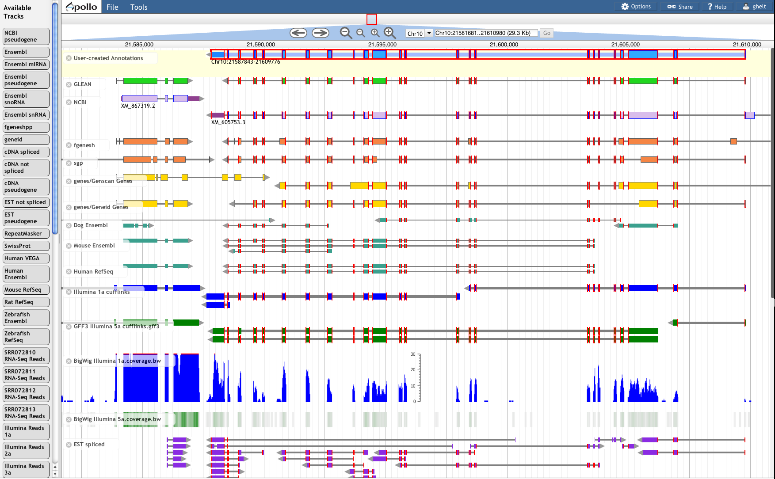





Web Apollo
A Web-based Genomics Annotation Editing Platform
Ed Lee, Gregg Helt, Justin Reese, Monica Munoz-Torres*, Christopher Childers, Rob Buels, Lincoln Stein, Ian Holmes, Christine Elsik, Suzanna Lewis
Biocuration 2013 | Cambridge, UK
Lawrence Berkeley National Laboratory, Joint Genome Institute, for the US Department of Energy at UCB

Slide 2

Web Apollo is:
The first real-time, collaborative genomics annotation editor on the Web
Easy-to-use environment for multiple, distributed users to review, update, and share genome feature markups

Slide 3
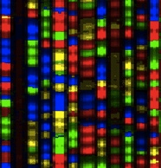
The need for an updated tool
Automated Annotation
Manual annotation
Experimental validation
Assembly
Requires optimized genome visualization and editing tools
More researchers involved
Cheaper sequencing
More genomes being sequenced
High throughput RNA-seq and improved automated annotation
(more assembly errors)
(lack of gold standard gene structure training data)
The democratization of genome-scale sequencing calls for a new kind of annotation editing tool.
Notes:
I only wish to highlight that the need for genome visualization and editing tools is what prompted the development of the genome browsers we commonly use.
But it was also necessary to create editing tools.
All these factors are part of a process we call ‘the democratization of genome-scale sequencing’, which calls for a new kind of tool.

Slide 4
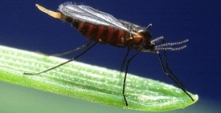
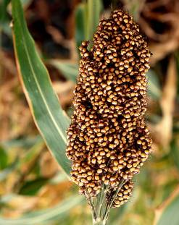
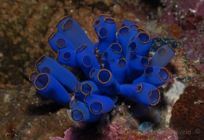
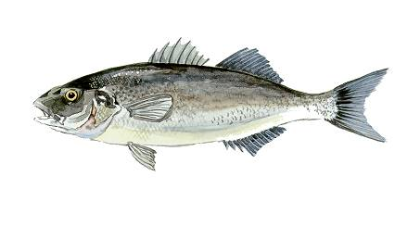




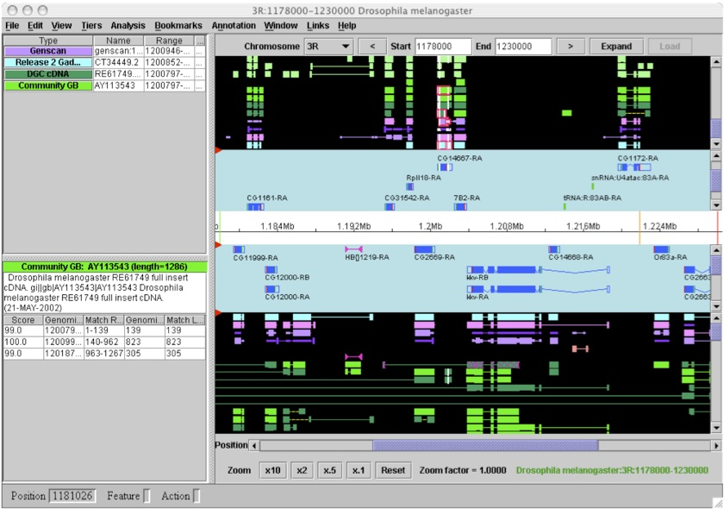
Desktop Apollo
Allows:
Access to computational analysis & experimental evidence
Manual curation
Includes:
Intuitive and varied tools
Compatibility with GMOD
Is:
Widely used (initially designed for centralized, resource-rich projects).

Slide 5

Desktop Apollo
BUT…
Requires Apollo Download & Chado Install
Annotation saved locally, in flat files; no support for sharing
One annotator at a time
Download & INSTALL

Slide 6
Java Web Start Apollo, an Improvement
Annotations saved directly to a centralized database
Java Web Start downloaded Apollo software more transparently
BUT…
Must load all data for a region at once
Edits from other users not visible without reloading
Potential issues with stale annotation data
Needs Java Installation

Slide 7





Web Apollo: Collaborative Annotation
No downloads required
Web-based
Annotations saved to centralized database
Edit server mediates multiple user edits
Uses dynamic (lazy) data loading: only the region of interest
Real-time annotation updates
Customizable to meet researchers’ needs: rules, appearance, etc.
Supports User Authentication & Authorization:
Read, Edit, Review, Complete, Publish (Export) annotations
Automatically promote tracks

Slide 8








Web Apollo Architecture
Annotators
BAM
BigWig
GFF3
VCF*
JBrowse visualization
User Interface
Web Apollo
(Javascript)
Apollo Edit Operations & User Management
(Javascript)
Server-side Data Service
JSON
Annotation Editing Engine
(Java)
Trellis Data Broker (Java)
Static Data Generation Pipeline (Perl)
Berkeley DB temporary store
User Management
Data Sources
Analysis Pipelines
Data Repositories
Annotation Exports
Chado
GFF3
- BAM
- BED
- BigWig
- GFF3
Chado
- MAKER output*
FASTA
MySQL
Permanent store
DAS servers
Notes:
Web Apollo is made of three components: 1) Web-Based Client. 2) Annotation Editing Engine. 3) Server-Side Data Service

Slide 9
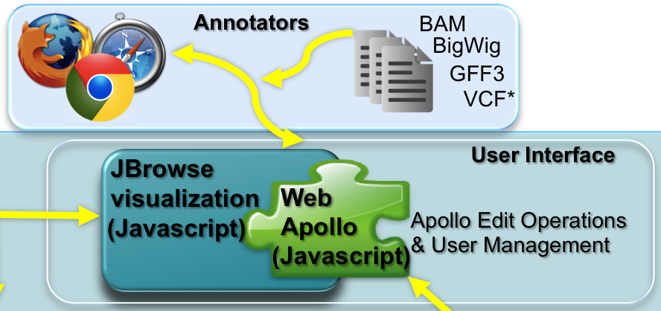
Web-based Client
Plug-in to JBrowse
Javascript genome annotation browser
Fast and responsive
Highly interactive
Visit P.93

Slide 10
Web-based Client
Extensions of JBrowse track features:
GUI for editing annotations
2 new kinds of tracks:
annotation editing
sequence alteration editing
Selection of features & sub-features
Dragging
Edge-matching
Communicates with annotation editing engine and data providing service.
Sends ‘Edit’ operations to the server, lets it decide what to do, server makes the ‘Edit’, pushes back to all clients *

Slide 11
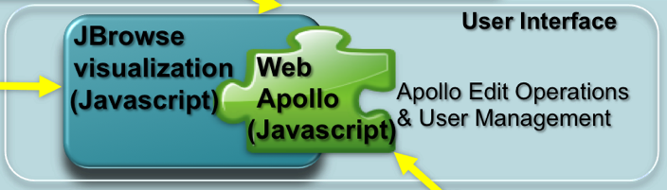
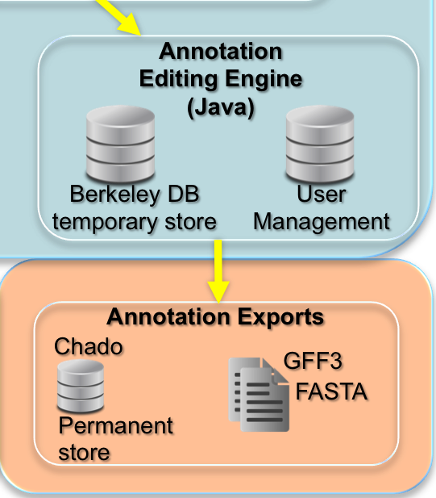
Annotation Editing Engine
The server:
Java servlet
GBOL data model: object model & API, based on the Chado schema
The editing logic is in the server:
selects longest ORF as CDS
flags non-canonical splice sites
Plug-in architecture for sequence alignment searches: BLAT
Uses BerkeleyDB
Stores Annotations, Edits, History
Supports Real Time Collaboration
Notes:
- The server is a Java servlet
- it uses the GMOD biological object layer (gbol) data model: object model & API, based on the Chado schema
- Editing logic is in the server:
-- selects longest ORF as CDS
-- flags non-canonical splice sites
- Plug-in architecture for sequence alignment searches, to locate region of interest: BLAT
- Berkeley DB stores annotations & annotation edits, and their History
- Real Time Collaboration

Slide 12
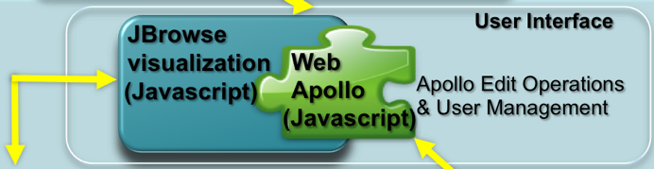
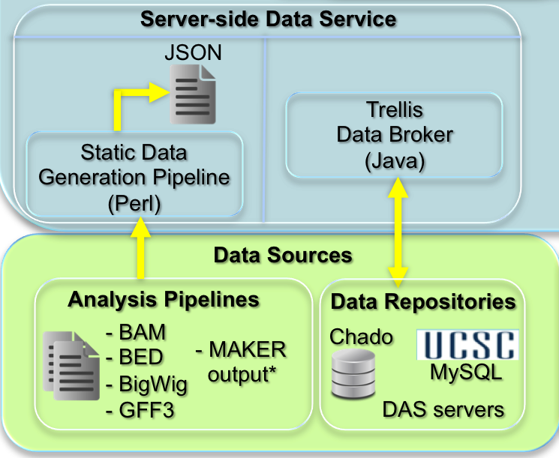
Server-side Data Service

Slide 13

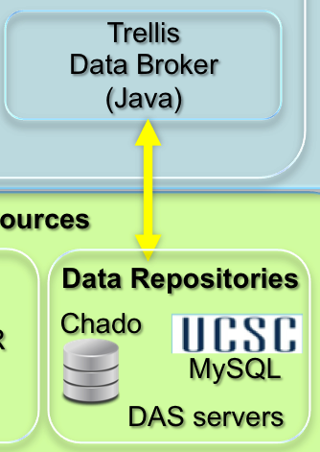
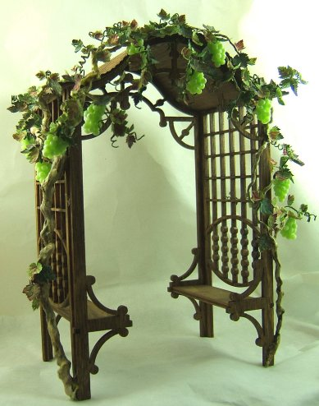
Server-side Data Service
Trellis
A data broker with plug-in architecture for both output formats and back-end data stores
Web Apollo support is implemented as plug-in that outputs JSON format
Also has output plug-ins for GFF3 & BED
On the back-end, we implemented 3 plug-ins for:
UCSC MySQL genome database
Chado
DAS servers (e.g.: Ensembl)

Slide 14
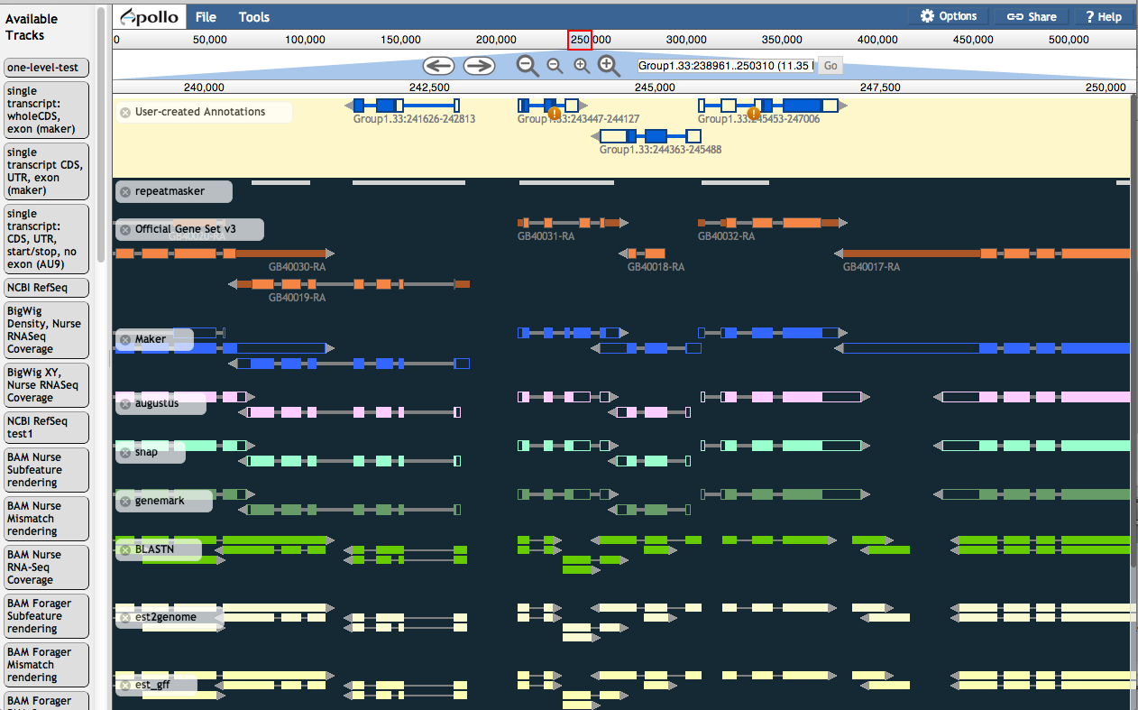
Further customization

Slide 15
Future Enhancements
Ability to annotate regulatory regions & features
Collapsing and expanding tracks
Sticky ‘User Annotations’ track
Genome slicing: annotating across contigs
Folding of intronic space

Slide 16
Releases & Demo
Release
http://genomearchitect.org/webapollo/releases
Demo Site
http://icebox.lbl.gov/WebApolloDemo
At GMOD
http://gmod.org/wiki/WebApollo

Slide 17
Source Code (BSD License)
Web Client and Static Data Generation Pipeline
https://github.com/berkeleybop/jbrowse
Annotation editing server
http://code.google.com/p/apollo-web
http://code.google.com/p/gbol
Trellis Data access server
http://code.google.com/p/genomancer

Slide 18
Thanks
To all our users & contributors! Especially:
Code: Mitch Skinner, Nomi Harris, Thomas Down, Carson Holt.
Feedback: Sue Brown, Sanjay Chellapilla, Daniel Ence, Juergen Gadau, Nicolae Herndon, Elisabeth Huguet, Carolyn Lawrence, Sasha Mikheyev, Barry Moore, Jan Oettler, Xiang Qin, Lukas Schrader, Kim Worley, Mark Yandell, Jing-Jiang Zhou. File reformatting: Anna Bennett.
To our funding agencies:
NIH: NIGMS and NHGRI.
DOE: Office of the Director, Office of Science, Office of Basic Energy Sciences.

