Slide 1
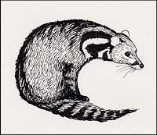
CViT Chromosome Visualization Tool http://sourceforge.net/projects/cvit/
Ethy Cannon
Iowa State University
January, 2014

Slide 2
CViT http://sourceforge.net/projects/cvit/
Perl utility that reads GFF files to produce PNG and SVG images.
Draws features on a genomic backbone (chromosomes, contigs, BACs, linkage groups, pseudomolecules, et cetera).
Features can be just about anything: loci, repeat densities, BLAST hits, centromere regions, inversion points, synteny blocks, et cetera.
Most coordinate systems supported: base pairs, centiMorgans, centiMcClintocks, anything with linear increasing or decreasing units.
Designed for overview images rather than detailed closeups.

Slide 3
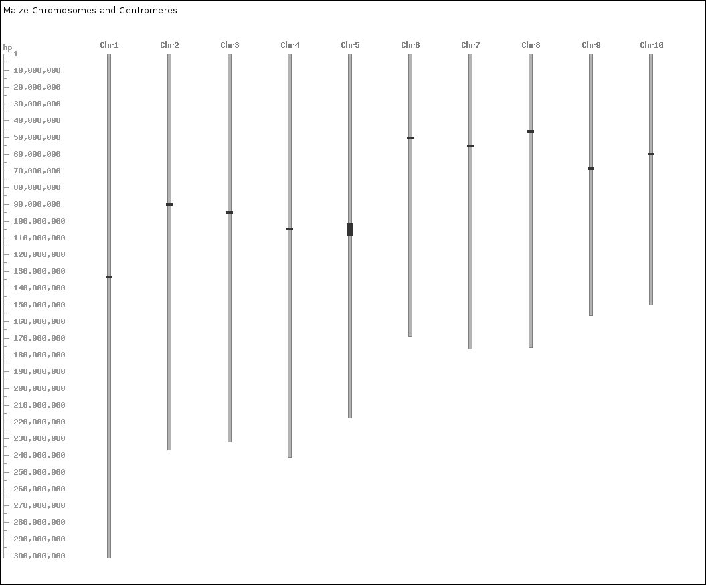
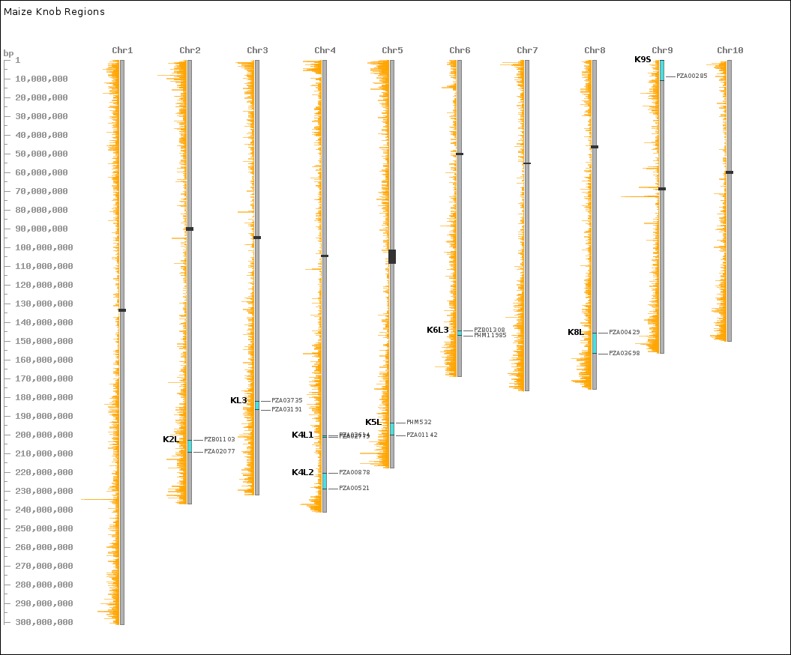
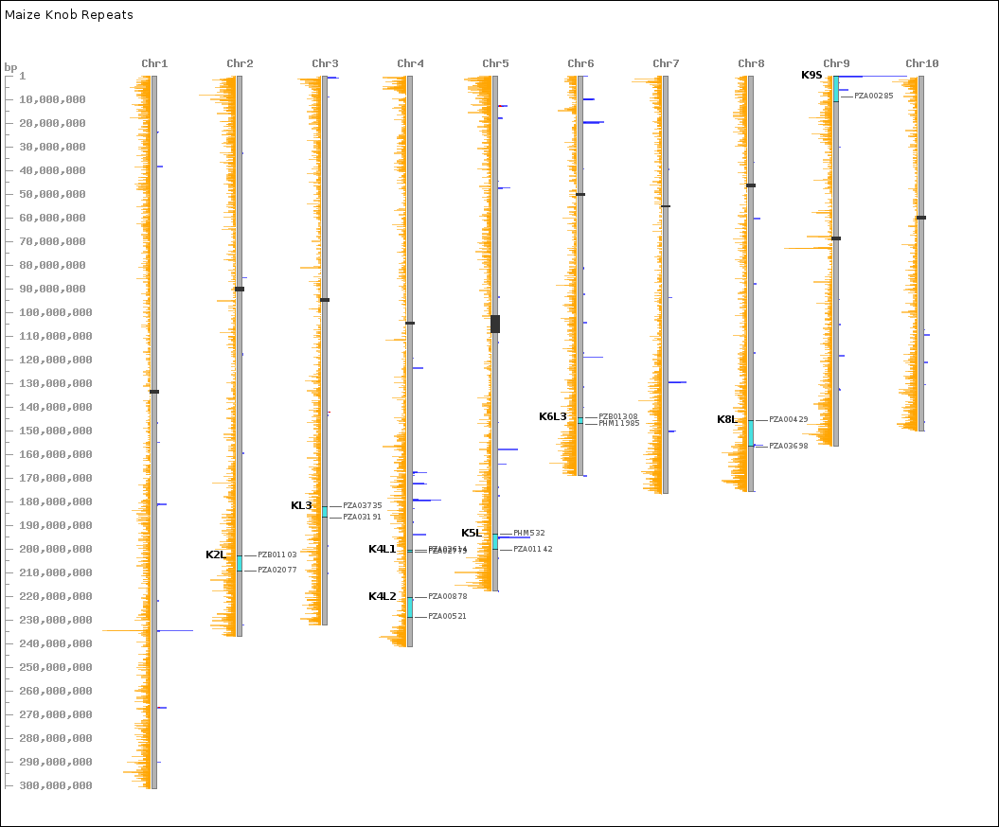
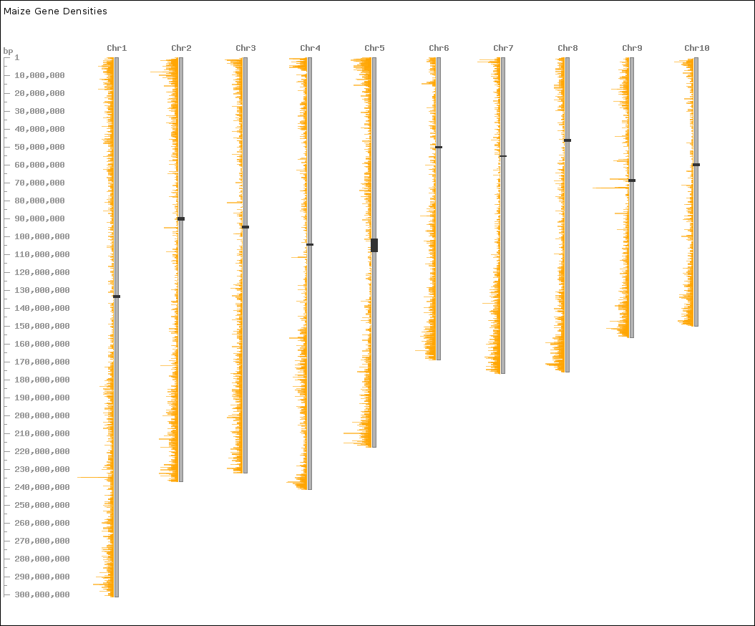
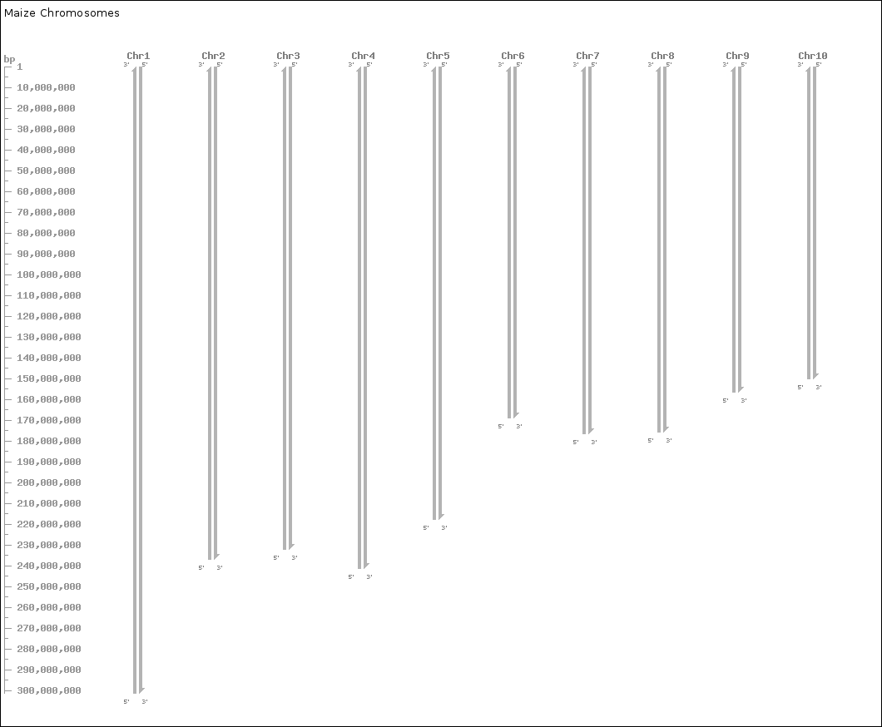

centromeres (black)
gene densities (orange)
knob regions (cyan)
flanking markers (gray)
180-bp hit densities (blue)
Maize chromosomal knobs are located in gene-dense areas and suppress local recombination.
Ghaffari R, Cannon EK, Kanizay LB, Lawrence CJ, Dawe RK.
Chromosoma. 2013 Mar;122(1-2):67-75

Slide 4
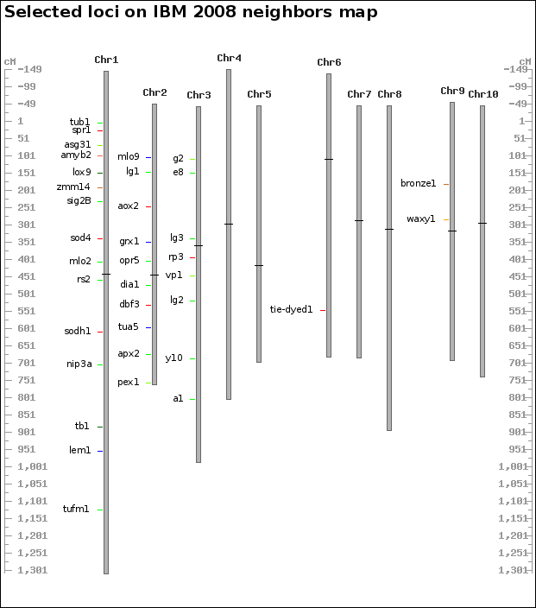
Schaeffer (Polacco), ML; Sanchez-Villeda, H; Coe, E. 2008. 0:1

Slide 5
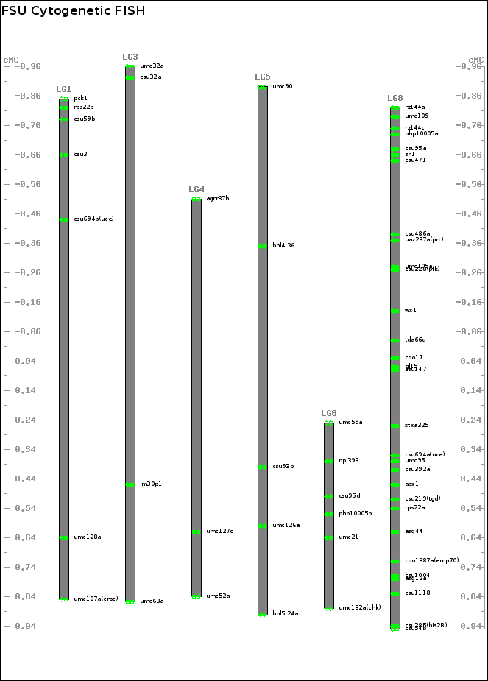
Figueroa, D; Bass, HW. 2012. Cell Chromosome Res. 20:363-80

Slide 6
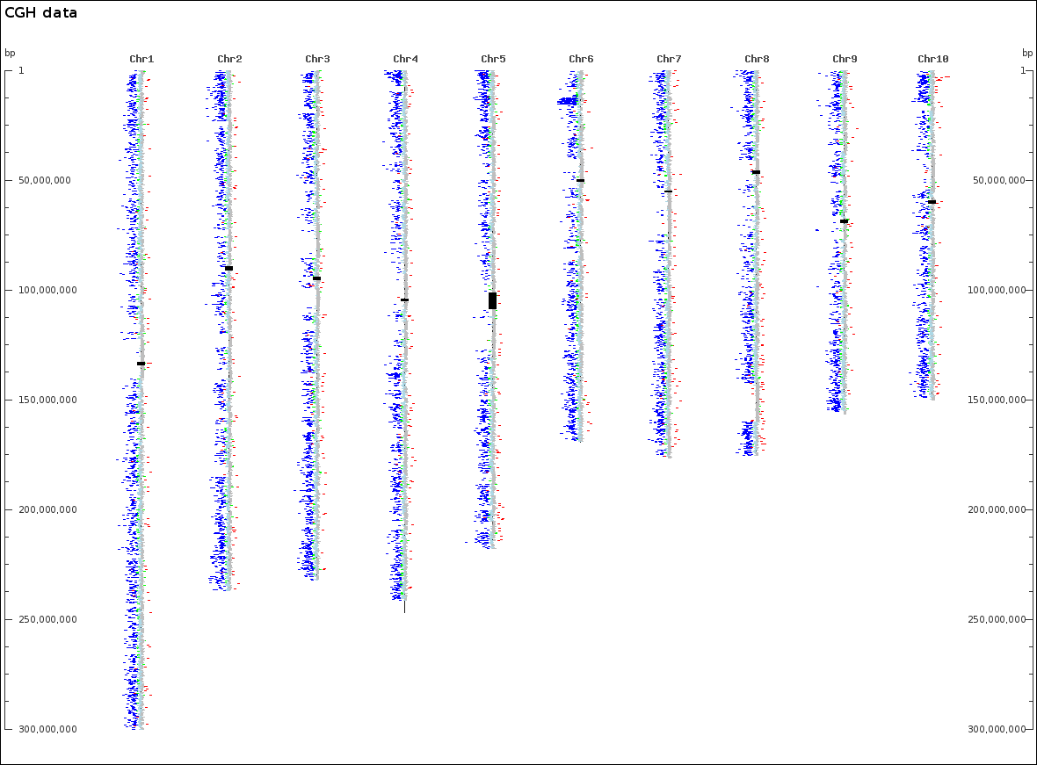
Data taken from:
Maize inbreds exhibit high levels of copy number variation (CNV) and presence/absence variation (PAV) in genome content.
Springer NM, Ying K, Fu Y, Ji T, Yeh CT, Jia Y, Wu W, Richmond T, Kitzman J, Rosenbaum H, Iniguez AL, Barbazuk WB, Jeddeloh JA, Nettleton D, Schnable PS.
PLoS Genet. 2009 Nov;5(11):e1000734

Slide 7
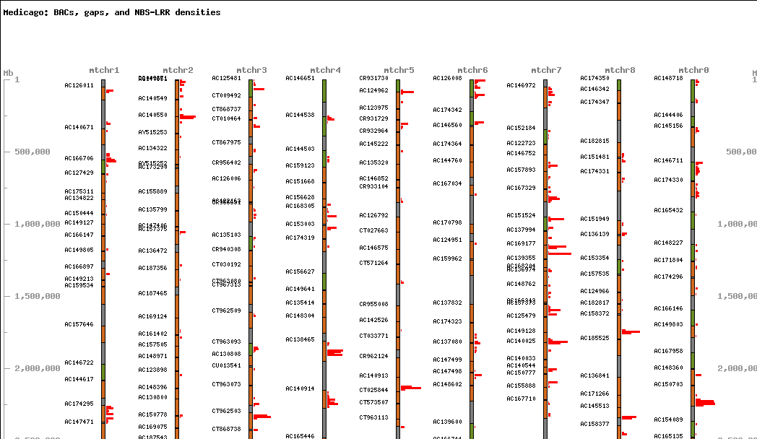
Early data from the Medicago truncatula sequencing project

Slide 8
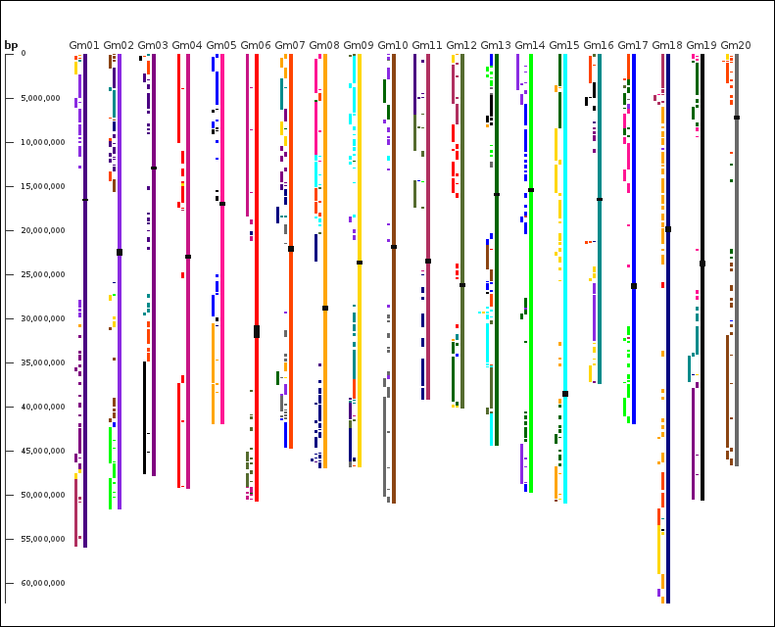

Soybean duplication synteny

Slide 9
CViT http://sourceforge.net/projects/cvit/
Nomenclature:
Chromosome: any sort of sequence “backbone” used for placing features.
Position: a dimensionless feature placed beside a chromosome.
Range: a feature with length placed beside a chromosome.
Marker: specialized position with no dimension.
Border: a feature with length placed directly on top of a chromosome.
Centromere: a specialized border.
Measure: a feature, with or without length, that has a value.

Slide 10
CViT http://sourceforge.net/projects/cvit/
The appearance of (almost) everything can be controlled through a configuration file.
; Label for image
; TYPE: string
title = 'CViT image'
; Space allowance for title in pixels, can ignore if font face and size set
; TYPE: integer|DEFAULT: 20
title_height = 20
; Font face file name to use for title, ignored if empty
; TYPE: font
title_font_face = vera/Vera.ttf
; Title font size in points, used only in conjuction with font_face
; TYPE: integer|DEFAULT: 10
title_font_size = 10
; Title font color
; TYPE: color
title_color = black
; Title location as x,y coords, ignored if missing
; TYPE: coordinates
title_location =
; Space around chroms, in pixels
; TYPE: integer|DEFAULT: 10
image_padding = 60
; How much to scale units (pixels per unit). NOTE: if set too high, the image
; will be too large to create
; TYPE: float|DEFAULT: .0025
scale_factor = .0025
; Color of the border around the image
; TYPE: color|DEFAULT: black
border_color = black
. . .

Slide 11
CViT http://sourceforge.net/projects/cvit/
Major glyph types: centromeres, positions, ranges, borders, markers, and measures
[centromere]
; Centromere rectangle or line extends this far on either side of the
; chromosome bar
; TYPE: integer|DEFAULT: 2
centromere_overhang = 2
; Color to use when drawing the centromere
; TYPE: color|DEFAULT: gray30
color = gray30
; Whether or not to use transparency
; TYPE: boolean|DEFAULT: 0
transparent = 0
; 1 = draw centromere label, 0 = don't
; TYPE: boolean|DEFAULT: 0
draw_label = 0
; Which built-in font to use for centromere labels (font_face overrides this
; setting) 0=gdLargeFont, 1=gdMediumBoldFont, 2=gdSmallFont, 3=gdTinyFont
; TYPE: enum|VALUES: 0,1,2,3|DEFAULT: 2
font = 2
; Font face file name to use for centromere label
; TYPE: font
font_face = vera/Vera.ttf
; Font size in points, used only in conjuction with font_face
; TYPE: integer|DEFAULT: 6
font_size = 6
; Start labels this many pixels right of region bar (negative value to move
; label to the left)
; TYPE: integer
label_offset = 4
; Color to use for labels
; TYPE: color|DEFAULT: gray30
label_color = gray30

Slide 12
CViT http://sourceforge.net/projects/cvit/
Major glyph types: centromeres, positions, ranges, borders, markers and measures
[position]
; Color to use when drawing positions, can be overridden with the
; color= attribute in the GFF file
; TYPE: color|DEFAULT: red
color = maroon
; Whether or not to use transparency
; TYPE: boolean|DEFAULT: 0
transparent = 0
; Shape to indicate a position
; TYPE: enum|VALUES: circle,rect,doublecircle|DEFAULT: circle
shape = circle
; Width of the shape
; TYPE: integer|DEFAULT: 5
width = 5
; Offset shape this many pixels from chromosome bar
; TYPE: integer
offset = 4
; Whether or not to "pileup" overlaping glyphs
; TYPE: boolean|DEFAULT: 1
enable_pileup = 1
; The space between adjacent, piled-up positions
; TYPE: integer|DEFAULT: 0
pileup_gap = 0
; 1 = draw position label, 0 = don't
; TYPE: boolean|DEFAULT: 1
draw_label = 1
; Which built-in font to use for position labels (font_face overrides this
; setting) 0=gdLargeFont, 1=gdMediumBoldFont, 2=gdSmallFont, 3=gdTinyFont
; TYPE: enum|VALUES: 0,1,2,3|DEFAULT: 2
font = 2
; Font face file name to use for labeling positions (overrides 'font' setting)
; TYPE: font
font_face = vera/Vera.ttf
; Font size in points, used only in conjunction with font_face
; TYPE: integer
font_size = 6
; Start labels this many pixels right of region bar (negative value to move
; label to the left)
; TYPE: integer
label_offset = 4
; Color to use for labels
; TYPE: color|DEFAULT: black
label_color = black

Slide 13
CViT http://sourceforge.net/projects/cvit/
Major glyph types: centromeres, positions, ranges, borders, markers and measures
[range]
; Color for drawing ranges; can be overridden with the color=
; attribute in GFF file.
; TYPE: color|DEFAULT: green
color = green
; Whether or not to use transparency
; TYPE: boolean|DEFAULT: 0
transparent = 0
; Draw range bars this thick
; TYPE: integer|DEFAULT: 6
width = 6
; Draw range bars this much to the right of the corresponding chromosome
; (negative value to move bar to the left)
; TYPE: integer
offset = 3
; Whether or not to "pileup" overlaping glyphs
; TYPE: boolean|DEFAULT: 1
enable_pileup = 1
; Space between adjacent, piled-up ranges
; TYPE: integer|DEFAULT: 0
pileup_gap = 0
; 1 = draw range label, 0 = don't
; TYPE: boolean|DEFAULT: 1
draw_label = 1
; Which built-in font to use for range labels (font_face overrides this setting)
; 0=gdLargeFont, 1=gdMediumBoldFont, 2=gdSmallFont, 3=gdTinyFont
; TYPE: enum|VALUES: 0,1,2,3|DEFAULT: 1
font = 1
; Font face file name to use for labeling ranges (overrides 'font' setting)
; TYPE: font
font_face = vera/Vera.ttf
; Font size in points, used only in conjunction with font_face
; TYPE: integer
font_size = 6
; Start labels this many pixels right of region bar (negative value to move
; label to the left)
; TYPE: integer
label_offset = 5
; Color to use for labels
; TYPE: color|DEFAULT: black
label_color = black

Slide 14
CViT http://sourceforge.net/projects/cvit/
Major glyph types: centromeres, positions, ranges, borders, markers and measures
[border]
; Color for filling borders; can be over-ridden with the color=
; attribute in GFF file.
; TYPE: color|DEFAULT: red
color = red
; Color for drawing borders; can be over-ridden with the color=
; attribute in GFF file.
; TYPE: color|DEFAULT: red
border_color = black
; 1=fill in area between borders, 0=don't
; TYPE: boolean|DEFAULT: 0
fill = 0
; Whether or not to use transparency
; TYPE: boolean|DEFAULT: 0
transparent = 0
; 1 = show labels, 0 = don't
; TYPE: boolean|DEFAULT: 1
draw_label = 1
; Built-in font to use for border labels (font_face overrides this setting)
; 0=gdLargeFont, 1=gdMediumBoldFont, 2=gdSmallFont, 3=gdTinyFont
; TYPE: enum|VALUES: 0,1,2,3|DEFAULT: 1
font = 1
; Font face file name to use for labeling borders (overrides 'font' setting)
; TYPE: font
font_face = vera/Vera.ttf
; Font size in points, used only in conjunction with font_face
; TYPE: integer
font_size = 6
; Start labels this many pixels right of chromosome (negative value to move
; label to the left)
; TYPE: integer
label_offset = 5
; Color to use for labels
; TYPE: color|DEFAULT: black
label_color = black

Slide 15
CViT http://sourceforge.net/projects/cvit/
Major glyph types: centromeres, positions, ranges, borders, markers and measures
[marker]
; Color for drawing markers; can be over-ridden with the color=
; attribute in GFF file.
; TYPE: color|DEFAULT: red
color = turquoise
; Whether or not to use transparency
; TYPE: boolean|DEFAULT: 0
transparent = 0
; Draw marker this much to the right of the corresponding chromosome
; (negative value to move bar to the left)
; TYPE: integer
offset = 2
; Marker tic is this long
; TYPE: integer|DEFAULT: 5
width = 5
; 1=draw marker labels, 0=don't
; TYPE: boolean|DEFAULT: 1
draw_label = 1
; Built-in font to use for labeling markers (font_face overrides this setting)
; 0=gdLargeFont, 1=gdMediumBoldFont, 2=gdSmallFont, 3=gdTinyFont
; TYPE: enum|VALUES: 0,1,2,3|DEFAULT: 1
font = 1
; Font face file name to use for labeling markers (overrides 'font' setting)
; TYPE: font
font_face = vera/Vera.ttf
; Font size in points, used only in conjunction with font_face
; TYPE: integer
font_size = 6
; Start label this far from the right of the marker (negative value=left)
; TYPE: integer
label_offset = 8
; Color to use for labels
; TYPE: color|DEFAULT: black
label_color = gray0

Slide 16
CViT http://sourceforge.net/projects/cvit/
Major glyph types: centromeres, positions, ranges, borders, markers and measures
[measure]
; Measure value is in either the score column (6th) of the GFF file or a
; value= attribute in the 9th column.
; TYPE: enum|VALUES: score_col,value_attr
value_type = score_col
; Minimum value; will be overridden if actual minimum value is less
; TYPE: integer|DEFAULT: 0
min = 0
; Maximum value; will be overridden if actual maximum value is greater
; TYPE: integer|DEFAULT: 0
max = 0
; How to display the measurement for each record
; TYPE: enum|VALUES: histogram,heat,distance|DEFAULT: heat
display = heat
; How to interpret the measure glyph (heatmap and distance only)
; TYPE: enum|VALUES: range,position,border,marker|DEFAULT: range
draw_as = range
; Heatmap and distance only: shape (don't use 'circle' if measure has meaningful length)
; TYPE: enum|VALUES: circle,rect|DEFAULT: rect
shape = rect
; Heatmap and distance only: width of rect or circle
; TYPE: integer|DEFAULT: 2
width = 2
; Heatmap and distance only: whether or not to "pileup" overlaping glyphs
; TYPE: boolean|DEFAULT: 1
enable_pileup = 1
; Heatmap and distance only: space between adjacent, piled-up ranges
; TYPE: integer|DEFAULT: 0
pileup_gap = 0
; Heatmap only: color scheme to use for scale
; TYPE: enum|VALUES: redgreen,grayscale|DEFAULT: redgreen
heat_colors = redgreen
; Histogram only: color of measure glyph
; TYPE: color|DEFAULT: red
color = red
; Distance only: max distance from chromosome
; TYPE: integer|DEFAULT: 25
max_distance = 25
; Histograms only: percentage of gap between chromosomes to fill with max values
; TYPE: float|DEFAULT: .9
hist_perc = .9
; Whether or not to use transparency
; TYPE: boolean|DEFAULT: 0
transparent = 0
; Distance from chromosome to draw shape
; TYPE: integer
offset = 2
; 1=draw marker labels, 0=don't
; TYPE: boolean|DEFAULT: 0
draw_label = 0
; 1 = fill in borders, 0 = don't
; TYPE: boolean|DEFAULT: 1
fill = 1
; Built-in font to use for labeling markers (font_face overrides this setting)
; 0=gdLargeFont, 1=gdMediumBoldFont, 2=gdSmallFont, 3=gdTinyFont
; TYPE: enum|VALUES: 0,1,2,3|DEFAULT: 1
font = 1
; Font face file name to use for labeling measures (overrides 'font' setting)
; TYPE: font
font_face = vera/Vera.ttf
; Font size in points, used only in conjunction with font_face
; TYPE: integer
font_size = 6
; Start labels this many pixels right of region bar (negative value to move
; label to the left)
; TYPE: integer
label_offset = 5
; Color to use for labels
; TYPE: color|DEFAULT: black
label_color = black

Slide 17
CViT http://sourceforge.net/projects/cvit/
Assign a record type to a specific glyph with its own drawing options by create a new configuration section and identifying a feature with its source and type column (source:type)
[hits]
feature = BLAST:hit
glyph = measure
offset = 2
width = 2
draw_label = 0
[genes]
feature = ensembl:gene
glyph = measure
color = PaleTurquoise3
offset = -2
width = 1
draw_label = 0
[knobs]
feature = knob:region
glyph = border
color = green
label_color = gray10

Slide 18
CViT http://sourceforge.net/projects/cvit/
GFF format:
Column 1: seqid: landmark to establish coordinate system for feature
Column 2: source: free text, describes how feature was generated
Column 3: type: what sort of feature this is
Column 4: start: beginning coordinate
Column 5: end: ending coordinate
Column 6: score: typically e-values or p-values
Column 7: strand: +, -
Column 8: phase: for type “CDS”, where feature begins with respect to reading frame
Column 9: attributes: free text in comma-separated key=value pairs
ID, Name, class, color, value

Slide 19
CViT http://sourceforge.net/projects/cvit/
perl cvit.pl [opt] gff-file-in [gff-file-in]*
-c <file> alternative config file (default: config/cvit.ini)
-h display this list of options
-i [png/svg] image type (default: png)
-l lean output: don't create legend or csv file
-s '<section_option>=<value>[,<section_option>=<value>]*'
conf file overrides
*Multiple gff input files make possible various layers: chromosomes, centromeres, borders, etc.
For example:
perl cvit.pl -c config/cvit_histogram.ini -o MtChrXxMtLjTEs \
data/MtChrs.gff data/BACborders.gff data/MtCentromeres.gff \
/web/medicago/htdocs/genome/upload/MtChrXxMtLjTEs.gff
Example: override conf file settings:
perl cvit.pl \
-s 'general_title=Homeologous Chromosomes,general_scale_factor=.00003' records.gff
The GFF data MUST contain some sequence records of type 'chromosome' or
there will be no way to draw the picture.

Slide 20
CViT http://sourceforge.net/projects/cvit/
Interactive CViT
CViT can be wrapped in web pages to be made interactive. Images with fewer than ~2000 features will render quickly, enabling images to be generated on-demand without significant delay.

Slide 21
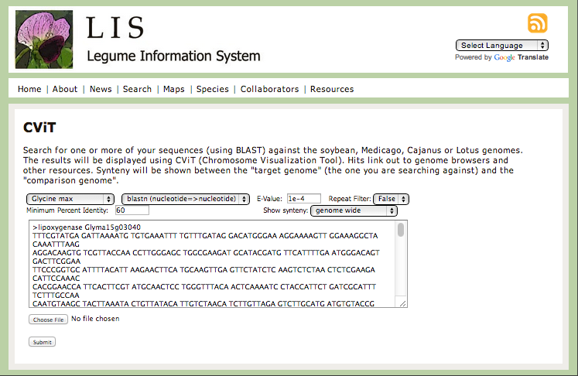

Slide 22
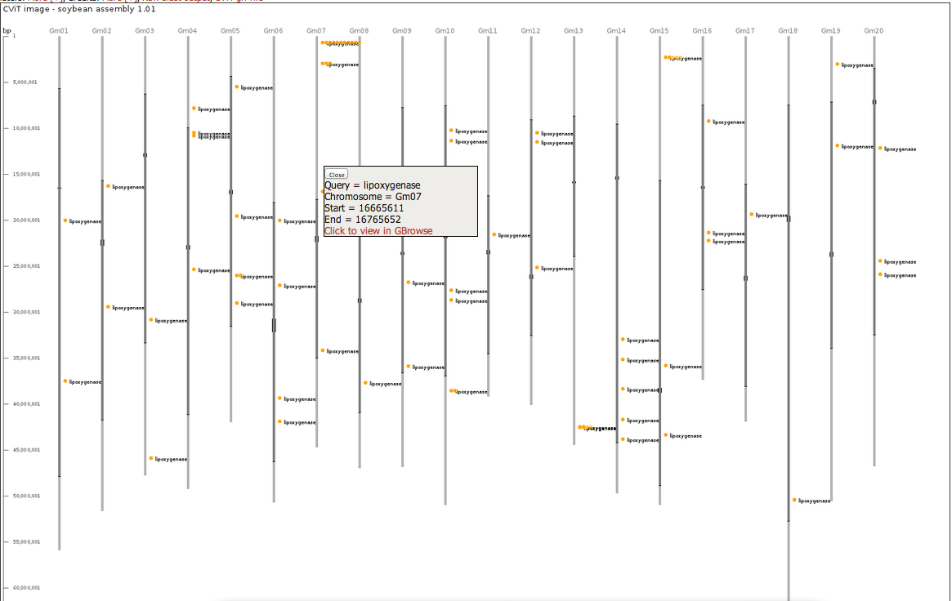
CViT outputs a .csv file that provides coordinates for every feature on the image. This file can be used to build imagemaps.
Attributes from the GFF file that are not interpreted by CViT are attached to their feature’s coordinates.

Slide 23
CViT http://sourceforge.net/projects/cvit/
Perl code is open source, available at URL above.
The code is not particularly sophisticated, with the hope that one doesn’t need a CS degree to understand and modify it.
Download includes a number of short Perl and Awk helper scripts for manipulating GFF files.

Slide 24


CViT http://sourceforge.net/projects/cvit/
Acknowledgements:
Co-developer:
Steven Cannon
MaizeGDB
Carolyn Lawrence (Iowa State University)
Carson Andorf
Scott Birkett (Pioneer)
Kelly Dawe (University of Georgia)
Rashin Ghaffari
Legume Information System
Andrew Farmer
Benjamin Deonovic (University of Iowa)
SoyBase
David Grant
Kevin Feeley

