Slide 1
The PLAIN Project
Bob Muller
Tair Techteam Manager

Slide 2
PLAIN
PLAnt INterface for Computation
To create an interface that makes it as easy as possible to access genomic data by computational means
To provide a computational interface for TAIR data

Slide 3
Why Another DW API?
BioMart, InterMine, Chado?
Performance for computational access
Flexibility for programmatic access
Power for usability, keeping it simple
Technology—off the shelf, standard, light
Modeling—complex, large data sets
Query—access through a query language

Slide 4
PLAIN Architecture

Slide 5
MDA Web Service Tool
An open-source, UML2-based tool that uses Model Driven Architecture (MDA) to generate high performance web services for custom data requirements

Slide 6
Data Warehouse
A portable, open-source version of the TAIR plant genomics data warehouse based on a revised, minimal schema and open source database technology (PostgreSQL)
A design approach suitable for managing high-performance access to complex genomic data types

Slide 7
Genomic Region DW

Slide 8
Warehouse Features
Only relevant data and features
Fewer complex relationships
ANSI standard data types
Non-normalized for efficient retrieval
Generic to any taxon
More general design (polymorphisms)
8

Slide 9
GeneSQL
ANSI standard SQL as base language
Parser gives access to full query language
Specific extensions provide powerful queries and optimized implementations for very specific tasks that would perform very poorly in standard relational queries
Example: Our Gene/SQL implementation adds ontology parent-child and polymorphic-range queries.

Slide 10
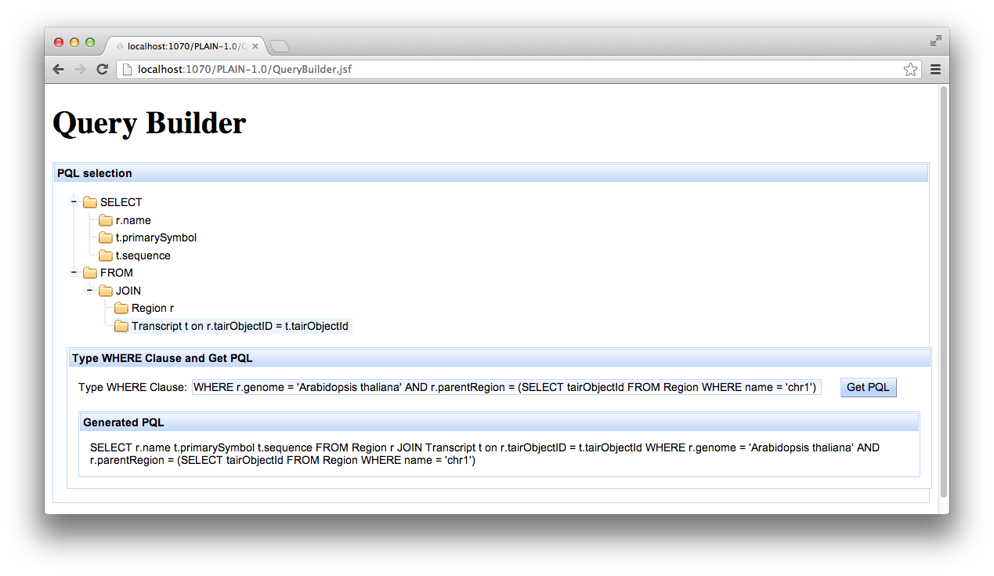
Query Builder

Slide 11

GeneSQL Example
SELECT p.name, p.isAllele, p.type, m.start, m.end
FROM Polymorphism p JOIN
Map m ON p.objectId = m.objectId
WHERE m.start BETWEEN 930 BP AND
1030 BP AND p.objectId MAPS
BETWEEN ‘Columbia’ and ‘Landsberg’
11

Slide 12
Conclusion
PLAIN: a comprehensive open-source toolset for computational access to genomic data
Show, don’t tell: get data by specification rather than by programming
Real Time: provide very fast, lightweight interfaces to data

