Slide 1
ABrowse - A General Purpose Genome Browser Framework
Lei Kong, Ph.D.
kongl@mail.cbi.pku.edu.cn
Center for Bioinformatics
Peking University

Slide 2
ABrowse
Data Visualization User Interface
Data Retrieve and Analysis
User Space
ABrowse Customization

Slide 3
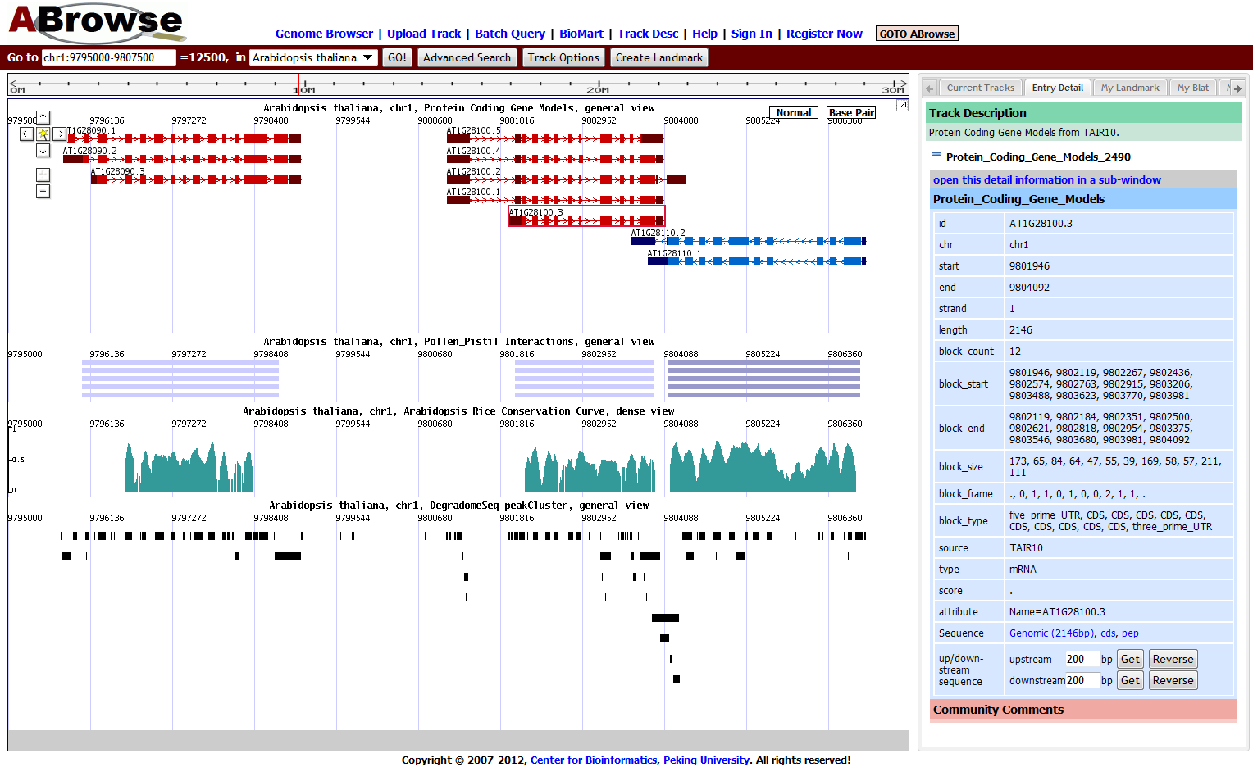
Navigation Bar
GFF Data
Expression Data
WIG Data
BED Data
Annotation Canvas
Information Panel

Slide 4
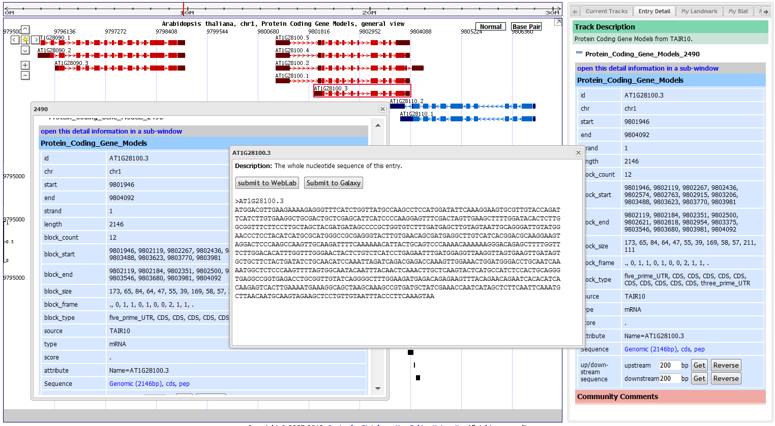
Display Information in Sub-windows

Slide 5
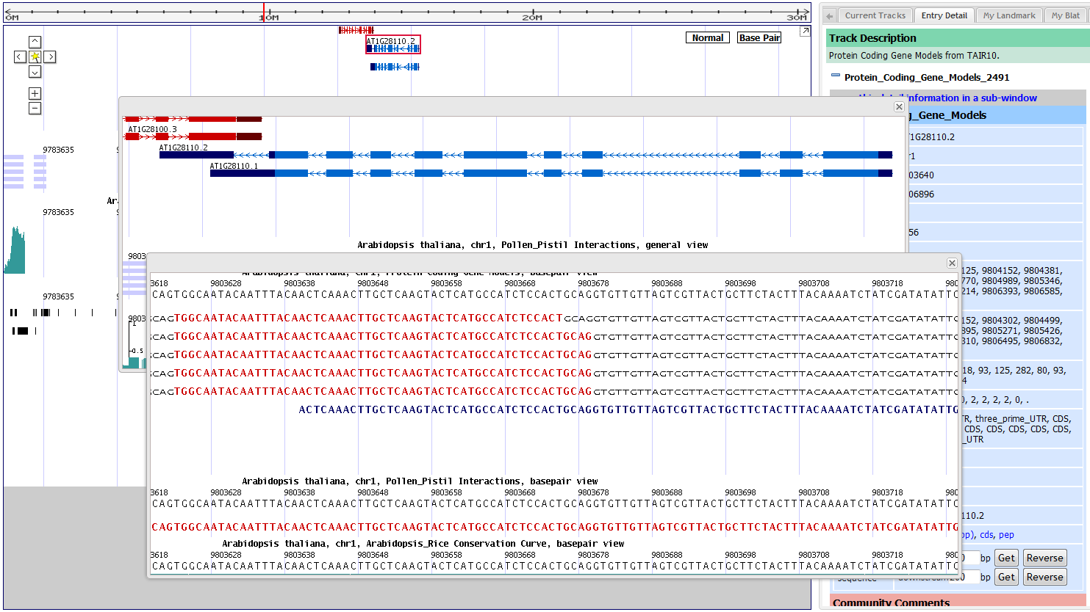
Multiple Sub Views in One Page

Slide 6
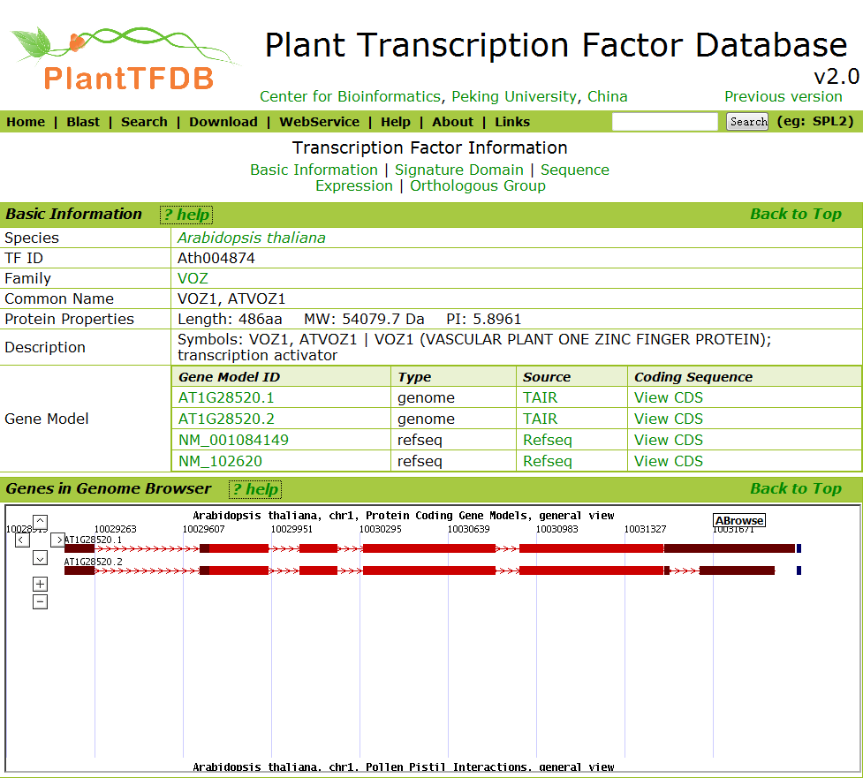
The main canvas can be embedded into html pages of other sites.

Slide 7
ABrowse
Data Visualization User Interface
Data Retrieve and Analysis
User Space
ABrowse Customization

Slide 8
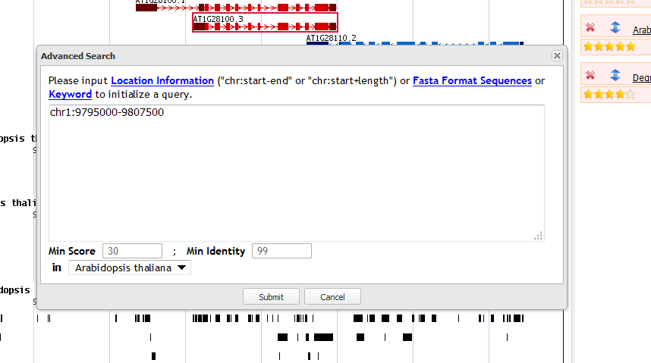
A Uniform Query Box for Location and Sequence Searching

Slide 9
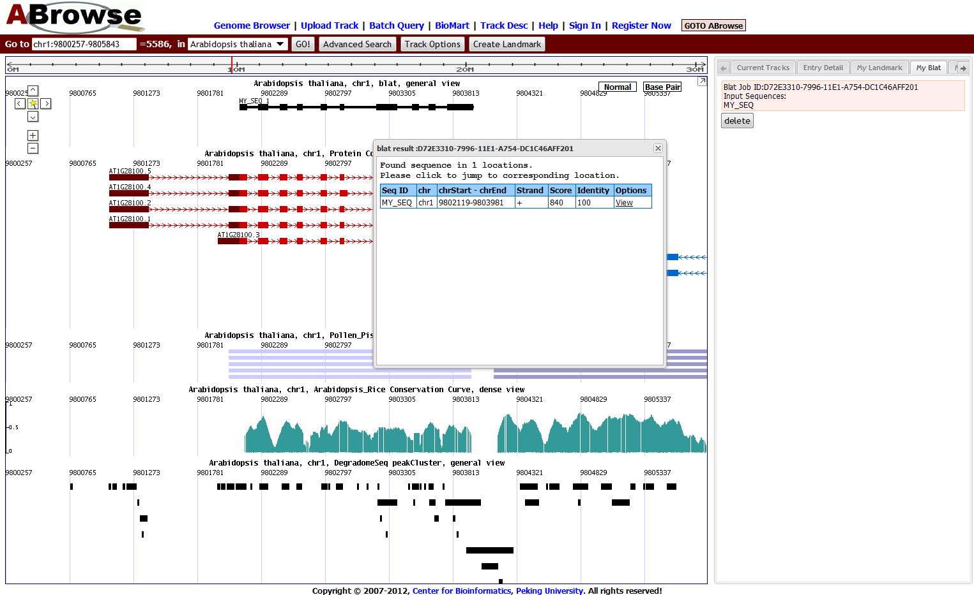
Sequence Search

Slide 10
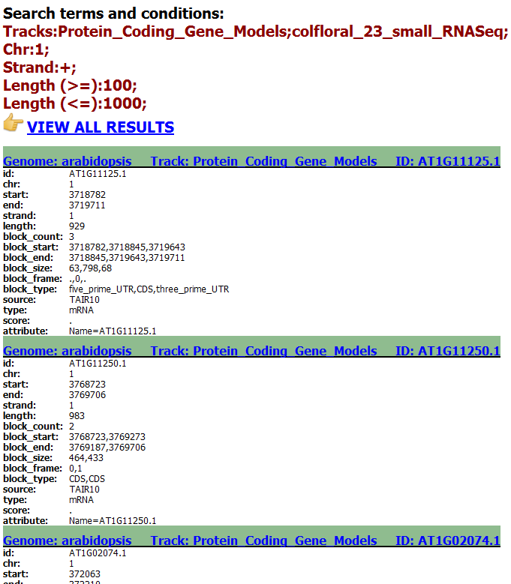
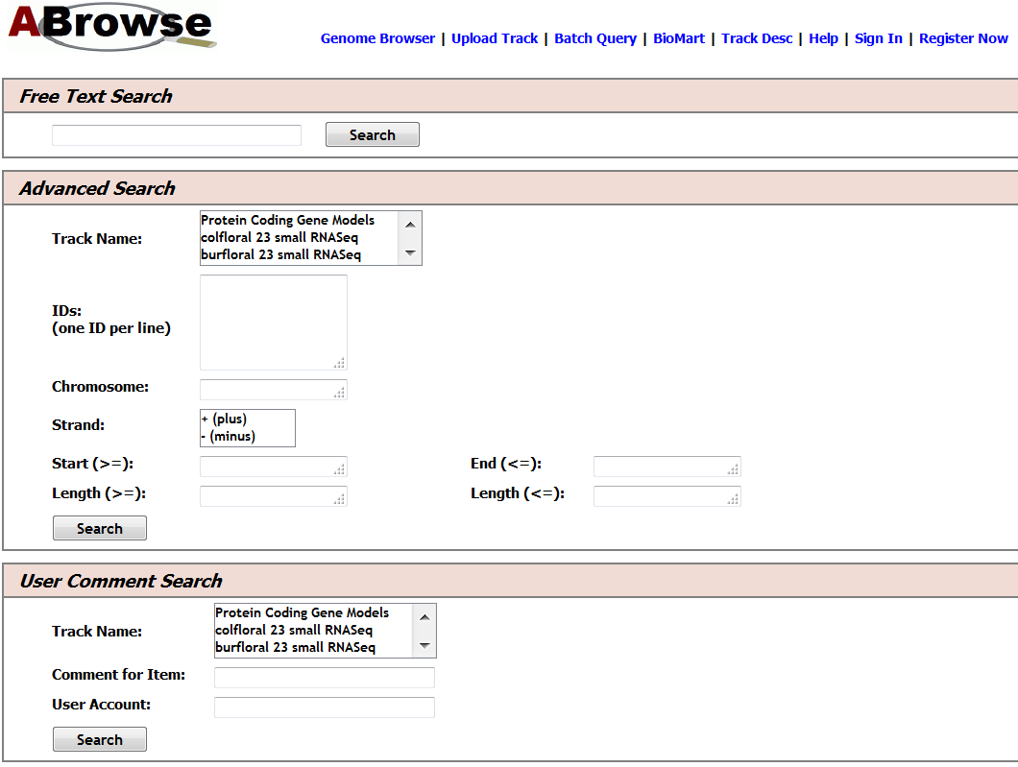
Full Text Search and Complex Query

Slide 11
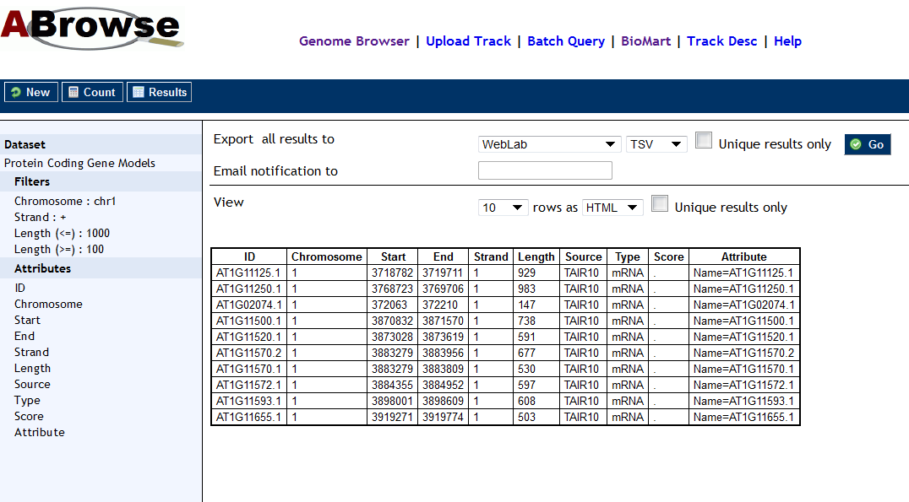
Compatible with BioMart

Slide 12
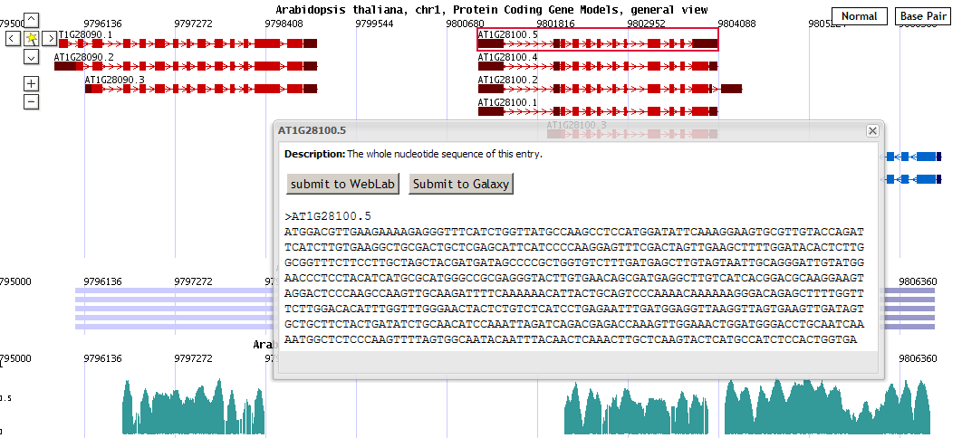
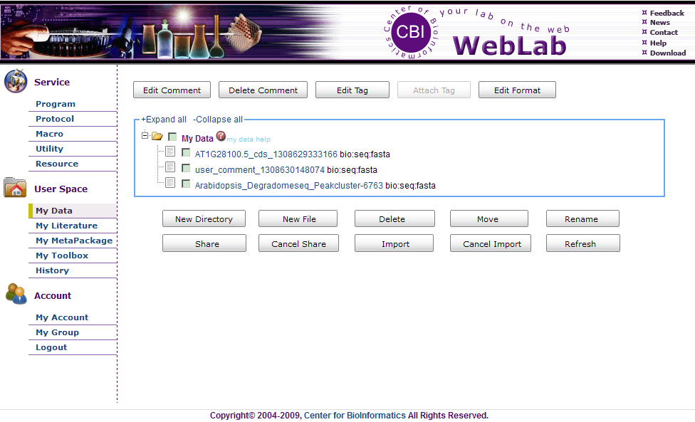
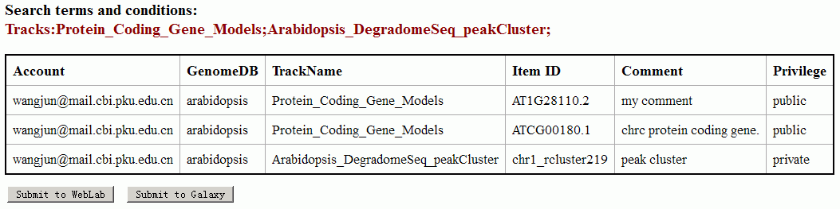
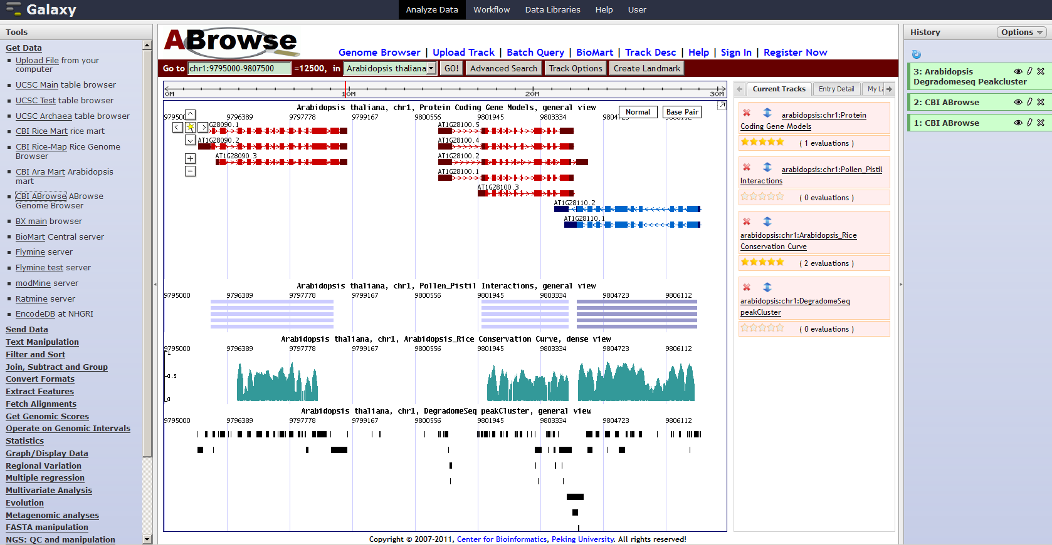
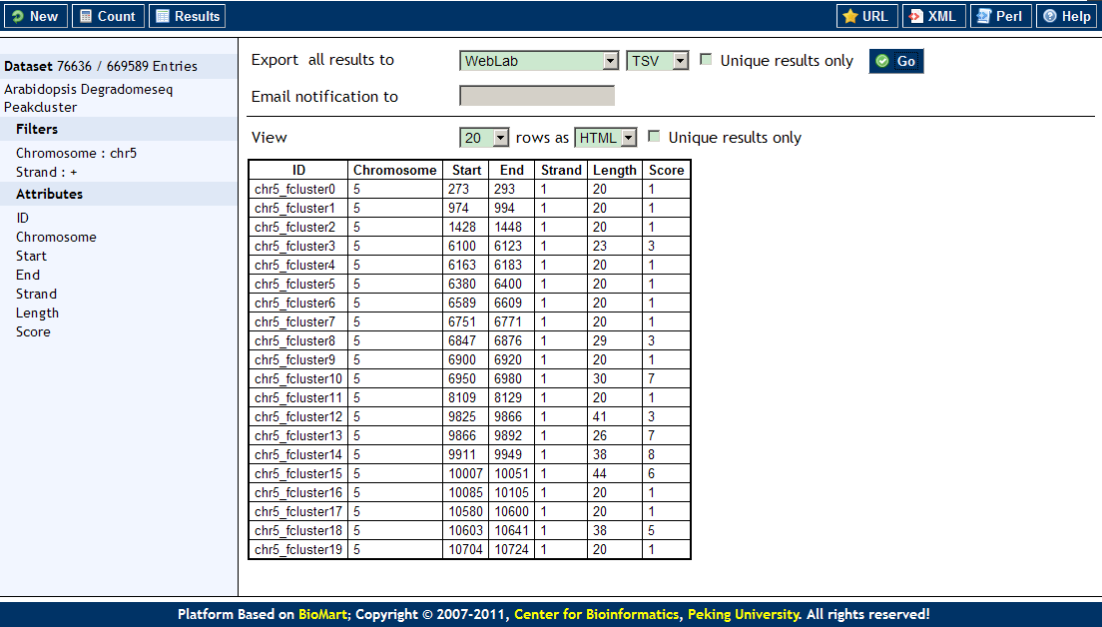
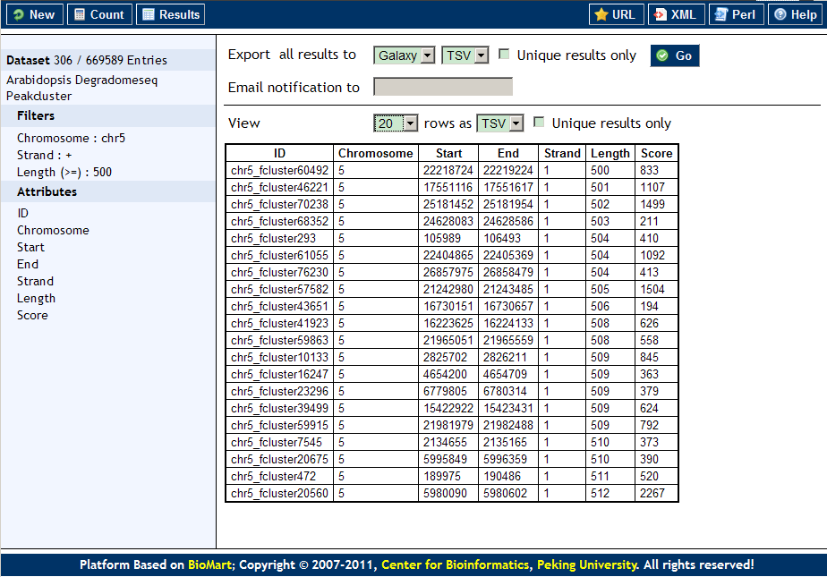
Submit data to external bioinformatics platforms

Slide 13
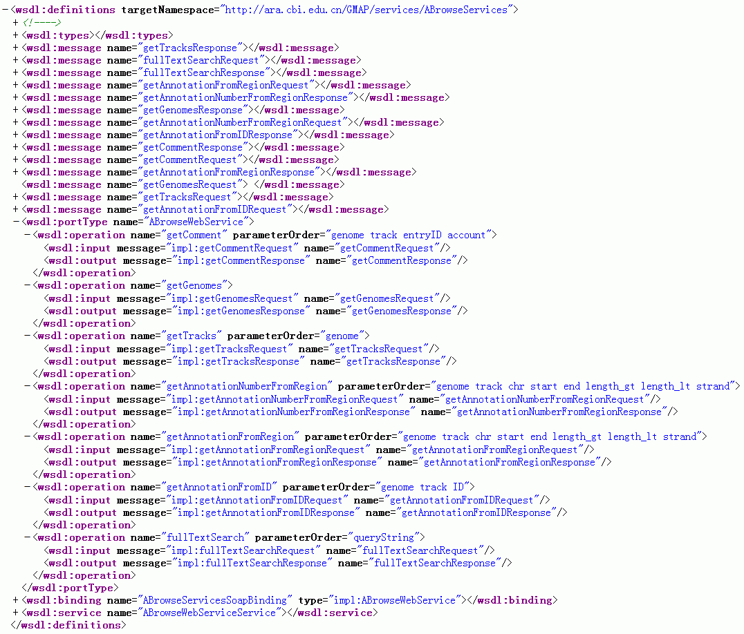
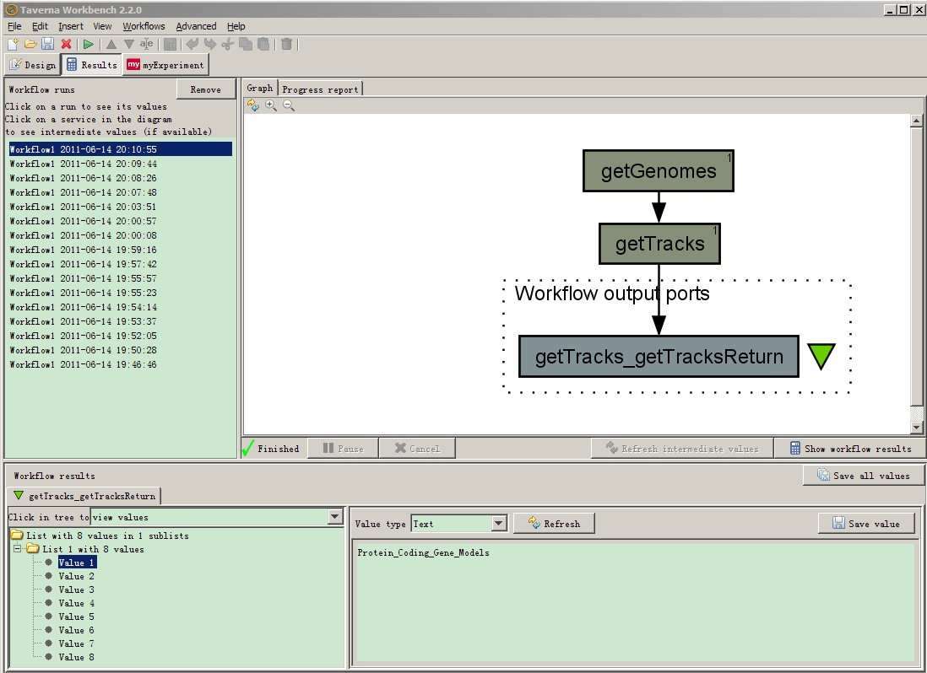
Providing Web Services Interface

Slide 14
ABrowse
Data Visualization User Interface
Data Retrieve and Analysis
User Space
ABrowse Customization

Slide 15
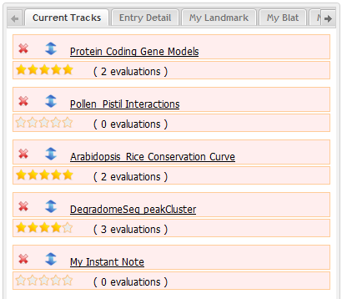
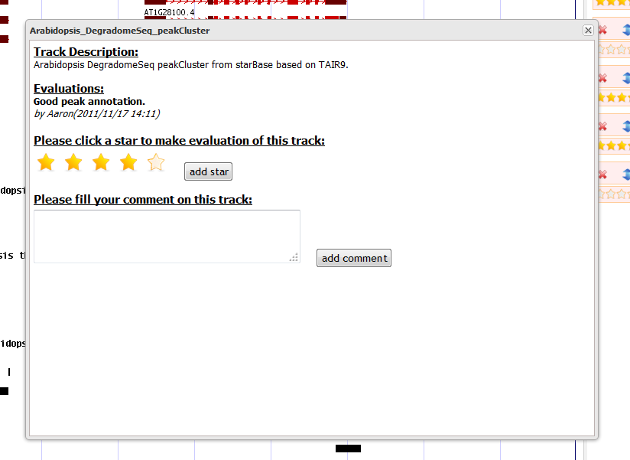
ABrowse Provides Track Evaluation Function

Slide 16
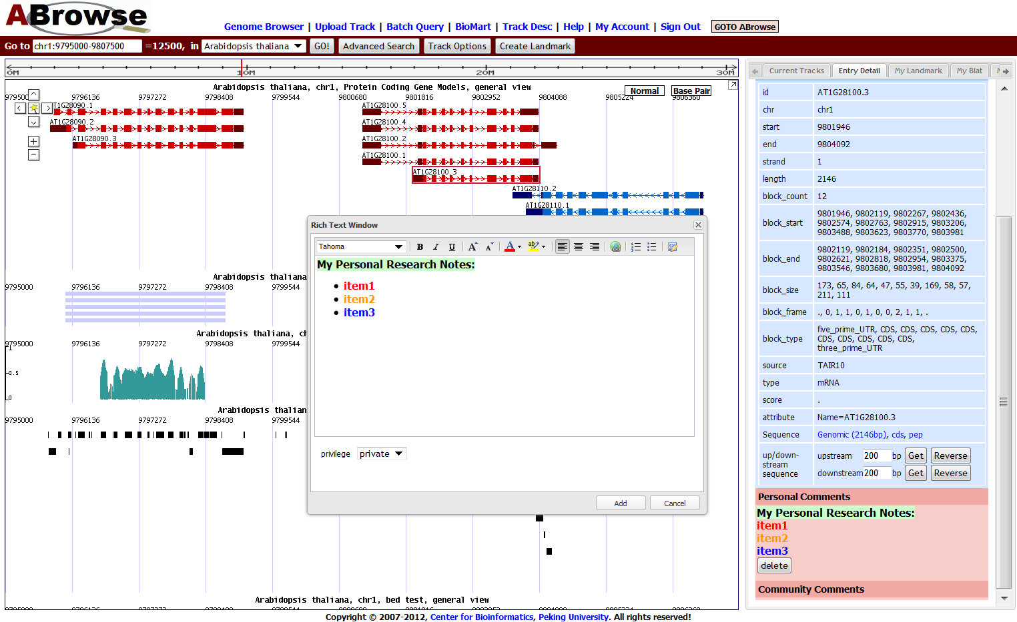
Adding/Managing Comments for a Single Entry

Slide 17
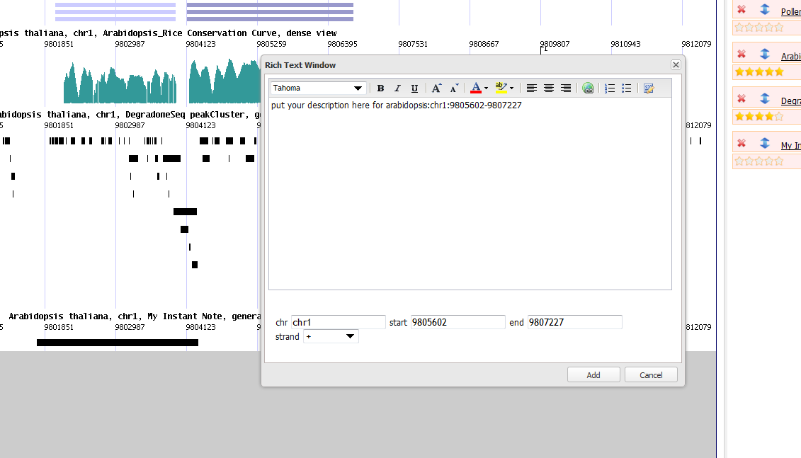
More flexible, user may create an instant note by selecting an area on the genome

Slide 18
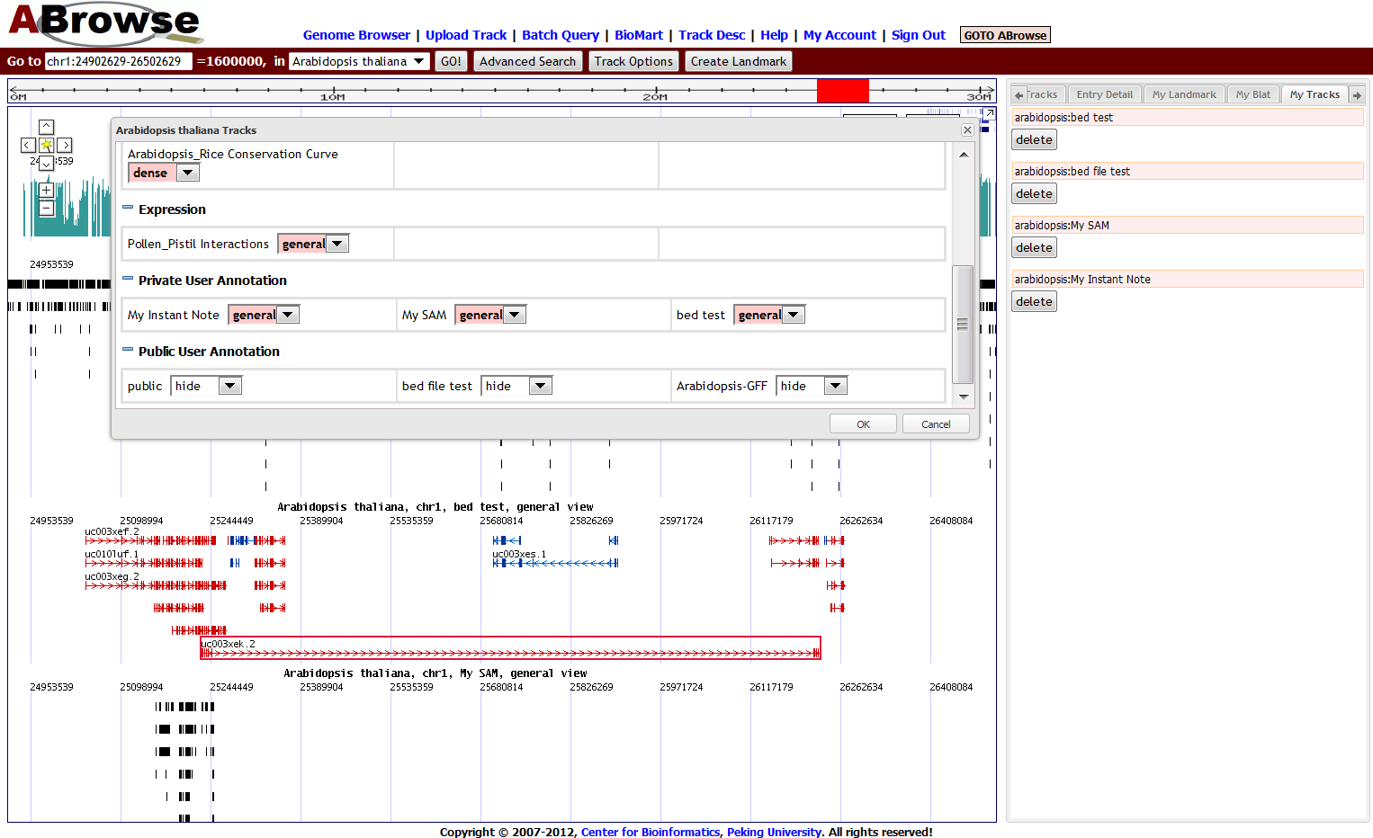
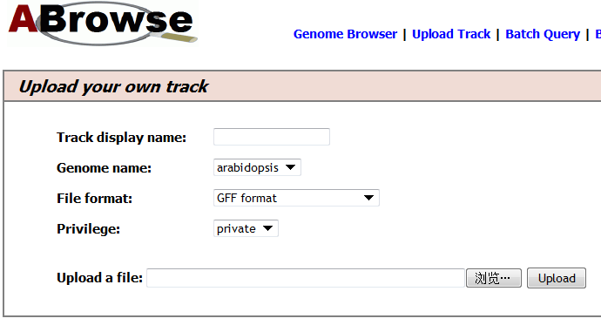
Uploading User tracks

Slide 19
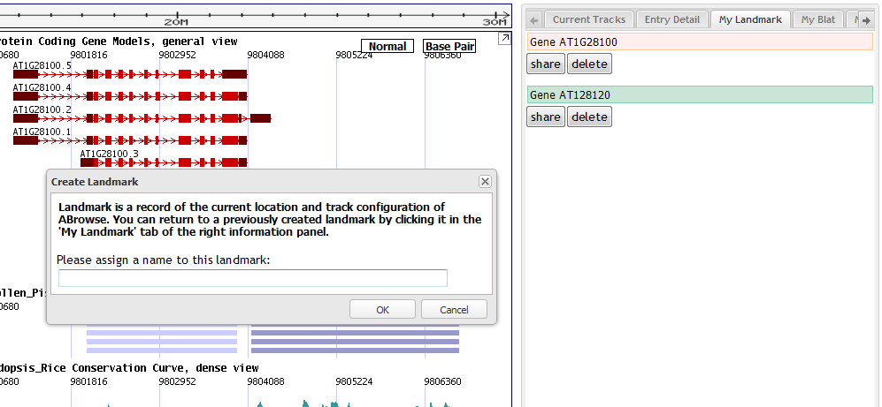
User May Create/Share Bookmark

Slide 20
ABrowse
Data Visualization User Interface
Data Retrieve and Analysis
User Space
ABrowse Customization

Slide 21
ABrowse Architecture
User Interaction Layer
SOAP-based Web Service for Data Retrieval
Genome Browser Web Interface
Bioinformatic Computational Applications (e.g., Galaxy, Taverna, WebLab)
Browsing Canvas
User-Space Web Interface
Data Query
Web Interface
Visualization Engine
User-Space Engine
Data Query Engine
Data Processing Layer
Annotation Database Layer
BioMart Engine
Notes:
Figure 1 ABrowse Framework Architecture
21

Slide 22
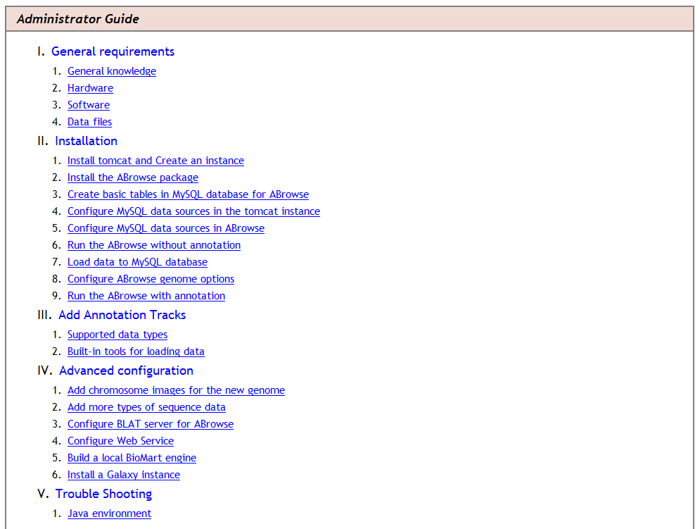
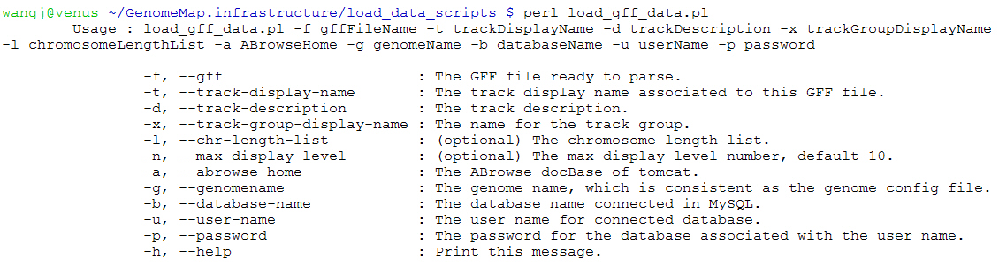
ABrowse for Site Administrator
We provide step by step installation guide.
We provide a set of utilities to help site administrators to import data.

Slide 23
ABrowse is Highly Configurable
global.abrowse.xml for globle settings
genome_name.abrowse.xml for each species, for example:
arabidopsis.abrowse.xml
japonica.abrowse.xml
indica.abrowse.xml

Slide 24
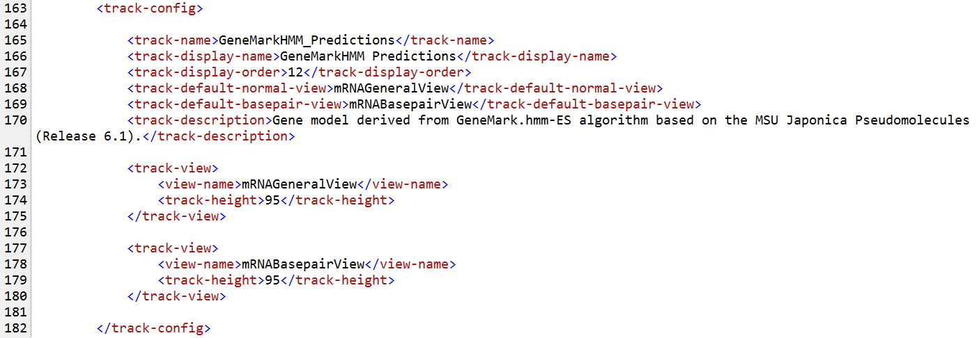
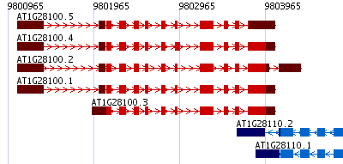
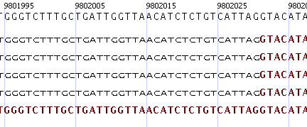
Each single track could have more than one type of view

Slide 25
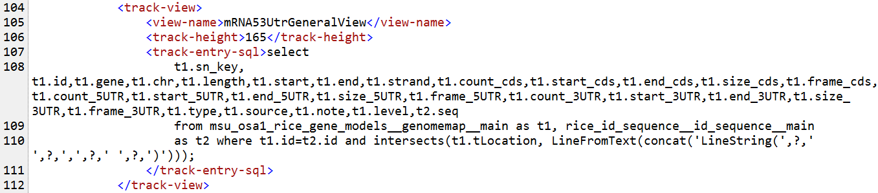
ABrowse is loosely coupled with DBMS and table schema.
Site admin may specify SQL sentence for each track view.
ABrowse demands the tables have 3 columns contains chromosome location including, chr name, chr start and chr end information.

Slide 26
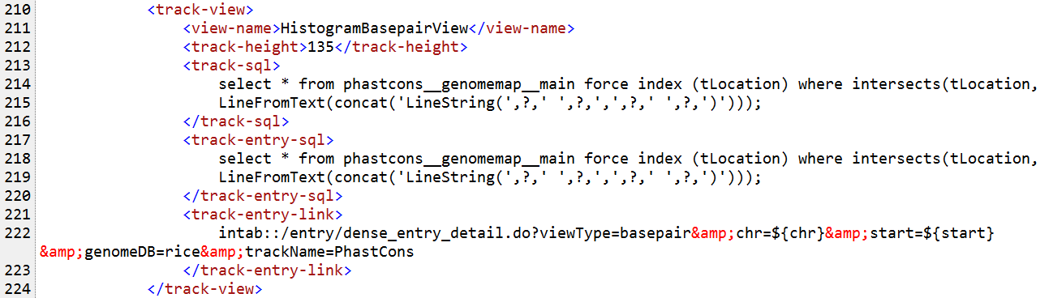
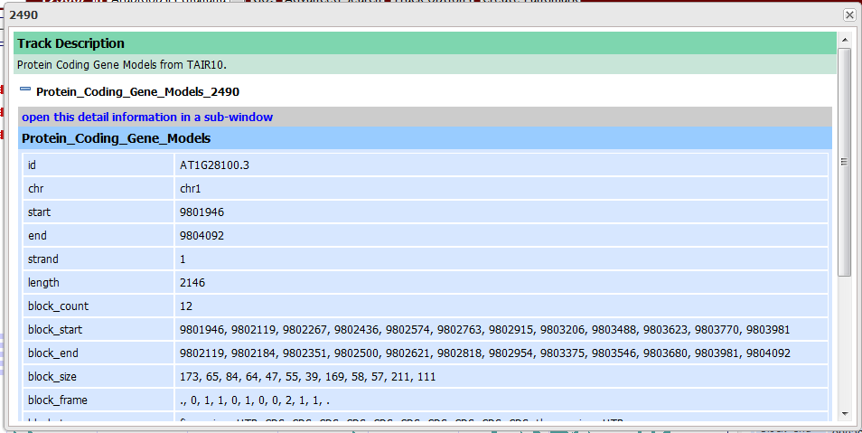
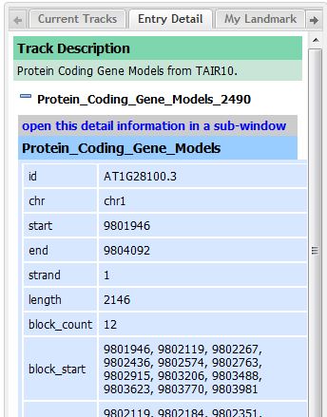
Controlling the Action of Clicking an Entry

Slide 27
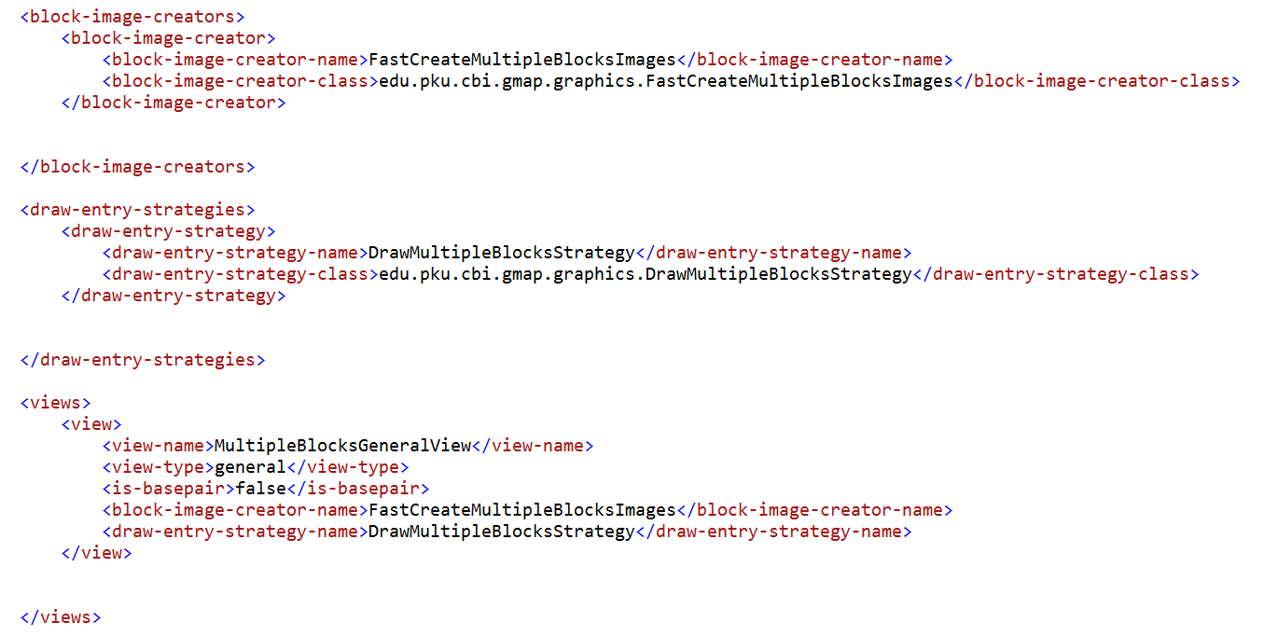
ABrowse for Developer
By writing rendering classes, developers could add new view types for tracks.
……
……
……

Slide 28
Conclusion
ABrowse provides an intuitive approach for users to navigate genome interactively.
ABrowse supports full text search and bulk data retrieve function.
A multiple functional user space is supported by ABrowse.
As a framework, ABrowse is easy to install and highly configurable.

Slide 29
Web Access Statistics
http://www.abrowse.org/

Slide 30
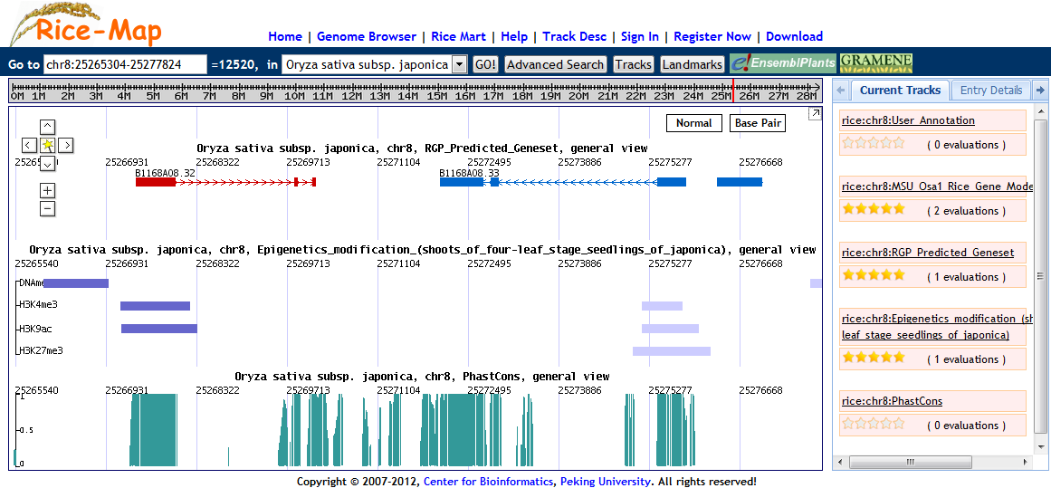

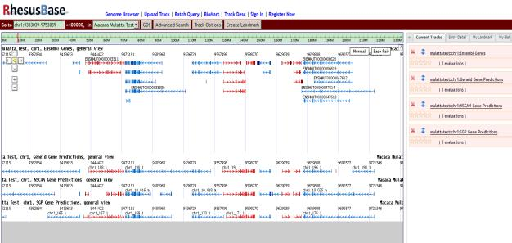
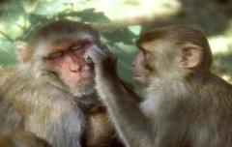
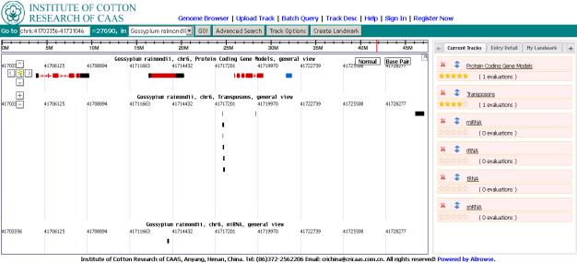

Rice-Map
RhesusBase
CottonDB
Notes:
30
http://fish.cbi.pku.edu.cn:8080/
http://202.205.131.254:8080/

Slide 31
Acknowledgement
WANG Jun, Ph.D. Student
Prof. GAO Ge
Prof. LUO Jingchu
We appreciate great help from
BioMart
Galaxy
TAIR
VISTA

Slide 32

Thanks for Your Attention
Comments & Suggestions to abrowse@mail.cbi.pku.edu.cn
http://www.abrowse.org/

