Slide 1
Overview of current resources and update on DAS Meeting Cambridge 2010
Jonathan Warren
Notes:
Sanger but not just sanger! EBI and DAS community
How many people know what DAS is already? Been around 10 years.

Slide 2
Content
What is DAS?
What resources are available?

Slide 3
User scenario:
Distributed Annotation System
Based on HTTP and XML
User perspective
Client
Choose coordinate system
Connects to one registry for DAS server list
Request a region of interest from the reference and many annotations from the DAS servers.

Slide 4
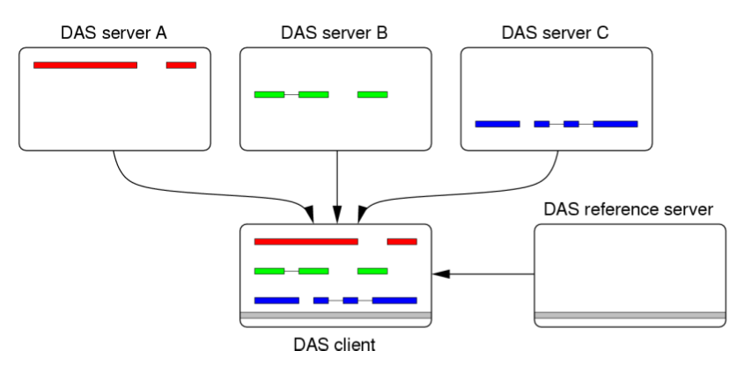
Vizualization of Distributed Annotation
Notes:
Ensembl, Gbrowse, Apollo

Slide 5
Some DAS 1.5/1.6 Commands:
Sources
Features
Sequence
types
Stylesheet
Structure
Alignment
Interaction

Slide 6
Why use DAS 1.6 over 1.5? http://www.ebi.ac.uk/~aj/1.6_draft7/documents/spec.html#coordinates
Clarification of the way DAS is being used - should promote interoperability
Represent features with more than two levels 1.6
-Represent Genes->Transcript->Exons
-GFF3 will be a supported format (Adapters for servers and databases).
-MyDAS server will support this without the need for a database
Reliably relate feature types to a more structured ontology
-cvId attributes in the xml for SO: or ECO ids - use of these may become mandatory in a future specification.

Slide 7
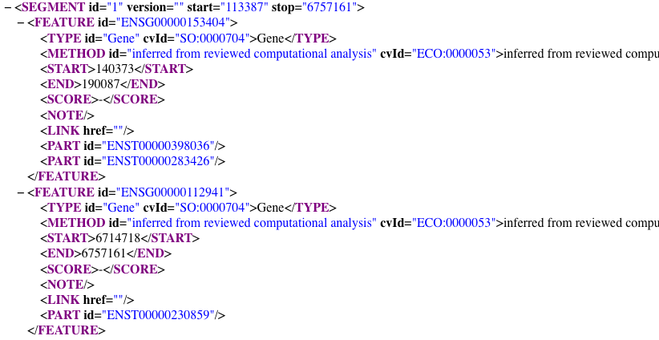

Slide 8
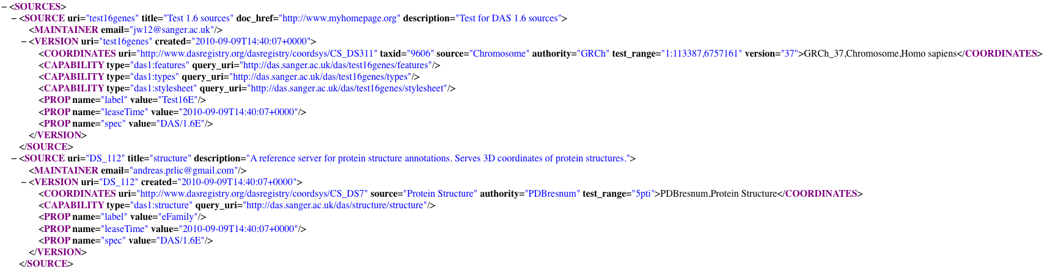
Sources documents have coordinate systems which mean you are mapping annotations to the correct genomes/sequences
Notes:
Shows coords and capabilities for this source - who to contact if a problem with server or data
This is has DS_ number for the structure source as it’s been registered with the registry.

Slide 9
Sources Doc Advantages:
Sources documents mean smoother running of ensembl and other DAS clients.
You can automatically load many DAS sources to the DAS registry using your sources document and the registry should keep in sync with new additions/deletions/alterations.
MyDAS and Proserver support the use of sources and all other 1.6 specification commands and responses.

Slide 10
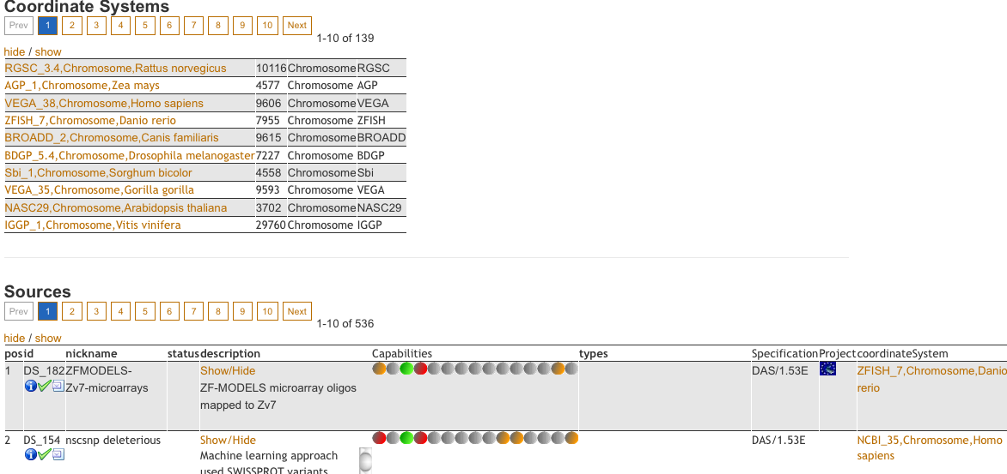
New Registry has search interface
Notes:
Jsdas
Web service
All javascript so code available to any web client and found on the registy web site.
Show some JSDAS queries and responses - also usable with any sources document not just the registry

Slide 11
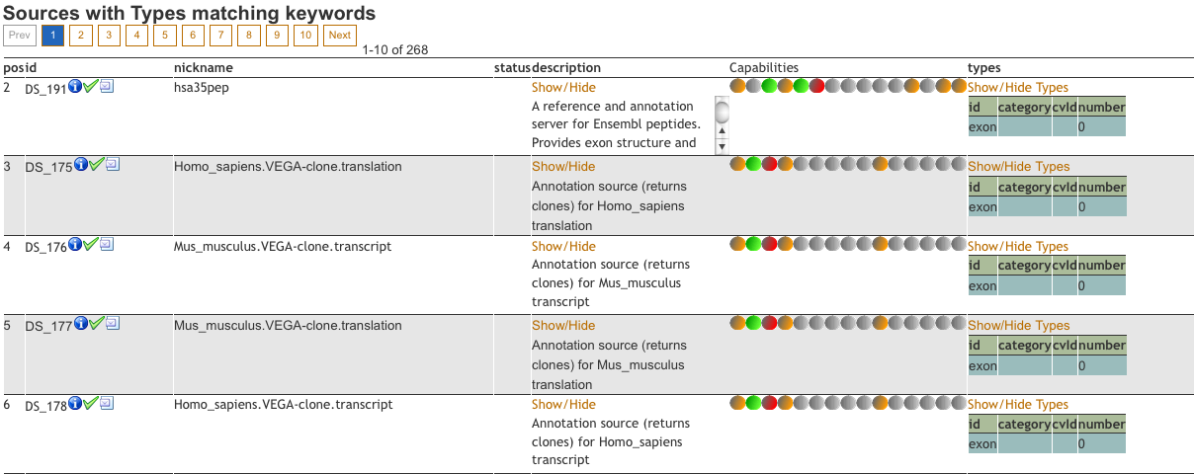

Slide 12
keywords parameter to sources cmds e.g. http://www.dasregistry.org/das/sources?keywords=zebrafish
* keywords parameter to coordinatesystem command http://www.dasregistry.org/das/coordinatesystem?keywords=gorilla
* added total, start, end attributes to coordinatesystem request response if rows specified http://www.dasregistry.org/das/coordinatesystem?keywords=gene&rows=1-10

Slide 13
Easy DAS
Upload files of various formats
Hosted at the EBI
No need for servers or databases.

Slide 14
1.6E proposals http://www.biodas.org/wiki/DAS1.6E
.WibbleDibble files!??
../das/DSN/format
<DASFORMAT>
<COMMAND name="das1:features">
<FORMAT name="das-JSON">
..if no types specified here then all types for this source have this format for this command
<TYPE id="gene"/>
<TYPE id="exon"/>
</FORMAT>
<FORMAT name="das-GoogleProtocolBuffers">
..if no types specified here then all types for this source have this format for this command
<TYPE id="gene"/>
<TYPE id="exon"/>
</FORMAT>
</COMMAND>
<COMMAND name="das1:entry_points">
<FORMAT name="das-JSON">
</FORMAT>
</COMMAND>
</DASFORMAT>

Slide 15
Other Extensions:
Das Writeback (implemented)
CRUD(Create, Read, Update and Delete)
Longer genomic alignments/compara
Addition to the standard alignment specification

Slide 16
New viewers supporting DAS
Dalliance Thomas Down
http://www.biodalliance.org/
http://www.biodalliance.org/human/ncbi36/
IGV Broad Institute
http://www.broadinstitute.org/igv/
Karyodas (Decipher, mykaryoview)
http://code.google.com/p/karyodas/
Apollo - new DAS DataAdapter release soon.
Jbrowse- Grant proposal
Notes:
Dalliance - smooth unlimited scrolling - all DAS based - extensive use of the DAS registry web service.

Slide 17
Other DAS clients:
Ensembl uses DAS to pull in genomic, gene and protein annotations. It also provides data via DAS.
Gbrowse is a generic genome browser, and is both a consumer and provider of DAS.
IGB is a desktop application for viewing genomic data.
SPICE is an application for projecting protein annotations onto 3D structures.
Dasty2 is a web-based viewer for protein annotations
Jalview is a multiple alignment editor.
PeppeR is a graphical viewer for 3D electron microscopy data.
DASMI is an integration portal for protein interaction data.
DASher is a Java-based viewer for protein annotations.
EpiC presents structure-function summaries for antibody design.
STRAP is a STRucture-based sequence Alignment Program.

Slide 18
Acknowledgments:
Andy Jenkinson (EBI)
Rafael Jiminez
Bernat Gel
Jose Villaveces
Gustavo Salazar
James Smith
Andreas Prlic
Gregg Helt
Lincoln Stein
Tim Hubbard
The DAS community

