Slide 1



A Construction Toolkit For Online Biological Databases
Lacey-Anne Sanderson

Slide 2
Project Update
What is Tripal
Tripal Version 0.2
Overview of Current Features
Tripal Version 0.3
In Depth Feature Explanation
Tripal API and Extensions

Slide 3


What is Tripal?
What is Tripal?
Tripal
Chado
Drupal
Notes:
Chado is a GMOD product that stores biological data in a very flexible way. Drupal is a content management systems that allows you to install a fully functional website (more information to come). Tripal is a drupal module (an extension to drupal) that makes chado content available and nicely displayed.

Slide 4
What is Tripal? (From a Biologist’s Point of View)
An open-source Biological Database that
Is easy to set up with few requirements
Lower IT Costs
Reliably stores your data without much more work than Excel Sheets
Upload data into chado completely through the web-interface
Display tables of data that are sortable, filterable and only contain the columns you care about
Facilitates sharing of data…
But only with the people you are ready to share it with

Slide 5
What is Tripal trying to Accomplish?
What is Tripal?
Simplify Construction of Biological Databases
Reduce development time, costs and IT resources
Simply Maintenance of Biological Databases
A non-technical site administrator can add content without knowing PHP, HTML, JavaScript.
Greater Flexibility of the Biological Website
Non-Biological Content: Social Networking, outreach, tutorials, publications, etc.
Layout and Theme
Expandability
Reusability
Notes:
Expandability
Site can be programmatically expanded in any way
Changes to base-code are not needed but modules are added.
Availability of an Application Programmer Interface (API)
Reusability
All code can be shared. Expansion modules created by one group can be shared with all.

Slide 6
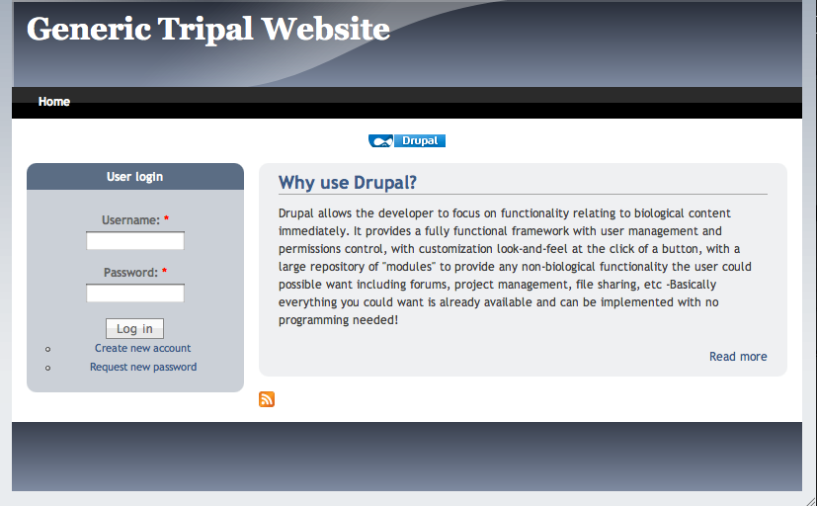
Why Drupal?
What is Tripal?
Widely used and supported.
A flexible, expandable platform
Start with a fully functional, professional website then simply add functionality to handle Biological Data
Handles User Management & Permission Control out of the box
Searching
Taxonomy/Tags
User Comments
Contact Forms
Forums
Menu’s
User Profiles
File Management

Slide 7
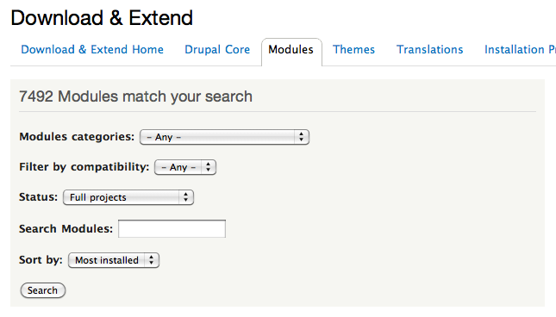
Why Drupal?
What is Tripal?
100’s of “modules” to extend the functionality of your website
Drupal Views: Custom SQL queries and tables
CCK: Add your own content to any page
Panels: Customize the layout of any page
Pathauto: Create path alias’
Wysywyg Editors
Webforms
CAPTCHA’s

Slide 8
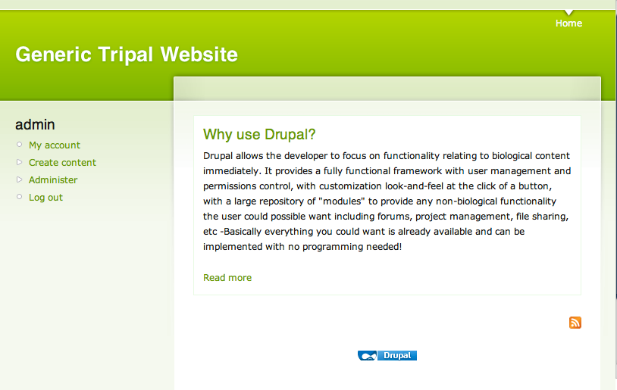
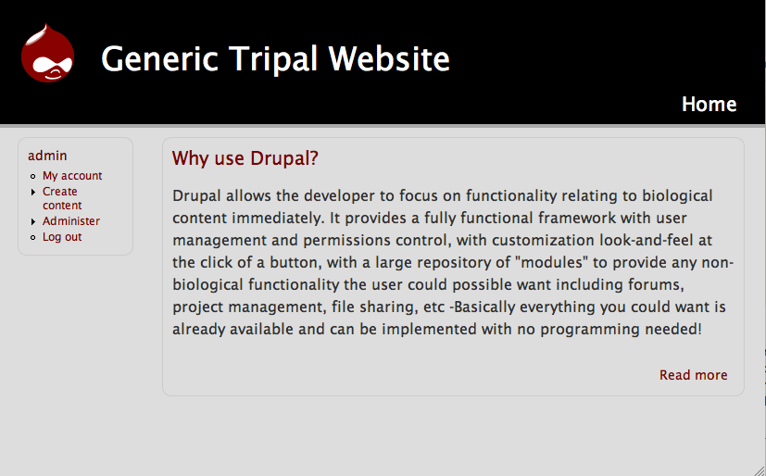
Why Drupal?
What is Tripal?
Fully Theme-able with 1000’s of themes freely available
Change the look-and-feel of your site with the click of a button
Notes:
Also create your own themes or modify others. There are even starter or simplified themes that exist to make it easier to create new themes.

Slide 9
Tripal Version 0.2
Tripal Version 0.2
Details Pages for Main Chado Content Types
Features, Organisms, etc.
Basic Listings of Content
Searching of Chado Content
Job Management
Allows running of longer jobs scheduled by cron
Materialized Views Support

Slide 10
Sites Using Tripal
Tripal Version 0.2
Genome Database for Vaccinium
http://www.vaccinium.org
Cool Season Food Legume Database
http://www.gabcsfl.org
Pulse Crops Genomics & Breeding
http://knowpulse2.usask.ca/portal/
Cacao Genome Database
http://www.cacaogenomedb.org
Fagaceae Genome Web
http://www.fagaceae.org
Citrus Genome Database
http://www.citrusgenomedb.org
Marine Genomics Project
http://www.marinegenomics.org
Notes:
All of them run Tripal 0.2 as of March 6, 2011 except Pulse Crops genomics and Breeding which runs a subversion revision approaching version 0.3.

Slide 11
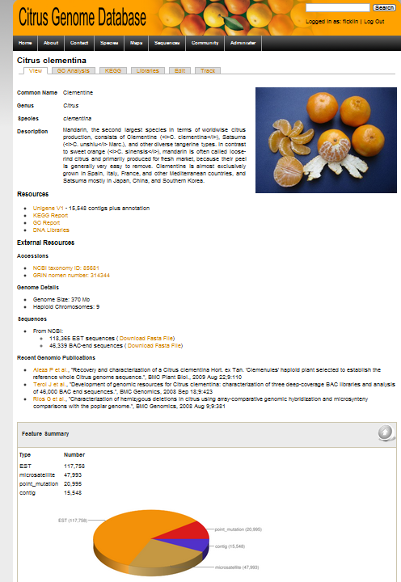
Organism
Tripal Version 0.2
Data from Organism table in Chado
Custom content added specifically to this page
Optional feature summary block added by Tripal: counts feature types in Chado.
Notes:
Custom content can be added using the Drupal Module CCK (Custom Construction Kit) or PHP coding in your node-chado_organism.tpl.php

Slide 12
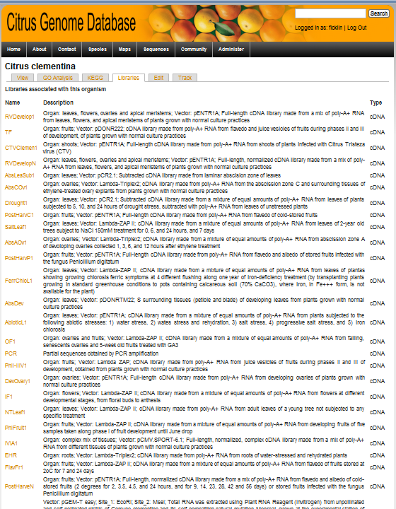
Libraries
Tripal Version 0.2
Shows all libraries (e.g. genomic BAC, EST, FOSMID, etc) available for a species
Notes:
A listing of libraries for a given organism. The columns of this listing cannot be changed. Each name link sto a details page for that library.

Slide 13
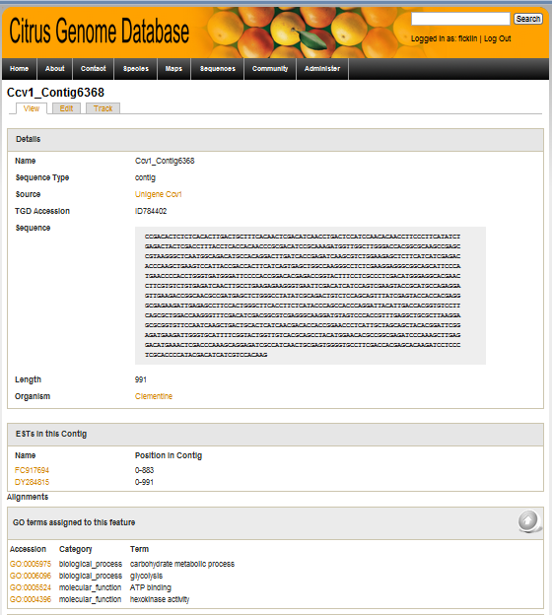
Features
Tripal Version 0.2
Data taken from the Chado
‘feature’ table.
EST’s in the contig alignment
GO terms annotated to this feature. Pulled directly from Chado.
Notes:
Features in chado are any sequence-related data (Sequence is optional).

Slide 14
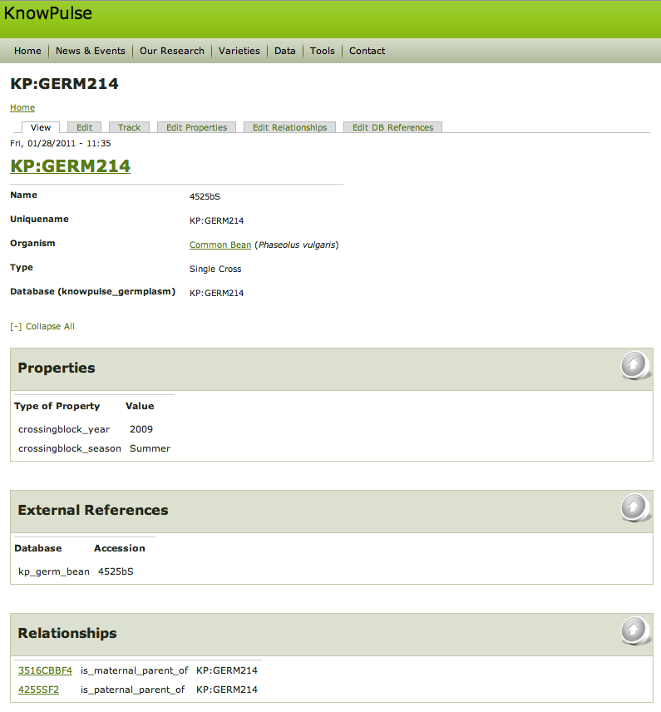
Stocks
Tripal Version 0.2
Data taken from the Chado
‘stock’ table.
Properties
(‘stockprop’)
External Database References
(‘dbxref’ <= ‘stock_dbxref’)
Stock Relationships (‘stock_relationship’)
Notes:
Stocks in chado are any biological unit upon which experiments can be done. For example, a plant/animal, a DNA extraction, a population of forage grasses, etc. Note you can edit this stock using the edit tab at the top of the page.

Slide 15
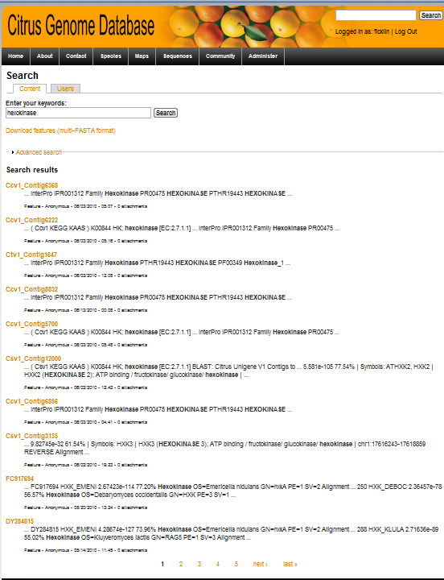
Searching
Tripal Version 0.2
Uses Drupal built-in search
Slow to index, but fast to search
Alternative methods may be desirable
Easy full-text search implementation.
Download FASTA file of results
Notes:
Searches both biological and non-biological data in your web page. This needs to be indexed.

Slide 16
Problems and Other Needs
Tripal Version 0.2
Problems with Version 0.2
Customizing of page layouts requires PHP/HTML programming
Feature pages are tailored for transcriptome data
API is limited
Other needs:
Increase support for more chado modules
Specifically, support the new Natural Diversity Module
Simplify data loading
Develop API for easier extension development
Support more complex features (e.g. genes)
Display details from related features
Ie: transcript details for a gene

Slide 17
Tripal Version 0.3
Tripal Version 0.3
One large step closer to the goals for Tripal!
New features in terms of Tripal Goals
Simplify Construction
Greater Flexibility
Expandability
Notes:
Simplify Construction of Biological Databases:
Data Loaders for GFF3 files, FASTA files and Ontologies
Chado Installer
More chado tables supported.
Greater Flexibility of the Biological Website:
Support of Drupal Views for custom SQL queries and display
Support of Drupal Blocks and Panels for custom page layouts
Expandability:
An improved API to assist developers in creating new applications using Drupal and Tripal.

Slide 18
New Data Loaders
Tripal Version 0.3
Allow users to upload data through the web interface
Programmed using PHP
No need to install BioPERL
New Loaders Include:
Ontology => Chado Controlled Vocabulary
GFF3 => Chado Features
FASTA file => Chado Features
Generic Excel Loader ^{Comming Soon!}
Support features, stocks, natural diversity data including genotypes and phenotypes, etc.

Slide 19
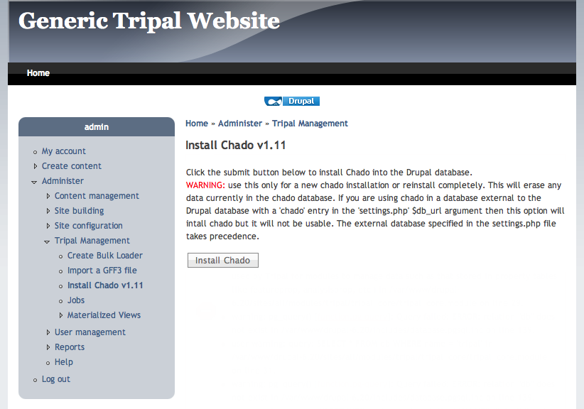
Chado Installation
Tripal Version 0.3
Installation of chado in a separate schema within the Drupal Database
Notes:
Installation within the same database allows greater interoperability between drupal and chado –facilitates the relationship between drupal content and chado data. Installation is at the click of a button but doesn’t install the associated chado scripts that often have a lot of dependencies.

Slide 20
Increased Chado Coverage
Tripal Version 0.3
Audit
Companalysis
Contact
Controlled Vocabulary
Expression
General
Genetic
Library
Mage
Map
Natural Diversity
Organism
Phenotype
Phylogeny
Publication
Sequence
Stock
WWW
* Full support for some of these modules (e.g. Natural Diversity) may come through incremental updates to version 0.3
Key:
Supported by Tripal v0.2
Supported by Tripal v0.3

Slide 21
Custom SQL Views
Tripal Version 0.3
Integration of Chado with the Drupal Views Module
Create custom SQL queries through the web-interface
Formatting of the results into a variety of formats including lists, tables, and RSS feeds
Sorting, Filtering (admin set values, user provided values and/or variables from the path)
Exporting of tables to Excel
Permissions handling
Notes:
Specifically it uses Drupal Views2

Slide 22
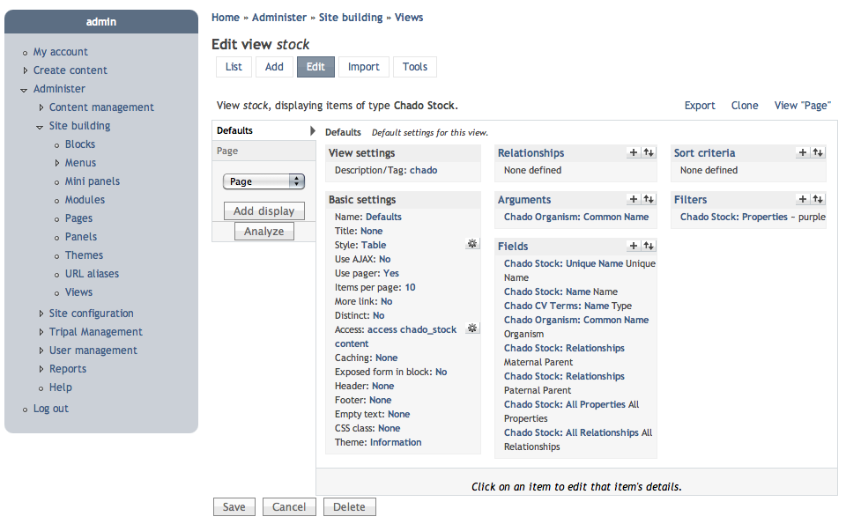
Custom SQL Views
Tripal Version 0.3
Create custom SQL queries through the web-interface
Notes:
Fields relate to columns in a table view. Filters allow you to control what rows or records are retrieved. Sort criteria is just a default; with the table style you can make the table headers click-sortable for your users which over-rides default sorting.

Slide 23
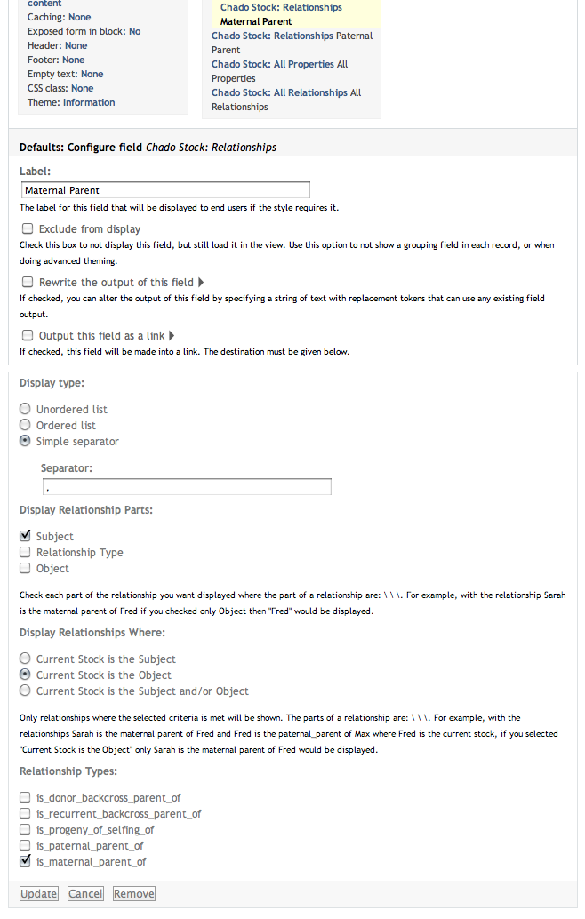
Custom SQL Views
Tripal Version 0.3
Each field has a number of options
Notes:
The options listed are for the stock relationship field. These options don’t filter the number of rows/results but simply the value in that column.

Slide 24
Custom SQL Views
Tripal Version 0.3
Automatically generates this query
SELECT stock.stock_id AS stock_id, stock.uniquename AS stock_uniquename, node.nid AS node_nid, stock.name AS stock_name, cvterm.name AS cvterm_name, organism.common_name AS organism_common_name, organism_node.nid AS organism_node_nid FROM stock stock
LEFT JOIN organism organism ON stock.organism_id = organism.organism_id
LEFT JOIN chado_stock chado_stock ON stock.stock_id = chado_stock.stock_id
LEFT JOIN node node ON chado_stock.nid = node.nid
LEFT JOIN cvterm cvterm ON stock.type_id = cvterm.cvterm_id
LEFT JOIN chado_organism chado_organism ON organism.organism_id = chado_organism.organism_id
LEFT JOIN node organism_node ON chado_organism.nid = organism_node.nid
WHERE organism.common_name = 'Soybean'
Notes:
This query is displayed by the Drupal Views in the create/edit views user interface but not to the users viewing the view.

Slide 25
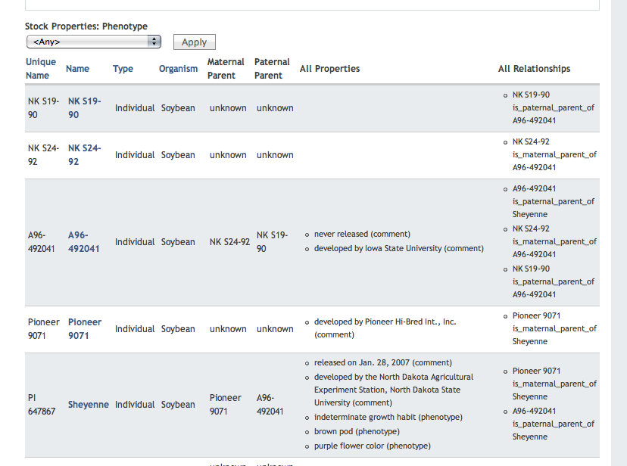
Custom SQL Views
And produces this table
Notes:
The links that are table headers allow click-sorting of those columns. Note: the name of the record is linked to it’s details page

Slide 26
Customizable Page Layouts
Expose Chado data to Drupal Panels in the form of blocks
Allows tripal administrators to arrange chado content on details pages
Decide if you want the Sequence Features page to only contain basic details and other details such as properties, relationships, annotation appear as tabs
Or combine everything onto a single page
Panels supports custom layouts with any combination of rows and columns

Slide 27
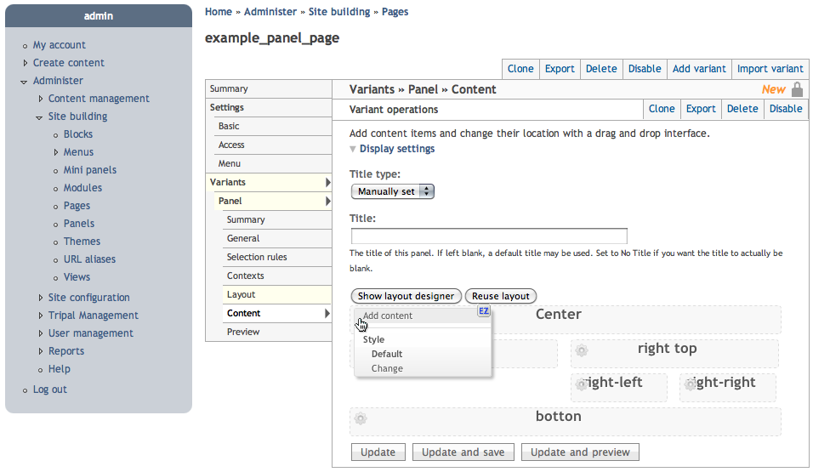
Customizable Page Layouts
Put content in any region you want
Notes:
You can also add your custom views to these pages.

Slide 28

Customizable Page Layouts
Panels supports custom layouts with any combination of rows and columns

Slide 29
The Tripal API
Tripal Version 0.3
At the Tripal-core level:
Sumbit/Update job status for the Jobs Management system
Add Materialized Views
Adding custom CV
At the Chado-centric module level:
Generic Insert/Update/Delete for Chado tables
Pie Charts and expandable tree browser for showing features with assigned ontologies
At the Analysis module level:
Functions for registering new analysis modules
Use of Drupal hooks for integrating new analyses

Slide 30
Tripal API: Select/Insert/Update
Tripal Version 0.3
Generic Select/Insert/Update functions
One select function allows querying of all chado tables
array tripal_core_chado_select (string $table_name, array $select_values)
Nested values array^{(example coming)} allows specifying foreign keys by means other than the primary key

Slide 31
Tripal API: Example Select
Tripal Version 0.3
Usage:
$columns = array( ‘feature_id’, ‘name’, ‘uniquename’ );
$values = array(
‘organism_id’ => array(‘genus’ => ‘Lens’),
‘type_id’ => array(
‘cv_id’ => array(‘name’ => ‘sequence’),
‘name’ => ‘gene’,
),
‘dbxref_id’ => array(
‘db_id’ => array(‘name’ => ‘NCBI’),
),
);
$result = tripal_core_chado_select('feature',$columns,$values);
The above example, returns an array of all Lentil genes with NCBI accessions
Updates and Inserts follow a similar scheme

Slide 32
Tripal Extensions
Tripal Extensions
Tripal can be extended
at the Application and
Analysis Module layers, or where Chado-centric modules are missing.
Anyone may develop Applications and Analysis modules
Anyone may help with development of Chado-centric modules but in coordination with core Tripal developers.
Notes:
The tripal distribution contains the Tripal core and chado-centric modules.

Slide 33
Tripal Extensions
Tripal Extensions
Tripal Extensions are made available through the Tripal SourceForge Site
http://tripal.sourceforge.net/?q=extensions
Some extensions coming soon include:
Breeder’s Toolbox Application
Alpha version available
Natural Diversity Module
Under Development
GBrowse Management Module
Under Development

Slide 34
Tripal Extensions
Tripal Extensions
Application: Breeder’s Module
Development: University of Saskatchewan and Washington State University
Will provide specialized Creation Forms, Details Pages and Views
Missing Chado-centric modules:
Genotype/Phenotype Natural Diversity Experiment Management Module
Development: University of Saskatchewan and Washington State University
Initial support is focused on Views
Dynamic Details Pages for projects/experiments

Slide 35
Tripal Extensions
Tripal Extensions
GBrowse Integration Module
Development: University of Saskatchewan
Will allow creation of GBrowse Instances through the web interface
Ability to sync specific feature libraries in chado with a given GBrowse instance
cURL module for integration of 3rd Party tools into a Drupal site.
Under development at Washington State University
Will allow seamless integration with other GMOD tools into the site (e.g. Gbrowse, CMAP)

Slide 36
Tripal Extensions
Tripal Extensions
Analysis Modules:
There are already modules developed for supporting the following analysis’:
BLAST
GO
Interpro
KEGG
Unigene
In version 0.2 these were include in core Tripal but have been moved to a separate Drupal Package

Slide 37
How to Contribute
Tripal Extensions
Tripal is still maturing but anyone can extend it to suit their needs.
These extensions can be shared with others and can be made available by on the Tripal website: http://tripal.sourceforge.net
If you are interested in developing an extension feel free to email the mailing list: gmod-tripal@lists.sourceforge.net

Slide 38




Contributing Organizations
Clemson University Genomics Institute
Meg Staton, Ph.D
University of Saskatchewan
Lacey-Anne Sanderson
Kirstin Bett, Ph.D
Main Bioinformatics Lab
Stephen Ficklin (project lead)
Chun-Huai Chen
Taein Lee
Dorrie Main, Ph.D
Il-Hyung Cho, Ph.D.
Sook Jung, Ph.D
Ontario Institute for Cancer Research
GMOD Coordinator, Scott Cain, Ph.D
Emory University
Previous GMOD Help Desk, Dave Clements

Slide 39




Funding Sources
Development of Tripal has been supported by components of several funded projects, including:
Current Funding
Tree Fruit GDR: Translating Genomics into Advances in Horticulture: USDA Specialty Crops Research Initiative, September 2009 – August 2013.
An Integrated Web-based Relational Database for the Curation of Cacao Genetic and Genomic Data: USDA-ARS SCA, January 2009 - January 2013.
Developing an Online Toolbox for Tree Fruit Breeding: Washington Tree Fruit Research Commission, April 2009 – March 2012.
RosBREED: Enabling Marker-assisted Breeding in Rosaceae: USDA Specialty Crops Research Initiative, September 2009 – August 2013
Genomics-Assisted Plant Breeding for Cool Season Food Legumes: University of Idaho Special Grants, USDA NIFA, May 2010 – April 2013
Loblolly Pine Genome Sequencing: USDA DOE, January 2011-January 2016
PURENET: Agriculture and Agri-Food Canada, May 2009 – March 2011
iMAP: Saskatchewan Pulse Growers Association, September 2010 – September 2013
Comparative Genomics of Environmental Stress Responses in North American Hardwoods: NSF Plant Genome Research Program, February 2011 - January 2015
Past Funding
Genomic Tool Development for the Fagaceae, NSF Award #0605135
Clemson University Genomics Institute (CUGI)
Clemson’s Cyberinfrastructure and Technology Integration Group (CITI)

Slide 40
Thank You!
Sourceforge: http://tripal.sourceforge.net
Mailing Lists: http://gmod.org/wiki/GMOD_Mailing_Lists
GMOD Tripal Pages: http://gmod.org/wiki/Tripal

