Slide 1







JBConnect Hooks (Plugins)
Client & Server Plugins
Workflow Service
…
Ie: JBlast
JBConnect
…
JBConnect REST API / HTTP
Socket.io (WebSockets)
Or
Custom Workflows
Waterline
ORM
Client Only – HTTP
(Traditional)
Apache,
Nginx,
…
DATABASE
Any DB: MySql, Postgre, MongoDB,
Redis, …
Traditional
JBrowse Plugins

Slide 2
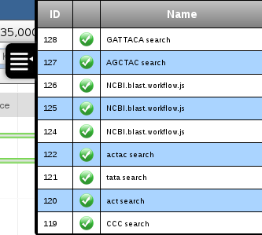
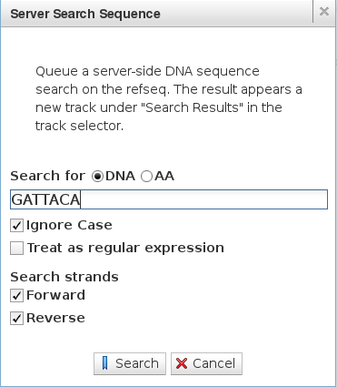
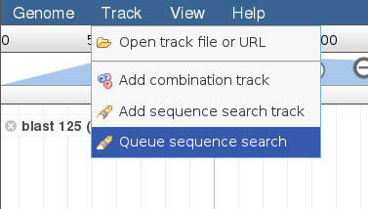
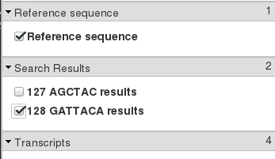
* Employs novel approach of RegexSequenceSearch running on the server side.

