Slide 1
Data Driven Foresight
Topic: Self-Healing Materials
Presentation by Liang, Puntigam, Yousofi
Notes:
Seiar

Slide 2
Web of Science Search String
Self heal* | AND | Material* | NOT | Biology
Self repair* |  | Polymer* |  | Biological system*
Autonom* repair* |  | Composite* |  | Organic material*
Autonom* heal* |  | Ceramic* |  | Wound heal*
 |  | Metal* |  | Medic*
 |  | Alloy* |  | Healthcare
 |  | Cement* |  | Spirit*
 |  | Concrete*
OR
TS=("self heal*" OR "self repair*" OR "autonom* repair*" OR "autonom* heal*")
AND TS=("material*" OR "polymer*" OR "composite*" OR "ceramic*" OR "metal*" OR "alloy*" OR "cement*" OR "concrete*")
NOT TS=("biology" OR "biological system*" OR "organic material*" OR "wound heal*" OR "medic*" OR "healthcare" OR "spirit*")
Notes:
Seiar

Slide 3
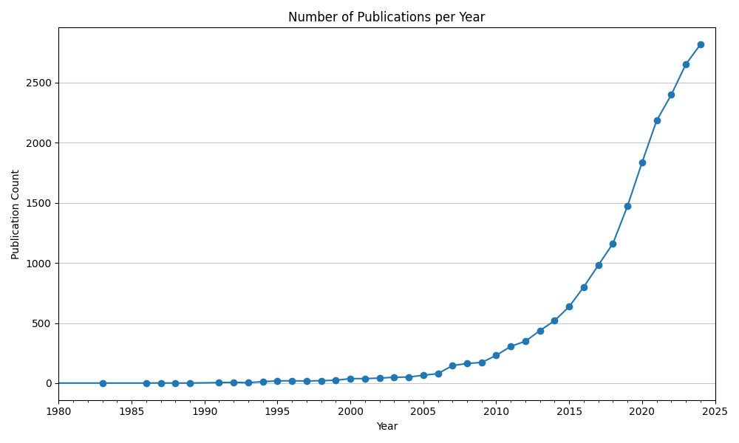
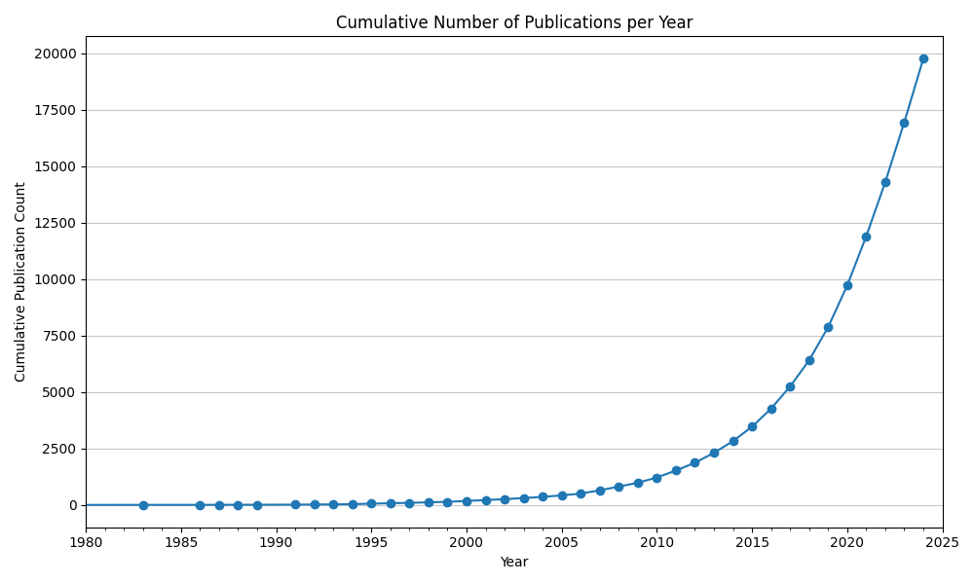
The total number of publications regarding self-healing materials is growing fast
Publications per year roughly double every five years
Total number of publications is expected to follow exponential growth for foreseeable future
Notes:
Seiar

Slide 4
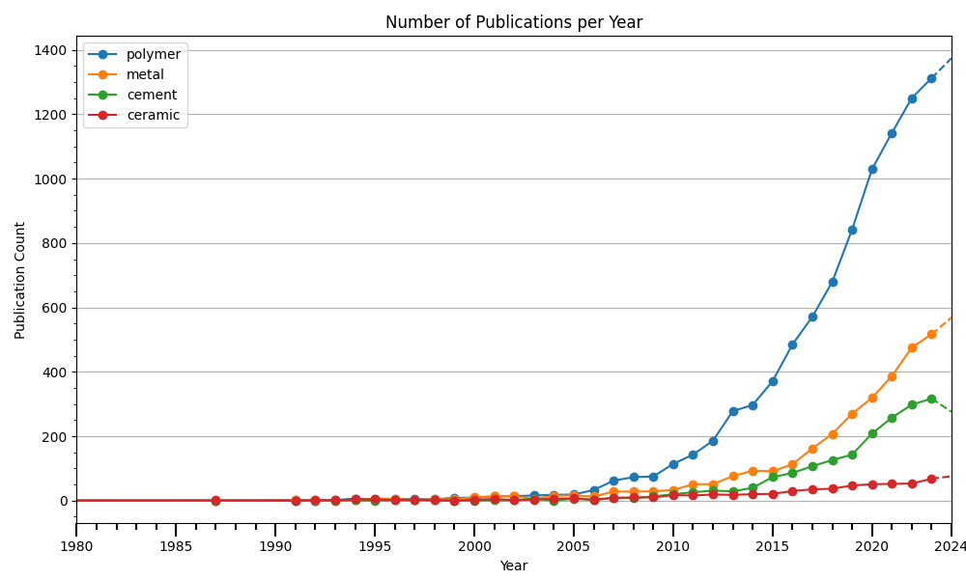
Polymers are the most researched material regarding self- healing properties
Research is focused on self-healing polymer materials
Yearly number of publications is generally rising across all material types
AND TS=("material*" OR "polymer*" OR "composite*" OR "ceramic*" OR "metal*" OR "alloy*" OR "cement*" OR "concrete*“)
Notes:
Seiar

Slide 5
Polymers are the most researched material regarding self- healing properties
Research is focused on self-healing polymer materials
Yearly number of publications is generally rising across all material types
AND TS=("material*" OR "polymer*" OR "composite*" OR "ceramic*" OR "metal*" OR "alloy*" OR "cement*" OR "concrete*“)
Notes:
Seiar

Slide 6
Polymers are the most researched material regarding self- healing properties
Research is focused on self-healing polymer materials
Yearly number of publications is generally rising across all material types
AND TS=("material*" OR "polymer*" OR "composite*" OR "ceramic*" OR "metal*" OR "alloy*" OR "cement*" OR "concrete*“)
Notes:
Seiar

Slide 7
Polymers are the most researched material regarding self- healing properties
Research is focused on self-healing polymer materials
Yearly number of publications is generally rising across all material types
AND TS=("material*" OR "polymer*" OR "composite*" OR "ceramic*" OR "metal*" OR "alloy*" OR "cement*" OR "concrete*“)
Notes:
Seiar

Slide 8
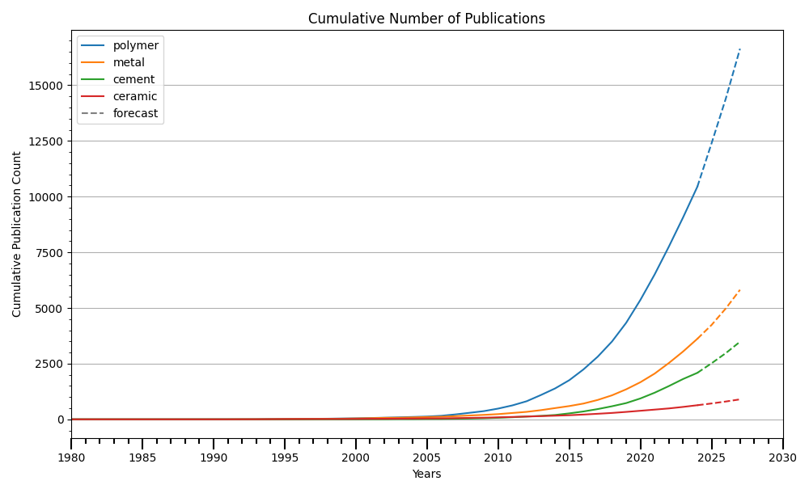
Number of annual publications expected to further grow
Total number of publications is currently growing rapidly
Using the given data, we can roughly forecast the number of publications for the coming years
Growth rate for research on metals and cement was comparable up to 2020. Since then, metal shows more potential
Notes:
Seiar

Slide 9
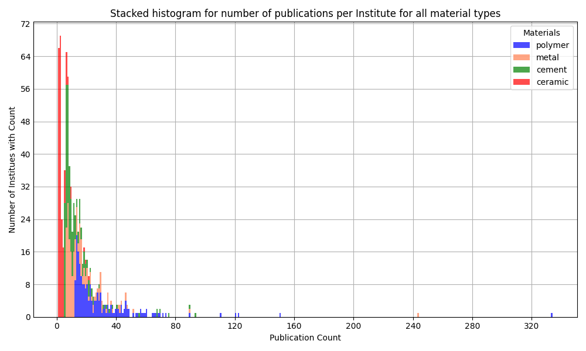
Highly Skewed Distribution of Affiliations
The majority of institutions have fewer than 25 published papers affiliated with them
The institution with the highest number of affiliations has more than 300 papers linked to it
All institutions researching polymers have published more than 10 papers on the topic – a few more than 100
Notes:
Georg

Slide 10
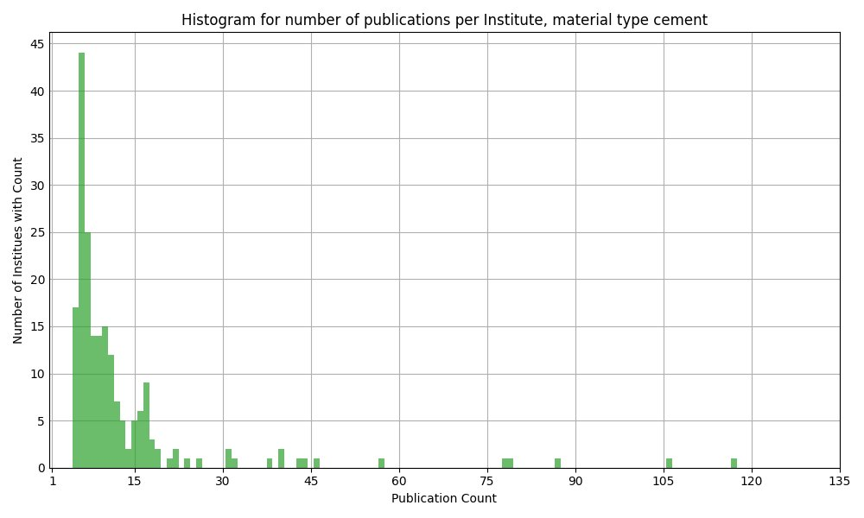
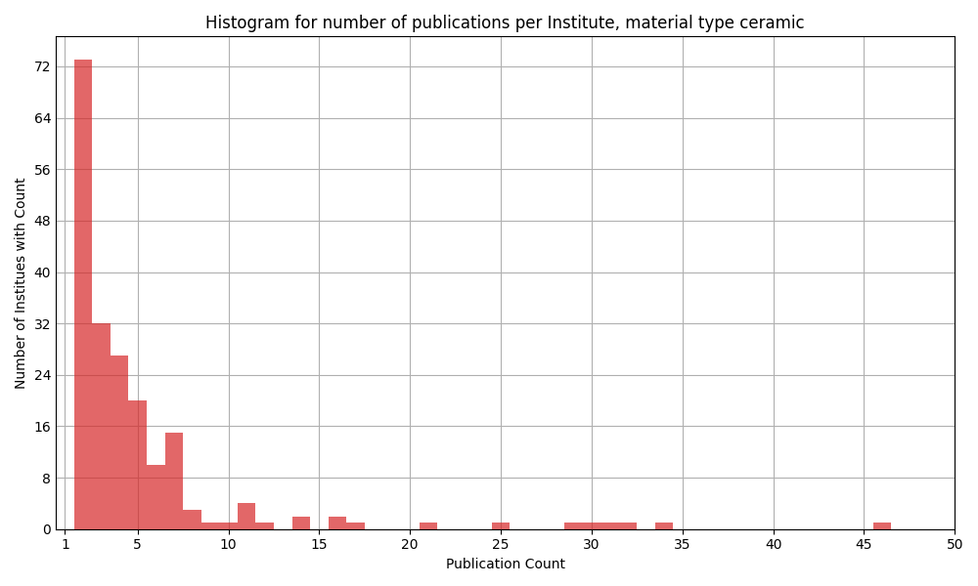
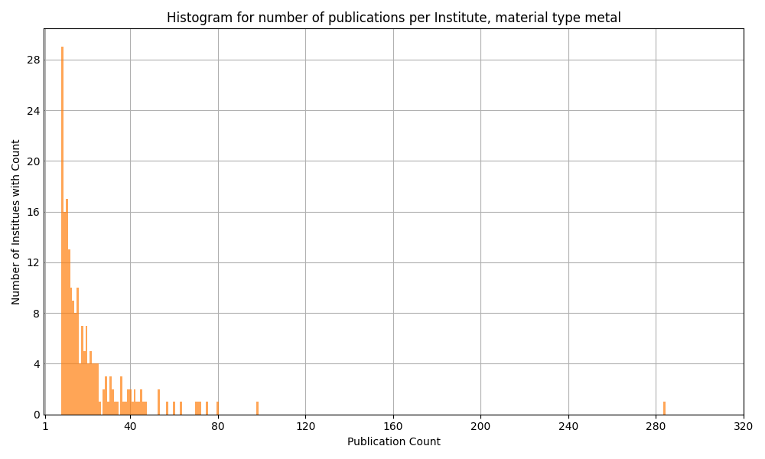
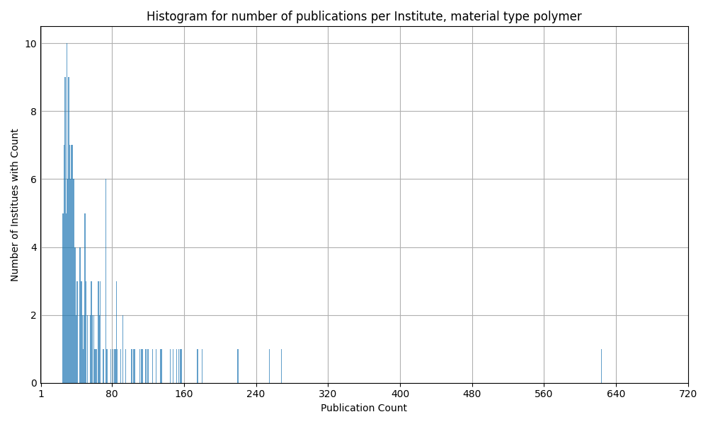
Notes:
Georg

Slide 11
Polymers
Detailed Analysis
Notes:
Andre

Slide 12
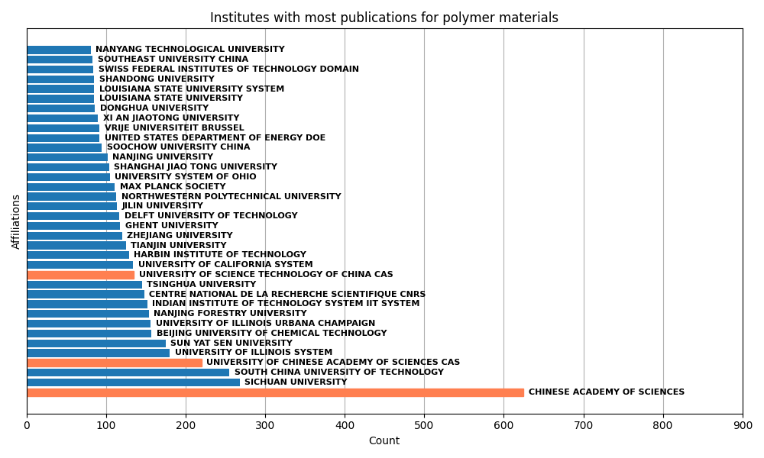
Chinese Academy of Sciences (CAS) dominates the field
The CAS has more than twice the number of affiliations as the institution with the second-highest number
Most institutions are located in China
The CAS appears under different names, e.g.:
Chinese Academy of Sciences
University of Chinese Academy of Sciences CAS
University of Science Technology of China CAS
Notes:
Andre

Slide 13
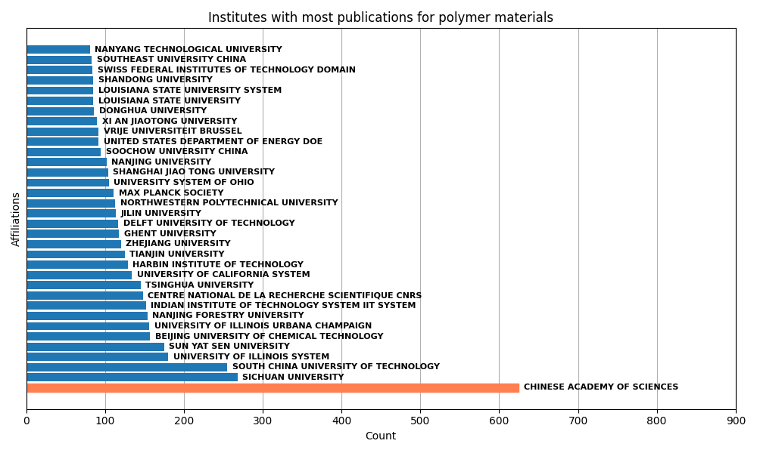
Chinese Academy of Sciences (CAS) dominates the field
Chinese Academy of Science is a head research organization, with several branches situated in China listed additionally
Publications attributed to variations of CAS have been consolidated under “Chinese Academy of Sciences” → others have thus been omitted
Notes:
Andre

Slide 14
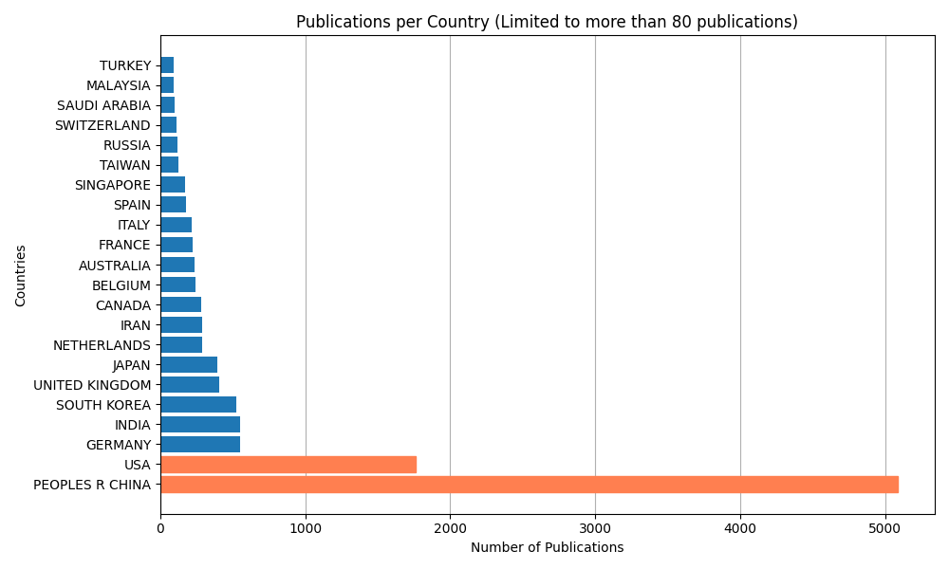
Most papers are affiliated with institutions in China and the USA
Notes:
Georg

Slide 15
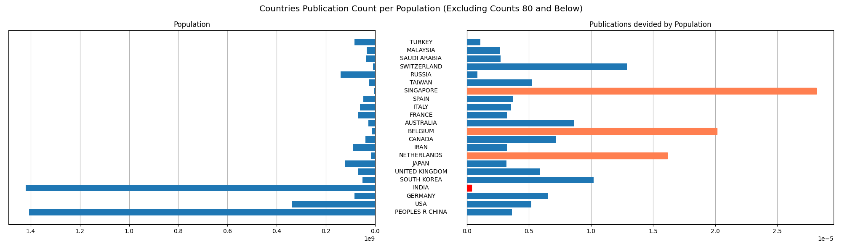
Adjusting for population size...
Singapore, Belgium, and the Netherlands have the highest number of publications affiliated to them
Population data is sourced from www.census.gov (January 2025)
Notes:
Georg

Slide 16
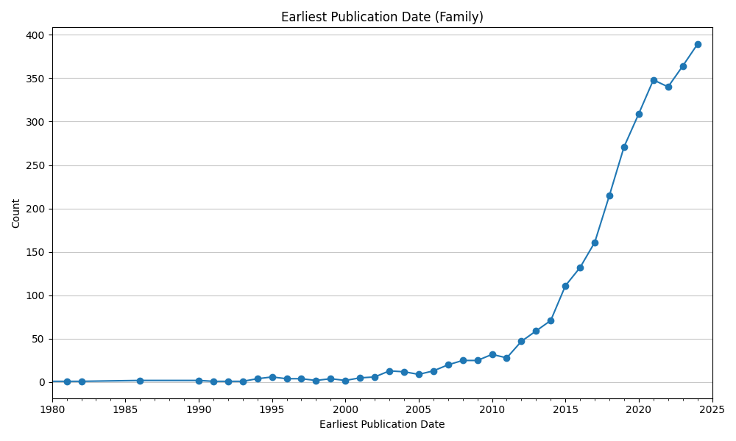
Exponential growth in patent activity
Exponential growth from 2014 onward
Small drop occurred in 2022 in an otherwise steep upward trajectory → likely due to COVID-19
(Data taken from espacenet, January 2025)
Notes:
Andre

Slide 17
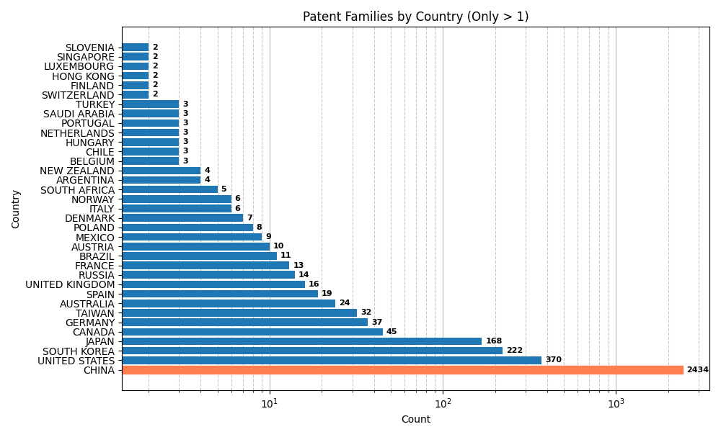
China dominates patent activity in self-healing materials
High activity in USA, South Korea, and Japan, but far behind China
Europe lags, with limited patent activity, suggesting a focus on other priorities or academic research
Strategic focus on China is crucial to track emerging trends and opportunities in this field
(Data taken from espacenet, January 2025)
Notes:
Andre

Slide 18
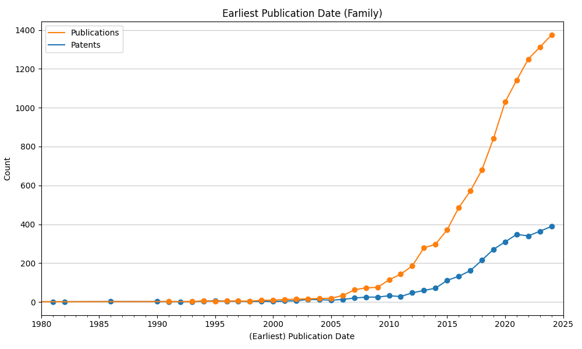
Publications outpacing patents - continued growth expected
Starting from 2010 the number of publications dominate the number of patents significantly
Research largely unaffected by COVID
Number of patents is expected to follow the upward trajectory in the coming years
(Data taken from espacenet, January 2025)
Notes:
Andre

Slide 19
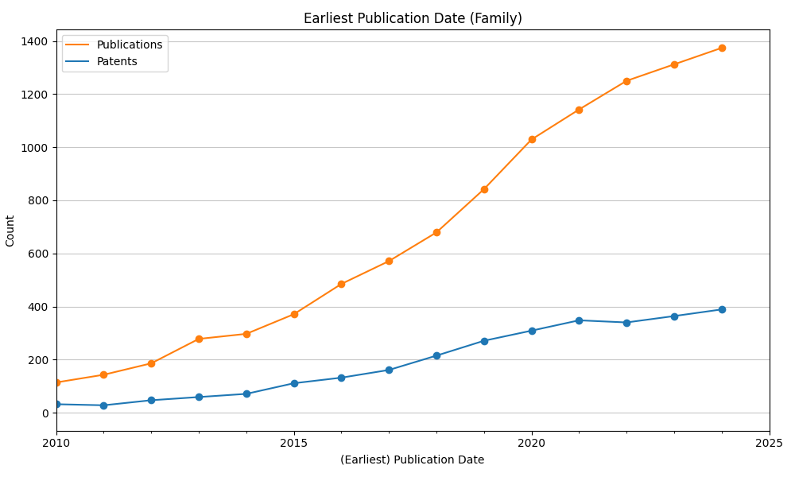
Publications outpacing patents - continued growth expected
Starting from 2010 the number of publications dominate the number of patents significantly
Research largely unaffected by COVID
Number of patents is expected to follow the upward trajectory in the coming years
(Data taken from espacenet, January 2025)
Notes:
Andre

Slide 20
Summary
Recommended Steps
The number of annual publications is expected to grow further
Research efforts are concentrated on polymers, with China and the USA leading globally
Patent activity, particularly in China, highlights the strategic importance of this region
Keep an eye on metal research
Investigate patent activity in China
Assess funding and investment opportunities in different countries
Market research
Notes:
Georg

Slide 21
Reflection
Data Driven Foresight is a efficient way to investigate current trends in research and development
Combination of publication data and patent data offers first insights into potential technological advances and emerging market opportunities
More data from other sources is needed for accurate assessment
Notes:
Seiar

