Slide 1
Data Driven Foresight
Topic: Self-Healing Materials
Presentation by Liang, Puntigam, Yousofi

Slide 2
Web of Science Search String
TS=("self heal*" OR "self repair*" OR "autonom* repair*" OR "autonom* heal*")
AND TS=("material*" OR "polymer*" OR "composite*" OR "ceramic*" OR "metal*" OR "alloy*" OR "cement*" OR "concrete*")
AND TS=("application*" OR "technolog*" OR "propert*" OR "performance") NOT TS=("biology" OR "biological system*" OR "hydrogel*" OR "gel*" OR "organic material*" OR "wound heal*" OR "medic*" OR "healthcare" OR "spirit*")
AND PY=(2015-2025)
Self heal* | AND | Material* | AND | Application* | NOT | Biology
Self repair* |  | Polymer* |  | Technolog* |  | Biological system*
Autonomous repair* |  | Composite* |  | Propert* |  | Hydrogel*
Autonomous heal* |  | Ceramic* |  | Performance* |  | Gel*
 |  | Metal* |  |  |  | Organic material*
 |  | Alloy* |  |  |  | Wound heal*
 |  | Cement* |  |  |  | Medic*
 |  | Concrete* |  |  |  | Healthcare
 |  |  |  |  |  | Spirit*
OR

Slide 3
Web of Science Search String
TS=("self heal*" OR "self repair*" OR "autonom* repair*" OR "autonom* heal*")
AND TS=("material*" OR "polymer*" OR "composite*" OR "ceramic*" OR "metal*" OR "alloy*" OR "cement*" OR "concrete*")
AND TS=("application*" OR "technolog*" OR "propert*" OR "performance") NOT TS=("biology" OR "biological system*" OR "hydrogel*" OR "gel*" OR "organic material*" OR "wound heal*" OR "medic*" OR "healthcare" OR "spirit*")
AND PY=(2015-2025)
Limit Data to 2015-2025

Slide 4
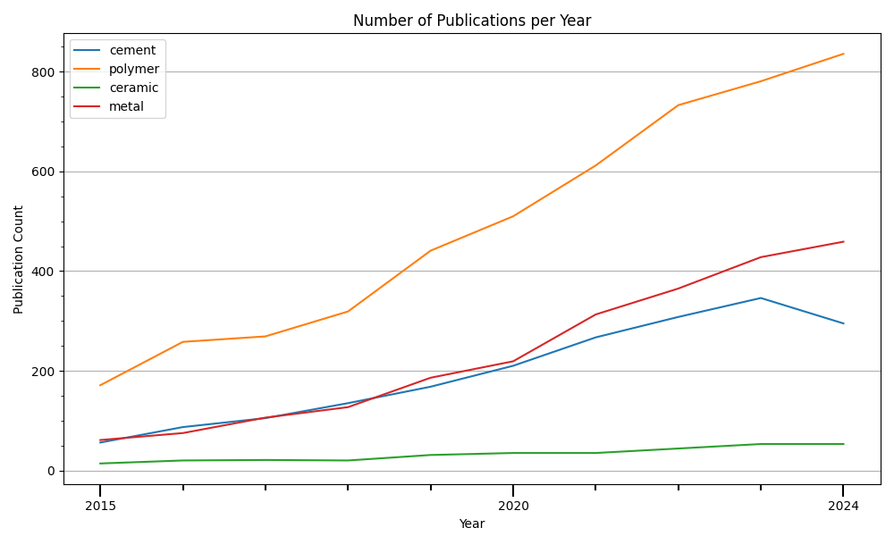
Number of annual publications for different material types
Yearly Number of Publications is generally rising for all material types.
The most amount of research is done regarding self-healing polymer materials

Slide 5
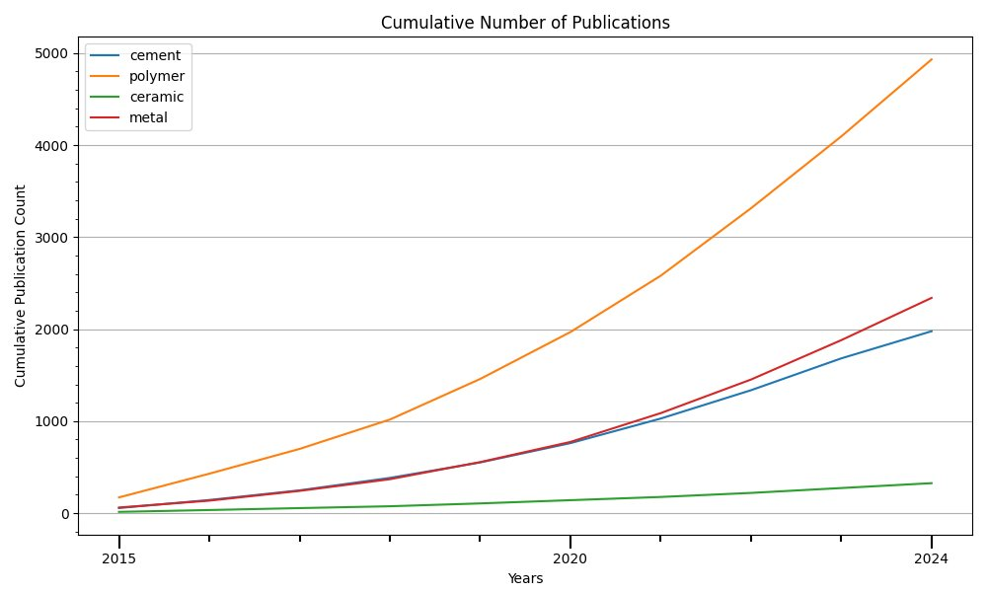
Number of annual publications for different material types (cumulative)
Total Number of Publications is growing non-linearly

Slide 6
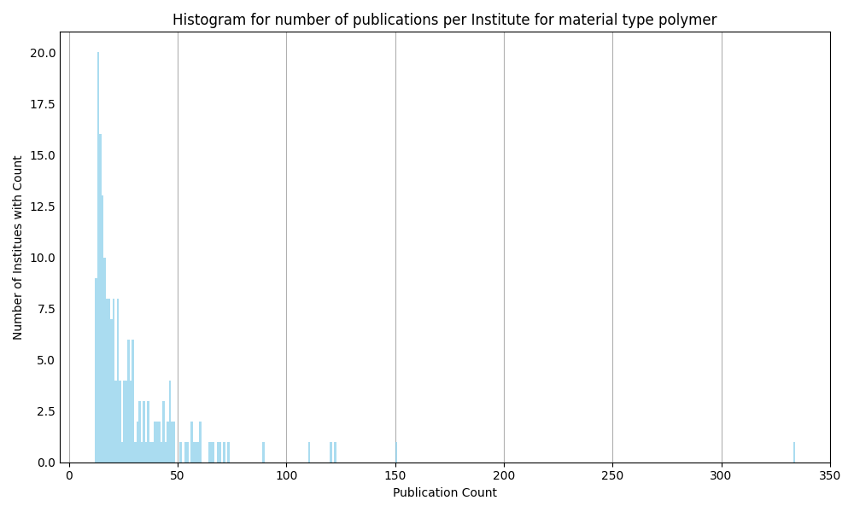
Histogram for number of publications per Institute regarding polymer materials
The majority of institutes has an affiliation with less than 25 published papers
The institute with the most affiliations has more than 300 papers that are affiliated with their institute
Look at top institutes on next slide

Slide 7
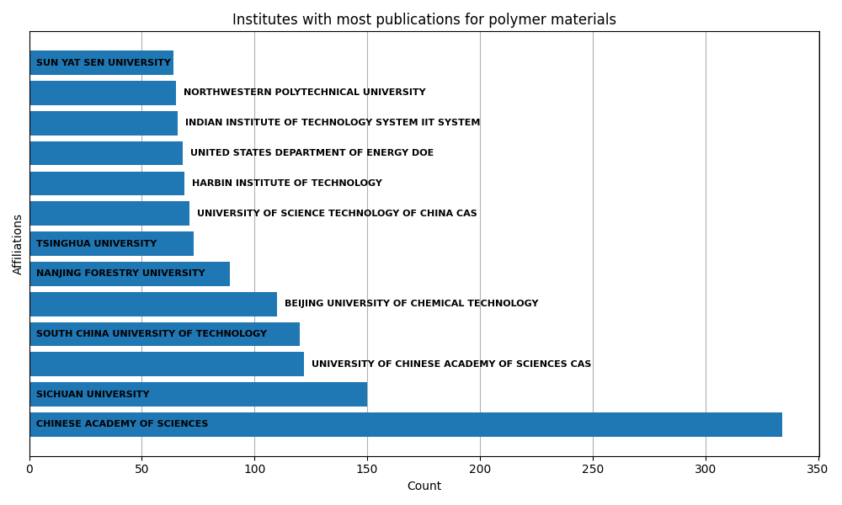
Institutes with most publications affiliated to them regarding polymer materials
The institute with the most affiliations has more than twice the amount of affiliations as the institute with the second most affiliations
Most institutes are located in China
The Chinese Academy of Sciences (CAS) is listed under three different names, possibly to different translations to English:
University of Chinese Academy of Sciences CAS
Chinese Academy of Sciences CAS
University of Science Technology of China CAS

Slide 8
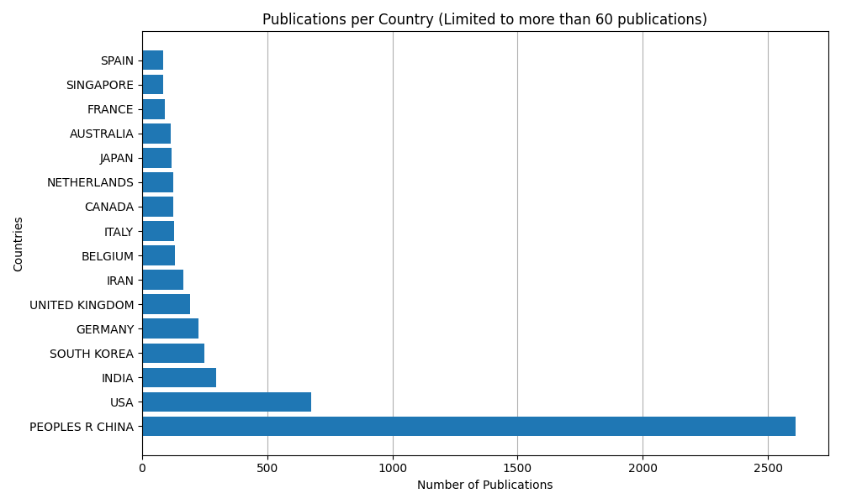
Countries with most publications affiliated to them regarding polymer materials
Most papers are published with affiliations to China or USA

Slide 9
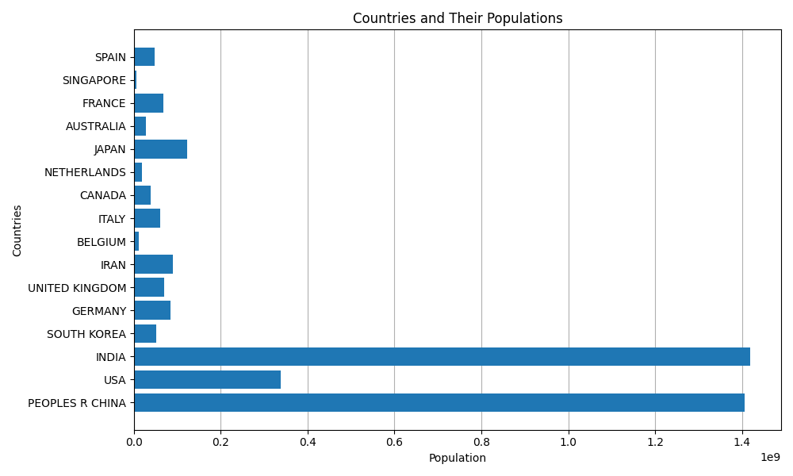
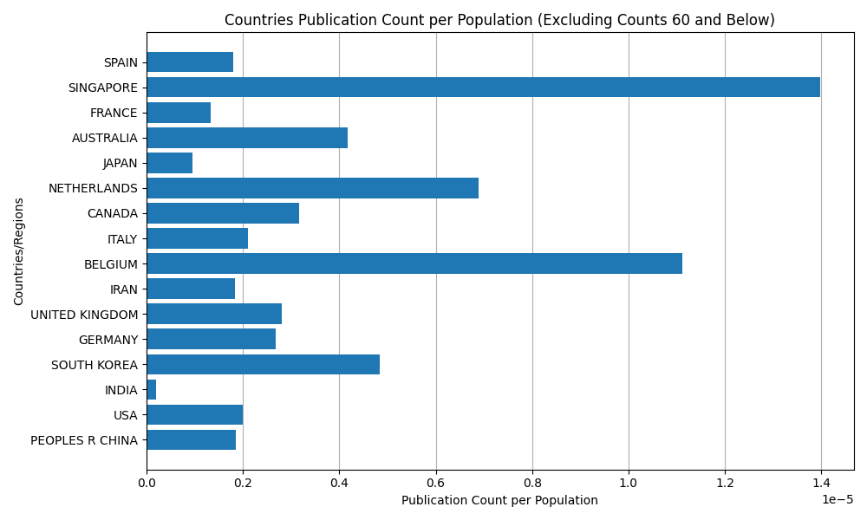
Countries with most publications affiliated to them regarding polymer materials, scaled by population
When compared to their population, Singapore and Belgium have the most publications affiliated to them
Population data taken from www.census.gov in January 2025

Slide 10
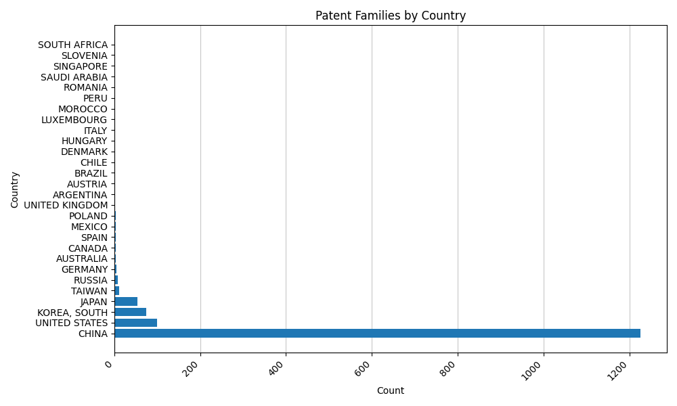
Espacenet
China leads globally, with the highest patent activity in self-healing materials, driven by strong innovation efforts.
USA, South Korea, and Japan follow as key contributors, but far behind China.
Europe lags, with limited patent activity, suggesting a focus on other priorities or academic research.
Strategic focus on China is crucial to track emerging trends and opportunities in this field.

Slide 11
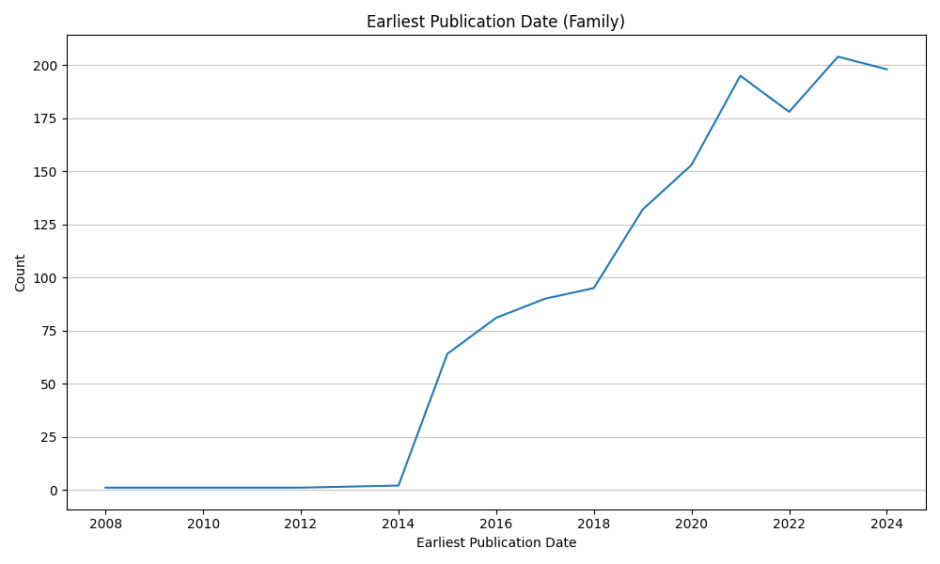
Espacenet

Slide 12
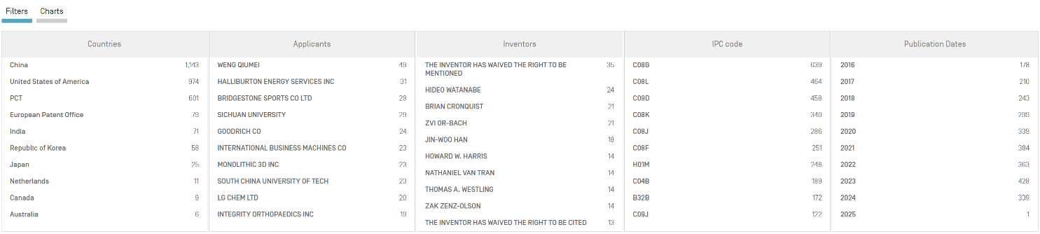
WIPO

Slide 13
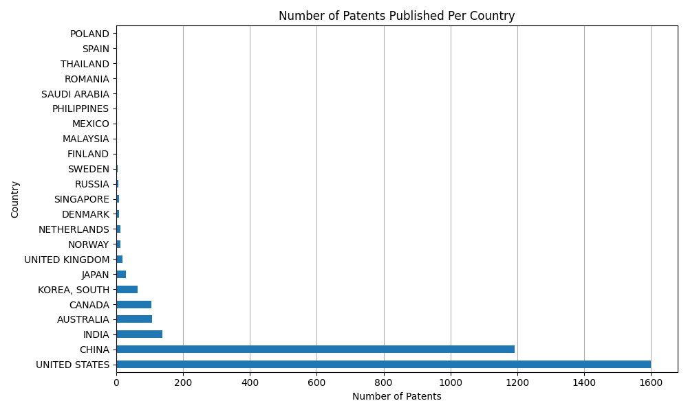
WIPO

Slide 14
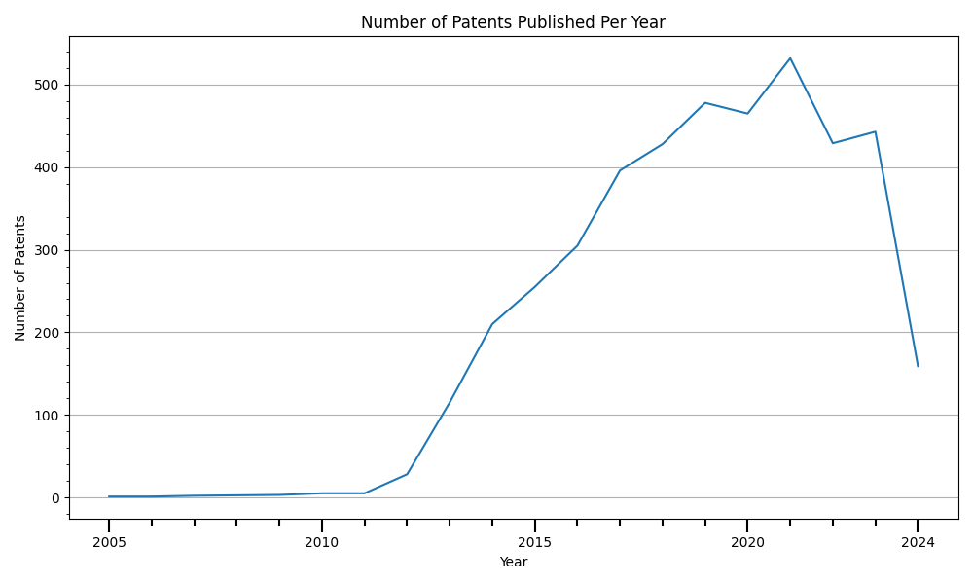
WIPO

