Slide 1
Data Driven Foresight
Topic: Self-Healing Materials
Presentation by Liang, Puntigam, Yousofi

Slide 2
Web of Science Search String
Self heal* | AND | Material* | AND | Application* | NOT | Biology
Self repair* |  | Polymer* |  | Technolog* |  | Biological system*
Autonomous repair* |  | Composite* |  | Propert* |  | Hydrogel*
Autonomous heal* |  | Ceramic* |  | Performance* |  | Gel*
 |  | Metal* |  |  |  | Organic material*
 |  | Alloy* |  |  |  | Wound heal*
 |  | Cement* |  |  |  | Medic*
 |  | Concrete* |  |  |  | Healthcare
 |  |  |  |  |  | Spirit*
OR
TS=("self heal*" OR "self repair*" OR "autonom* repair*" OR "autonom* heal*")
AND TS=("material*" OR "polymer*" OR "composite*" OR "ceramic*" OR "metal*" OR "alloy*" OR "cement*" OR "concrete*")
AND TS=("application*" OR "technolog*" OR "propert*" OR "performance")
NOT TS=("biology" OR "biological system*" OR "hydrogel*" OR "gel*" OR "organic material*" OR "wound heal*" OR "medic*" OR "healthcare" OR "spirit*")
AND PY=(2015-2025)

Slide 3
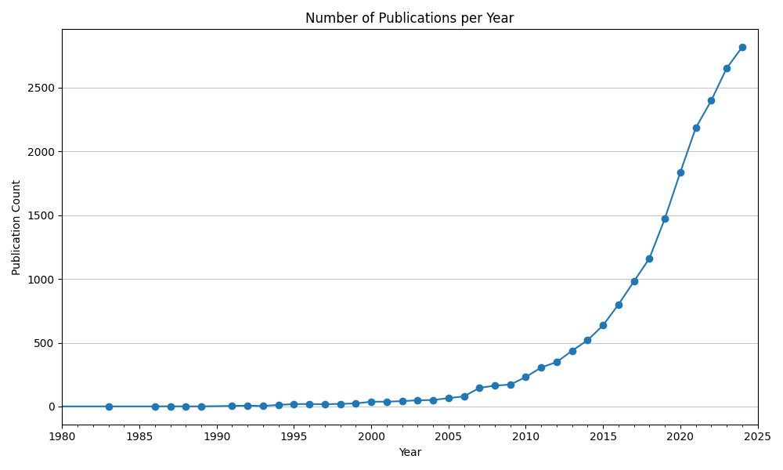
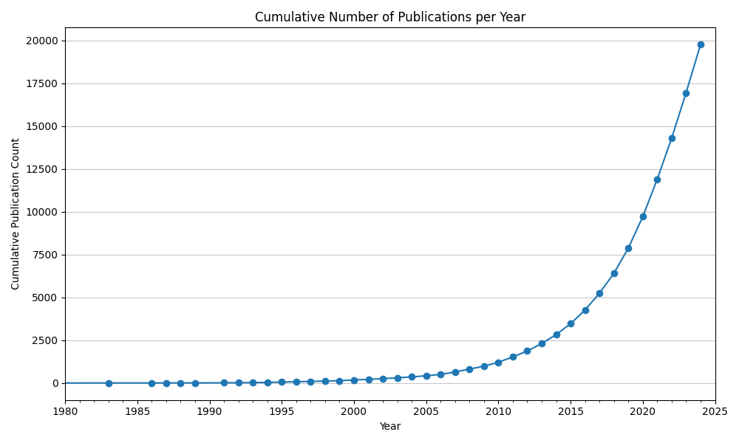
Total number of publications regarding self-healing materials is growing fast
Publications per year double roughly every 5 years
Total number of publications grows roughly quadratically

Slide 4
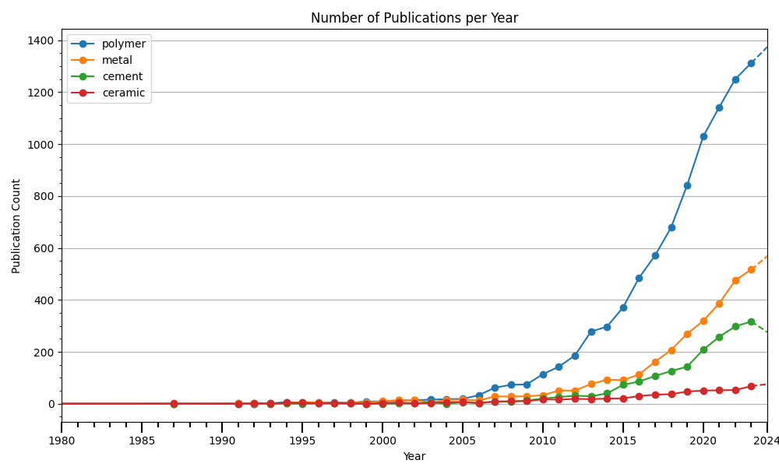
Polymers are the most researched material regarding self healing properties
The most amount of research is done regarding self-healing polymer materials
Yearly Number of Publications is generally rising for all material types.
AND TS=("material*" OR "polymer*" OR "composite*" OR "ceramic*" OR "metal*" OR "alloy*" OR "cement*" OR "concrete*“)

Slide 5
Polymers are the most researched material regarding self healing properties
The most amount of research is done regarding self-healing polymer materials
Yearly Number of Publications is generally rising for all material types.
AND TS=("material*" OR "polymer*" OR "composite*" OR "ceramic*" OR "metal*" OR "alloy*" OR "cement*" OR "concrete*“)

Slide 6
Polymers are the most researched material regarding self healing properties
The most amount of research is done regarding self-healing polymer materials
Yearly Number of Publications is generally rising for all material types.
AND TS=("material*" OR "polymer*" OR "composite*" OR "ceramic*" OR "metal*" OR "alloy*" OR "cement*" OR "concrete*“)

Slide 7
Polymers are the most researched material regarding self healing properties
The most amount of research is done regarding self-healing polymer materials
Yearly Number of Publications is generally rising for all material types.
AND TS=("material*" OR "polymer*" OR "composite*" OR "ceramic*" OR "metal*" OR "alloy*" OR "cement*" OR "concrete*“)

Slide 8
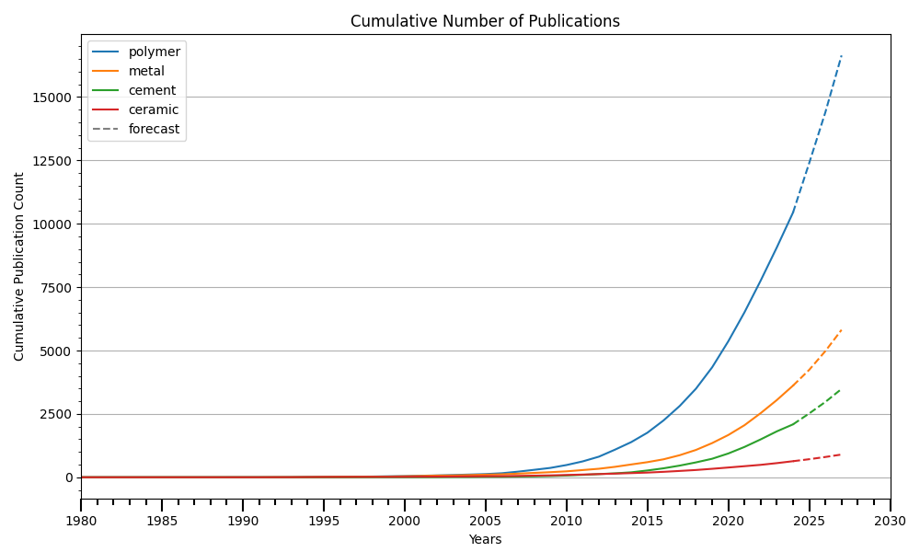
Number of annual publications expected to further grow
Total Number of Publications is growing approximately quadratically at the current time
We can use the given data to roughly forecast the number of publications for the next years
Research for metal and cement was done equally much up to 2020. Since then there was more research regarding metals

Slide 9
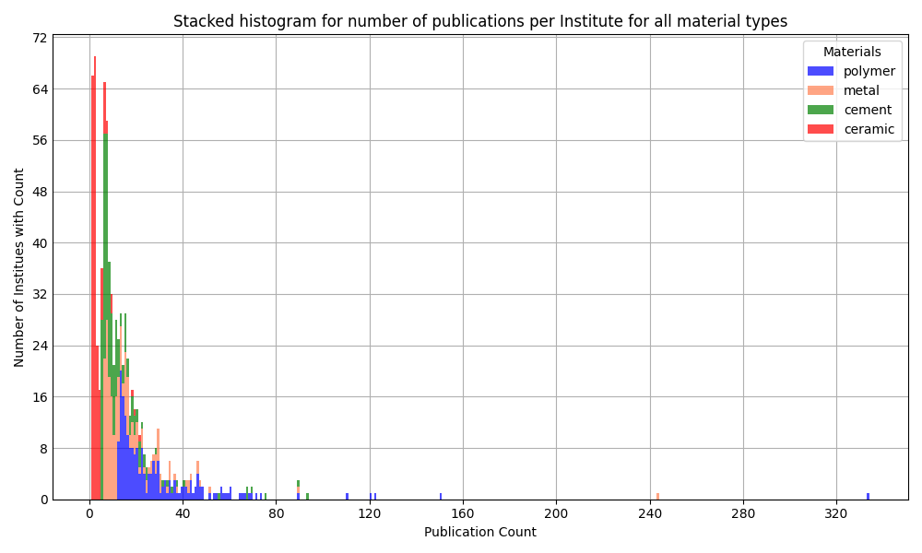
Analysis of affiliations
The majority of institutes have an affiliation with less than 25 published papers
The institute with the most affiliations has more than 300 papers that are affiliated with their institute
All institutes that research polymers have published more than 10 papers on the topic already
Look at top institutes for polymers on next slide

Slide 10
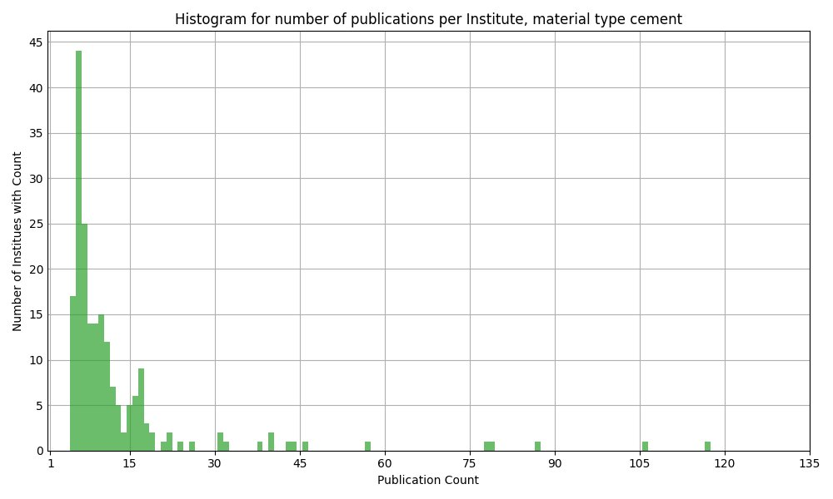
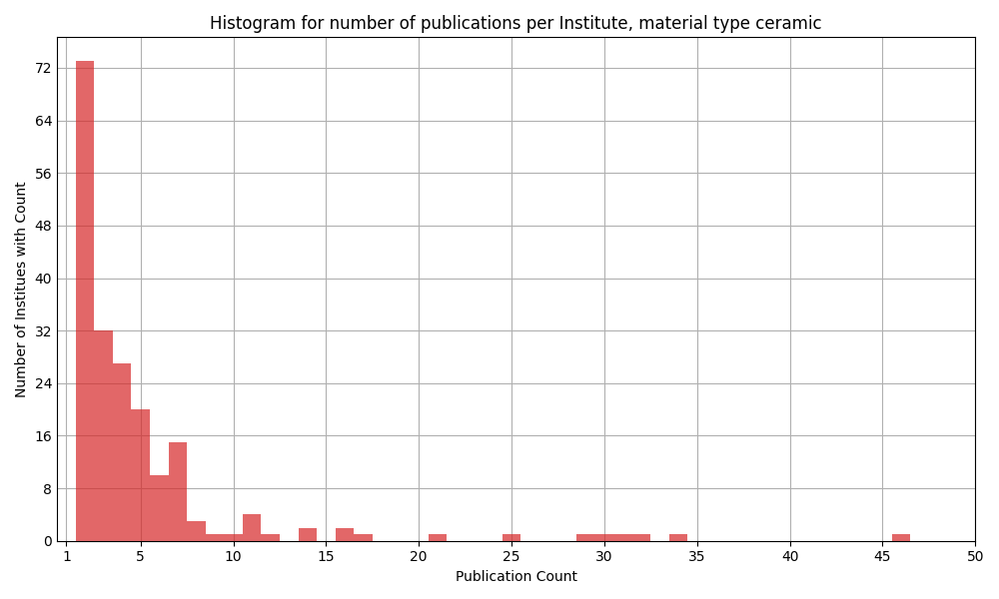
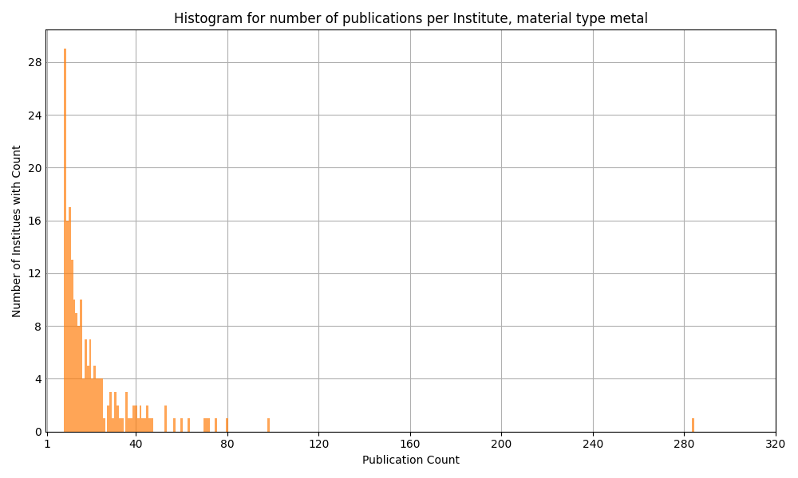
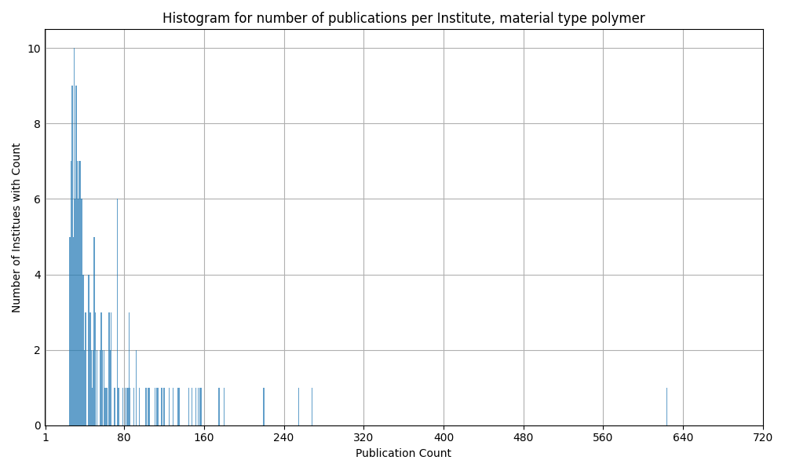

Slide 11
Polymers
Detailed Analysis

Slide 12
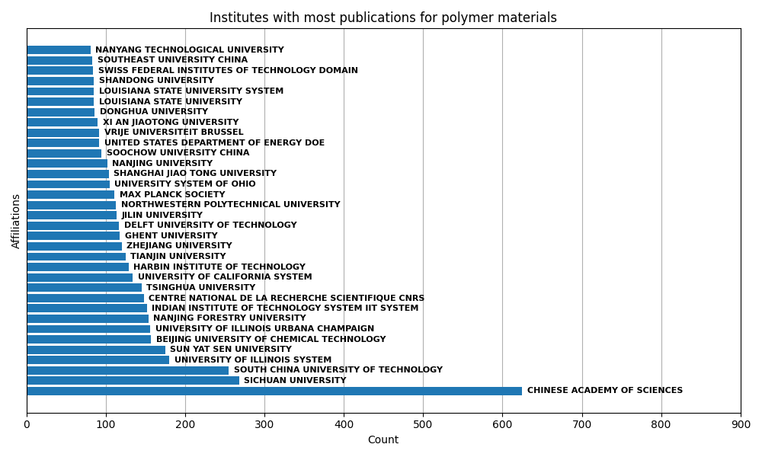
Institutes with most publications affiliated to them regarding polymer materials
The institute with the most affiliations has more than twice the amount of affiliations as the institute with the second most affiliations
Most institutes are located in China
The Chinese Academy of Sciences (CAS) is listed under three different names, possibly to different translations to English:
Chinese Academy of Sciences
University of Chinese Academy of Sciences CAS
University of Science Technology of China CAS

Slide 13
Institutes with most publications affiliated to them regarding polymer materials
Chinese Academy of Science is a research organization, while others are university branches situated in Beijing and Hefei respectively
Publications mentioned under variations of CAS are all included in “Chinese Academy of Sciences” → others have thus been omitted

Slide 14
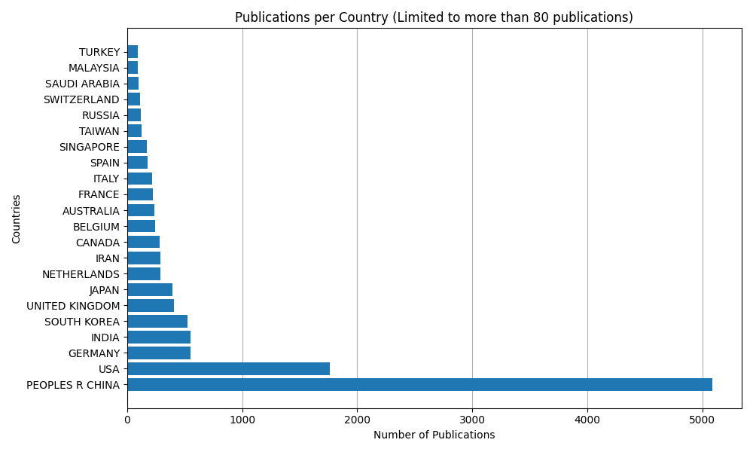
Countries with most publications affiliated to them regarding polymer materials
Most papers are published with affiliations to China or USA

Slide 15
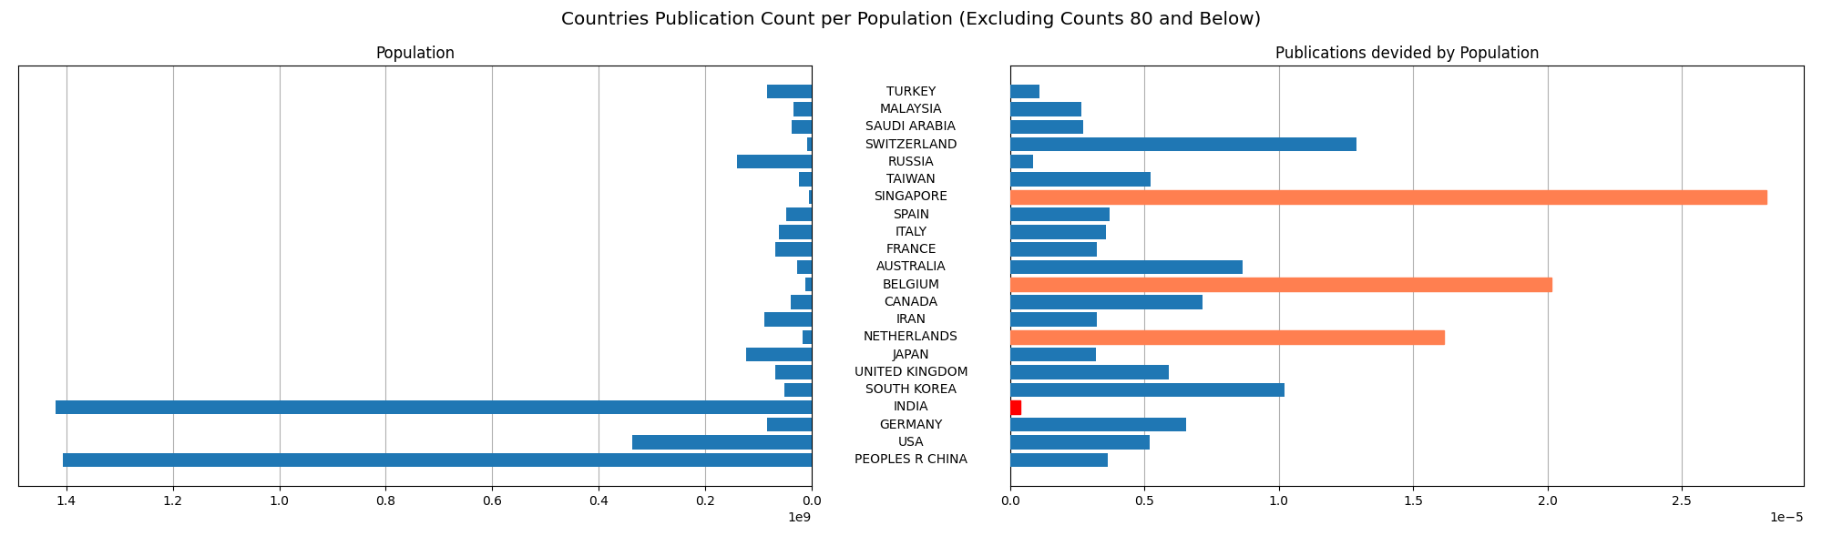
Countries with most publications affiliated to them regarding polymer materials, scaled by population
When compared to their population, Singapore and Belgium and the Netherlands have the most publications affiliated to them
Population data taken from www.census.gov in January 2025

Slide 16
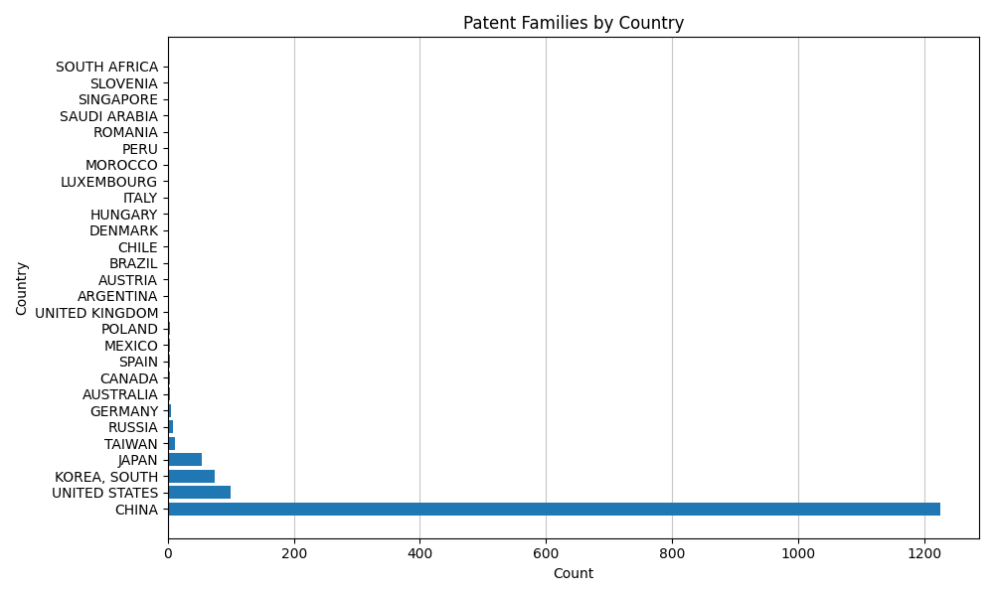
Espacenet Data: Patent families
China leads globally, with the highest patent activity in self-healing materials, driven by strong innovation efforts.
USA, South Korea, and Japan follow as key contributors, but far behind China.
Europe lags, with limited patent activity, suggesting a focus on other priorities or academic research.
Strategic focus on China is crucial to track emerging trends and opportunities in this field.

Slide 17
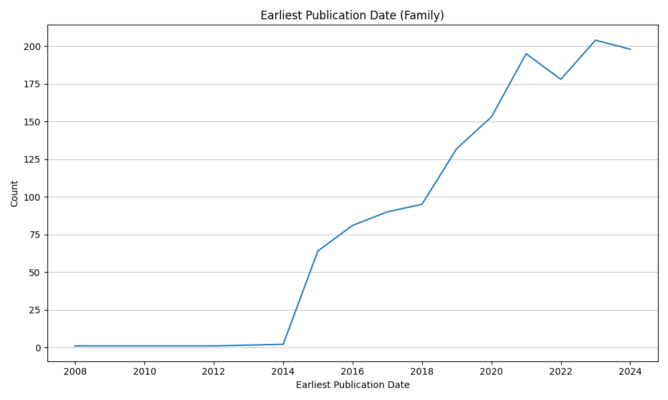
Espacenet
Data before 2015 shown likely due to the earliest publication being before 2015, while current publication of the corresponding patent is from 2015 onward

Slide 18
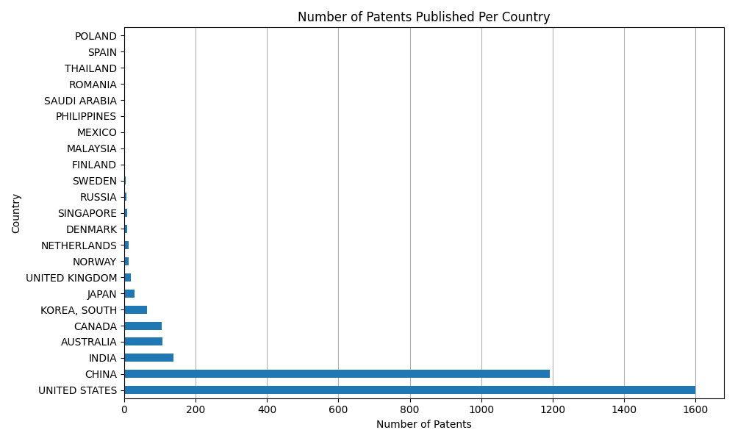
WIPO
WIPO additionally manages the rights to 605 international patents (not shown in graph)
Unlike Espacenet, WIPO is dominated by the USA
India, Australia and Canada have a much higher number of patents published compared to Espacenet

Slide 19
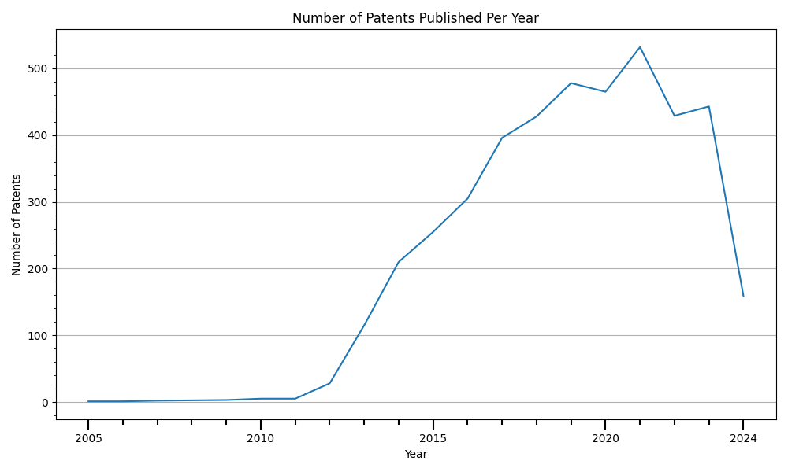
WIPO
Visible decline from 2021 onwards
Given the dominance of the USA in WIPO, the decline is likely in large part due to a declining number of patents published in that area
Possible links to the Ukraine-Russia conflict that emerged in early 2022 and the economic regression that followed in many Western countries

Slide 20
Summary

