Slide 1
Data Driven Foresight
Topic: Self-Healing Materials
Presentation by Liang, Puntigam, Yousofi

Slide 2
Web of Science Search String
Self heal* | AND | Material* | NOT | Biology
Self repair* |  | Polymer* |  | Biological system*
Autonom* repair* |  | Composite* |  | Organic material*
Autonom* heal* |  | Ceramic* |  | Wound heal*
 |  | Metal* |  | Medic*
 |  | Alloy* |  | Healthcare
 |  | Cement* |  | Spirit*
 |  | Concrete*
OR
TS=("self heal*" OR "self repair*" OR "autonom* repair*" OR "autonom* heal*")
AND TS=("material*" OR "polymer*" OR "composite*" OR "ceramic*" OR "metal*" OR "alloy*" OR "cement*" OR "concrete*")
NOT TS=("biology" OR "biological system*" OR "organic material*" OR "wound heal*" OR "medic*" OR "healthcare" OR "spirit*")

Slide 3
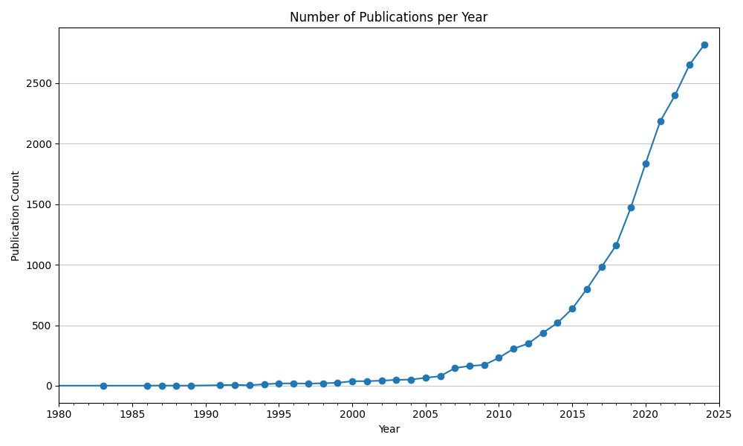
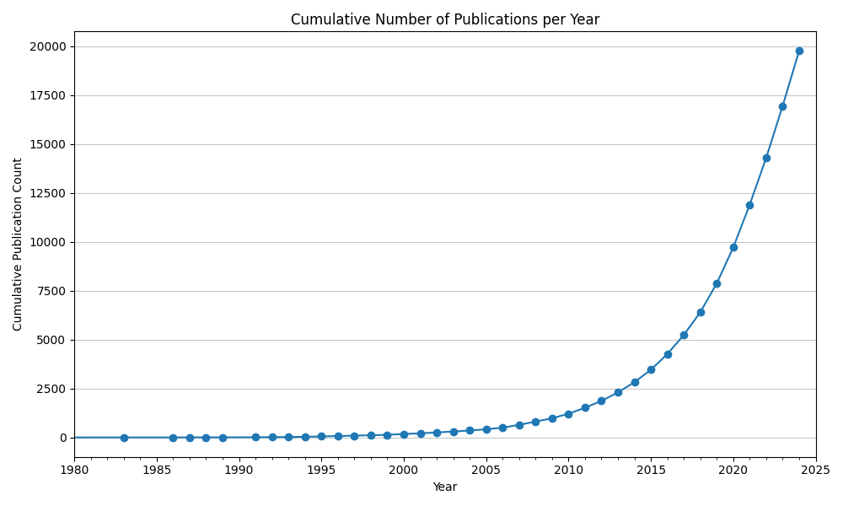
The total number of publications regarding self-healing materials is growing fast
Publications per year roughly double every five years
Total number of publications is increasing at an approximately quadratic rate.

Slide 4
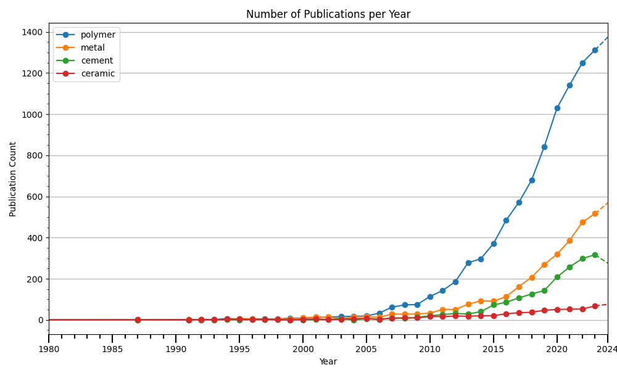
Polymers are the most researched material regarding self- healing properties
The largest amount of research focuses on self-healing polymer materials
Yearly number of publications is generally rising across all material types
AND TS=("material*" OR "polymer*" OR "composite*" OR "ceramic*" OR "metal*" OR "alloy*" OR "cement*" OR "concrete*“)

Slide 5
Polymers are the most researched material regarding self- healing properties
The largest amount of research focuses on self-healing polymer materials
Yearly number of publications is generally rising across all material types
AND TS=("material*" OR "polymer*" OR "composite*" OR "ceramic*" OR "metal*" OR "alloy*" OR "cement*" OR "concrete*“)

Slide 6
Polymers are the most researched material regarding self- healing properties
The largest amount of research focuses on self-healing polymer materials
Yearly number of publications is generally rising across all material types
AND TS=("material*" OR "polymer*" OR "composite*" OR "ceramic*" OR "metal*" OR "alloy*" OR "cement*" OR "concrete*“)

Slide 7
Polymers are the most researched material regarding self- healing properties
The largest amount of research focuses on self-healing polymer materials
Yearly number of publications is generally rising across all material types
AND TS=("material*" OR "polymer*" OR "composite*" OR "ceramic*" OR "metal*" OR "alloy*" OR "cement*" OR "concrete*“)

Slide 8
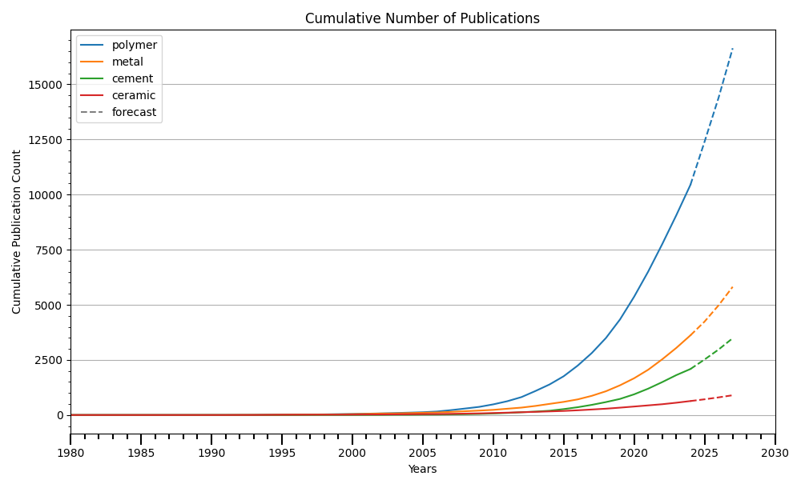
Number of annual publications expected to further grow
Total number of publications is currently growing at an approximately quadratic rate
Using the given data, we can roughly forecast the number of publications for the coming years
Research on metals and cement was comparable up to 2020. Since then, more research has focused on metals

Slide 9
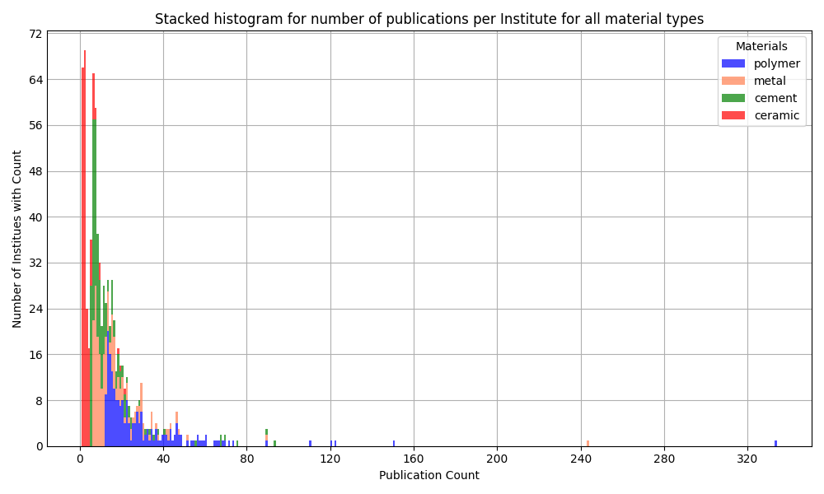
Analysis of affiliations
The majority of institutes have fewer than 25 published papers affiliated with them
The institute with the highest number of affiliations has more than 300 papers linked to it
All institutes researching polymers have published more than 10 papers on the topic
Look at top institutes for polymer research on the next slides

Slide 10
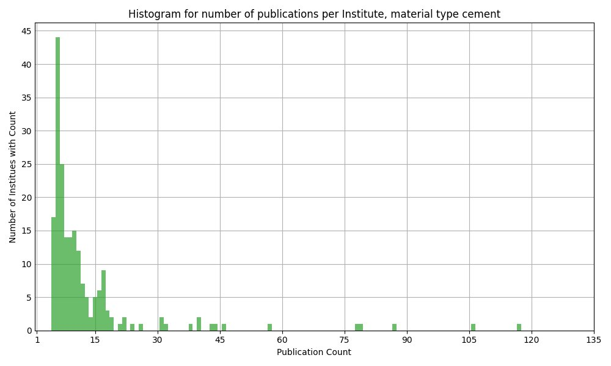
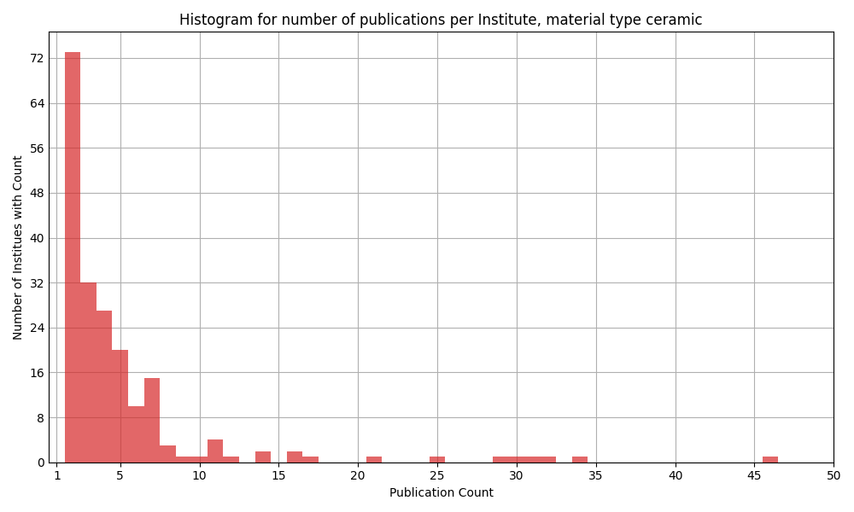
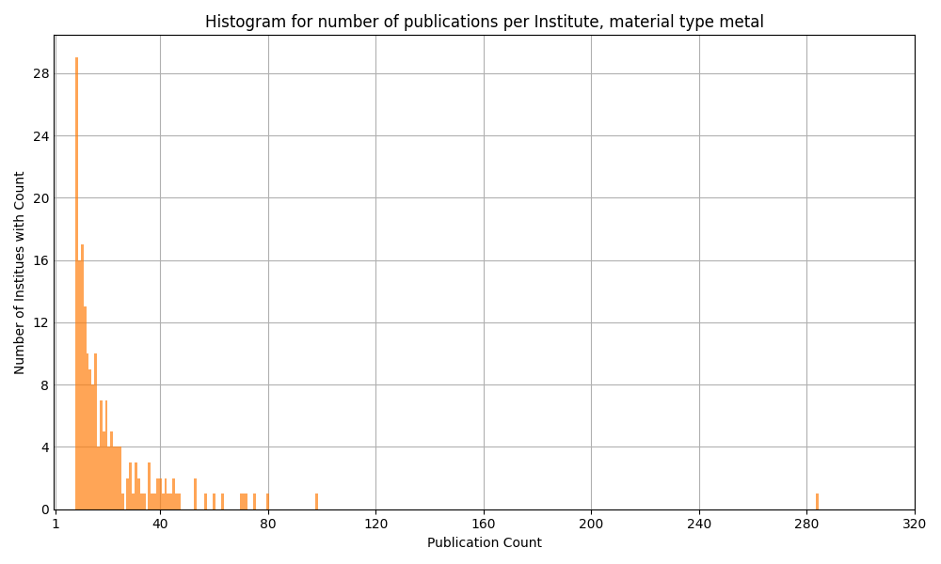
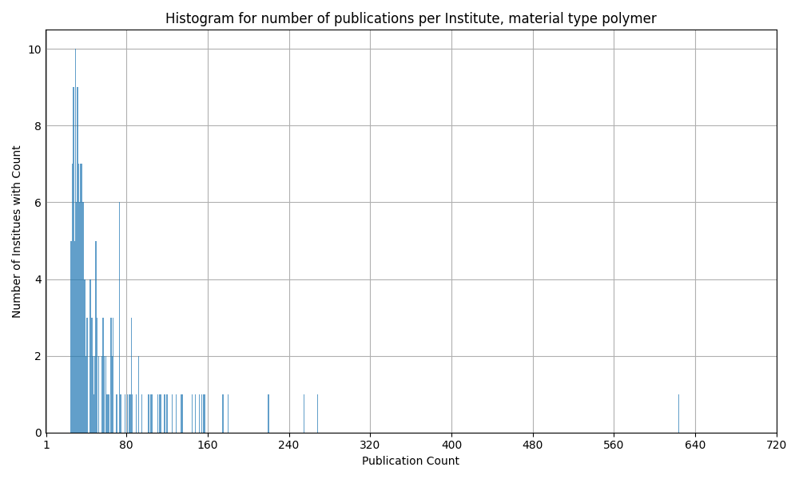

Slide 11
Ggf. Zusammenfassung Publikationsdynamik
Statt einzelne Stichpunkte

Slide 12
Polymers
Detailed Analysis

Slide 13
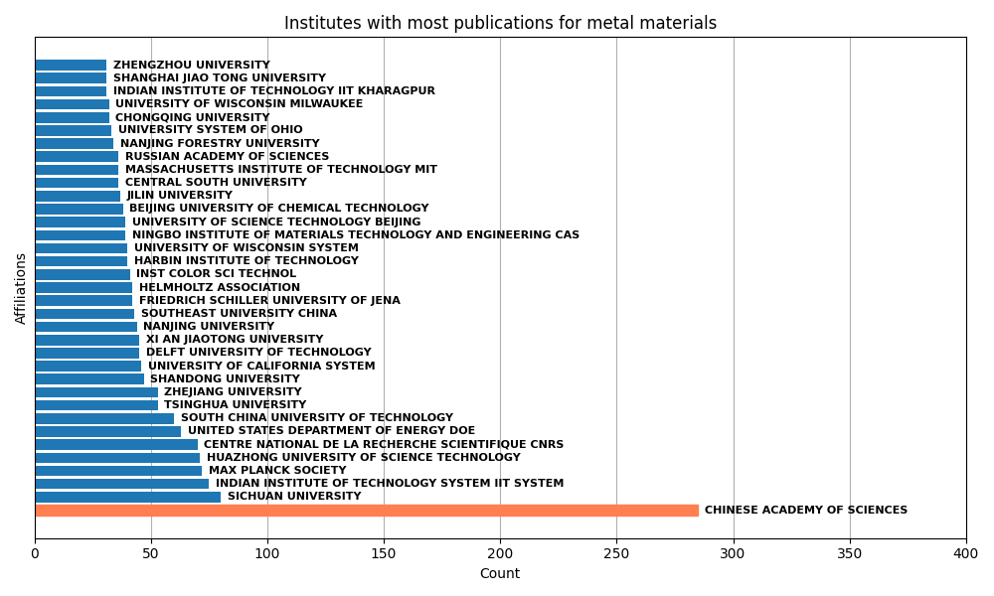
Institutes with most publications affiliated to them regarding polymer materials
The institute with the most affiliations has more than twice the number of affiliations as the institute with the second-highest number
Most institutes are located in China
The Chinese Academy of Sciences (CAS) appears under three different names, possibly due to translation variations:
Chinese Academy of Sciences
University of Chinese Academy of Sciences CAS
University of Science Technology of China CAS

Slide 14
Institutes with most publications affiliated to them regarding polymer materials
Chinese Academy of Science is a research organization, while others are university branches situated in Beijing and Hefei respectively
Publications attributed to variations of CAS have been consolidated under “Chinese Academy of Sciences” → others have thus been omitted

Slide 15
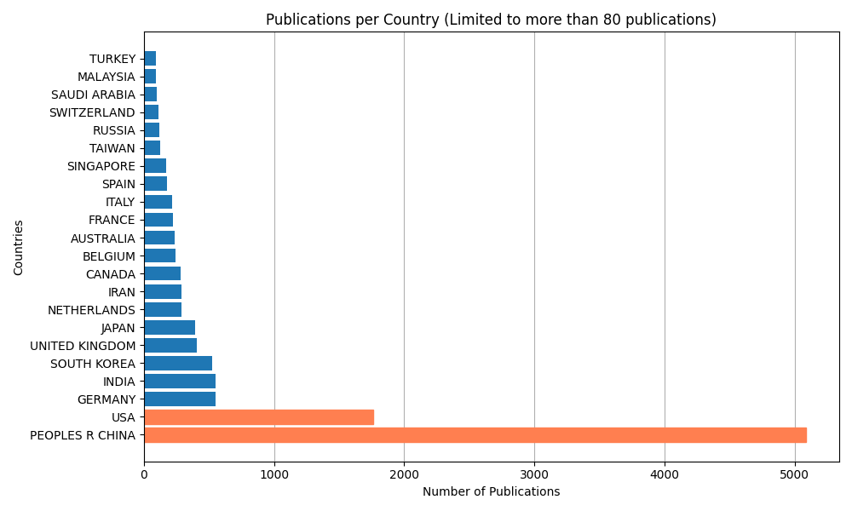
Countries with most publications affiliated to them regarding polymer materials
Most papers are affiliated with institutions in China and the USA

Slide 16
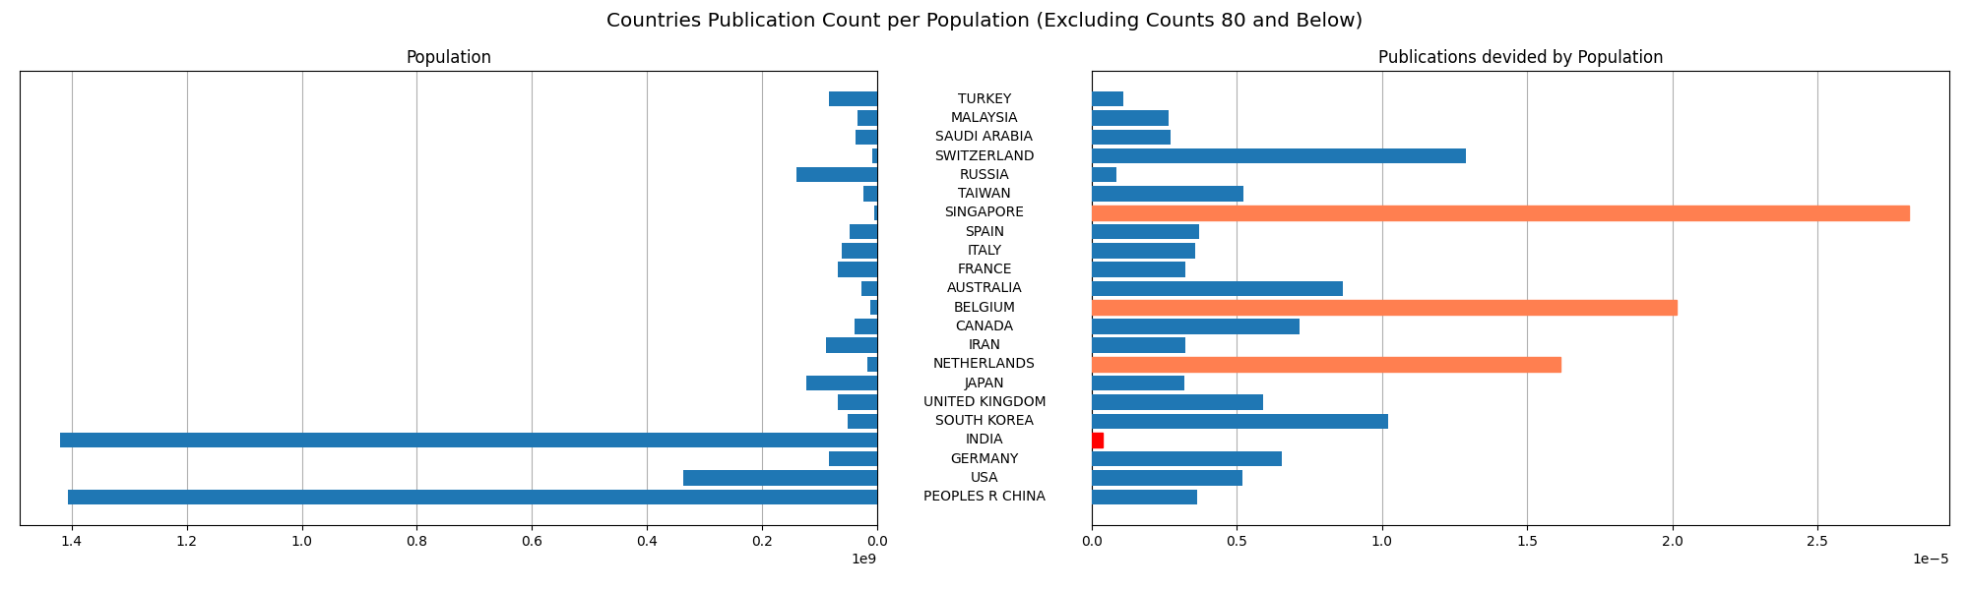
Countries with most publications affiliated to them regarding polymer materials, scaled by population
When adjusted for population size, Singapore, Belgium, and the Netherlands have the highest number of publications affiliated to them
Population data is sourced from www.census.gov (January 2025)

Slide 17
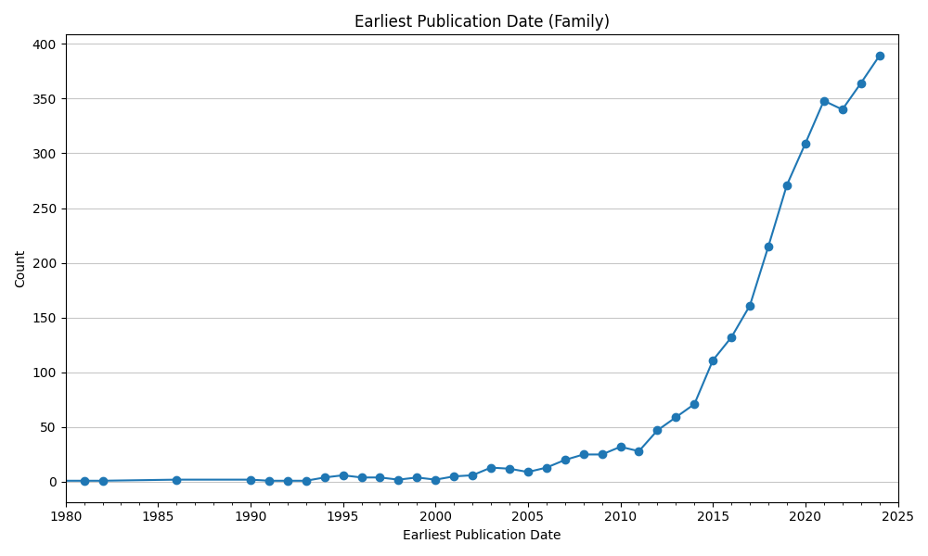
Espacenet data:
Exponential growth in patent activity
Noticable increase in activity began in 2005
Exponential growth from 2014 onward
Small drop occurred in 2022 in an otherwise steep upward trajectory → likely due to COVID-19

Slide 18
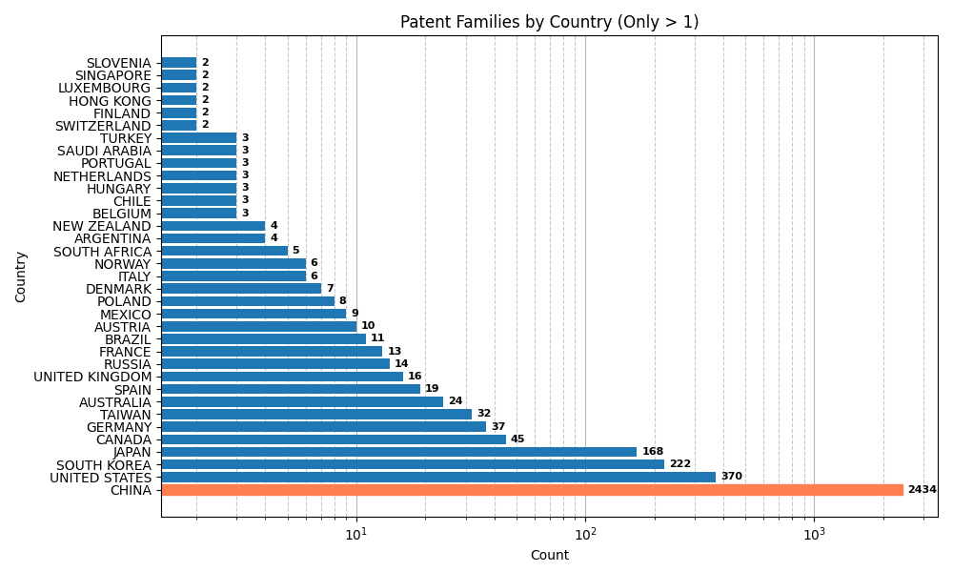
China dominates patent activity in self-healing materials - strategic focus is needed
China leads globally, with the highest patent activity in self-healing materials, driven by strong innovation efforts
USA, South Korea, and Japan follow as key contributors, but far behind China
Europe lags, with limited patent activity, suggesting a focus on other priorities or academic research
Strategic focus on China is crucial to track emerging trends and opportunities in this field

Slide 19
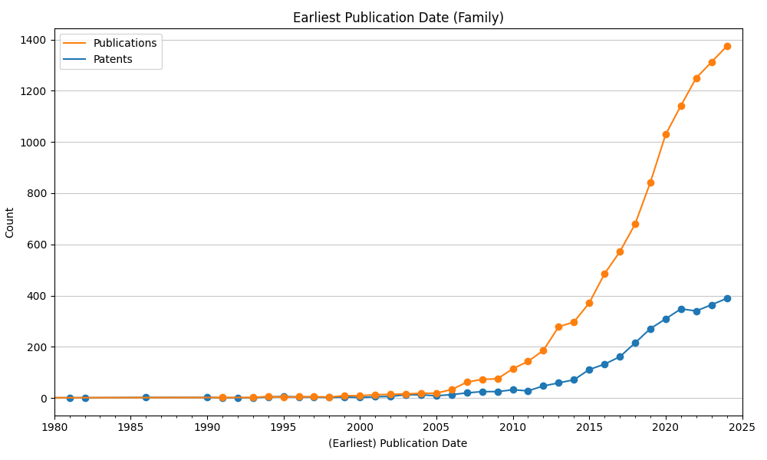
Publications outpacing patents - continued growth expected
Starting from 2013 the number of publications dominate the number of patents significantly
Research largely unaffected by COVID
Number of patents is expected to follow the upward trajectory in the coming years

Slide 20
Summary
Summary fehlt
The number of annual publications is expected to grow further
The total number of publications shows a roughly quadratic growth pattern
Research efforts are concentrated on polymers, with China and the USA leading globally
Patent activity, particularly in China, highlights the strategic importance of this region

