Slide 1

Full Stack Web GIS Project CINEMAP
Aybüke Küçük

Slide 2
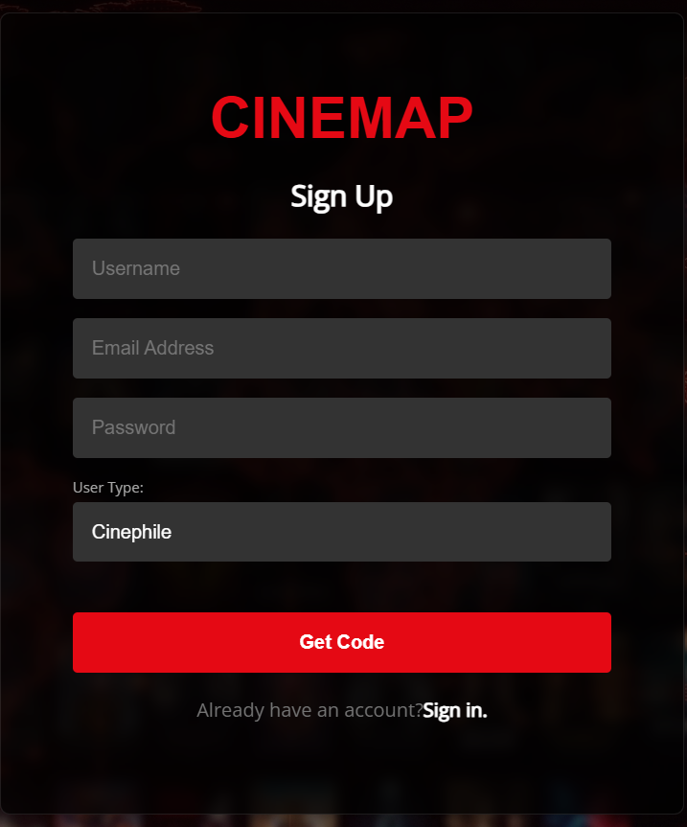
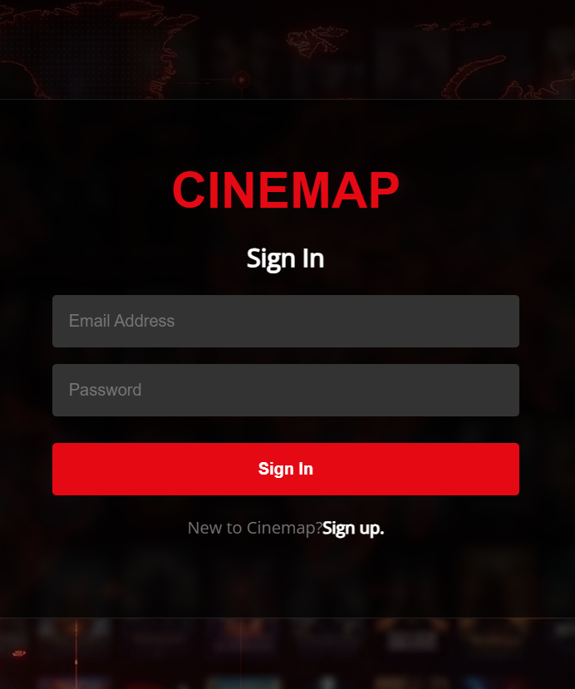
Login Page

Slide 3
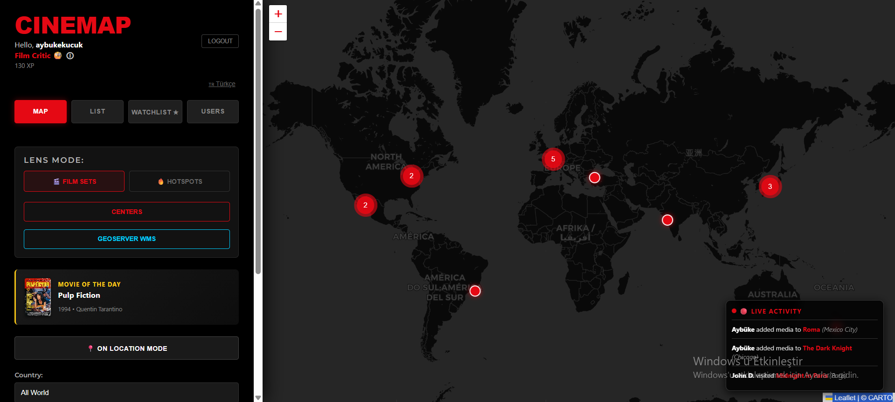
CineMap Project

Slide 4
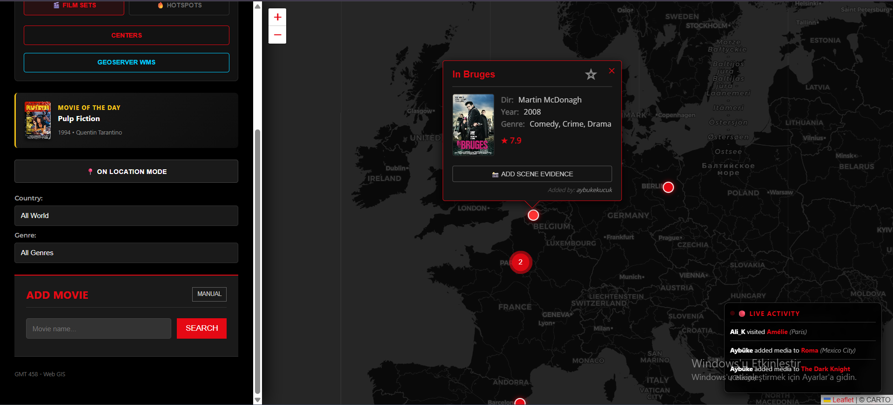
CineMap Project

Slide 5
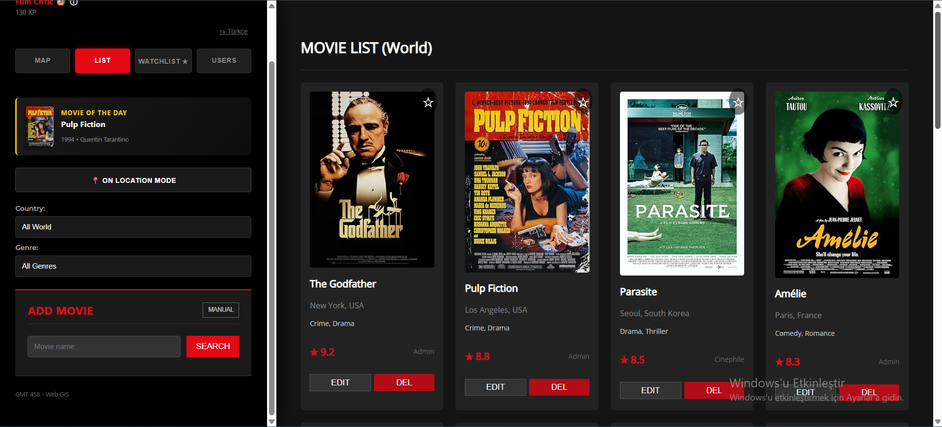
Movie List

Slide 6
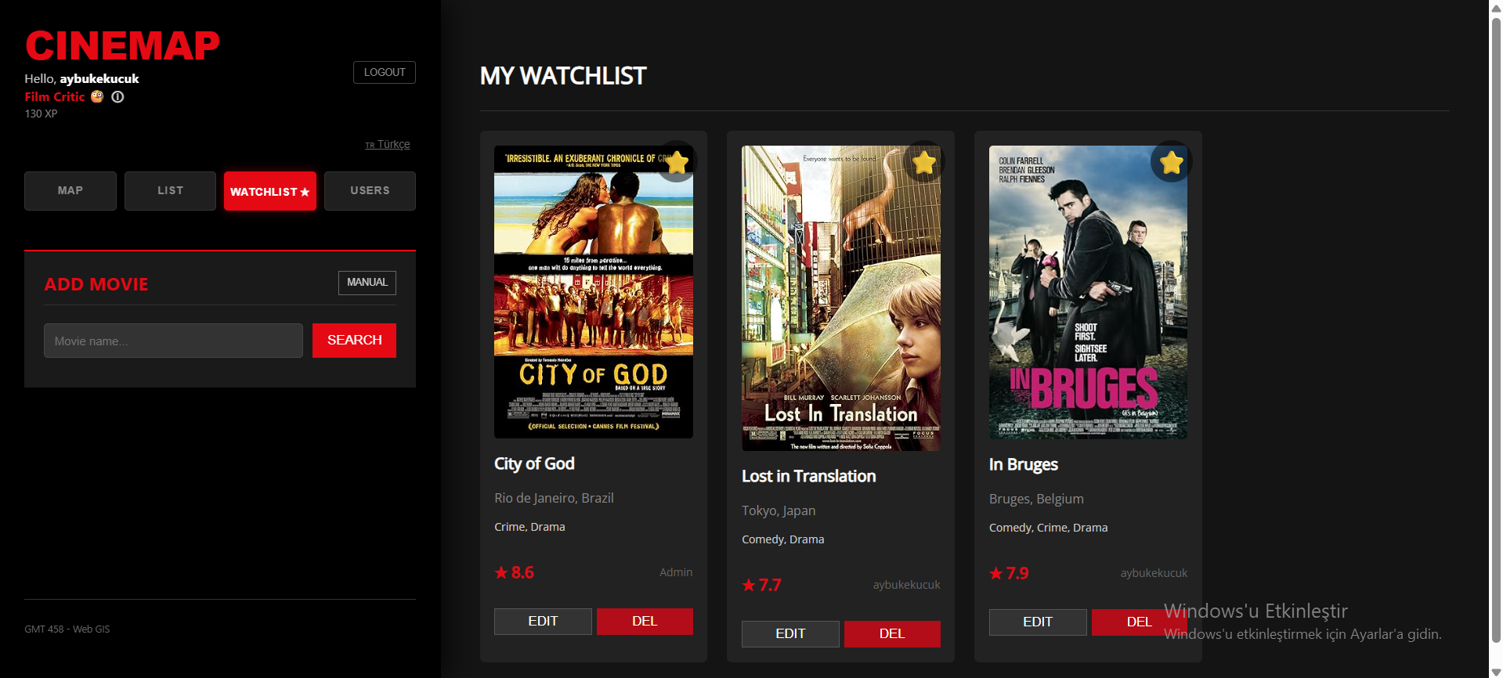
Watchlist

Slide 7

User Experience

Slide 8
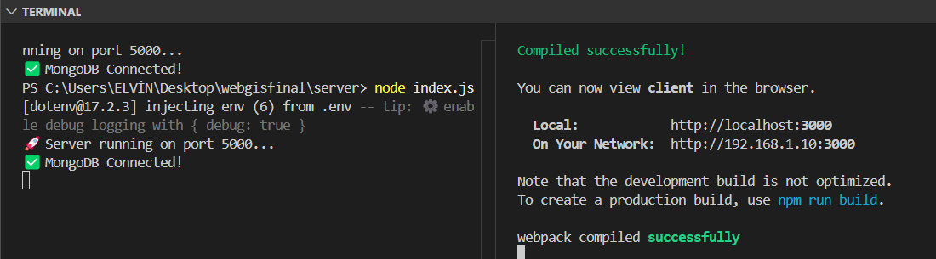
Database

Slide 9
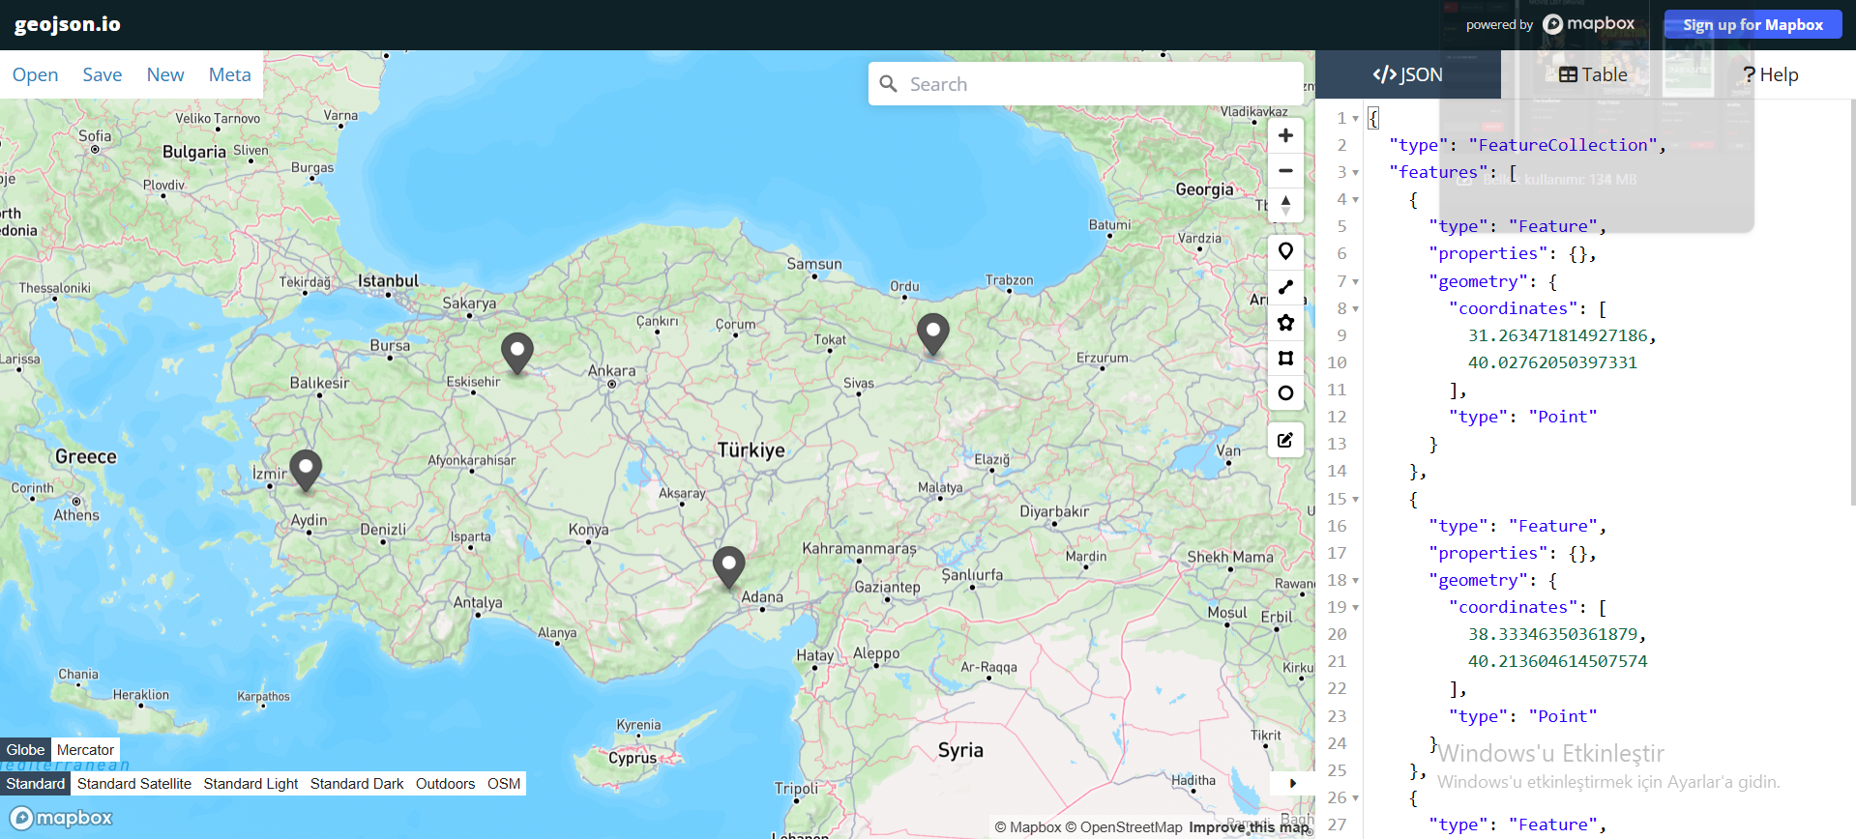
GeoJSON

Slide 10
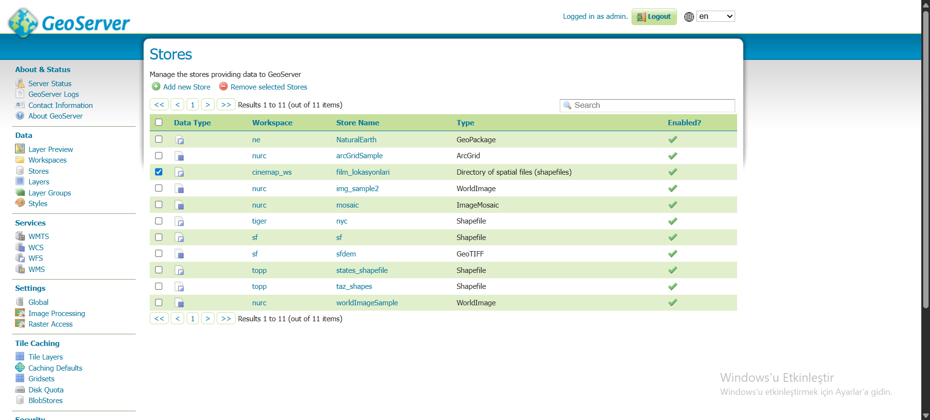
GeoServer

Slide 11
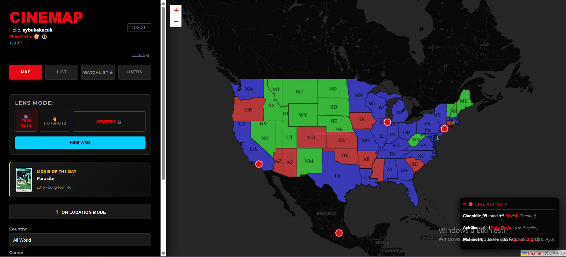
WMS

Slide 12
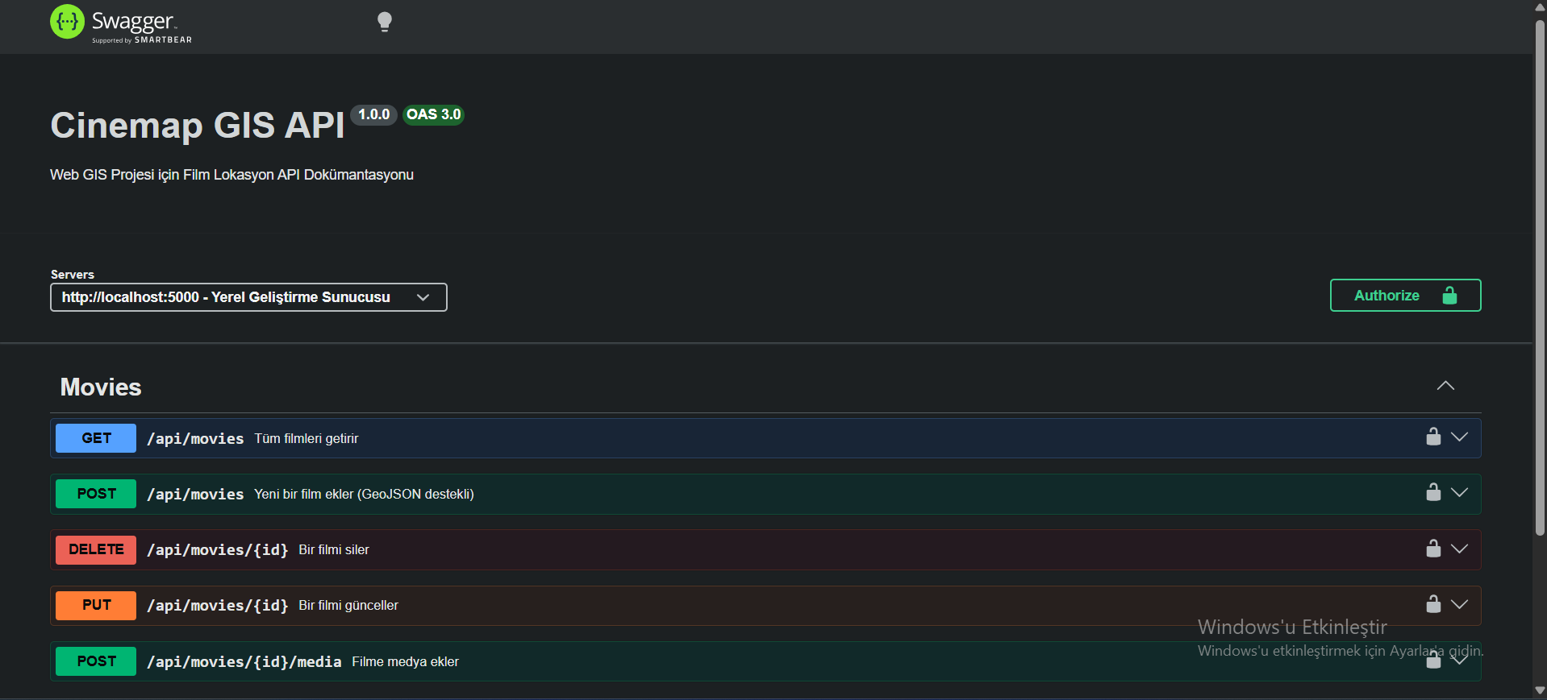
Swagger Documentation

Slide 13
WMS

Slide 14
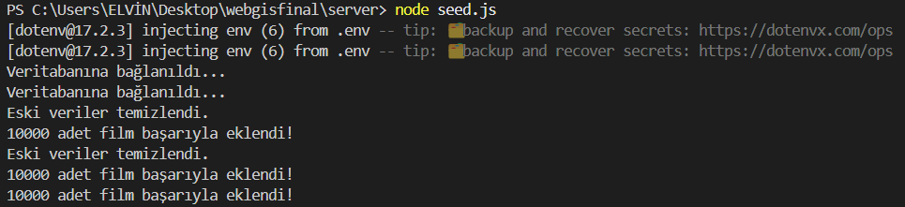
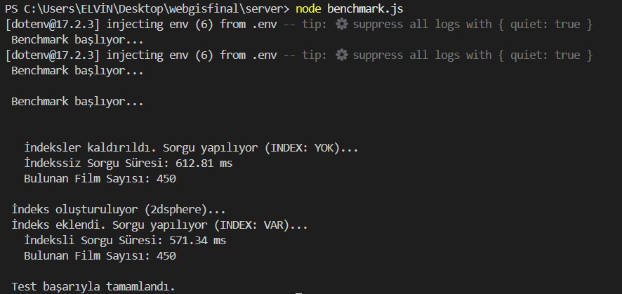
Tests

Slide 15
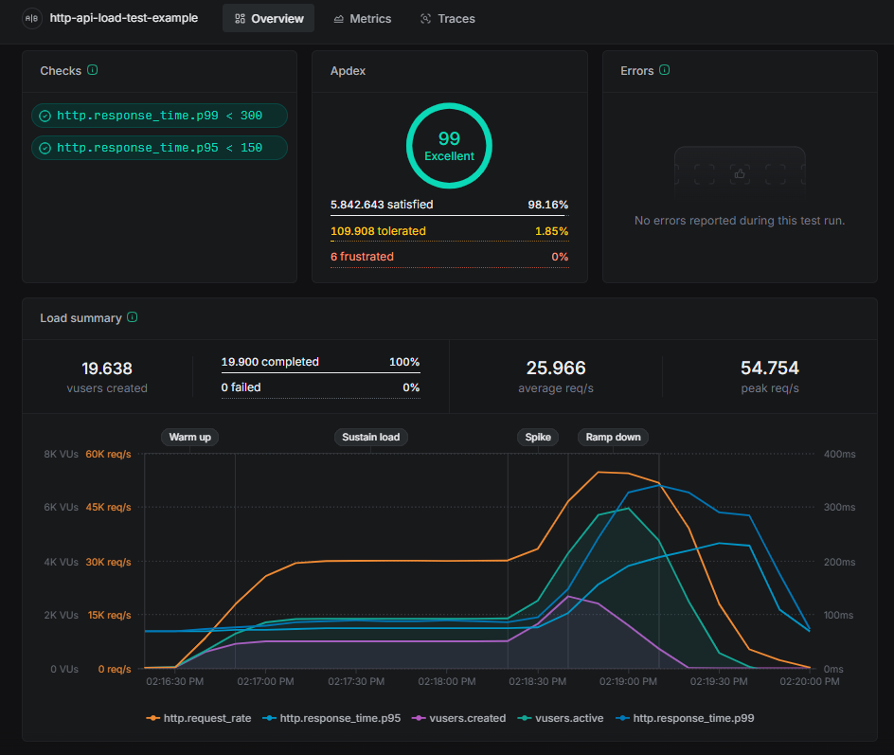
Tests

Slide 16

Thank You For Listening!

