Slide 1
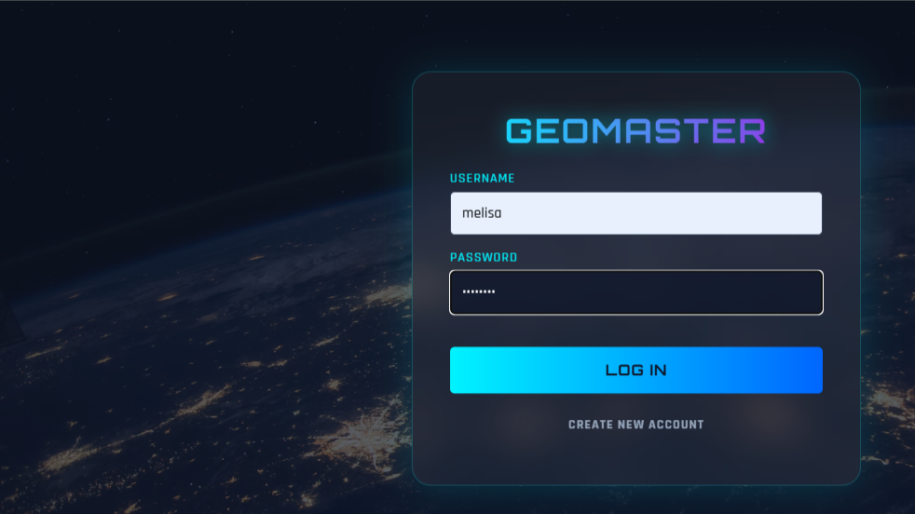
GeoMaster: Full-Stack Web GIS Application
2200674029 Melisa BURGU
–
GMT 458 Final Project

Slide 2
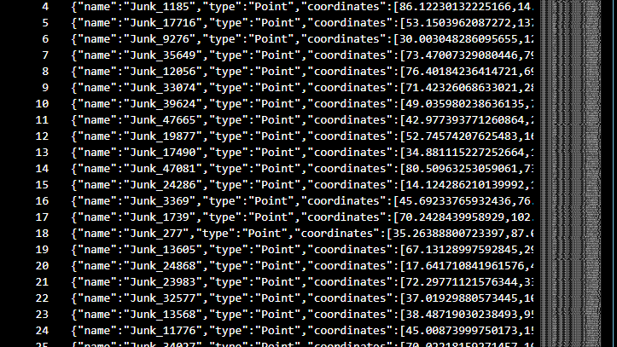
System Architecture & Tech Stack
Frontend: HTML5, CSS3, Leaflet.js
Backend: Node.js, Express.js (REST API)
Database: NoSQL (NeDB) - GeoJSON Storage

Slide 3
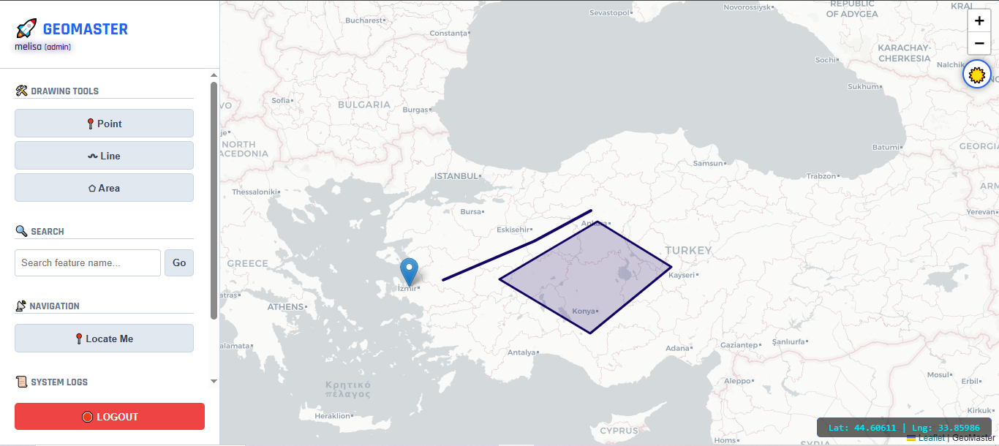
Interactive Map Interface & Filtering
Dynamic Filtering (Date & Attributes)
GeoJSON Visualization
User-Friendly Side Panel

Slide 4
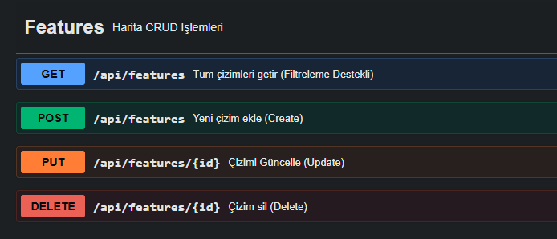
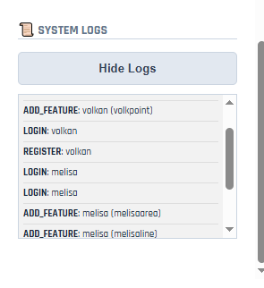
Backend Logic & CRUD Operations
Create, Read, Update, Delete (CRUD)
RESTful API Architecture
Spatial Data Validation

Slide 5
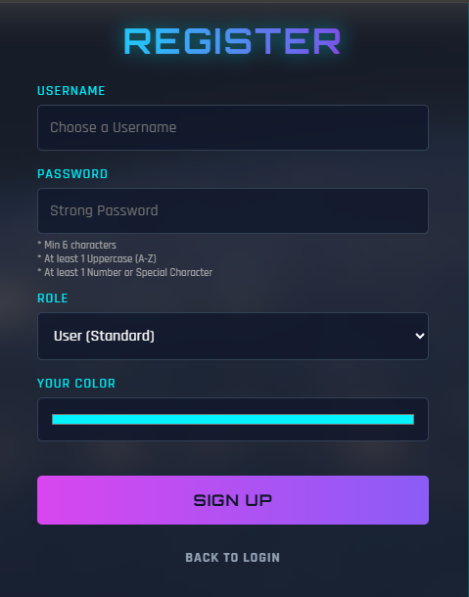
Security & Authentication
Authentication: JWT (JSON Web Token)
Security: Bcrypt (Password Hashing)
Protection: Secure Routes

Slide 6
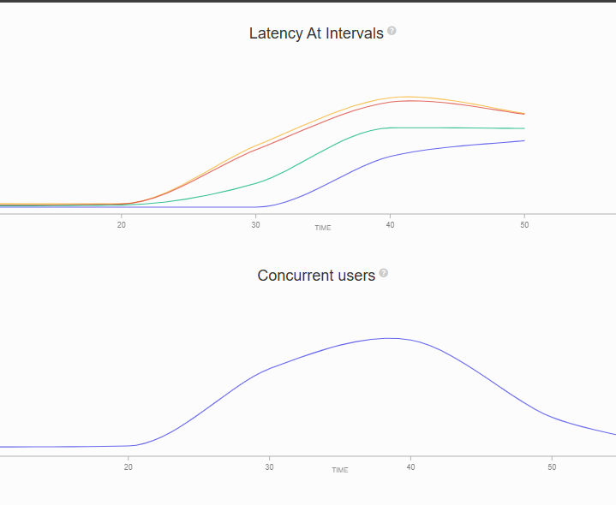
Performance Testing & Live Deployment
Optimization: Spatial Indexing (38ms ➔ 0.5ms)
Testing: Artillery Load Testing
Deployment: LocalTunnel (Live Access)

Slide 7
Thank You!
Melisa Burgu
GitHub: https://github.com/GMT-458-Web-GIS/full-stack-web-gis-melisaburgu

