Slide 1
The Minority Report
Members: Christopher Yi, Jim Banya, Shafiullah Hashimi, and Rohit Barua

Slide 2
Background & Motivation
All four of us are minority soon-to-be CS graduates who will soon be seeking employment in a very competitive job market
Race issues are coming to a forefront in a deeply charged socioeconomic climate
Our concerns over our job search must include more uncomfortable questions in light of this
Can discrimination still pose a hurdle before and during employment?

Slide 3
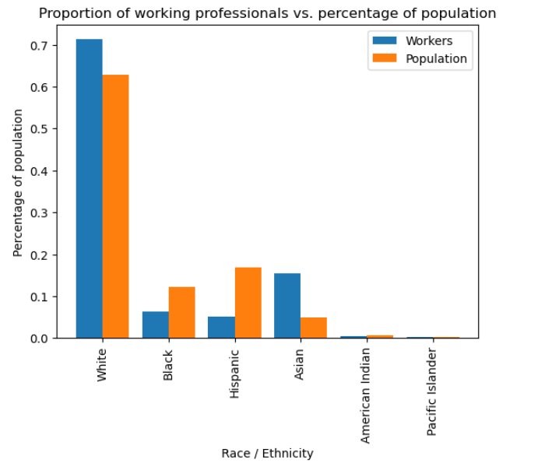

Slide 4
Challenges
Gathering appropriate sources with an ample number of samples but also an appreciable amount of relative features
Interpreting the different data sets the group members mined independently
Actually solving the “problem” proved to be a mystery

Slide 5

Method (Chris)
Christopher chose to examine two data sets
The first was through the lens of the K-nearest neighbors algorithm
$$\hat{y}=f\left(x\right)=y_{nn}\left(x\right)$$
$$nn\left(x\right)=argmin_{n=1,…,N}{\left|\left|x−x_{n}\right|\right|}_{2}^{2}=argmin_{n=1,…,N}\sum_{d=1}^{D}{{\left(x_{d}−x_{nd}\right)}^{2}}$$
Attempt to sort individuals into buckets with regards to their race using distance between numerical inputs

Slide 6

Method (Chris)
The second dataset was used to build linear regression models
$$f\left(x\right)=w_{0}+\sum_{d=1}^{D}{w_{d}}x_{d}=w^{T}x$$
Attempt to see if generated weights indicate a form of bias (i.e. identifying characteristics like gender or race are weighted higher than experience / performance) in determining some resultant label like salary / compensation
Evaluated through minimizing residual sum of squares, or RSS
$$RSS\left(w\right)={\left(y−Xw\right)}^{T}\left(y−Xw\right)$$
$$w^{∗}=argmin_{w}RSS\left(w\right)$$

Slide 7

Experiment (Chris)
The initial dataset did indeed yield very poor results when attempting to sort employees into “race” buckets through KNN (in this case, 2-NN)
However, explanatory power of this dataset is weak
It is simulated data and of extremely small size
Meant more as a proof of concept before the second data set

Slide 8
Experiment (chris)
The second data set of much larger, real data yielded better results
Built two multiple linear regression models
Each used separate data frames preprocessed separately with regards to gender and race
Before building the models, simple scatterplots created to see if any correlations could be detected visually

Slide 9
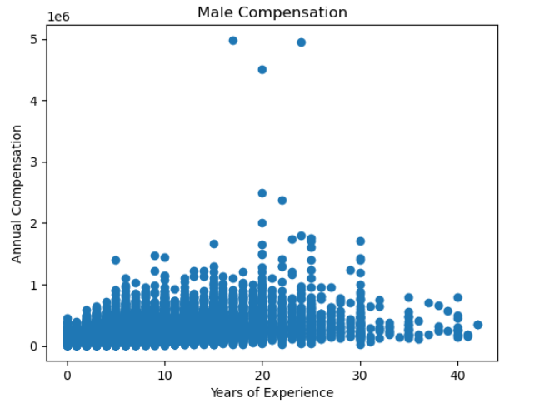
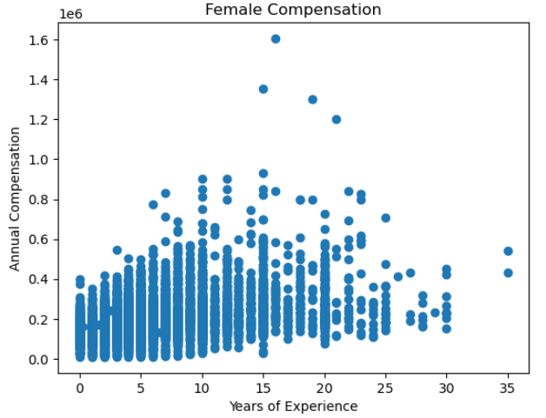

Slide 10
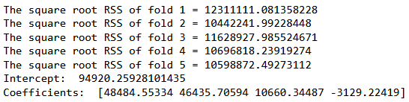
Experiment (chris)
Over several runs, weights indicated that males did indeed earn more on average than women to the tune of approximately $5000 if all other variables held steady
Next, verified results by building another OLS model through statsmodel API

Slide 11
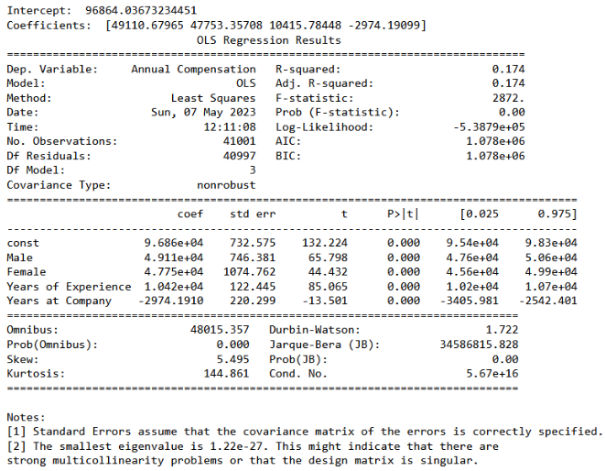

Slide 12
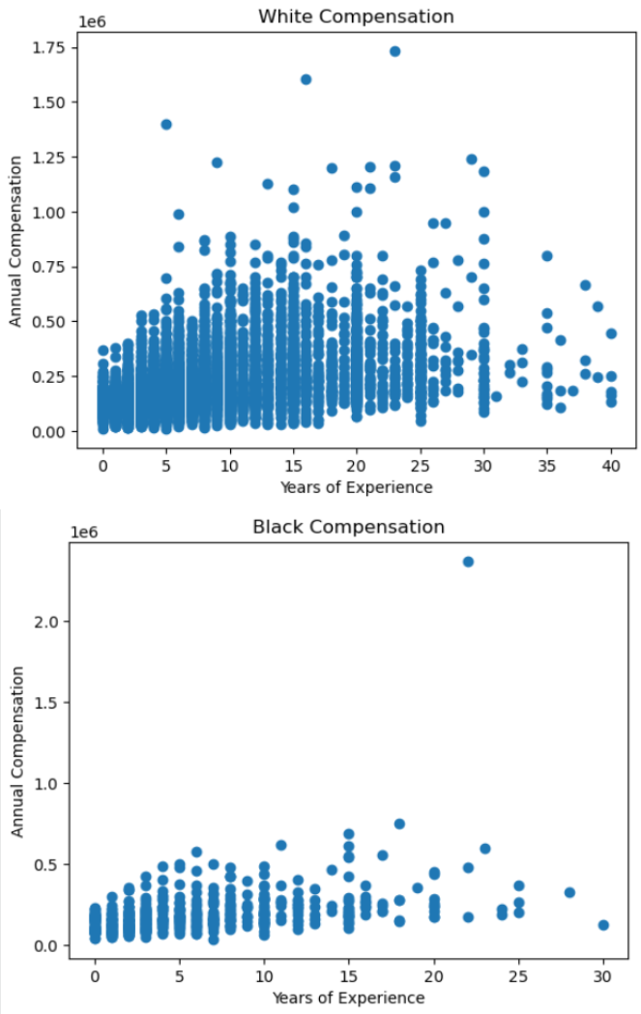
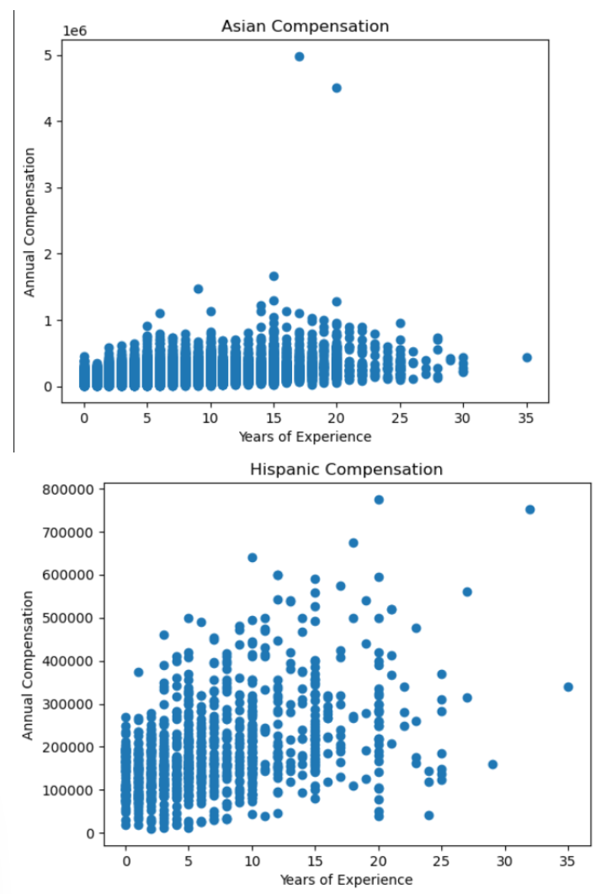

Slide 13
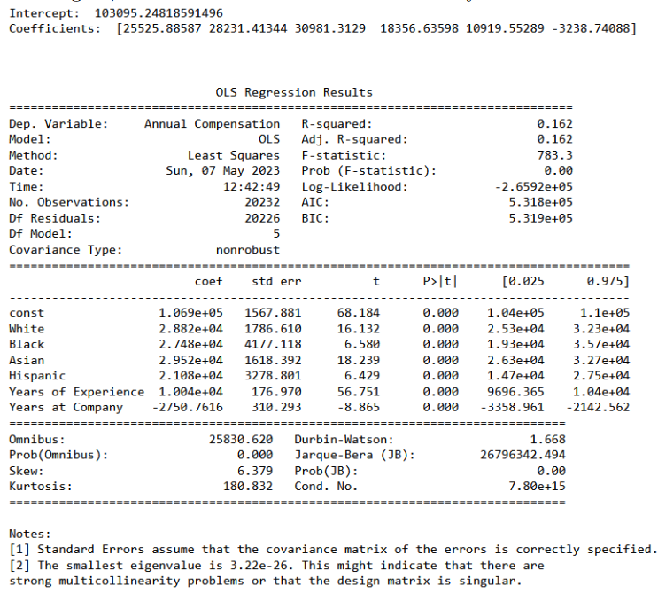

Slide 14
Preliminary Conclusions
There does seem to be some form of gender based pay gap that causes average compensation of female employees to lag behind their male counterparts of similar experience
This data is flawed since a significant number of responses that did not affirm a gender identity or racial identity were culled

Slide 15

Method (Rohit)
Rohit chose to examine one data set
Campus recruitment data set consisting of attributes such as gender, level of education, and salary
The data set was examined using the K-nearest neighbors classification
$$\hat{y}=f\left(x\right)=y_{nn}\left(x\right)$$
$$nn\left(x\right)=argmin_{n=1,…,N}{\left|\left|x−x_{n}\right|\right|}_{2}^{2}=argmin_{n=1,…,N}\sum_{d=1}^{D}{{\left(x_{d}−x_{nd}\right)}^{2}}$$
Sort buckets based on two genders, male and female using Euclidean distance between numerical inputs

Slide 16
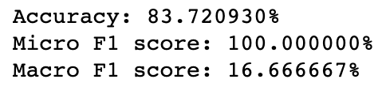
Experiment (Rohit)
The KNN classification led to interesting results (2-NN)
Although accuracy and micro f1 score hints at a possible relationship between gender and the other features
Macro f1 score also indicates that the data set is somehow imbalanced, which could be due to the sample size being small
A larger sample size may yield different results
Theoretically a great proof of concept and would be much more interesting with larger sample

Slide 17

Method(Shafiullah)
I analyzed two datasets that were related to one another
I used Linear Regression Model and KNN to determine discrepancies between male and female employment.
The data set was examined using the K-nearest neighbors classification
$$\hat{y}=f\left(x\right)=y_{nn}\left(x\right)$$
$$nn\left(x\right)=argmin_{n=1,…,N}{\left|\left|x−x_{n}\right|\right|}_{2}^{2}=argmin_{n=1,…,N}\sum_{d=1}^{D}{{\left(x_{d}−x_{nd}\right)}^{2}}$$

Slide 18

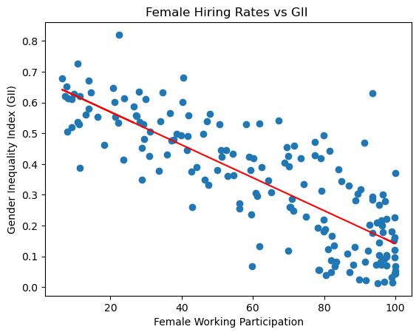
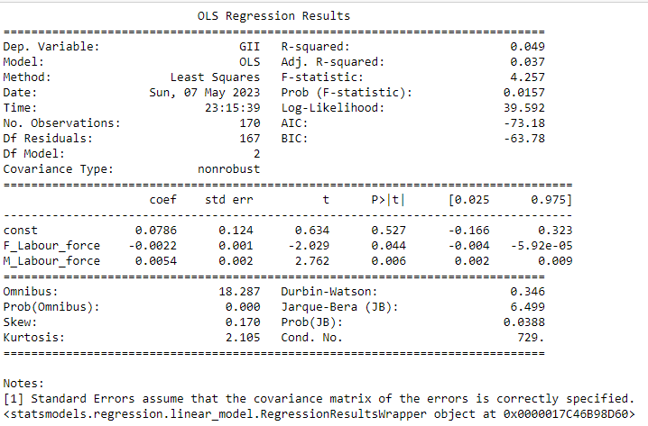
Experiment(Shafiullah)
Based on the data sets, We have used linear regression to fit the model to explore the relationship between the female working participation and gender inequality.
We used OLS to help us understand the relationship between GII and the country's GDP and make certain assumptions such as, "countries with high GDP have low GII and countries with low GDP have high GII." The OLS summary helps us analyze which variables are most likely to influence a country's GII.

Slide 19

Experiment 2
KNN lead to this:
The goal was to get some more insight about pay gap discrepancies between women and men based on feature selection, and to identify the more important variables that would affect the wage gap.
The result indicates that the accuracy, macro, and micro accuracy are sufficient.

Slide 20
Method(Jim)
Similar to Chris, I analyzed two data sets.
The first was simulated data set from Human Resources Diversity Analysis.
The second was from Levels FYI.

Slide 21
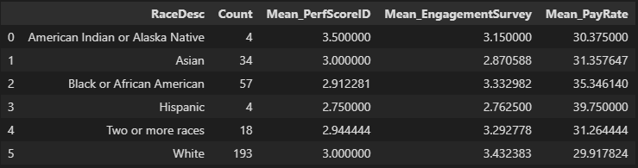
Method(Jim)
We wanted to perform a deeper level of analysis beyond the original bar graphs. But the number of samples was an issue.
To try and combat this, we attempted to calculate the mean values for key features.

Slide 22
Method(jim)
Next up, Levels FYI.
This data set had substantially more data.
Similar to Chris, I performed linear regression analysis.
The main difference here is that I used the Sklearn(scikit-learn) library.

Slide 23
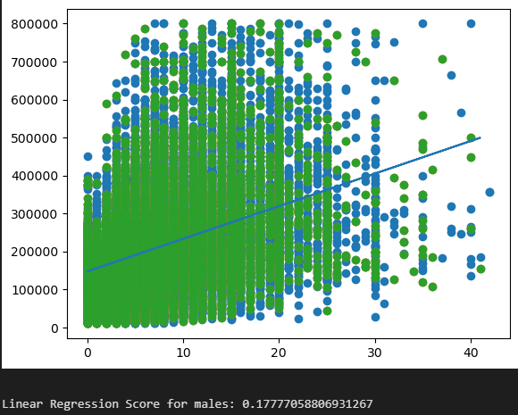
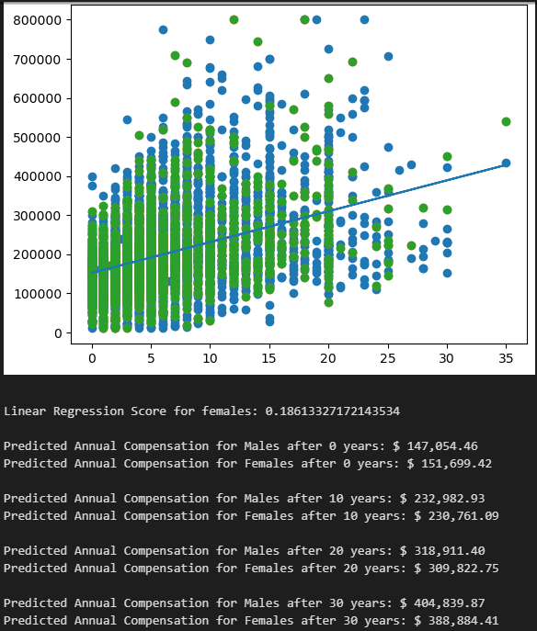
Method(jim)

Slide 24
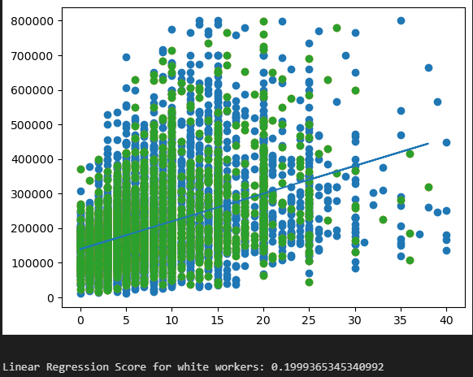
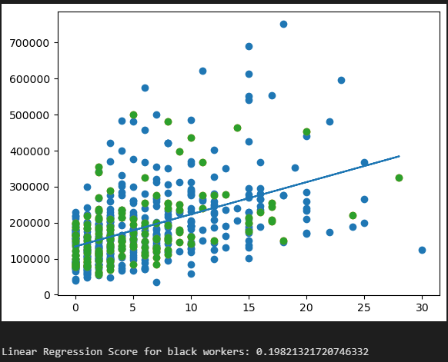
Method(jim)

Slide 25
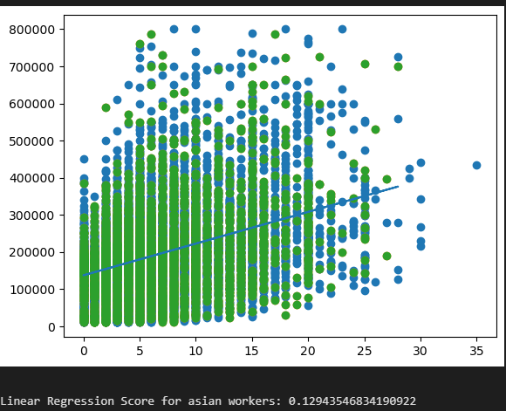
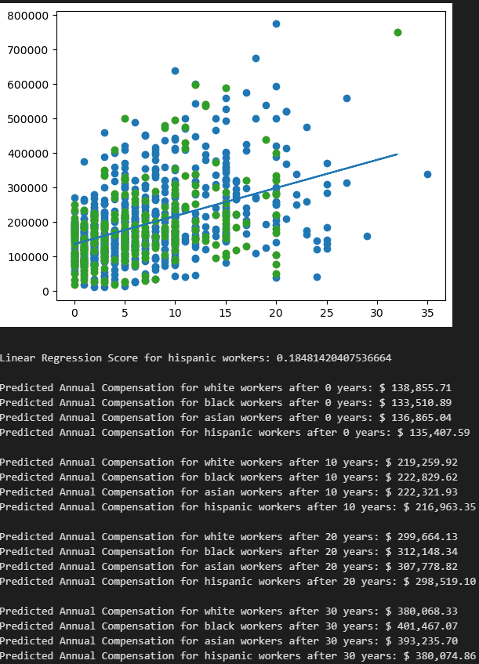
Method(Jim)

Slide 26
Conclusion
Mixed results.
Underrepresentation is evident
There were a high number of respondents that did not confirm gender identity or race.

