Slide 1


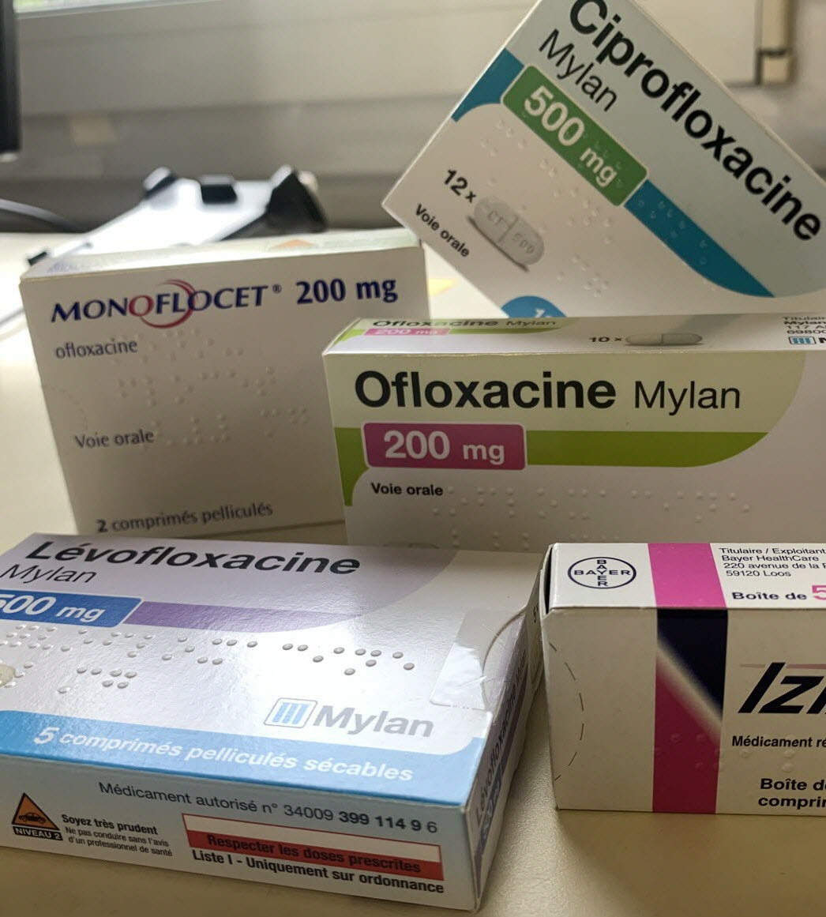

Mixing functional and multiblock approaches to explore One Health antimicrobial resistance in France
Gaspard Martet, Stéphanie Bougeard, Claire Chauvin
Anses, Unité Epidémiologie, Santé et Bien-être (EpiSaBE), Laboratoire de Ploufragan-Plouzané-Niort, France
gaspard.martet@anses.fr
15/07/2026
Notes:
Présenter la structure dans laquelle je travaille et avec qui je travaille

Slide 2
Introduction

Slide 3




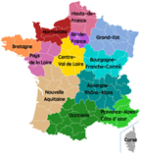
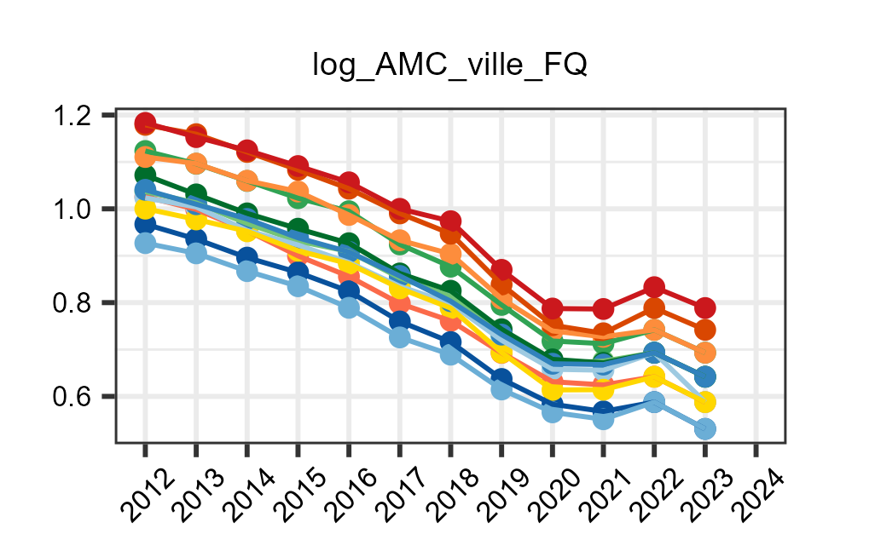
Scientific context
Primary Care setting
Consumption
Antimicrobial resistance: forecast of 10 million deaths/year by 2050
E.coli
Resistance
Fluoroquinolone (FQ)
Launched in 2021: One-Health Meta Network with 42 academic partners
Data
Response block
Adjustment block
One Health blocks
19 variables
11 variables
1 variable
24 variables
Animals
12 régions
Humans
12 régions
Fluroquinolone Resistance
Antimicrobial consumption
12 régions
12 régions
2024
2024
2012
…
2012
…
2024
2024
7 variables
…
…
2012
2012
Environnement
12 régions
2024
2012
…
Notes:
Peut-être ici mettre un peu plus en avant le contexte scientifique (première bande) et les datas (bande du bas) en faisant apparaître les blocks plus explicitement, peut-être mettre des cartes de la France en ptit comme on a fait et un graphe qui veut dire qu’on a des variables dans le temps. Plutôt que le cube qui fait plutôt penser au three-way alors que là c’est pas ce qu’on veut montrer.

Slide 4
State of the art of existing methods for multiblock and temporal data
Three-way GSCA (Choi 2018)⁵
Functional GSCA (Suk 2016)⁶
Dynamic multiblock Partial least square regression (dynamic Mb-PLS)
Notes:
Pour l’instant ça on ne fait rien.

Slide 5
Scientific Problematic
How can temporal and regional variations in fluoroquinolone resistance in France primary care settings be explained within a One Health framework ?
Notes:
More than 67 OH candidate variable
inclusion of companion animals, addressing a gap highlighted by Jin et al. (2023).
Faire lien entre JACRIA like et besoin de panel regression models
Test : Fischer test between ols and fixed effects

Slide 6
Methods

Slide 7



Scientific Problematic
First Step: Dimension reduction
Second step: Modeling relationships
a) Time dimension
b) Variable dimension
GSCA³
All blocks scale
3D blocks (regions*variable*time)
2D blocks (regions*fPC1)
One block scale
…
…
…
…
…
Year k
…
Clustering of variable around latent components²
Var p
Year 1
Var 1
Var 2
Smoothing + fPCA¹
Variable scale
fPC1 Var 1

Slide 8
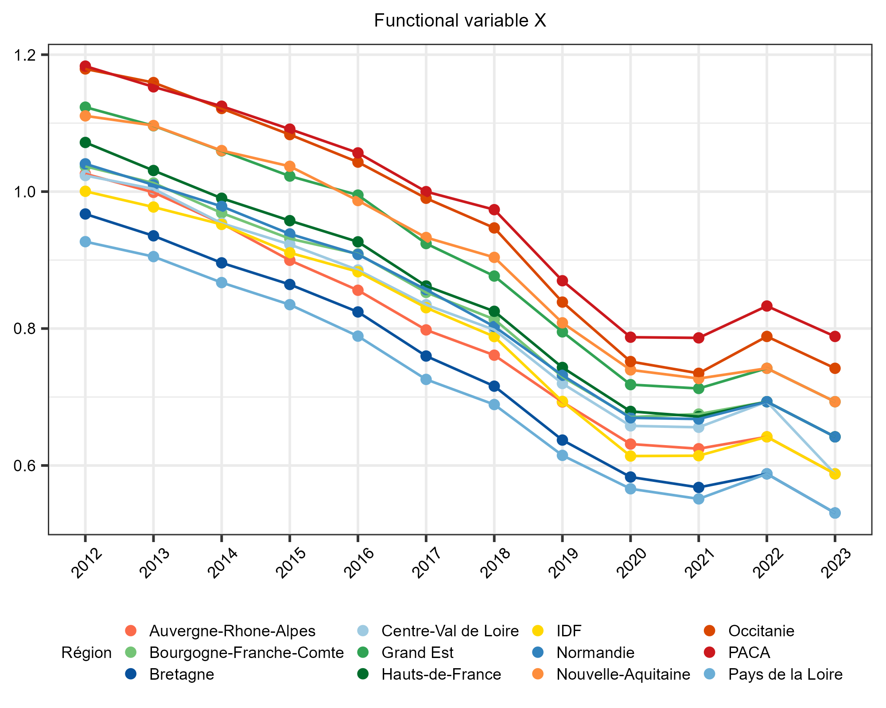
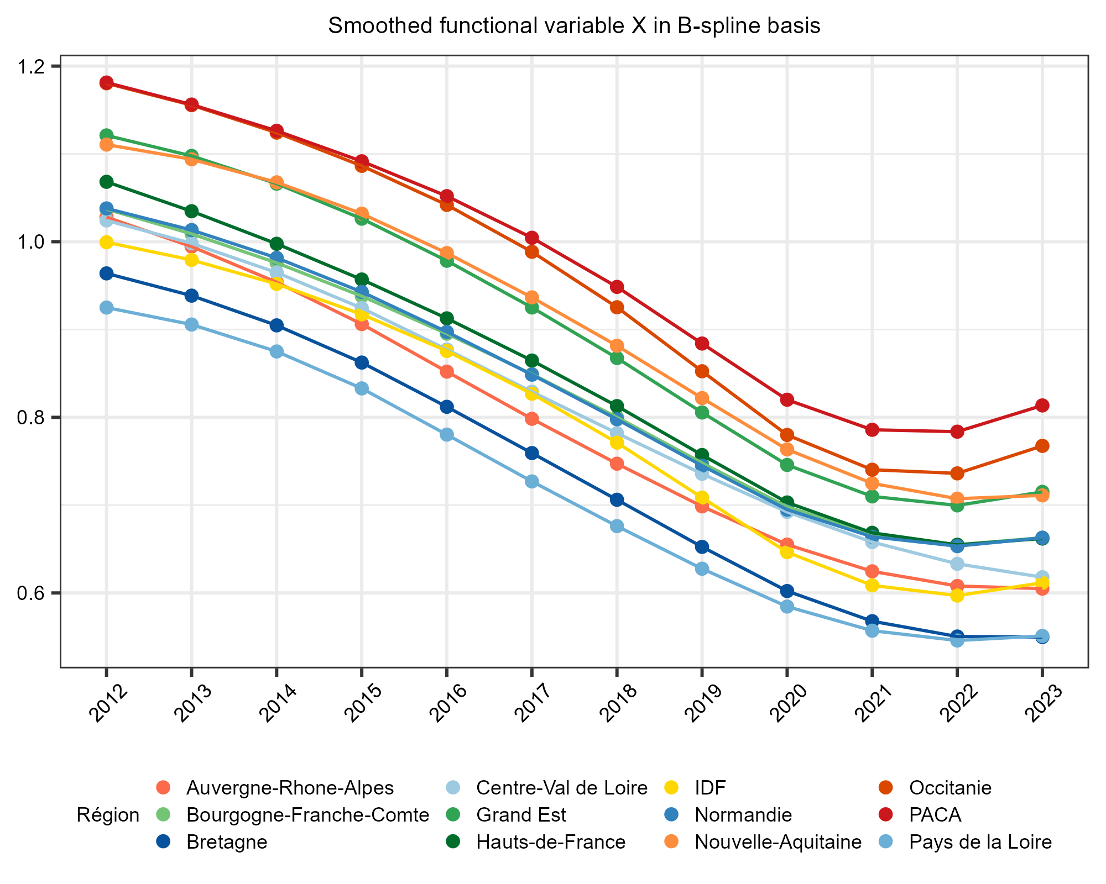
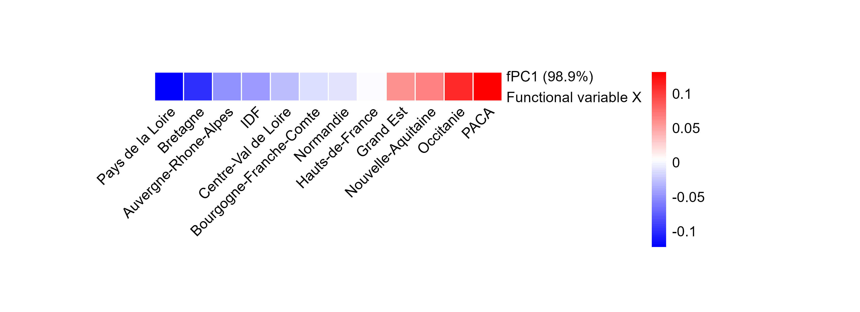
How to summarize temporal information ?
Projection B-spline basis
Local polynomials
Smoothed function
Rules
Order m : max polynomes degree = m-1
K basis functions: m < K < n here K = 5
98,9% of explained variance
fPCA permits to summarize the main functional mode of variation into a vector.
No time mode anymore → vector of independant observations
Notes:
More than 67 OH candidate variable
inclusion of companion animals, addressing a gap highlighted by Jin et al. (2023).
Faire lien entre JACRIA like et besoin de panel regression models
Test : Fischer test between ols and fixed effects

Slide 9
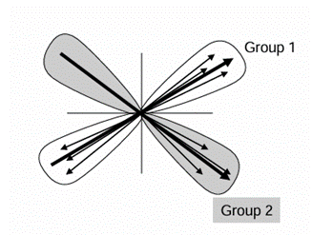
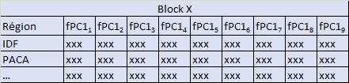
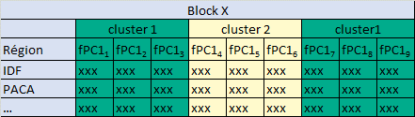
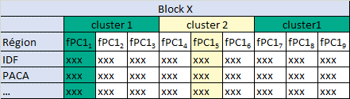
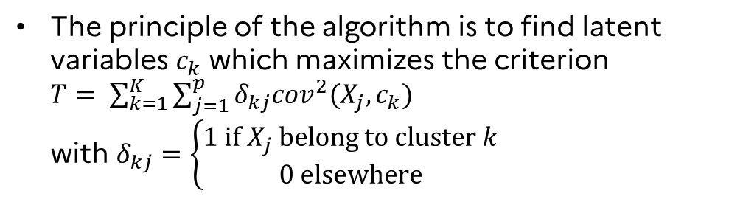
How to remove redundancy within a block ?
Block X (K=2, p=9)
Clustering of components arouns latent variables (Vigneau & Qannari, 2003)
fPC1₁
The principle of the algorithm is to find latent variables $c_{k}$ which maximizes the criterion $T= \sum_{k=1}^{K}{\sum_{j=1}^{p}{δ_{kj}{cov}^{2}(X_{j}, c_{k})}}$ with $δ_{kj}=\left\{\begin{aligned}1 if X_{j} belong to cluster k \\ 0 elsewhere\end{aligned}\right.$
fPC1₂
c₁
fPC1₃
fPC1₉
fPC1₄
fPC1₈
fPC1₅
fPC1₇
fPC1₆
c₂
Clustering of variables around latent component
We keep only variables which are the most relevant for us
Correlated each other
Correlated each other
Correlated each other
Remark: This method also permit to obtain unidimensional blocks, a necessary assumption for applying the model GSCA
Notes:
Peut-être essayer d’associer le dessin au tableau excel

Slide 10

















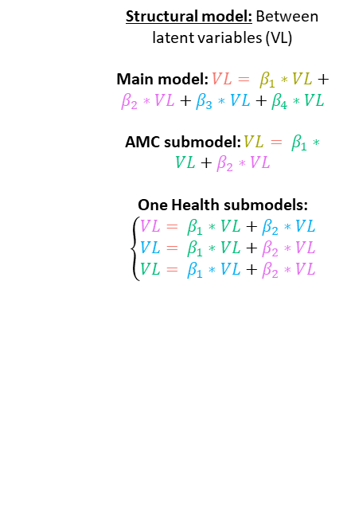
How to modelize resistance and One Health relationships ?
Generalized structured component Analysis (GSCA)³
Main model
Antimicrobial consumption (AMC) adjustment Submodel
Structural model: Between latent variables (VL)
Main model: $VL= β_{1}∗VL+β_{2}∗VL+β_{3}∗VL+β_{4}∗VL$
AMC submodel: $VL= β_{1}∗VL+β_{2}∗VL$
One Health submodels: $$\left\{\begin{aligned}VL= β_{1}∗VL+β_{2}∗VL \\ VL= β_{1}∗VL+β_{2}∗VL \\ VL= β_{1}∗VL+β_{2}∗VL\end{aligned}\right.$$
One Health submodels
$$β$$
VL
VL
VL
VL
VL
$$β$$
$$β$$
$$β$$
$$β$$
$$β$$
Measurment model: from original fPC1 to latent variables (VL) and vice-versa example with Humans block
$$\left\{\begin{aligned}{VL}_{Humans}= \sum_{i=1}^{p}{w_{i}{fPC1}_{i}} \\ {fPC1}_{i}=c_{i}∗{VL}_{Humans} \\ …\end{aligned}\right.$$
$$w$$
$$c$$
$$w$$
$$c$$
$$w$$
$$c$$
$$w$$
$$c$$
$$w$$
$$c$$
Y
AMC
Humans
Animals
Environnement
Notes:
More than 67 OH candidate variable
inclusion of companion animals, addressing a gap highlighted by Jin et al. (2023).
Faire lien entre JACRIA like et besoin de panel regression models
Test : Fischer test between ols and fixed effects

Slide 11
Results

Slide 12
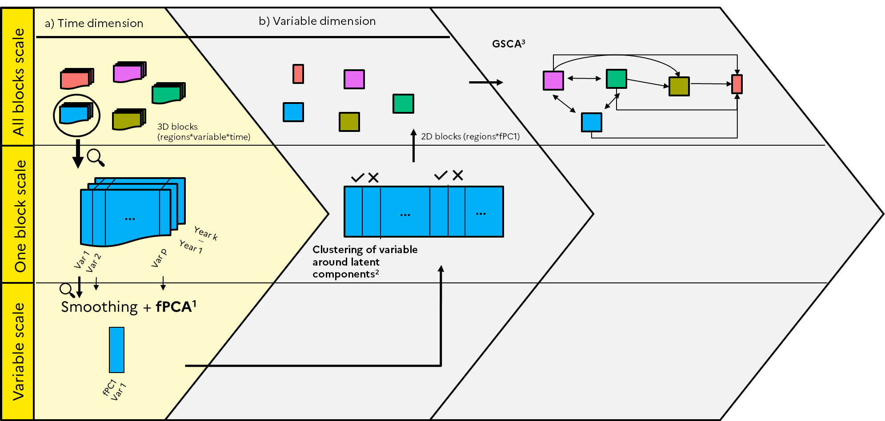
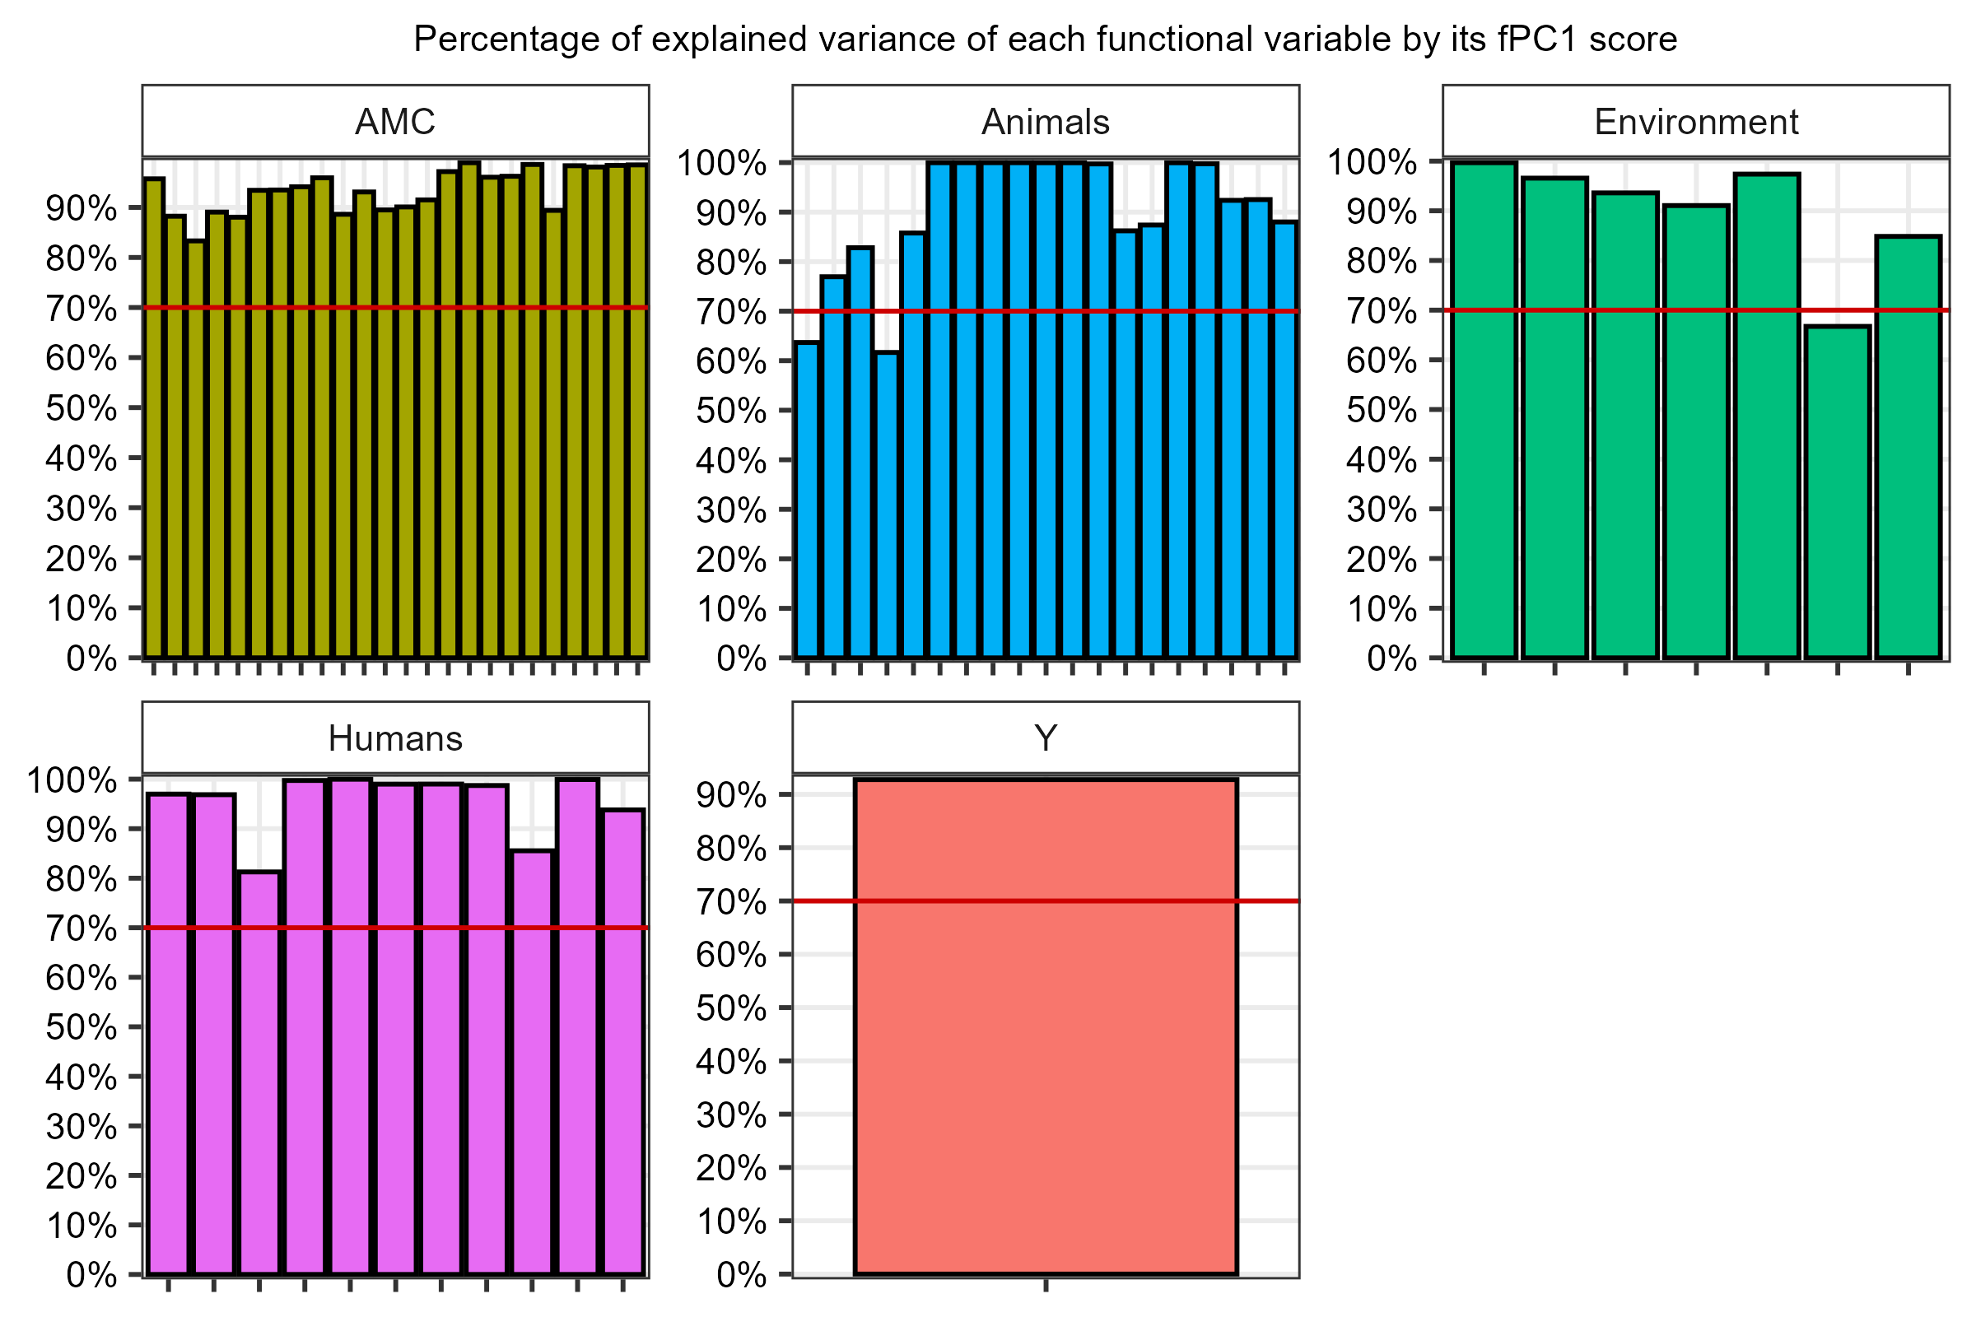
Summary of temporal information
The fPC1 scores generally summarize an important proportion of variation over the time (above 70%)
Notes:
Faire une petite phrise grisée pour les parties qu’on n’explique pas, ici on ne met pas la fPC2. Le tableau on le vire. Mettre l’histogramme du % d’inertie avec une hline de 70% pour montrer qu’on résume bien les variables avec les fPC1

Slide 13
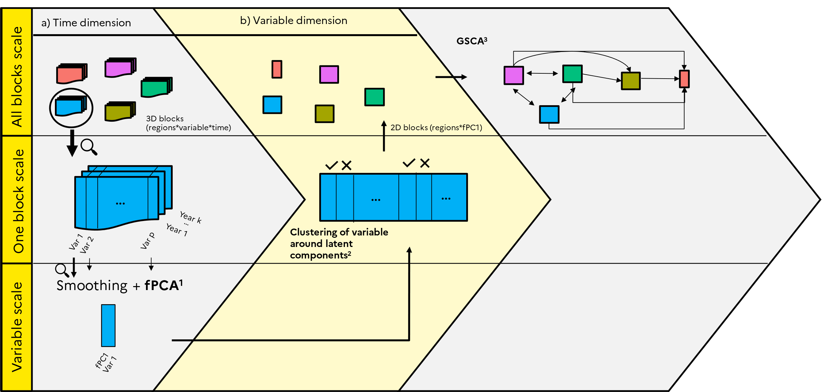
Reduction of number of variable
Notes:
Mettre les variables sélectionnées dans chaque block. En gros, à gauche, mettre le nombre de variables par blocs au débur, pui le nombre de cluster, puis le nombre de variables dans chaque cluster, pui la variable finale avec son pourcentage de variance.

Slide 14
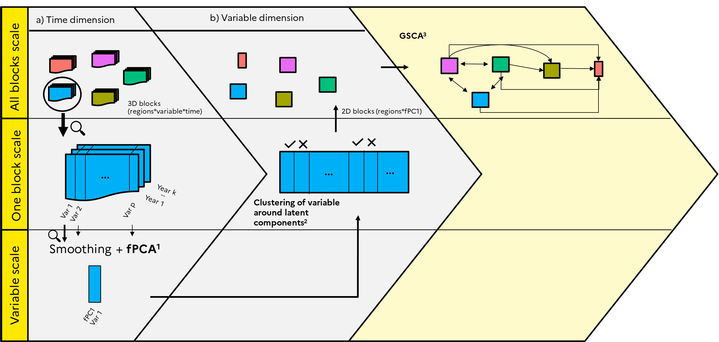
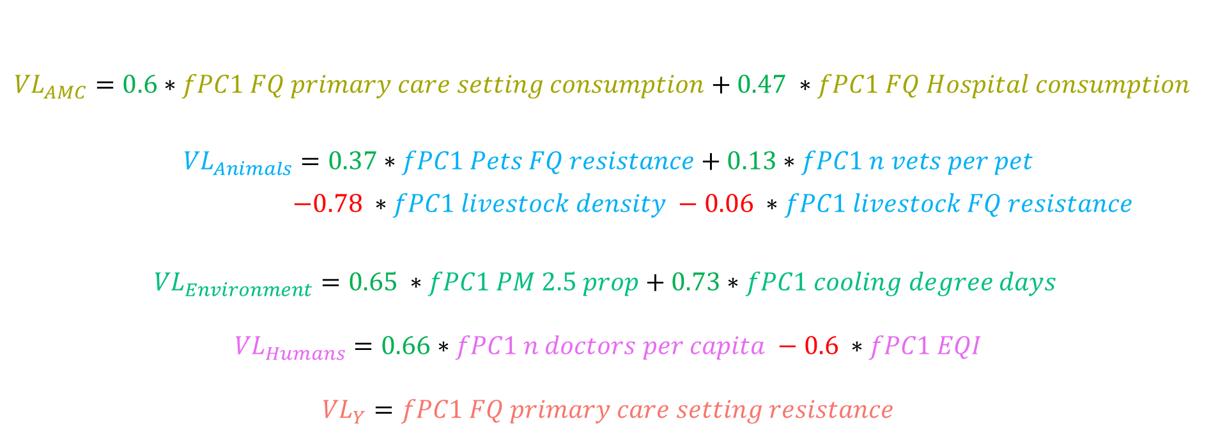
Modelisation of relationships – Measurment model GSCA
$${VL}_{AMC}=0.6∗fPC1 FQ primary care setting consumption+0.47 ∗fPC1 FQ Hospital consumption$$
$${VL}_{Animals}=0.37∗fPC1 Pets FQ resistance+0.13∗fPC1 n vets per pet$$ $−0.78 ∗fPC1 livestock density −0.06 ∗fPC1 livestock FQ resistance$
$${VL}_{Environment}=0.65 ∗fPC1 PM 2.5 prop+0.73∗fPC1 cooling degree days$$
$${VL}_{Humans}=0.66∗fPC1 n doctors per capita −0.6 ∗fPC1 EQI$$
$${VL}_{Y}=fPC1 FQ primary care setting resistance$$
Notes:
Idée: en dessous des équations, rajouter des cartes de la France avec gradient selon valeur de la VL.

Slide 15
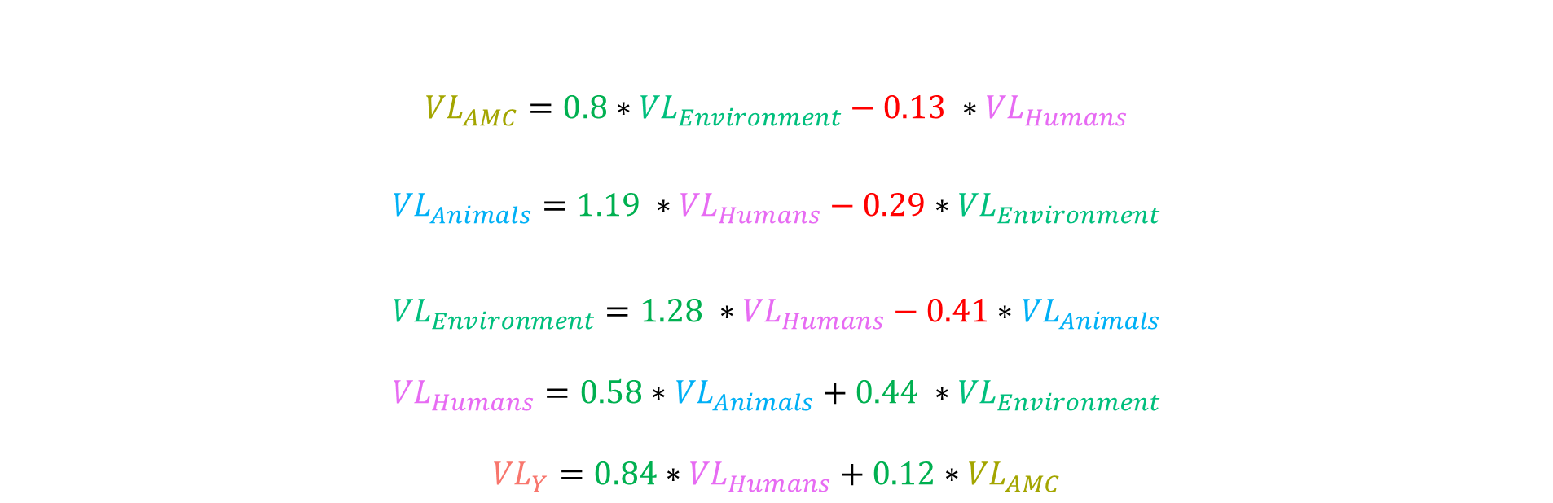
Modelisation of relationships – Structural model GSCA
$${VL}_{AMC}=0.8∗{VL}_{Environment}−0.13 ∗{VL}_{Humans}$$
$${VL}_{Animals}=1.19 ∗{VL}_{Humans}−0.29∗{VL}_{Environment}$$
$${VL}_{Environment}=1.28 ∗{VL}_{Humans}−0.41∗{VL}_{Animals}$$
$${VL}_{Humans}=0.58∗{VL}_{Animals}+0.44 ∗{VL}_{Environment}$$
$${VL}_{Y}=0.84∗{VL}_{Humans}+0.12∗{VL}_{AMC}$$
Notes:
Idée: en dessous des équations, rajouter des cartes de la France avec gradient selon valeur de la VL.

Slide 16
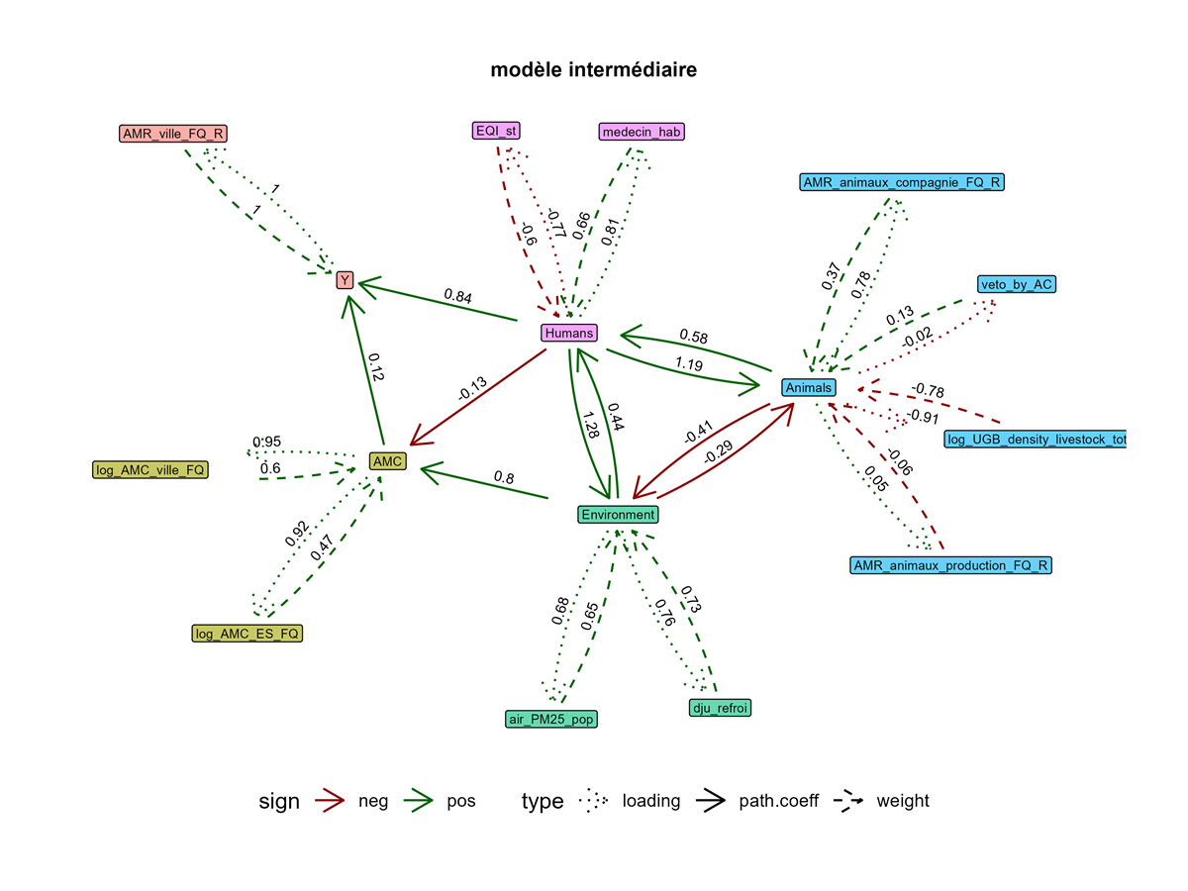
Modelisation of relationships – Genaral graphe GSCA
Notes:
Idée: en dessous des équations, rajouter des cartes de la France avec gradient selon valeur de la VL.

Slide 17
Conclusion and perspectives

Slide 18
Conclusion and Perspectives
How can temporal and regional variations in fluoroquinolone resistance in France primary care settings be explained within a One Health framework ?
Conclusion
Limits
Perspectives
fPCA → summary of temporal dimension → independent observations.
Clustering of variables around latent component: reduce redundancy
GSCA: modelizes relationships between blocks. Main model + submodels = One Health framework
FQ resitance mainly explained by Humans block than consumption block: EQI ↓ doctor/population ratio ↑
One Health blocks: common factor: urban/rural regional gradient. Higher resistance in urban regions
Only one fPC: only main trends considered. Interesting little temporal variation at some years should be included.
Selected variables are correlated to other variables not considered for modelization.
Small sample size (n=12): be carreful with interpretation
Apply three-way GSCA (Choi, 2018) with more than one fPC or functional GSCA (Suk, 2016) directly with original functional variables
Look at correlation with variables not selected after clustering.
Consider department scale to increase sample size or extand the method to european countries
Notes:
Ne faire qu’une slide conclusion/perspective, en 4-5 mots. Un point résultats, point méthodos, limite et on en vient aux perspectives.

Slide 19
References
Ramsey, J. O. and Silverman, B. W. (2005). Functional Data Analysis, Chapter 8.
Vigneau, E., & Qannari, E. M. (2003). Clustering of Variables Around Latent Components. Communications in Statistics - Simulation and Computation, 32(4), 1131–1150.
Hwang H., Takane Y. (2004). Generalized Structured Component Analysis. Psychometrika Vol.69, No. 1, 81–99.
Bougeard S., Hanafi M. (2023). Prediction model for multiblock data with or without intermediate blocks. Estimation by PLS Path Modeling.
Choi J. Y., Hwang H. (2018). Three-Way Generalized Structured Component Analysis.
Suk H. W., Hwang H. (2016). Functional Generalized Structured Component Analysis. Psychometrika
Notes:
More than 67 OH candidate variable
inclusion of companion animals, addressing a gap highlighted by Jin et al. (2023).
Faire lien entre JACRIA like et besoin de panel regression models
Test : Fischer test between ols and fixed effects

