Slide 1

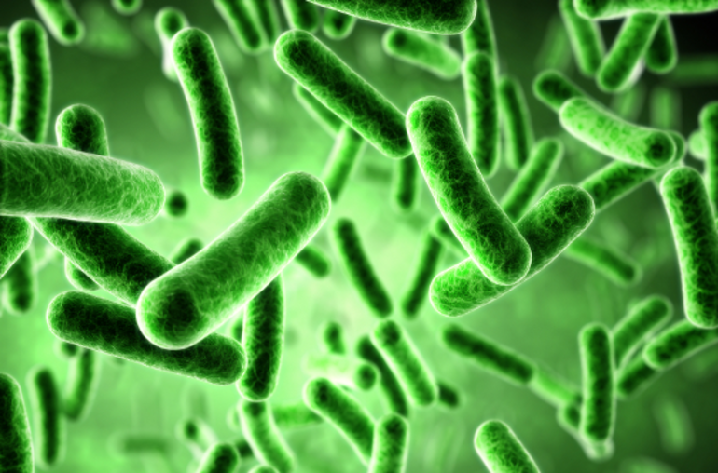
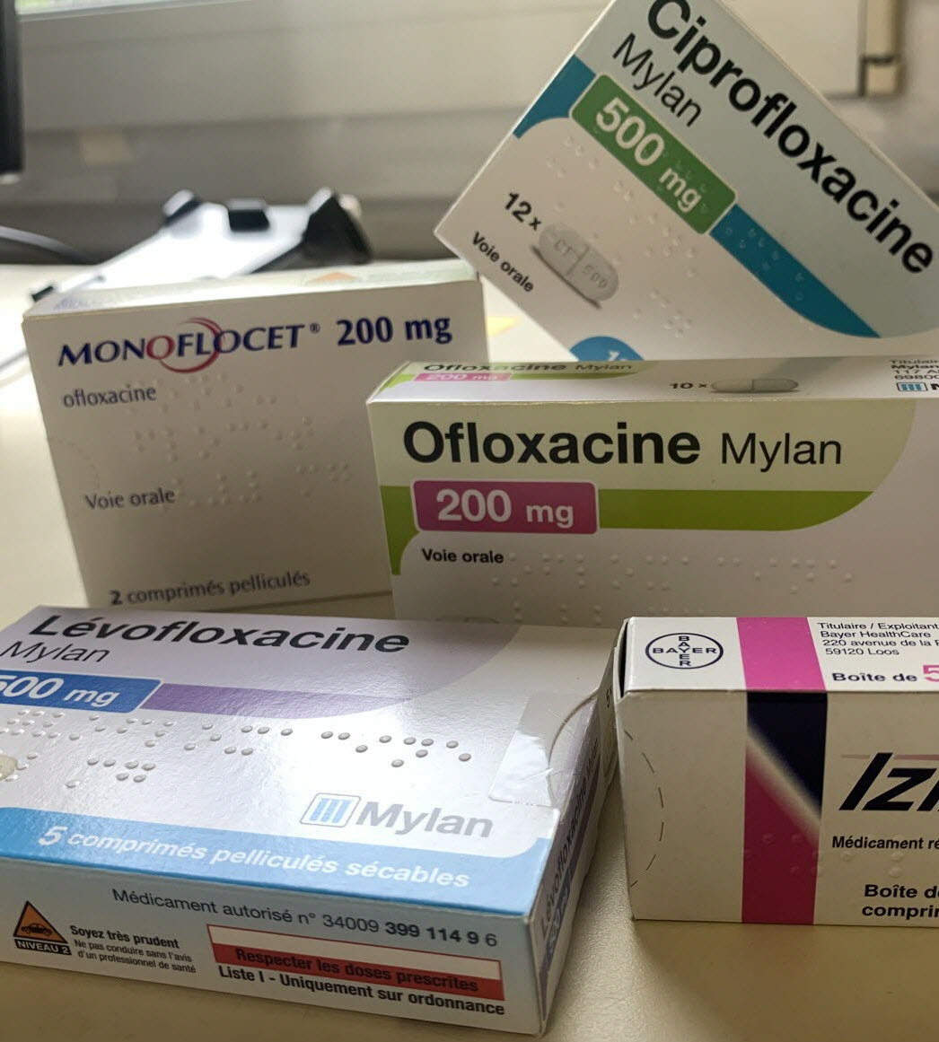

Mixing functional and multiblock approaches to explore One Health antimicrobial resistance in France
Gaspard Martet, Stéphanie Bougeard, Claire Chauvin
Anses, Unité Epidémiologie, Santé et Bien-être (EpiSaBE), Laboratoire de Ploufragan-Plouzané-Niort, France
gaspard.martet@anses.fr
15/07/2026

Slide 2
Introduction

Slide 3






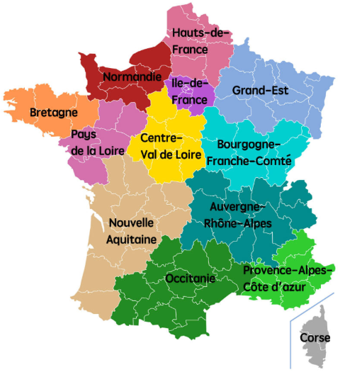

Context
Additional variables
Humans variables (ex : number of doctors/livers)
Environment variables (ex : PM 2,5 mm)
AMR: forecast of 10 million deaths/year by 2050
Launched in 2021: One-Health Meta Network with 42 academic partners
Animals variables (ex : UGB density livestock)
E.coli
Fluoroquinolone (FQ)
Primary Care setting
K.pneumoniae
AMR
Third-generation cephalosporins (C3G)
AMC
EHPAD
From 2012 to 2024
S.aureus
Etc.
Hospitals
Etc.
Notes:
More than 67 OH candidate variable
inclusion of companion animals, addressing a gap highlighted by Jin et al. (2023).
Faire lien entre JACRIA like et besoin de panel regression models
Test : Fischer test between ols and fixed effects

Slide 4
State of the art of existing methods for temporal data
Linear mixed model (LMM)
Generalized linear mixed model (GLMM)
Generalized estimating equations (GEE)
Generalized Least Square (GLS)
Time series
Functional methods
Notes:
More than 67 OH candidate variable
inclusion of companion animals, addressing a gap highlighted by Jin et al. (2023).
Faire lien entre JACRIA like et besoin de panel regression models
Test : Fischer test between ols and fixed effects

Slide 5
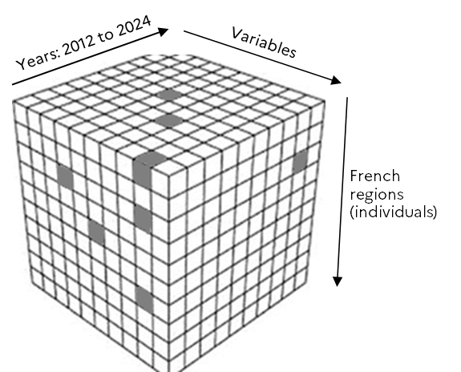
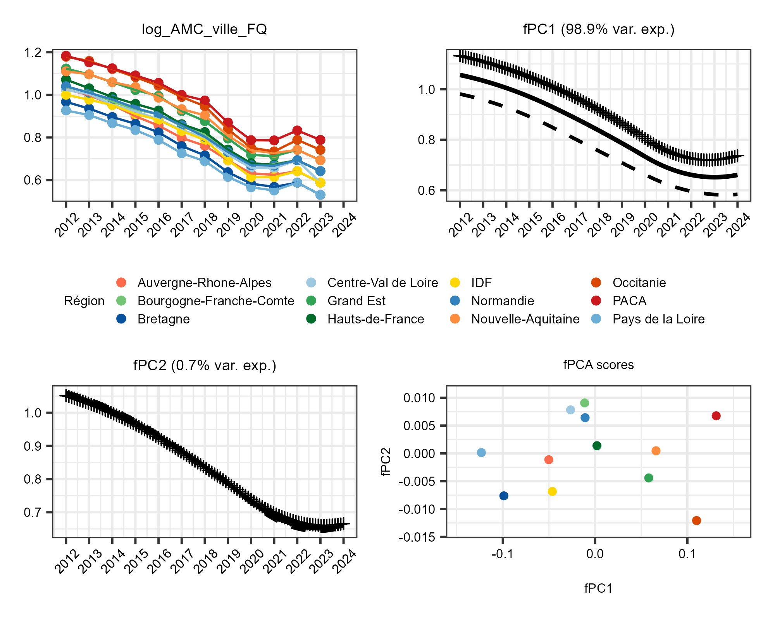
Blocks of functionnal variables to block of classic variables
5 blocks:
Y (AMR FQ PCS), response block, 1 variable
Antimicrobial consumption (AMC), 21 variables
Animals, 19 variables
Environment, 7 variables
Humans, 11 variables
région | fPC1_var1 | fPC1_var2 | …
IDF | xx | xx | xx
PACA | xx | xx | xx
… | … | … | …
fPCA¹ on 1 functional variable
We perform fPCA independently on each variable
Notes:
More than 67 OH candidate variable
inclusion of companion animals, addressing a gap highlighted by Jin et al. (2023).
Faire lien entre JACRIA like et besoin de panel regression models
Test : Fischer test between ols and fixed effects

Slide 6
Methods

Slide 7
Scientific Problematic
How can temporal and regional variations in fluoroquinolone resistance in France primary care settings be explained within a One Health framework ?
Notes:
More than 67 OH candidate variable
inclusion of companion animals, addressing a gap highlighted by Jin et al. (2023).
Faire lien entre JACRIA like et besoin de panel regression models
Test : Fischer test between ols and fixed effects

Slide 8
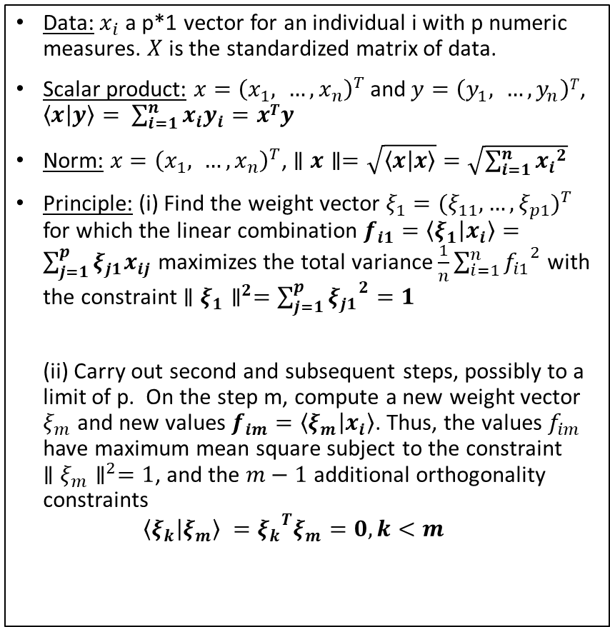
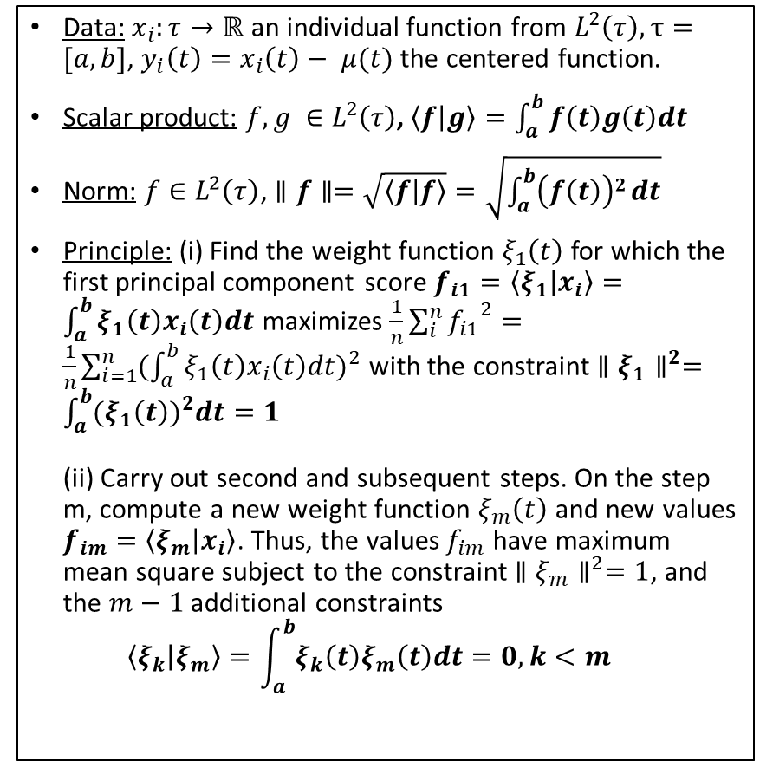
Functional Principal Component Analysis¹
Classic PCA
Functional PCA
Data: $x_{i}$ a p*1 vector for an individual i with p numeric measures. $X$ is the standardized matrix of data.
Scalar product: $x={\left(x_{1}, …,x_{n}\right)}^{T}$ and$y=\left(y_{1}, …,y_{n}\right)T$, $\left\langle x | y\right\rangle = \sum_{i=1}^{n}{x_{i}y_{i}}=xTy$
Norm: $x={\left(x_{1}, …,x_{n}\right)}^{T}$, $∥x∥=\sqrt{\left\langle x | x\right\rangle }=\sqrt{\sum_{i=1}^{n}{{x_{i}}^{2}}}$
Principle: (i) Find the weight vector $ξ_{1}={(ξ_{11},…,ξ_{p1})}^{T}$ for which the linear combination $f_{i1}=\left\langle ξ_{1} | x_{i}\right\rangle =\sum_{j=1}^{p}{ξ_{j1}x_{ij}}$ maximizes the total variance $\frac{1}{n}\sum_{i=1}^{n}{{f_{i1}}^{2}}$ with the constraint ${∥ξ_{1}∥}^{2}=\sum_{j=1}^{p}{{ξ_{j1}}^{2}}=1$ (ii) Carry out second and subsequent steps, possibly to a limit of p. On the step m, compute a new weight vector $ξ_{m}$ and new values $f_{im}=\left\langle ξ_{m} | x_{i}\right\rangle$. Thus, the values $f_{im}$ have maximum mean square subject to the constraint ${∥ξ_{m}∥}^{2}=1$, and the $m−1$ additional orthogonality constraints $\left\langle ξ_{k} | ξ_{m}\right\rangle ={ξ_{k}}^{T}ξ_{m}=0, k<m$
Data: $x_{i}:τ→ℝ$ an individual function from $L^{2}\left(τ\right), τ=[a,b]$, $y_{i}\left(t\right)=x_{i}\left(t\right)− μ(t)$ the centered function.
Scalar product: $f, g ∈L^{2}\left(τ\right)$, $\left\langle f | g\right\rangle =\int_{a}^{b}{f\left(t\right)g\left(t\right)dt}$
Norm: $f∈L^{2}\left(τ\right)$, $∥f∥=\sqrt{\left\langle f | f\right\rangle }=\sqrt{\int_{a}^{b}{\left(f\left(t\right)\right)2}dt}$
Principle: (i) Find the weight function $ξ_{1}\left(t\right)$ for which the first principal component score $f_{i1}=\left\langle ξ_{1} | x_{i}\right\rangle =\int_{a}^{b}{ξ_{1}\left(t\right)x_{i}\left(t\right)dt}$ maximizes $\frac{1}{n}\sum_{i}^{n}{{f_{i1}}^{2}}=\frac{1}{n}\sum_{i=1}^{n}{{(\int_{a}^{b}{ξ_{1}\left(t\right)x_{i}\left(t\right)dt})}^{2}}$ with the constraint ${∥ξ_{1}∥}^{2}=\int_{a}^{b}{{(ξ_{1}\left(t\right))}^{2}dt}=1$ (ii) Carry out second and subsequent steps. On the step m, compute a new weight function $ξ_{m}\left(t\right)$ and new values $f_{im}=\left\langle ξ_{m} | x_{i}\right\rangle$. Thus, the values $f_{im}$ have maximum mean square subject to the constraint ${∥ξ_{m}∥}^{2}=1$, and the $m−1$ additional constraints $\left\langle ξ_{k} | ξ_{m}\right\rangle =\int_{a}^{b}{ξ_{k}\left(t\right)ξ_{m}\left(t\right)dt}=0, k<m$
Notes:
More than 67 OH candidate variable
inclusion of companion animals, addressing a gap highlighted by Jin et al. (2023).
Faire lien entre JACRIA like et besoin de panel regression models
Test : Fischer test between ols and fixed effects

Slide 9
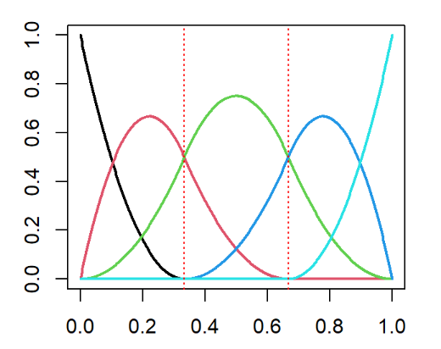
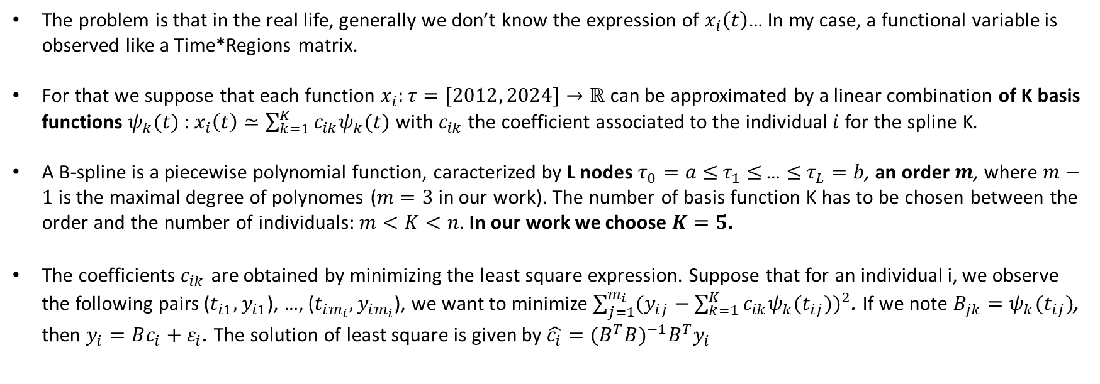


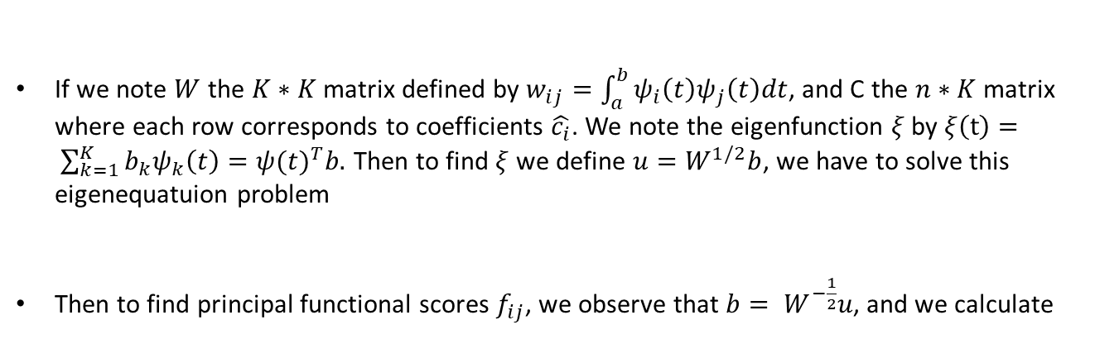
Decomposition of functions in B-spline basis
The problem is that in the real life, generally we don’t know the expression of $x_{i}\left(t\right)$… In my case, a functional variable is observed like a Time*Regions matrix.
For that we suppose that each function $x_{i}:τ=[2012, 2024]→ℝ$ can be approximated by a linear combination of K basis functions $ψ_{k}(t)$: $x_{i}\left(t\right)≃\sum_{k=1}^{K}{c_{ik}ψ_{k}(t)}$ with $c_{ik}$ the coefficient associated to the individual $i$ for the spline K.
A B-spline is a piecewise polynomial function, caracterized by L nodes $τ_{0}=a≤$ $τ_{1}$ $≤$ … $≤$ $τ_{L}=b$, an order $m$, where $m−1$ is the maximal degree of polynomes ($m=3$ in our work). The number of basis function K has to be chosen between the order and the number of individuals: $m<K<n$. In our work we choose $K=5$.
The coefficients $c_{ik}$ are obtained by minimizing the least square expression. Suppose that for an individual i, we observe the following pairs ($t_{i1}, y_{i1}$), …, ($t_{im_{i}}, y_{im_{i}}$), we want to minimize $\sum_{j=1}^{m_{i}}{{(y_{ij}−\sum_{k=1}^{K}{c_{ik}ψ_{k}(t_{ij})})}^{2}}$. If we note $B_{jk}=ψ_{k}(t_{ij})$, then $y_{i}=Bc_{i}+ε_{i}$. The solution of least square is given by $\hat{c_{i}}={(B^{T}B)}^{−1}B^{T}y_{i}$
B-spline basis order 3
If we note $W$ the $K∗K$ matrix defined by $w_{ij}=\int_{a}^{b}{ψ_{i}\left(t\right)ψ_{j}\left(t\right)dt}$, and C the $n∗K$ matrix where each row corresponds to coefficients $\hat{c_{i}}$. We note the eigenfunction $ξ$ by $ξ\left(t\right)= \sum_{k=1}^{K}{b_{k}ψ_{k}\left(t\right)}={ψ(t)}^{T}b.$ Then to find $ξ$ we define $u=W^{1/2}b$, we have to solve this eigenequatuion problem
Then to find principal functional scores $f_{ij}$, we observe that $b= W^{−\frac{1}{2}}u$, and we calculate
$$\frac{1}{n}W^{1/2}C^{T}CW^{1/2}u= ρu$$
$$f_{ij}={\hat{c_{i}}}^{T}Wb_{j}$$
Notes:
More than 67 OH candidate variable
inclusion of companion animals, addressing a gap highlighted by Jin et al. (2023).
Faire lien entre JACRIA like et besoin de panel regression models
Test : Fischer test between ols and fixed effects

Slide 10
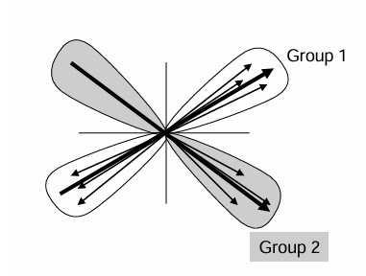
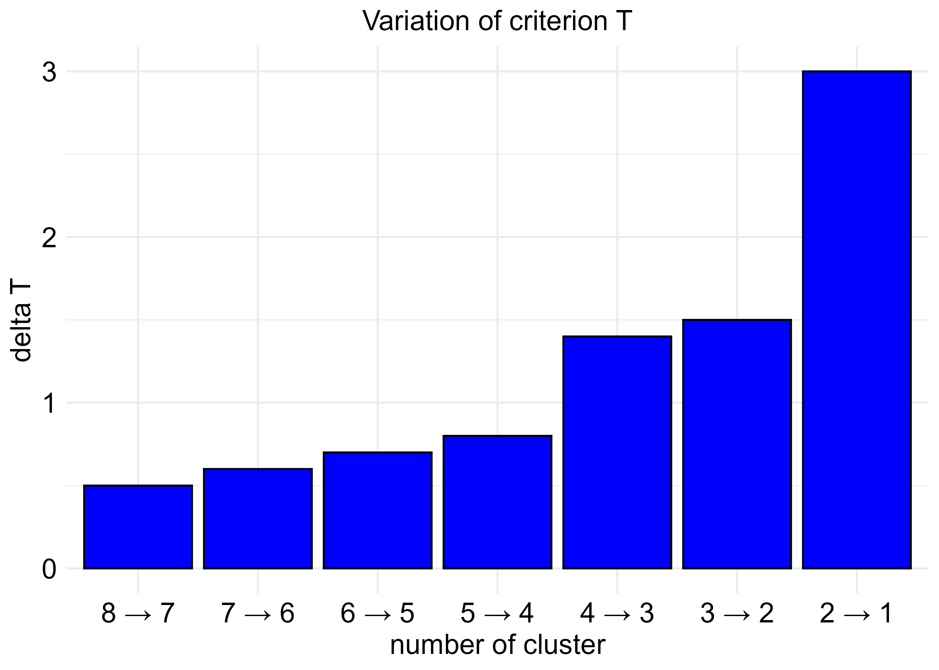
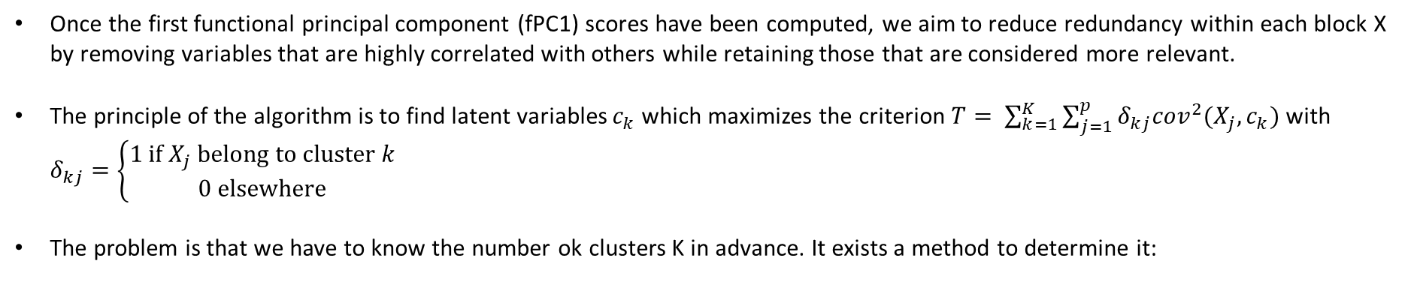
Clustering of variables around latent components²
Once the first functional principal component (fPC1) scores have been computed, we aim to reduce redundancy within each block X by removing variables that are highly correlated with others while retaining those that are considered more relevant.
The principle of the algorithm is to find latent variables $c_{k}$ which maximizes the criterion $T= \sum_{k=1}^{K}{\sum_{j=1}^{p}{δ_{kj}{cov}^{2}(X_{j}, c_{k})}}$ with $δ_{kj}=\left\{\begin{aligned}1 if X_{j} belong to cluster k \\ 0 elsewhere\end{aligned}\right.$
The problem is that we have to know the number ok clusters K in advance. It exists a method to determine it:
The K chosen is the one for which the increase of the criterion T is maximum (except to K = 1). Here we choose K = 3 clusters.
For each block independtly:
Clustering of variables around latent component
We keep only variables which are the most relevant for us
Notes:
More than 67 OH candidate variable
inclusion of companion animals, addressing a gap highlighted by Jin et al. (2023).
Faire lien entre JACRIA like et besoin de panel regression models
Test : Fischer test between ols and fixed effects

Slide 11
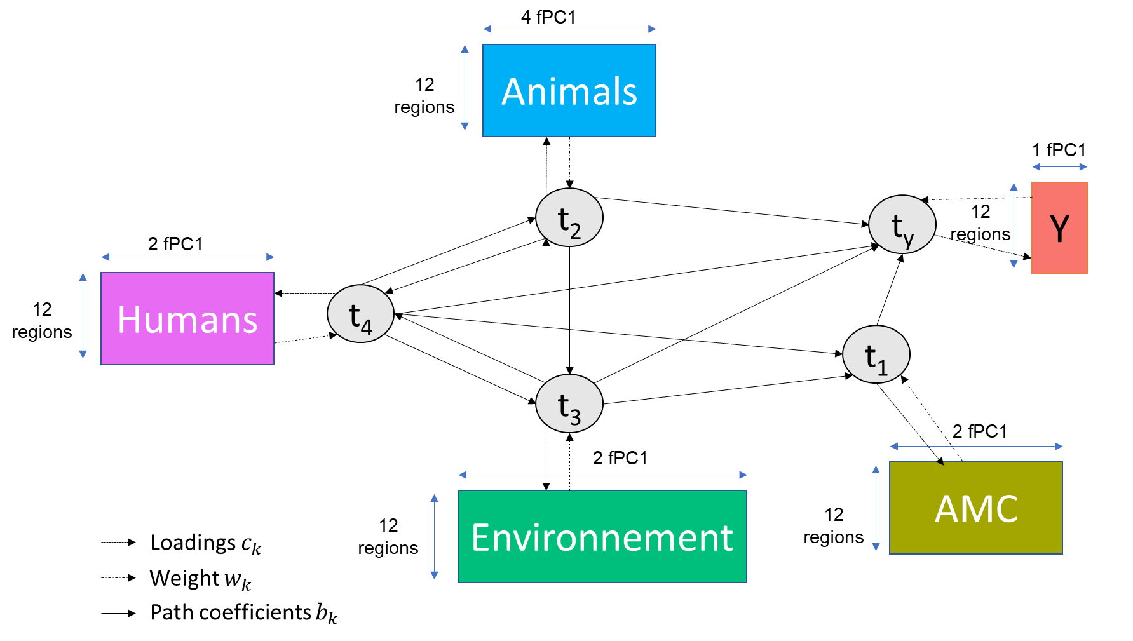
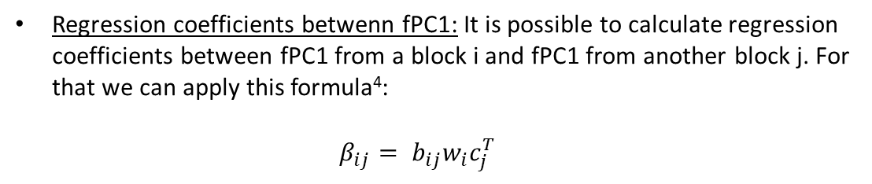
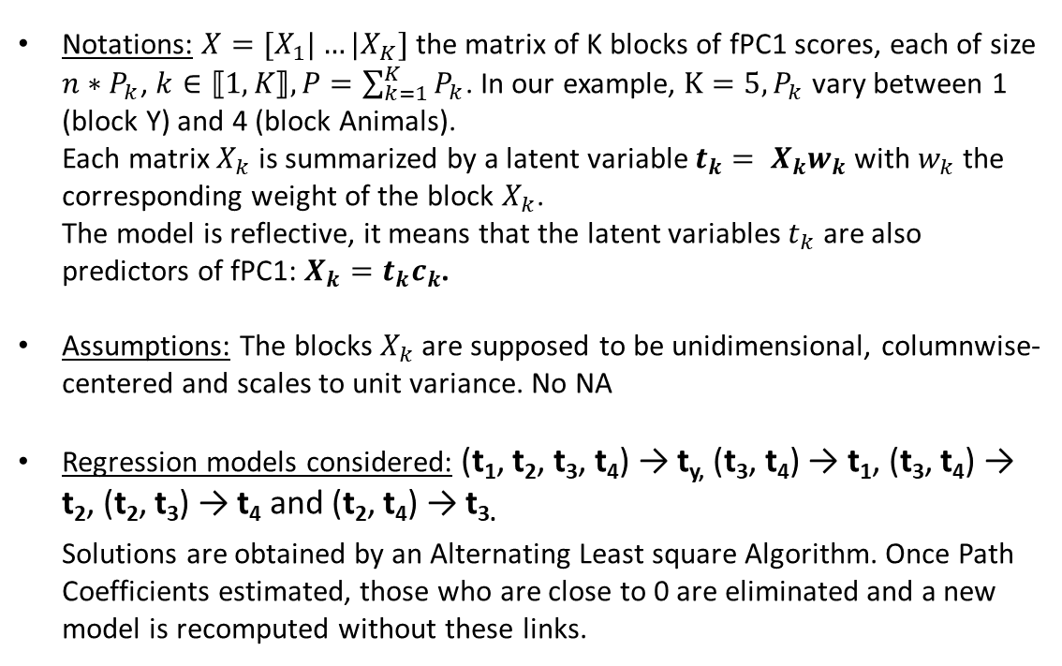
Generalized structured component analysis (GSCA)³
Notations: $X=[X_{1}|…|X_{K}]$ the matrix of K blocks of fPC1 scores, each of size $n∗P_{k}$, $k∈⟦1,K⟧, P=\sum_{k=1}^{K}{P_{k}}$. In our example, $K=5, P_{k}$ vary between 1 (block Y) and 4 (block Animals). Each matrix $X_{k}$ is summarized by a latent variable $t_{k}= X_{k}w_{k}$ with $w_{k}$ the corresponding weight of the block $X_{k}$. The model is reflective, it means that the latent variables $t_{k}$ are also predictors of fPC1: $X_{k}=t_{k}c_{k}$.
Assumptions: The blocks $X_{k}$ are supposed to be unidimensional, columnwise-centered and scales to unit variance. No NA
Regression models considered: (t₁, t₂, t₃, t₄) → t_{y,} (t₃, t₄) → t₁, (t₃, t₄) → t₂, (t₂, t₃) → t₄ and (t₂, t₄) → t_{3.} Solutions are obtained by an Alternating Least square Algorithm. Once Path Coefficients estimated, those who are close to 0 are eliminated and a new model is recomputed without these links.
FIT measures
FIT: global FIT of the model (R2 equivalent)
AFIT: adjusted FIT
FIT M: FIT of the measurement model (from latent variables to original fPC1).
FIT S: FIT of the structural model (between latent variables
Regression coefficients betwenn fPC1: It is possible to calculate regression coefficients between fPC1 from a block i and fPC1 from another block j. For that we can apply this formula⁴: $β_{ij}= b_{ij}w_{i}c_{j}^{T}$
Notes:
More than 67 OH candidate variable
inclusion of companion animals, addressing a gap highlighted by Jin et al. (2023).
Faire lien entre JACRIA like et besoin de panel regression models
Test : Fischer test between ols and fixed effects

Slide 12
Results

Slide 13
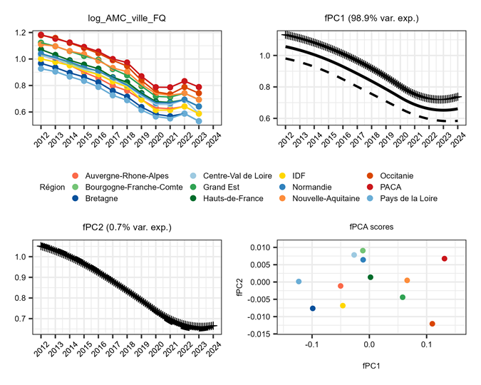
fPC1 interpretation of retained variable
fPC1 represents the global intensity of antimicrobial consumption over the time → PACA and Occitanie have a lot of consumption of fluoroquinolone in primary care setting whereas Bretagne and Pays de la Loire have few consumption.
Notes:
More than 67 OH candidate variable
inclusion of companion animals, addressing a gap highlighted by Jin et al. (2023).
Faire lien entre JACRIA like et besoin de panel regression models
Test : Fischer test between ols and fixed effects

Slide 14
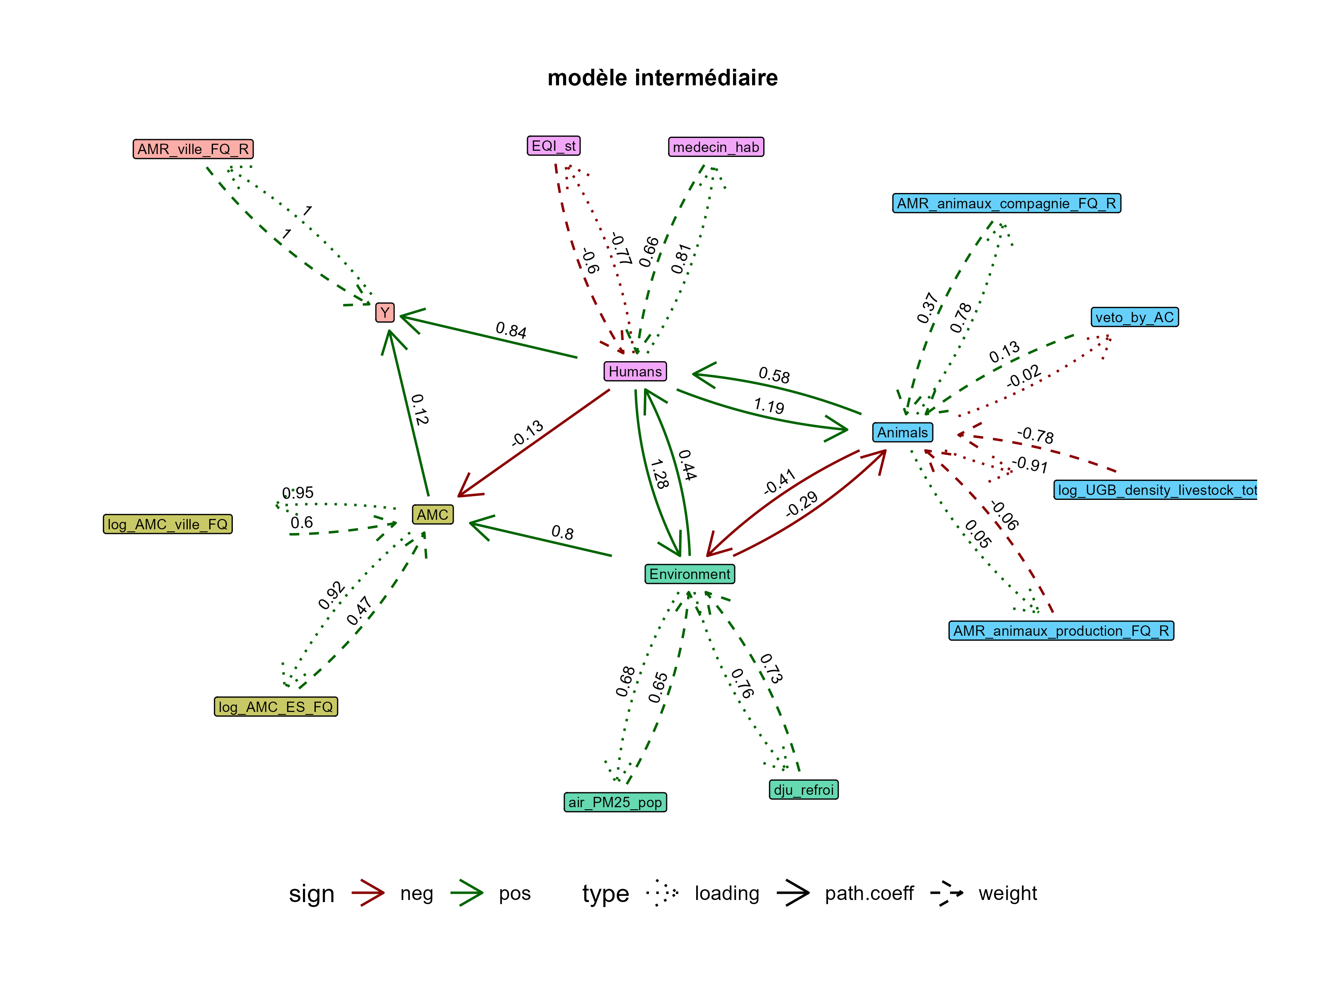
Final model
Interpretation
AMC doesn’t explain very well AMR, it’s more the humans block which explain it well. Indeed if in a considered region, there are a lot of doctors and people doesn’t trust in public institutions, then the resistance is high. In addition, this humans block have a negative effect on AMC.
Environment block has a positive effect on AMC and humans blocks but a negative effect on animals block. That is correlated to urbanism/rurality.
Limit: bootstrap confidence intervals are not represeneted in this graph but they are very high, it’s because of the sample size (n = 12 regions). Some variables are probably correlated to variables not selected by CLV algorithm.
AFIT: 0.54
FIT_M: 0.59
FIT_S: 0.8
Notes:
More than 67 OH candidate variable
inclusion of companion animals, addressing a gap highlighted by Jin et al. (2023).
Faire lien entre JACRIA like et besoin de panel regression models
Test : Fischer test between ols and fixed effects

Slide 15
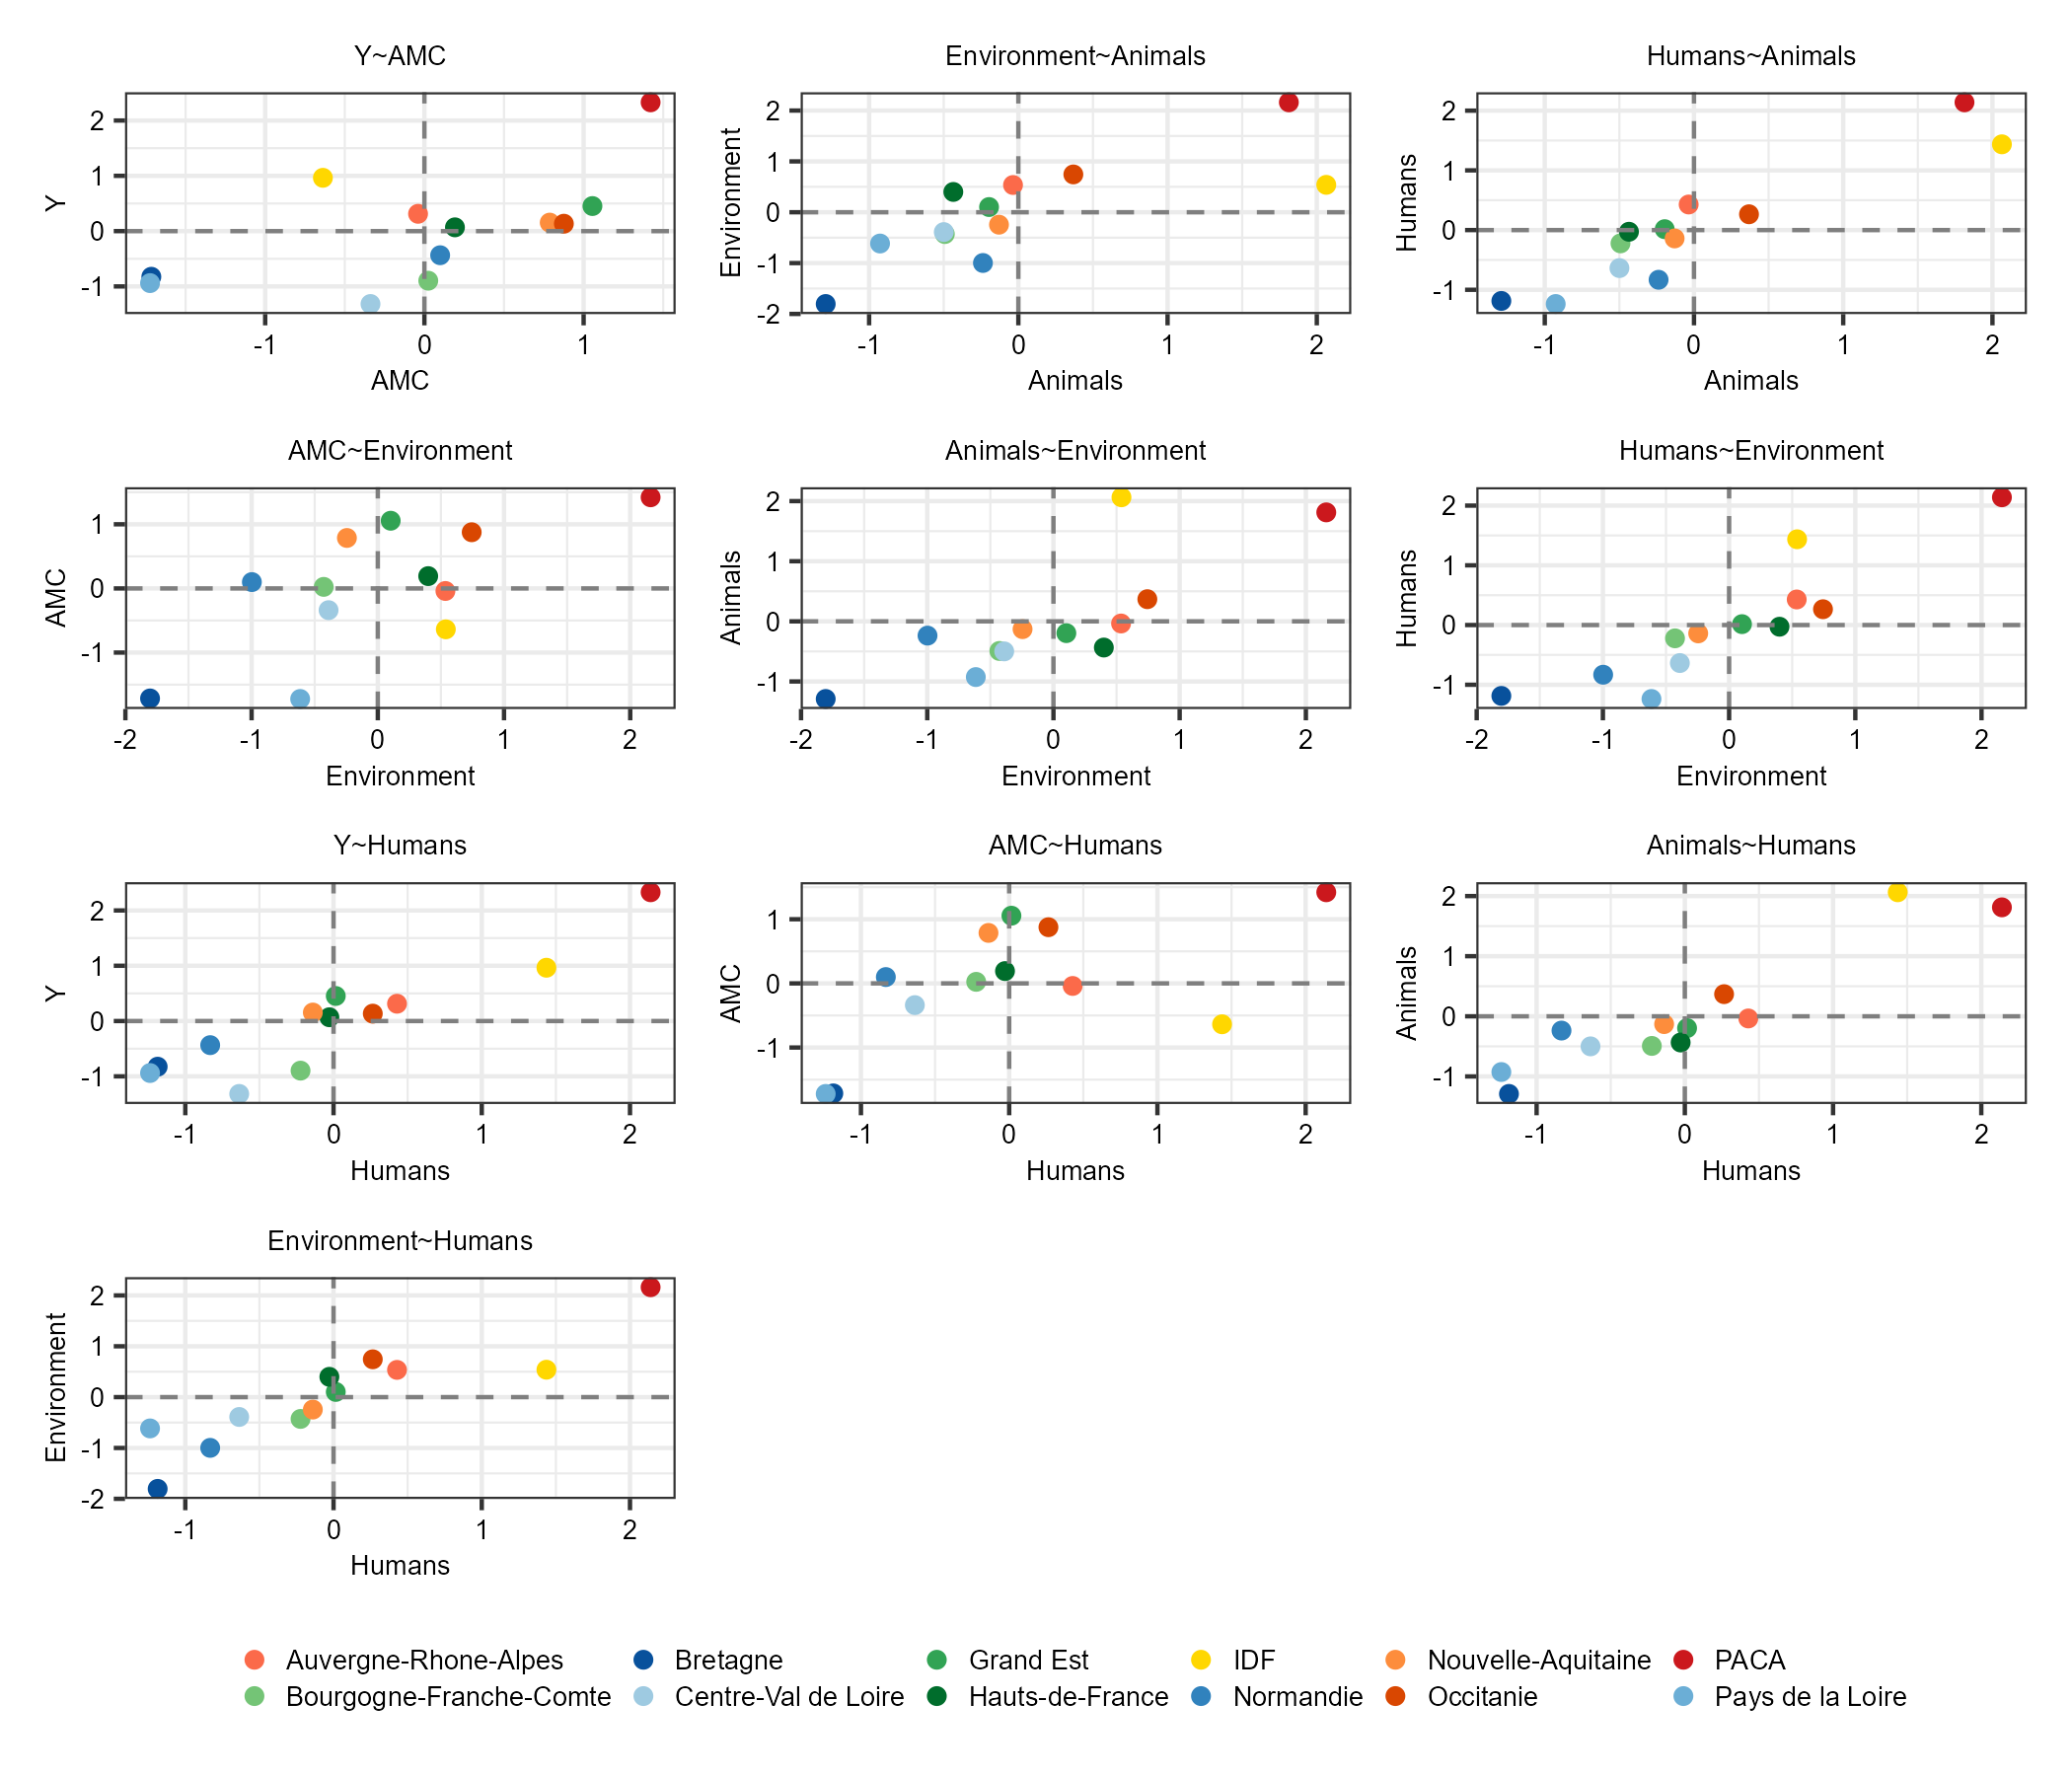
Scatterplot of latent variables
Interpretation
The positive relation between Y block and Humans block is characterized by PACA which has a lot of doctors per population and few trust in institutions, this region has a lot of resistance.
Some regions have an high AMC level but few resistance: Grand-Est, Occitanie, Nouvelle-Aquitaine.
PACA and sometimes IDF could be considered as atypical regions and have some values very different compared to other regions and can drive the values of path coefficients. The sample size is also a limitation.
Notes:
More than 67 OH candidate variable
inclusion of companion animals, addressing a gap highlighted by Jin et al. (2023).
Faire lien entre JACRIA like et besoin de panel regression models
Test : Fischer test between ols and fixed effects

Slide 16
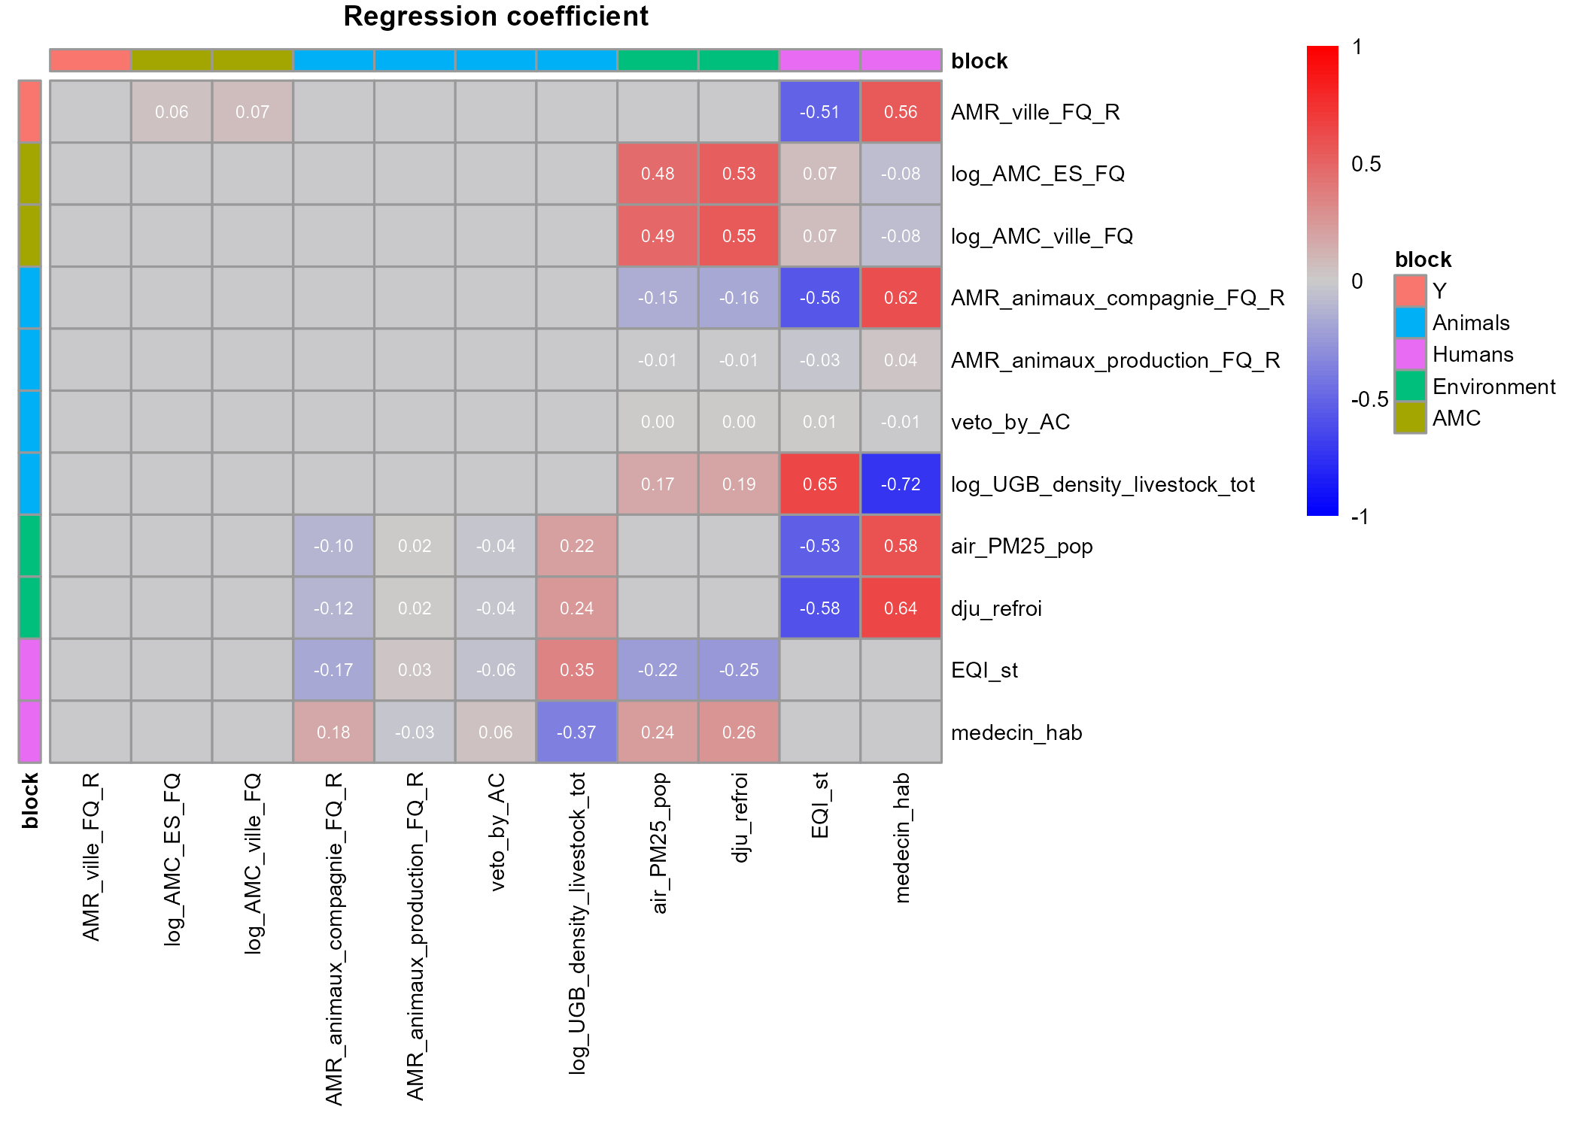
Regression coefficients between fPC1 scores
Interpretation
Example: AMR_ville_FQ_R = 0.56*medecin_hab – 0.51 EQI_st + 0.06 log_AMC_ES_FQ + 0.07 log_AMC_ville _FQ
It’s low EQI and high number of doctors per population which explain the most the regional resistance of fluoroquinolone in primary care setting.
The consumption of FQ in hospitals and primary care setting are positively explained by polution of the air (PM 2.5) and the use of climatisation (dju_refroi). These two variables are also well explained by variables of the Humans block
FQ resistance in pets is also chracterized by a lot of doctors per population (surprisingly not vet) and low EQI.
Notes:
More than 67 OH candidate variable
inclusion of companion animals, addressing a gap highlighted by Jin et al. (2023).
Faire lien entre JACRIA like et besoin de panel regression models
Test : Fischer test between ols and fixed effects

Slide 17
Conclusion and perspectives

Slide 18
Conclusion
fPCA allows us to go from a functional variable to a principal component score, which permit us to summarize the temporal dimension of a variable and to obtain independent observations.
Then the use of GSCA permits us to explore relational links between blocks and to consider several statistical models: a main one (with Y = AMR_ville_FQ_R as response variable) and submodels. It’s ideal for taking into account the One Health dimension of our problem.
The resistance of Fluoroquinolone in primary care setting is surprisingly mainly explained by the humans block more than the animicrobial consumption of Fluoroquinolone. Indeed, a low EQI, and a high level of doctors per population is associated with a high level of fluoroquinolone resistance at the regional scale.
Environment block is characterized by pollution, Animals block mainly by livestock density. The common point of the three One Health blocks is the urban/rural characteristic of the region. There are more resistance in urban regions.
Notes:
More than 67 OH candidate variable
inclusion of companion animals, addressing a gap highlighted by Jin et al. (2023).
Faire lien entre JACRIA like et besoin de panel regression models
Test : Fischer test between ols and fixed effects

Slide 19
Limits and perspective
The sample size is low (n=12 regions). This is the main limit because a consequence of that is that the estimation of model parameters are not stable. An idea would be to work at the departmental scale instead of regional scale but it’s difficult because there is no enough data of AMC and AMR at departmental scale.
We summarized functional variables with only one principal component score. Generally this fPC1 summarizes mean differences over the time between regions but not some noises at some years which could be interesting to consider in our analysis. A perspective could be to use Three-way GSCA⁵ with more than one principal component.
The final goal of our work would be to perform functional GSCA⁶ directly to functionnal variable without doing any fPCA.
The relations observed are interesting but should be consider regarding their correlation with other variables not selected by the clustering of variables method.
Notes:
More than 67 OH candidate variable
inclusion of companion animals, addressing a gap highlighted by Jin et al. (2023).
Faire lien entre JACRIA like et besoin de panel regression models
Test : Fischer test between ols and fixed effects

Slide 20
References
Ramsey, J. O. and Silverman, B. W. (2005). Functional Data Analysis, Chapter 8.
Vigneau, E., & Qannari, E. M. (2003). Clustering of Variables Around Latent Components. Communications in Statistics - Simulation and Computation, 32(4), 1131–1150.
Hwang H., Takane Y. (2004). Generalized Structured Component Analysis. Psychometrika Vol.69, No. 1, 81–99.
Bougeard S., Hanafi M. (2023). Prediction model for multiblock data with or without intermediate blocks. Estimation by PLS Path Modeling.
Choi J. Y., Hwang H. (2018). Three-Way Generalized Structured Component Analysis.
Suk H. W., Hwang H. (2016). Functional Generalized Structured Component Analysis. Psychometrika
Notes:
More than 67 OH candidate variable
inclusion of companion animals, addressing a gap highlighted by Jin et al. (2023).
Faire lien entre JACRIA like et besoin de panel regression models
Test : Fischer test between ols and fixed effects

