Slide 1
Autograding C++ Assignments
By
George Mattingly

Slide 2
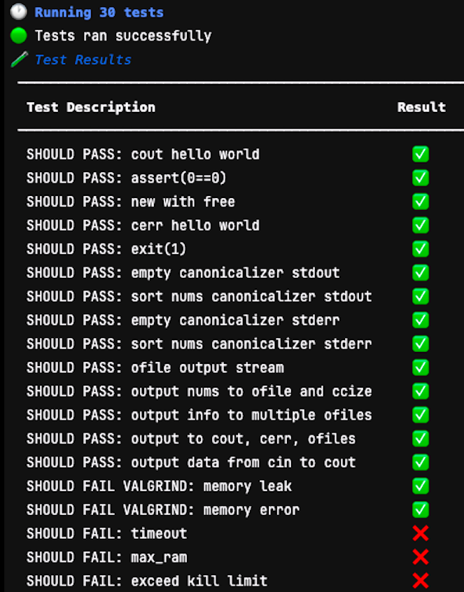
What is an Autograder?
An autograder is a piece of software that takes student homework submissions and automatically checks for accuracy
It then returns a grade based on all the tests a submission passes or fails.

Slide 3
Motivation
Autograder’s provide many quality-of-life improvements such as:
Wanted to make professor’s lives easier for grading. (mention time at UMD)
Replacing the need for most manual grading
Provide immediate feedback to students
Encourages more testing on code
Encourages clean and efficient code

Slide 4
Downsides of Using an Autograder:
Not getting specific feedback on your homework
Would need updating anytime companies changed their codebase
Could be tedious to update assignments if classes change
If the programming language for the course changes, the entire autograder would be useless

Slide 5
Goals
The autograder should be able to:
Tests should easily be able to be added by the professor for any given assignment.
Tests should be ran when the student submits their code to GradeScope
Tests should be given a score on pass/fail.

Slide 6
Goals Cont.
That score should then be posted in GradeScope.
Students should be able to see which tests they passed or failed.
Tests should give some feedback for students to fix

Slide 7
Roadmap:
Many moving parts working in unison
First step is picking a platform. I chose GradeScope because that is used by Franciscan.
Next step is to decide on a language to build the autograder for since the requirments will change depending on the language.

Slide 8
Roadmap Cont.
I chose C++ as the language for the autograder because Franciscan recently switched back to C++ from Python
For Unit testing, C++ requires a testing framework. I had two reasonable choices: GoogleTest and Catch2.
For the application to be uploaded to GradeScope, Docker is used to contain the required software in a version of Ubuntu Linux for it to work every time the same way.

Slide 9
What is GradeScope?
GradeScope is a platform to post grades for students.
It is used in the CS and SFE departments because of it’s ability to setup programming assignments

Slide 10
Why did I use GradeScope?
I chose to go with this platform because it is used in the CS and SFE departments.
There may have been better options but this one had resources readily available for getting started on building and integrating autograders on the site.

Slide 11

Docker is like a virtual machine but is less resource intensive and faster to get up and running.
It is widely used in application development because of the stability and speed they provide in development.
It helps one avoid the issue of software only working on specific operating systems while also not using as many resources as a virtual machine.

Slide 12
GoogleTest vs. Catch2
GoogleTest and Catch2 are both C++ frameworks that help one write C++ unit tests faster.
GoogleTest is a bit more complex and needs CMake to get working but allows for some more complex tests.
Catch2 is good because it is simple to setup and use with minimal effort and does not require CMake.
In testing, I tried both frameworks to compare how each faired.
Went with GoogleTest because I found GoogleTest easier to understand

Slide 13
CMake
Cmake is a way to build applications in a clean manner
I use it in my project to build the googletest framework and allow it to be used in the execution of the tests I’ve written.

Slide 14
Using a premade Autograder
Found a premade autograder that used Catch2 testing framwork
Problem with autograder was that it only accepted 1 header file for C++
Tried adding capability to add more files but ran into issues with code.

Slide 15
Running an Autograder on GradeScope
Was successful initially with getting the autograder to run
Problems started occurring when I tried to add more files to the tests such as other .cpp files
I decided as well that I wanted to use GoogleTest instead of Catch2 because I had become more familiar with it.

Slide 16
Changing the Autograder for GoogleTest
Almost immiediately ran into problems when reconfiguring the code to work with GoogleTest
Had to write all the CMakeList.txt files to setup the project from scratch since Cmake wasn’t being used in the original project
Many of the python scripts either didn’t work properly or were setup for Catch2’s framework.

Slide 17
Using the prebuild still saved time
While several parts weren’t helpful, there were a couple big python files that helped tremendously in the project.
Some aspects that were supposed to make subdirectories however were busted and I needed to use a bash script inside the run_test file instead.

Slide 18
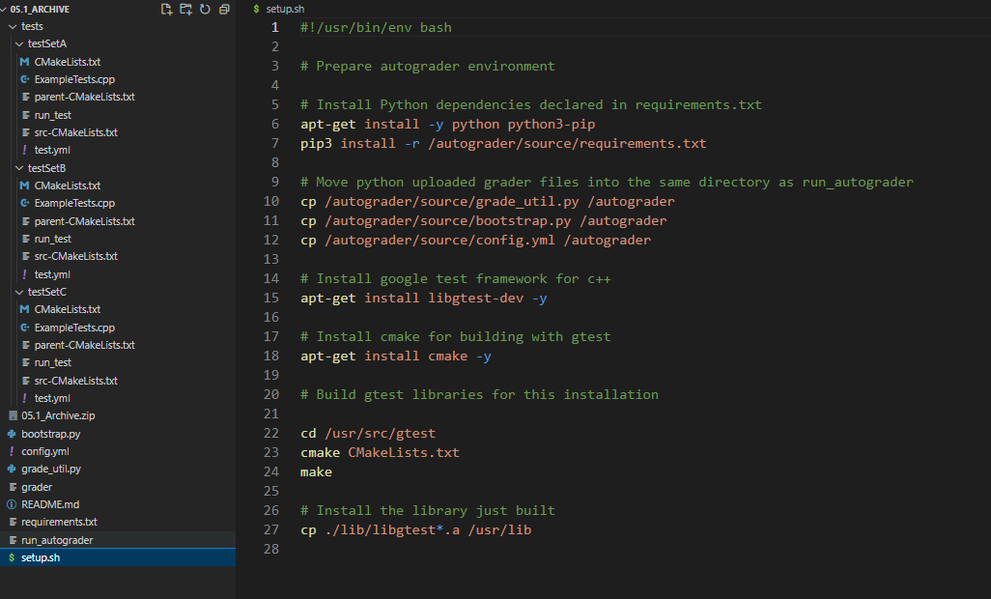
Setup.sh file
This file setup all the dependencies in the project.
This is what was used to make sure the docker container was generated with all the needed tools.
Without this, nothing would run, because it’s a new machine on creation.

Slide 19
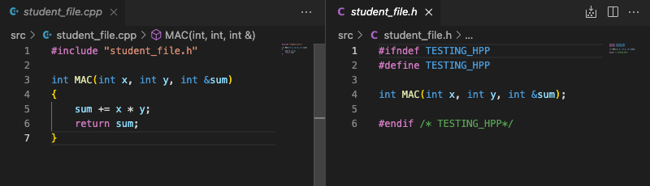
Taking a look at the code:
I used a very basic example of what a student submission would be.
In practice, there would be many functions, classes, and more files

Slide 20
Results of Autograder:
After several trials and patches, the autograder successful ran
The autograder successfully gave each test a score that I assigned to it and posted it in the overall grade report for the student’s view.

Slide 21
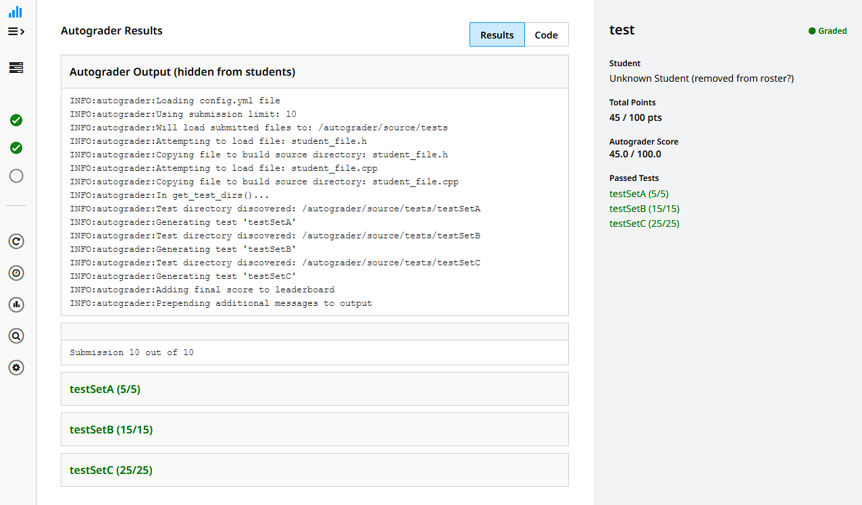

Slide 22
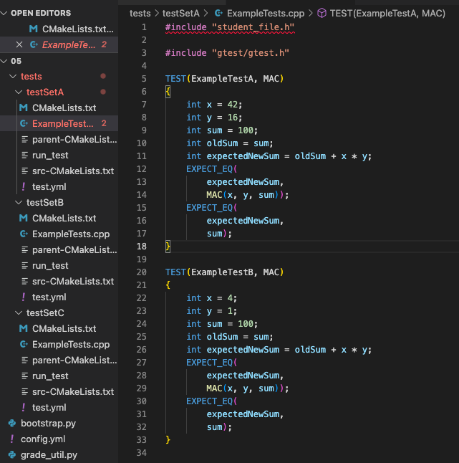
Adding more tests
In the current version, a test can be added by making a new folder in the test directory and copying over the files from the other tests folders.
The test.yml file needs to have a new name for the test and how many points it will be worth.
Then it’s as easy as deleting the ExampleTests.cpp and adding the tests to the folder!

Slide 23
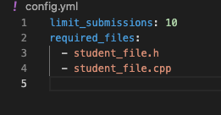
Making new Tests Cont.
The professor using this autograder can specify which files the autograder expects from the student by putting it in the config.yml file.

Slide 24
Updates going forward
Make it so that the student can submit any number of files instead of needing to specify in the config.yml which ones are allowed to be submitted.
Clean up all the unused code in the project.
Update the repository with better explanations of setting up new tests

Slide 25
Acknowledgements:
Dr. Frezza
Doug Reynolds

Slide 26
References:
https://google.github.io/googletest/
https://cmake.org/about/
https://www.docker.com/
https://github.com/UgiR/gradescope-autograde-cpp

