Slide 1
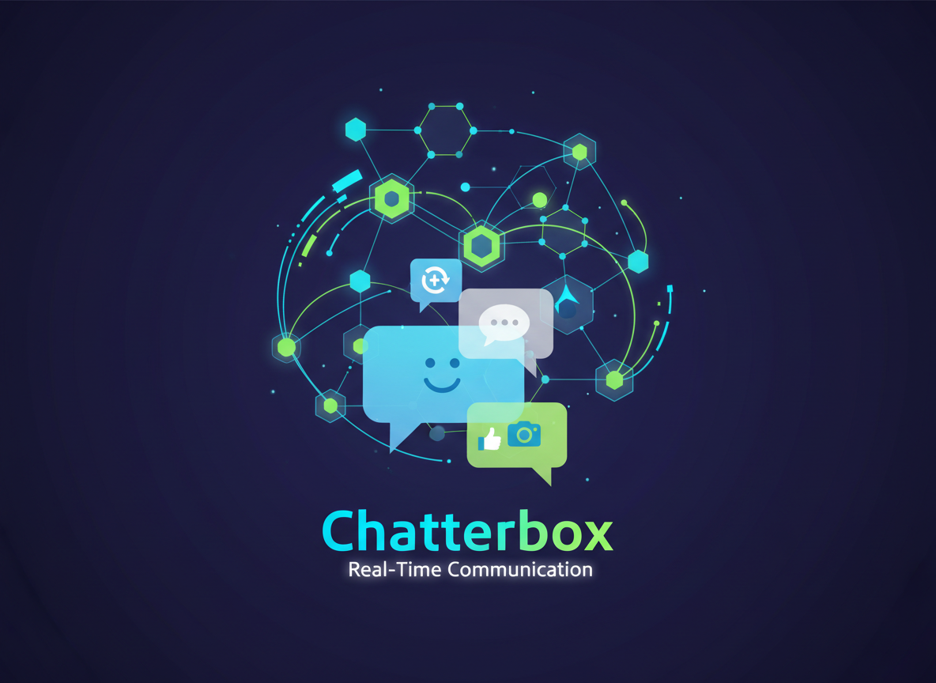
Chatterbox: A Real-time WebSocket Chat Application

Slide 2
Introduction
Real-time applications such as chat systems require continuous communication between clients and servers.
Traditional web applications use HTTP request-response architecture, which:
Is stateless
Does not support persistent connections
Introduces latency for live updates
To overcome these limitations, this project implements a real-time chat system using WebSockets and JWT authentication.

Slide 3
Problem Statement
Traditional HTTP-based systems are inefficient for:
Instant messaging applications
Live collaboration tools
Real-time dashboards
Challenges:
No persistent connection
High server load due to polling
No built-in multi-user broadcasting
Security concerns in real-time systems
Therefore, a scalable and secure real-time architecture is required.

Slide 4
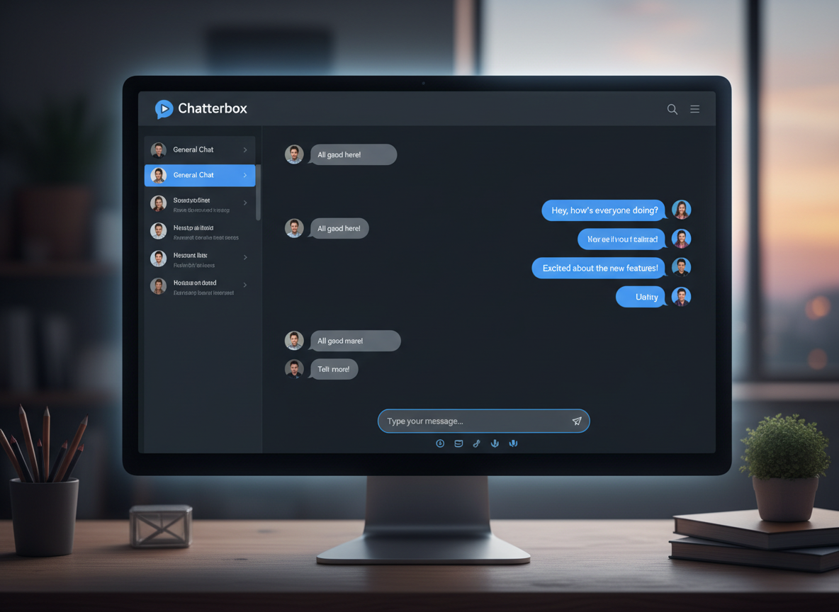
Proposed Solution
Develop a real-time chat application using:
FastAPI (Asynchronous backend framework)
WebSocket protocol (Persistent communication)
JWT (Secure authentication mechanism)
SQLite database (Data persistence)
HTML, CSS, JavaScript (Frontend UI)
This ensures:
Instant message delivery
Secure user authentication
Persistent chat storage
Multi-user support

Slide 5
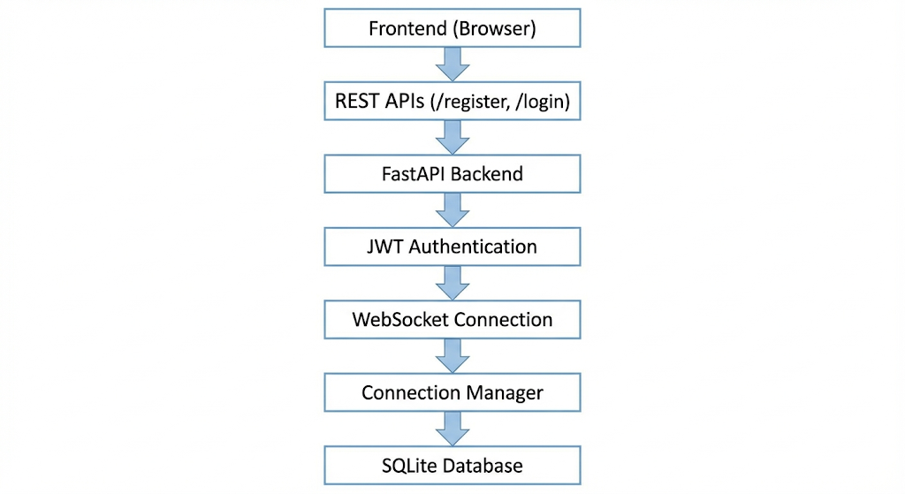
System Architecture

Slide 6
Authentication Mechanism (JWT)
We implemented JWT-based authentication.
Flow:
User logs in
Server generates JWT token
Token stored in browser
Token passed during WebSocket connection
Server validates token before allowing chat access
Advantages:
Stateless authentication
Secure access control
Scalable session handling

Slide 7
Backend Modules
1️⃣ FastAPI Server
Handles HTTP and WebSocket endpoints
2️⃣ WebSocket Manager
Tracks active connections
Broadcasts messages
3️⃣ Authentication Module
Password hashing (bcrypt)
JWT token generation
4️⃣ Database Module
Stores users
Stores chat history

Slide 8
Frontend Design
Frontend consists of:
Login & Registration Page
Chat Interface Page
Features:
Token stored in localStorage
Automatic redirection after login
Message differentiation:
  Current user → Right side
  Other users → Left side
Modern minimal UI for better user experience.

Slide 9
WebSocket Working
WebSocket establishes a persistent connection between client and server.
Unlike HTTP:
No repeated requests
Real-time bidirectional communication
Server pushes messages instantly
Broadcast Logic:
When one user sends message
Server sends it to all connected clients

Slide 10
Database Schema
Users Table:
id
username
hashed_password
Messages Table:
id
username
message
timestamp
Benefits:
Persistent chat history
User management
Scalable structure

Slide 11
Key Features
Real-time multi-user chat
JWT-based secure authentication
Persistent message storage
Message alignment (Me vs Others)
Asynchronous backend
Multi-client testing supported

Slide 12
Testing & Results
Tested with:
Multiple browser sessions
Incognito windows
Simultaneous users
Results:
Instant message broadcasting
Secure user validation
Stable WebSocket connections
Persistent chat history

Slide 13
Technologies Used
Backend:
Python
FastAPI
WebSockets
SQLite
JWT
bcrypt
Frontend:
HTML
CSS
JavaScript
Tools:
VS Code
Uvicorn
Browser DevTools

Slide 14
Advantages and Limitations
Advantages
High performance asynchronous system
Secure authentication mechanism
Scalable architecture
Real-time communication
Lightweight and efficient
Limitations
SQLite limits enterprise-scale deployment
No private chat feature
No file sharing
Basic UI (can be improved with React)

Slide 15
Future Enhancements
Online users list
Private chat rooms
Typing indicators
End-to-end encryption
React-based frontend
Docker containerization
Cloud deployment

Slide 16
Conclusion
Chatterbox successfully demonstrates:
Real-time WebSocket communication
Secure JWT-based authentication
Multi-user broadcasting
Persistent chat history
Clean frontend-backend separation

Slide 17
Thank you

