Slide 1
Automatic building detection from optical satellite images
Using Deep Learning
楊尚峰 陳心蓓

Slide 2
About the Project
01.
Algorthim
04.
Model Design
02.
AE vs Deep ResNet
05.
Prediction & Results
03.
Conclusion
06.
Dataset & Data Augmentation
OTSU & Dhash
Autoencoder & Deep ResNet
Comparison in 2 models
Explanation of Results
Suggestion & QA

Slide 3
01
About the Project
Dataset & Data Augmentation

Slide 4
Our goal is to train a neural network to predict building region in satellite images.
We had built 2 models for the project:
Autoencoder & Deep ResNet

Slide 5
Working Environment
GPU
TensorFlow
IDE
RTX 1060 6 GB
2.1
Spyder & Pycharm

Slide 6

WHU Building DataSet
8
Multiple
Cities Images
Satellite Source
204
Free
512*512 images
$0
TW & Wuhan & LA…
Quickbird & IKONOS & ZY-3…
Fast Download
Awesome

Slide 7
Data Augmentation
Step 1
Step 2
Step 3
Step 4
Randomly generate 4 coordinates
Cut 256*256 out from original image with 4 coordinates
Rotate in 90 / 180 / 270 degree
Flip horizontally and vertically

Slide 8
204 -> 4896
Due to the limit of our device，we only use :
1080 training + 144 testing
2700 training + 168 testing

Slide 9
02
Model Design
Autoencoder & Deep ResNet

Slide 10
Design Steps
Customize
Tuning
Imitation
Activation Function & Loss & Batch Size
Add layers & change filters
Segnet
ResNet50

Slide 11
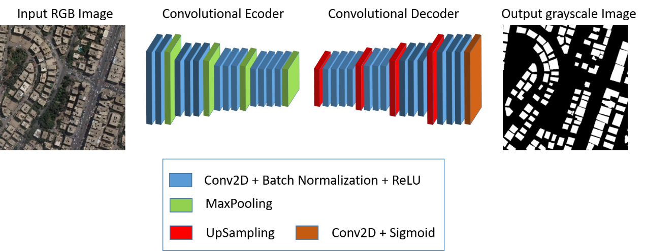
Autoencoder

Slide 12
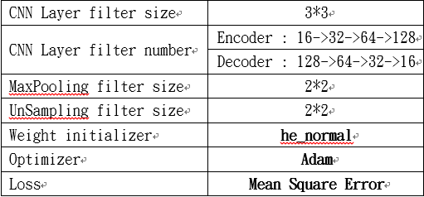
Autoencoder

Slide 13
Deep ResNet

Slide 14
Deep ResNet

Slide 15
03
Prediction & Results
Explanation of Results

Slide 16
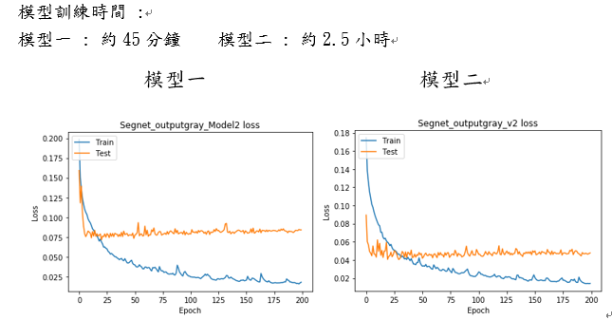
Autoencoder

Slide 17
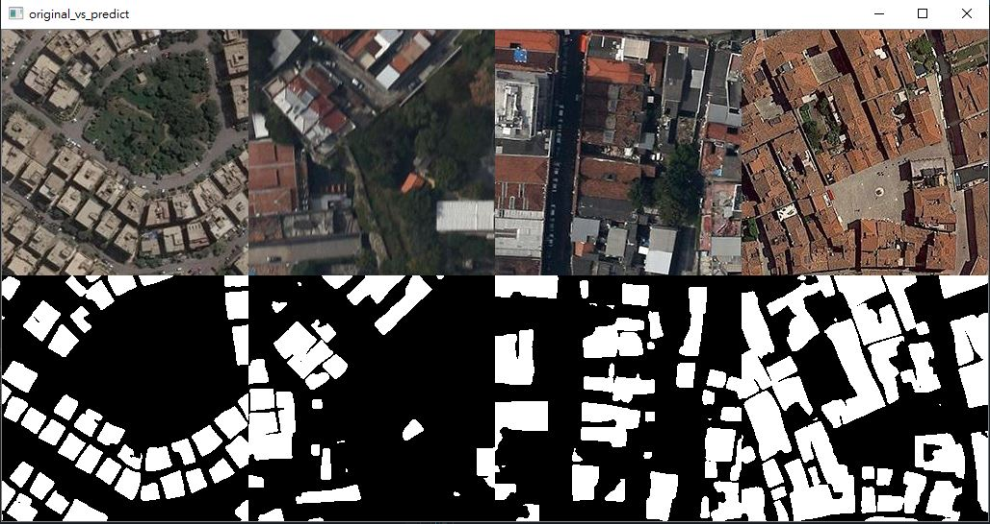
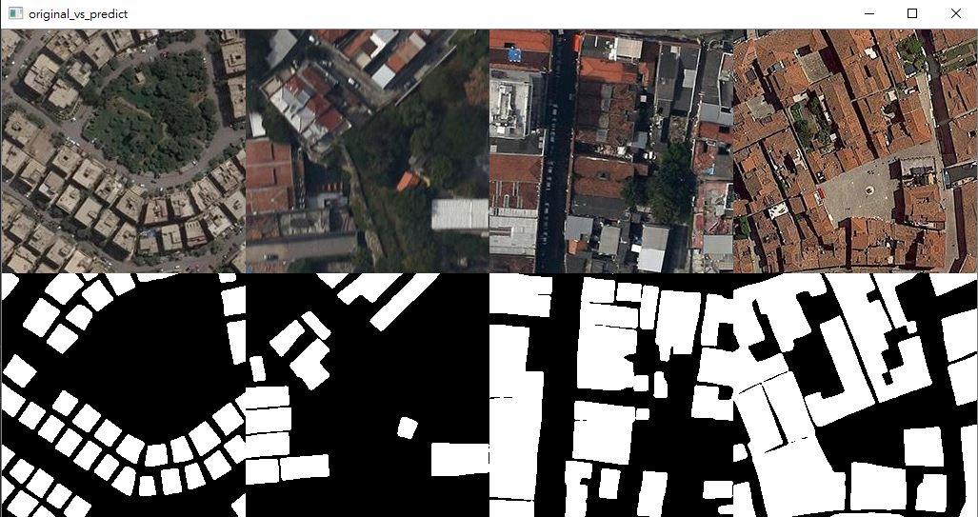
Autoencoder
Model | Epoch | Batch Size | MSE | Val MSE
1 | 200 | 16 | 0.0253 | 0.0811
2 | 200 | 16 | 0.0153 | 0.0519
Model 1 Model 2

Slide 18
Autoencoder
圖形完整度
模型一預測出的形狀較為破碎，而模型二預測出的形狀完整度較高。
預測時間
兩組模型在預測上的速度都很不錯，平均預測一張約0.8-1.26秒之間，
模型二速度略遜於模型一。
適合的預測對象
模型一在小面積建物細節把握較好
模型二能適應較多種類的建物

Slide 19
Deep ResNet

Slide 20
Deep ResNet

Slide 21
Deep ResNet

Slide 22
04
Algorthim
OTSU & Dhash

Slide 23
Improve Segmentation
Get Vague Images
Quantify
Predict
Threshold
1
Color isn’t fully seperated
3
how similar it is compare with ground truth
2
Image Binarization
4

Slide 24
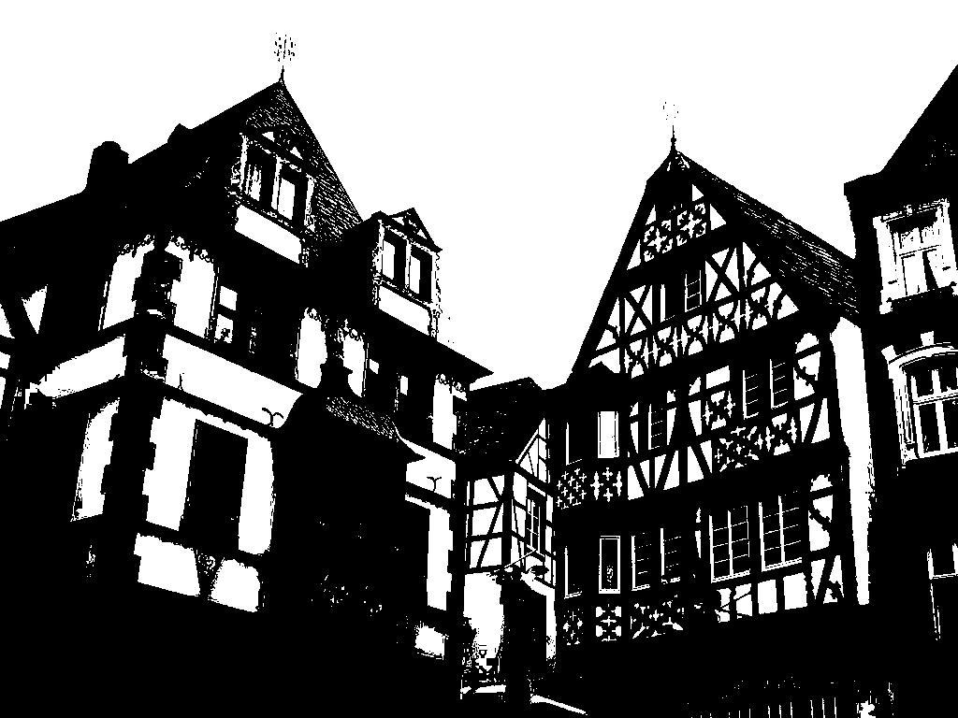
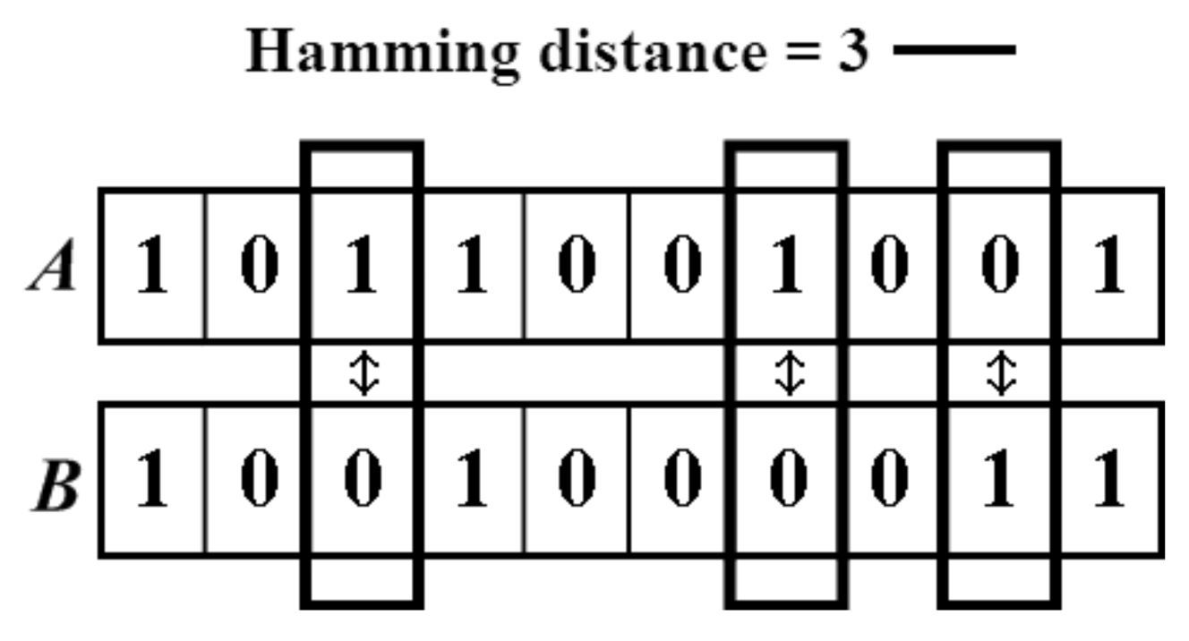
Algorithm We Applied
OTSU
Dhash
Considered the best algorithm in determine binary threshold
Better Algortithm in Perceptual hash algorithms

Slide 25
OTSU
Easy Calculate
Foreground
Background
Exhaustive method
Support in OpenCV
Flaws
Only 7 equations
High grayscale
Low grayscale
Kind of Unefficiency
Import CV2
Not working in some cases

Slide 26
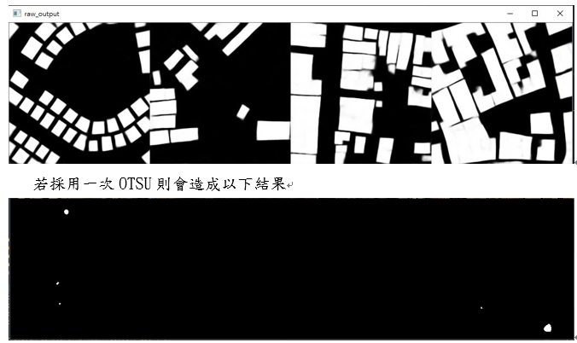
OTSU

Slide 27
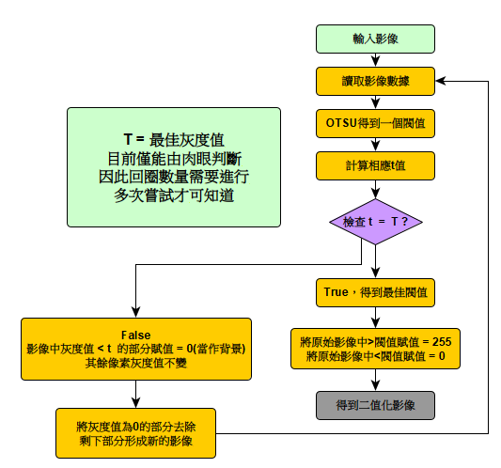
Recursive OTSU
Result : 迴圈數量不易控制，後來改用平均灰度值後，發現效果還不錯

Slide 28
Dhash
Easy Calculate
Resize to 8*8
Grayscale
Hammimg Distance
Only 4 steps
Pixel1 > Pixel2 : 1
Pixel1 > Pixel2 : 0
檔案名稱(.jpg) | n值 | 檔案名稱 | n值
406_90 | 6 | 18_90 | 3
421_90 | 4 | 42_90 | 13
428_90 | 6 | 50_90 | 16
469_90 | 4 | 66_90 | 12
35_90 | 17 | 74_90 | 15
59_90 | 7 | 98_90 | 8
75_90 | 8 | 114_90 | 11
83_90 | 17 | 120_90 | 15
2_90 | 10 | 122_90 | 9
10_90 | 5 | 130_90 | 20
N>10 / N<6

Slide 29
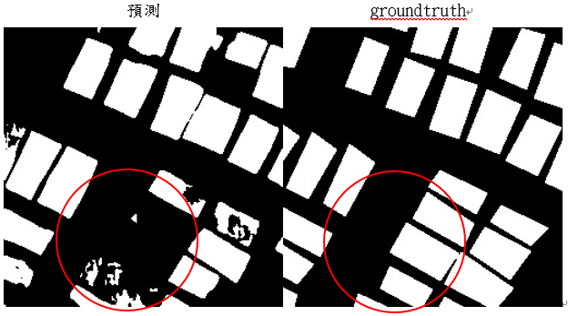
Dhash
N = 13 ，圖中紅圈處，預測圖形明顯有2棟建物未能成功分類。

Slide 30
05
AE vs Deep ResNet
Comparison in 2 models

Slide 31
Comparison
Attributes \ Model | Autoencoder | Deep ResNet
Training time | 2 h 45 min | 11 h
Predict time | faster | slower
Model Loss
Parameters | Over 1,200,000 | Nearly 700,000

Slide 32
06
Conclusion
Suggestion & QA

Slide 33
Conclusion
Autoencoder精確度中上但耗時短，適合進行初步辨識建物
ResNet精確度高但耗時太久，且對電腦效能要求較高
完全使用CNN Layer使模型保有彈性，接受任意尺寸影像輸入
Otsu算法在部分建物面積與背景差異過大的圖片上效果較差
未來可以增加訓練/測試資料數量，目前只有2700張稍嫌不足
增加Data Augmentation 方式(如調整亮度/透鏡畸變/Scaling等)

Slide 34
Thanks!
Do you have any questions?

