Slide 1
Friendly Competition
A critical analysis of the NYC Government’s job openings
Geoffery Mullings - Feb. 2016

Slide 2
Which Agency Has The Most Openings?
Dept. of Health & Mental Hygiene
(1247)
Dept. of Environmental Protection
(398)
Dept. of Design & Construction
(278)
Notes:
Insert bar plot of count(NYC_Jobs["Agency"]) here, only. Circle DHMH.

Slide 3
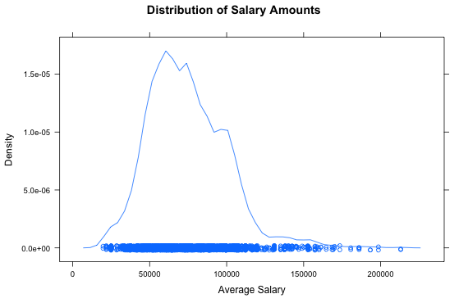
Which Agencies Have The Highest And Lowest Paying Positions?
Salary Averages
Minimum: $19,760
Maximum: $213,000
Notes:
Do a density plot here of ConJobsSal[AvgSal]

Slide 4
Which Agencies Have The Highest And Lowest Paying Positions?
Agencies with the lowest paying 2.5% of jobs (less than $23,773 annually)
Office of Administrative Trials and Hearings: 8 positions
Office of Collective Bargaining: 2 positions
Notes:
Insert a bar plot of sort(table(ConJobsSal[AvgSal <= 23387, "Agency"]))

Slide 5
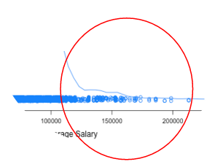
Which Agencies Have The Highest And Lowest Paying Positions?
Agencies with the highest paying 2.5% of jobs (more than $125,486 annually)
Department of Health and Mental Hygiene: 52 positions
Department of Sanitation: 14 positions
Department of Correction: 12 positions
Department of Business Services: 12 positions
Department of Environmental Protection: 10 positions
Notes:
Insert a bar plot of sort(table(ConJobsSal[AvgSal >= 126720, "Agency"]))

Slide 6
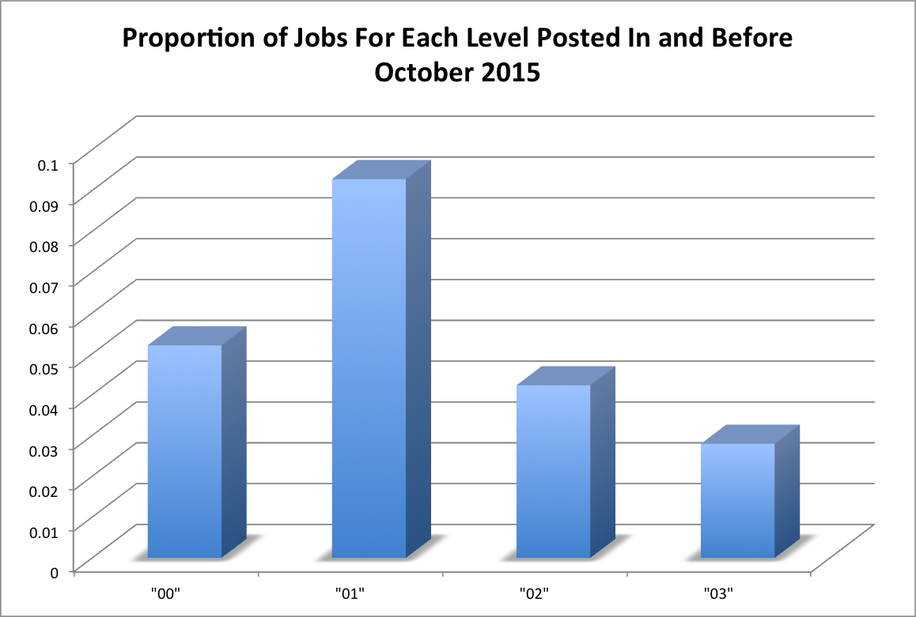
Which Openings Take The Longest To Fill?
Job levels and wages may matter!
Notes:
Need to present data on the ratio of jobs taking more than 4 months to fill: http://www.forbes.com/sites/nextavenue/2012/11/14/5-tips-for-getting-a-government-job/#1bd12f8b7ca8

Slide 7
Friendly Competition
A critical analysis of the NYC Government’s job openings
Geoffery Mullings
February 2016
Email: GeoffMullings@gmail.com

