Slide 1
图的连通性 在社会网络研究中的应用
Hongfei Yan
2020/12/22

Slide 2
社会网络
社会网络：每个人是一个顶点，两个人之间的认识关系作为有向边.
我认识某明星，但该明星不认识我
六度分隔理论：世界上任何互不相识的两人，只需要很少的中间人就能够建立起联系.
理论在一个大的范围“世界”上成立，但在一些特殊情况下，在较小的“子集”里面反而不成立
比如我们的班级：作为公共必修课，来自不同的院系/年级，建立联系反而困难起来
我们来研究这张“子图”性质，

Slide 3
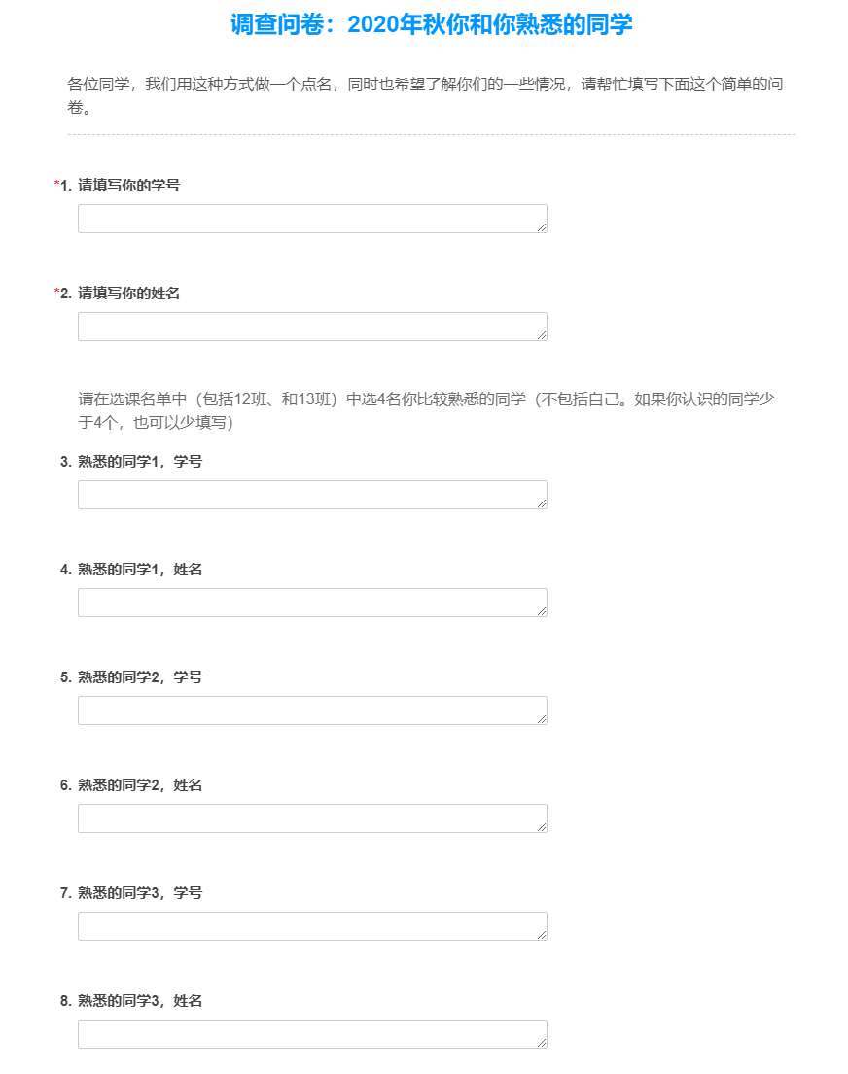

Slide 4
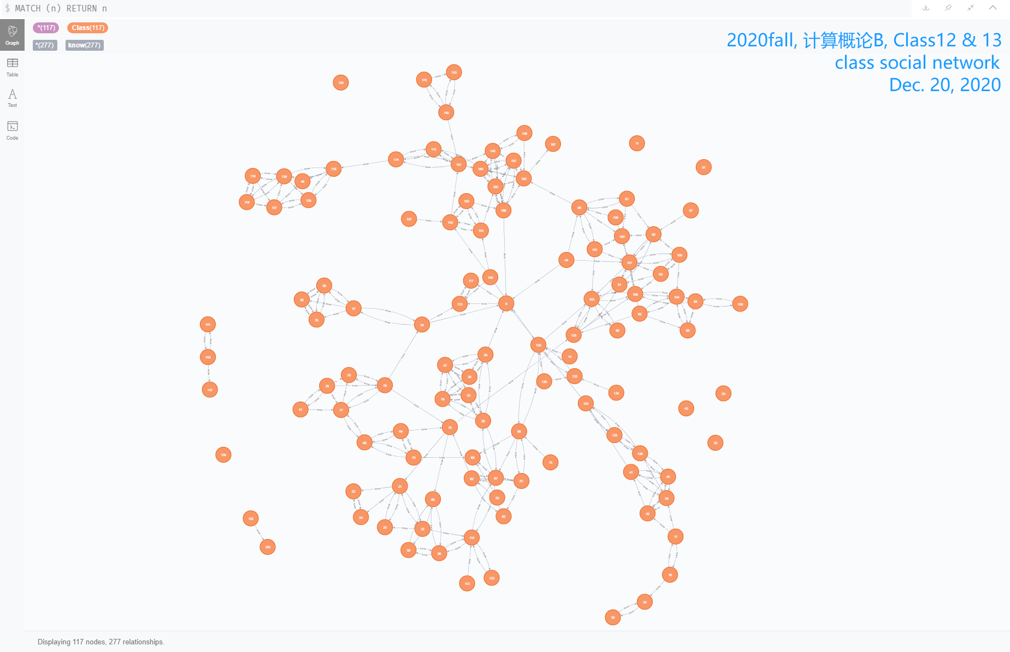

Slide 5
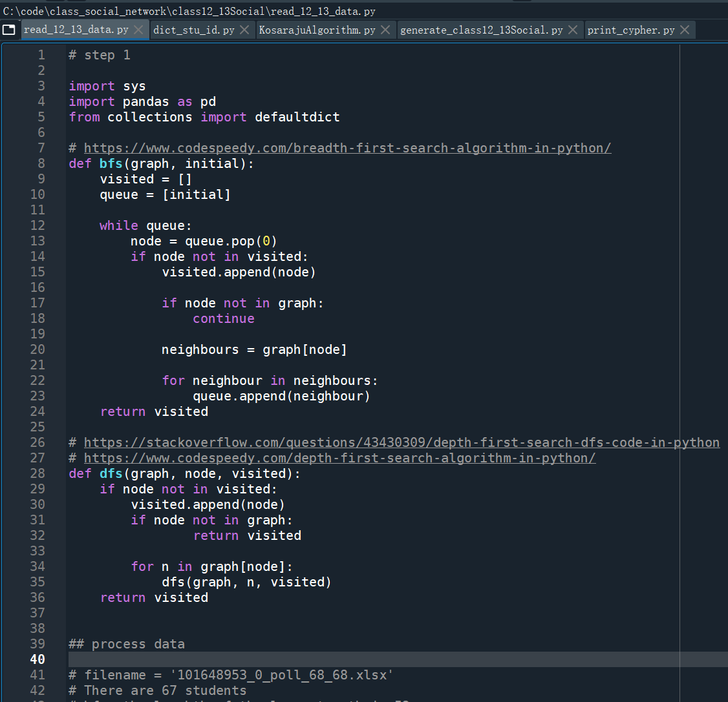
Notes:
# step 1
import sys
import pandas as pd
from collections import defaultdict
# https://www.codespeedy.com/breadth-first-search-algorithm-in-python/
def bfs(graph, initial):
visited = []
queue = [initial]
while queue:
node = queue.pop(0)
if node not in visited:
visited.append(node)
if node not in graph:
continue
neighbours = graph[node]
for neighbour in neighbours:
queue.append(neighbour)
return visited
# https://stackoverflow.com/questions/43430309/depth-first-search-dfs-code-in-python
# https://www.codespeedy.com/depth-first-search-algorithm-in-python/
def dfs(graph, node, visited):
if node not in visited:
visited.append(node)
if node not in graph:
return visited
for n in graph[node]:
dfs(graph, n, visited)
return visited
## process data
# filename = '101648953_0_poll_68_68.xlsx'
# There are 67 students
# bfs: the lenghth of the longest path is 52
# dfs: the lenghth of the longest path is 52
# filename = '101648953_0_poll_104_104.xlsx'
# There are 103 students
# bfs: the lenghth of the longest path is 76
# dfs: the lenghth of the longest path is 76
# filename = '101648953_0_poll_118_118.xlsx'
# There are 116 students
# bfs: the lenghth of the longest path is 79
# dfs: the lenghth of the longest path is 79
filename = '101648953_0_poll_119_119.xlsx'
# There are 117 students
# bfs: the lenghth of the longest path is 79
# dfs: the lenghth of the longest path is 79
df = pd.read_excel(filename, usecols=[6, 7, 8, 10, 12, 14])
#, encoding=sys.getfilesystemencoding())
data = df.values
print("There are {} students.".format(len(data)))
## create graph
graph = {}
isolated_vertex = defaultdict(str)
for i in range(len(data)):
if data[i][0] not in graph:
neighbours = data[i][2:]
neis = filter(lambda x: x != '(空)', neighbours)
neis = list(map(int, neis))
if len(neis) == 0:
isolated_vertex[data[i][0]] = data[i][1]
graph[data[i][0]] = []
else:
graph[data[i][0]] = neis
with open('class12_13Social.raw.txt', 'w', encoding=sys.getfilesystemencoding()) as f:
for key in graph.keys():
f.write("{} :".format(key))
for i in graph[key]:
f.write(" {}".format(i))
f.write("\n")
f.close()
ids = sorted(graph)
## bfs travel
maxp = 0
for i in ids:
bfs_path = bfs(graph, i)
maxp = max(maxp, len(bfs_path))
#print(len(bfs_path), bfs_path)
#print("bfs: the lenghth of the longest path is {}".format(maxp))
## dfs travel
maxp = 0
for i in ids[::-1]:
dfs_path = dfs(graph, i, [])
maxp = max(maxp, len(dfs_path))
#print(len(dfs_path), dfs_path)
print("dfs: the lenghth of the longest path is {}".format(maxp))

Slide 6
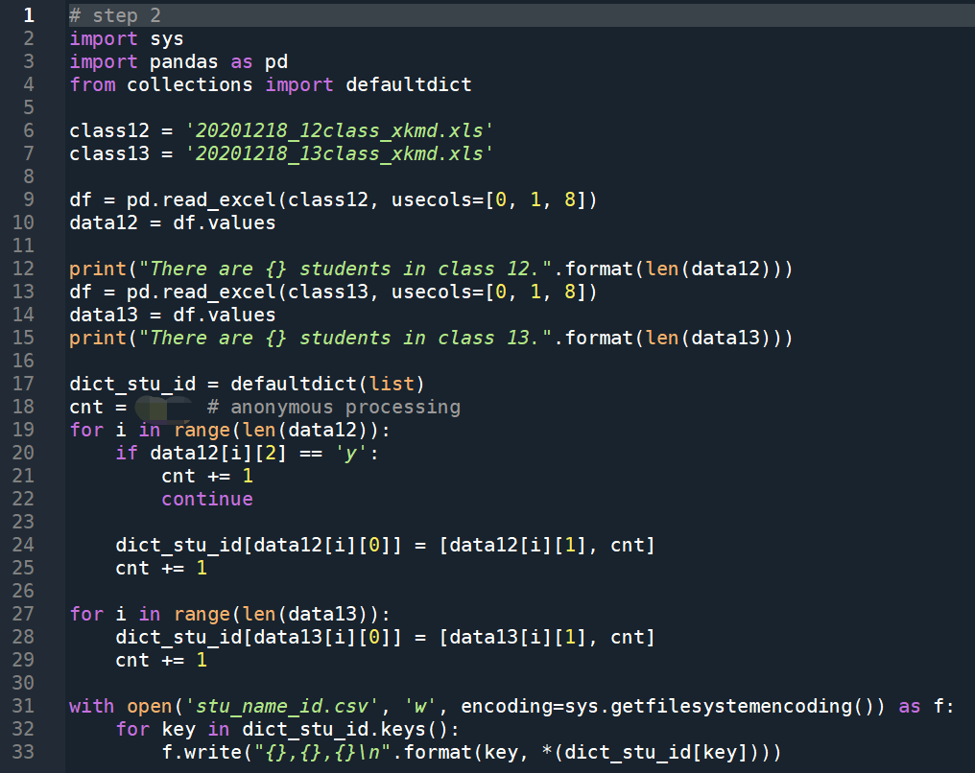
Notes:
# step 2
import sys
import pandas as pd
from collections import defaultdict
class12 = '20201218_12class_xkmd.xls'
class13 = '20201218_13class_xkmd.xls'
df = pd.read_excel(class12, usecols=[0, 1, 8])
data12 = df.values
print("There are {} students in class 12.".format(len(data12)))
df = pd.read_excel(class13, usecols=[0, 1, 8])
data13 = df.values
print("There are {} students in class 13.".format(len(data13)))
dict_stu_id = defaultdict(list)
cnt = XX # anonymous processing
for i in range(len(data12)):
if data12[i][2] == 'y':
cnt += 1
continue
dict_stu_id[data12[i][0]] = [data12[i][1], cnt]
cnt += 1
for i in range(len(data13)):
dict_stu_id[data13[i][0]] = [data13[i][1], cnt]
cnt += 1
with open('stu_name_id.csv', 'w', encoding=sys.getfilesystemencoding()) as f:
for key in dict_stu_id.keys():
f.write("{},{},{}\n".format(key, *(dict_stu_id[key])))

Slide 7
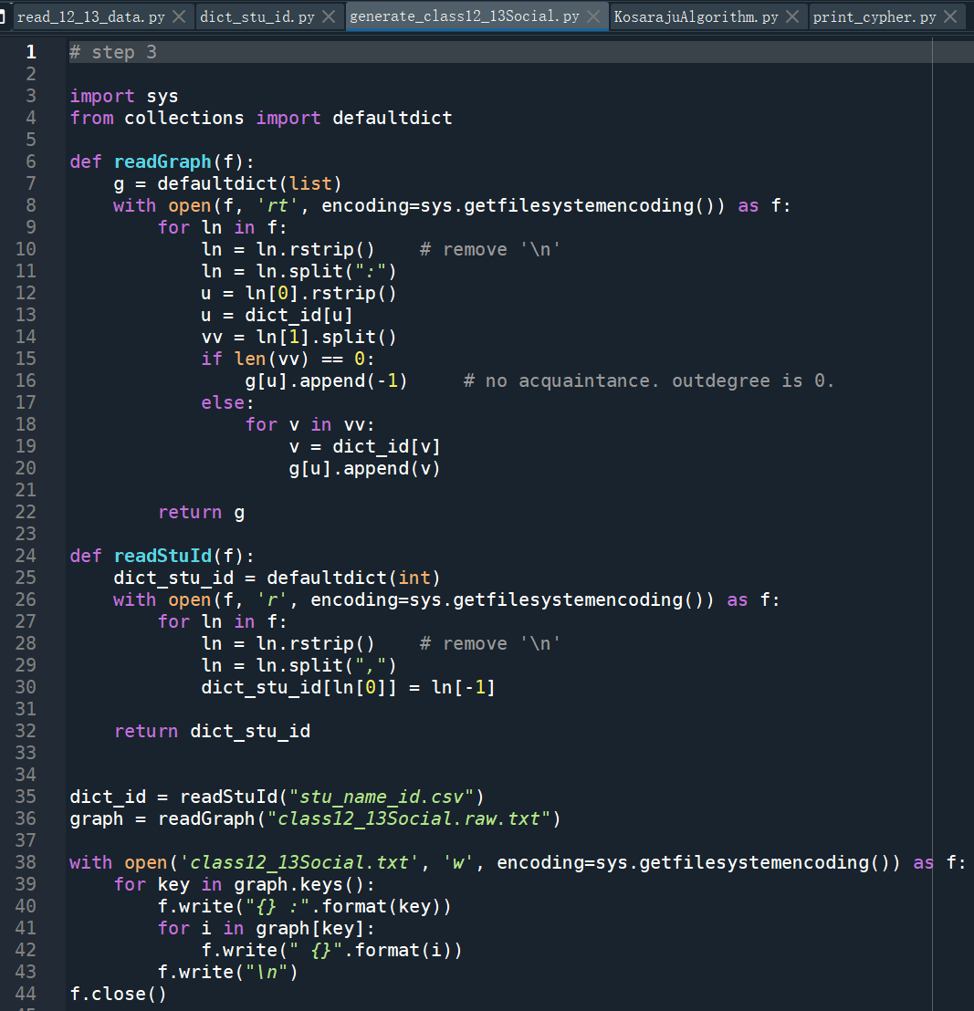
Notes:
# step 3
import sys
from collections import defaultdict
def readGraph(f):
g = defaultdict(list)
with open(f, 'rt', encoding=sys.getfilesystemencoding()) as f:
for ln in f:
ln = ln.rstrip() # remove '\n'
ln = ln.split(":")
u = ln[0].rstrip()
u = dict_id[u]
vv = ln[1].split()
if len(vv) == 0:
g[u].append(-1) # no acquaintance. outdegree is 0.
else:
for v in vv:
v = dict_id[v]
g[u].append(v)
return g
def readStuId(f):
dict_stu_id = defaultdict(int)
with open(f, 'r', encoding=sys.getfilesystemencoding()) as f:
for ln in f:
ln = ln.rstrip() # remove '\n'
ln = ln.split(",")
dict_stu_id[ln[0]] = ln[-1]
return dict_stu_id
dict_id = readStuId("stu_name_id.csv")
graph = readGraph("class12_13Social.raw.txt")
with open('class12_13Social.txt', 'w', encoding=sys.getfilesystemencoding()) as f:
for key in graph.keys():
f.write("{} :".format(key))
for i in graph[key]:
f.write(" {}".format(i))
f.write("\n")
f.close()

Slide 8
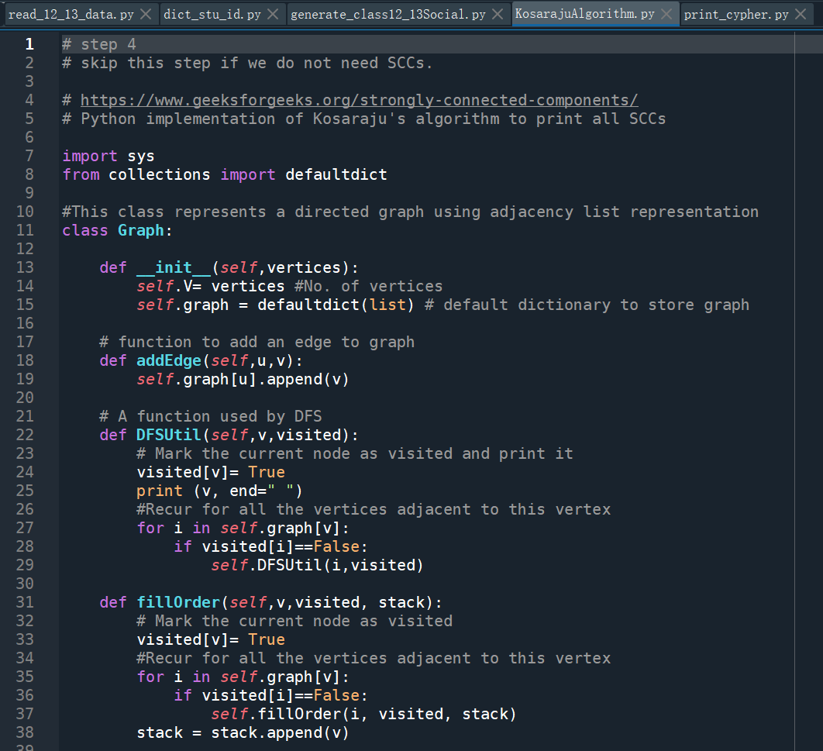
Notes:
# step 4
# skip this step if we do not need SCCs.
# https://www.geeksforgeeks.org/strongly-connected-components/
# Python implementation of Kosaraju's algorithm to print all SCCs
import sys
from collections import defaultdict
#This class represents a directed graph using adjacency list representation
class Graph:
def __init__(self,vertices):
self.V= vertices #No. of vertices
self.graph = defaultdict(list) # default dictionary to store graph
# function to add an edge to graph
def addEdge(self,u,v):
self.graph[u].append(v)
# A function used by DFS
def DFSUtil(self,v,visited):
# Mark the current node as visited and print it
visited[v]= True
print (v, end=" ")
#Recur for all the vertices adjacent to this vertex
for i in self.graph[v]:
if visited[i]==False:
self.DFSUtil(i,visited)
def fillOrder(self,v,visited, stack):
# Mark the current node as visited
visited[v]= True
#Recur for all the vertices adjacent to this vertex
for i in self.graph[v]:
if visited[i]==False:
self.fillOrder(i, visited, stack)
stack = stack.append(v)
# Function that returns reverse (or transpose) of this graph
def getTranspose(self):
g = Graph(self.V)
# Recur for all the vertices adjacent to this vertex
for i in self.graph:
for j in self.graph[i]:
g.addEdge(j,i)
return g
# The main function that finds and prints all strongly
# connected components
def printSCCs(self):
stack = []
# Mark all the vertices as not visited (For first DFS)
visited =[False]*(self.V)
# Fill vertices in stack according to their finishing
# times
for i in range(self.V):
if visited[i]==False:
self.fillOrder(i, visited, stack)
# Create a reversed graph
gr = self.getTranspose()
# Mark all the vertices as not visited (For second DFS)
visited =[False]*(self.V)
# Now process all vertices in order defined by Stack
while stack:
i = stack.pop()
if visited[i]==False:
gr.DFSUtil(i, visited)
print()
# Create a graph given in the above diagram
class_social_file = "class12_13Social.txt"
outdegree0 = set()
g = Graph(200) # there are 116 lines in class12_13Social.txt
with open(class_social_file, 'r', encoding=sys.getfilesystemencoding()) as f:
for ln in f:
ln = ln.rstrip() # remove '\n'
ln = ln.split(":")
u = int(ln[0].rstrip())
vv = [int(x) for x in ln[1].split()]
if vv[0] == -1: # no acquaintance. outdegree is 0.
#if len(vv) == 0:
outdegree0.add(u)
else:
for v in vv:
g.addEdge(u, v)
'''
g.addEdge(1, 0)
g.addEdge(0, 2)
g.addEdge(2, 1)
g.addEdge(0, 3)
g.addEdge(3, 4)
'''
print ("Following are strongly connected components in given graph")
g.printSCCs()

Slide 9
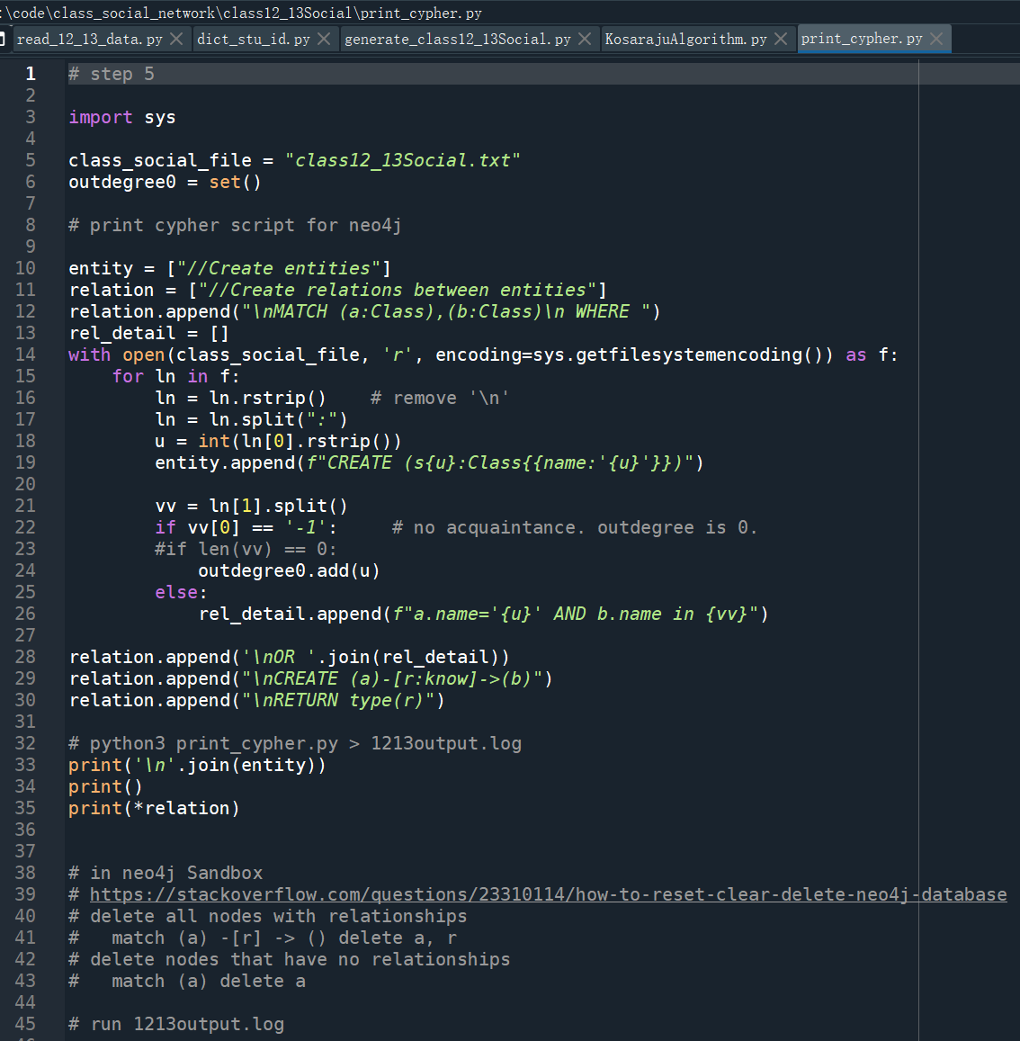
Notes:
# step 5
import sys
class_social_file = "class12_13Social.txt"
outdegree0 = set()
# print cypher script for neo4j
entity = ["//Create entities"]
relation = ["//Create relations between entities"]
relation.append("\nMATCH (a:Class),(b:Class)\n WHERE ")
rel_detail = []
with open(class_social_file, 'r', encoding=sys.getfilesystemencoding()) as f:
for ln in f:
ln = ln.rstrip() # remove '\n'
ln = ln.split(":")
u = int(ln[0].rstrip())
entity.append(f"CREATE (s{u}:Class{{name:'{u}'}})")
vv = ln[1].split()
if vv[0] == '-1': # no acquaintance. outdegree is 0.
#if len(vv) == 0:
outdegree0.add(u)
else:
rel_detail.append(f"a.name='{u}' AND b.name in {vv}")
relation.append('\nOR '.join(rel_detail))
relation.append("\nCREATE (a)-[r:know]->(b)")
relation.append("\nRETURN type(r)")
# python3 print_cypher.py > 1213output.log
print('\n'.join(entity))
print()
print(*relation)
# in neo4j Sandbox
# https://stackoverflow.com/questions/23310114/how-to-reset-clear-delete-neo4j-database
# delete all nodes with relationships
# match (a) -[r] -> () delete a, r
# delete nodes that have no relationships
# match (a) delete a
# run 1213output.log

Slide 10
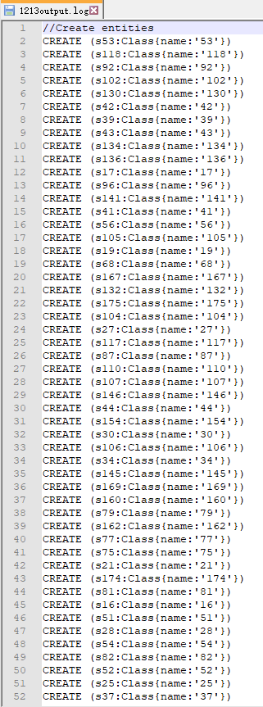
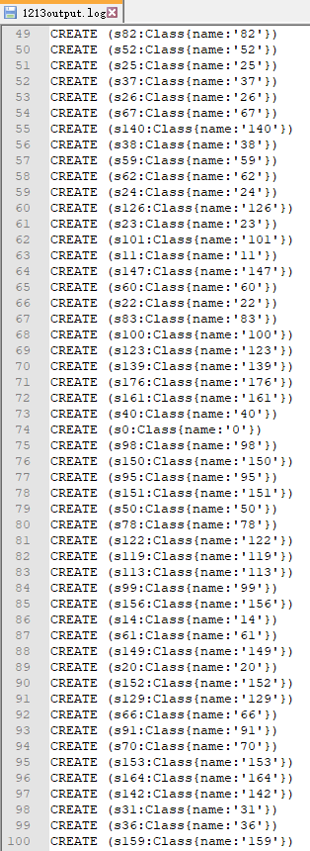
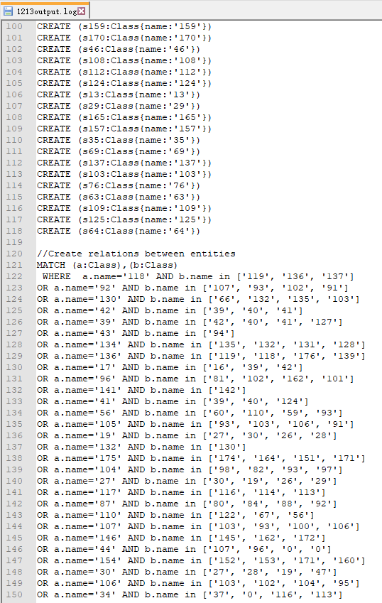
Notes:
//Create entities
CREATE (s53:Class{name:'53'})
CREATE (s118:Class{name:'118'})
CREATE (s92:Class{name:'92'})
CREATE (s102:Class{name:'102'})
CREATE (s130:Class{name:'130'})
CREATE (s42:Class{name:'42'})
CREATE (s39:Class{name:'39'})
CREATE (s43:Class{name:'43'})
CREATE (s134:Class{name:'134'})
CREATE (s136:Class{name:'136'})
CREATE (s17:Class{name:'17'})
CREATE (s96:Class{name:'96'})
CREATE (s141:Class{name:'141'})
CREATE (s41:Class{name:'41'})
CREATE (s56:Class{name:'56'})
CREATE (s105:Class{name:'105'})
CREATE (s19:Class{name:'19'})
CREATE (s68:Class{name:'68'})
CREATE (s167:Class{name:'167'})
CREATE (s132:Class{name:'132'})
CREATE (s175:Class{name:'175'})
CREATE (s104:Class{name:'104'})
CREATE (s27:Class{name:'27'})
CREATE (s117:Class{name:'117'})
CREATE (s87:Class{name:'87'})
CREATE (s110:Class{name:'110'})
CREATE (s107:Class{name:'107'})
CREATE (s146:Class{name:'146'})
CREATE (s44:Class{name:'44'})
CREATE (s154:Class{name:'154'})
CREATE (s30:Class{name:'30'})
CREATE (s106:Class{name:'106'})
CREATE (s34:Class{name:'34'})
CREATE (s145:Class{name:'145'})
CREATE (s169:Class{name:'169'})
CREATE (s160:Class{name:'160'})
CREATE (s79:Class{name:'79'})
CREATE (s162:Class{name:'162'})
CREATE (s77:Class{name:'77'})
CREATE (s75:Class{name:'75'})
CREATE (s21:Class{name:'21'})
CREATE (s174:Class{name:'174'})
CREATE (s81:Class{name:'81'})
CREATE (s16:Class{name:'16'})
CREATE (s51:Class{name:'51'})
CREATE (s28:Class{name:'28'})
CREATE (s54:Class{name:'54'})
CREATE (s82:Class{name:'82'})
CREATE (s52:Class{name:'52'})
CREATE (s25:Class{name:'25'})
CREATE (s37:Class{name:'37'})
CREATE (s26:Class{name:'26'})
CREATE (s67:Class{name:'67'})
CREATE (s140:Class{name:'140'})
CREATE (s38:Class{name:'38'})
CREATE (s59:Class{name:'59'})
CREATE (s62:Class{name:'62'})
CREATE (s24:Class{name:'24'})
CREATE (s126:Class{name:'126'})
CREATE (s23:Class{name:'23'})
CREATE (s101:Class{name:'101'})
CREATE (s11:Class{name:'11'})
CREATE (s147:Class{name:'147'})
CREATE (s60:Class{name:'60'})
CREATE (s22:Class{name:'22'})
CREATE (s83:Class{name:'83'})
CREATE (s100:Class{name:'100'})
CREATE (s123:Class{name:'123'})
CREATE (s139:Class{name:'139'})
CREATE (s176:Class{name:'176'})
CREATE (s161:Class{name:'161'})
CREATE (s40:Class{name:'40'})
CREATE (s0:Class{name:'0'})
CREATE (s98:Class{name:'98'})
CREATE (s150:Class{name:'150'})
CREATE (s95:Class{name:'95'})
CREATE (s151:Class{name:'151'})
CREATE (s50:Class{name:'50'})
CREATE (s78:Class{name:'78'})
CREATE (s122:Class{name:'122'})
CREATE (s119:Class{name:'119'})
CREATE (s113:Class{name:'113'})
CREATE (s99:Class{name:'99'})
CREATE (s156:Class{name:'156'})
CREATE (s14:Class{name:'14'})
CREATE (s61:Class{name:'61'})
CREATE (s149:Class{name:'149'})
CREATE (s20:Class{name:'20'})
CREATE (s152:Class{name:'152'})
CREATE (s129:Class{name:'129'})
CREATE (s66:Class{name:'66'})
CREATE (s91:Class{name:'91'})
CREATE (s70:Class{name:'70'})
CREATE (s153:Class{name:'153'})
CREATE (s164:Class{name:'164'})
CREATE (s142:Class{name:'142'})
CREATE (s31:Class{name:'31'})
CREATE (s36:Class{name:'36'})
CREATE (s159:Class{name:'159'})
CREATE (s170:Class{name:'170'})
CREATE (s46:Class{name:'46'})
CREATE (s108:Class{name:'108'})
CREATE (s112:Class{name:'112'})
CREATE (s124:Class{name:'124'})
CREATE (s13:Class{name:'13'})
CREATE (s29:Class{name:'29'})
CREATE (s165:Class{name:'165'})
CREATE (s157:Class{name:'157'})
CREATE (s35:Class{name:'35'})
CREATE (s69:Class{name:'69'})
CREATE (s137:Class{name:'137'})
CREATE (s103:Class{name:'103'})
CREATE (s76:Class{name:'76'})
CREATE (s63:Class{name:'63'})
CREATE (s109:Class{name:'109'})
CREATE (s125:Class{name:'125'})
CREATE (s64:Class{name:'64'})
//Create relations between entities
MATCH (a:Class),(b:Class)
WHERE a.name='118' AND b.name in ['119', '136', '137']
OR a.name='92' AND b.name in ['107', '93', '102', '91']
OR a.name='130' AND b.name in ['66', '132', '135', '103']
OR a.name='42' AND b.name in ['39', '40', '41']
OR a.name='39' AND b.name in ['42', '40', '41', '127']
OR a.name='43' AND b.name in ['94']
OR a.name='134' AND b.name in ['135', '132', '131', '128']
OR a.name='136' AND b.name in ['119', '118', '176', '139']
OR a.name='17' AND b.name in ['16', '39', '42']
OR a.name='96' AND b.name in ['81', '102', '162', '101']
OR a.name='141' AND b.name in ['142']
OR a.name='41' AND b.name in ['39', '40', '124']
OR a.name='56' AND b.name in ['60', '110', '59', '93']
OR a.name='105' AND b.name in ['93', '103', '106', '91']
OR a.name='19' AND b.name in ['27', '30', '26', '28']
OR a.name='132' AND b.name in ['130']
OR a.name='175' AND b.name in ['174', '164', '151', '171']
OR a.name='104' AND b.name in ['98', '82', '93', '97']
OR a.name='27' AND b.name in ['30', '19', '26', '29']
OR a.name='117' AND b.name in ['116', '114', '113']
OR a.name='87' AND b.name in ['80', '84', '88', '92']
OR a.name='110' AND b.name in ['122', '67', '56']
OR a.name='107' AND b.name in ['103', '93', '100', '106']
OR a.name='146' AND b.name in ['145', '162', '172']
OR a.name='44' AND b.name in ['107', '96', '0', '0']
OR a.name='154' AND b.name in ['152', '153', '171', '160']
OR a.name='30' AND b.name in ['27', '28', '19', '47']
OR a.name='106' AND b.name in ['103', '102', '104', '95']
OR a.name='34' AND b.name in ['37', '0', '116', '113']
OR a.name='145' AND b.name in ['160', '169', '164', '146']
OR a.name='169' AND b.name in ['160', '161', '162', '0']
OR a.name='160' AND b.name in ['164', '161', '145', '169']
OR a.name='79' AND b.name in ['34', '75', '77', '78']
OR a.name='162' AND b.name in ['160', '161', '164', '167']
OR a.name='77' AND b.name in ['79', '78', '69']
OR a.name='75' AND b.name in ['93', '60', '21', '105']
OR a.name='21' AND b.name in ['20', '22', '23', '24']
OR a.name='174' AND b.name in ['175', '171', '151', '176']
OR a.name='81' AND b.name in ['96', '102', '92', '93']
OR a.name='16' AND b.name in ['17', '71', '54']
OR a.name='28' AND b.name in ['67', '19', '29', '30']
OR a.name='54' AND b.name in ['48', '50']
OR a.name='82' AND b.name in ['104', '98', '107', '105']
OR a.name='25' AND b.name in ['68']
OR a.name='37' AND b.name in ['35', '36', '34', '38']
OR a.name='26' AND b.name in ['27', '19', '80', '29']
OR a.name='67' AND b.name in ['110', '28', '68', '62']
OR a.name='140' AND b.name in ['152', '154', '130', '113']
OR a.name='38' AND b.name in ['35', '36', '37']
OR a.name='59' AND b.name in ['56', '60']
OR a.name='62' AND b.name in ['61', '63', '67', '75']
OR a.name='24' AND b.name in ['23']
OR a.name='126' AND b.name in ['39', '40', '123', '124']
OR a.name='23' AND b.name in ['24']
OR a.name='101' AND b.name in ['96', '107', '102', '103']
OR a.name='60' AND b.name in ['59', '56']
OR a.name='22' AND b.name in ['20', '21', '110', '45']
OR a.name='83' AND b.name in ['100', '106', '91', '107']
OR a.name='100' AND b.name in ['83', '92', '107', '104']
OR a.name='123' AND b.name in ['124', '126', '127']
OR a.name='139' AND b.name in ['137', '176']
OR a.name='176' AND b.name in ['139', '136', '45', '46']
OR a.name='161' AND b.name in ['145', '162', '164', '169']
OR a.name='40' AND b.name in ['41', '42', '39', '126']
OR a.name='0' AND b.name in ['116', '117', '113', '131']
OR a.name='98' AND b.name in ['104']
OR a.name='150' AND b.name in ['172', '149']
OR a.name='95' AND b.name in ['94', '106', '108', '98']
OR a.name='151' AND b.name in ['162', '174', '175', '145']
OR a.name='50' AND b.name in ['48', '54']
OR a.name='78' AND b.name in ['79']
OR a.name='122' AND b.name in ['110']
OR a.name='119' AND b.name in ['118', '136', '137']
OR a.name='113' AND b.name in ['117', '114', '116']
OR a.name='99' AND b.name in ['103', '85']
OR a.name='14' AND b.name in ['15', '48', '130']
OR a.name='61' AND b.name in ['66', '63', '67']
OR a.name='149' AND b.name in ['150', '172', '170', '151']
OR a.name='20' AND b.name in ['21']
OR a.name='152' AND b.name in ['153', '154', '155', '151']
OR a.name='129' AND b.name in ['130', '132', '93', '128']
OR a.name='66' AND b.name in ['61', '67', '130', '68']
OR a.name='91' AND b.name in ['107', '80', '92', '105']
OR a.name='70' AND b.name in ['64', '69', '121', '68']
OR a.name='153' AND b.name in ['169', '152', '154']
OR a.name='164' AND b.name in ['169', '160', '175', '161']
OR a.name='142' AND b.name in ['173', '147', '141', '144']
OR a.name='31' AND b.name in ['76', '77']
OR a.name='36' AND b.name in ['38', '35']
OR a.name='159' AND b.name in ['158']
OR a.name='170' AND b.name in ['172', '149', '150']
OR a.name='46' AND b.name in ['45', '47']
OR a.name='108' AND b.name in ['94', '95']
OR a.name='112' AND b.name in ['110']
OR a.name='124' AND b.name in ['126', '123', '0']
OR a.name='13' AND b.name in ['66']
OR a.name='29' AND b.name in ['26', '27', '28', '0']
OR a.name='165' AND b.name in ['127', '138', '168']
OR a.name='157' AND b.name in ['152']
OR a.name='35' AND b.name in ['36', '38']
OR a.name='69' AND b.name in ['64', '70', '77', '71']
OR a.name='137' AND b.name in ['136', '139', '46', '45']
OR a.name='103' AND b.name in ['106', '105', '99', '93']
OR a.name='76' AND b.name in ['78', '79', '77', '31']
OR a.name='63' AND b.name in ['62']
OR a.name='109' AND b.name in ['90', '86', '107', '96']
OR a.name='125' AND b.name in ['165', '127']
OR a.name='64' AND b.name in ['75', '71', '70', '69']
CREATE (a)-[r:know]->(b)
RETURN type(r)

Slide 11


Notes:
https://neo4j.com/sandbox/
neo4j 的sandbox，得用 chrome浏览器访问。另外，可能需要装个 谷歌访问助手，sandbox好像被墙掉了。

Slide 12
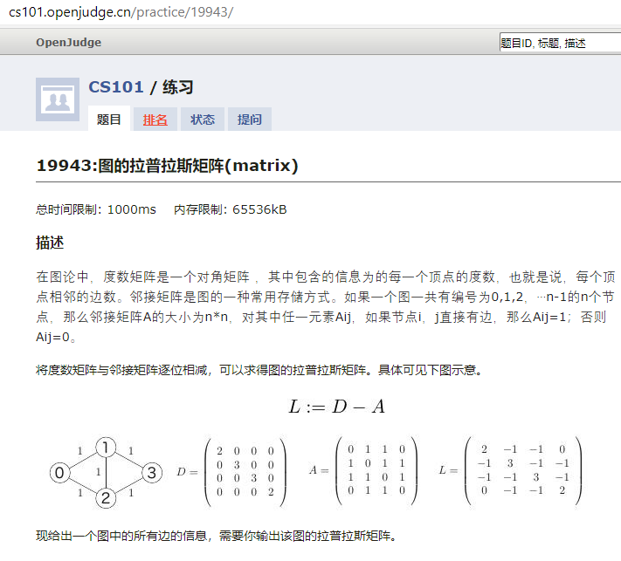
recap
Notes:
http://cs101.openjudge.cn/practice/19943/

Slide 13
图Graph的概念
就像“羊”在英文中并不是一个单独的词
中文的“图画”在英文中有很多对应的单词，其意义大不相同
Painting: 用画刷画的油画
Drawing: 用硬笔画的素描/线条画
Picture: 真实形象所反映的画，如照片等，如take picture
Image: 由印象而来的画，遥感影像叫做image，因是经过传感器印象而来
Graph: 重在由一些基本元素构造而来的图，如点、线等
Figure: 轮廓图的意思，某个侧面的轮廓，所以有figure out的说法
Diagram: 抽象的概念关系图，如电路图、海洋环流图、类层次图
Chart: 由数字统计得来的柱状图、饼图、折线图
Map: 地图
Plot: 地图上的一小块

Slide 14
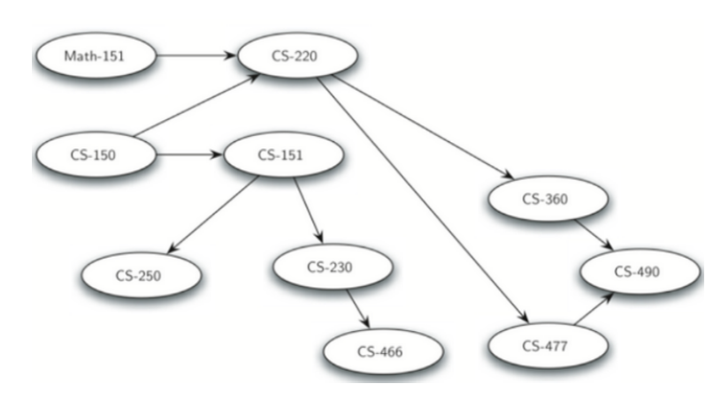
图Graph的概念
图Graph由节点和边构成
图可以用来表示现实世界中很多事物
道路交通系统、航班线路、互联网连接、或者大学中课程的先修次序（不能有环）

Slide 15
图Graph的概念
一旦对图相关问题进行了准确的描述，就可以采用处理图的标准算法来解决那些看起来很艰深的问题
对于人来说，人脑的识别模式能够轻而易举地判断地图中不同地点的相互关联，但计算机并没有这样的能力；
但如果用图来表示地图，就可以解决很多对地图很熟悉甚至专业的人才能解决的问题，甚至能超越；
互联网是由成千上万的计算机所连接起来的复杂网络，也可以通过图算法来确定计算机之间达成通讯的最短、最快或者最有效的路径。
大学课程之间的先修依赖关系，也适合用图来表示
生活中大量的事情适合用图来表示

Slide 16
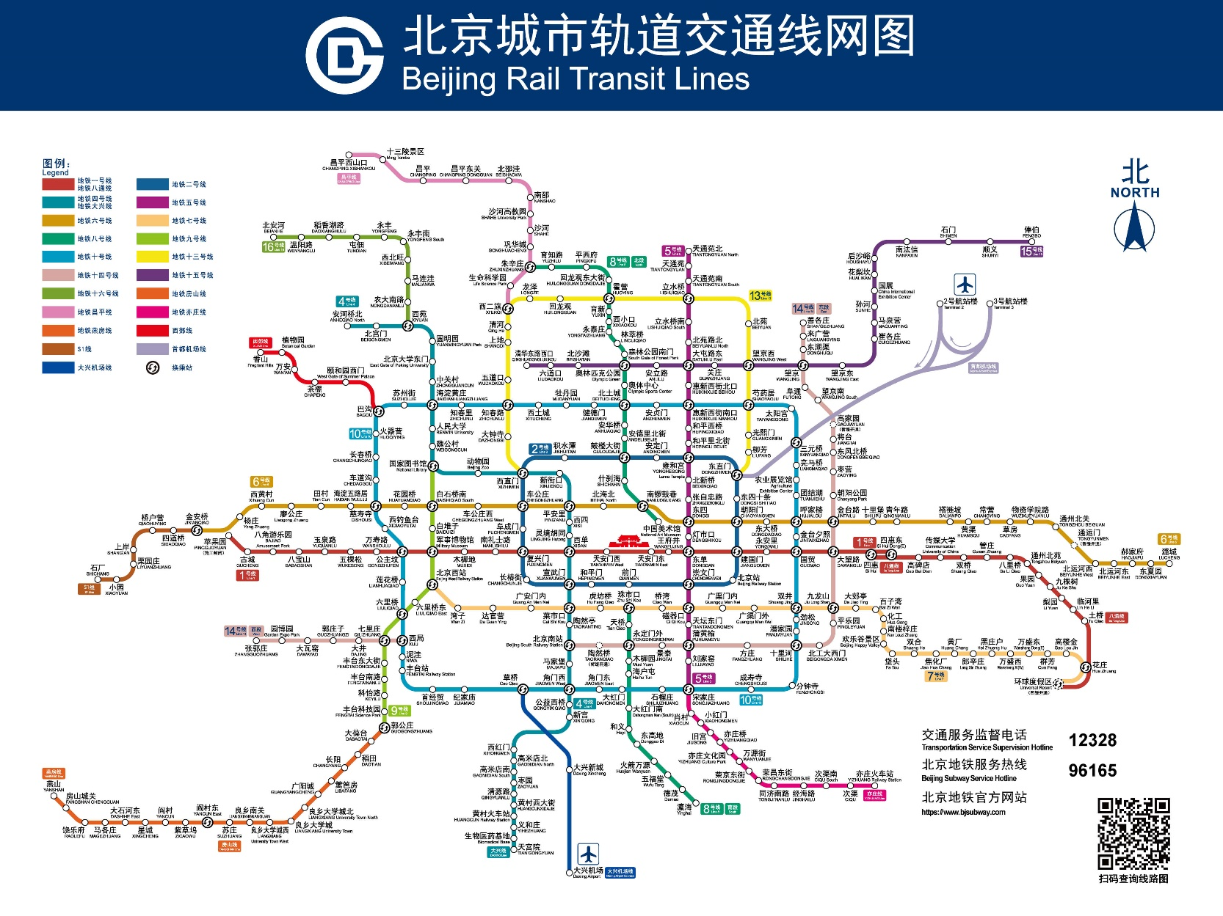
公共交通中的图结构
2019年12月，北京市轨道交通路网运营线路达23条、总里程699.3公里、车站405座(包括换乘站62座)。 在建线路15条。 到2020年，北京地铁形成线网由30条运营，总长1177公里的轨道交通网络。
截至2016年底，北京公交系统有1020条运营线路，公交站点近2000个。

Slide 17
社交网络：六度分离理论
世界上任何两个人之间通过最多6个人即可建立联系
互联网社交网络的兴起将每个人联系到一起
在社会中有20%擅长交往的人，建立了80%的连接
区别于随机网络，保证了六度分隔的成立
引出了无尺度网络的研究
现实中的复杂网络多属于无尺度网络
无尺度网络一般指无标度网络。具有严重的异质性，其各节点之间的连接状况（度数）具有严重的不均匀分布性：
网络中少数称之为Hub点的节点拥有极其多的连接，而大多数节点只有很少量的连接。
少数Hub点对无标度网络的运行起着主导的作用。
从广义上说，无标度网络的无标度性是描述大量复杂系统整体上严重不均匀分布的一种内在性质。

Slide 18
术语表
顶点Vertex
也称“节点Node”，是图的基本组成部分，顶点具有名称标识Key，
也可以携带数据项 payload
边Edge
也称“弧Arc”，是图的另一个基本组成部分，作为2个顶点之间关系的表示，边连接两个顶点；
边可以是单向 one-way 或者双向 two-way 的，
如果一个图中的所有边都是单向的，就称这个图为“有向图 directed graph”
如果判断一条边是单边还是双边：看边两端节点的地位是不是对称/对待的
权重Weight
为了表达从一个顶点到另一个顶点的“代价”，可以给边赋权；
例如公交网络中两个站点之间的“距离”、“通行时间”和“票价”都可以作为权重。

Slide 19
图的定义
图（Graph）是由顶点的有穷非空集合和顶点之间边的集合组成，通常表示为：
G ( V, E ) ，其中，G表示一个图，V是图G中顶点的集合，E是图G中边的集合。
在图中需要注意的是：
线性表中我们把数据元素叫元素，树中将数据元素叫结点，在图中数据元素，我们则称之为顶点（Vertex）。
线性表可以没有元素，称为空表；树中可以没有节点，称为空树；但是，在图中不允许没有顶点（有穷非空性）。
线性表中的各元素是线性关系，树中的各元素是层次关系，而图中各顶点的关系是用边来表示（边集可以为空）。

Slide 20
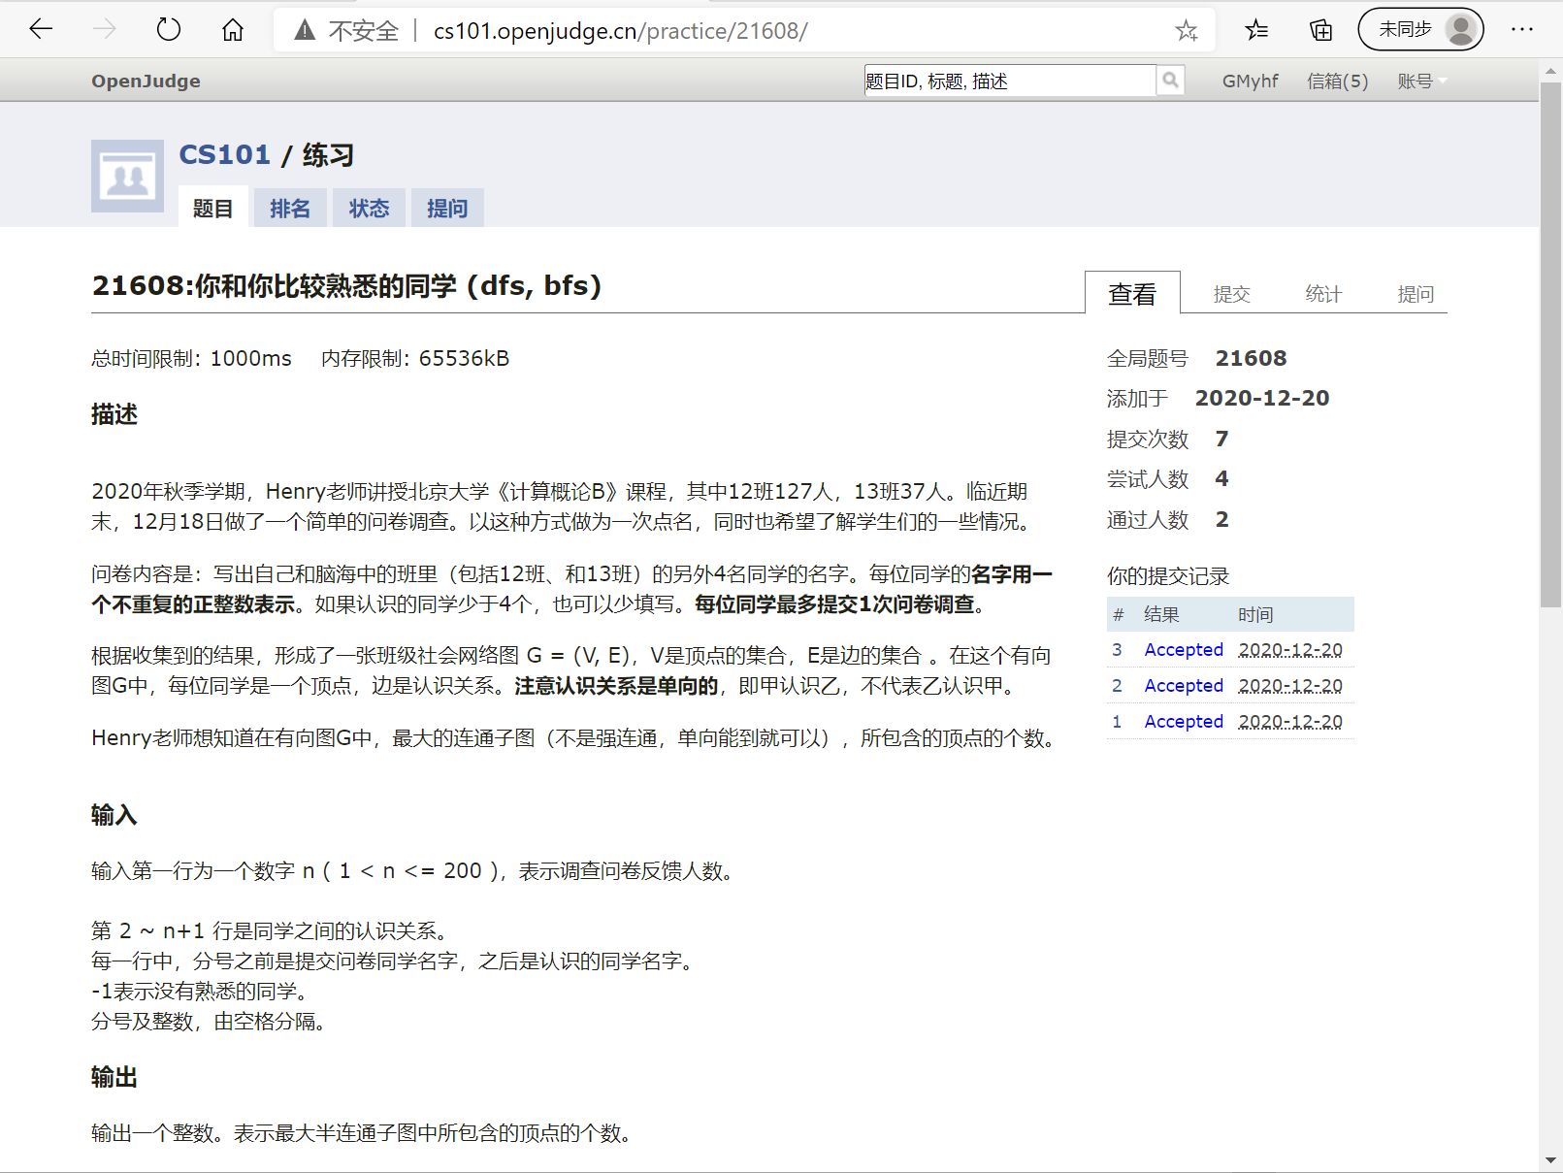
Notes:
bfs, dfs都可以过。dfs可以练习递归写法，非递归写法。

Slide 21
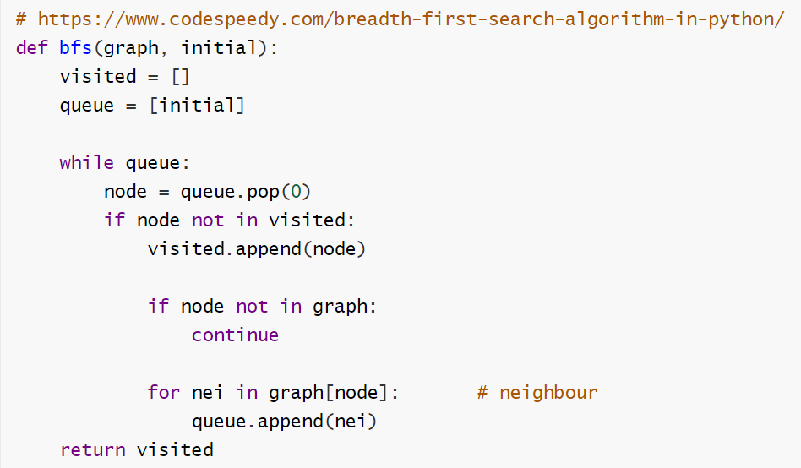

Slide 22
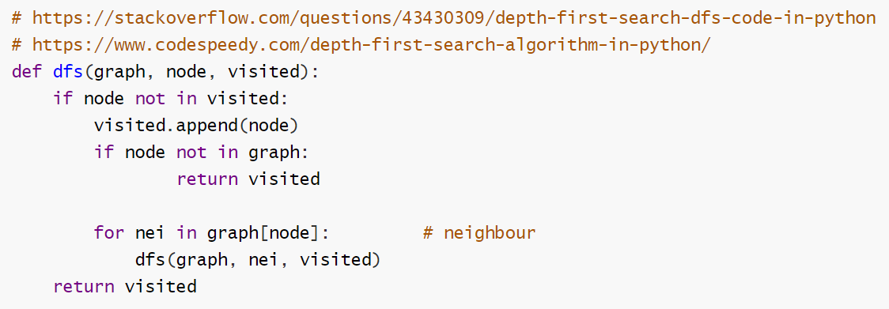

Slide 23
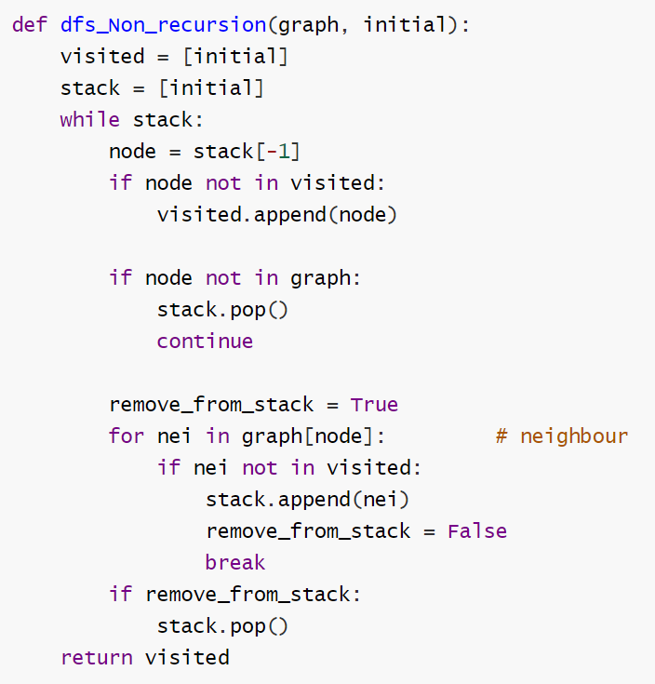

Slide 24
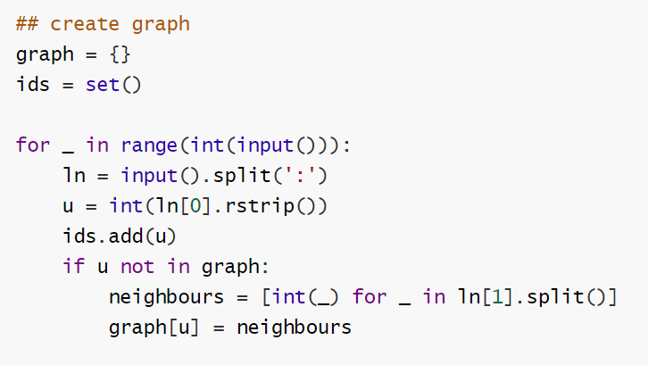

Slide 25
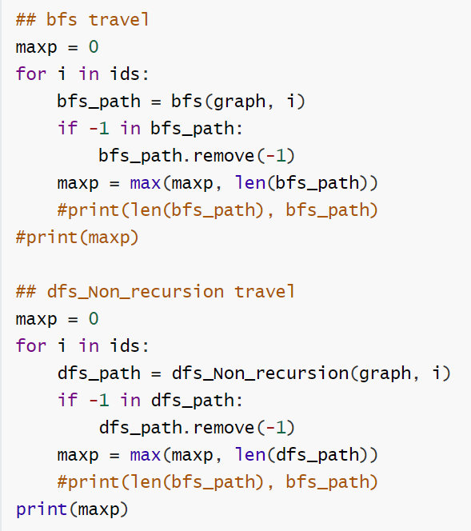
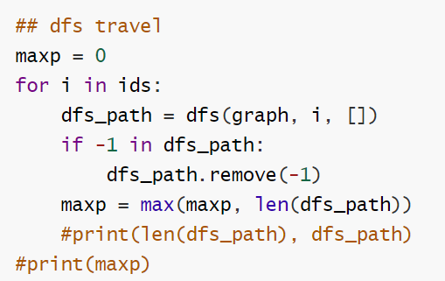

Slide 26
Recap: 八皇后， http://cs101.openjudge.cn/practice/1756
可以深度优先搜素dfs，
也可以宽度优先搜索bfs

Slide 27
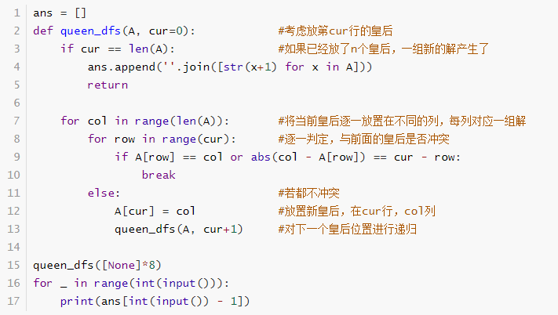

Slide 28
