Slide 1
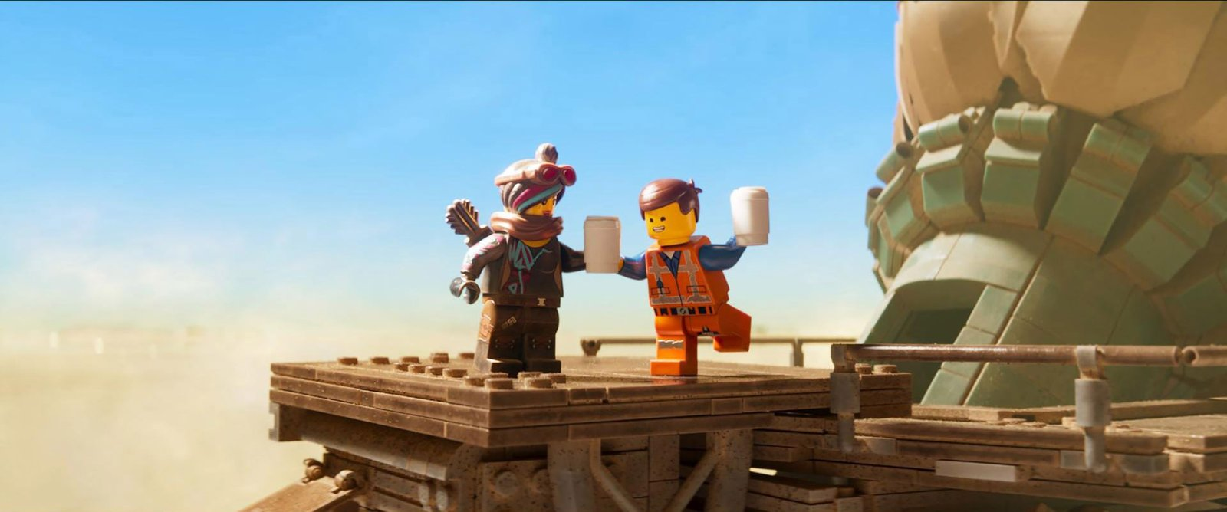
01
When the Brick Reached the Screen
How LEGO Became a
Cross-Media Play Company
FILM × TV × GAMES × DIGITAL PLATFORMS
VRIO + RELATED DIVERSIFICATION
Press → to begin. Click yellow buttons to explore.
Images: official LEGO Group / Universal Pictures press assets

Slide 2
LEGO ENTERTAINMENT STRATEGY
02
Choose a Path: How Does Entertainment Return Value to the Brick?
Each medium has a distinct job. Click a card to jump to its case.
FILM
TV
GAMES
DIGITAL PLATFORMS
Turn LEGO play into a mass-cultural event
Build owned IP through characters and continuity
Let players break, build, and remake worlds
Convert recurring engagement into sets and insight
Explore FILM →
Explore TV →
Explore GAMES →
Explore DIGITAL PLATFORMS →
The question is not whether entertainment can make money. It is whether entertainment strengthens the System in Play.
Frameworks: resource-based view (VRIO) and related diversification.

Slide 3
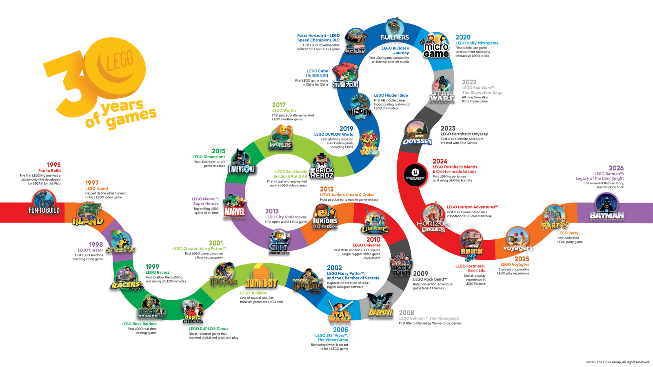
LEGO ENTERTAINMENT STRATEGY
03
LEGO Did Not Pivot Overnight—it Gradually Translated Play into Worlds
1978
Minifigure becomes a character canvas
1995
First commercial game
1999
LEGO Star Wars
2011
NINJAGO owned universe
2014
The LEGO Movie
2023
LEGO Fortnite
Sources: LEGO Group history; Game On: 30 Years of LEGO Video Games (2025).

Slide 4
LEGO ENTERTAINMENT STRATEGY
04
Entertainment Creates the Most Value When Stories Become Buildable Play Again
FILM / TV / GAMES
PHYSICAL SETS
CHARACTERS & WORLDS
REACH & ENGAGEMENT
THE LOOP
NEW DEMAND & IDEAS
PLAYERS REMAKE STORIES
Related diversification passes only when it shares core resources and returns new value to physical play.
Strategic interpretation: a related-diversification loop built on LEGO's System in Play.

Slide 5
LEGO ENTERTAINMENT STRATEGY
05
Film Makes LEGO's Building Grammar Mass Culture—but Production Should Stay Partner-Led
≈ $1.1B
Cumulative worldwide box office of LEGO films by 2020
Film creates more than a toy commercial:
• Recognizable characters: Emmet, Wyldstyle, and more
• A reusable voice: humor, rebuilding, rule-breaking
• Brand meaning: any world can become LEGO play
Conclusion: LEGO should own the creative standards and product loop, while studios absorb production and distribution volatility.
← Back to Media Map
Source: Universal Pictures and LEGO Group five-year exclusive film partnership announcement (2020).

Slide 6
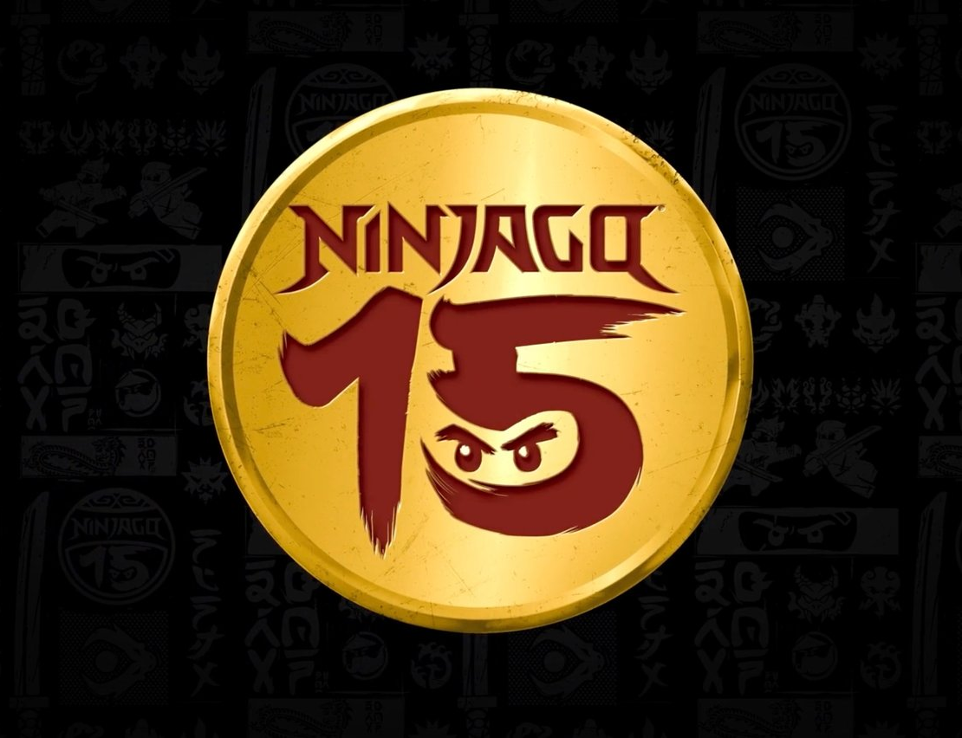
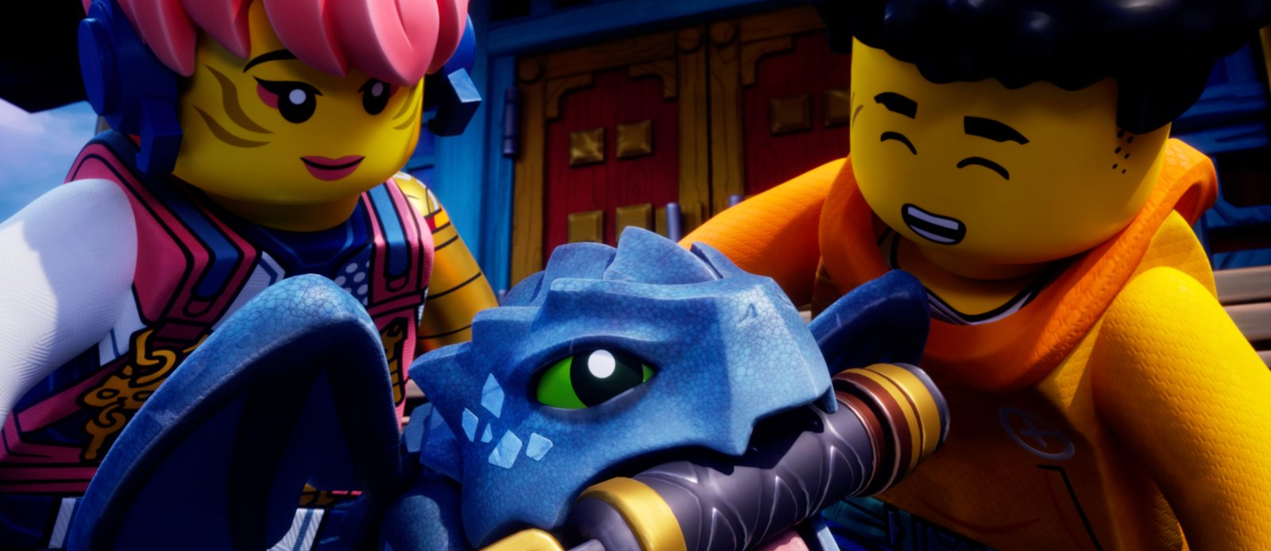
LEGO ENTERTAINMENT STRATEGY
06
NINJAGO Turned Character Continuity into a 15-Year Evergreen Asset
500+
200+
15 YEARS
SETS
TV EPISODES
OWNED ENTERTAINMENT IP
TV is not a one-off exposure. It is the operating rhythm for character growth, new villains, world expansion, and recurring set design.
← Back to Media Map
Source: LEGO NINJAGO 15th Anniversary announcement (2026): longest-running homegrown IP; 500+ sets and 200+ episodes.

Slide 7
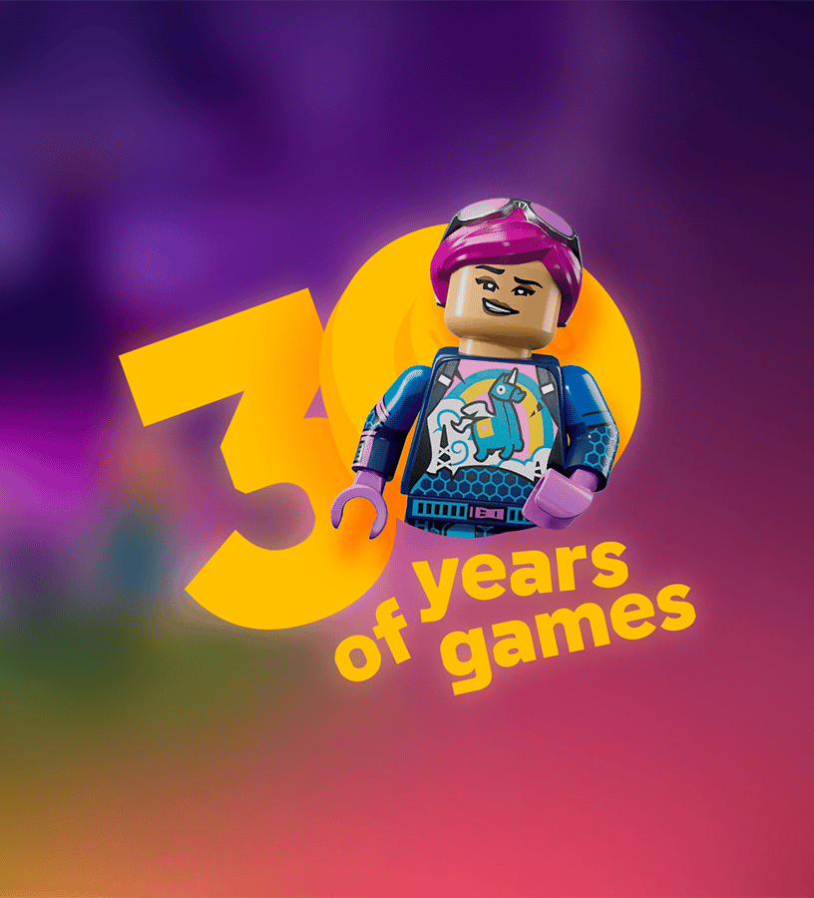
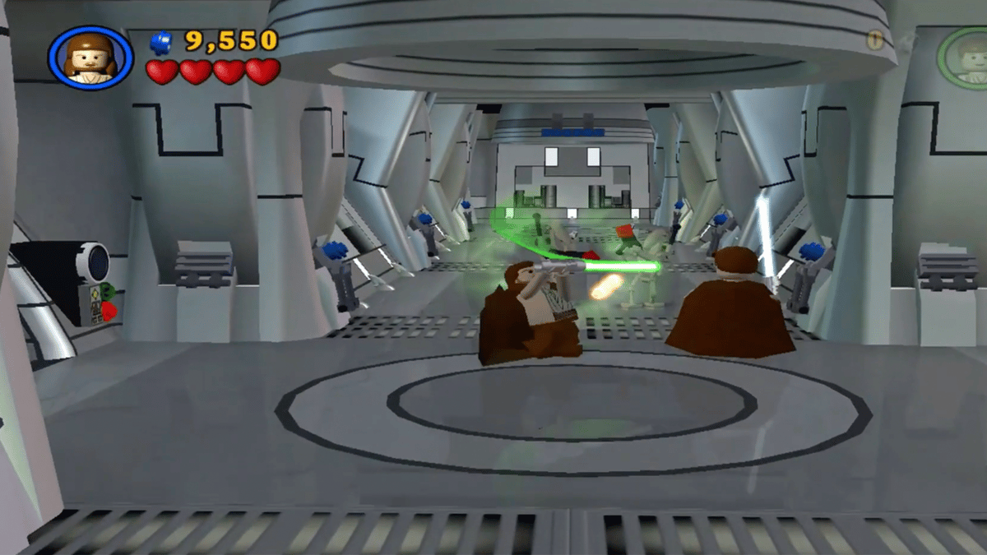
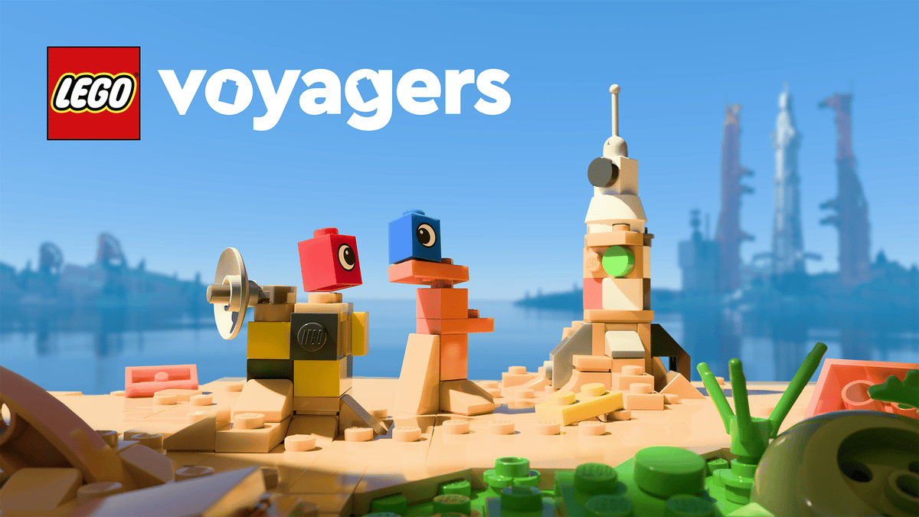
LEGO ENTERTAINMENT STRATEGY
07
Games Turn Audiences into Players—LEGO's Edge Is Translation, Not AAA Production
200+
THE TRANSFERABLE PLAY GRAMMAR
GAME TITLES SINCE 1995
BREAK → COLLECT → BUILD → COOPERATE → COMEDIC REMIX
This grammar is harder to copy than any single engine or studio.
← Back to Media Map
Source: Game On: 30 Years of LEGO Video Games (LEGO Group, 2025).

Slide 8
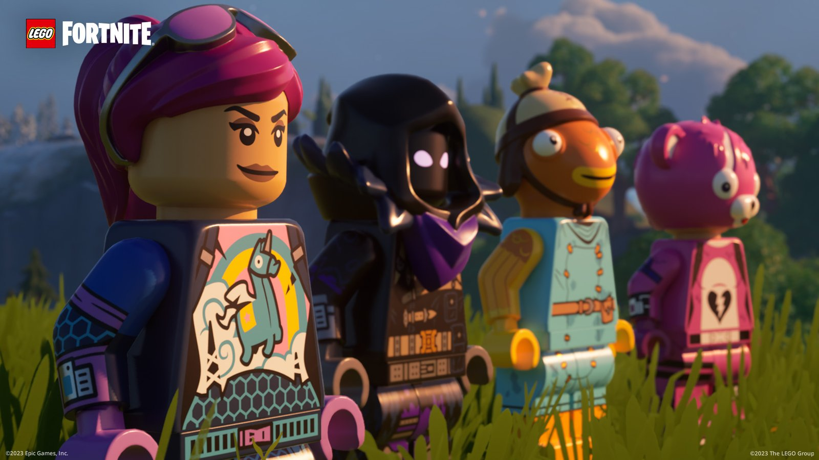
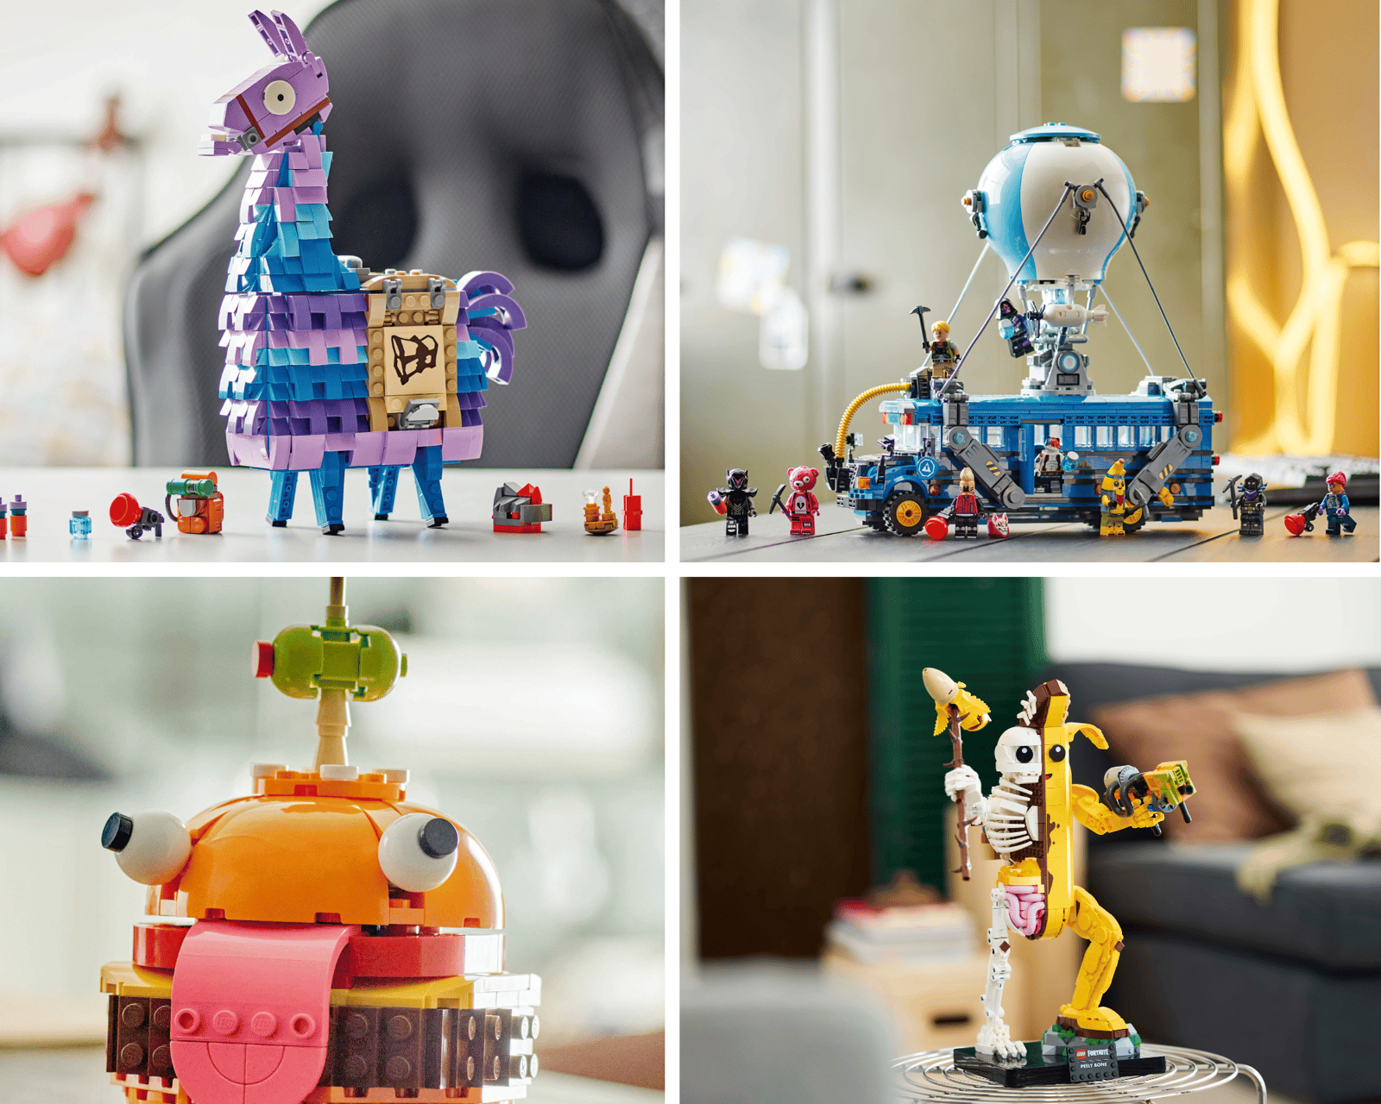
LEGO ENTERTAINMENT STRATEGY
08
Digital Platforms Turn One-Off Content into Persistent Worlds—and Feed Demand Back to Sets
ON SCREEN
Open worlds, creator islands, live updates, millions of participants
OFF SCREEN
Characters, places, and items become physical sets; selected sets unlock digital rewards
← Back to Media Map
Sources: LEGO Fortnite releases (2023–2025); LEGO Group Annual Report 2025.

Slide 9
LEGO ENTERTAINMENT STRATEGY
09
Four Media Are Not Duplicate Bets—they Form an IP Production System
FILM
TV
GAMES
DIGITAL PLATFORMS
BURST REACH
CONTINUITY
AGENCY
RECURRENCE
Turns play into culture
Lets characters and worlds compound
Lets players remake the world
Connects content, community, data, and products
REACH
CONTINUITY
AGENCY
RECURRENCE
Portfolio logic: film creates peaks, TV compounds relationships, games create agency, and platforms sustain the loop.
Synthesis: the complementary role of four media in LEGO's IP system.

Slide 10
LEGO ENTERTAINMENT STRATEGY
10
VRIO Shows LEGO's Durable Advantage Still Comes from Its Core—not from Owning a Studio
RESOURCE / CAPABILITY
V
R
I
O
VERDICT
SYSTEM IN PLAY
Compatibility + recombination
✓
✓
✓
✓
SUSTAINED ADVANTAGE
Brand + family trust
✓
✓
✓
✓
SUSTAINED ADVANTAGE
Brick / minifigure visual grammar
✓
✓
✓
✓
SUSTAINED ADVANTAGE
World → play → product translation
✓
✓
✓
✓
SUSTAINED ADVANTAGE
Film production / distribution
✓
–
–
△
PARTNER CAPABILITY
AAA development / platform operations
✓
–
–
△
PARTNER CAPABILITY
VRIO conclusion: LEGO should control the architecture and translation—not vertically integrate every specialist production step.
VRIO: Value / Rarity / Inimitability / Organization. Framework: Barney (1991).

Slide 11
LEGO ENTERTAINMENT STRATEGY
11
The Boundary of Related Diversification: Share Resources and Return Value to the Brick
CHARACTERS & STORIES
ENGAGEMENT & COMMUNITY
PHYSICAL BRICKS
FILM / TV / GAMES
RELATED
Stories become sets
Platforms activate physical sales
SHARED: brand, minifigure grammar, compatibility, design capability, retail channels
INSIGHT & IDEAS
NEW SETS / NEW PLAY
OVER THE LINE
Isolated content bets
No shared resources, no product return
Related diversification creates economies of scope through shared resources and complementarity—while controlling complexity.

Slide 12
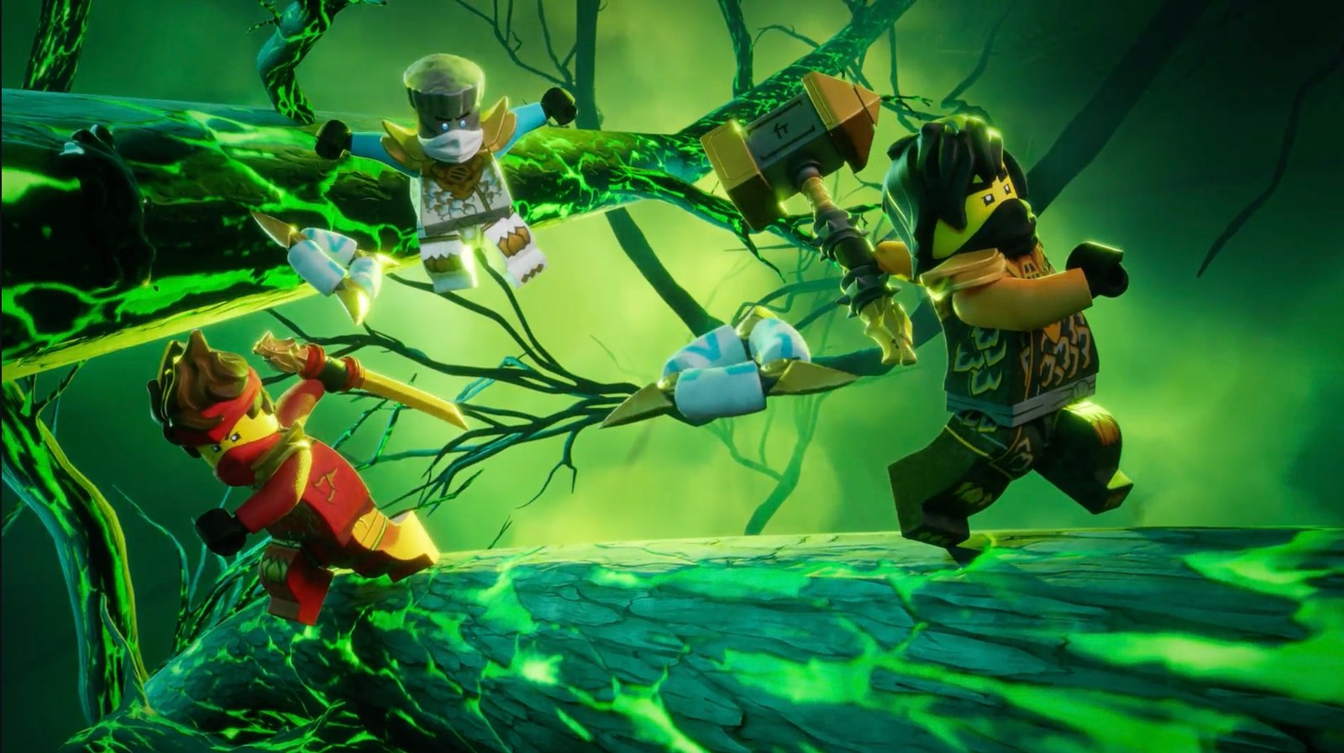
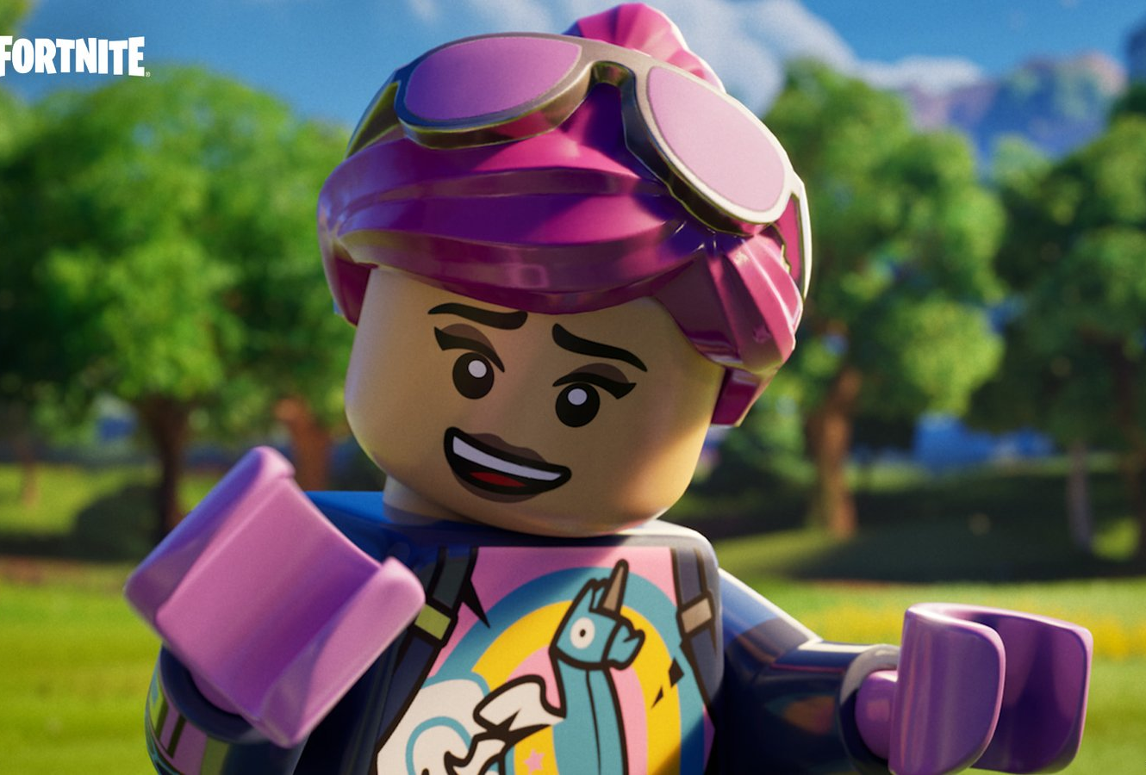
LEGO ENTERTAINMENT STRATEGY
12
Four Cases Show that Entertainment Requires Different Control Models
LEGO Star Wars
LEGO NINJAGO
The LEGO Movie
LEGO Fortnite
EXTERNAL IP
OWNED IP
CO-CREATION
PLATFORM ECOSYSTEM
VALUE
Borrow reach, strengthen product
VALUE
Characters and sets compound together
VALUE
Amplifies brand meaning
VALUE
Strongest digital–physical loop
RISK
Licensing and approval dependence
RISK
Ongoing content investment
RISK
Box-office volatility
RISK
Platform and data governance
Sources: official LEGO Group case materials (Star Wars, NINJAGO, The LEGO Movie, LEGO Fortnite).

Slide 13
LEGO ENTERTAINMENT STRATEGY
13
The 2004 Lesson Is Not “Avoid Entertainment”—It Is “Do Not Let Complexity Outrun Capability”
DKK 6.704B
−DKK 1.931B
2004 REVENUE
2004 NET LOSS
WHAT THE COMPANY DID
CAUSALITY BOUNDARY
• Dispose of or separate non-core, capital-intensive businesses
• Transfer electronic-game platforms to licensing partners
• Reduce complexity and rebuild capital discipline
The report does not prove that entertainment caused the crisis.
It supports a narrower conclusion: diversification destroys value when product complexity, capital commitments, and new capabilities exceed organizational capacity.
Source: The LEGO Group Annual Report 2004. Causal interpretation remains deliberately cautious.

Slide 14
LEGO ENTERTAINMENT STRATEGY
14
Three Paths Forward: the Choice Is What to Control—and What to Outsource
A
B
C
BRICK-FIRST LICENSING
FULL VERTICAL INTEGRATION
HYBRID ECOSYSTEM ORCHESTRATOR
LOW CAPITAL / LOW CONTROL
HIGH CAPITAL / HIGH CONTROL
Own the architecture; rent execution
Safer, but cedes owned worlds and data
Largest capability gaps and volatility
Best fit with VRIO
Explore This Path →
Explore This Path →
Explore This Path →
Vote first, then see the score: which path best protects the brick core while enabling entertainment growth?
Click any option to enter its scoring branch.

Slide 15
LEGO ENTERTAINMENT STRATEGY
15
OPTION A | Brick-First Licensing: Feasible, but It Cedes Digital Relationships and Owned Worlds
3.55 / 5
ADVANTAGE
Capital-light, fast to execute, insulated from content volatility
COST
Weak accumulation of owned IP and player data; partners control platform and story cadence
Best when platform economics deteriorate, partner terms are exceptional, or the organization is not ready to manage a cross-media portfolio.
← Back to Three Options
See Recommendation →
Weighted score: core fit 25%, owned IP 20%, feasibility 20%, digital–physical synergy 20%, risk protection 15%.

Slide 16
LEGO ENTERTAINMENT STRATEGY
16
OPTION B | Full Vertical Integration: Maximum Control, but a Battle in Non-Rare, Unpredictable Capabilities
3.05 / 5
TEMPTATION
Own IP, distribution, data, and release windows end to end
RISK
Studios, AAA development, and platform operations are not LEGO's VRIO core; capital intensity and hit volatility amplify complexity
The score rises only if LEGO can acquire a mature team, preserve its culture, and prove a closed loop with physical play.
← Back to Three Options
See Recommendation →
The weighted score is a strategic judgment, not an official LEGO forecast.

Slide 17
LEGO ENTERTAINMENT STRATEGY
17
OPTION C | Hybrid Ecosystem Orchestrator: Keep the Hard-to-Copy Core, Partner for Specialist Production
LEGO MUST OWN
LEGO SHOULD PARTNER FOR
4.45 / 5
• System in Play architecture
• Owned-IP road map
• Product–story loop
• Child safety and brand standards
• Cross-media data governance
• Film production and distribution
• AAA production capacity
• Game engines and platform operations
• Global content distribution
• Specialized technology and talent peaks
Core governance questions: Who owns the characters? Who can use the data? Who bears content failure? How do sets synchronize? How can LEGO exit a platform?
← Back to Three Options
Go to Conclusion →
Recommendation: Hybrid Entertainment Ecosystem Orchestrator.

Slide 18
LEGO ENTERTAINMENT STRATEGY
18
Final Judgment: Expand Entertainment—but Keep Bricks at the Core
CONTINUE TO EXPAND
• Owned worlds: NINJAGO and DREAMZzz
• Persistent digital spaces and creator ecosystems
• Projects that generate sets, repeat play, and new mechanics
STAY DISCIPLINED
• Do not acquire unrelated capabilities for “content scale”
• Do not treat box office, subscriptions, or active users as the end goal
• Every project must prove its return to physical play
Entertainment should extend the System in Play—not replace it.
Recommendation based on VRIO, related diversification, and comparative cases.

Slide 19
LEGO ENTERTAINMENT STRATEGY
19
Build Governance Before Worlds: a Three-Stage Path to Lock Growth into the Physical–Digital Loop
0–12 MONTHS
1–3 YEARS
3+ YEARS
GOVERN THE PORTFOLIO
REPLICATE THE LOOP
OWN SELECTIVELY
• Create an entertainment investment committee
• Standardize IP, data, and safety terms
• Set a “return to the brick” metric for every project
• Replicate LEGO Fortnite-style mechanisms
• Orchestrate owned IP across TV, games, and sets
• Screen projects with small prototypes
• Acquire only distinctive, integrable creative capabilities
• Retain studio and platform partners
• Exit content that does not create synergy
GOVERN FIRST
REPLICATE SYNERGY
OWN SELECTIVELY
Illustrative staged road map; investments require partner terms and project-level business cases.

Slide 20
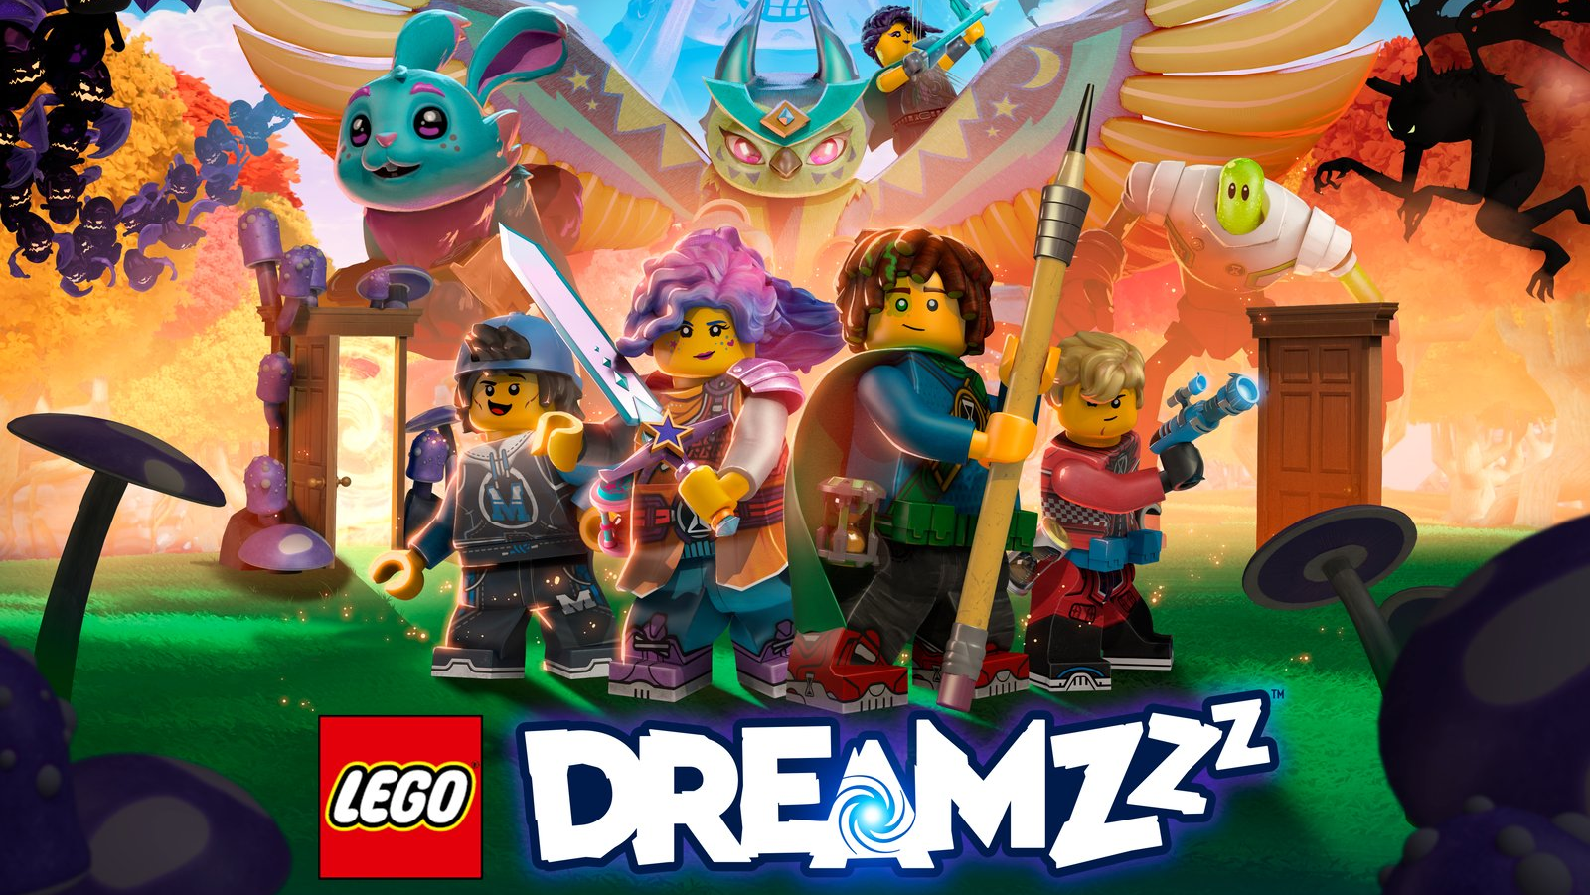
20
THE LAST BRICK
LEGO'S FUTURE IS NOT
TO BECOME A “CONTENT COMPANY”
IT IS TO BECOME THE COMPANY BEST AT TURNING
STORIES, SCREENS, AND PLATFORMS BACK INTO BUILDABLE PLAY.
Back to Start ↺
Back to Options
The test: will the next entertainment investment make a physical brick more valuable?

