Slide 1
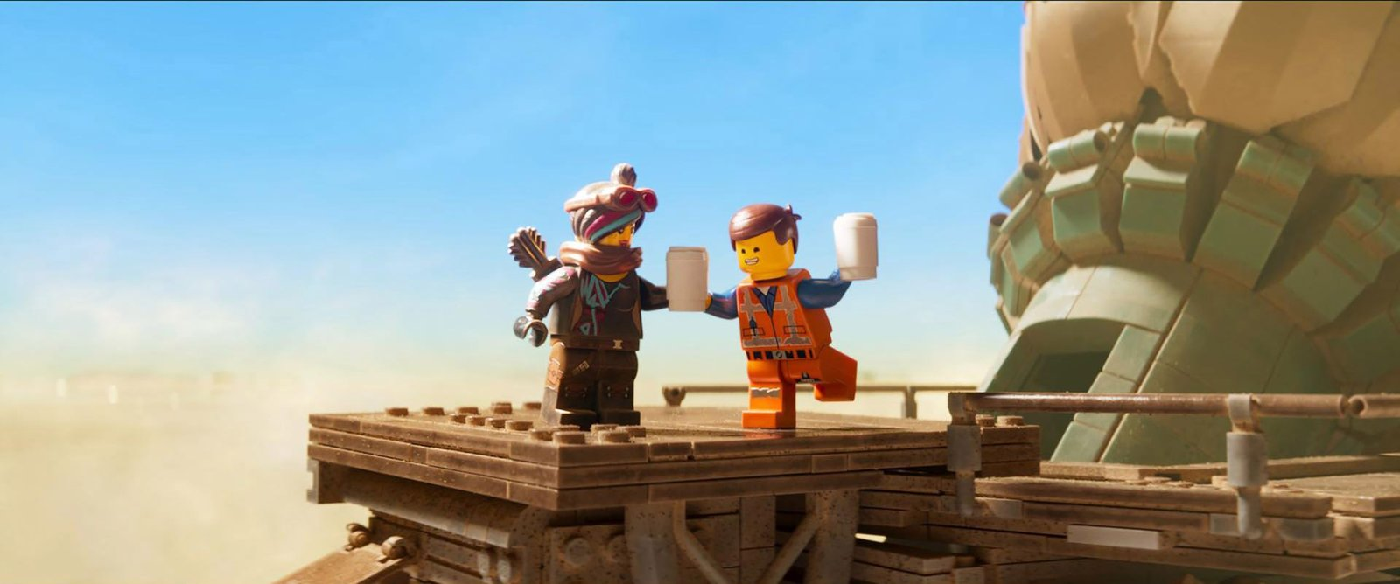
01
Building Beyond the Brick
How Entertainment Changed LEGO's Direction
BRICKS × CHARACTERS × STORIES × SCREENS
VRIO + RELATED DIVERSIFICATION
A strategy story about identity, capability, and growth.
Images: official LEGO Group / Universal Pictures press assets

Slide 2
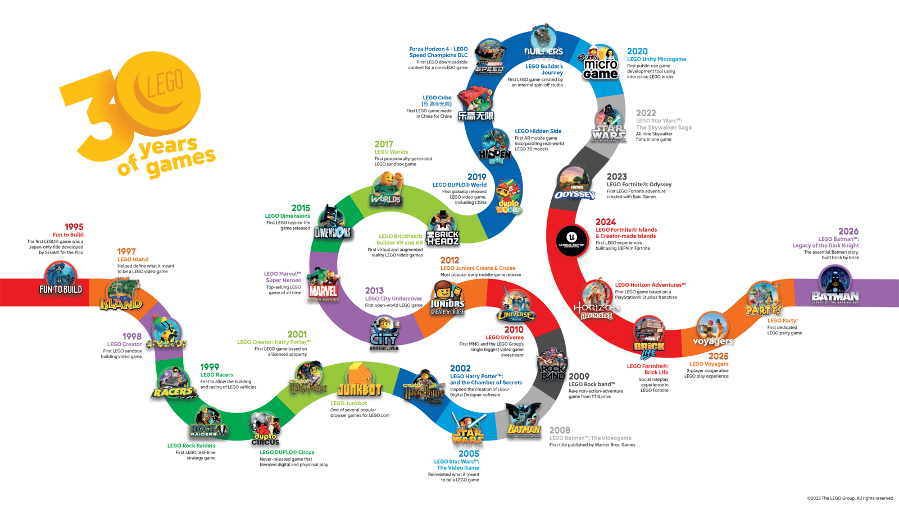
LEGO ENTERTAINMENT STRATEGY
02
LEGO's Original Advantage Was a System—not a Hit Toy
1932
Woodworking becomes a toy company
1958
Interlocking brick becomes a compatible system
1978
Minifigure turns objects into characters
1999
LEGO Star Wars enters a borrowed world
2011
NINJAGO builds an owned universe
2023
LEGO Fortnite opens a persistent digital world
Source: LEGO Group history and company timeline.

Slide 3
LEGO ENTERTAINMENT STRATEGY
03
Minifigures Turned Construction into Storytelling
LOCATIONS & VEHICLES
CHARACTERS & WORLDS
PHYSICAL BRICKS
MINIFIGURE ROLES
STORY
PLATFORM
CONTINUING STORIES
RULES & CONFLICT
Minifigures gave LEGO the same primitives used by film, TV, and games: characters, worlds, rules, conflict, and goals.
Before entering entertainment, LEGO had already built a story platform inside the brick system.

Slide 4
LEGO ENTERTAINMENT STRATEGY
04
Licensed Worlds Taught LEGO to Translate Fandom into Buildable Play
LEGO TRANSLATION
NEW SETS & COLLECTORS
EXTERNAL IP
BUILD / BREAK / REMIX
IP
TO BRICKS
BORROWED REACH
FANS ENTER PLAY
Star Wars proved that a mature audience could be converted into LEGO-shaped demand.
LEGO's capability was not copying outside IP—it was translating a story into LEGO play.

Slide 5
LEGO ENTERTAINMENT STRATEGY
05
The 2004 Crisis Exposed the Cost of Expansion without Core Fit
DKK 6.704B
−DKK 1.931B
2004 REVENUE
2004 NET LOSS
THE RESPONSE
STRATEGIC LESSON
• Dispose of or separate non-core, capital-intensive businesses
• Transfer electronic-game platforms to licensing partners
• Reduce complexity and rebuild capital discipline
The crisis was not caused by entertainment alone. It exposed a broader failure: complexity grew faster than LEGO's capabilities and strategic focus.
Source: The LEGO Group Annual Report 2004. Causal interpretation remains deliberately cautious.

Slide 6
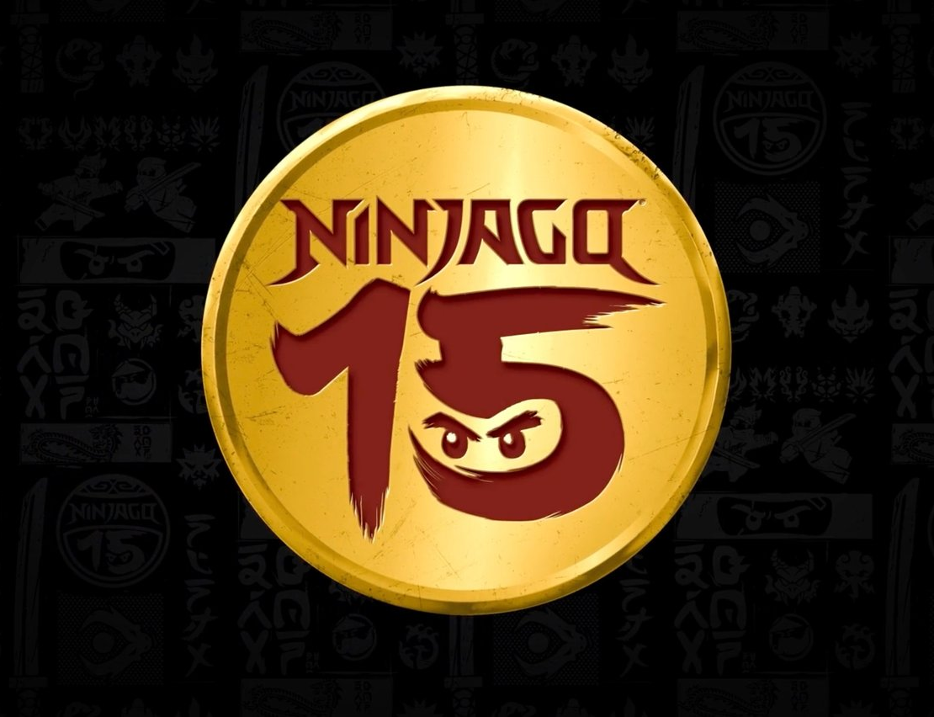
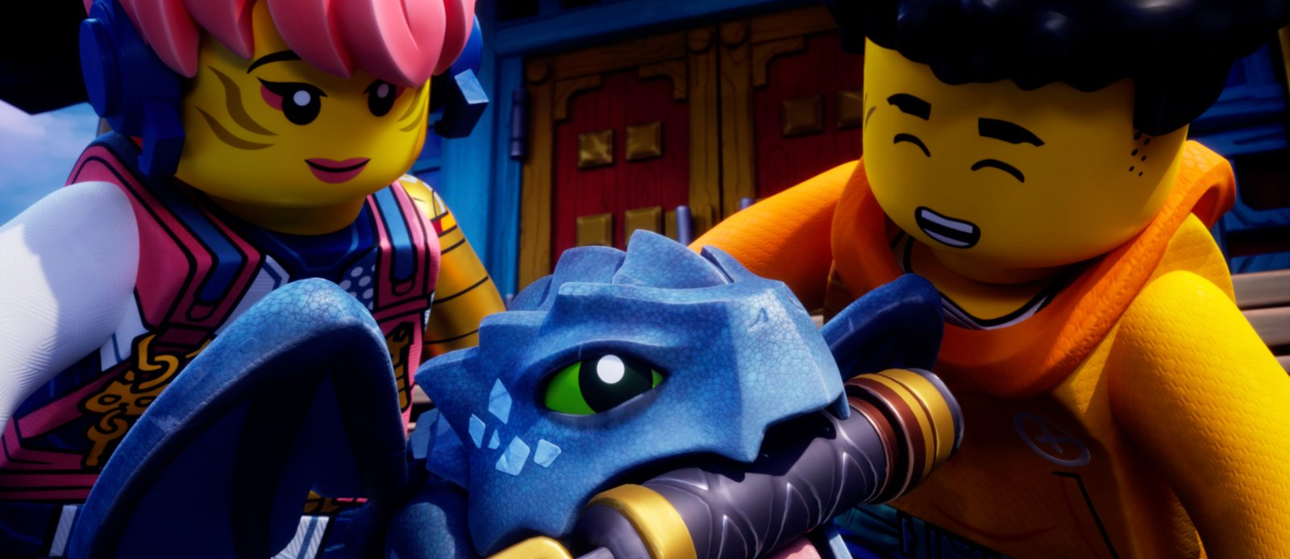
LEGO ENTERTAINMENT STRATEGY
06
NINJAGO Turned Product Characters into a Renewable, Owned Story World
500+
200+
15 YEARS
SETS
TV EPISODES
OWNED ENTERTAINMENT IP
TV became the operating rhythm: stories introduced heroes, villains, vehicles, and locations that returned as new sets and renewed demand.
Media Roles
Source: LEGO NINJAGO 15th Anniversary announcement (2026): longest-running homegrown IP; 500+ sets and 200+ episodes.

Slide 7
LEGO ENTERTAINMENT STRATEGY
07
The LEGO Movie Made LEGO's Play Philosophy the Story
≈ $1.1B
Cumulative worldwide box office of LEGO films by 2020
The film turned LEGO's play philosophy into culture:
• Everything can be rebuilt and recombined
• Instructions guide—but do not limit—imagination
• Any world can become LEGO play
Control the brand, story direction, and product loop; let specialist studios absorb production and distribution risk.
Media Roles
Source: Universal Pictures and LEGO Group five-year exclusive film partnership announcement (2020).

Slide 8
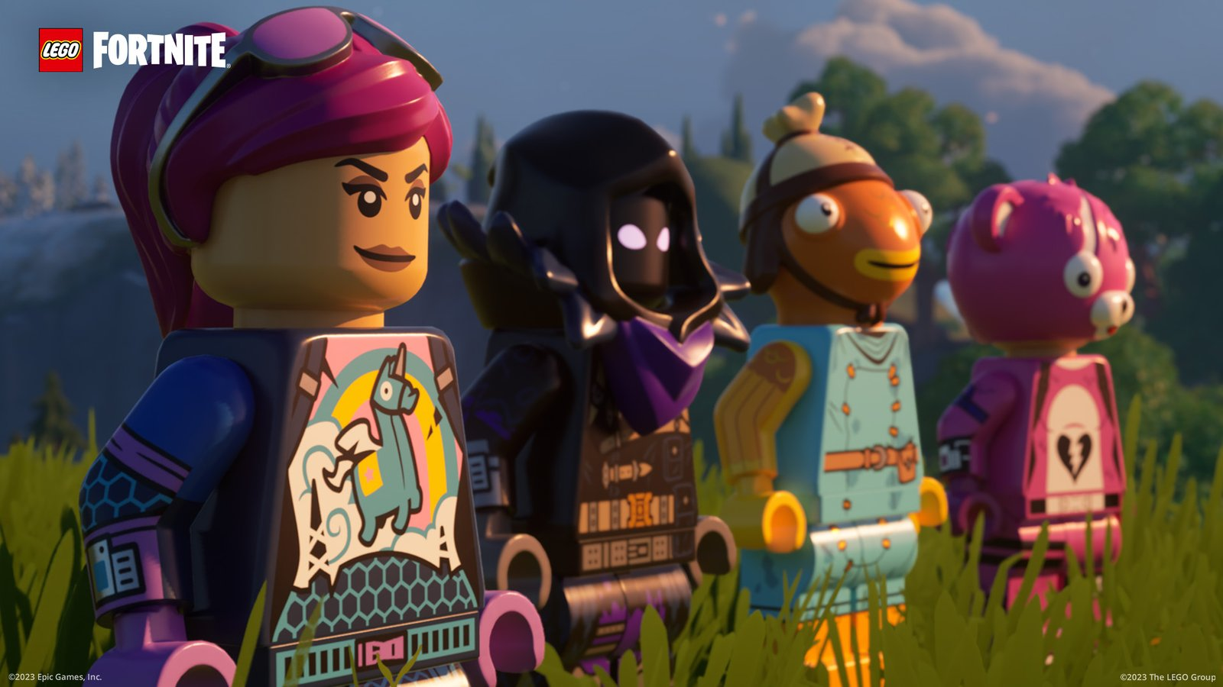
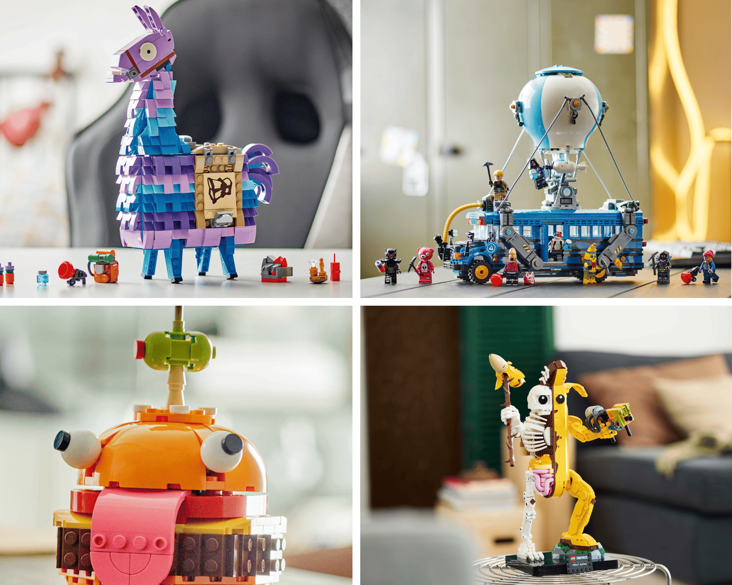
LEGO ENTERTAINMENT STRATEGY
08
LEGO Fortnite Turned One-Off Content into a Persistent Relationship
DIGITAL WORLD
Open worlds, live updates, community creation, and daily participation
RETURN TO THE BRICK
Digital characters, places, and mechanics can become sets—and sets can pull players back online
Media Roles
Sources: LEGO Fortnite releases (2023–2025); LEGO Group Annual Report 2025.

Slide 9
LEGO ENTERTAINMENT STRATEGY
09
Film, TV, Games, and Platforms Perform Different Jobs in One IP System
FILM
TV
GAMES
DIGITAL PLATFORMS
BURST REACH
CONTINUITY
AGENCY
RECURRENCE
Turns play into culture
Lets characters and worlds compound
Lets players remake the world
Connects content, community, data, and products
REACH
CONTINUITY
AGENCY
RECURRENCE
Film creates peaks; TV compounds relationships; games create agency; platforms sustain participation.
Together, the four media extend IP life and feed new demand back to physical play.

Slide 10
LEGO ENTERTAINMENT STRATEGY
10
Entertainment Changed LEGO from Selling Products to Managing a Play Ecosystem
CHARACTERS & STORIES
ENGAGEMENT & COMMUNITY
PHYSICAL BRICKS
FILM / TV / GAMES
BEFORE
Design more sets
Sell through more markets
SHARED: brand, minifigure grammar, compatibility, design capability, retail channels
INSIGHT & IDEAS
NEW SETS / NEW PLAY
NOW
Create worlds and relationships
Renew physical and digital play
Entertainment shifts LEGO from one-off product sales toward a system that repeatedly generates stories, participation, and products.

Slide 11
LEGO ENTERTAINMENT STRATEGY
11
Three Paths Forward—and Only One Balances Growth, Control, and Complexity
A
B
C
BRICK-ONLY EXTENSION
FULL ENTERTAINMENT GROUP
ECOSYSTEM ORCHESTRATOR
LOWEST RISK / LIMITED UPSIDE
HIGHEST CONTROL / HIGHEST COMPLEXITY
OWN CORE / PARTNER EXECUTION
Treat entertainment mainly as marketing
Own studios, games, and platforms
Own worlds and standards; rent specialist production
LOWEST RISK
HIGHEST RISK
RECOMMENDED
Which path expands entertainment without repeating the complexity trap?
The evidence points to the ecosystem-orchestrator model.

Slide 12
LEGO ENTERTAINMENT STRATEGY
12
VRIO Shows that LEGO's Durable Advantage Still Comes from the Core
RESOURCE / CAPABILITY
V
R
I
O
VERDICT
SYSTEM IN PLAY
Compatibility + recombination
✓
✓
✓
✓
SUSTAINED ADVANTAGE
Brand + family trust
✓
✓
✓
✓
SUSTAINED ADVANTAGE
Brick / minifigure visual grammar
✓
✓
✓
✓
SUSTAINED ADVANTAGE
World → play → product translation
✓
✓
✓
✓
SUSTAINED ADVANTAGE
Film production / distribution
✓
–
–
△
PARTNER CAPABILITY
AAA development / platform operations
✓
–
–
△
PARTNER CAPABILITY
LEGO should control the System in Play, brand, visual grammar, and world-to-product translation—not vertically integrate every specialist production step.
VRIO: Value / Rarity / Inimitability / Organization. Framework: Barney (1991).

Slide 13
LEGO ENTERTAINMENT STRATEGY
13
Related Diversification Works Only When Entertainment Returns Value to the Brick
CHARACTERS & STORIES
ENGAGEMENT & COMMUNITY
PHYSICAL BRICKS
FILM / TV / GAMES
RELATED
Stories become sets
Platforms activate physical demand
SHARED: brand, minifigure grammar, compatibility, design capability, retail channels
INSIGHT & IDEAS
NEW SETS / NEW PLAY
OVER THE LINE
Isolated content bets
No shared resources, no product return
The test is simple: does the entertainment project share core resources and strengthen physical play?

Slide 14
LEGO ENTERTAINMENT STRATEGY
14
Recommendation: Keep Bricks at the Core; Use Entertainment to Expand the System
OWN MORE WORLDS
• Build more owned characters and worlds
• Create persistent digital spaces and communities
• Back projects that generate sets, repeat play, and new mechanics
OWN FEWER STUDIOS
• Partner for film production, game development, and platforms
• Retain control of brand, play principles, data, and child safety
• Require every project to return value to physical play
Partner for production. Control the play system.
Recommendation based on VRIO, related diversification, and comparative cases.

Slide 15
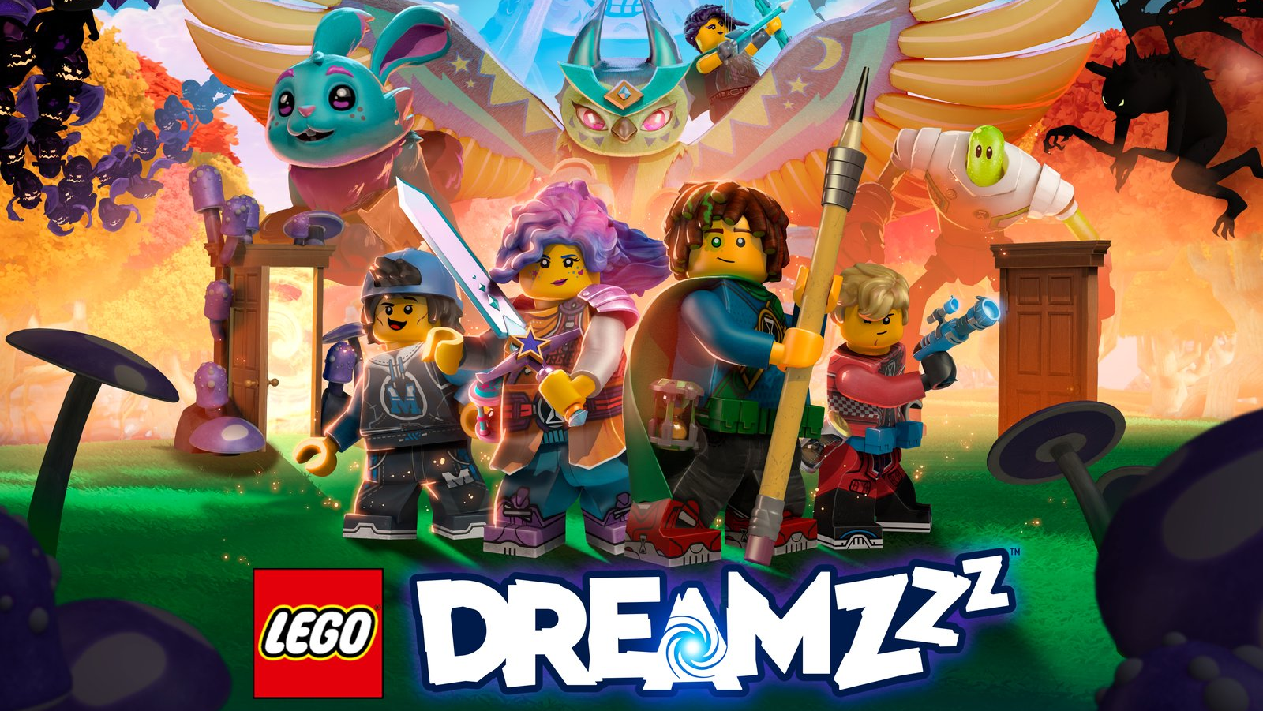
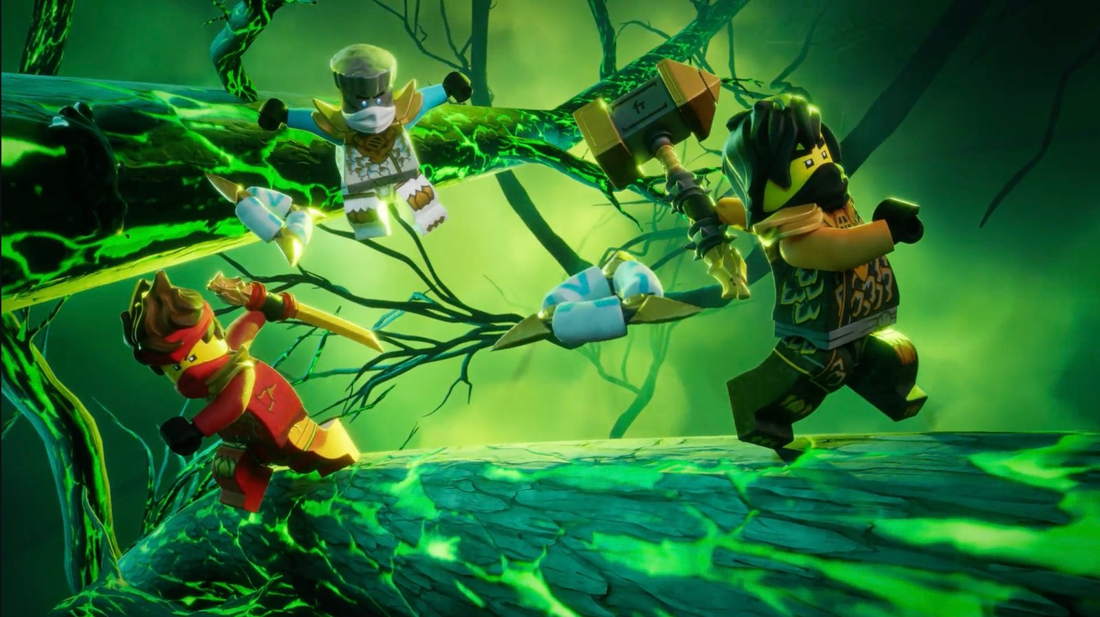
15
THE LAST BRICK
LEGO'S FUTURE IS NOT
TO BECOME AN ENTERTAINMENT CONGLOMERATE
IT IS TO OWN MORE WORLDS, PARTNER FOR PRODUCTION,
AND CONTROL THE PLAY SYSTEM.
Back to Start ↺
Back to Options
Entertainment must return value to the brick.

