Slide 1
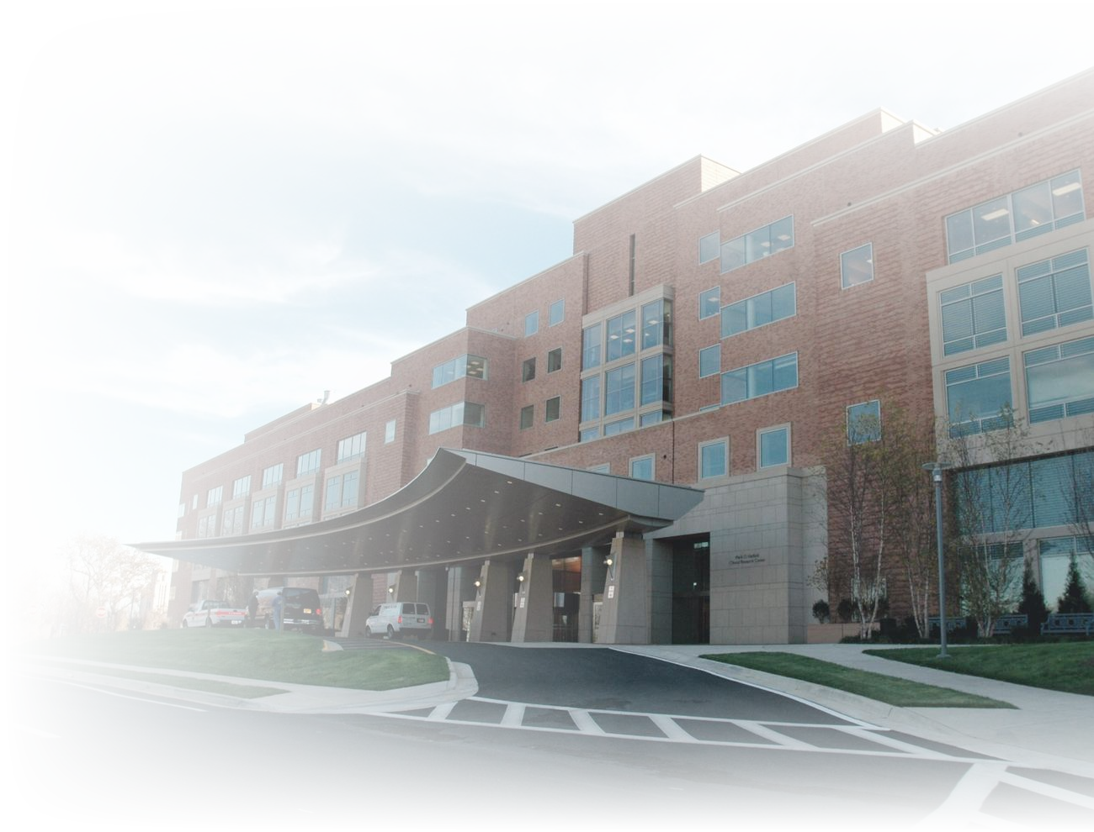

You Deliver Care, We Optimize Revenue.
Uncovering revenue.
Strengthening hospital performance.
A revenue identification and recovery partnership for Cook County Health's emergency and trauma care.
HOSPITAL PARTNERS
CONFIDENTIAL — FOR DISCUSSION PURPOSES
01 / 08
Notes:
Cover: one column, hospital photo on the right. The right-hand stats panel was removed on 2026-10-26 to match the web deck.

Slide 2
02 | EXECUTIVE SUMMARY
We work inside the revenue cycle you already run.
01 / CONTEXT
02 / OPPORTUNITY
03 / SUPPORT
04 / OUTCOME
The pressure
The gap
What LaborForce adds
The goal
Hospitals face reimbursement challenges, rising operational costs, complex payer requirements, and growing uncompensated care obligations.
In ED, trauma and other encounters, Workers' Compensation, Third-Party Liability, auto and other responsible-party coverage can go unidentified or unpursued by traditional workflows.
Specialized payer identification, patient engagement, revenue auditing, payer verification, and lien administration support.
Identify additional reimbursement, improve revenue realization, and reduce avoidable administrative work — without replacing current systems or teams.
HOW IT WORKS
01
Technology screening
02
Specialist review
03
Direct patient contact
04
Follow-through
Injury-related encounters are flagged from existing registration and billing data.
Analysts determine the likely responsible payer and what information is missing.
Dedicated staff confirm the facts and close gaps, respecting each patient's choices.
Billing corrections, lien support, and payer follow-up until the account resolves.
02 / 08

Slide 3
03 | THE CHALLENGE
Revenue that traditional workflows may overlook.
Patients often arrive after workplace incidents, motor vehicle accidents, or injuries involving another liable party. Registration and billing workflows may not consistently capture or resolve:
Whether the injury occurred while the patient was working
Whether a motor vehicle or other third party may be responsible
01
02
WHERE THE REVENUE GOES
Injury-related encounter
Workplace injury, motor vehicle accident, or incident involving a third party
Whether another insurer or payer should be investigated
Whether the hospital has the right claim, attorney, or payer information
03
04
Responsible payer missed
Not identified at registration, or identified but not followed through
Whether a hospital lien is available, documented, and followed up
Whether unresolved cases need investigation after discharge
05
06
Absorbed by the hospital
Written off as bad debt or uncompensated care
Valid reimbursement opportunities may remain unidentified, incorrectly routed, delayed, or insufficiently pursued.
THE CONSEQUENCE
03 / 08

Slide 4
04 | FIVE CRITICAL FUNCTIONS
The LaborForce solution.
A specialized operational layer.
01
01
Proactive Revenue Identification
Review injury-related encounters, identify potentially responsible payers, and prioritize accounts for investigation.
02
Dedicated Patient Engagement
02
Outreach to verify injury circumstances and collect missing claim, employer, insurer, or attorney information.
03
Payer Verification & RCM Coordination
03
Coordinate findings with registration, billing, and revenue cycle teams for payer determination and follow-up.
04
Revenue Auditing & Reconciliation
04
Monitor unresolved cases, flag missing or inconsistent information, and track case status and reimbursement.
05
Lien Administration & Recovery
05
Support approved lien documentation, follow-up, and reimbursement tracking within the legal and contractual framework.
LaborForce works alongside your billing and collections teams.
04 / 08
Notes:
Five-layer waterfall: findings flow from identification (01) down to lien administration and recovery (05). LaborForce works alongside the hospital's billing and collections teams.

Slide 5
05 | FINANCIAL OPPORTUNITY
Turn hidden revenue opportunities into visible results.
PLANNING INPUTS
ANNUAL INCREMENTAL NET COLLECTIONS
IDENTIFIED ENCOUNTERS / YEAR
150,000
$36M
9,000
01 Annual ED encounters
ASSOCIATED GROSS CHARGES / YEAR
25,000
200,000
≈ $3M a month · ≈ $99K a day · $108M over three years
$90M
02 Additional coverage identified
6%
VOLUME & COVERAGE
COVERAGE SENSITIVITY
A visible share of every visit.
What changes as coverage improves?
2%
10%
$36M at 6% identified coverage
03 Average incremental net collection
$4,000
$500
$5,000
04 Average ED charge
$10,000
$3,000
$15,000
Additional coverage identified
Other encounters
ANNUAL ENCOUNTERS
×
ADDITIONAL COVERAGE
×
NET COLLECTION / ENCOUNTER
=
ANNUAL NET COLLECTIONS
150,000
6%
$4,000
$36,000,000
05 / 08
Notes:
Static version of the interactive planning model at its starting scenario: 150,000 ED encounters × 6% additional coverage × $4,000 net per encounter = $36M per year; 9,000 identified encounters; $90M associated gross charges at a $10,000 average ED charge. Each figure in the grid = 1,000 ED encounters. Illustrative planning model, not a forecast.

Slide 6
06 | PROPOSED PARTNERSHIP
90-day pilot.
John H. Stroger, Jr. Hospital.
PHASE 01
DAYS 1 – 15
PHASE 02
DAYS 16 – 60
PHASE 03
DAYS 61 – 90
15 of 90 days
45 of 90 days
30 of 90 days
Discovery & Baseline
Identification & Investigation
Validation & Review
Review current injury-related registration, payer identification, billing, and follow-up. Agree on pilot scope, eligibility criteria, compliance requirements, and baseline measures.
Evaluate designated encounters, conduct authorized patient outreach, identify alternative payer sources, and coordinate verified findings with existing hospital teams.
Reconcile outcomes, review billing corrections and collections, assess operational impact, and recommend continued monitoring and potential expansion.
HOW TO READ THE PILOT
COOK COUNTY HEALTH PROVIDES
LABORFORCE PROVIDES
Many claims take longer than 90 days to resolve. The pilot measures leading indicators and any collections realized; final financial performance is reviewed as the identified account cohort matures.
Executive sponsor and agreed pilot scope
ED volume, payer mix, and current TPL/WC workflow data
Compliance requirements and data-access terms
Screening, specialist review, and case investigation
Dedicated patient outreach and lien administration support
Joint reporting at days 30, 60, and 90
06 / 08

Slide 7
07 | PROPOSED SUCCESS METRICS
Transparent. Measurable.
Jointly reviewed.
Leading
Financial
Operational
Quality
Early signals that cases are being found and verified
What the program returns, net of adjustments
Effect on hospital teams and account flow
Safeguards that stay in place throughout
Encounters screened and flagged
Number and % with verified additional responsible-party coverage
Accounts accepted for billing correction or recovery action
Additional collections attributable to the program, net of reversals and adjustments
Incremental net revenue after program costs
Staff workload
Turnaround time
Unresolved account aging
Compliance
Patient experience
Documentation quality
JOINT REVIEW CADENCE
LAUNCH
DAY 30
DAY 60
DAY 90
Scope, eligibility criteria, and baseline agreed
Baseline confirmed; screening volumes and first flagged cohort
Verification rate, accounts accepted for correction, staff workload impact
Collections to date, cohort maturity, and a joint decision on continuation
07 / 08

Slide 8

08 | OUR ASK
Our ask: a 90-day pilot at John H. Stroger, Jr. Hospital.
Strengthen Cook County Health's fiscal resilience while supporting accessible, high-quality care for the community — through a focused, transparent, and measurable pilot, reviewed jointly at days 30, 60, and 90.
01
02
03
Confirm sponsor & scope
Share baseline data
Agree & launch
Executive sponsor and pilot scope at Stroger Hospital
ED volume, payer mix, and the current TPL/WC workflow
Compliance requirements and success metrics; launch Phase 1
Thank you
We look forward to discussing the pilot with your leadership team.
08 / 08

