Slide 1
Analysis of Music Data: Predicting Successful Music Trends
Garrett Deblois
Kelly Hull
Sarah Madden
Irene Zhou

Slide 2
What are the limitations of our dataset?
Parameters defined
Valence
Energy
Explicitness
Danceability
Popularity
“Liveness” (music)
Loudness
“Instrumentalness”
“Speechiness”
Tempo
Duration
Genre
Year

Slide 3
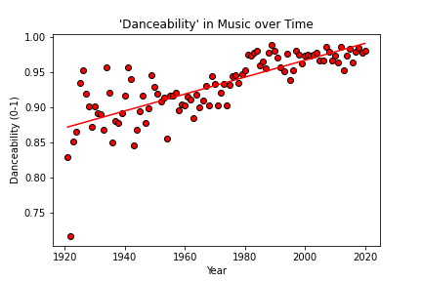
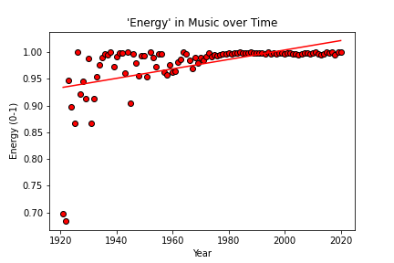
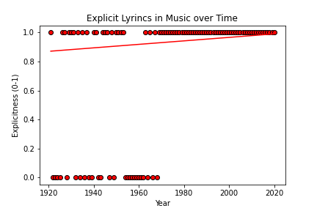
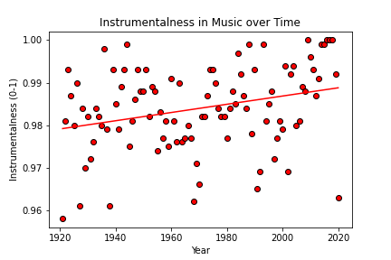
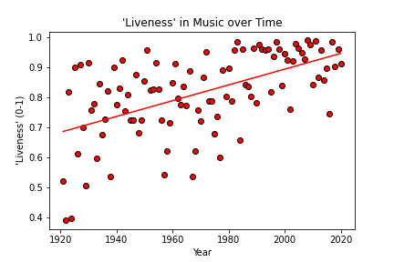
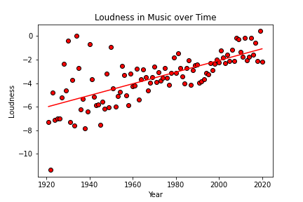
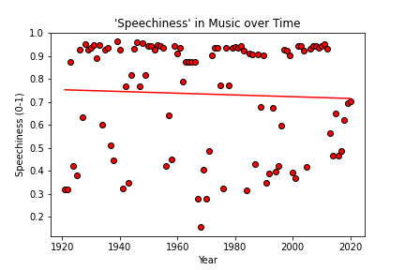
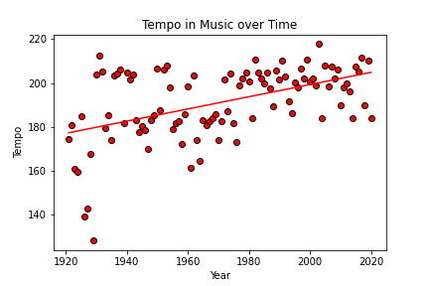
How have the parameters that define the dataset changed over time?

