Slide 1

ADM 1100 INTRODUCTION TO BUSINESS MANAGEMENT November 7, 2018

Slide 2
Agenda
Individual Projects – Questions
Chapter 12 & 13
Guest speaker – next lecture – attendance required!

Slide 3
CHAPTER 12

Slide 4
Understanding Communication
What is Communication?
The transfer and understanding of meaning.
Interpersonal communication
Communication between two or more people
Organizational communication
All the patterns, network, and systems of communications within an organization

Slide 5
Understanding Communication (2 of 2)
Functions of Communication:
Control
Motivation
Emotional Expression
Information

Slide 6
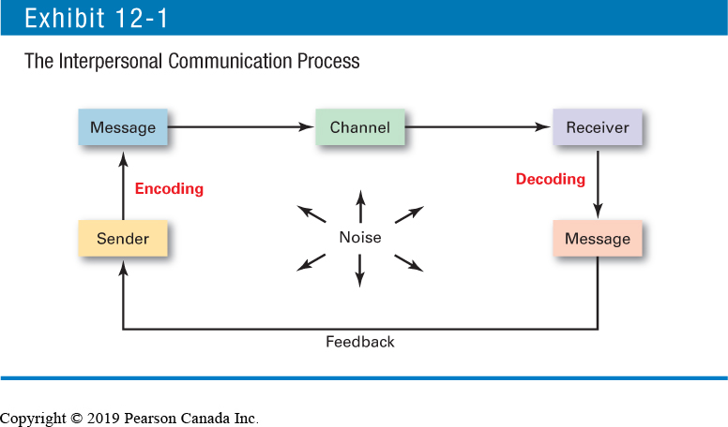
The Interpersonal Communication Process

Slide 7
Methods of Interpersonal Communication
Channels for Interpersonal Communication Techniques
A wide variety of communication channels:
Face-to-face
Telephone
Group meetings
Formal presentations
Memos
Postal mail
Fax
Publications
Bulletin boards
Audio-/videotapes
Hot lines
Email
Computer conference
Voice mail
Teleconference
Videoconference

Slide 8
Methods of Interpersonal Communication
Channels for Interpersonal Communication Techniques
12 questions to help evaluate communication methods:
Feedback. How quickly can the receiver respond to the message?
Complexity capacity. Can the method effectively process complex messages?
Breadth potential. How many different messages can be transmitted using this method?

Slide 9
Methods of Interpersonal Communication
Confidentiality. Can communicators be reasonably sure their messages are received only by those for whom they’re intended?
Encoding ease. Can the sender easily and quickly use this channel?
Decoding ease. Can the receiver easily and quickly decode messages?

Slide 10
Methods of Interpersonal Communication
Time–space constraint. Do senders and receivers need to communicate at the same time and in the same space?
Cost. How much does it cost to use this method?
Interpersonal warmth. How well does this method convey interpersonal warmth?

Slide 11
Methods of Interpersonal Communication
Formality. Does this method have the needed amount of formality?
Scanability. Does this method allow the message to be easily browsed or scanned for relevant information?
Time of consumption. Does the sender or receiver exercise the most control over when the message is dealt with?

Slide 12
Methods of Interpersonal Communication
Nonverbal communication: communication transmitted without words.
Body language: gestures, facial expressions, and other body movements that convey meaning.
Verbal intonation (paralinguistics): An emphasis given to words or phrases that conveys meaning.

Slide 13
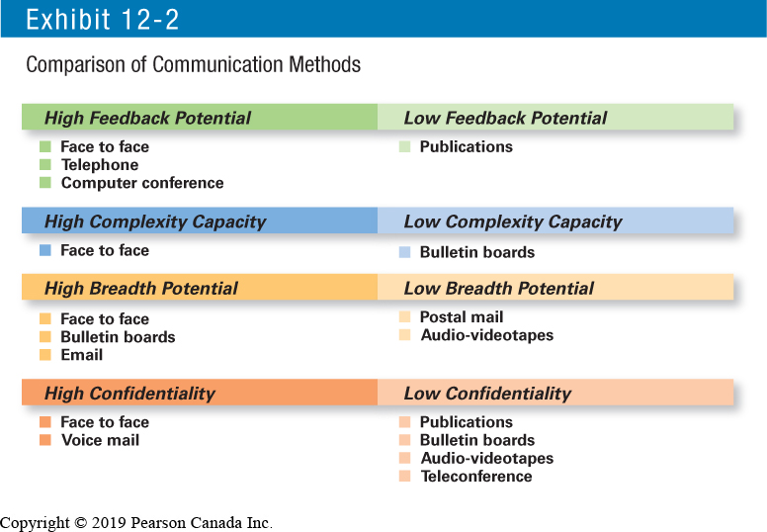
Methods of Interpersonal Communication

Slide 14
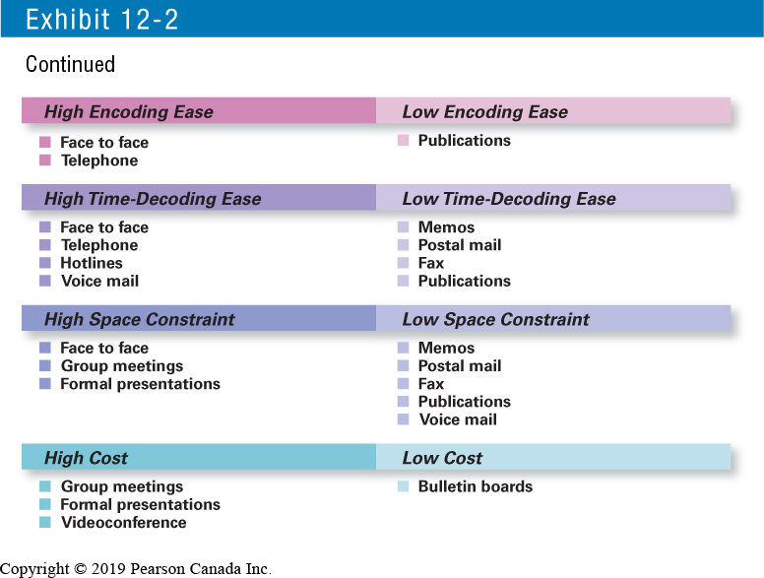
Methods of Interpersonal Communication

Slide 15
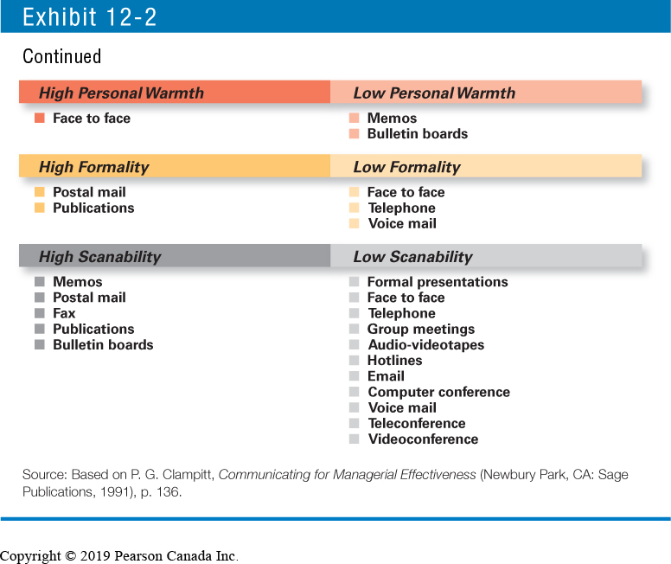
Methods of Interpersonal Communication

Slide 16
Effective Interpersonal Communication
How Distortions Can Happen in Interpersonal Communication:
Sender
Message
Channel
Receiver
Feedback Loop

Slide 17
Effective Interpersonal Communication
Barriers to Effective Interpersonal Communication:
Filtering:
The deliberate manipulation of information to make it appear more favourable to the receiver
Emotions:
Disregarding rational and objective thinking processes and substituting emotional judgments when interpreting messages
Information Overload:
When the information we have to work with exceeds our processing capacity

Slide 18
Effective Interpersonal Communication
Selective Perception:
Individuals interpret “reality” based on their own needs, motivations, experience, background, and other personal characteristics
Defensiveness:
When threatened, reacting in a way that reduces the ability to achieve mutual understanding

Slide 19
Effective Interpersonal Communication
Language:
The different meanings of and specialized ways (jargon) in which senders use words can cause receivers to misinterpret their messages.
Jargon:
Specialized terminology or technical language that members of a group use to communicate among themselves.

Slide 20
Effective Interpersonal Communication
Overcoming Barriers to Communication
Use Feedback
Simplify Language
Listen Actively
Constrain Emotions
Watch Nonverbal Cues

Slide 21
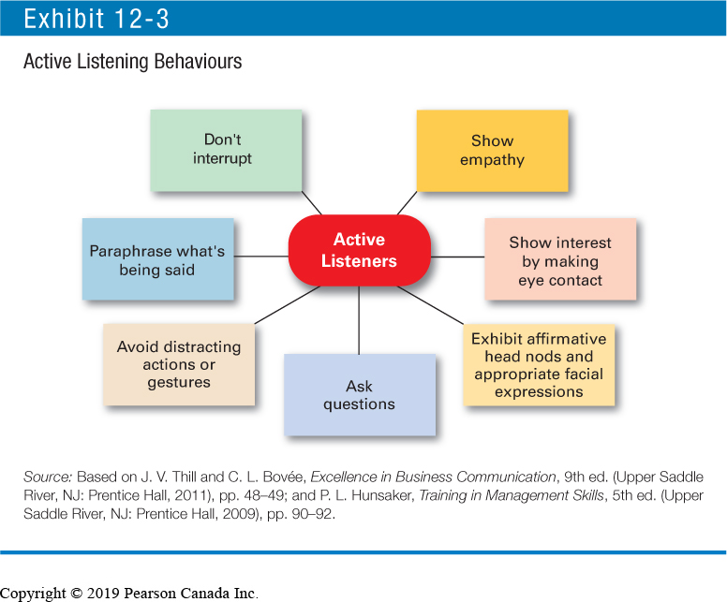
Active Listening Behaviours

Slide 22
Organizational Communication
Formal Communication
Communication that follows the official chain of command or is part of the communication required to do one’s job.
Informal Communication
Communication that is not defined by the organization’s hierarchy.

Slide 23
Organizational Communication
Direction of Communication Flow
Downward
Communications that flow from managers to employees to inform, direct, coordinate, and evaluate employees.

Slide 24
Organizational Communication
Direction of Communication Flow
Upward
Communications that flow from employees up to managers to keep them aware of employee needs and how things can be improved to create a climate of trust and respect.

Slide 25
Organizational Communication
Lateral (Horizontal) Communication:
Communication that takes place among employees on the same organizational level.

Slide 26
Organizational Communication
Diagonal Communication:
Communication that cuts across both work areas and organizational levels.

Slide 27
Organizational Communication
Communication Networks:
The variety of patterns of vertical and horizontal flows of organizational communication.

Slide 28
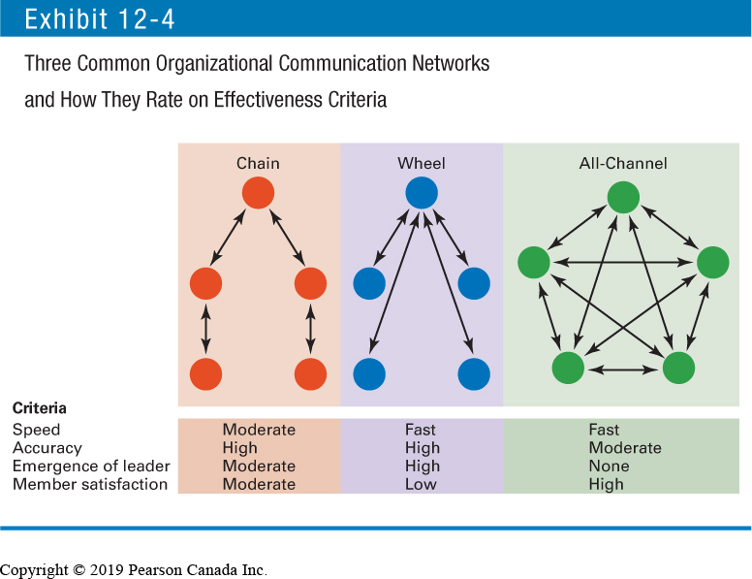
Three Common Organizational Communication Networks and How They Rate on Effectiveness Criteria

Slide 29
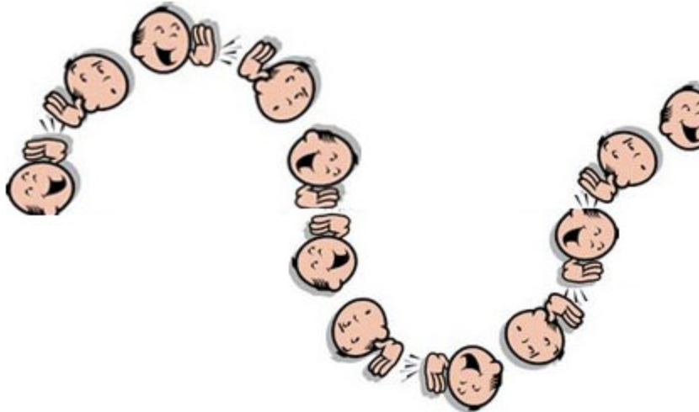
Organizational Communication
The Grapevine
The informal organizational communication network.

Slide 30
Organizational Communication
Workplace Design and Communication
Another factor that influences organizational communication is workplace design.
Open Workplaces
Workplaces with few physical barriers and enclosures

Slide 31
Communication Issues in Today`s Organizations
Managing Communication in an Internet World
New technology has created special communication challenges:
legal and security issues
personal interaction.

Slide 32
Communication Issues in Today`s Organizations
Ethical Communication
Communication that includes all relevant information, is true in every sense, and is not deceptive in any way.

Slide 33
CHAPTER 13

Slide 34
The Human Resource Management Process
Why Human Resources Management is Important
It can be a significant source of competitive advantage
An important part of organizational strategies
Adds value to the firm
High-performance work practices:
Work practices that lead to both high individual and high organizational performance.

Slide 35
High-Performance Work Practices
Self-managed teams Decentralized decision making Training programs to develop knowledge, skills, and abilities Flexible job assignments Open communication Performance-based compensation Staffing based on person–job and person–organization fit Extensive employee involvement Giving employees more control over decision making Increasing employee access to information
Sources: C. H. Chuang and H. Liao, “Strategic Human Resource Management in Service Context: Taking Care of Business by Taking Care of Employees and Customers,” Personnel Psychology, Spring 2010, pp. 153–196; M. Subramony, “A Meta-Analytic Investigation of the Relationship Between HRM Bundles and Firm Performance,” Human Resource Management, September–October 2009, pp. 745–768; M. M. Butts et al., “Individual Reactions to High Involvement Work Practices: Investigating the Role of Empowerment and Perceived Organizational Support,” Journal of Occupational Health Psychology, April 2009, pp. 122–136; and W. R. Evans and W. D. Davis, “High-Performance Work Systems and Organizational Performance: The Mediating Role of Internal Social Structure,” Journal of Management, October 2005, p. 760.

Slide 36
The Human Resource Management Process
Human Resources for Non-HR Managers
Small vs. large organizations
Large organizations have HR function.
Smaller organizations may rely on managers to handle HR issues.

Slide 37
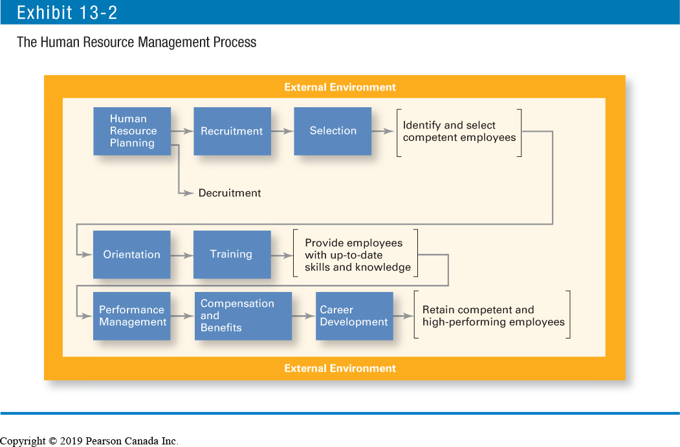
The Human Resources Management Process

Slide 38
The Human Resource Management Process
External Factors That Affect the HRM Process
The Economy
Labour Union
Collective Bargaining Agreement
Government Legislation
The Canadian Human Rights Act, Occupational Health and Safety Act, The Employment Equity Act
Demographic Trends

Slide 39
Identifying and Selecting Competent Employees
Human Resources (HR) Planning
Ensuring that the organization has the right number and kinds of capable people in the right places and at the right times

Slide 40
Identifying and Selecting Competent Employees – Assessing current HR
Job Analysis:
An assessment that defines a job and the behaviours necessary to perform them.

Slide 41
Identifying and Selecting Competent Employees
Job Description:
A written statement of what the jobholder does, how it is done, and why it is done.
Job Specification:
A written statement of the minimum qualifications that a person must possess to perform a given job successfully.

Slide 42
Identifying and Selecting Competent Employees
Recruitment:
The process of locating, identifying, and attracting capable applicants to an organization.
Decruitment:
Techniques for reducing the organization’s workforce.

Slide 43
Major Sources of Potential Job Candidates
Source | Advantages | Disadvantages
Internet | Reaches large numbers of people; can get immediate feedback | Generates many unqualified candidates
Employee referrals | Knowledge about the organization provided by current employee; can generate strong candidates because a good referral reflects on the recommender | May not increase the diversity and mix of employees
Company website | Wide distribution; can be targeted to specific groups | Generates many unqualified candidates
College/university recruiting | Large centralized body of candidates | Limited to entry-level positions
Professional recruiting organizations | Good knowledge of industry challenges and requirements | Little commitment to specific requirements organization

Slide 44
Decruitment Options
Option | Description
Firing | Permanent involuntary termination
Layoffs | Temporary involuntary termination; may last only a few days or extend to years
Attrition | Not filling openings created by voluntary resignations or normal retirements
Transfers | Moving employees either laterally or downward; usually do not reduce costs but can reduce intraorganizational supply–demand imbalances
Reduced workweeks | Having employees work fewer hours per week, share jobs, or perform their jobs on a part-time basis
Early retirements | Providing incentives to older and more senior employees for retiring before their normal retirement dates
Job sharing | Having employees share one full-time position

Slide 45
Identifying and Selecting Competent Employees
Selection Process:
The process of screening job applicants to ensure that the most appropriate candidates are hired.
Selection:
Predicting which applicants will be (or will not be) successful in performing well on the criteria the organization uses to evaluate performance.
Selection errors:
Reject errors for potentially successful applicants
Accept errors for ultimately poor performers

Slide 46
Identifying and Selecting Competent Employees
Types of Selection Devices
Application Forms
Written Tests
Performance Simulations
Interviews
Background Investigations
Physical Examinations

Slide 47
Selection Devices
Selection Device | Strengths | Weaknesses
Application forms | Relevant biographical data and facts that can be verified have been shown to be valid performance measures for some jobs. When items on the form have been weighted to reflect job relatedness, this device has proved to be a valid predictor for diverse groups. | Usually only a couple of items on the form prove to be valid predictors of job performance, and then only for a specific job. Weighted-item applications are difficult and expensive to create and maintain.
Written tests | Tests of intellectual ability, spatial and mechanical ability, perceptual accuracy, and motor ability are moderately valid predictors for many semi-skilled and unskilled lower-level jobs in manufacturing. Intelligence tests are reasonably good predictors for supervisory positions. | Intelligence and other tested characteristics can be somewhat removed from actual job performance, thus reducing their validity.
Performance-simulation tests | Tests are based on job analysis data and easily meet the requirement of job relatedness. Tests have proven to be valid predictors of job performance. | They are expensive to create and administer.

Slide 48
Selection Devices
Selection Device | Strengths | Weaknesses
Interviews | Interviews must be structured and well organized to be effective predictors. Interviewers must use common questions to be effective predictors. | Interviewers must be aware of the legality of certain questions. Interviews are subject to potential biases, especially if they are not well structured and standardized.
Background investigations | Verifications of background data are valuable sources of information. | Reference checks are essentially worthless as a selection tool.
Physical examinations | Physical exams have some validity for jobs with certain physical requirements. | Managers must be sure that physical requirements are job related and do not discriminate.

Slide 49
Identifying and Selecting Competent Employees
Other Selection Approaches
Interviews
Interviews in which candidates are evaluated on how well they handle role play in mock scenarios
Background Investigations
Verification of application data
Reference checks:
Lack validity because self-selection of references ensures only positive outcomes
Physical Examinations
Useful for physical requirements

Slide 50
Quality of Selection Devices as Predictors
Position
Selection Device | Senior Management | Middle and Lower Management | Complex Nonmanagerial | Routine Work
Application forms | 2 | 2 | 2 | 2
Written tests | 1 | 1 | 2 | 3
Work sampling | — | — | 4 | 4
Assessment centres | 5 | 5 | — | —
Interviews | 4 | 3 | 2 | 2
Verification of application data | 3 | 3 | 3 | 3
Reference checks | 1 | 1 | 1 | 1
Physical exams | 1 | 1 | 1 | 2
Note: Validity is measured on a scale from 5 (highest) to 1 (lowest). A dash means “not applicable.”

Slide 51
Providing Employees with Needed Skills and Knowledge
Employee Orientation
Orientation
Familiarizes new employee with work-unit goals
Clarifies how his or her job contributes to unit goals
Introduces employee to his or her co-workers

Slide 52
Providing Employees with Needed Skills and Knowledge
Employee Training:
Type | Includes
General | Communication skills, computer systems application and programming, customer service, executive development, management skills and development, personal growth, sales, supervisory skills, and technological skills and knowledge
Specific | Basic life/work skills, creativity, customer education, diversity/cultural awareness, remedial writing, managing change, leadership, product knowledge, public speaking/presentation skills, safety, ethics, sexual harassment, team building, wellness, and others

Slide 53
Employee Training Methods
Traditional Training Methods On the job—Employees learn how to do tasks simply by performing them, usually after an initial introduction to the task. Job rotation—Employees work at different jobs in a particular area, getting exposure to a variety of tasks. Mentoring and coaching—Employees work with an experienced worker who provides information, support, and encouragement; also called apprenticing in certain industries. Experiential exercises—Employees participate in role playing, simulations, or other face-to-face types of training. Workbooks/manuals—Employees refer to training workbooks and manuals for information. Classroom lectures—Employees attend lectures designed to convey specific information. Technology-Based Training Methods CD-ROM/DVD/videotapes/audiotapes—Employees listen to or watch selected media that convey information or demonstrate certain techniques. Videoconferencing/teleconferencing/satellite TV—Employees listen or participate as information is conveyed or techniques demonstrated. E-learning—Internet-based learning where employees participate in multimedia simulations or other interactive modules.

Slide 54
Retaining Competent and High Performance Employees
Performance Management System:
A process of establishing performance standards and evaluating performance in order to arrive at objective HR decisions, as well as to provide documentation to support those decisions.

Slide 55
Advantages and Disadvantages of Performance Appraisal Methods
Method | Advantage | Disadvantage
Written essays | Simple to use | More a measure of evaluator’s writing ability than of employee’s actual performance
Critical incidents | Rich examples; behaviourally based | Time consuming; lack quantification
Graphic rating scales | Provide quantitative data; less time-consuming than others | Do not provide depth of job behaviour assessed
BARS | Focus on specific and measurable behaviours | Time consuming; difficult to develop job behaviours
Multiperson comparisons | Compare employees with one another | Unwieldy with large number of employees; legal concerns
MBO | Focuses on end goals; results oriented | Time consuming
360-degree feedback | Thorough | Time consuming

Slide 56
Retaining Competent and High Performance Employees
What Happens When Performance Falls Short?
Discipline
Actions taken by a manager to enforce an organization’s standards and regulations
Employee Job Counselling
A process designed to help employees overcome performance-related problems

Slide 57
Retaining Competent and High Performance Employees
Types of Compensation
Base wage or salary
Wage and salary add-ons
Incentive payments
Skill-based pay

Slide 58
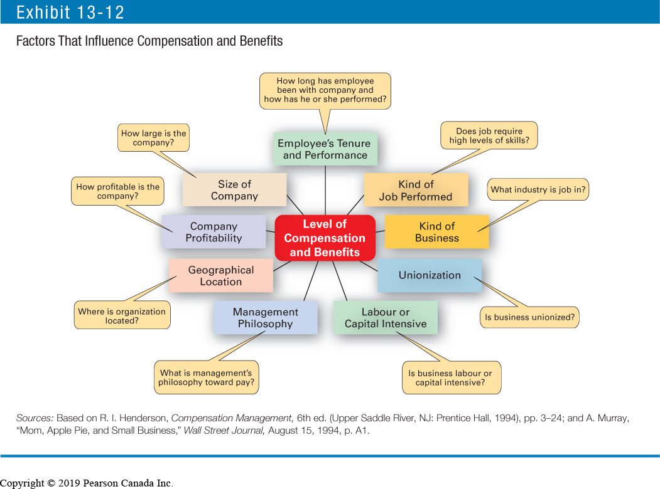
Factors That Influence Compensation and Benefits

Slide 59
Retaining Competent and High Performance Employees
Career Defined
A sequence of positions held by a person during his or her lifetime.
Career Development
Provides for information, assessment, and training.
Helps attract and retain highly talented people.
Boundaryless Career
A career in which individuals, not organizations, define career progression, organizational loyalty, important skills, and marketplace value.

Slide 60
Contemporary Issues in Managing Human Resources
Workforce Diversity
Recruitment for diversity
Managing downsizing
Managing sexual harassment

Slide 61
Contemporary Issues in Managing Human Resources
Work-Life Balance
Employees have personal lives that they don’t leave behind when they come to work.
Organizations have become more attuned to their employees by offering family-friendly benefits:
On-site child care
Summer day camps
Flextime
Job sharing
Leave for personal matters
Flexible job hours

Slide 62
Next week!
Guest lecture – attendance required
Chapter 14 & 16
Individual projects due!

