Slide 1
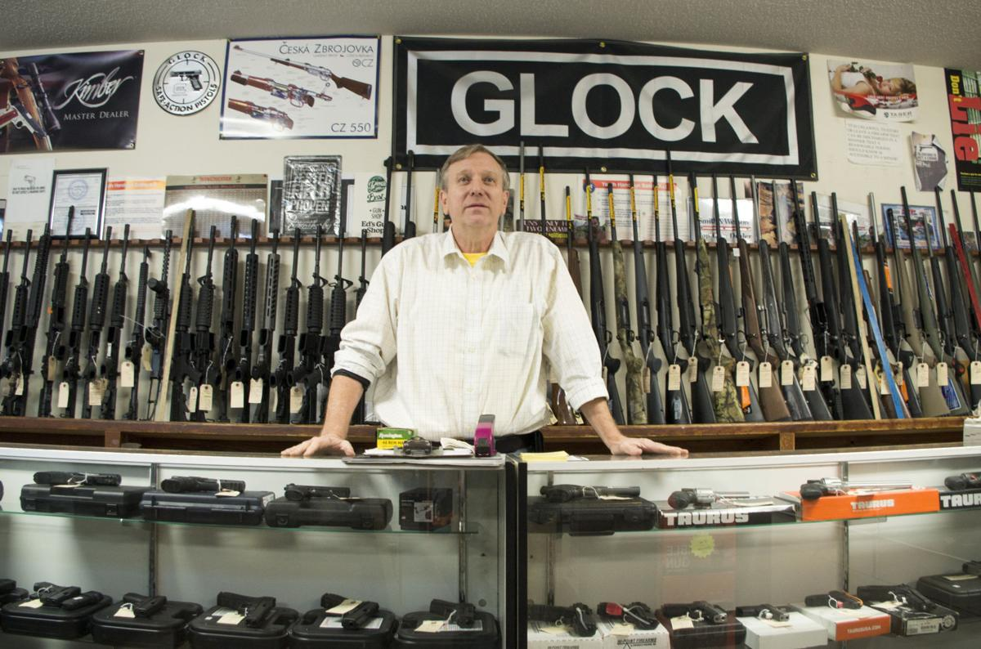
Gun Shop C++ Code idea
DEVELOPED BY;
Georgi Georgiev ,Angel Zhelqzkov , Martin Bakalov, Mihail Atanasov

Slide 2
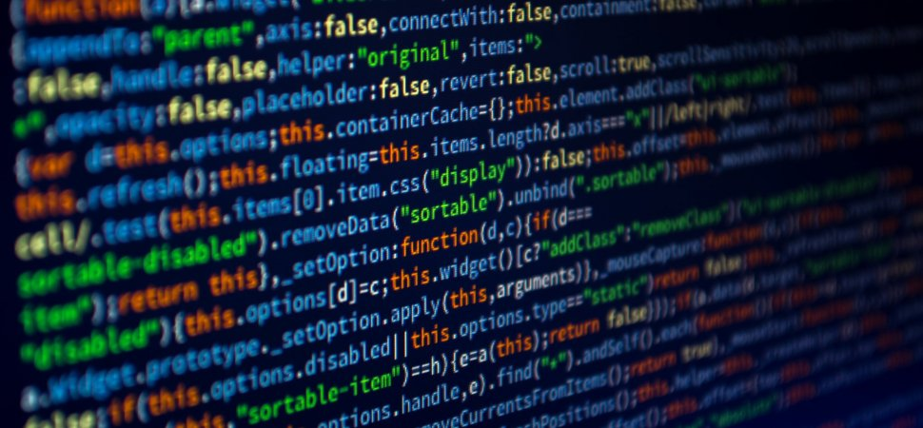
What did we use?
C++
Google
GitHub

Slide 3
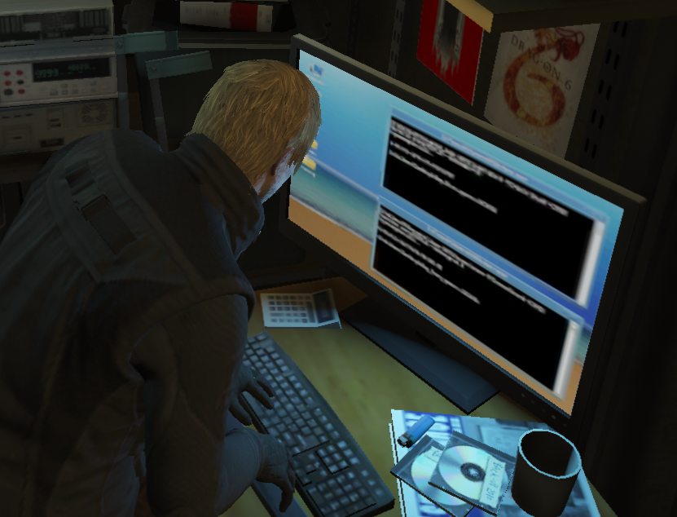
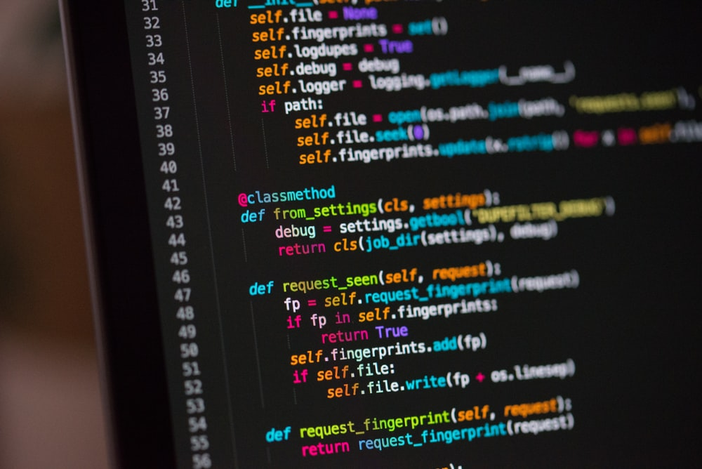
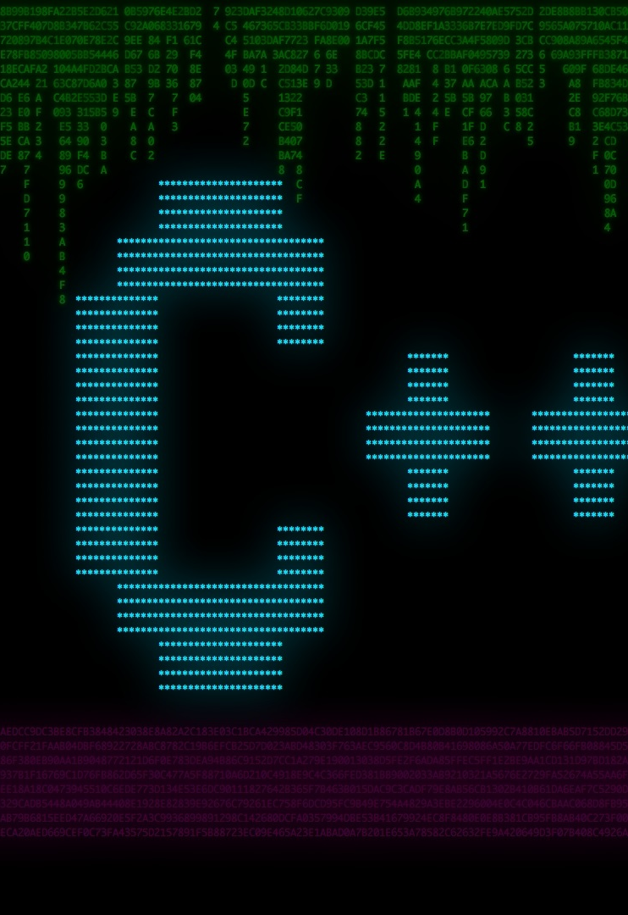
How we started?
Adding Guns
Adding Accounts
Adding Orders

Slide 4

How does it work?
We've created a new computer console program, that can help gun sellers do their work more efficiently!

Slide 5
Our program in the future
Real databases
more functionality
much more comfortable to use

Slide 6
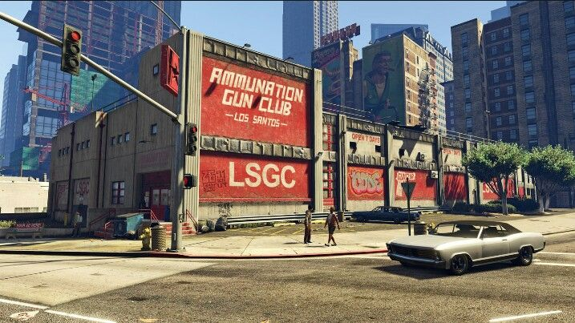
Thank you
FOR YOUR ATTENTION
!

