Slide 1

Adaptive ∆-Stepping Algorithm for Communication-Efficient Distributed Computing in Heterogeneous and Mobile Environments
Gourinath – AM.EN.U4CSE20129
Karthik Prasad – AM.EN.U4CSE20240
Amrita School of Computing | Amrita Vishwa Vidyapeetham | Amritapuri

Slide 2
Introduction
The problem to be addressed in this project is the lack of effective algorithms for communication-efficient distributed computing in heterogeneous and mobile environments. This problem arises due to the varying hardware configurations, processing capabilities, and node mobility in real-world distributed systems.
The relevance of this problem lies in the prevalence of such diverse environments in modern computing scenarios. As computing environments become increasingly heterogeneous and mobile, there is a growing need for algorithms that can adapt to these conditions. The relevance is further underscored by the practical applications of distributed computing systems across various domains.
In summary, the project aims to address the problem of inefficient communication in heterogeneous and mobile distributed computing environments and is relevant due to the widespread existence of such environments in contemporary computing and its potential impact on various practical applications.

Slide 3
Motivation
Imagine a dynamic smart city, brimming with diverse devices like traffic cameras, environmental sensors, and streetlight controllers. These devices vary in hardware capabilities and mobility. In this complex environment, traditional distributed computing algorithms struggle to efficiently manage data processing and communication. Enter the enhanced ∆-stepping algorithm from this project, a game-changer. This algorithm thrives in this diverse landscape by optimizing communication, adapting to each device's unique attributes, and intelligently distributing computational tasks. The result? Swift data processing, efficient resource allocation, and enhanced urban management—improving traffic flow, environmental monitoring, and energy efficiency, ultimately elevating the residents' quality of life in the smart city.

Slide 4
Background Study/Related Work
Title &year | Problem | Contributions | Limitations | Open problems/Future work
1.Communication-Efficient ∆-Stepping for Distributed Computing Systems Date of Conference: 21-23 June 2023 Publisher: IEEE | The problem identified in this paper is the lack of efficient single source shortest path (SSSP) algorithms designed for distributed computing systems, especially in the context of diverse smart devices with limited computing resources. The existing SSSP algorithms are mostly designed for shared-memory systems, and when deployed on distributed networks, communication delay becomes a significant performance bottleneck.

Slide 5
Persisting Challenges
1.Adapting to Heterogeneous Environments: Devising algorithms that can effectively utilize the varying hardware capabilities and processing power of nodes in a heterogeneous environment is challenging. The algorithm needs to allocate tasks optimally to nodes with different computing resources, ensuring efficient resource utilization.
2.Handling Node Mobility: In a mobile environment, nodes may join or leave the network or change their locations dynamically. Managing node mobility and ensuring continuous computation progress despite node movements require sophisticated strategies to track node status and handle data migration effectively.
3.Dynamic Network Changes: The distributed system may experience changes in the network topology due to node mobility or connectivity fluctuations. The algorithm needs to adapt to such changes to maintain data consistency and efficient communication between nodes.

Slide 6
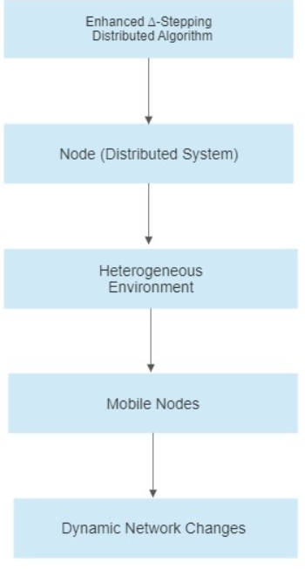
High Level Design

Slide 7
Project Contributions
Objective 1: Literature Review and Problem Analysis
Conduct a comprehensive literature review on ∆-stepping algorithms, distributed computing, and related research in the context of heterogeneous and mobile environments.
Analyze the challenges and requirements for efficiently handling the single source shortest path (SSSP) problem in such distributed systems.
Objective 2: Algorithm Design and Prototyping
Design an adaptive ∆-stepping algorithm that dynamically adjusts computation and communication strategies based on node heterogeneity and mobility.
Create a prototype of the algorithm, focusing on the core components of the master-slave architecture and initial message coordination.
Objective 3: Implementation of Message Coordination
Implement the message coordination architecture for minimizing message exchanges between computing nodes.
Develop basic communication protocols and data structures required for task distribution and synchronization

Slide 8
Outcomes/Deliverables
Improved Communication Efficiency: The enhanced ∆-stepping algorithm is expected to reduce communication overhead in the distributed system. By efficiently managing the exchange of information between nodes, the algorithm can minimize message delays and network congestion, leading to improved overall system performance.
Adaptability to Diverse Environments: The project aims to create an algorithm that can adapt to heterogeneous and mobile environments. As a result, the distributed system will be able to efficiently utilize the varying hardware capabilities and processing power of nodes and handle node mobility and dynamic network changes seamlessly.
Enhanced Robustness and Scalability: The algorithm's adaptability and optimized resource allocation are likely to contribute to increased robustness and scalability of the distributed system. It will be able to handle a larger number of nodes and tasks while maintaining efficient computation progress.

Slide 9
Assumptions/Declarations:
Homogeneous Task Execution: The project assumes that each task or computation in the distributed system can be executed by any node in the network without significant variations in performance. In other words, the algorithm does not explicitly consider tasks that require specialized hardware or specific node capabilities.
Synchronized Clocks: The project assumes that the clocks of the nodes in the distributed system are synchronized or that the time differences between nodes' clocks are negligible. This assumption is often made in distributed computing to simplify timestamp-based algorithms and coordination mechanisms.

Slide 10
Algorithms
At least 2 substantial algorithms to be implemented as part of Project Phase I needs to be explained.
Maximum 2 slides

Slide 11
Current status
Demonstrate the current implementation status.
At least 40% of the implementation should be shown

Slide 12
References
"Communication-Efficient ∆-Stepping for Distributed Computing Systems," presented at the Conference Name, 21-23 June 2023.
"EdgeIoT: Mobile Edge Computing for the Internet of Things," Date of Publication: 16 December 2016.
"Mobile Edge Computing: A Survey," Date of Publication: 08 September 2017.

Slide 13
Thank You

