Slide 1
Community based interactive learning web application.
TEAM MEMBERS
Krishna: krishnasai3cks@gmail.com
Praneeth: gpraneeth621@gmail.com
Saketh: sakethnandn.k@gmail.com
KEERTHI: keerthiks1223@gmail.com
College: Guru nanak institute of technology
Department: CSE

Slide 2
Introduction
Online learning is the new trend for the next generation students to learn new concepts easily with lesser cost with availability everywhere the internet is present. While most of the courses online are video lectures a better alternative is to use interactive learning to attract students to learn new topics in a fun way while interacting with the tutors(a website or GUI which automates teaching process).
The best way is to make a website which provides an interface and required technology for the community to create free interactive courses to the learners. A website is more feasible because it is reachable to everyone with internet and a web browser. This is going to be simple and fun to learn for beginners and also to intermediates who want to learn how to contribute to online projects.

Slide 3
Interactive learning
What is interactive learning?
Interactive learning is learning that involves the student. The best way to involve the student is to make them a part of the learning process instead of video lectures, classroom teaching etc.,.
Interactive teaching is a way of teaching which will benefit both the teacher and the student because even the teacher starts as a beginner. Interactive learning also means asking doubts to the faculty whenever possible but this does not happen in normal classes. Hence with the use of technology we can make the endless learning process simple, efficient, cost effective and easily accessible around the world.

Slide 4
Software Requirements
The software requirements for this domain are simple. We use either python or NodeJS for the backend and HTML/CSS/JS for the front end. Software requirements are very basic for the project and hence this is very cost effective.
Requirements:
• FRONT END : HTML/CSS/JS.
• BACK END : Python/Django (or) NodeJS
• OPERATING SYSTEM : WINDOWS 7,8,10
• IDE : PyCharm/Visual Studio Code.

Slide 5
Hardware Requirements
Hardware Requirements:
• RAM : At least 2GB ram.
• Processor: dual core.
• Hard Disk: 512GB.

Slide 6
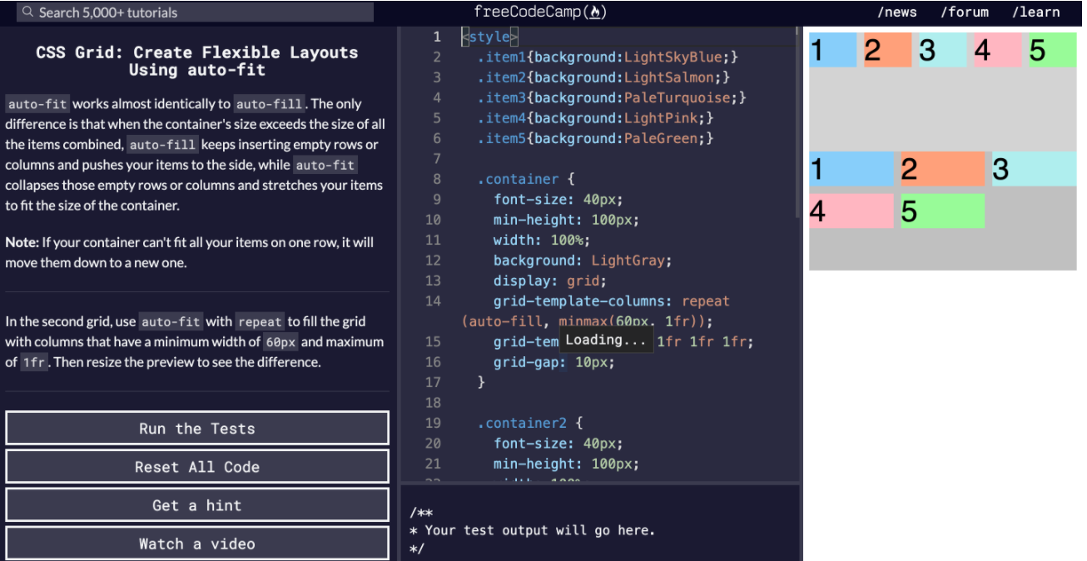
Similar Projects.
FREECODECAMP:
Free code camp is an online learning platform which provides online learning platform to the students in web development with javascript and data science/machine learning with python.

Slide 7
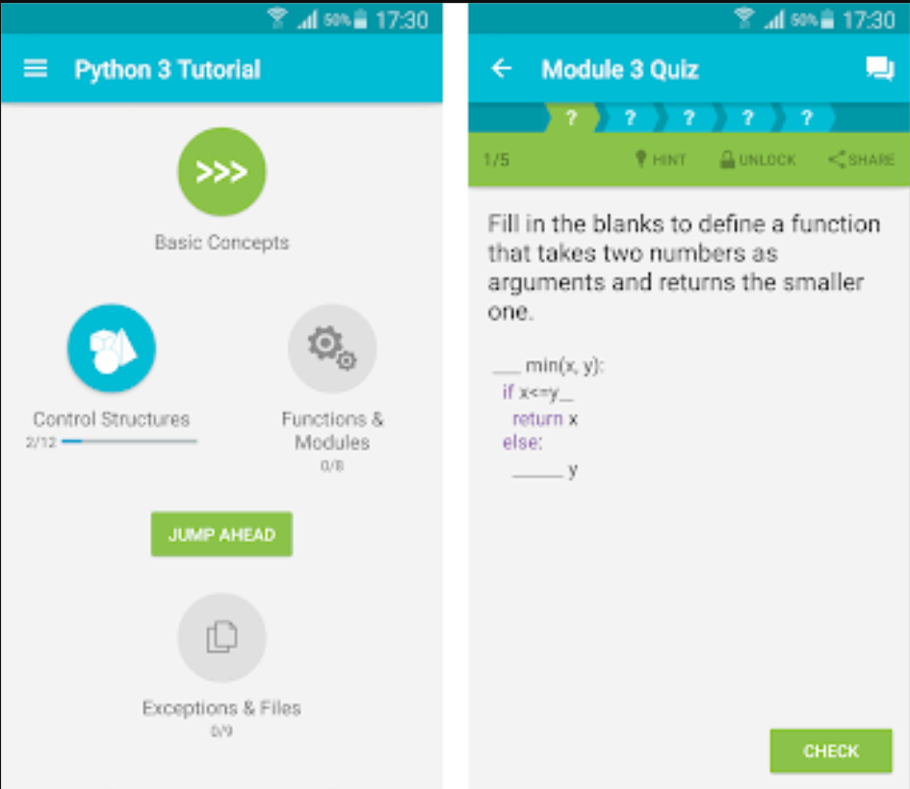
Similar Projects.
SOLOLEARN:
Solo learn is an excellent learning platform for beginners to grasp the basics of a concept in a fun and interactive way. By solving quizzes. This helps the student to get well versed with the syntax and basic functionalities of languages.

Slide 8
Future Enhancements
Using an ML based approach to use an AI for doubt clarification.
Using web scraping with AI to automatically give information to the learner regarding any error messages without wasting any time searching online for answers.
Visual representation of navigating the website and all the features of the website.

Slide 9
Conclusion
We have proposed a futuristic idea which is going to be the future of online learning, teaching and open source programming. It has been proven that how interactive teaching is effective to a student's growth. The end product is highly accessible everywhere in the world which is inexpensive, fun and the best alternative.

Slide 10
Thank You

