Slide 1


Code Innovation Series - Guru Nanak Institute of Technology 2021
Project EdWebGo Read to share
A smart platform to connect readers and books across the cities.

Slide 2
Team: “Coding_Team”
Kandukuri Abhinav Reddy _{3rd year CSE,GNITC}
Kantam Akash Sagar_{3rd year CSE ,GNITC}
Katta Ganesh _{3rd year CSE ,GNITC}
Mylapuram Yagnesh _{3rd year CSE ,GNITC}

Slide 3
Project Overview
Online Platform to connect readers and books across the city in a cost-efficient and reliable way, Targeting every student and reader.
EdwebGo is optimized by creating a smart ecosystem and features easy access for everyone.

Slide 4
Current issues for readers
Books are expensive for exam preparation, Graduates especially doctors and engineers, and other fields.
Not enough libraries are available for readers. Even if libraries exist, issues faced are
Recruitment, education, and retention of librarians.
Role of libraries in academic programs.
Impact of Information Technology on library services.
Creation, control, and preservation of books.
Chaos in scholarly communication.
Support of new users.
Hard to find recommendations from diverse books.
No perfect ecosystem for renting books from libraries & other students , no proper delivery system exists.

Slide 5
Current issues for readers
Many students claim these issues:
The physical library space is not flexible enough to change with the needs of students and staff. It is also too small to cope with rising student numbers.
There is no allowance in the budget for makerspaces or other activities
Students cannot find a way to reuse, rent or sell the books they have and cannot find books they require at budget

Slide 6
Product Features
Students, libraries and sellers can sell or rent books.
Option of home delivery or self-collection available, by the introduction of a feature called "Map U", one of its kind.
Users can choose to remain anonymous without giving their personal details while using inter-college and are hubs.

Slide 7
Unique Features
Introducing inter-college and area Hub on the platform, where students, readers in social can coordinate and order books for rent or buying which decreases the cost and time.
Smart chat recommendation allows users to connect to the hub and stay anonymous and coordinate in group discussions while ordering and suggesting books.
This creates an eco-system for all the students and libraries to dispatch and recommend books in an efficient way

Slide 8
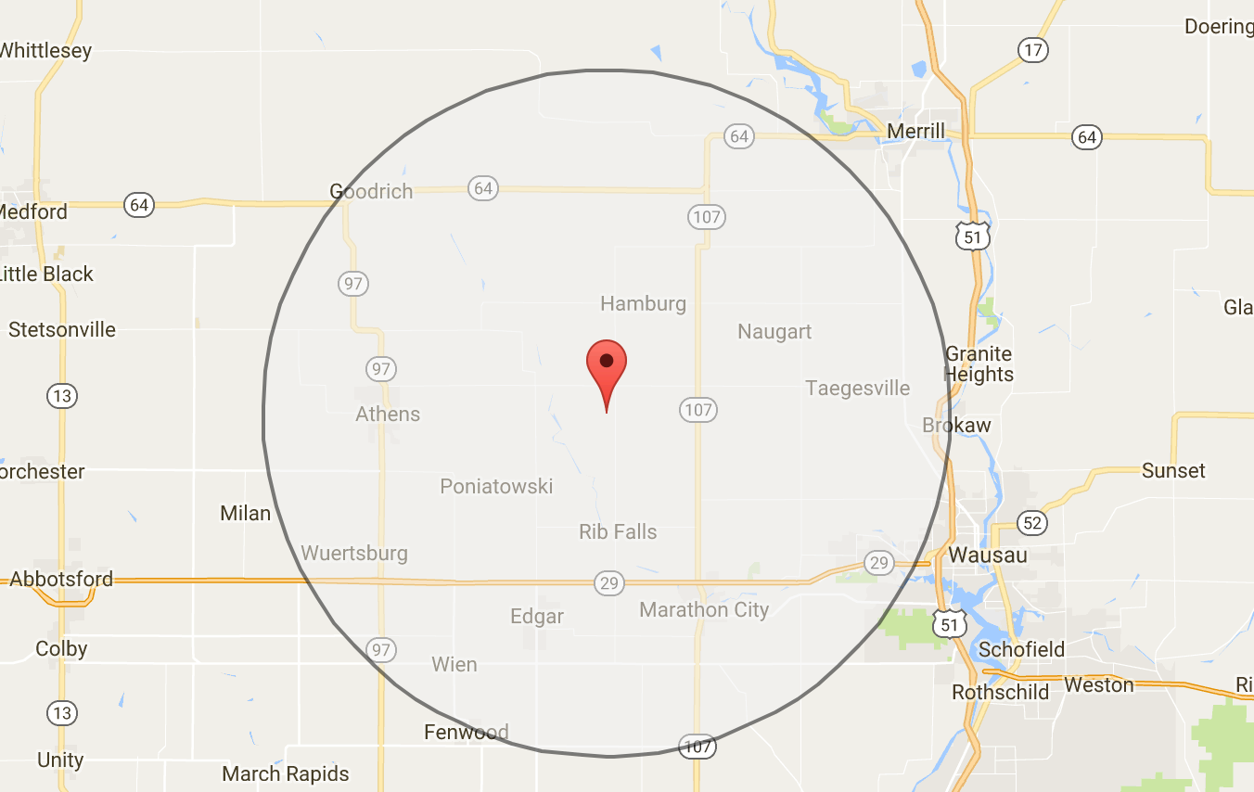
Unique Features
“Map U” features:
User can adjust search radius.
Ready to rent a book
Ready to sell book
Integrated smart chat

Slide 9
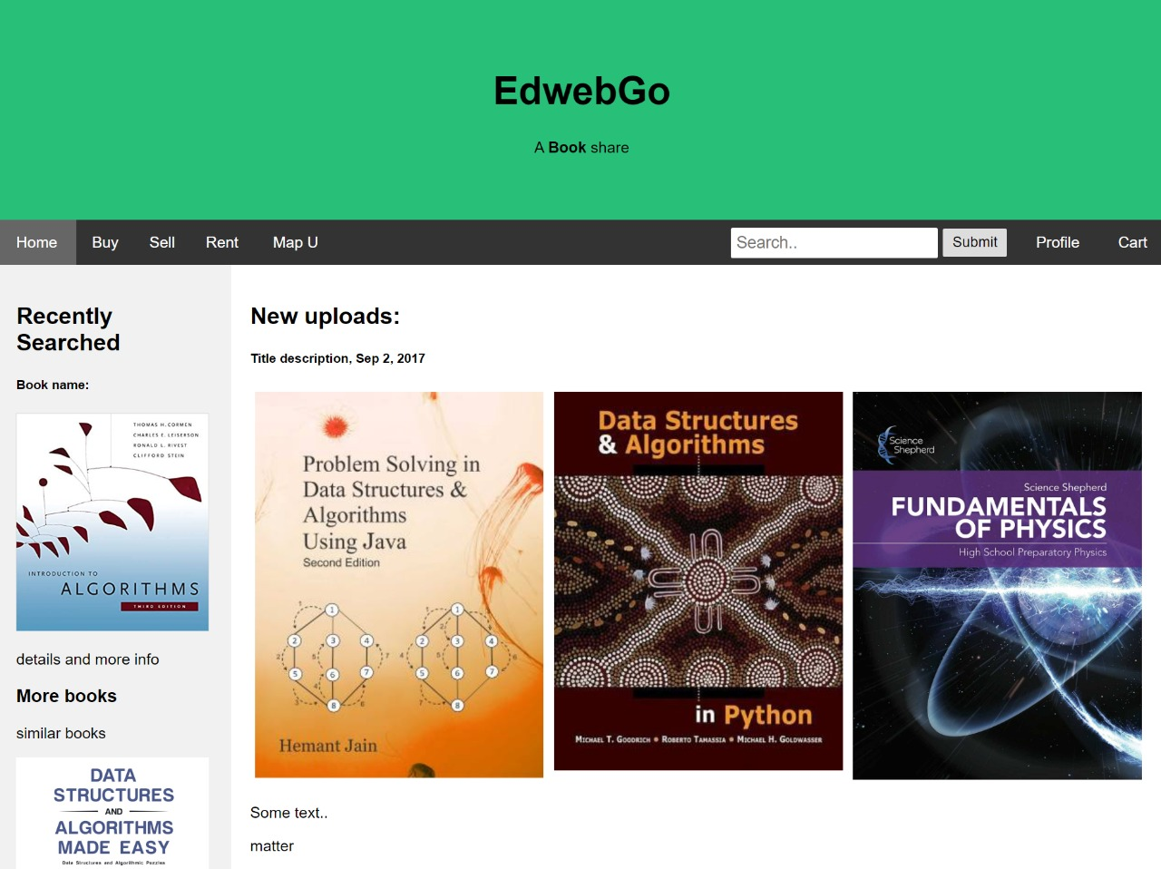
Home Page

Slide 10
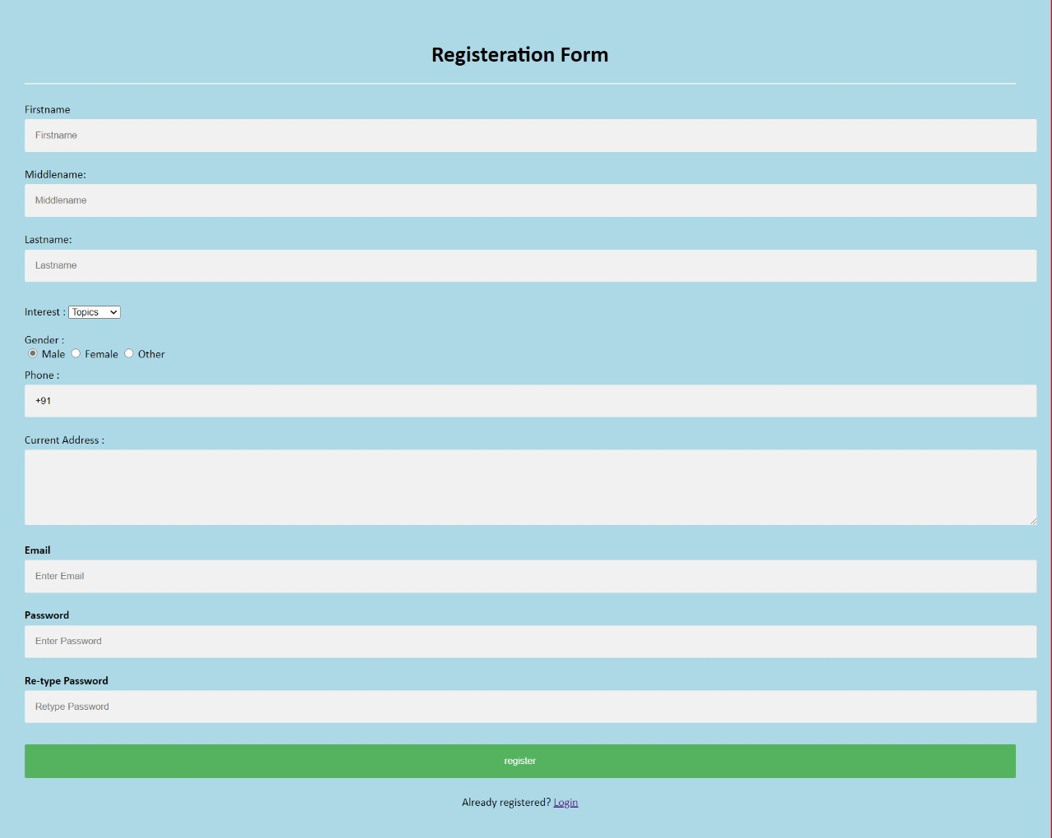
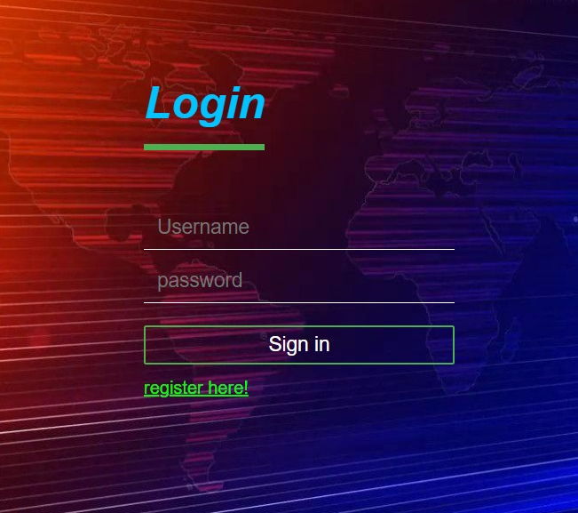
Registration and Login Page

Slide 11
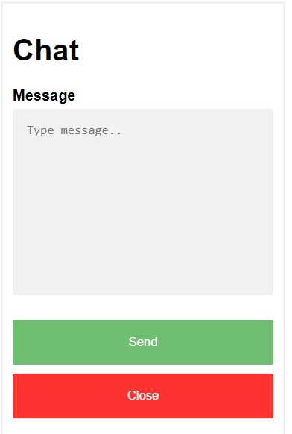
Chat Bot

Slide 12
Unique Selling Point, vision
Made in India.
Chat system between reader and seller as per their requirement.
Inter-students hubs to deliver books not only from students but also creating chain between colleges and college students to save time in searching and filtering recommendations.

Slide 13
Market & Revenue
$5.25 billion: Amazon's current annual revenue from book sales, according to one of Packer's sources. That means books account for 7% of the company's $75 billion in total yearly revenue.
Population of students high- Bangalore, Chennai, Hyderabad, Kanpur & Mumbai.
Hyderabad Student Population Census
Year | Population | Growth Rate
2020 | 10,004,000 | 2.70%
2019 | 9,741,000 | 2.73%
2018 | 9,482,000 | 2.92%

Slide 14
Target audience
Engineers
Doctors
Students
Libraries
Book stores
Reading enthusiasts who desire to sell or buy or rent books from other students

Slide 15
Links
GitHub: Coding_Team

Slide 16
Thank You

