Slide 1
3. Extraction of Road and Lane Boundary from Satellite Imagery
Desheng Liu, Honghao Xu, Yifei Ge, Xu Teng

Slide 2
Procedure
Download aerial images according to GPS trajectory
For each image
Detect edges
Extract lines by Hough transformation
Remove invalid lines (based on distance from trajectory)
Use ML (line regression) to separate points into different lane groups
Convert coordinates from pixel-based to lat- and lon-based

Slide 3
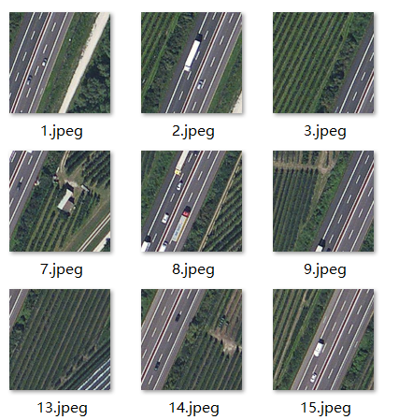
Getting Image
Getting image near all trajectory(automatically detected that the highest resolution is 19)
Getting a big raw image for the whole path for the result analysis.

Slide 4
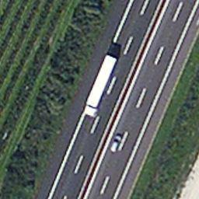
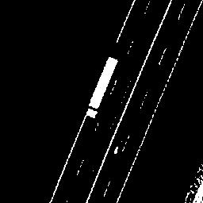
Image preprocessing
Turn the image from rgb to gray, and filter the gray level to avoid the noise caused by the crop field nearby.

Slide 5
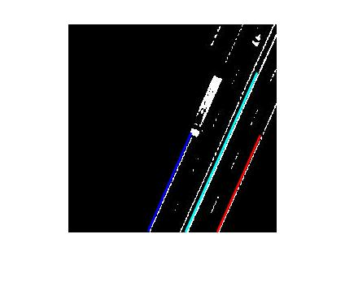
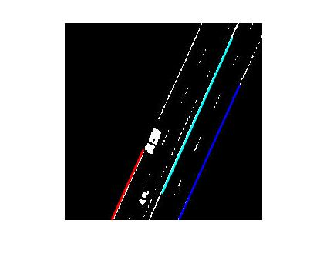
Algorithm Detail – Edge detection and Hough transformation
Using These method to get the longest three edge of each image.

Slide 6
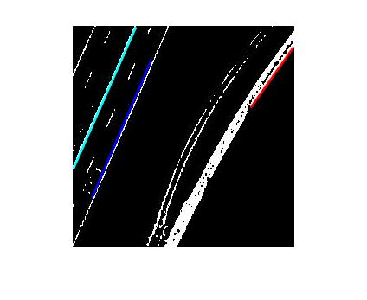
Algorithm Detail – Edge detection and Hough transformation

Slide 7
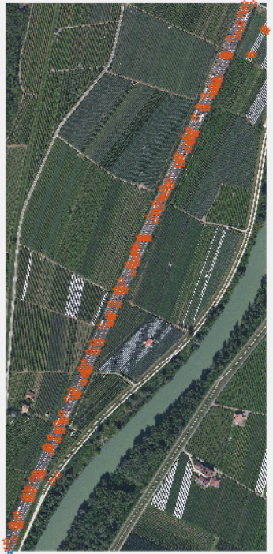
Algorithm Detail – Line Regression

Slide 8
Algorithm Detail – Line Regression
Since the road is basically a line, so we used the linear regression method in machine learning.
First we learned the Traj points and take the result as a standard result for the road.

Slide 9
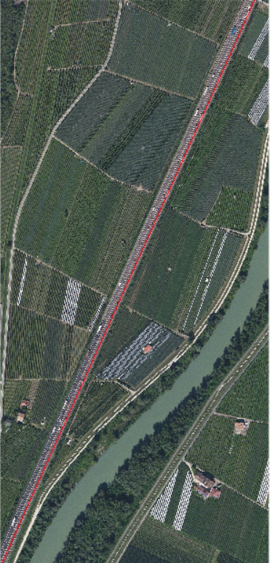
Algorithm Detail – Line Regression

Slide 10
Algorithm Detail – Line Regression
Then we made a calculation and estimation. A lane is about five meter width, which equal about 34.5( two pixel extra boundary for the line width).
We take all the start and end point we get from Hough and filter them with distance to standard line with the threshold (34.5 and 69).
Points distance in 0-34.5 is regard as the right lane.
Points distance in 34.5-69 and on the left of the standard lane regard as the left lane.

Slide 11
Algorithm Detail – Line Regression
We take two more time linear regression for the point on the right lane and left lane to prove our method’s correctness.

Slide 12
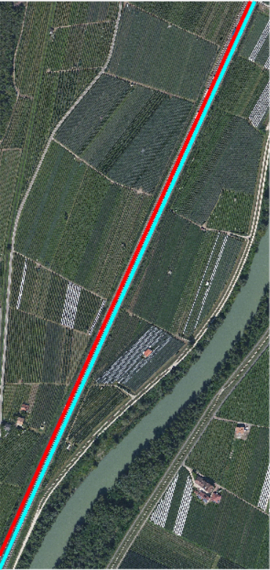
Algorithm Detail – Line Regression

Slide 13
Decide about the lane boundary
The leaned line is in the middle of each lane, and we use it to separate the left right boundary of the road and the mid of the road.
Points on the right of the right lane line should be the right boundary. The same method used to get the mid and left.

Slide 14
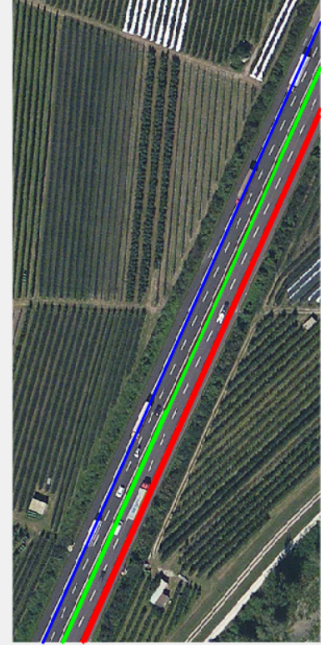
Result

Slide 15
Result
We calculate the points with the pixel coordinate back to the longitude and latitude, and saved them in three different csv data file for the mid of the road, left boundry and right boundry.

Slide 16
Result
46.395 | 11.296
46.396 | 11.297
46.396 | 11.296
46.398 | 11.298
46.398 | 11.298
46.399 | 11.298
46.398 | 11.298
46.4 | 11.299
46.399 | 11.299
46.401 | 11.3
46.4 | 11.299
46.402 | 11.3
46.401 | 11.3
46.402 | 11.301
46.402 | 11.3
46.396 | 11.296
46.401 | 11.299
46.401 | 11.299
46.401 | 11.3
46.401 | 11.299
46.403 | 11.301
46.403 | 11.301
46.396 | 11.296
46.397 | 11.297
46.396 | 11.297
46.397 | 11.297
46.397 | 11.297
46.398 | 11.298
46.397 | 11.297
46.399 | 11.298
46.399 | 11.298
46.4 | 11.299
46.399 | 11.298
46.4 | 11.299
46.4 | 11.299
46.4 | 11.299

Slide 17
Thank You

