Slide 1
Banking Application Case Study

Slide 2
Customer
private int customerId; private String firstName,lastName; private Address address; private Account account;
public int getCustomerId(); public void setCustomerId(int customerId); public String getFirstName(); public void setFirstName(String firstName); public String getLastName(); public void setLastName(String lastName); public Address getAddress(); public void setAddress(Address address); public Account getAccount(); public void setAccount(Account account);
Customer Class Diagram

Slide 3
Account Class Diagram
Account
private float balance; private long accountNo;
public float getBalance(); public void setBalance(float balance); public long getAccountNo(); public void setAccountNo(long accountNo);

Slide 4
Address Class Diagram
Address
private int pincode; private String city,state;
public int getPincode(); public void setPincode(int pincode); public String getCity(); public void setCity(String city); public String getState(); public void setState(String state);

Slide 5
Banking Utility Class Diagram
BankingUtility
private static int CUSTOMER_ID_COUNTER=1000; private static long ACCOUNT_NUM_GENERATOR=10000000;

Slide 6
Banking Services Layer
public int acceptCustomerDetails(String firstName, String lastName,String addressCity,
String addressState, int addressPinCode);
public long openAccount(int customerId,float initBalance) throws InvalidAmountException, CustomerNotFoundException;
public long showBalance(int customerId,float accountNo) throws AccuntNotFoundException, CustomerNotFoundException;
(Contd)

Slide 7
public float depositAmount(int customerId, long accountNo, float amount) throws CustomerNotFoundException, AccountNotFoundException;
public float withdrawAmount(int customerId, long accountNo, float amount) throws InsufficientAmountException, CustomerNotFoundException, AccountNotFoundException;
public boolean fundTransfer(int customerIdTo, long accountNoTo, int customerIdFrom, long accountNoFrom, float transferAmount) throws InsufficientAmountException, CustomerNotFoundException, AccountNotFoundException;

Slide 8
Banking DAO Services Layer
public int insertCustomer(Customer customer);
public long insertAccount(int customerId, Account account);
public Customer getCustomer(int customerId);
public Account getAccount(int customerId, long accountNo);

Slide 9
Exceptions
CustomerNotFoundException.
AccountNotFoundException.
InvalidAmountException.
InsufficientAmountExcption.

Slide 10
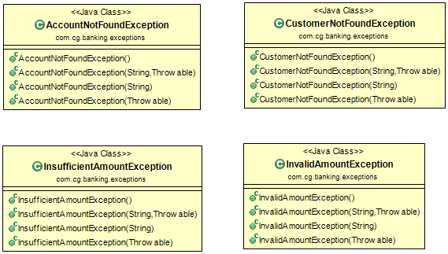
Exceptions

Slide 11
Thank You
Presented by :
G.N.L. RAVI Teja
j.Vishal
n.Pavan kalyan
j.meher

