Slide 1
Banking Application Case Study

Slide 2
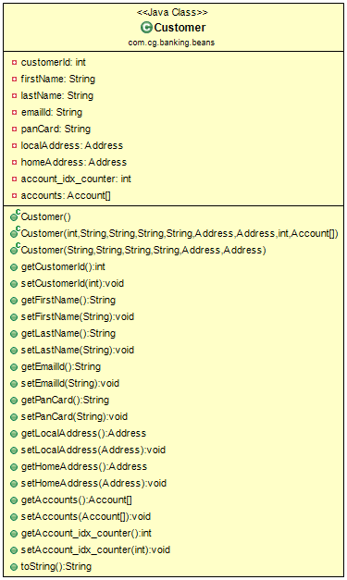
Customer Class Diagram

Slide 3
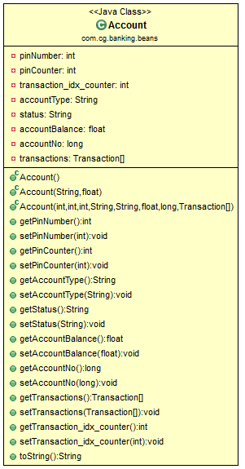
Account Class Diagram

Slide 4
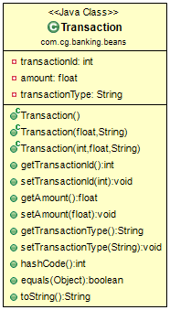
Transaction Class Diagram

Slide 5
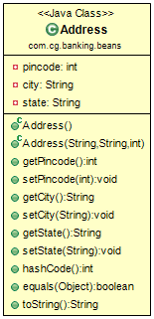
Address Class Diagram

Slide 6
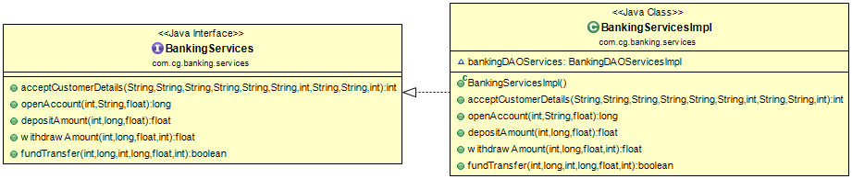
Banking Services Layer

Slide 7
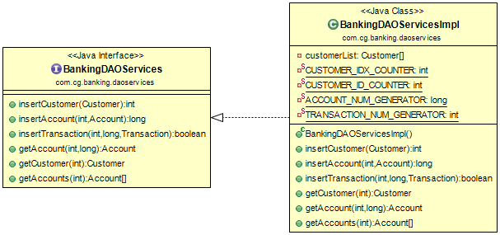
Banking DAO Services Layer

Slide 8
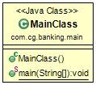
Main/Client Class

Slide 9
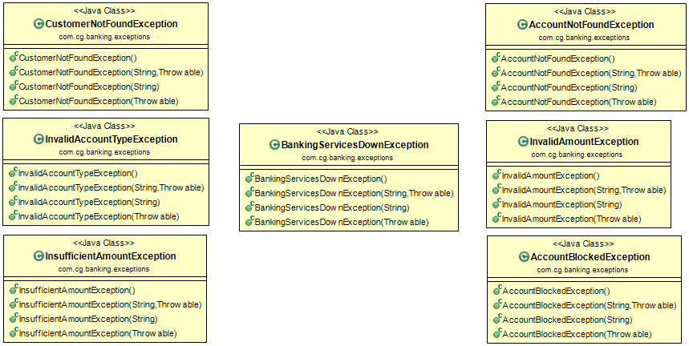
Exceptions

Slide 10
Thank You
Presented by :
G.N.L. RAVI Teja
j.Vishal
n.Pavan kalyan
j.meher

