Slide 1

EXPEDIA HOTEL RECOMMENDATION
Using Big Data technologies to make hotel recommendation predictions

Slide 2





LakshmiNarasimhan
Narayanan
Pradyumna
Davuloori
Sathya Anurag
Siruguppa
Meet The Team

Slide 3
Project progression
Agenda for the presentation
Data description
Introduction
Data collection
Data exploration
Data modification and exploration
PCA
Dimension reduction
Data descritpion
Machine Learning Algorithms
Data exploration
K Means Clustering
Logistic Regression
Random forest
PCA
Machine learning Algorithms
Demo
Demo
Visualizations and demo on data-bricks

Slide 4

Dataset
Source
Destinations.csv
150 latent features for the hotel search destination ids.
Kaggle : Expedia Hotel Recommendations.
Dataset
Processing
~37 million rows of data.
150 hotel clusters.
Features: User information and hotel information.
Example: User country and hotel country.
Sampled the data.
Loaded data to S3 bucket and connected to Databricks.
Cleaned check-in, check-out date features having timestamps.

Slide 5
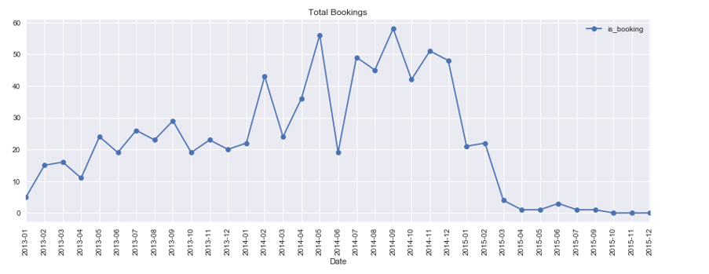
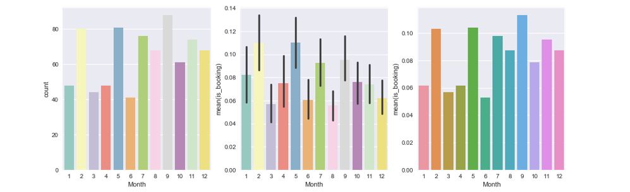
Data Exploration

Slide 6
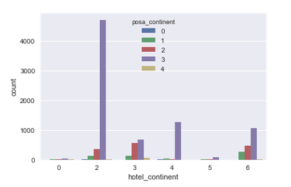
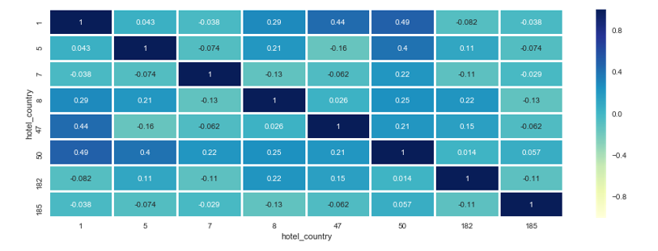
Data Exploration-2
Notes:
Site name - site_nameID of the Expedia point of sale (i.e. Expedia.com, Expedia.co.uk, Expedia.co.jp, ...)
posa_continent- ID of continent associated with site_name
hotel_continent - Hotel continentint

Slide 7
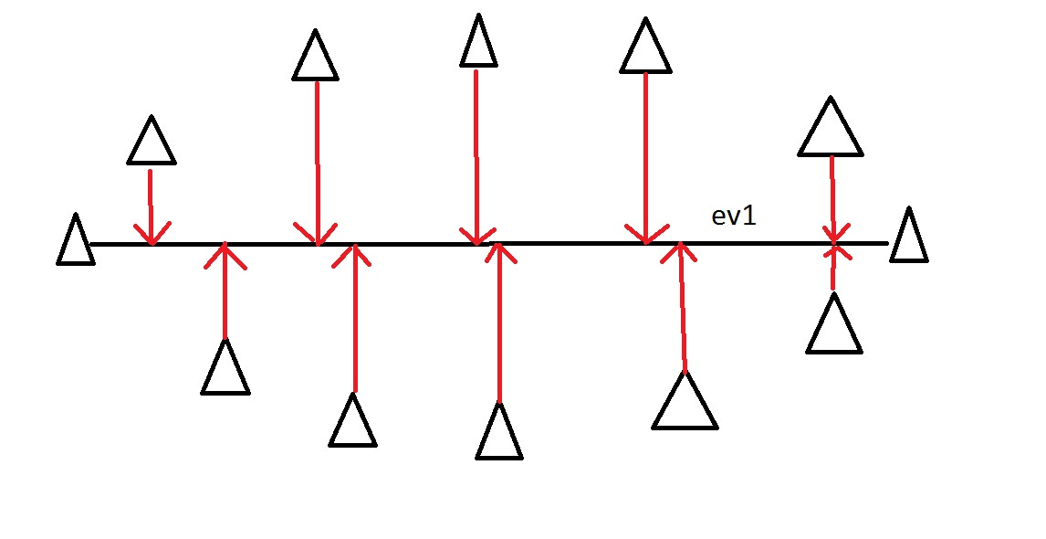
Principal Component Analysis
150 features.
Many features with high correlation.
Reduced to 3 features
Saves space and time!

Slide 8
Model Comparision
Summary of all Models
0.73%
2.93%
18.14%
K Means Clustering
Logistic Regression
Random forest

Slide 9

RECOMMENDATION SYSTEM DEMO
DEMO
https://dbc-5b74efc7-29dd.cloud.databricks.com/#notebook/32/dashboard/60/present
https://c4cmr806.caspio.com/dp.asp?AppKey=94585000b8412b4f3d804e98ba34

Slide 10
References
https://www.kaggle.com/domesc/explore-data
https://www.kaggle.com/c/expedia-hotel-recommendations/discussion/20684
https://spark.apache.org/docs/2.1.0/ml-classification-regression.html
http://spark.apache.org/docs/latest/sparkr.html

Slide 11
THANKS

