Slide 1

TEAM !XENON
The Maze game

Slide 2

Our Team
GNMilev19 - Scrum Trainer
VLMladenov19 - Back-end Developer
SMDimitrov19 - QA Developer
ZDNanev19 - Front-end Developer

Slide 3
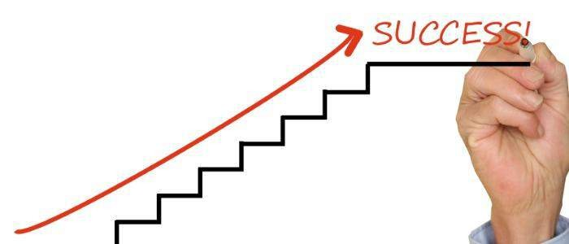
Stages of realization
Arrange tasks to every person in the team.
Working on our given tasks.
Preparing for the project presentation.

Slide 4









Technologies we used

Slide 5


Slide 6
Thank you for your attention!

