Slide 1

TEAM !XENON
The Maze game

Slide 2

Our Team
GNMilev19 - Scrum Trainer
VLMladenov19 - Back-end Developer
SMDimitrov19 - QA Developer
ZDNanev19 - Front-end Developer

Slide 3
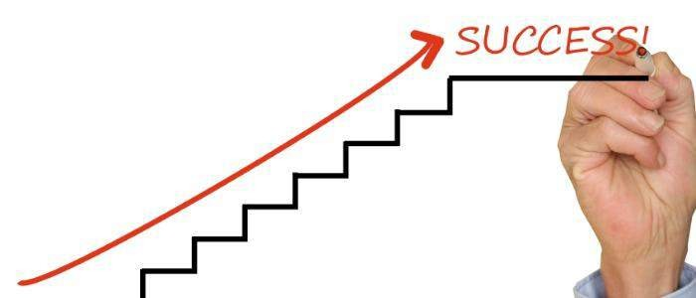
Stages of realization
We have had a lot of meetings, where we have discussed everyone’s tasks.
After giving away the tasks each one of us had to do, we started to realize them.
The process of the project’s realization went smooth.
At this point the game is done, but we still have ideas about the project, in the future.

Slide 4









Technologies we used

Slide 5
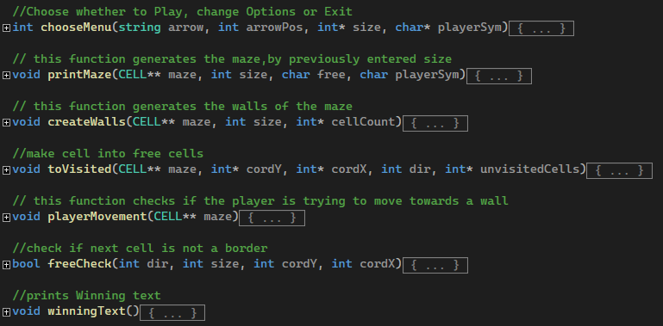
Used functions

Slide 6
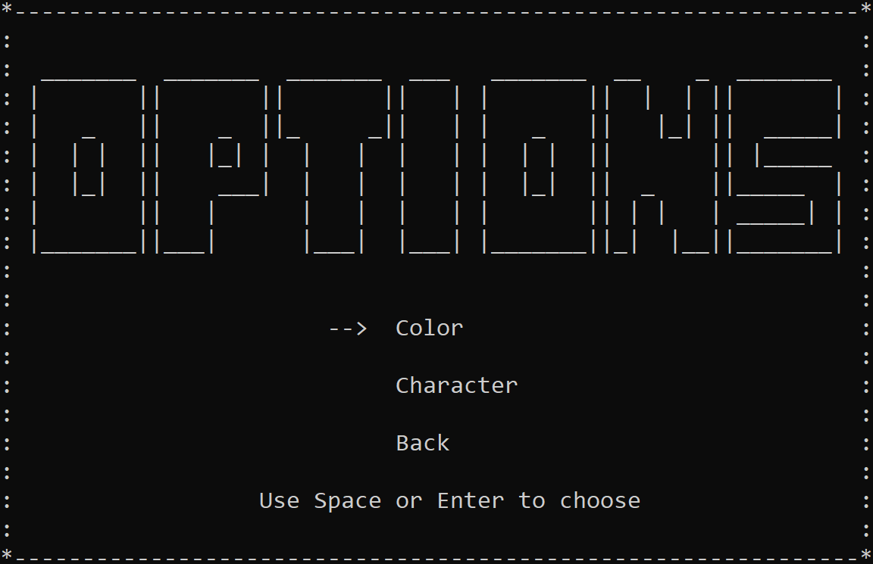
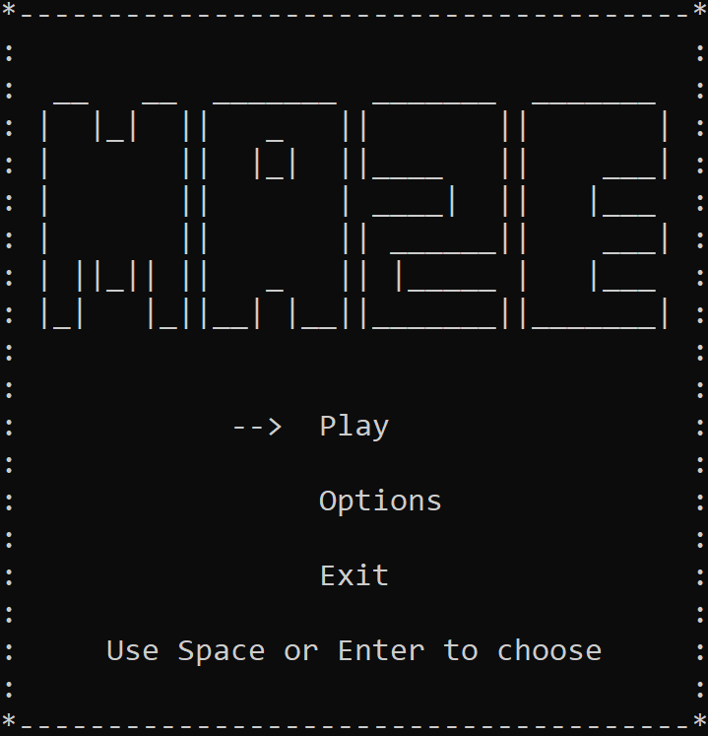
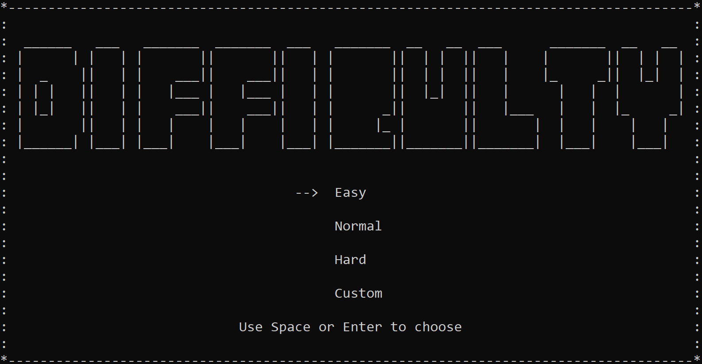
Menu photos

Slide 7


Slide 8
Thank you for your attention!

