Slide 1
A Domain-Specific Language for Hardware in the Loop Testing
By: Graham Power

Slide 2
The Problem
For domain specific hardware, say for nuclear physics, testing of the hardware required specific knowledge of the field not usually not possessed by programmers
On the other hand, writing efficient and optimized tests requires programming knowledge not usually possessed by these field specialists
This creates an information divide, where no one person possesses all the knowledge required to write efficient hardware tests

Slide 3
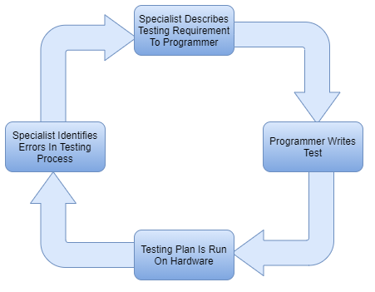
The Current Workflow
Specialist Side
Programmer Side

Slide 4
The Solution
Provide a way for the domain specialist to write their own code for hardware testing
This will bridge the knowledge divide, allowing the specialist to develop a hardware testing program much faster than by having to go through a programmer without the domain specific knowledge
A Domain-Specific Language (DSL) fits this description

Slide 5
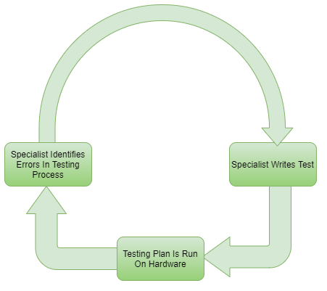
The Current Workflow

Slide 6
Requirements of the DSL
The DSL must write like a functional acceptance test
The DSL must allow for assertions that either fail the test and halt, or fail just the step and then move on
The DSL must allow for steps to be labeled and referenced in later steps
The DSL must support basic logic operations (AND, OR, NOT)
The DSL must support basic comparisons (EQUAL, GREATERTHEN, LESSTHEN) with tolerances (+- some %)
The DSL must allow for constant voltages & currents to be read
The DSL must allow for general constant electrical Inputs
The DSL must allow for comments using the # symbol

Slide 7
Stretch Goals for the DSL
The DSL should allow for user defined I/O functions to be implemented
The DSL should allow for sending/receiving packets over various serial interfaces
The DSL should be able to communicate with some external hardware (Oscilloscope, Multimeter, etc.)
The DSL should allow for blocks which are constantly checked throughout the entire test
The DSL should support matching a digitized input to a mathematical function within some tolerance (+- some %)
The DSL should allow for delays in the test either in fixed time or until some comparison is true

Slide 8
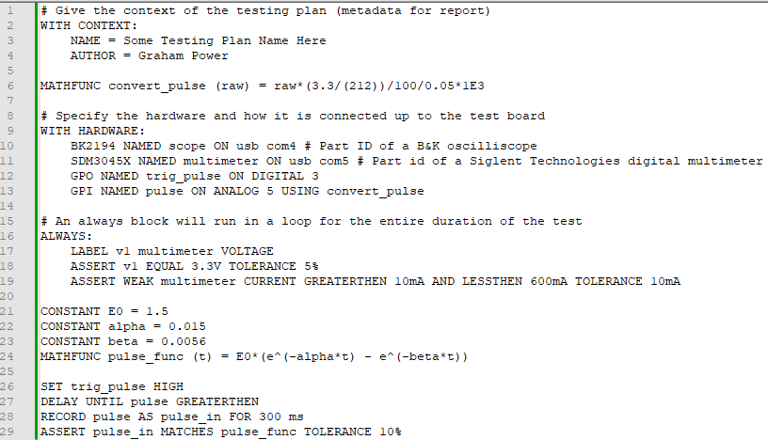
Sample DSL Script
1 V

Slide 9
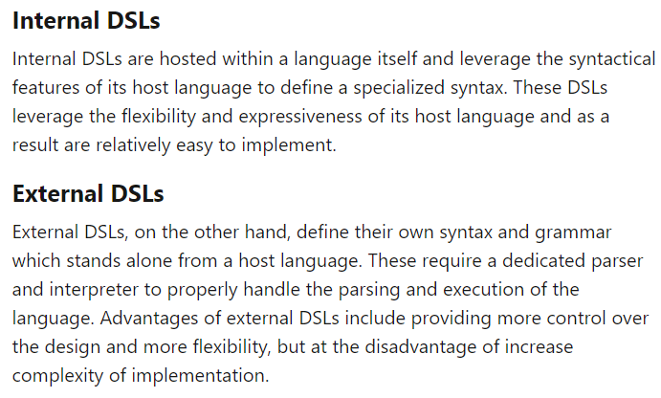
DSL Implementation
Ideally Using an External DSL
Implement in Python using ply library (wraps lex and yacc)
https://dev.to/fractalis/creating-a-dsl-in-python-dj6

