Slide 1
CS434 Project Document version 2
POSTECH CSE 김근우

Slide 2
Goal Assumptions
Sorting key/value records stored on disk
The input does not fit in memory
The input does not fit in disk
Distributed sorting key/value records stored on multiple machines
each machine has several disks
Distributed/parallel sorting key/value records stored on multiple disks on multiple machines

Slide 3
Project settings
Naming convention

Slide 4
Naming convention
Variable: Camel case(each word is capitalized, except possibly the first word)
Class: Pascal case
Module:
Method: Camel case
Method parentheses: yes for side effect
* Others will follow this doc(https://docs.scala-lang.org/style/naming-conventions.html)

Slide 5
Design
Communication model
State transition rules
State diagram
Flow chart

Slide 6
Types of node
Master: Single node for coordination
Slave: Multiple nodes in which actual data is stored and sorting happens

Slide 7
4 phase of protocol
Sampling: generate information for distribution of data
Sort/Partition phase: sorting in parallel at each slave
Shuffle phase: data exchange via the master node under its coordination
Merge phase: data from other machines properly merged into a single chunk fit into a single disk

Slide 8
Communication model
Slave
Slave
MasterConnectionHandler
MasterConnectionHandler
Main
FileTransferQueue
Main
FileTransferQueue
Master
FileReceivingServer
FileReceivingServer
Main
SlavePool
Slave
MasterConnectionHandler
Main
FileTransferQueue
FileReceivingServer

Slide 9
Port
Master rpc server – 6602
Slave rpc server - 6603

Slide 10
Message
All messages extend trait Message
Contents
Slave’s ID

Slide 11
Messages
Name | StartSampleMessage
When | All slaves make connection with master
Sender | Master
Receiver | Slave
contents | void

Slide 12
Messages
Name | MetainfoMessage
When | Slave finish to sample its input data
Sender | Slave
Receiver | Master
contents | Minimum key value Maximum key value

Slide 13
Messages
Name | MetainfoTableMessage
When | Master collect MetainfoMessage from all slaves
Sender | Master
Receiver | Slave
contents | Slave’s network information list Pivot list

Slide 14
Messages
Name | FinishSortMessage
When | Slave finish to sort its input message
Sender | Slave
Receiver | Master
contents | void

Slide 15
Messages
Name | StartShuffleMessage
When | Master collect FinishSortMessage from all slaves
Sender | Master
Receiver | Slave
contents | void

Slide 16
Messages
Name | FileTransferFinishMessage
When | Slave finish to send all data for single appropriate peers
Sender | Slave
Receiver | Slave
contents | void

Slide 17
Messages
Name | SlaveSuccessMessage
When | Slave finish to send its data to appropriate peers and receive data. Also, it complete merge sort to its disk.
Sender | Slave
Receiver | Master
contents | void

Slide 18
Variables
name | Location | Definition | Critical reason (atomic operations are needed
connectionCount | Master | The number of slaves that make a TCP connection | Yes
metainfoCount | Master | The number of slaves sent MetainfoMessage | Yes
sortedCount | Master | The number of slaves sent FinishSortMeesage | Yes
successCount | Master | The number of slaves sent SlaveSuccessMessage | Yes
metainfoMessageSent | Slave | Whether a slave sent MetainfoMessage | No
finishSortMessageSent | Slave | Whether a slave sent FinishSortMessage | No
sortedComplete | Slave | Whether data after shuffling is sorted in a disk of slave | No
slaveId | Slave | Slave’s ID needed to be included in all messages it send | No
fileTransferFinishCount | Slave | The number of peer slaves sent FileTransferFinishMessage | Yes

Slide 19
States
Master
Init
Sample
Sortcheck
ShuffleCheck
Success
Slave
Init
Sample
Sort
Shuffle
Success
Fail

Slide 20
State transition rules (Master)
Init -> Sample
connectionCount == n
Sample -> SortCheck
metainfoCount == n
SortCheck -> ShuffleCheck
sortedCount == n
ShuffleCheck -> Success
SuccessCount == n
- State transition
- Condition
“n” is the number of slave

Slide 21
State transition rules (Slave)
Init -> Sample
Received(StartSampleMessage) == True
Init -> Fail
Connection fail to Master
Sample -> Sort
Received(MetainfoTableMessage) == True, metainfoMessageSent == True
Sample -> Fail
Fail to get MetainfoTableMessage within a time, Received(MetainfoTableMessage) == True, metainfoMessageSent == False
Sort -> Shuffle
Received(StartShuffleMessage) == True, finishSortMessageSent == True
Sort -> Fail
Received(StartShuffleMessage) == True, finishSortMessageSent == False
Shuffle -> Success
fileTransferFinishCount == n, size(fiileTransferQueue) == 0, sortedComplete == True
Shuffle -> Fail
Received out of bound data

Slide 22
State diagram
Master
Init
Sample
SortCheck
ShuffleCheck
Success

Slide 23
State diagram
Slave
Init
Sample
Sort
Shuffle
Fail
Success

Slide 24
Flow Chart
Slave
Master
Slave
Init
Init
Init
Sample
StartSampleMessage
StartSampleMessage
Sample
Sample
MetainfoMessage
MetainfoMessage
SortCheck
MetainfoTableMessage
MetainfoTableMessage
Sort
Sort
FinishSortMessage
FinishSortMessage
ShuffleCheck

Slide 25
Flow Chart (cont’d)
Slave
Master
Slave
ShuffleCheck
StartShuffleMessage
StartShuffleMessage
Shuffle
Shuffle
File
File
FileTransferFinishMessage
FileTransferFinishMessage
Me
rge
Me
rge
Success
Success
SlaveSuccessMessage
SlaveSuccessMessage
Success

Slide 26
Slave ordering

Slide 27
Ordering
We need to assign a proper id to each slaves
slaves are ordered by its sequence of connecting to master node
slave’s id can be 1 ~ n
slave’s id can be inferred from slave list of MetainfoTableMessage

Slide 28
Sampling

Slide 29
Sampling - Master
Get 10 samples from each slave
Select pivot positions which divide a range between minimum and maximum key value into N subdivision for each slave

Slide 30
Sampling - Slave
Randomly select 10 data
Send them to master

Slide 31
Test

Slide 32
logging
Master prints log message listing every slave who finish a task for a state at every state
Slave prints its state whenever it changes its state

Slide 33
System test
Settings
2 slaves (1 with localhost, 1 in local network)
1 in local network cause error. Fail to make rpc call with local address => (I manually put public IP)
10,0000 bytes for each slave (1000 lines of data for each)
Output dir should be “inputdir/output”
Slave
run -M 141.223.175.214 -O ./testData/slave1/output -I ./testData/slave1
run -M 141.223.175.214 -O ./testData/slave2/output -I ./testData/slave2
Master
- run 2

Slide 34
END

Slide 35
Report

Slide 36
구현 상황
현재까지 구현된 정도는 다음과 같습니다.
Slave가 마스터에 연결
Sampling한 결과를 Master가 slave들에게 배포
각각의 Slave에서 input data를 전송해야 할 peer slave를 기준으로 분류한다. 여기서 사용되는 기준은 앞서 sampling한 결과를 사용한다.
분류가 완료되었으면 데이터를 각각의 peer slave들에게 보낸다. (Shuffling)
Data를 전부 받았으면 merge sort를 실행한다. (구현중)

Slide 37

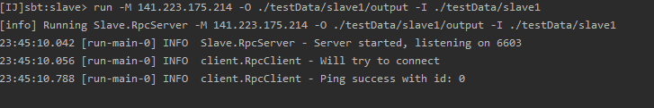
Demo (Master with 2 Slaves)
$(master) run 2
$(slave1) run -M 141.223.175.214 -O ./testData/slave1/output -I ./testData/slave1

Slide 38
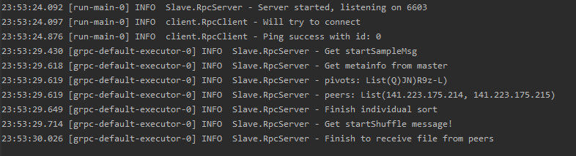
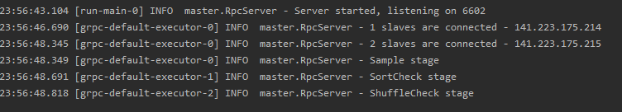
Demo (Master with 2 Slaves)
$(slave2) run -M 141.223.175.214 -O ./testData/slave2/output -I ./testData/slave2
(Master)

Slide 39
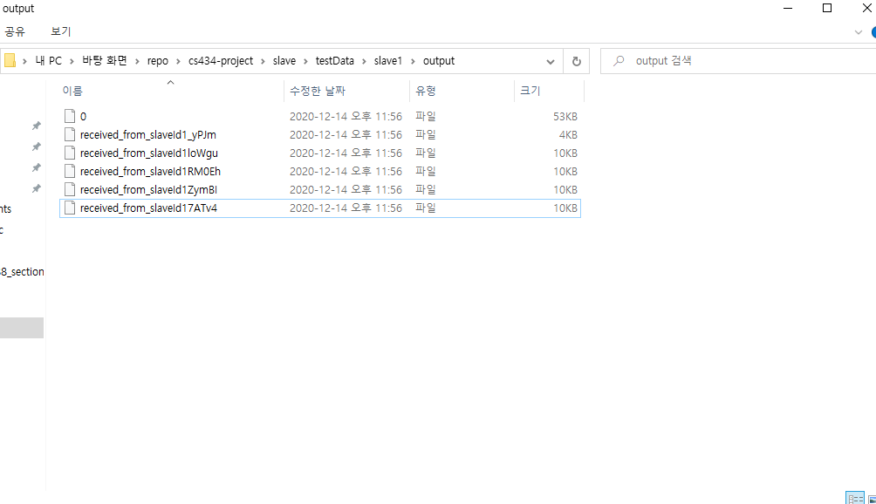
Demo (Master with 2 Slaves)
(slave1)

