Slide 1
Iris Classification
Semester 1 project for Foundation of AI Applications Lab (20ECP-118) by Aditya Kumar of 20BCS38/A
UID - 20BCS7555

Slide 2
Problem Statement
This problem is centered around predicting the type of an iris flower (setosa, versicolor, or virginica) based on the flower's parameters such as petal length, petal width, etc.

Slide 3
Solution
To solve this problem, we build an ML model that takes as inputs 4 parameters:
petal length
petal width
sepal length
sepal width
and predicts which iris type the flower belongs to:
setosa
versicolor
virginica
To be precise, the model will return probabilities for the flower to belong to each type.

Slide 4
Key Features/Benefits
To distinguish between different species of the Iris flower based on four measurements (features): sepal length, sepal width, petal length, and petal width.

Slide 5

Software Used
.NET Core 3.1
ML.NET

Slide 6
Workflow

Slide 7
Step – 1: Class Classes that map to the Dataset
Here we create two classes that represent our dataset. The first class represents the features and the second class represents the result.

Slide 8
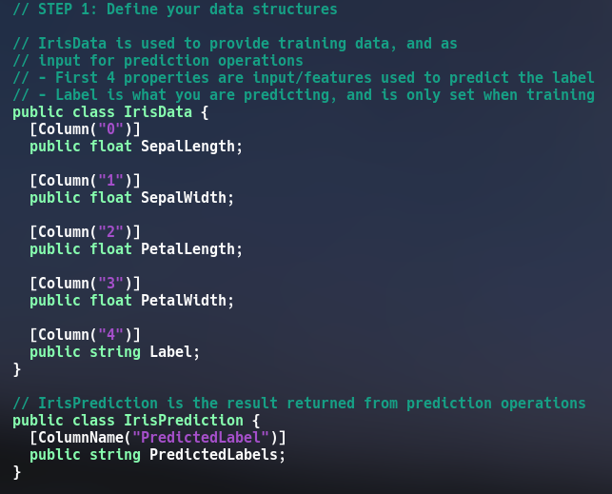

Slide 9
Step – 2: Create a Pipeline and Load the Data
A pipeline is a set of classes in ML.NET that allows us to load external data, transform it to format suitable for training and train the model

Slide 10
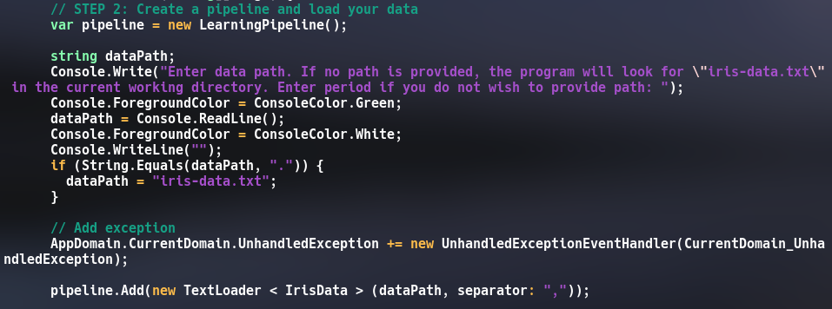

Slide 11
Step – 3: Transform the Data
Data needs to be transformed from string data to numeric data since training can only be carried out on numeric data. So the column labels are assigned numbers. This is achieved by using a Dictionarizer object.
Next, we use a ColumnConcatenator to merge all the features into one single string.

Slide 12
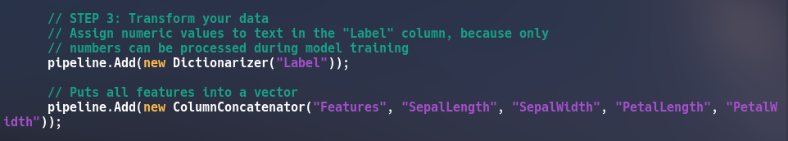

Slide 13
Step – 4: Add a Learning Algorithm
Here we add a learning algorithm that can train a classification model. This algorithm is StochasticDualCoordinateClassifier object.
Then we convert back the numeric label into the original text using PredictedLabelColumnOriginalValueConverter object.

Slide 14
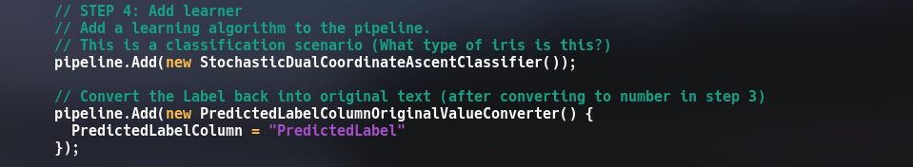

Slide 15
Step – 5: Train the Model
In this step, we simply call the Train() method of the pipeline object to train our model.

Slide 16
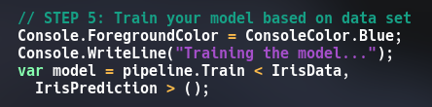

Slide 17
Step – 6: Use the Model to Make Prediction
Now we can test the model by passing new set of features and then allow the model to predict the class it belongs.

Slide 18
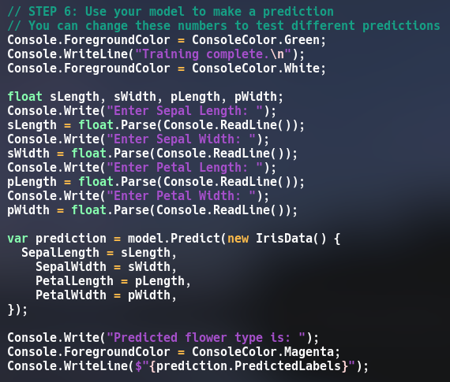

Slide 19
Result

Slide 20
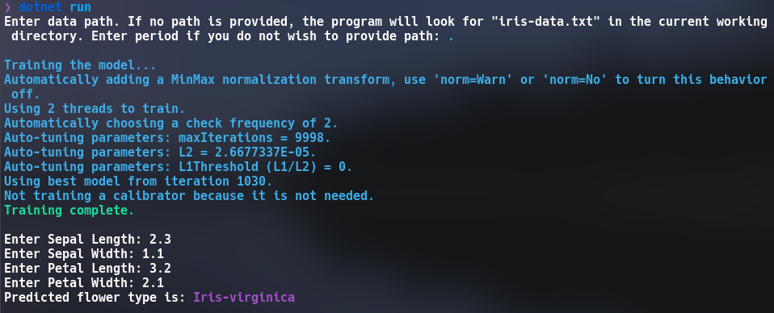

Slide 21
THANK YOU

