Slide 1

Group 9: Jeannie Chiem, Binyi Wu, Nick Rivera

Slide 2
Outline
Project Introduction
Real-World Constraints
Industry Standards
Costs
Project Description
Algorithms
Hardware
Software
Demonstration

Slide 3
Project Introduction
Our application
  Filters out bright shapes from a camera’s input
  Detects the movement of the bright object
  Moves a “robot” on the screen to follow the changing motion of the light

Slide 4
Real-World Constraints
Limited by environment
  We use brightness to check for movement
  Does not work when the camera is facing a bright light
Limited by camera quality
  We tried to detect certain colors, but the limited range of colors prevented us from distinguishing between close colors
  Colors in the camera’s center will always be washed-out
Limited by speed of hardware
  We tried to convert RGB colors to HSV, but the hardware was not fast enough to do this
  Combined with the washed-out camera input, this prompted us to switch to detecting bright objects

Slide 5
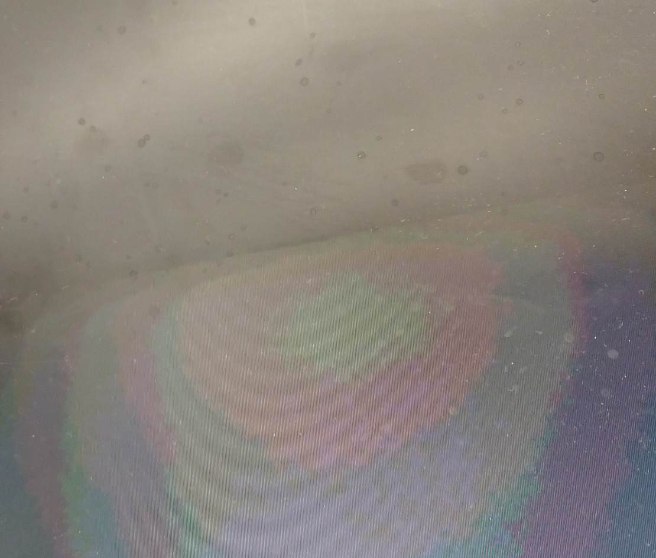
Washed-Out Colors
The rings of brightness in the center of the image made it difficult to correctly find the colors of objects to track them

Slide 6
Real-World Constraints
Applications for
  Hands-free controllers
  Hands-free movement

Slide 7
Industry Standards
RGB
  We’re using 4-bits for red, green, and blue
  The standard is 8-bits each (255 red, 255 green, 255 blue)
  This limits the range of colors that we can interpret
HSV
  Hue → Color
  Saturation → Washed-out or colorful?
  Value → Dark or bright?
  Board was not fast enough to perform this conversion

Slide 8
Costs
Components
  FPGA
    Faster FPGAs can do more advanced image processing but are more expensive
  Camera
    Better cameras can detect more colors but are more expensive
  Robot with locomotion device

Slide 9
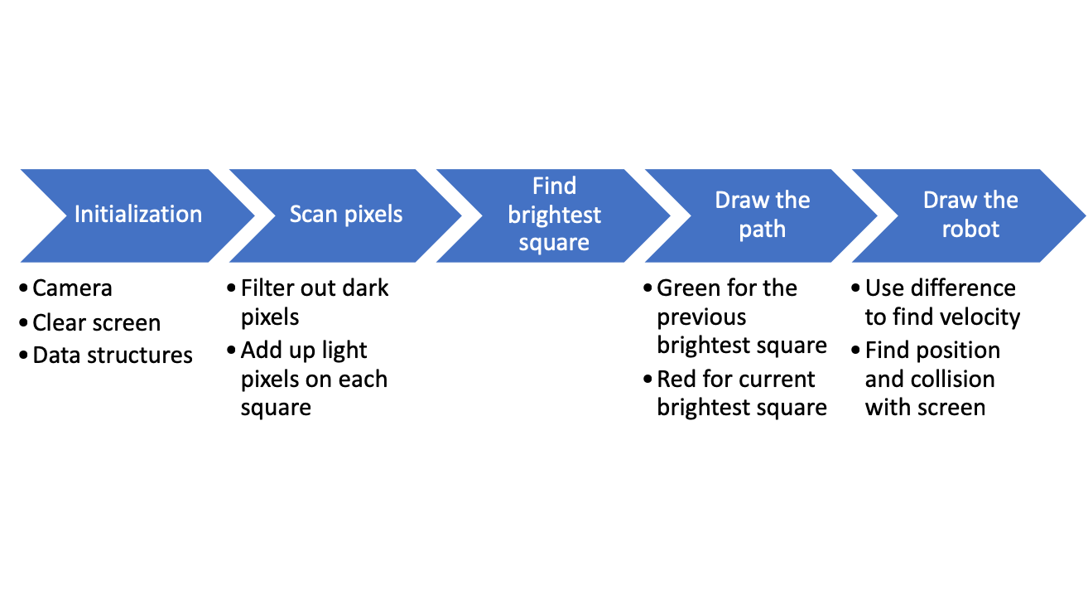
Project Description

Slide 10
Algorithms
We scan each pixel and read its RGB value
  Easiest to implement
  Easiest to debug
Alternatives
  We could have sampled
  More difficult, especially when macros do not work in functions

Slide 11
Hardware
No parts of our algorithm were implemented in hardware
It is time consuming to interface hardware and software components

Slide 12
Software
We implemented most of the program’s logic in software
  The scanning logic
  The color filter logic
  The different sections of the display
We used software implementations because it is easier to write all the logic in one place
  Easier to change
  More familiar
  More uniform
  Easier to debug

Slide 13
Demonstration
Watch live!

Slide 14
References
https://www.mathworks.com/matlabcentral/answers/230051-filter-image-such-that-only-certain-colours-show

