Slide 1
Credit Score ESTIMATION
Gabriele Nanni

Slide 2
The Idea
Starting from an already given dataset
Preprocessing(Removing columns, add derived attributes, discretize)
Build a Bayesian Network based on the knowledge available (and based on personal belief)
Use the data to determine the conditional probabilities
Check if the results are acceptable

Slide 3
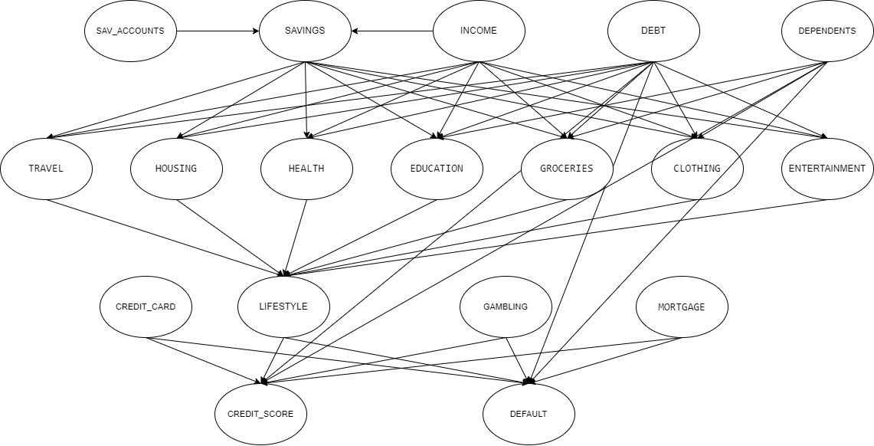
The Network

Slide 4
The Results
Pretty much allinged with the expectations (qualitatively speaking)
Some intresting outcomes
Probably influenced by a skewed distribution

Slide 5
What Could Be Done Better
LIFESTYLE formula
More elements to consider
Expert advice for the network
More and better distributed Data

Slide 6
Thanks for the attention

