Slide 1
Portfolio website – G Nolan
Aims and priorities
Site outline
Wireframes & basic description
“Mood board” – images, colours, fonts, etc

Slide 2
Aims & Priorities

Slide 3
Site Outline

Slide 4
Wireframes & basic description

Slide 5
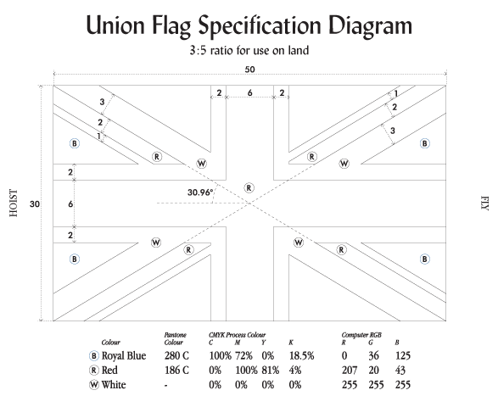
“Mood board” – images, colours, fonts, etc
Union flag:
3:5 ratio
Diagonals 6x(3w/2r/1w)
Red cross 6x
White fimbriation 2x
Blue – rgb(0, 36, 125)
Red – rgb(207, 20, 43)

