Slide 1




Energy-Efficient Multi-UAV Data Collection for IoT Networks with Time Deadlines
Oussama Ghdiri, Esprit School of engineering – Tunisia
Wael Jaafar, Carleton University – Canada
Safwan Alfattani, University of Ottawa – Canada
Jihene Ben Abderrazak, Esprit School of engineering – Tunisia
Halim Yanikomeroglu, Carleton University – Canada
December 9, 2020

Slide 2
INTRODUCTION

Slide 3
Energy-Efficient Multi-UAV Data Collection for IoT Networks with Time Deadlines
Oussama Ghdiri, Wael Jaafar, Safwan Alfattani, Jihene Ben Abderrazak, and Halim Yanikomeroglu
127 Devices every second*
25 in 2020**
Billion
* Source: McKinsey
** Source: Statista

Slide 4
Energy-Efficient Multi-UAV Data Collection for IoT Networks with Time Deadlines
Oussama Ghdiri, Wael Jaafar, Safwan Alfattani, Jihene Ben Abderrazak, and Halim Yanikomeroglu
5G Will Unlock the full potential of IoT

Slide 5
Energy-Efficient Multi-UAV Data Collection for IoT Networks with Time Deadlines
Oussama Ghdiri, Wael Jaafar, Safwan Alfattani, Jihene Ben Abderrazak, and Halim Yanikomeroglu
How to collect data efficiently?

Slide 6
Energy-Efficient Multi-UAV Data Collection for IoT Networks with Time Deadlines
Oussama Ghdiri, Wael Jaafar, Safwan Alfattani, Jihene Ben Abderrazak, and Halim Yanikomeroglu
Introduction
1
Related Works
2
Problem Formulation
3
Proposed Solution
4
Results and Discussion
5
Conclusion

Slide 7
1
Related Works

Slide 8
Energy-Efficient Multi-UAV Data Collection for IoT Networks with Time Deadlines
Oussama Ghdiri, Wael Jaafar, Safwan Alfattani, Jihene Ben Abderrazak, and Halim Yanikomeroglu
"UAV Trajectory Planning for Data Collection from Time-Constrained IoT Devices,“
in IEEE Transactions - Jan. 2020
Time sensitive data
Single UAV
No consideration of energy limitations
1| Related Works 2|PROBLEM FORMULATION 3|PROPOSED SOLUTION 4|RESULTS AND DISCUSSION 5|Conclusion

Slide 9
Energy-Efficient Multi-UAV Data Collection for IoT Networks with Time Deadlines
Oussama Ghdiri, Wael Jaafar, Safwan Alfattani, Jihene Ben Abderrazak, and Halim Yanikomeroglu
"Energy-Efficient Data Gathering Framework-Based Clustering via Multiple UAVs in Deadline-Based WSN Applications,"
in IEEE Access – Nov. 2018
Multiple UAVs
Time sensitive data
Clustred WSN
Non-pratical system modeling
1| Related Works 2|PROBLEM FORMULATION 3|PROPOSED SOLUTION 4|RESULTS AND DISCUSSION 5|Conclusion

Slide 10


Energy-Efficient Multi-UAV Data Collection for IoT Networks with Time Deadlines
Oussama Ghdiri, Wael Jaafar, Safwan Alfattani, Jihene Ben Abderrazak, and Halim Yanikomeroglu
Our Solution
Multiple UAVs
Clustered IoT network
Optimize the number of deployed UAVs
Optimize UAVs’ trajectories
Minimize the total energy
1| Related Works 2|PROBLEM FORMULATION 3|PROPOSED SOLUTION 4|RESULTS AND DISCUSSION 5|Conclusion

Slide 11
2
PROBLEM FORMULATION

Slide 12
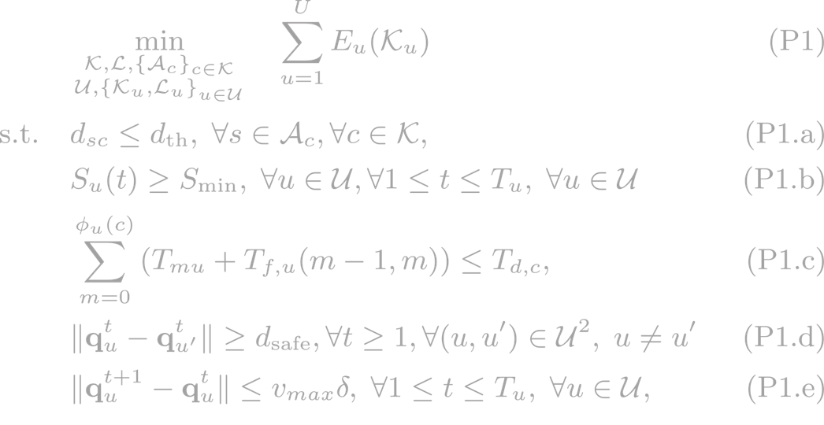

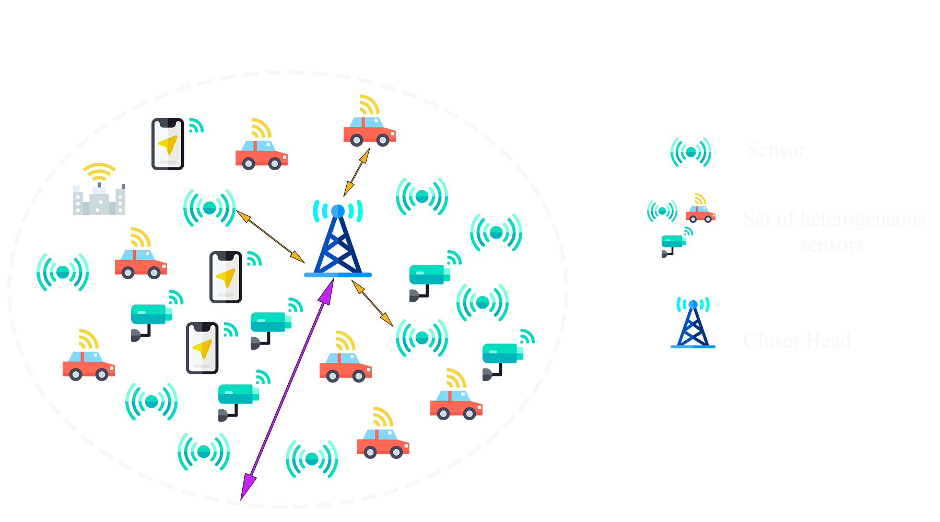

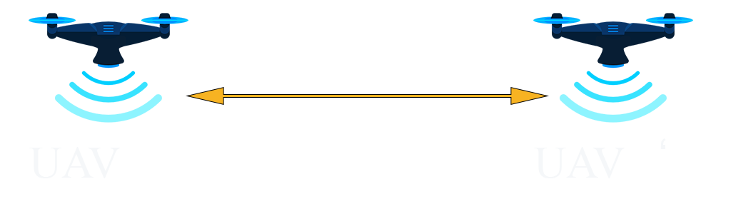
Energy-Efficient Multi-UAV Data Collection for IoT Networks with Time Deadlines
Oussama Ghdiri, Wael Jaafar, Safwan Alfattani, Jihene Ben Abderrazak, and Halim Yanikomeroglu
Minimize the total consumed energy
Ensure a successful communication between SN and CH
Guarantee that enough energy is available
Satisfy that UAV collects data from CHs before deadlines
Ensure that no collisions occurs between UAVs
1| Related Works 2|PROBLEM FORMULATION 3|PROPOSED SOLUTION 4|RESULTS AND DISCUSSION 5|Conclusion

Slide 13
3
PROPOSED SOLUTION

Slide 14
Energy-Efficient Multi-UAV Data Collection for IoT Networks with Time Deadlines
Oussama Ghdiri, Wael Jaafar, Safwan Alfattani, Jihene Ben Abderrazak, and Halim Yanikomeroglu
Problem (P1) is complicated to be directly solved
Problem (P1) can be divided to two subproblems
1. Sensors clustering and CHs placement
2. UAVs trajectory planning
1| Related Works 2|PROBLEM FORMULATION 3|PROPOSED SOLUTION 4|RESULTS AND DISCUSSION 5|Conclusion

Slide 15
Energy-Efficient Multi-UAV Data Collection for IoT Networks with Time Deadlines
Oussama Ghdiri, Wael Jaafar, Safwan Alfattani, Jihene Ben Abderrazak, and Halim Yanikomeroglu
IoT Sensors Clustering
Minimize energy consumption
Extend age of information (AoI)
Minimum number of CHs
CHs closer to dock station
1| Related Works 2|PROBLEM FORMULATION 3|PROPOSED SOLUTION 4|RESULTS AND DISCUSSION 5|Conclusion

Slide 16
Energy-Efficient Multi-UAV Data Collection for IoT Networks with Time Deadlines
Oussama Ghdiri, Wael Jaafar, Safwan Alfattani, Jihene Ben Abderrazak, and Halim Yanikomeroglu
IoT Sensors Clustering
Centroid based methods
K-means
(Proposed) Customize K-means (Algo. 1)
Hierarchical Clustering
Hierarchical Cluster Analysis
1| Related Works 2|PROBLEM FORMULATION 3|PROPOSED SOLUTION 4|RESULTS AND DISCUSSION 5|Conclusion

Slide 17
Energy-Efficient Multi-UAV Data Collection for IoT Networks with Time Deadlines
Oussama Ghdiri, Wael Jaafar, Safwan Alfattani, Jihene Ben Abderrazak, and Halim Yanikomeroglu
Multi-UAV Trajectory Planning
Graph-Based Approach
Shortest path
Vehicle Routing Problem with Time Windows
1| Related Works 2|PROBLEM FORMULATION 3|PROPOSED SOLUTION 4|RESULTS AND DISCUSSION 5|Conclusion

Slide 18
Energy-Efficient Multi-UAV Data Collection for IoT Networks with Time Deadlines
Oussama Ghdiri, Wael Jaafar, Safwan Alfattani, Jihene Ben Abderrazak, and Halim Yanikomeroglu
Multi-UAV Trajectory Planning
Three metaheuristics algorithms :
Guided local search
Simulated annealing
Tabu search
1| Related Works 2|PROBLEM FORMULATION 3|PROPOSED SOLUTION 4|RESULTS AND DISCUSSION 5|Conclusion

Slide 19
4
RESULTS AND DISCUSSION

Slide 20
Energy-Efficient Multi-UAV Data Collection for IoT Networks with Time Deadlines
Oussama Ghdiri, Wael Jaafar, Safwan Alfattani, Jihene Ben Abderrazak, and Halim Yanikomeroglu
Required number of CHs for different d_{th}
Comparing the performance of clustering algorithms
Small d_{th} → Higher number of CHs
Algo. 1 provides the best clustering performance
1| Related Works 2|PROBLEM FORMULATION 3|PROPOSED SOLUTION 4|RESULTS AND DISCUSSION 5|Conclusion

Slide 21
Energy-Efficient Multi-UAV Data Collection for IoT Networks with Time Deadlines
Oussama Ghdiri, Wael Jaafar, Safwan Alfattani, Jihene Ben Abderrazak, and Halim Yanikomeroglu
CHs placement and UAVs trajectories
Example of UAVs trajectories
2000 SNs
48 clusters and CHs
1| Related Works 2|PROBLEM FORMULATION 3|PROPOSED SOLUTION 4|RESULTS AND DISCUSSION 5|Conclusion

Slide 22
Energy-Efficient Multi-UAV Data Collection for IoT Networks with Time Deadlines
Oussama Ghdiri, Wael Jaafar, Safwan Alfattani, Jihene Ben Abderrazak, and Halim Yanikomeroglu
Consumed Energy for different deadlines
Same deadline for all CHs
Collecting data within a range consumes less energy
1| Related Works 2|PROBLEM FORMULATION 3|PROPOSED SOLUTION 4|RESULTS AND DISCUSSION 5|Conclusion

Slide 23
Energy-Efficient Multi-UAV Data Collection for IoT Networks with Time Deadlines
Oussama Ghdiri, Wael Jaafar, Safwan Alfattani, Jihene Ben Abderrazak, and Halim Yanikomeroglu
Consumed Energy for different battery capacities
Tabu search is slightly better
12 UAVs
2500 mAh battery capacity
1| Related Works 2|PROBLEM FORMULATION 3|PROPOSED SOLUTION 4|RESULTS AND DISCUSSION 5|Conclusion

Slide 24
5
CONCLUSION

Slide 25
Energy-Efficient Multi-UAV Data Collection for IoT Networks with Time Deadlines
Oussama Ghdiri, Wael Jaafar, Safwan Alfattani, Jihene Ben Abderrazak, and Halim Yanikomeroglu
Multi-UAV data collection problem in clustered IoT networks, where sensed data have time deadlines, was investigated
Deployment energy costs were minimized through a two-step optimization approach:
1) IoT sensors clustering and CHs optimal placement
2) UAVs deployment and trajectories planning
1| Related Works 2|PROBLEM FORMULATION 3|PROPOSED SOLUTION 4|RESULTS AND DISCUSSION 5|Conclusion

Slide 26
Energy-Efficient Multi-UAV Data Collection for IoT Networks with Time Deadlines
Oussama Ghdiri, Wael Jaafar, Safwan Alfattani, Jihene Ben Abderrazak, and Halim Yanikomeroglu
Our customized K-means clustering method outperformed baseline approaches in terms of number of CHs
Tabu search provided the best UAVs deployment strategies for energy minimization
1| Related Works 2|PROBLEM FORMULATION 3|PROPOSED SOLUTION 4|RESULTS AND DISCUSSION 5|Conclusion

Slide 27

THANK YOU
arxiv.org/abs/2009.06838
Scan me to
Access the paper

