Slide 1


CY: 2018 / 2019
LAB 3
predictive analysis for accidents in France
4 DS 1

Slide 2





Our Team
Ben Dahmen Ghazi
Sabbagh Wiem
Chandoul Wejdane
Khmiri Achref
Ghdiri Oussama
2

Slide 3
Plan
1
Introduction
2
Business Understanding
3
Data Understanding
4
Modeling
5
Deployment
6
Conclusion

Slide 4
Introduction

Slide 5
Problematic
We stumbled upon this article which talks about a Machine Learning project whose goal is to predict the number of accidents over the next two hours in Los Angeles to improve road traffic management.
We found the idea very promising and with great potential for every single city in the world, if we could predict the number of accidents that are going to happen in a certain day , the authorities could deal with them a lot better .
5

Slide 6
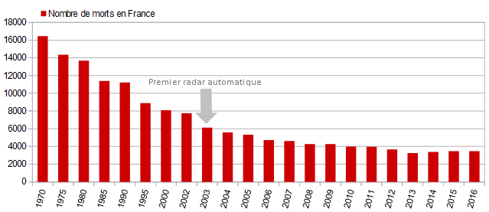
Introduction
Number of road Traffic Deaths in France since 1970
6

Slide 7
Introduction
2.500Lives/year are being lost
Delayed ambulance response times
The inability to resuscitate patients
at the scene
*Source : Roger Thayne, former Chief Executive of the Staffordshire Ambulance Service to the BBC,
7

Slide 8
Business Understanding

Slide 9
Business understanding
Business objectives:
Data science goals:
Identify what makes a commune more prone to accidents.
  Realize a feature importance study on our model to tell what makes a commune have the most accidents.
Prevent future deaths caused by ambulance delays.
  Predict future accidents.
9

Slide 10
Data understanding and preparation

Slide 11

Data understanding and preparation
Data Source:
52 csv files: 4 files representing the accidents of each year from 2005 to 2017
caractéristiques.csv
Lieux.csv
usagers.csv
vehicules.csv
Data Source: Holidays in France
11

Slide 12
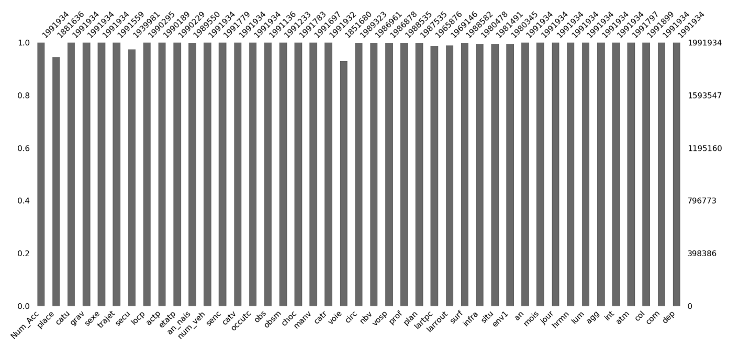
Data understanding and preparation
After gathering all the files together using we noticed that we have a lot of missing data:
12

Slide 13
Data understanding and preparation
How we fixed this issue ?
We deleted the variables that are correlated to “com” and “dep” and the variable that have a lot of missing data (like V2 it has more than 90% of missing data)
For the qualitative variables we replaced the missing values with the mode
13

Slide 14
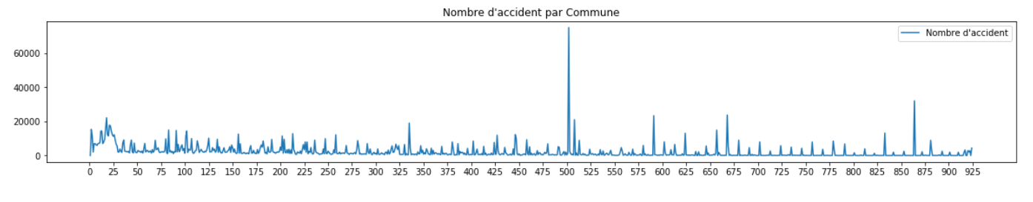
Data understanding and preparation
Commune with the highest number of accidents
14

Slide 15
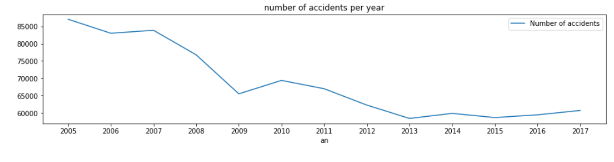
Data understanding and preparation
Is the number of accidents per year decreasing?
15

Slide 16
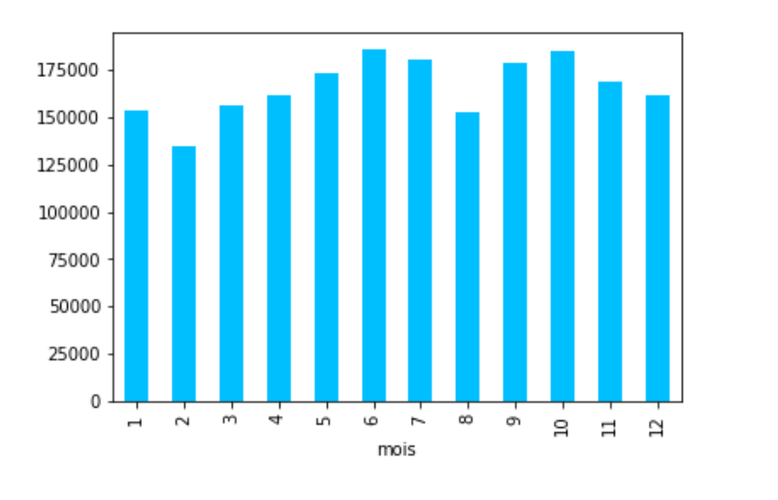
Data understanding and preparation
Accident frequency rate per month
16

Slide 17
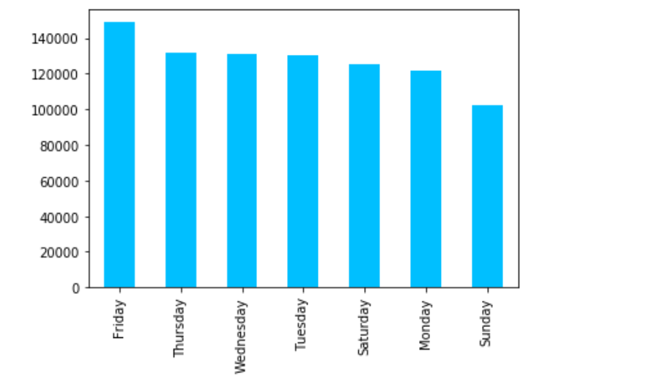
Data understanding and preparation
Accident frequency rate per day
17

Slide 18
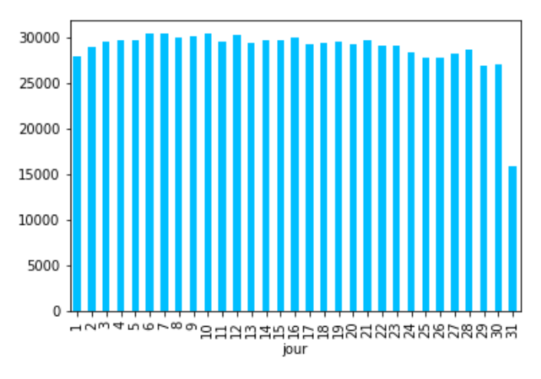
Data understanding and preparation
Which day of the month is not safe
18

Slide 19
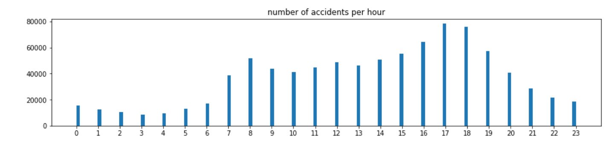
Data understanding and preparation
Number of accidents per hour
19

Slide 20
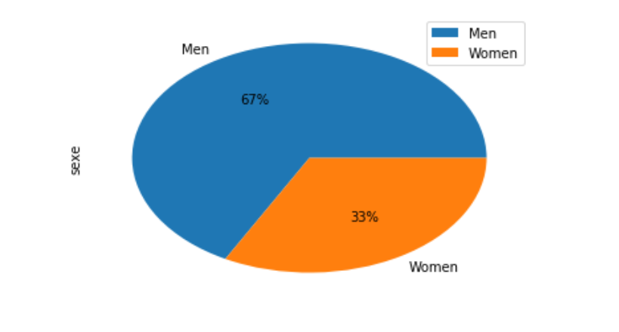
Data understanding and preparation
are women worse drivers than men ?
20

Slide 21
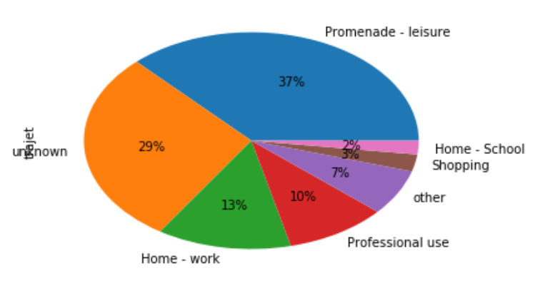
Data understanding and preparation
Reasons of going outside
21

Slide 22
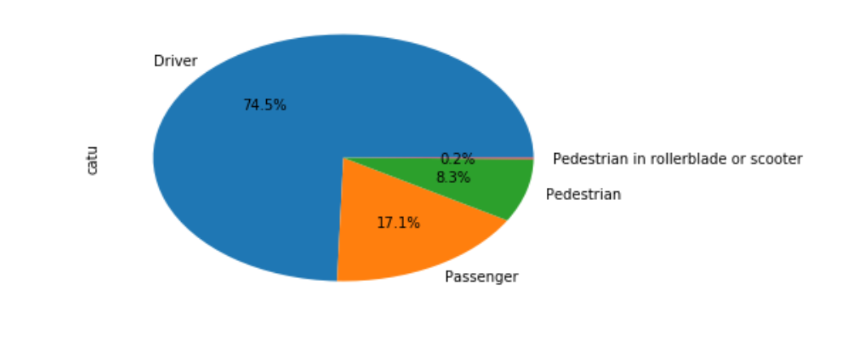
Data understanding and preparation
Passengers Categories
22

Slide 23
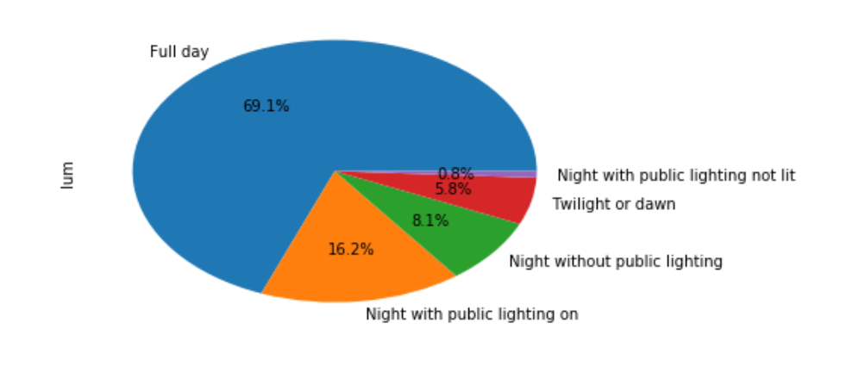
Data understanding and preparation
Lightening conditions
23

Slide 24
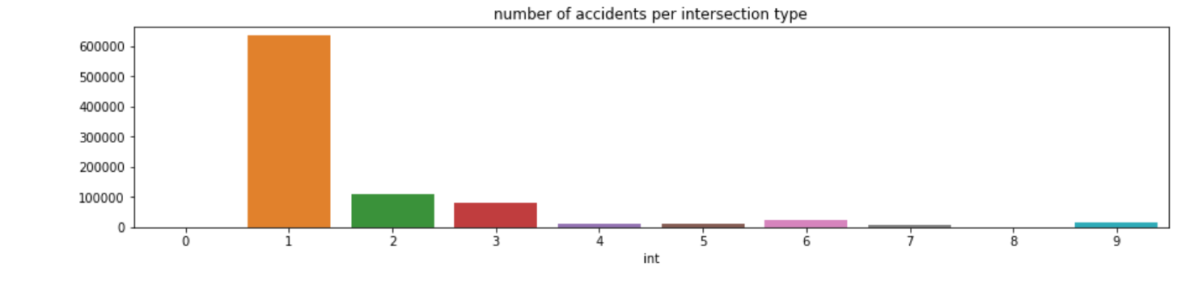
Data understanding and preparation
Type of intersections
24

Slide 25
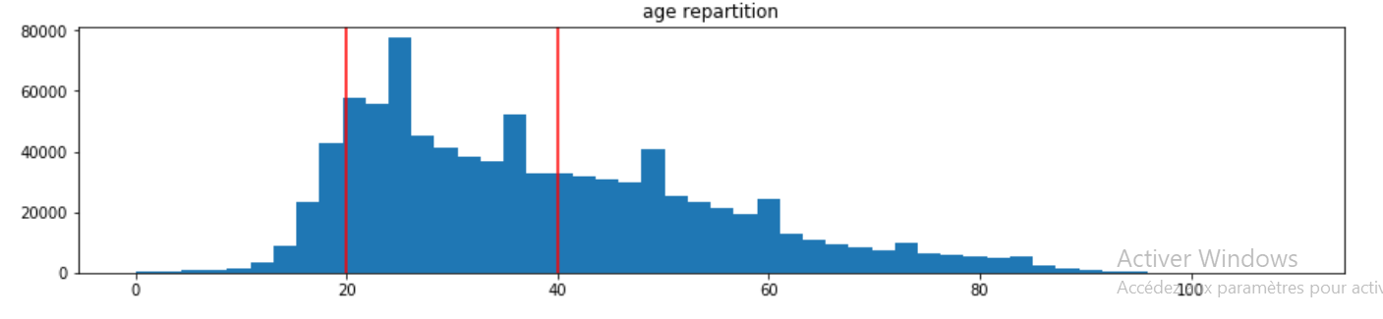
Data understanding and preparation
Age of passengers
25

Slide 26
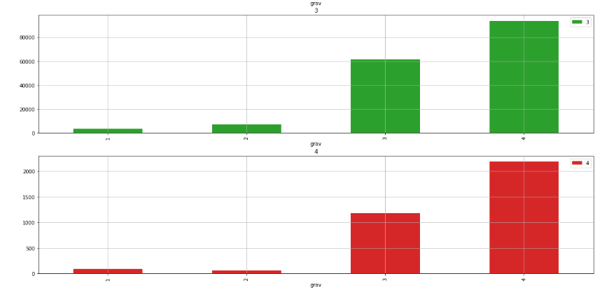
Data understanding and preparation
Accident severity for every passengers category
26

Slide 27
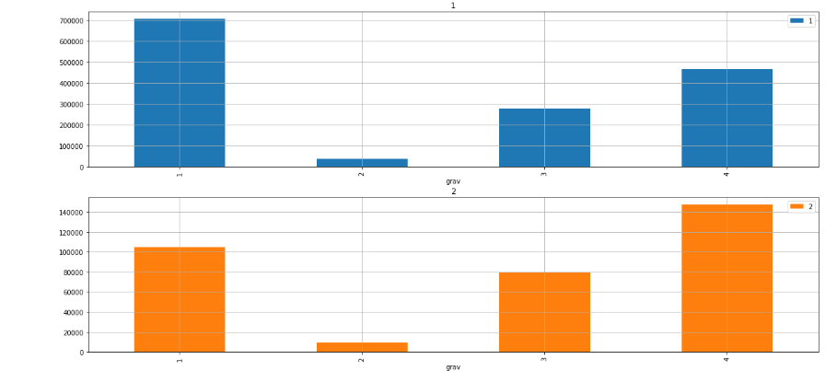
Data understanding and preparation
Accident severity for every passengers category
27

Slide 28
Modeling

Slide 29
Modeling
We used these models
Random Forest Regressor
Linear regression
Time Series prediction using fb Prophet
29

Slide 30
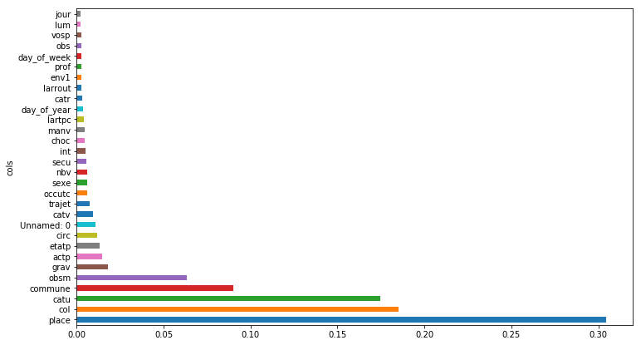
Modeling
Feature importance
30

Slide 31
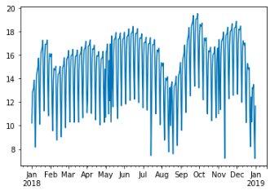
Modeling
Time Series
31

Slide 32
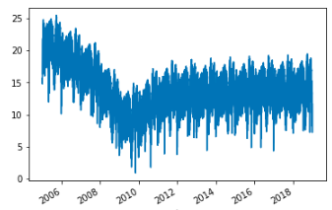
Modeling
Time Series
32

Slide 33
Deployment

Slide 34
Conclusion

Slide 35
Conclusion
we provided a predicting solution of the number of accidents , that can be used to determine how much stuff is needed on special days and if the ambulances should be on alert state.
35

