Slide 1
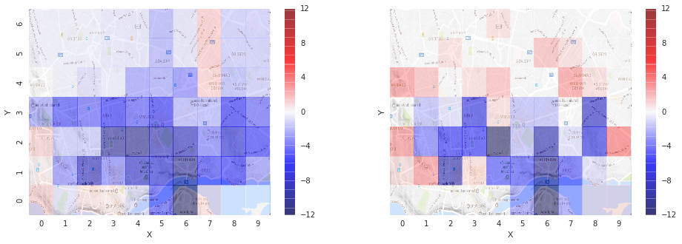
Go-Search Predictive Supply Demand Heatmap
Kaktusio’s members: Budhi S. Wibowo | Eling Meyatmaja

Slide 2
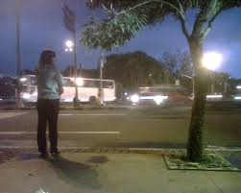
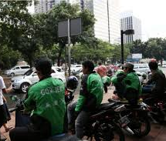
Waiting at the wrong place?

Slide 3
Unbalanced Supply & Demand
D2
S
D1
P2
P1

Slide 4

Price Increase?
What if
we can reposition drivers before demand arise?

Slide 5
Predictive Heatmap
Predict 30 min in advance
Demand in loc i for time t
RSME < 0.8
Machine Learning
Supply in loc i for time t
Updated every 10 minutes

Slide 6
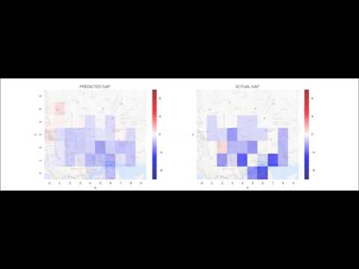

Slide 7
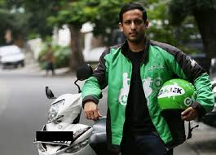

Benefits
drivers
customers
Maximize revenue
Less idle time
No price increase
Less waiting time

Slide 8

Driver Senang, Pelanggan pun Riang

Slide 9
Future Work?
Improve model accuracy
Kernel Method
Convolution
Prescriptive Analytics
Recommend driver where to go to optimize global supply demand.

